Slide 1
Tennessee Promise update: Cohorts 1 and 2
Emily House
Tennessee Higher Education Commission
Spring Quarterly Meeting
April 20, 2016

Slide 2
Mar-April
Second
Mandatory
Meeting
August 1
Community
Service Deadline
Jan-Feb 5
First mandatory meeting
February 15
FAFSA Completion
Deadline
14-15 Public and Private HS Seniors: ~74,400
22,500
31,985
38,165
Nov 1
Application
Closes
43,105
58,000
Fall 2015: 16,291 enroll

Slide 3
Cohort 1 (HS class of 2015)
Where TN Promise Cohort 1 enrolled:
85 percent community colleges (and APSU)
13 percent TCATs
2 percent Promise-eligible TICUA institutions
Of those who completed all requirements but did not enroll (N = 6,200):
Four-year institutions
Private/out of state
Did not enroll (workforce, military)

Slide 4
Cohort 1, TNP Students
 | TN Promise CC students | FTF out of HS, Fall 2014 (CCs) | FTF at CCs, Fall 2015 | FTF at CCs, Fall 2014
Race
White | 74% | 70% | 74% | 69%
African Amer | 14% | 19% | 18% | 19%
Hispanic | 4% | 5% | 3% | 4%
Female | 56% | 56% | 56% | 56%
Average ACT | 19.1 | 18.7 | 18.9 | 18.7
Average GPA | 3.05 | 3.04 | 3.00 | 3.04
Financial aid
ANY Pell | 53% | 53% | 55% | 51%
FULL Pell | 34% | 40% | 33% | 40%
Pell covers T&F | 45% | 53% | 44% | 51%
TELS | 58% | 48% | 43% | 48%
Notes:
Average annual TN Promise award amount is $850, per Tim Phelps and James Snider.

Slide 5
First-time Freshmen: Enrollment
 | Fall 2015 | Fall 2014 | Delta
FTF Enrollment
TBR CCs | 21,679 | 17,379 | 24.7%
TCATs | 10,432 | 8,691 | 20.0%
TBR Universities | 10,977 | 11,983 | -8.4%
UT | 7,611 | 7,977 | -4.6%
TOTAL | 50,699 | 46,030 | 10.1%
Notes:
This varies by institution. Surge in transfer in 2 years?
Not using causal language, but this likely has a lot do to with Promise. BUT – this is not BECAUSE OF PROMISE.
Likely some new entrants, though – the decrease in 4 years is not equal to the increase in CCs and TCATs, so we must have some new people in there too.

Slide 6
First-time Freshmen: ACT Scores
 | Fall 2015 | Fall 2014 | Delta
FTF average ACT score
TBR CCs | 18.9 | 18.8 | 0.1
TBR Universities | 22.1 | 21.9 | 0.2
UT | 25.5 | 24.7 | 0.8

Slide 7
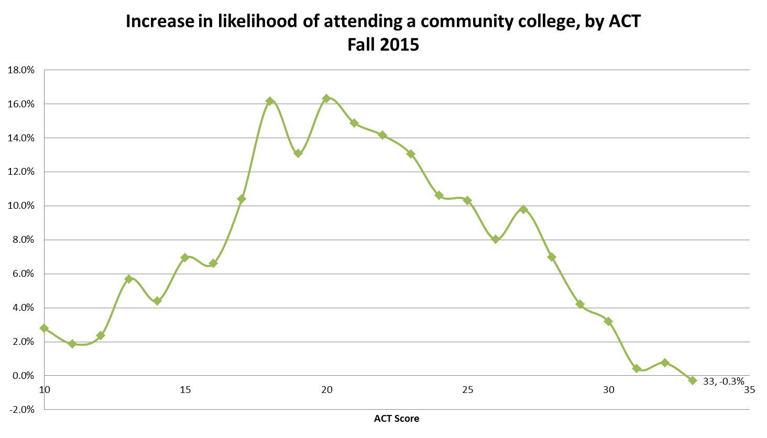
Notes:
Most of these students are on the margin of being academically eligible to attend a four-year versus a two-year. Increase in odds compared to past 3 years (2012-2014.)

Slide 8
Fall-Spring retention
80.6 percent of Tennessee Promise students persisted Fall-Spring.
78.5 percent at CCs
94.7 percent at TCATs
In prior years:
~80 percent retention of first-time freshmen, right out of high school at CCs
~70 percent of ALL students at CCs
Notes:
This is great – maintained retention rate in light of huge enrollment increase. Testament to support services, CC staff, etc. TCATs are a little different to compare to prior years, but this is comparable to prior years.

Slide 9
Fall 2015 GPAs
First-time, full time freshmen right out of high school at CCs: 2.03
Lower than prior years.
Effect of co-requisite remediation model? Effect of increased enrollment?
First-time, full time freshmen right out of high school at universities: 2.71
Varies by institution; similar to prior years.
Notes:
FA14 – 2.29, FA13 2.35
ALL CC students (including older, PT) – 2.03 in Fall 2015, 2.18 in Fall 2014 – so it’s comparable to the FTFT right out of HS.

Slide 10
Fall term GPAs
Sector | Fall 2015 | Fall 2014 | Fall 2013
Community colleges | 2.03 | 2.29 | 2.35
Public 4-year universities | 2.71 | 2.71 | 2.69
- First-time, full time freshmen, right out of high school (most similar student to a Tennessee Promise student.)

Slide 11
Cohort 2 – HS class of 2016
Mar-April
Second
mandatory
meeting
August 1
Community
Service Deadline
Fall 2016 Third mandatory meeting
Jan-Feb
First mandatory meeting
Feb 22
FAFSA Completion
Deadline
15-16 Public and Private HS Seniors: ~75,000
Ongoing
48,959
Nov 2
Application
Closes
51,464
59,598
Notes:
Reflects a slightly different timeline/order of events. So far, program retention is a bit higher than last year.

Slide 12
Tennessee Promise – Cohort 2
Student and academic characteristics:
50 percent female
63 percent white, 21 percent black, 4 percent Hispanic
Vast majority intend to attend a CC
Average ACT: 20.2
Average HS GPA: 3.08

Slide 13
Next Steps
Research, research, research
TN Promise students enrolling elsewhere
“Waterfall” – when do students drop off the TN Promise, and where do they end up?
Students enrolling in 2- vs. 4-year institutions
Variation by high school (collaboration with TN DOE), county, region
Persistence and retention (Fall to spring, Year 1-2)
Notes:
As I said earlier, this is just a first pass using this data. We have many more questions that we can and will explore – these are just some of them.

Slide 14
College-going Rate
Fall 2015 CGR: 62.5 percent
One-year increase of 4.6 percentage points (Fall 2014 CGR: 57.9 percent)
Approximately 4,000 new entrants into higher education in Tennessee.
Most at CCs and TCATs

Slide 15
CGR over time

Slide 16
CGR by state
Notes:
Where we started.

Slide 17
CGR by state
Notes:
Where we are now.

Slide 18
CGR by county
 | 2014 CGR | 2015 CGR | 1-year delta
Top 3 (# high school grads) | 59.8% | 61.5% | 1.7%
All others | 57.2% | 62.8% | 5.6%
Top 6 (# high school grads) | 61.3% | 64.6% | 3.2%
All others | 55.6% | 61.0% | 5.4%
Statewide | 57.9% | 62.5% | 4.6%
Top 6: Shelby, Davidson, Knox, Rutherford, Hamilton, Williamson

Slide 19
CGR by county
 | 2014 CGR | 2015 CGR | 1-year delta
“Original” tnAchieves counties | 59.5% | 61.5% | 2.0%
All others | 56.6% | 63.3% | 6.7%
Statewide | 57.9% | 62.5% | 4.6%
tnAchieves counties: Anderson, Blount, Bradley, Campbell, Claiborne, Davidson, Dyer, Fentress, Grainger, Greene, Hamblen, Hancock, Jefferson, Knox, Lake, Loudon, Madison, Meigs, Morgan, Obion, Pickett, Roane, Scott, Sevier, Shelby, Sullivan, Union

Slide 20
Questions? Thank you!
emily.house@tn.gov

