Slide 1
Tennessee Higher Education Commission
Legislative Update
April 21, 2016

Slide 2
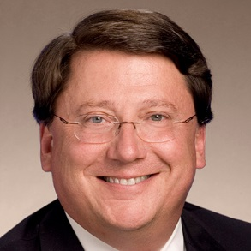
House Bill 2578 The FOCUS Act
House Floor Vote 71-19-2
Senate Floor Vote 31-1
Sponsors:
Rep. Ryan Williams (R-Cookeville)
and Senator Mark Norris (R-Collierville)
Restructures the Board of Regents and establishes six separate governing boards for universities currently governed by TBR.
THEC duties are enhanced in several areas, including: the approval of institutional mission statements, binding tuition setting authority, strategic financial plans, and required orientation training with continuing education for all state university board members.
As amended, also shifts appointing authority for three THEC members from the Governor to the legislature. The executive branch still appoints six members, and the ex-officio appointments are unchanged.

Slide 3
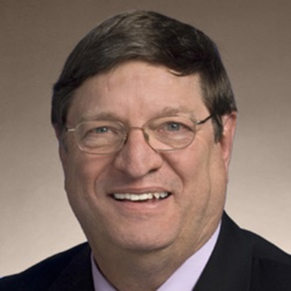
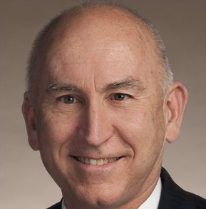
House Bill 1696 UT Board of Trustees
House Floor Vote 76-17
Senate Floor Vote 30-0
Sponsors:
Rep. Harry Brooks (R-Knoxville)
and Senator Richard Briggs (R-Knoxville)
This bill’s primary purpose is to address the scope of authority of the Board of Trustees and the President of the UT system by delineating specific powers and duties in much greater detail than what is currently in Tennessee code. Also codifies Board of Trustee bylaws as related to established committees and their roles.
THEC will administer an orientation training program, as well as ongoing continuing education, to advise members of the board of their powers and duties.
In line with THEC duties under the FOCUS Act, training will include the perspectives of national experts in higher education governance, addressing such topics as: the responsibilities of governing boards; legal and ethical duties; upholding academic standards, academic freedom, and intellectual diversity; budget development; presidential searches; higher education/K-12 collaboration; and strategic goal-setting.

Slide 4
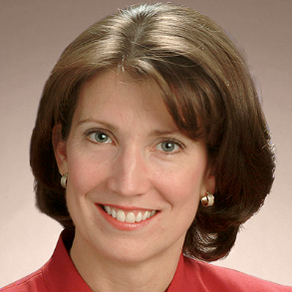
House Bill 2573 Higher Education Authorization Act of 2016
House Floor Vote 81-9
Senate Floor Vote 31-0
Sponsors:
Rep. Susan Lynn (R-Mt. Juliet)
and Senator Mike Bell (R-Riceville)
Updates the Postsecondary Education Authorization Act of 1974.
Creates a new optional, expedited “fast-track” authorization process for nationally and regionally accredited institutions satisfying the eligibility requirements.
THEC is directed to develop new administrative rules with stakeholder collaboration, modify the regulatory fee structure, and publish comprehensive performance data of fast track schools on the agency’s website.

Slide 5
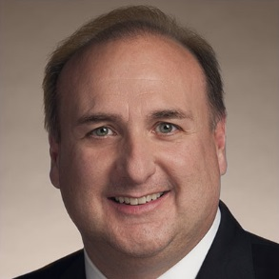
Senate Bill 1625 Fee Waivers for State Employees
Senate Floor Vote 32-0
House Floor Vote 93-0
Sponsors:
Senator Paul Bailey (R-Sparta)
and Rep. Joe Pitts (R-Clarksville)
Modifies the statute slightly to create scheduling flexibility for state employees utilizing their fee waiver benefit.
Permits a state employee to take more than one course in a semester. Currently, they are limited to “one course per term.”
Fiscal impact from the bill is non-significant since only scheduling flexibility is modified.
The legislation clarifies that state employees may use the existing higher education fee waiver benefit for up to four courses per academic year, as long as the dates of instruction do not overlap.
Accommodates accelerated or other special class terms/schedules.

Slide 6
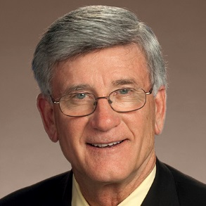
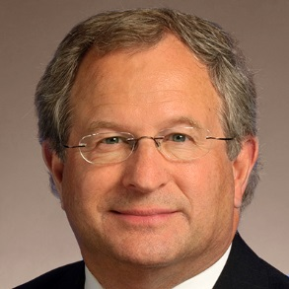
Senate Bill 514 Tuition Discounts & Waivers
Senate Floor Vote 31-0
House Floor Vote 86-5
Sponsors:
Senator Todd Gardenhire (R-Chattanooga)
and Rep. Mark White (R-Memphis)
Authorizes the Executive Director of THEC to convene a task force to examine the statutory tuition discount and waiver programs offered at public institutions of higher education in Tennessee.
The task force will be composed of a Senate and House member, as well as one representative each from the Dept. of Human Resources, the Dept. of Finance & Administration, the Board of Regents, the UT system, THEC, and the Office of Legislative Budget Analysis.
Legislation requires developing policy recommendations for the General Assembly related to increasing efficiency, accountability, and cost-effectiveness. Final recommendations are due by December 15, 2016.

Slide 7
Senate Bill 2394 Foreign Student Reporting
Senate Floor Vote 29-0
House Floor Vote 97-0
Sponsors:
Senator Paul Bailey (R-Sparta)
and Rep. Ryan Williams (R-Cookeville)
Institutions are no longer required to automatically report to the Department of Safety the number of foreign students possessing an F-1 or M-1 student visa enrolled at the beginning and end of each term.
Instead, the Commissioner of Safety is authorized to issue a subpoena for valid law enforcement purposes to compel an institution to produce those same totals, as well as the names and addresses of the students who do not finish a term.

Slide 8
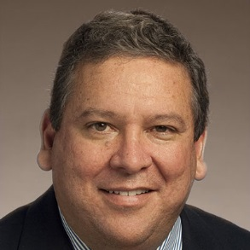
Senate Bill 1431 In-State Tuition for Military Dependents
Senate Floor Vote 32-0
House Floor Vote 95-0
Sponsors:
Senator Todd Gardenhire (R-Chattanooga)
and Rep. Gerald McCormick (R-Chattanooga)
Grants in-state tuition and fees at public higher education institutions to dependent children of military parents, regardless of place of residency, if the military parent perished as the result of a targeted attack that occurred in Tennessee.
To be eligible for the in-state tuition and fee rate under this bill, the dependent child must be enrolled as a full-time student at a state institution of higher education prior to attaining the age of 23.
Applies to members of the armed forces of the United States on active duty and members of the Tennessee National Guard.

Slide 9
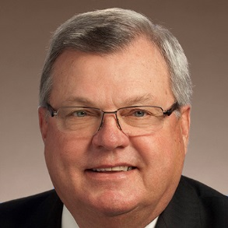
House Bill 1836 VETS Campus Designation
House Floor Vote 89-0
Senate Floor Vote 32-0
Public Chapter 657
Sponsors:
Rep. Curtis Johnson (R-Clarksville)
and Senator Mark Norris (R-Collierville)
This bill permits private nonprofit institutions of higher education in the state to apply for the “VETS” campus designation from THEC.
Previously, only public higher education institutions were eligible for this designation.
Institutions must satisfy all statutory qualifications related to faculty training, veteran student orientation, and prior learning assessment review processes.

Slide 10
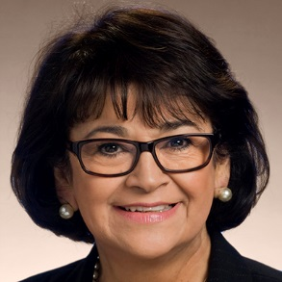
House Bill 458 Student Immunizations
House Floor Vote 89-0
Senate Floor Vote 31-0
Sponsors:
Rep. Tilman Goins (R-Morristown) and
Senator Dolores Gresham (R-Somerville)
Currently, T.C.A. § 49-7-124 requires new incoming students at any public institution of higher education in this state who live in on-campus student housing to produce proof of adequate immunization against meningococcal disease as recommended by the Centers for Disease Control and Prevention (CDC).
This bill requires institutions to accept proof of a student's prior or current military service as proof of any immunization required of the student for enrollment at the institution.
Intent of legislation is to remove barriers to enrollment and acknowledge immunizations received during military service.

Slide 11
House Bill 1680 TICUA State Authorization
House Floor Vote 96-0
Senate Floor Vote 33-0
Pubic Chapter 666
Sponsors:
Rep. Harry Brooks (R-Knoxville)
and Senator Dolores Gresham (R-Somerville)
Clarifies the federal authorization process for independent, non-profit institutions operating in Tennessee that accept federal financial aid for their students.
Establishes a listing of certain higher education institutions operating in Tennessee for purposes of U.S. Department of Education regulations.
Requires THEC to maintain and publish on its web site a list of such approved institutions.

Slide 12
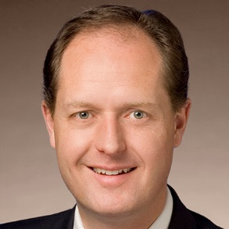
Senate Bill 2447 Campus Crime Awareness & Prevention
Senate Floor Vote 30-0
House Floor Vote 92-1
Sponsors:
Senator Jack Johnson (R-Franklin) and
Rep. Glen Casada (R-Franklin)
Mandates that Tennessee public institutions of higher education shall require all entering freshmen during orientation to receive instruction aimed at increasing the awareness and prevention of sexual assault, sexual battery, sexual harassment, and date rape.
The bill also encourages institutions to offer instruction aimed at increasing the awareness and prevention of the crimes mentioned above, as well as hate crime offenses, to all students.

