Slide 1
Tennessee Education Lottery Scholarship (TELS) Program Annual Report
Tennessee Higher Education Commission
Summer Quarterly Meeting
July 22, 2015

Slide 2
Program overview
Merit based, lottery-funded program
First implemented in AY 2004-05
Primarily serves traditional-aged students
Four scholarship types
HOPE
Aspire (income-based supplement)
GAMS (merit-based supplement)
Access

Slide 3
Program overview
Eligibility
HOPE: 3.0 GPA or 21 ACT
Aspire: 3.0 GPA or 21 ACT; family AGI ≤ $36,000
GAMS: 3.75 GPA and 29 ACT
Access: 2.75-2.99 GPA and 18-20 ACT; family AGI ≤ $36,000
Award amounts
Differ by institution type, enrollment status

Slide 4
FT award amounts – Fall and Spring
 | HOPE (base) | GAMS (HOPE with merit supplement) | ASPIRE (HOPE with need supplement) | ACCESS Award
Award Amount (4-yr.) | $4,000 | $5,000 | $5,500 | $2,750
Award Amount (2-yr.) | $2,000 | $2,500 | $2,750 | $1,375
Minimum High School GPA | 3.00 | 3.75 | 3.00 | 2.75-2.99
Minimum ACT Composite | or 21 | and 29 | or 21 | and 18-20
Family Adjusted Gross Income | N/A | N/A | $36,000 or less | $36,000 or less
Notes:
Fall and Spring ONLY, so this is different from the table in the report itself.

Slide 5
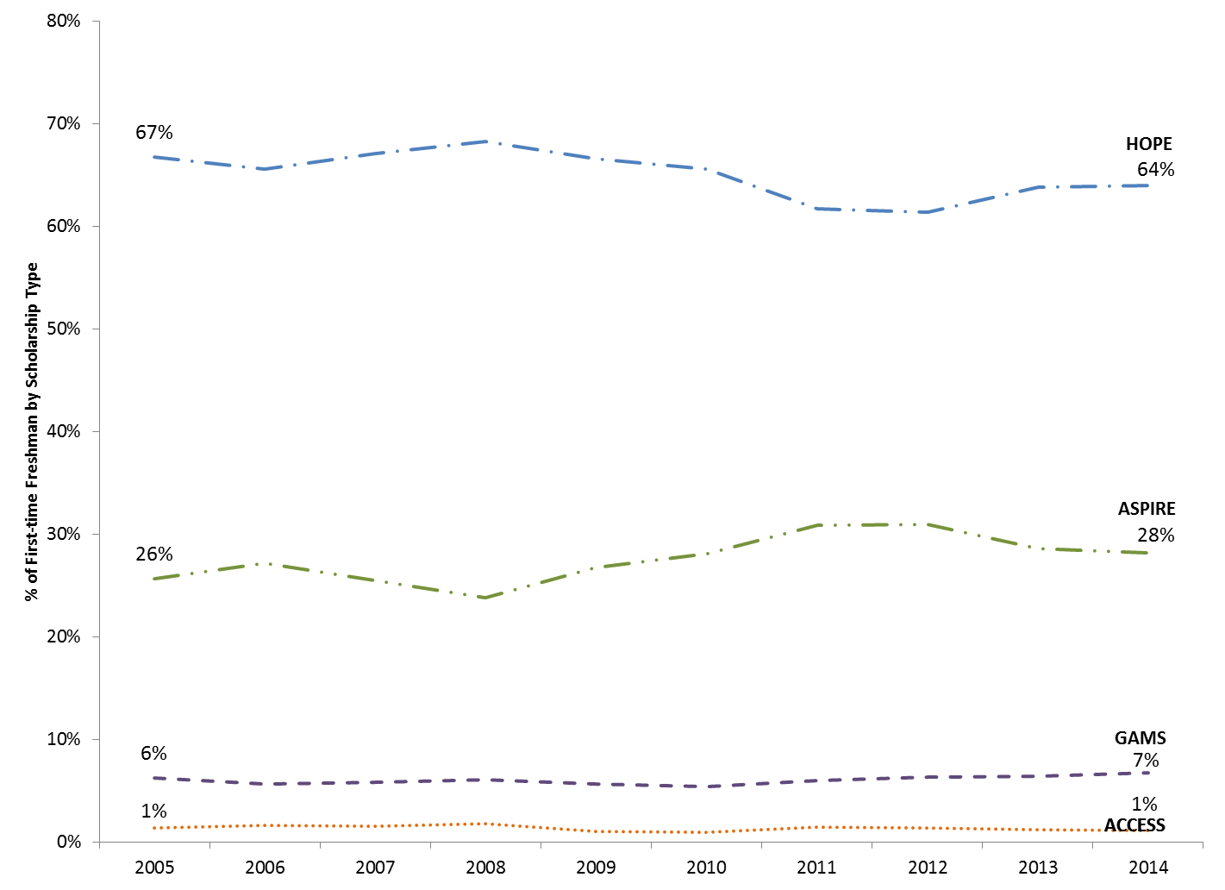
FTF receiving TELS, by award type

Slide 6
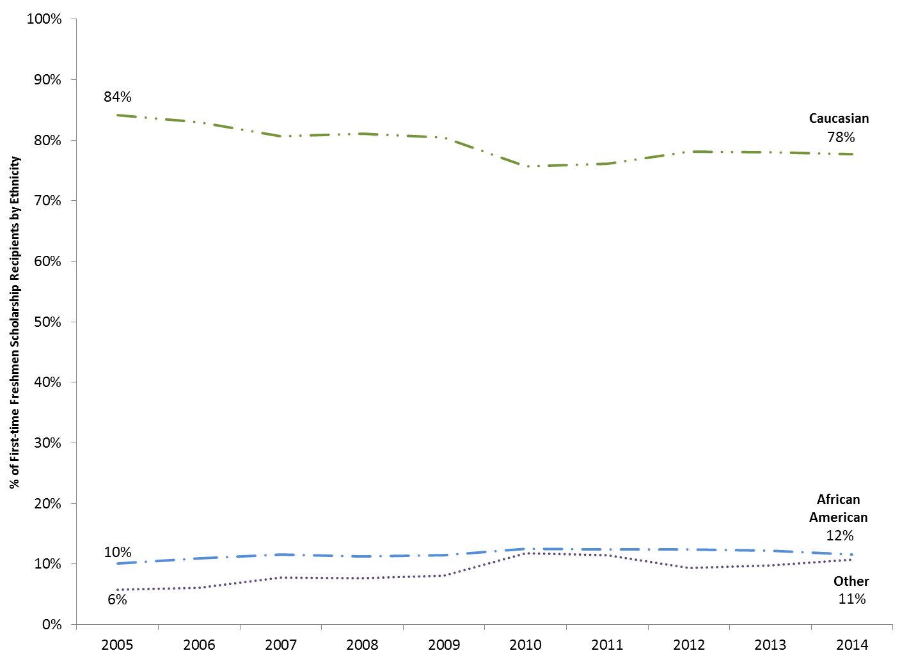
FTF receiving TELS, by race

Slide 7
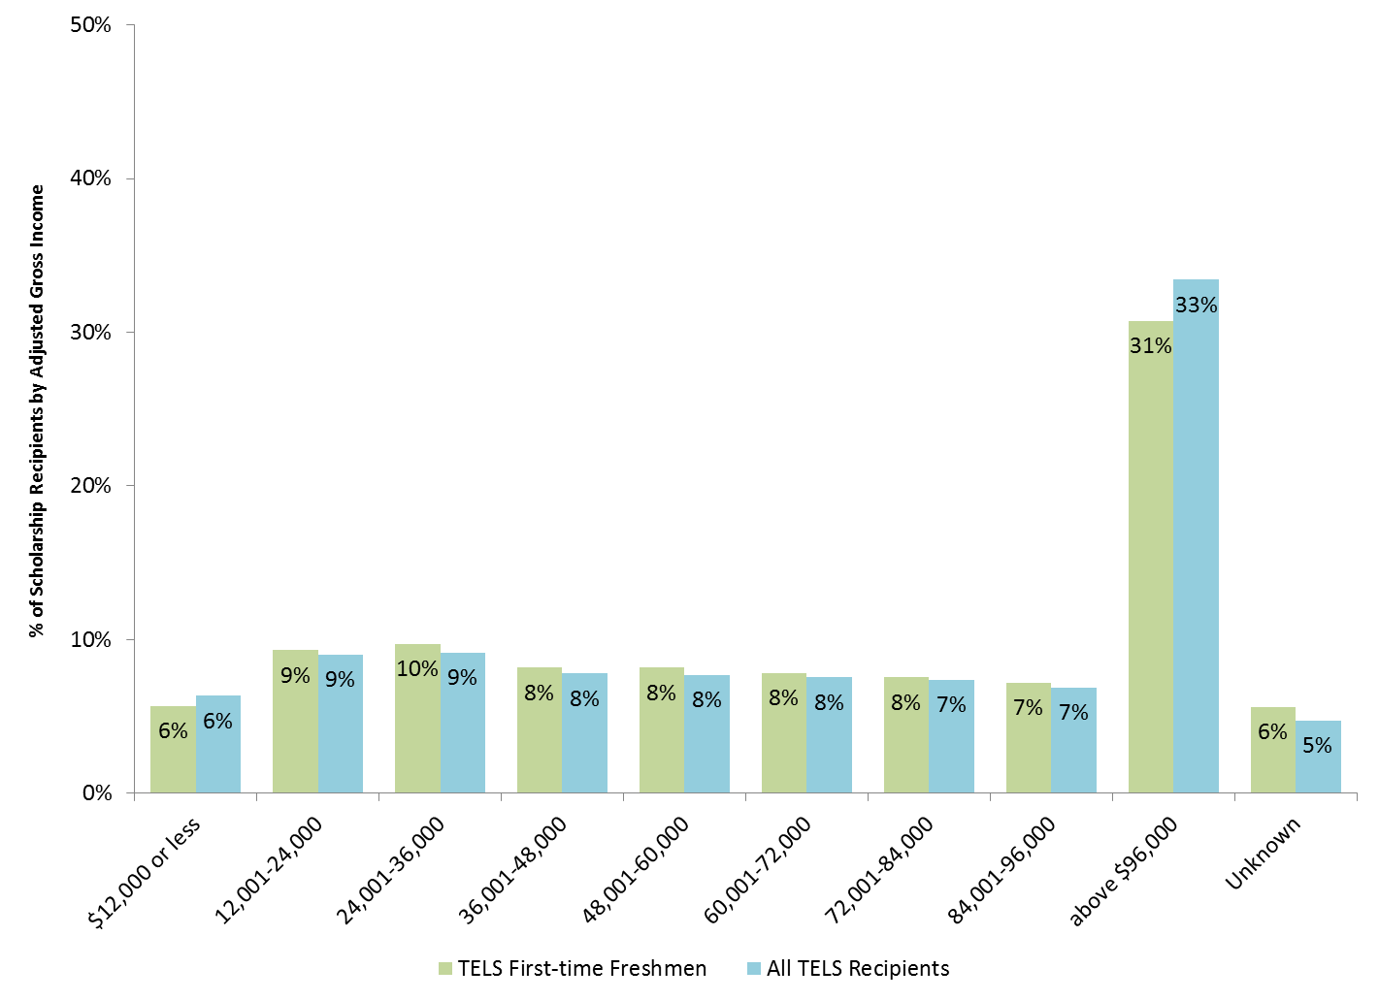
TELS recipients, by family AGI

Slide 8
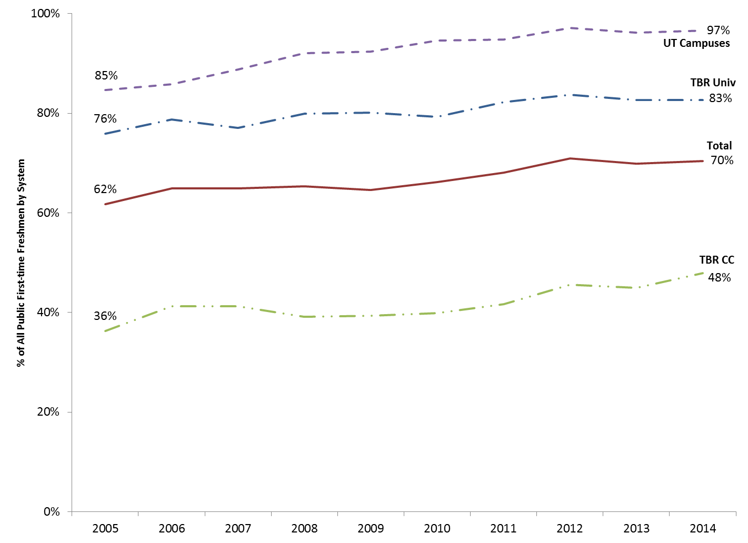
FTF receiving TELS, by public system
Notes:
TICUA: About 4,000 FTF and 11,500 students total.

Slide 9
To renew TELS awards
At 24 and 48 credit hour checkpoints:
Earn 2.75 GPA
Remain enrolled full (part) time
At 72, 96, and 120 credit hour checkpoints:
Earn 3.0 GPA, OR
Have earned 3.0 in previous term; cumulative GPA of 2.75 or higher
Remain enrolled full (part) time

Slide 10
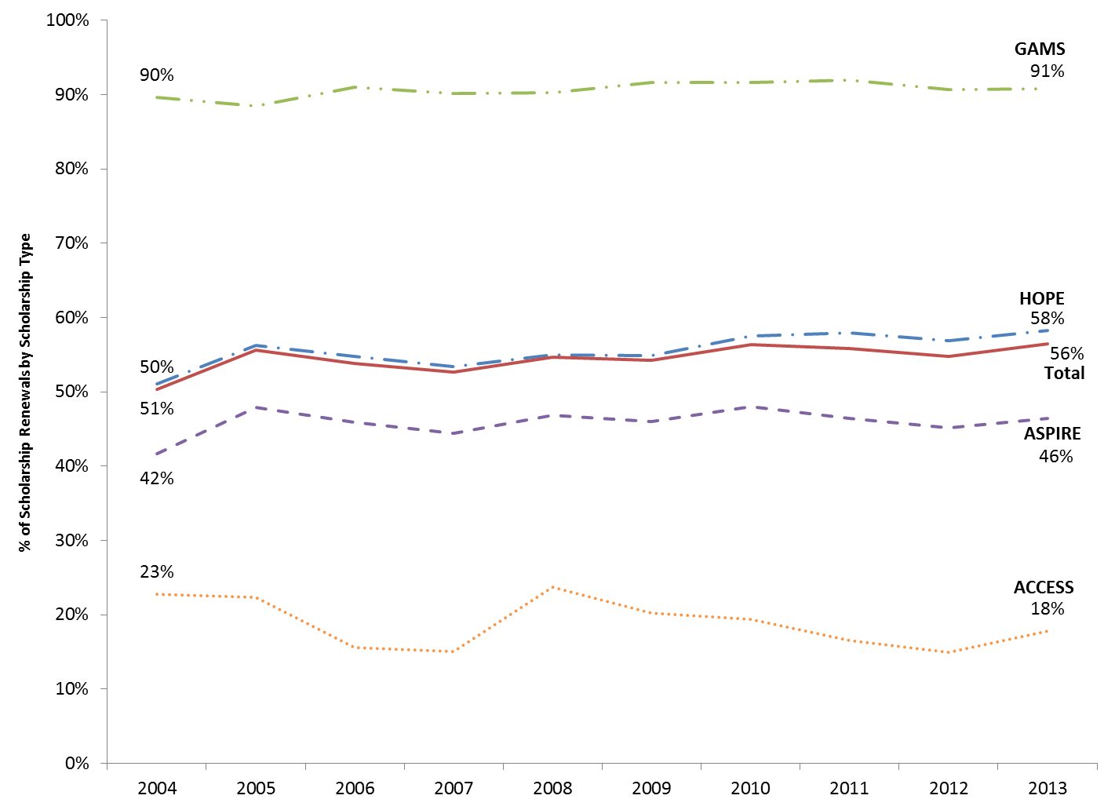
FTF 1-2 year TELS renewal rates

Slide 11
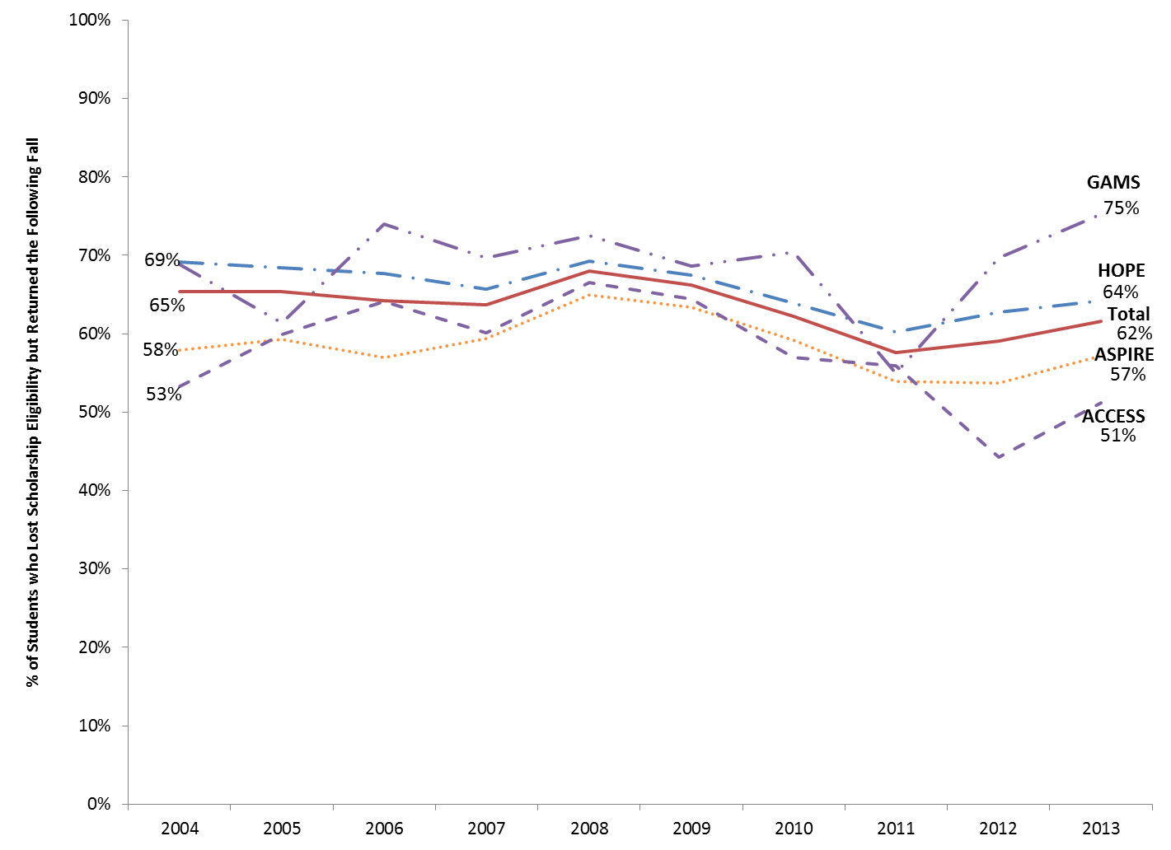
FTF retention, despite losing TELS

Slide 12
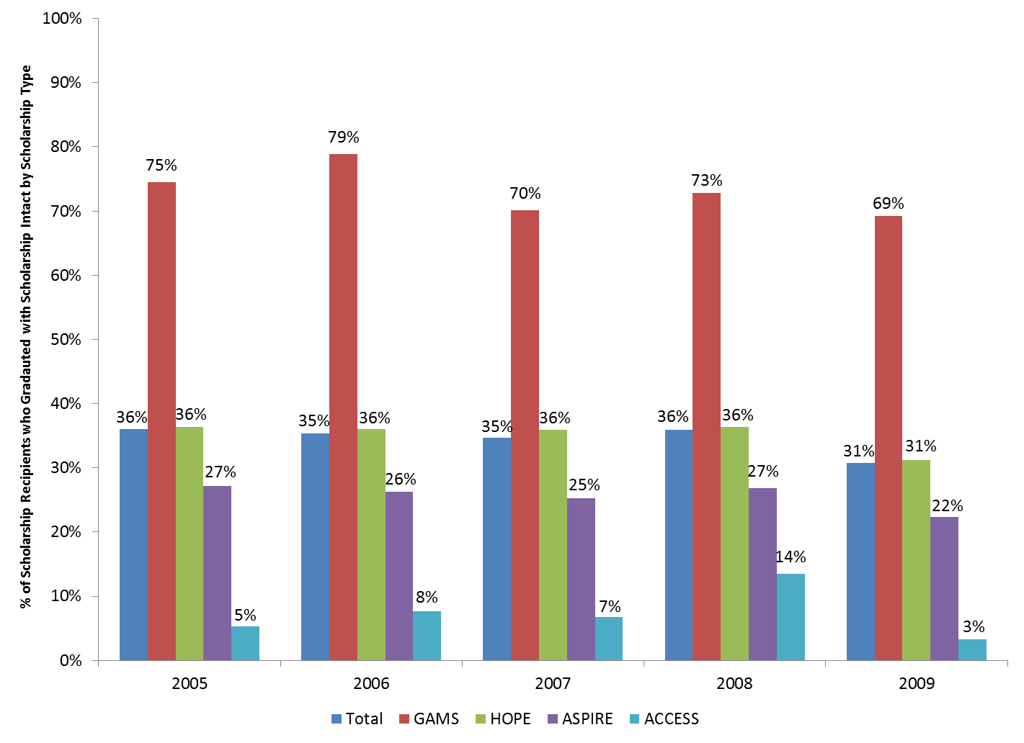
Graduate with TELS award “in tact”

Slide 13
Program costs and growth
2004-05:
31,000 award recipients
$86M in awards
2013-14:
70,000 award recipients
$269M in awards

Slide 14
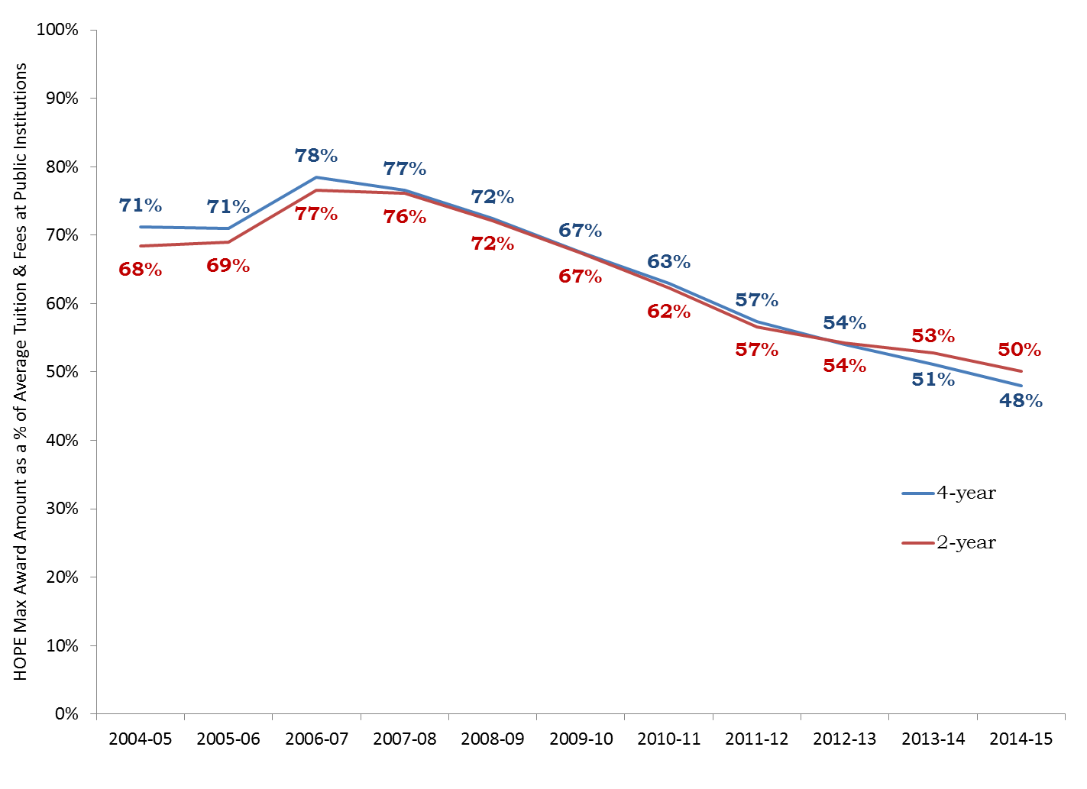
HOPE award as % of tuition and fees
Notes:
Public IHEs only

Slide 15
Relationship to TN Promise
Funds ($ ~300M) transferred from Lottery Reserve to Tennessee Promise trust
$100M remains in reserve
TELS awards “hit” first; funds awarded prior to Tennessee Promise funds

Slide 16
Upcoming changes to HOPE
4-year institution (FT)
Years 1 and 2 - $3,500
Years 3 and 4 - $4,500
2-year institution (FT)
Years 1 and 2: $3,000
Why?
To address issues re: scholarship retention?
To help fund Tennessee Promise

Slide 17
Upcoming changes to Aspire
Community college students no longer eligible, as their base award amount has increased.
Many of these students are full-Pell eligible.
Tennessee Promise is “last dollar” award

Slide 18
Discussion
How will different award amounts change:
Program participation?
Scholarship renewal?
Student retention?
Student choice of institution?

Slide 19
TELS Annual Report (and other reports) available: http://www.tn.gov/thec/Legislative/Reports.html
emily.house@tn.gov
615-741-0731

