Slide 1
2015-2020 Outcomes Funding Formula
Tennessee Higher Education Commission
July 22, 2015
Tennessee Higher Education Commission

Slide 2
Overview
Foundation of Outcomes-Based Funding Formula
The role the Formula Review Committee and other stakeholders played in the process
Proposed changes to the formula
Comparison of 2015-20 Proposed Formula effects to the 2010-15 Current Formula effects
Next Steps

Slide 3
Outcomes Funding Foundation
In January 2010, Tennessee passed the “Complete College Tennessee Act.”
The legislation called for reforms in several areas:
Student transfer
Research collaboration
Funding formula policy

Slide 4
Complete College
Tennessee Act of 2010
“Develop, after consultation with the Board of Regents and the University of Tennessee Board of Trustees, policies and formulae or guidelines for fair and equitable distribution and use of public funds … that are consistent with and further the goals of the statewide master plan. The policies and formulae or guidelines shall result in an outcomes-based model.”

Slide 5
Developing an Outcomes Model
The exclusive use of outcomes — rather than beginning or end of term enrollment — and the inclusion of mission differentiated weights for each campus, are the two primary formula innovations introduced by CCTA.
Enrollment simply no longer factors into TN higher education state funding.

Slide 6
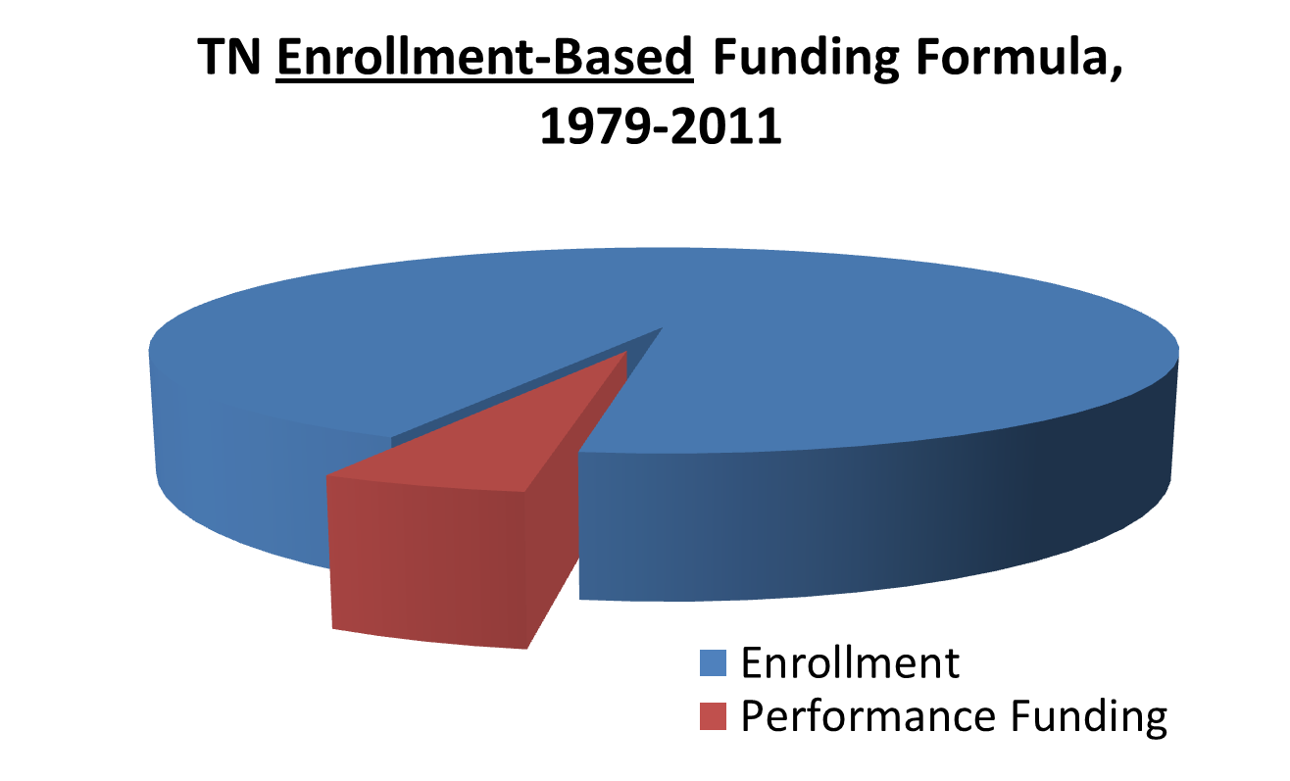

Slide 7
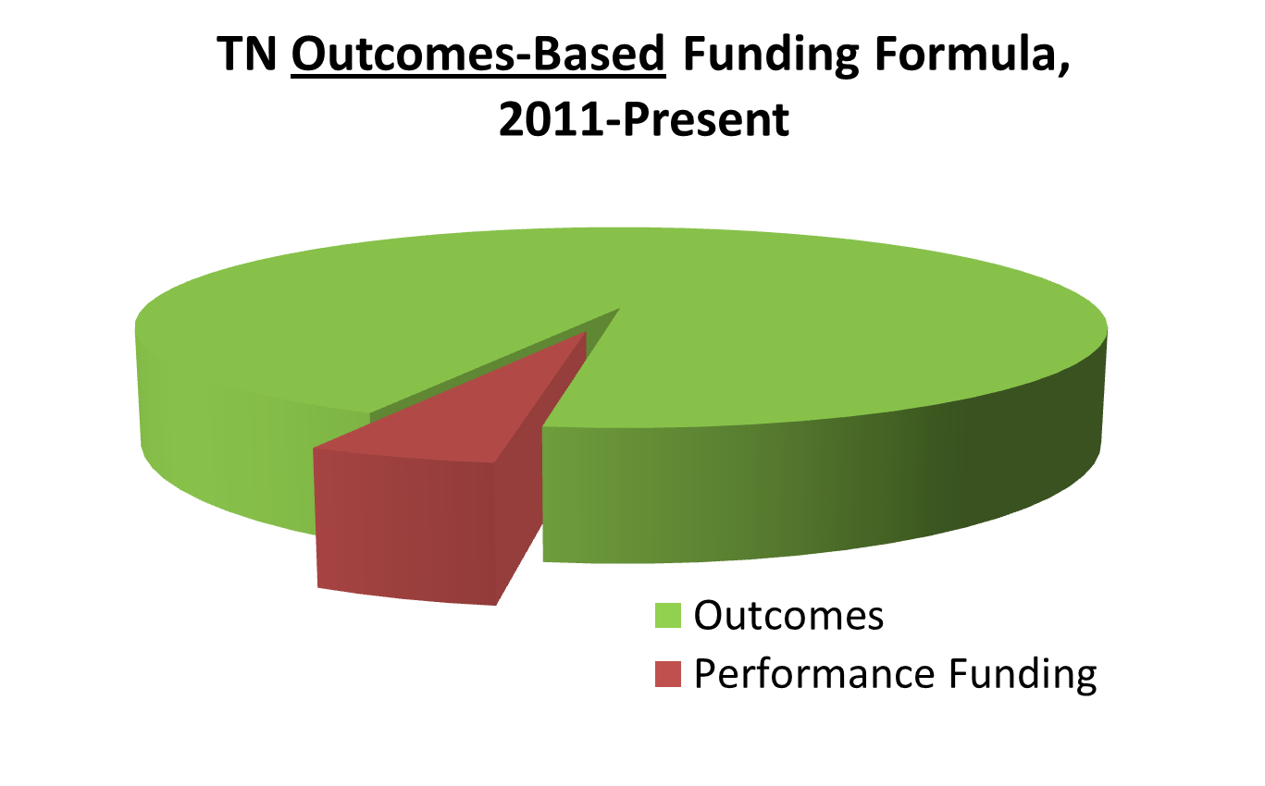

Slide 8
Formula Review Precedent
In Summer 2010 THEC convened a Formula Review Committee (FRC) to discuss and debate the new formula design.
The FRC included representatives from higher education and state government.
Presidents/chancellors were queried about what outcomes to include and the priority of those outcomes to their institutions.
Over the last five years, the FRC has convened annually to review strengths and weaknesses of the formula.

Slide 9
Formula Review Committee 2015-2020
A 2015-20 FRC, made up of presidents, provosts, CFOs, faculty and state government representatives, was convened in early 2015.
The 2015-20 FRC has met at least once a month since February, proposing and reviewing changes to the current model.
All presidents/chancellors were also asked to propose and review formula changes.
The Statutory Formula Review Committee convened in late June.

Slide 10
Overview of Changes
Outcome Definition Changes
Removal/Replacement of Outcomes
Subpopulation and Subpopulation Premium Alterations
Updated Mission Weights
Removal of Out-of-State Tuition Deduction
Removal of Salary Multiplier
Underlying Structural Change

Slide 11
Outcome Changes
Current Model |  | Proposed Model
Community College Outcomes |  | Community College Outcomes
Students Accumulating 12 hrs. |  | Students Accumulating 12 hrs.
Students Accumulating 24 hrs. |  | Students Accumulating 24 hrs.
Students Accumulating 36 hrs. |  | Students Accumulating 36 hrs.
Dual Enrollment |  | Dual Enrollment
Associates |  | Associates
Long-term Certificates |  | Long-term Certificates
Short-term Certificates |  | Short-term Certificates
Job Placements |  | Job Placements
Remedial & Development Success |  | Remedial & Development Success
Transfers out with 12 hrs. |  | Transfers out with 12 hrs.
Workforce Training |  | Workforce Training
Awards per 100 FTE |  | Awards per 100 FTE

Slide 12
Outcome Changes
Current Model |  | Proposed Model
University Outcomes |  | University Outcomes
Students Accumulating 24 hrs. |  | Students Accumulating 30 hrs.
Students Accumulating 48 hrs. |  | Students Accumulating 60 hrs.
Students Accumulating 72 hrs. |  | Students Accumulating 90 hrs.
Bachelors and Associates Degrees |  | Bachelors and Associates Degrees
Masters/Ed Specialist Degrees |  | Masters/Ed Specialist Degrees
Doctoral / Law Degrees |  | Doctoral / Law Degrees
Research and Service |  | Research and Service
Transfers Out with 12 hrs. |  | Transfers Out with 12 hrs.
Degrees per 100 FTE |  | Degrees per 100 FTE
Six-Year Graduation Rate |  | Six-Year Graduation Rate

Slide 13
Definitional Changes
Short-term Certificates (Less than 1 YR):
In the current model all academic and technical certificates that represent the highest award earned at the time of a student’s stop-out are counted.
In the proposed model all technical certificates are counted, regardless of whether a student stops-out or continues to be enrolled. Certificates defined as academic are not counted.

Slide 14
Definitional Changes
Awards per 100 FTE (Community Colleges) & Degrees per 100 FTE (Universities):
In the current model both degree-seeking and non-degree-seeking undergraduate students (e.g. dual enrollment students) are included in the FTE metric.
In the proposed model only degree-seeking undergraduate students are included.

Slide 15
Outcome Removals
Remedial and Development Success (Community Colleges):
In the proposed model this success is captured as a new focus population.
Transfers Out with 12 hours (Universities):
During the formula review process, committee members identified this outcome for removal.

Slide 16
Outcome Replacements
Progression Metrics (Universities):
In the current model universities are rewarded when students attain 24-, 48- and 72-credit hours.
In the proposed model universities are rewarded when students attain 30-, 60- and 90-credit hours.
These progression metric replacements incentivize on-time completion.

Slide 17
Subpopulation Changes
Current Formula |  | Proposed Formula
Subpopulations (Both Sectors) |  | Focus Populations (Both Sectors)
Adults |  | Adults
Low-income |  | Low-income
 |  | Academically Underprepared
Subpopulation Premiums |  | Focus Population Premiums
40% for Each Population |  | 80% for One Focus Population
 |  | 100% for Two Focus Populations
 |  | 120% for Three Focus Populations

Slide 18
Subpopulation Changes
Change terminology from “subpopulations to “focus populations” to adequately reflect their purpose.
Add Academically Underprepared as a focus population to both sectors:
Compensates for Remedial & Development Success’ removal as an outcome from the community college sector.
The formula review committee proposed its inclusion for the university sector.
Tentatively defined as those identified for remediation or who scored an 18 or below on the ACT Composite Score.
At universities the population is limited to students who start as first-time, full-time freshman at that school.

Slide 19
Subpopulation Changes
Proposed adjustment of applied premiums:
In the current model an outcome receives a 40% premium when it qualifies for either of the two subpopulations. An outcome that qualifies for both subpopulations therefore receives an 80% premium.
In the proposed model the premiums are elevated and graduated. If an outcome qualifies for:
One of the three focus populations, it receives an 80% premium.
Two of the three focus populations, it receives a 100% premium.
All three focus populations, it receives a 120% premium.
At universities, an outcome that qualifies solely for Academically Underprepared receives a 20% premium.

Slide 20
Mission Weights
As in the current model, weights in the proposed model still largely reflect institutional mission as defined by presidents and chancellors.
At the suggestion of TBR the community college sector utilizes a consistent weighting structure for completion outcomes to reflect the needs of the State.

Slide 21
Out-of-State Tuition Deduction
In the current model a portion of each institution’s formula calculation is deducted to reflect that institution’s out-of-state enrollment.
In the proposed model institutions do not have funding deducted for out-of-state enrollment.
FRC members and institutional stakeholders expressed a need to enroll out-of-state students in order to meet both institutional and state needs (e.g. Drive to 55).
The deduction implicitly discourages out-of-state enrollment.

Slide 22
Salary Monetization Removal
In the current model weighted outcomes are monetized by multiplying the Southern Regional Education Board’s average faculty salary of similar Carnegie Classification institutions.
Members of the FRC asserted that this allowed outside policy — from other states — to unduly influence the formula.
In the proposed model the weighted outcomes are not monetized.

Slide 23
Underlying Structural Change
The removal of monetization allows the proposed model to focus on distributing funds based on changes to shares of funding.
This structural change allows for perfect calibration, obviating the need for a phase-in period of the new model.
The current model was phased-in over three years due to imperfect calibration.

Slide 24
Calibrated Scales
The current model uses scales to compare outcomes of different magnitudes.
Scales were also used as a tool to help calibrate the current model.
With perfect calibration in the proposed model, the scales can now be mathematically-derived, allowing for more intuitive and logical scales.

Slide 25
Weighted Outcomes & State Appropriation
Relationship: Current Model
State Appropriations Recommendation
Correlation = 0.91
Weighted
Outcomes

Slide 26
Weighted Outcomes & State Appropriation
Relationship: Proposed Model
State Appropriations Recommendation
Correlation = 0.95
Weighted
Outcomes

Slide 27
Next Steps
Finalize Model Components:
Scales
Weights
Premium levels
Academically Underprepared Definition
All stakeholders review the model.
Present a finalized new model to institutional leaders across the state.

Slide 28
2015-2020 Outcomes Funding Formula
Tennessee Higher Education Commission
July 22, 2015
Tennessee Higher Education Commission

Slide 29
Current vs. Proposed Model Effects

Slide 30
Current vs. Proposed Model Effects

Slide 31
Current vs. Proposed Model Effects

Slide 32
Current vs. Proposed Model Effects

