Slide 1
Campus Responses to Outcomes-Based Funding in Tennessee
Erik Ness, Mary Deupree, & Denisa Gándara
University of Georgia
Tennessee Higher Education Commission
Work Session, Fall 2015 Commission Meeting
Nashville, Tennessee
November 18, 2015
Notes:
How colleges and universities have responded to outcomes-based funding, a new method of allocating state funds for public higher education institutions in Tennessee
TN often viewed as a trailblazer in this area
Study funded by the Tennessee Higher Education Commission and the Ford Foundation
Preliminary findings from this project.

Slide 2
Study Design
Ethnographic case study design:
Middle Tennessee State University
Pellissippi State Community College
Southwest Tennessee Community College
University of Tennessee, Knoxville
“Most-different” systems design for case selection, with variation by:
Institution type
System membership
Geographic variation
Initial performance under the new formula

Slide 3
Data Collection and Analysis
Two site visits: summer and fall of 2013
Documents: institution websites, institutional memos, speeches from university administrators, strategic plans, meeting materials, newspaper accounts
Interviews and observations
Inductive and deductive coding

Slide 4
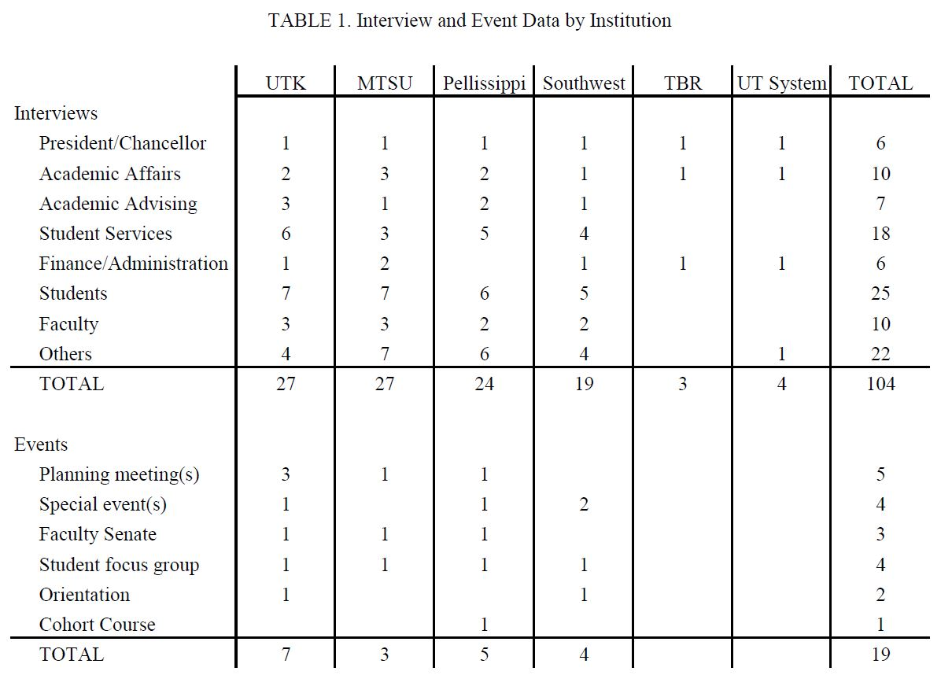

Slide 5
Thematic Findings
Robust completion efforts across four campuses
“It’s the right thing to do”
“We’re competitors of a sort, but we’re also colleagues”
“The formula assumes a level playing field and it’s not”

Slide 6
Robust campus completion activity
Not saying that we weren't concerned about retention and graduation before, but the model -- the funding model was not based on that. It was based on headcount. So once some of that shifted, the priorities that I've been engaged with in my career at the university easily became number one and two on agendas, that they no longer were -- Well, we'll get to it next week, or we just can't deal with that right now. We're focused on this. But rather no, what can you tell us about this?
- UT, Knoxville administrator
Notes:
This is an example of clean alignment between state and campus graduation and retention efforts. In fact, on all 4 campuses respondents overwhelmingly agreed that emphasizing completion is “just the right thing to do.”

Slide 7
“It’s the right thing to do”
We’re not going to complain, you know, I’ve made the most compelling case I could make. Nothing’s going to be done – this is what we’ve got, we’re not going to complain, we’re going to make it work. And that’s the mindset we have here. The outcomes-based, you know, I think it’s wonderful. I don’t think we ought to be looking at inputs. Inputs don’t really tell you anything. The output formula is what it ought to be.
- Southwest senior administrator
Notes:
One approach has been to provide more structured academic paths. This quote represents some student discontent, which we also found on the other 3 campuses.

Slide 8
“We’re competitors of a sort, but we’re also colleagues”
I think there’s still a good sense of collegiality among the institutions and trying to move forward, because it is an overall state goal we’re trying to accomplish. I think one of the benefits of this year was the full funding of the formula by the governor and the legislature. You know, I think it gets trickier when it’s not fully funded and then really you see institutions who are taking dollars from other institutions through performance. You know, I think if that happens year after year, you have – it could create some potential tension and real issues.
- Pellissippi State senior administrator
Notes:
PSCC has been the most intentional about tying campus plan to the formula. Even stretching a bit to provide General Education certificates at mid-point toward Associate’s degree.

Slide 9
“The formula assumes a level playing field and it’s not”
The formula assumes, I think, that everybody’s equal and everyone is not equal by any stretch… We’ve got some good students but at the same time, the bulk of the students or a significant number of those students just didn’t get it. And we’re stuck with them. We’re getting graded how we get them through when in fact, you ought to have more resources to help those students… I think that’s our concern with the formula, that it just assumes a level playing field and it’s not.
- MTSU senior administrator
Notes:
This is a quote about Completion by Design and Jobs for the Future in NC. Essentially, we argue that although Gates and Lumina (who fund CBD and JFF) are advocating models or approaches to completion, campuses still perceive that they have control in the specific policies.

Slide 10
Recommendations
For campuses
Align strategic planning efforts with the state formula
Prioritize student learning
Seek additional resources

Slide 11
Recommendations
For states
Promote a public agenda for higher education
Communicate clearly the formula’s measures and objectives
Account for campus context in formula
Accentuate collaboration among campuses

