Slide 1
Statutory Reports & Research Overview

Slide 2
Reports & Research
Statutory Reports
Fact Book
Off-Campus Locations
Other Reports
Legislative County Profiles Report
High School Senior Opinion Survey
Research
Performance Funding
Lottery Scholarship
Public Agenda (Master Plan)
Profiles & Trends
Articulation and Transfer
Joint Report on Pre-K through Higher Ed.
TELS reports
THEC/ACT Freshmen Success Reports
Supply & Demand
FAFSA Requirement
Drop Out Study
Institutional Default Rate
TELS research
General Education
State Appropriations
Workforce Needs
Student Activity Fees
LEAP Program Overview
Educational Attainment
TTC & CC wage returns
Cost of excess credits
College-Going Rate
Employment & Earnings

Slide 3
Reports & Research
Statutory Reports – http://tn.gov/thec/Legislative/Reports.html
Other Reports & Research – http://thec.ppr.tn.gov/THECSIS/
GIS – http://thec.ppr.tn.gov/THECSIS/GIS/GIS.aspx
Tennessee Employment & Earnings Dashboard - http://esm.collegemeasures.org/esm/tennessee/
Notes:
Finally, all of this information is online on our website and can be accessed via the following links.

Slide 4
Tennessee Education Lottery Scholarship Program Annual Report

Slide 5
Purpose
The report provides an overview of…
Revenues & Expenditures
Student demographics and trends
Scholarship renewal rates and trends
Retention rates and trends
Graduation rates and trends

Slide 6
Tennessee Education Lottery Scholarship
(TELS) Program
Merit-based, lottery-funded scholarship program;
Implemented in 2004;
Program reached maturity in 2008-09;
Primarily serves traditional-aged students;
Unique in that it has a need-based component;
Students can now use the award for summer (began Summer 2012)

Slide 7
Section 1:
Program Overview

Slide 8
Lottery Revenues & Expenditures,
Fiscal Years 2008-09 to 2012-13
Revenue
Expenditures
Revenue w/ Interest

Slide 9
Lottery for Education Reserve at June 30,
Fiscal Years 2003-04 through 2011-12

Slide 10
Recipients and Expenditures,
2004-05 through 2011-12

Slide 11
HOPE Max Award (Fall & Spring Only),
2004-05 to 2012-13

Slide 12
HOPE Max Award as a % of Average Tuition & Fees at Public Institutions, 2004-05 to 2012-13

Slide 13
Section 2:
First-time Freshmen Recipient Demographics

Slide 14
Growth of TELS FTF and distribution of TELS FTF by system, Fall 2004 – Fall 2012

Slide 15
TELS freshmen as a percent of all FTF
by system, Fall 2004-2012

Slide 16
Distribution of TELS FTF by scholarship program, Fall 2004 – Fall 2012

Slide 17
Distribution of TELS FTF by scholarship program, Fall 2004 – Fall 2012

Slide 18
TELS FTF freshmen by ethnicity,
Fall 2004-2012
(74%)
(21%)

Slide 19
Median family AGI of TELS FTF by Race
(2012 dollars), Fall 2004 – Fall 2012
$∆$ = 35,283
$∆$ = 40,106

Slide 20
Proportion of HOPE & ASPIRE FTF by initial qualifications met, gender, and ethnicity, Fall 2012

Slide 21
Section 3:
Scholarship Renewal

Slide 22
Scholarship Renewal Requirement
3.00
2.75
Cumulative College GPA
Provisional Track
(3.0 Term GPA also required)
24
48
72
96
Cumulative Credit Hours (Attempted)

Slide 23
1st to 2nd Year Scholarship Renewal Rates by Program, Fall 2004 – Fall 2011 TELS FTF

Slide 24
1st to 2nd Year Scholarship Renewal Rates by System, Fall 2004 – Fall 2011 TELS FTF

Slide 25
1st to 2nd Year Scholarship Renewal Rates by Qualifications Met, Fall 2004 – Fall 2011 TELS FTF

Slide 26
1st to 2nd Year Scholarship Renewal Rates
by AGI, Fall 2011 TELS FTF

Slide 27
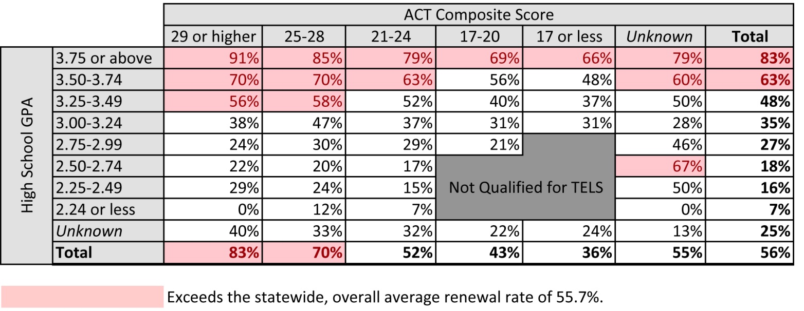
1st to 2nd Year Scholarship Renewal Rates
by H.S. GPA and ACT Composite, Fall 2011 TELS FTF

Slide 28
Section 4:
Retention for TELS FTF who Lost the Scholarship during their 1st Year

Slide 29
1st to 2nd Year Retention Rates for
TELS FTF that Lost Scholarship in 1st Year
by Program, Fall 2004 – Fall 2011

Slide 30
1st to 2nd Year Retention Rates for
TELS FTF (HOPE & ASPIRE) that Lost Scholarship in 1st Year by Qualifications Met, Fall 2004 – Fall 2011

Slide 31
Section 5:
Graduation with Scholarship

Slide 32
5-year Graduation Rates with Scholarship Intact by Scholarship Type, Fall 2004 - Fall 2007 Cohorts

Slide 33
5-year Graduation Rates with Scholarship Intact by Initial Qualifications Met (HOPE & ASPIRE only), Fall 2004 – Fall 2007 Cohorts

Slide 34
Section 5:
6-yr Graduation with
or without Scholarship

Slide 35
6-year graduation rates by scholarship type,
Fall 2006 cohort

Slide 36
6-year graduation rates by system,
Fall 2006 cohort

Slide 37
6-year graduation rates by initial qualifications met (HOPE & ASPIRE), Fall 2004 – Fall 2006 cohorts

Slide 38
Longitudinal Scholarship Renewal, Retention, and Graduation Rates, Fall 2006 TELS FTF

Slide 39
Questions?
Report will be available at:
http://tn.gov/thec/Legislative/Reports.html
under the “2013 Legislative/Reports Section.”

