Slide 1
Informational Webinar
Troy Grant
Assistant Executive Director for P-16 Initiatives
Tennessee Higher Education Commission

Slide 2
The Drive to 55 is Governor Bill Haslam’s initiative to meet our future workforce needs by having 55% of Tennesseans equipped with a college degree or certificate by the year 2025.

Slide 3
Coordinates and supports the efforts of postsecondary institutions in the State of Tennessee.
Policy Entity
Higher Education Funding
Academic Program Approval
Capital Spending Recommendation and Monitoring
Tuition Recommendation
Data Analysis
Program Development
Capacity Building

Slide 4
Office of P-16 Initiatives
Purpose
Every Tennessean should have the opportunity to pursue higher education. We create the resources and programs that transform college aspirations into reality.

Slide 6
Program Overview
Advise TN will serve 10,000+ junior and senior students across Tennessee
30 college advisors
Trained college access professionals focused on one thing: helping students enter and succeed in higher education
1 advisor to approximately every 350 students
School partnership is key
Advise TN college advisors will be placed in partner high schools that have articulated their strong commitment to building a college-going culture
Schools will be selected through a competitive bid process
Three year commitment, pending availability of funding
Advisor services will be rooted in research and best practices sourced from Tennessee and around the nation

Slide 7
Theory of Change
Committed Partnership
Partner high schools
Advise TN
Individualized Advising
Research-based interventions
Data tracking
Increased Student Outcomes
College-going culture
Sustainability

Slide 8
Proof Point
2005 – 2011 GEAR UP TN Grant
10.7 percentage point increase in college-going rate
Some high schools increased college-going rates over 20 percentage points
2012 – 2019 GEAR UP TN Grant
Serves nearly 13,500 students per year
FAFSA completion increase of nearly 20 percentage points, one high school had more than 90% of seniors complete a FAFSA this year.
5% increase in college-going rates

Slide 9
School Partnership
At its core, Advise TN is a partnership between the Tennessee Higher Education Commission and the partner high school.
What can we accomplish together?
Every school is unique
Supplement – not replace
College advisors as part of the team
Culture of college-going

Slide 10
Metrics
College applications
College acceptances
College enrollment
Scholarship applications and awards
FAFSA completion
Tennessee Promise Scholarship application completion
Completion of Tennessee Promise required meetings and service hours
ACT scores
Student participation in one-on-one advising sessions
Student participation in college visits
Student and/or parent participation in college workshops and services, including, but not limited to, Path to College events (TN FAFSA Frenzy, College Application Week, College Signing Day, and College Planning Night)
Student use of CollegeforTN.org

Slide 11
Services
One-on-one student advising
Workshops for students and families
Senior college applications
Tennessee Promise application
College Application Week
FAFSA Completion services
College fairs
Scholarship applications
ACT preparation
College Signing Day
Financial aid literacy
Summer melt interventions
FAFSA verification assistance

Slide 12
Organizational Chart
Advise TN Program Director
Advise TN Regional Coordinator
College Advisor
Administrators
Counselors
Teachers
Partner High School

Slide 13
Partner School Selection
Who is eligible?
Public high schools serving 9th – 12th grade
College-going rate less than the state average over a three year time period (Fall 2013 – Fall 2015)
A list of schools that meet the college-going rate requirement is available in the Advise TN Request for Proposal located at www.tn.gov/thec/topic/advisetn

Slide 14
Partner School Selection
Selection is based on a school’s commitment to building a college-going culture and partnering with Advise TN
Notice of Interest
Proposals due by August 12, 2016
Two part review process:
Reader review
Team meetings on August 24 – 31, 2016
School selections on September 6, 2016

Slide 15
Request for Proposals
RFP and application packet available at www.tn.gov/thec/topic/advisetn
Four sections:
Cover Letter
School Commitment to the Advise TN Partnership
School Enrollment Information
Letters of Support
10 page limit, excluding cover page and letters of support
Focus on school commitment to building a college-going culture and partnering with Advise TN
How to submit a proposal:
Due August 12, 2016
Email to Melinda.Dunn@tn.gov

Slide 16
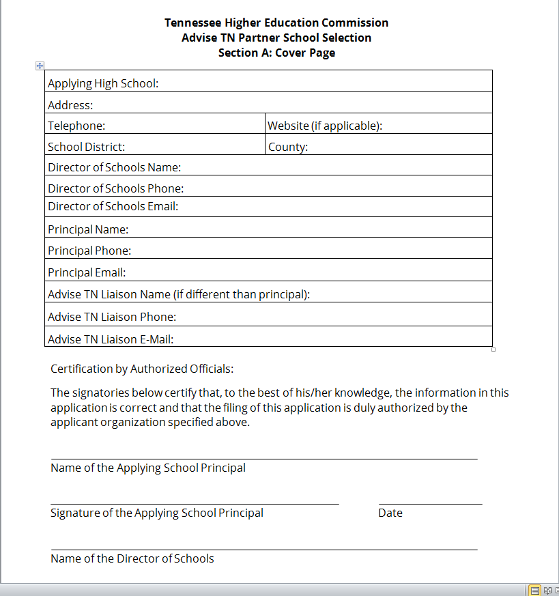
Section A: Cover Page
The high school is the applying entity
High school and school district information
Contact information for the Advise TN Liaison, if different from the principal
Principal signature
Director of schools signature

Slide 17
Section B: School Commitment to the Advise TN Partnership
Outline the school’s commitment to increasing the number of student who access and succeed in postsecondary education.
How does Advise TN address school needs
What existing student-level services or interventions are currently in place? How can these be aligned with Advise TN?
How will the entire school community support efforts to improve college-going rates? How will school staff partner with the college advisor?
One-on-one advising: understanding your school’s schedule, how can one-on-one advising sessions with juniors and seniors be accomplished?
Office space

Slide 18
Section B: School Commitment to the Advise TN Partnership
Commitment Chart
Designation of an Advise TN liaison
Collaborative development and implementation of an Advise TN work plan
Allow time for one-on-one advising
Partner with Advise TN staff in arranging and allowing students to attend at least one college visit
Path to College Events
Workshops
Text messaging platform
Memorandum of understanding, data agreements, evaluation.
College Access Steering Committee
School counselor professional development
Principal and liaison workshop
Advisor as a member of your team

Slide 19
Section C: School Enrollment Information
Data Element | 2015 – 2016 Academic Year | 2016 – 2017 Academic Year (anticipated)
Number of 11th Grade Students
Number of 12th Grade Students
Number of 9th -12th Grade Students

Slide 20
Section D: Letters of Support
Applying high schools must provide a letter of support from:
Director of schools
High school principal
At least one counselor working with high school seniors
Applicants are encouraged to elicit additional letters of support from community partners and other key staff who will participate in building a school college-going culture.

Slide 21
Scoring Rubric
A detailed scoring rubric is available as Attachment C of the Request for Proposals. This document outlines the weight assigned to each question and outlines how readers will be determine your proposals score.
www.tn.gov/thec/topic/advisetn

Slide 22
Important Dates
THEC releases Advise TN Call for Proposals | 05/19/2016
Submission of Notice of Interest | Ongoing
Deadline for receipt of Advise TN proposal | 08/12/2016 by 4PM CDT
Notifications are delivered to partner schools selected for team interviews | 08/22/2016
Partner school team meetings (includes, at minimum, the principal and a counselor) | 08/24/2016 – 08/31/2016
THEC announces selected schools | 09/06/2016
Mandatory principal workshop in Nashville | 09/21/2016
Advisors start delivering services in partner schools | 10/12/2016

Slide 23
Open Positions
Program Director
2 – 3 Regional Coordinator
30 College Advisors
Ideally, college advisors will come from the communities they will serve. Please feel free to share the job openings.
www.tn.gov/thec/topic/advisetn

Slide 24
Questions?
Troy Grant
Assistant Executive Director for P-16 Initiatives
Tennessee Higher Education Commission
Troy.Grant@tn.gov
615-532-0423
www.tn.gov/thec/topic/advisetn

