Slide 1
2021-22 Funding Recommendations

Slide 2
2021-22 State Appropriations
$36M for outcomes-based formula units and TCATs
$8.9M for specialized units
$8.6M for strategic initiatives
$9.4M for statewide priorities

Slide 3
2021-22 State Appropriations
$34.4M to the outcomes-based formula units
Largest appropriation increases - CCs
  Motlow State Community College
    13.4% increase ($2.6M increase)
  Columbia State Community College
    7.2% increase ($1.3M increase)
Largest appropriation increases - Universities
  Austin Peay State University
    9.1% increase ($4.6M increase)
  East Tennessee State University
    3.8% increase ($2.7M increase)
$1.6M for the TN Colleges of Applied Technology
    2.1% increase above 2020-21

Slide 4
University Outcome Changes
* Includes raw counts for reverse associate degrees. In the funding formula, these degrees count as 0.5 each for the community college and university.

Slide 5
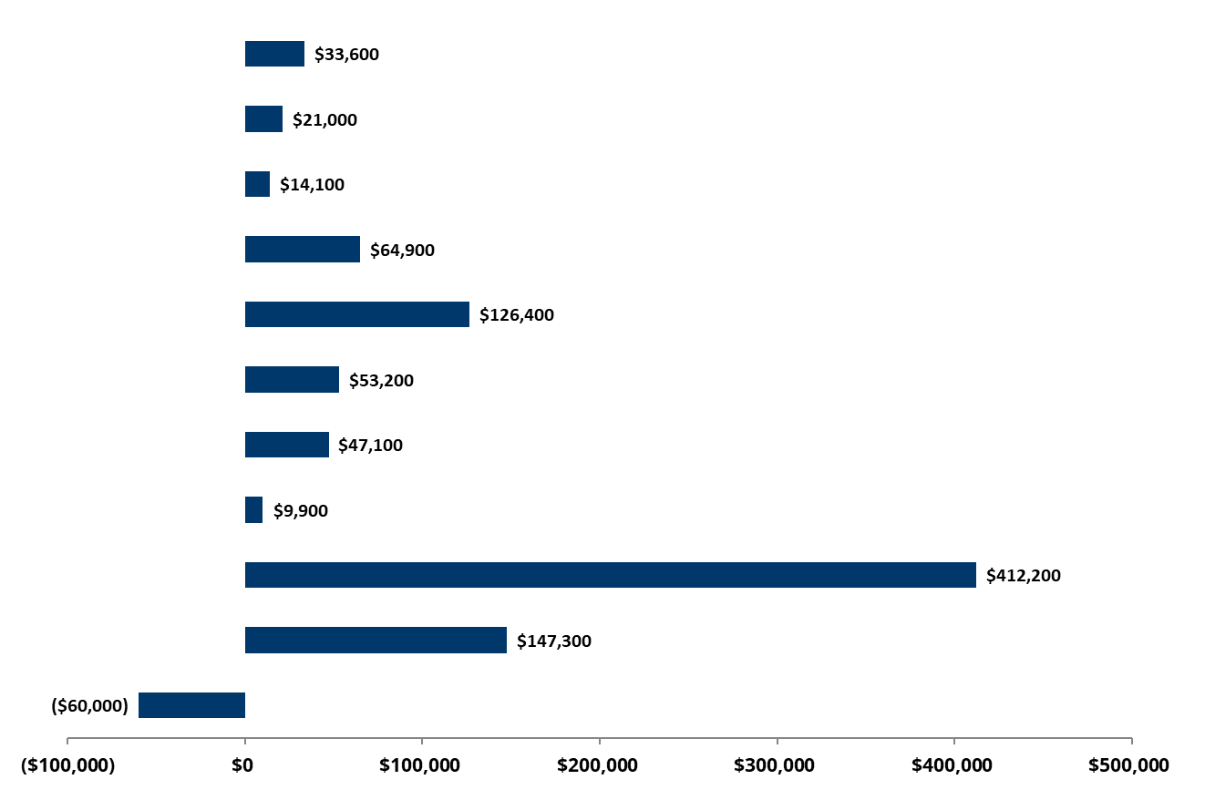
Breakdown of Component Parts
University of Tennessee at Chattanooga
Starting Point: $841,100
30 hr. Progression
60 hr. Progression
90 Hr. Progression
Bachelors & Associate
Degrees
Masters & Ed Specialists
Doctoral Degrees
Research & Service
Degrees per 100 FTE
6YR Graduation Rate
Fixed Costs
Total Recommendation: $2,893,700
Quality Assurance

Slide 6
Community College Outcome Changes
* Includes raw counts for reverse associate degrees. In the funding formula, these degrees count as 0.5 each for the community college and university.

Slide 7
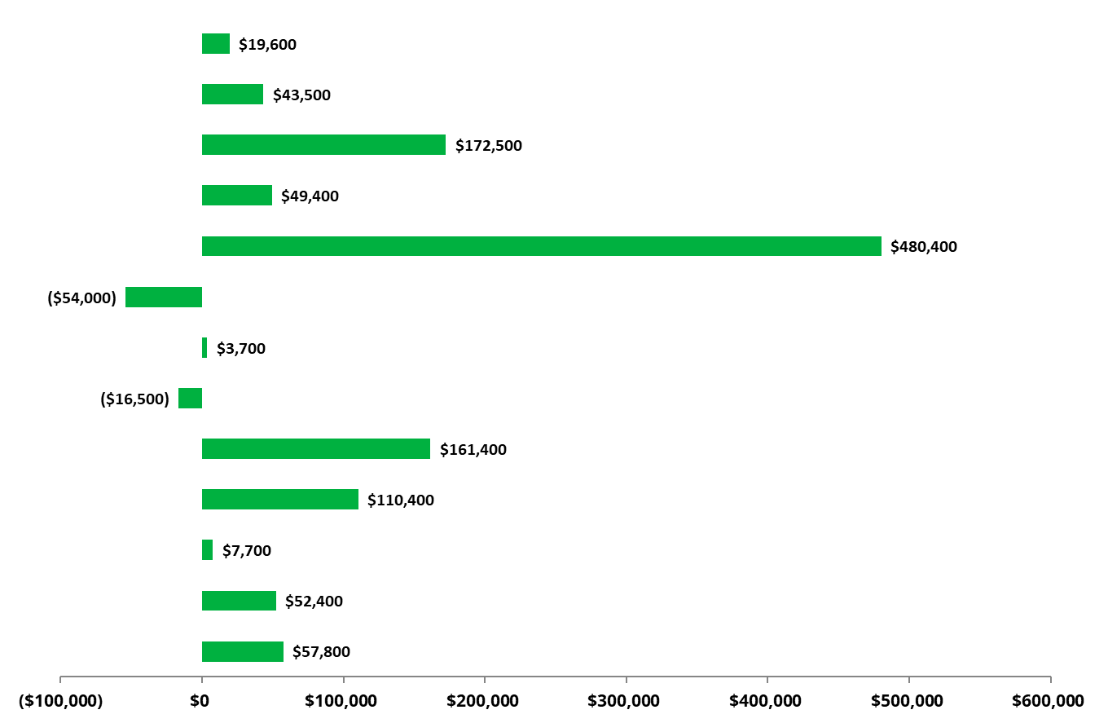
Breakdown of Component Parts
Columbia State Community College
12 hr. Progression
Starting Point: $179,100
24 hr. Progression
36 hr. Progression
Dual Enrollment
Associate Degrees
1-2 Yr. Certificates
<1 Yr. Certificates
Job Placements
Transfers Out
Workforce Training
Awards per 100 FTE
Total Recommendation: $1,267,400
Fixed Costs
Quality Assurance

Slide 8
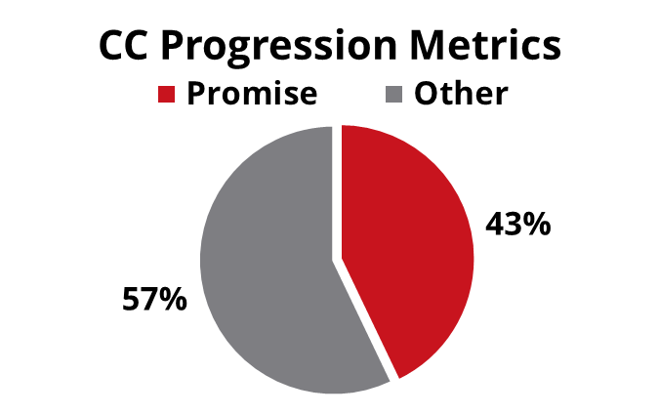
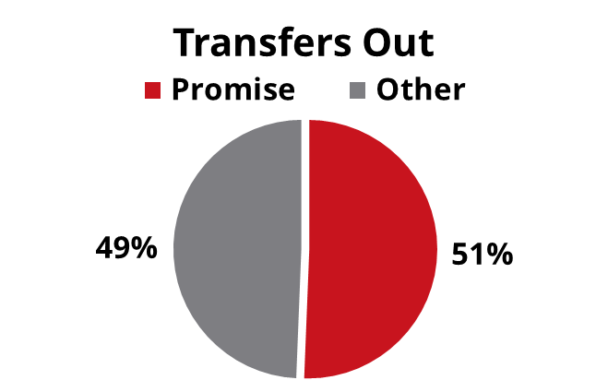
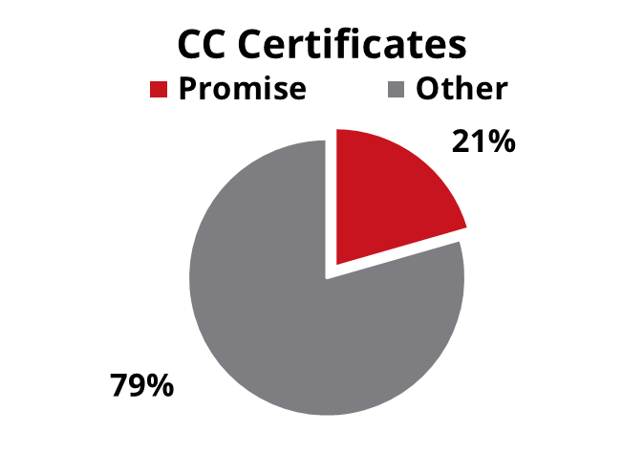
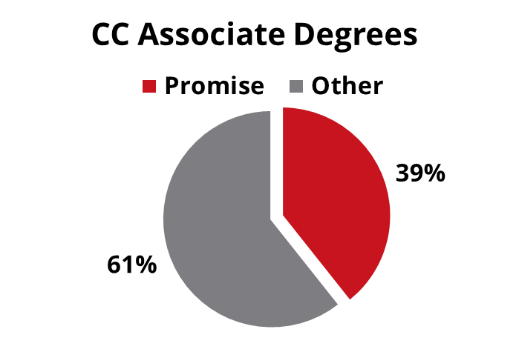
TN Promise and the Outcomes Pipeline

Slide 9
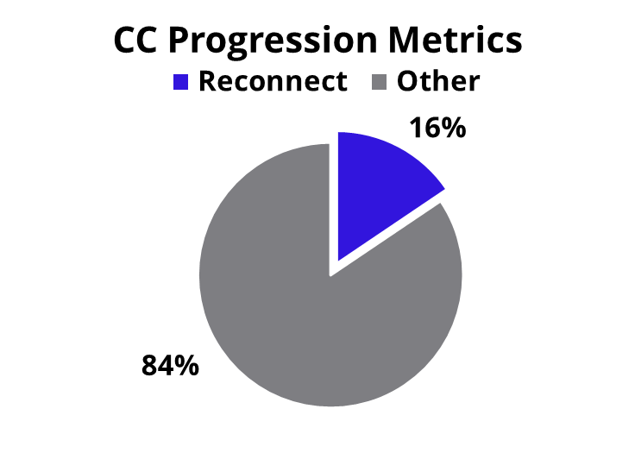
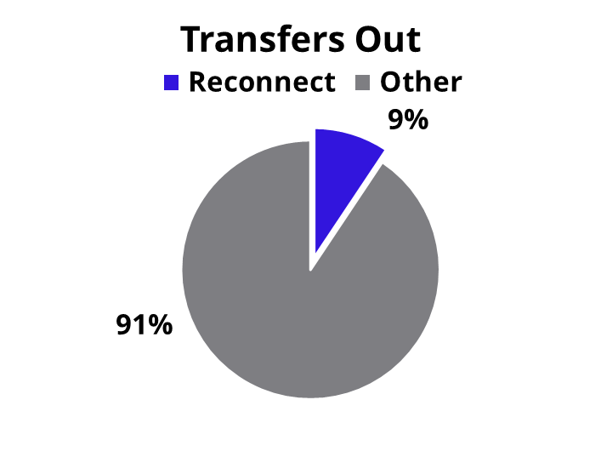
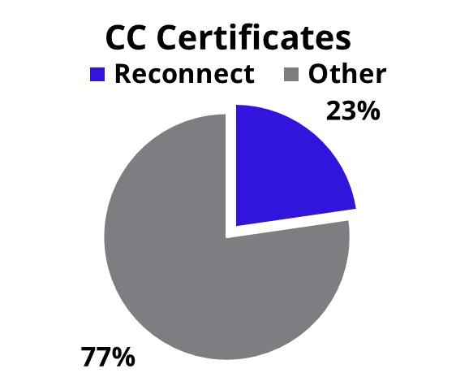
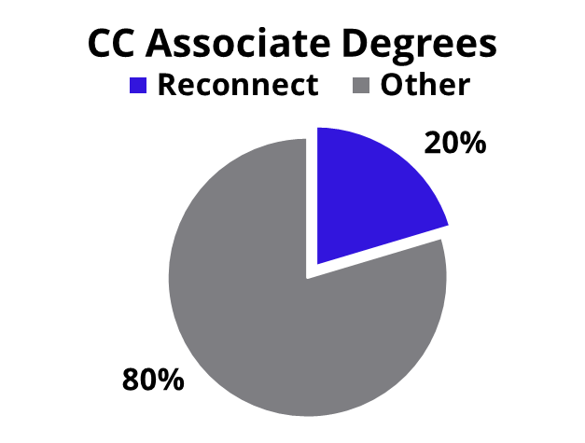
TN Reconnect and the Outcomes Pipeline

Slide 10
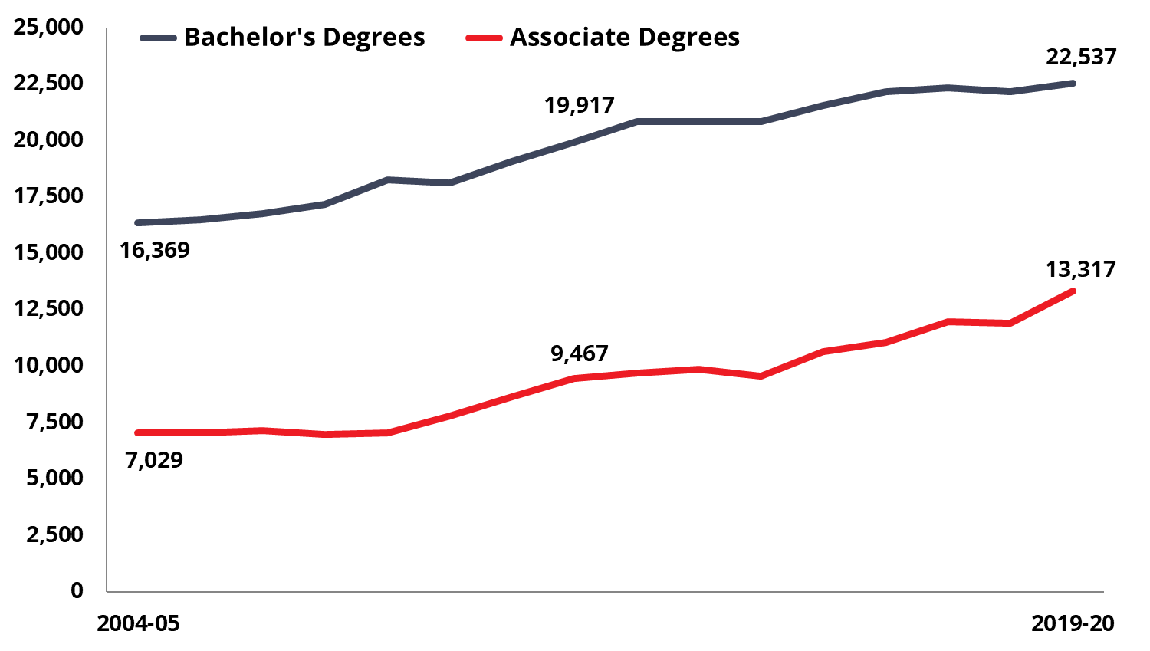
Drive to 55: Undergraduate Degree Production

Slide 11
2021-22 Appropriation Recommendation
Specialized Units Operating Appropriations
  $7.3M to Medical Units
  $1.1M to Agriculture Units
  $400,000 to Research and Public Service Units
Specialized Units Strategic Initiatives
  $6.6M to UT Institute of Agriculture
  $2.0M to TSU Cooperative Extension
Statewide System Priorities
  $9.35M to Tennessee Board of Regents
    TCAT Safety and Security – $5,900,000
    TCAT Student Success Support – $2,700,000
    Competency-Based Education Capacity – $750,000

Slide 12
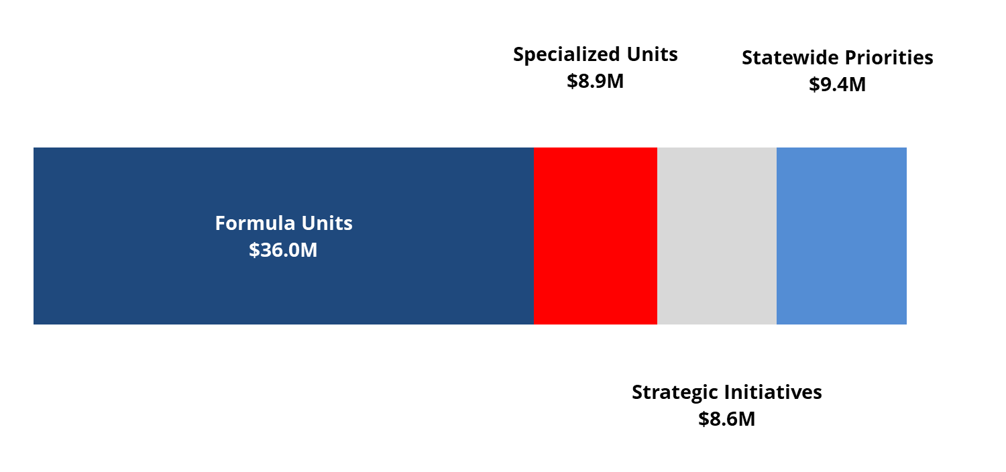
2021-22 Appropriation Recommendation
Total Recommendation = $1.76 Billion

Slide 13
III. 2021-22 Student Fee Recommendations

