Slide 1
Master Planning &
Campus Perspective
March 21, 2018
Patti Miller Carl Manka Arthur Lidsky

Slide 2
Agenda
1. Typical College and University Plans
2. The Strategic Plan
For Example: Emory University
For Example: Clemson University as an example
3. Organizing For Planning
4. Campus Planning

Slide 3

Planning is an unnatural process; it is much more fun to do something.
The nicest thing about not planning is that failure comes as a complete surprise, rather than being preceded by a period of worry and depression. Sir John Harvey-Jones

Slide 4

1.
Typical College and University Plans
Strategic / Academic Plan
Enrollment Plan
Campus Master Plan
Facility Plan
Capital Plan
Operating Budget
Fundraising Campaign Planning
Sustainability Plan
Student/Campus Life Plan
Residential Life Plan
Technology Plan
Curriculum Plan
Emergency Management Plan
Landscape, Circulation, Transportation, & Parking Plan
Which is the “Master” Plan???

Slide 5
Comprehensive Campus Planning
Academics
Finances
Strategic
Planning
Campus Life
Campus & Facilities

Slide 6
Comprehensive Campus Planning
Academics
Finances
Strategic
Planning
Campus Life
Campus & Facilities

Slide 7
2.
The Strategic Plan
The Strategic Plan is Essential to a Successful Campus Plan
Unfortunately, Most Strategic Plans are Neither Strategic nor Plans

Slide 8
An Effective Strategic Plan
Mission Statement
Goals are long term and aspirational – they are intentional
Vision
Objectives are short-term, measurable steps to reach a goal
Values
Tasks are all the steps needed to achieve the objectives
GOALS
OBJECTIVES
TASKS

Slide 9

For Example:
Cornell University’s Strategic Plan Goals
Enroll, educate, and graduate the most deserving, promising, and diverse student body possible. Provide all students (undergraduate, graduate, professional) with an education that is innovative, distinctive, and of the highest quality, and that inspires in them a zest for learning.
Maintain and enhance world leadership in research, scholarship, and creativity.
Maintain and enhance efforts to recruit, nurture, and retain a diverse faculty who are outstanding scholars and teachers and an excellent, diverse staff who provide outstanding support to faculty and students.
Strengthen the public engagement of the university's education, research, and clinical programs with local, national, and international communities, consonant with its stature as an academically distinguished private university with a public mission.

Slide 10
For Example:
Cornell University’s Strategic Plan Objectives
Faculty Excellence
Increase the size and quality of faculty in strategically important academic areas.
Significantly increase the diversity of faculty through new hires and enhanced retention efforts.
Ensure competitive faculty compensation.
Develop and implement policies to retain highly valued faculty.
Devise and implement new mechanisms or policies for rewarding outstanding faculty and for continually assessing faculty performance as scholars and teachers.

Slide 11
For Example:
Cornell University’s Strategic Plan Goals
Objective 1: Increase the size and quality of faculty in strategically important academic areas.
Rationale: Many Cornell departments are already relatively small, compared to peer institutions, and it is critical to maintain or selectively enhance faculty size in distinguished departments that are too small, and to have the capacity to invest in faculty positions in areas of substantial potential and opportunity.
Actions:
Emphasize a faculty recruitment strategy of building from the bottom (recruiting new Ph.D.s and "rising stars") over the next five years, recognizing that this may not be appropriate for all units or at all times within a given unit.
In strategically important areas, where a significant percentage of high-quality faculty are nearing retirement, pre-fill during the next five years a significant proportion of expected faculty retirements across the next ten years.

Slide 12
For Example:
Emory University’s Strategic Plan Process
2015 - 2017
2017 - 2018
2018
Collect University-wide input from Emory community
Develop fact base and 10 year aspiration plan
Approve final plan with Board of Trustees
Define strategic goals with clear targets
Implement new strategic plan
Develop initiatives and roadmap for implementation
2 to 3 Year Process

Slide 13
Emory University’s Strategic Plan Stakeholders
Steering Committee
Executive Liaisons
Advisory Committee
Faculty Advisory Committee
Board of Trustees
University Senate Executive Committee
Council of Deans
Student Leaders
Emory Alumni Board Executive Committee

Slide 14
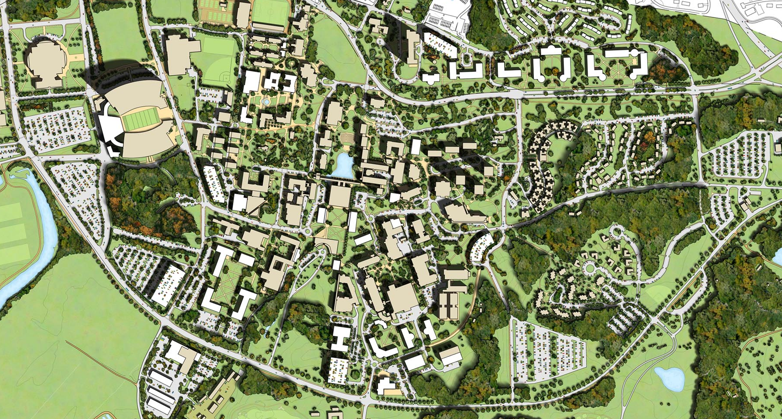
For Example:
In 2000, James Barker, then President of Clemson University had a simple vision:
“Clemson will be one of the nation’s top-20 public Universities”
At that time, Clemson was ranked as 37 in US News and World Report

Slide 15
Clemson’s Academic/Strategic Plan
Five Vision Themes
Academics, Research and Service
Campus Life
Student Performance
Educational Resources
Clemson's National Reputation
The Board Approved the Vision and 27 Goals

Slide 16
Implications
☑
320 New Faculty/emphasis on research
Increasing proportion of Grad Students
Increasing Quality: Students, Faculty, Staff
Decreasing Dependency on the State
Significant increase in Fund-raising: Capital & Endowment
Significant increase in required space
☑
Resulting Campus Plan
Reflected these Ongoing Changes
☑
☑
☑
Doubled Research $$$ in Three years
Increased Quality of Student Applicants
Created a joint Corporate/Institutional research park
New academic and student life facilities
☑
☑
CURRENTLY RANKED 23rd IN US NEWS

Slide 17
Who Needs to be Involved?
3.
Organizing For Planning
President’s Executive Cabinet
Planning Committee
Faculty, Staff, Students, Administrators
Facilities Staff
IT Staff
Trustees
Community Representatives

Slide 18
Two Committees plus Task Forces
Decision Making
President’s Executive Cabinet
One Person Should be Common to Both Committees
Shapes Decisions
Planning Committee
9 to 12 Campus Representatives
Taskforce
Taskforce
Taskforce
Taskforce
Taskforce
Taskforce
Expand Participation with Various Special Topic Task Forces
Faculty, Staff, Students, Administrators

Slide 19
What Information Matters?
Academic Information
Changes in Enrollment
Changes in Programs
Changes in Number of Faculty
Changes in Research Programs
Changes in Curriculum and Pedagogy
Accreditation Issues and Concerns

Slide 20
What Information Matters?
Campus Life Information
Changes in Programs
Changes in Residential Policy
Changes in Service Requirements
Changes in Athletic and Recreation Programs
Financial Information
Capital Plans
Extent of Deferred Maintenance
Capital Campaign
Operating Support
Changes in State and Other External Funding

Slide 21
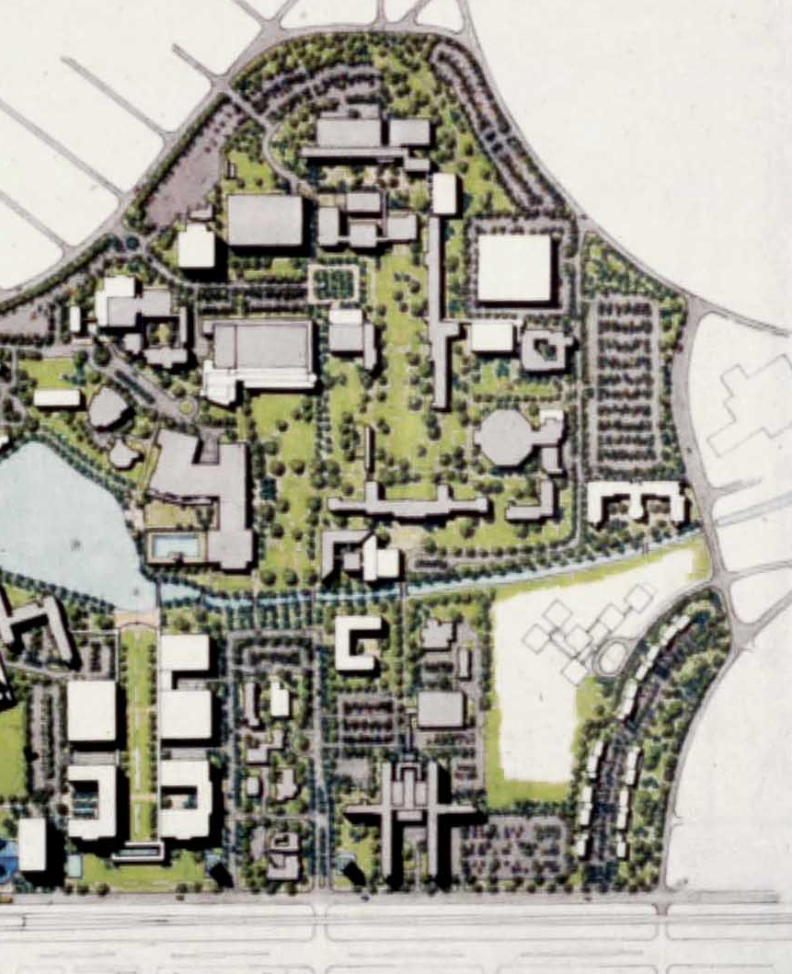
What Information Matters?
Physical Information
Environs:
Changes in the Environs that have
  Implications for the Campus
Campus
Circulation: Pedestrian, Jogging, Bicycle
Circulation: Vehicular, Parking
Topography
Landscape/Open Space
Predominant Building Use
Design Features/Issues
Facilities

Slide 22
What Information Matters?
Facilities
How much space does the university have?
How is it being used?
Who is it assigned to?
What condition is it in?
Is it appropriate?
Does it support current and anticipated pedagogy,
curriculum, and research?

Slide 23
4.
Campus Planning
From Vision to Reality
From Paper to Concrete
Mission
Vision
Values
Strategic Plan
Campus Plan
$
Facility Plans & Feasibility
$
Facility Program
$
Architectural Design
$
Construction/Renovation
$

Slide 24
The Vocabulary of Planning
Mission
Vision
Needs
Priorities
Resources
Programs
Initiatives
Curriculum
Pedagogy
Alternatives
Benchmarking
Enrollment
Funding
Utilization
Participation
Consensus
Implementation
The Vocabulary of Design
Campus Planning
Campus Planning
Architectural Style
Building Elements
Campus Style
Design Principles
Lighting
Materials
Massing
Scale
Site Characteristics
Street Furniture
Campus Plan
Campus
Design

Slide 25
4.
Campus Planning
Mission
Vision
Values
Strategic Plan
Campus Plan
Facility Plans & Feasibility
Facility Program
Architectural Design
Construction/Renovation

Slide 26
A Generic Campus Planning Process
1
2
3
4
5
Planning
Assumptions
Program, Building & Campus
Analysis & Assessment
University Needs
Alternatives
Campus
Plan
Space Utilization
Classrooms, Labs, Studios, Offices, Library
Program
Curriculum,
Pedagogy
Strategic Plan
Guidelines
Concept
Alternatives
Meetings: Faculty,
Students, Staff,
Administration
Peers
Planning Assumptions
Building
Analysis: Academic, Housing, Campus Life
Needs
Concept
Alternatives
Campus
Plan
Departments
Locations
Net and GSF
Appropriateness
Past Studies, Assessments, Proposals, and On-going Projects
Priorities
Institutional Values
Concept
Alternatives
Campus
Analysis
Zoning
Building Use
Pedestrian &
Vehicular Circ
Parking
Topography
Landscape
Outdoor Fields
Intensity of Use

Slide 27
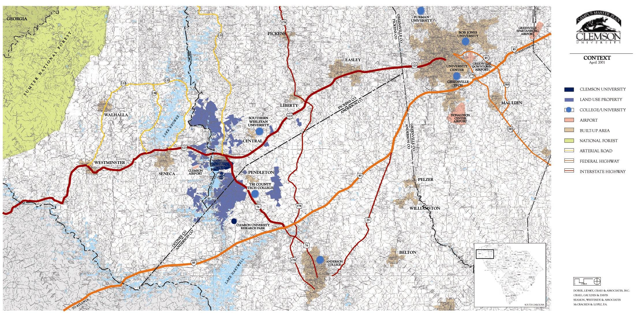
Context and Environs
Greenville
Georgia
Anderson

Slide 28
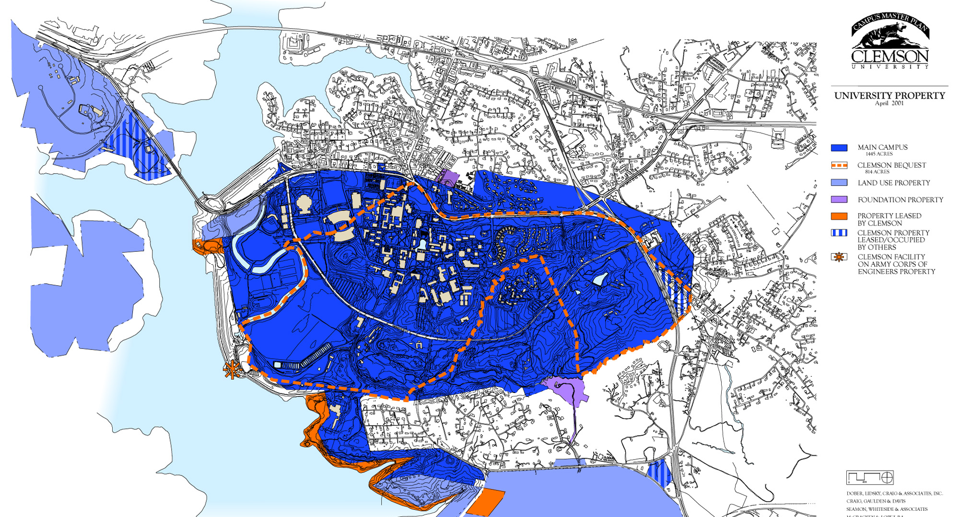
Land Ownership

Slide 29
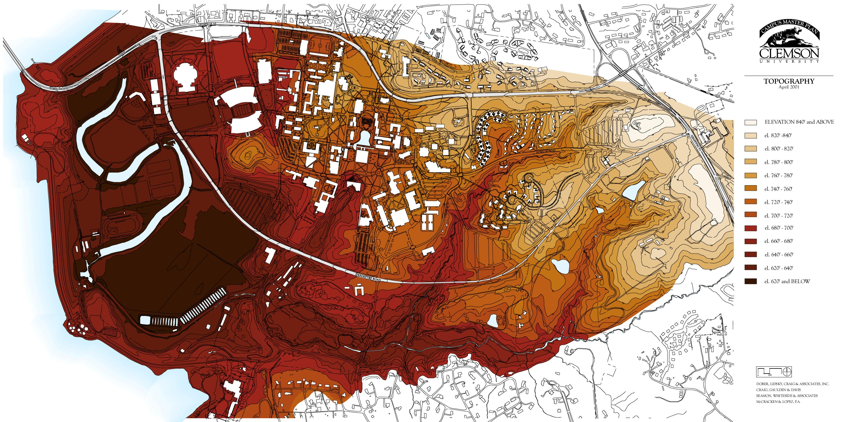
Topography

Slide 30
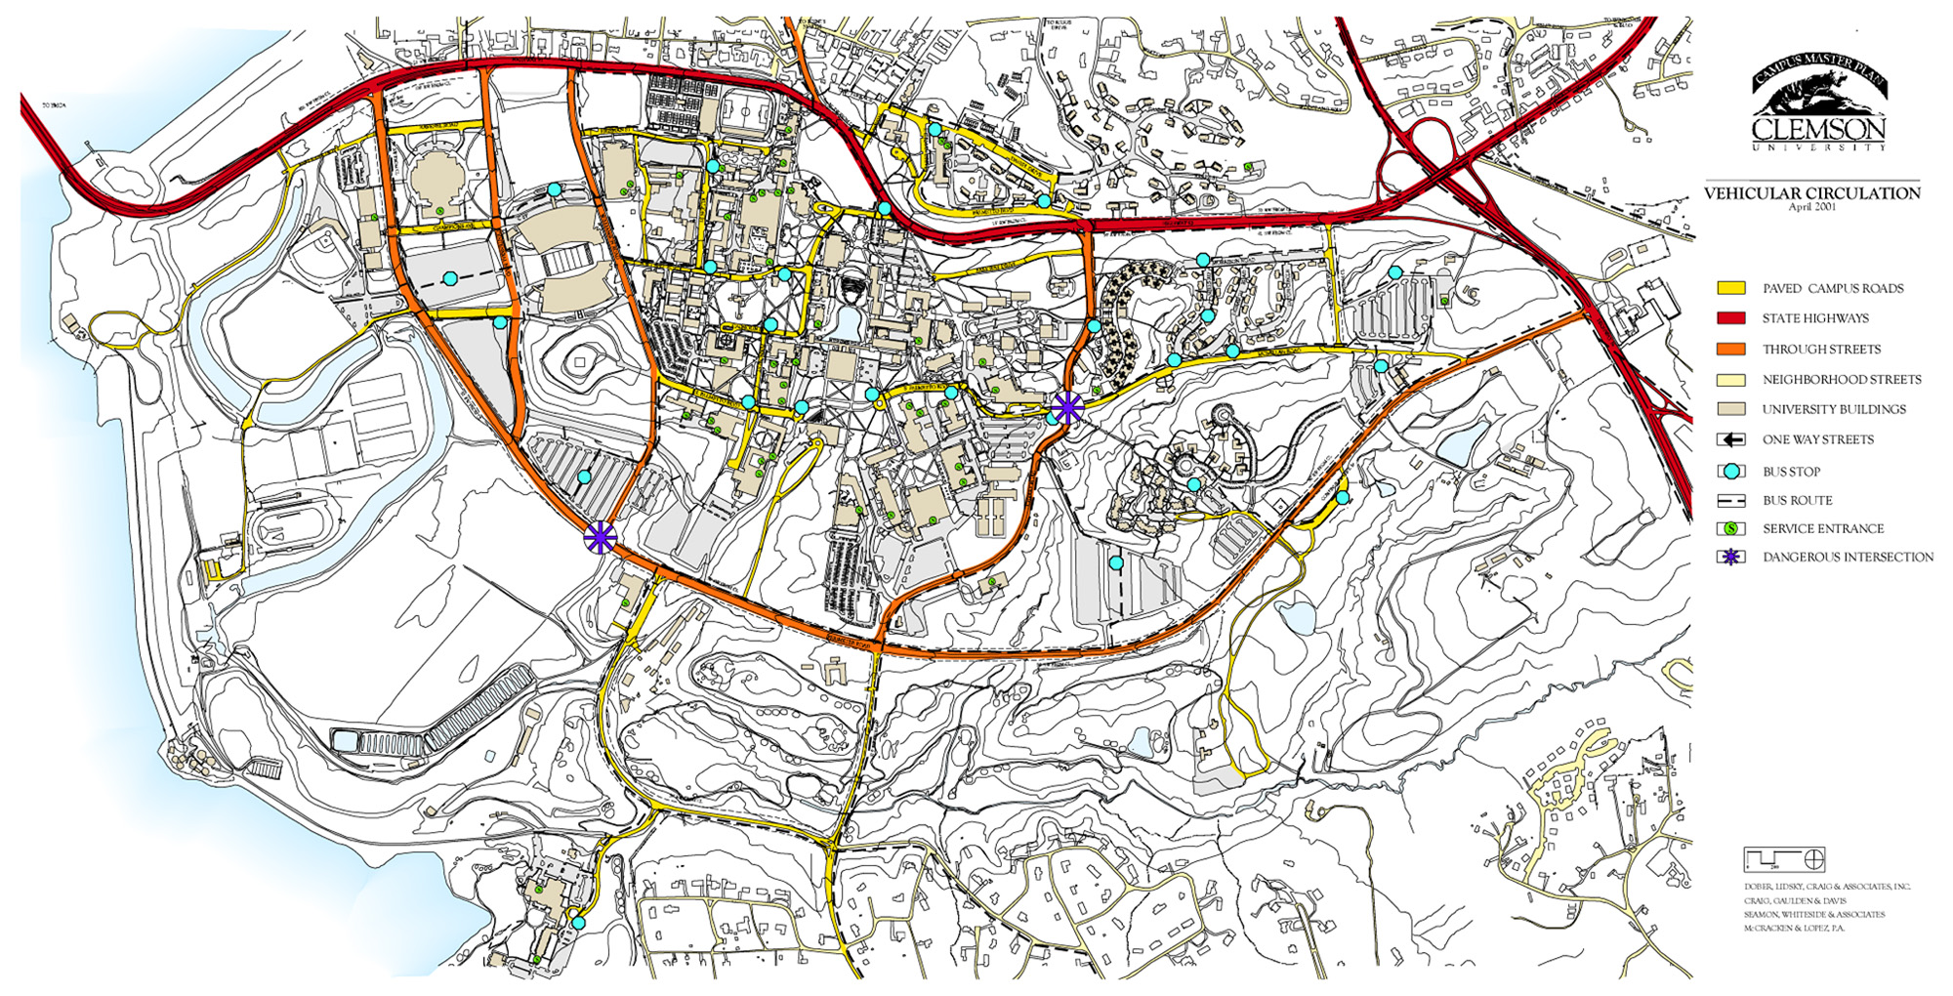
Vehicular Circulation

Slide 31
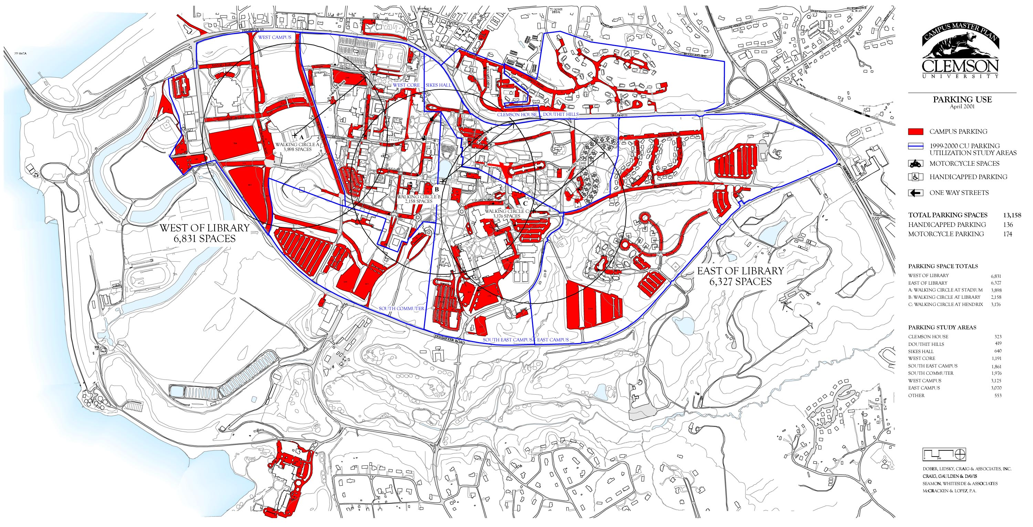
Parking
13,000 Spaces 83 Spaces/100 Students 56 Spaces/100 students Peers

Slide 32
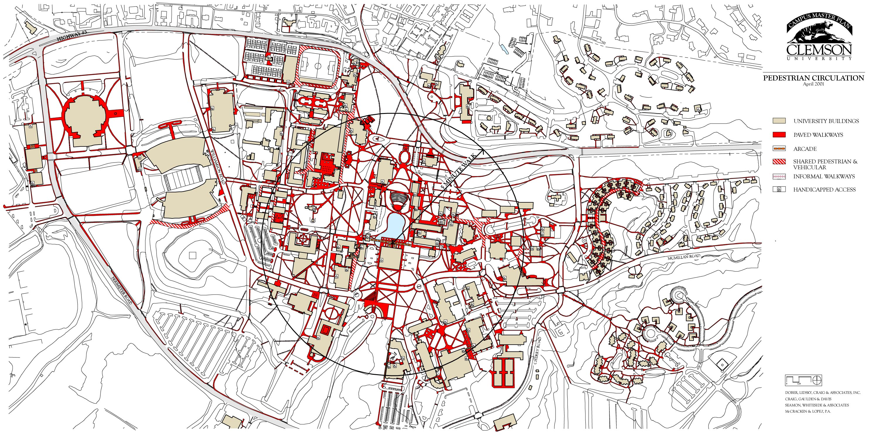
Pedestrian Circulation

Slide 33
CAMPUS ANALYSIS
Land Acquisition
Boundary Landscape
Gateways
Lighting & Signage
Outdoor Artwork
Views and Vistas
Design Guidelines
Campus Design Issues & Opportunities

Slide 34

Break?

Slide 35
FACILITIES ANALYSIS
How much space?
Does it meet standards?
How does it compare to Peers?
How is it being used?
Is it appropriate? Is it safe?
What is its condition?
How much do we need?
What are our priorities/

Slide 36
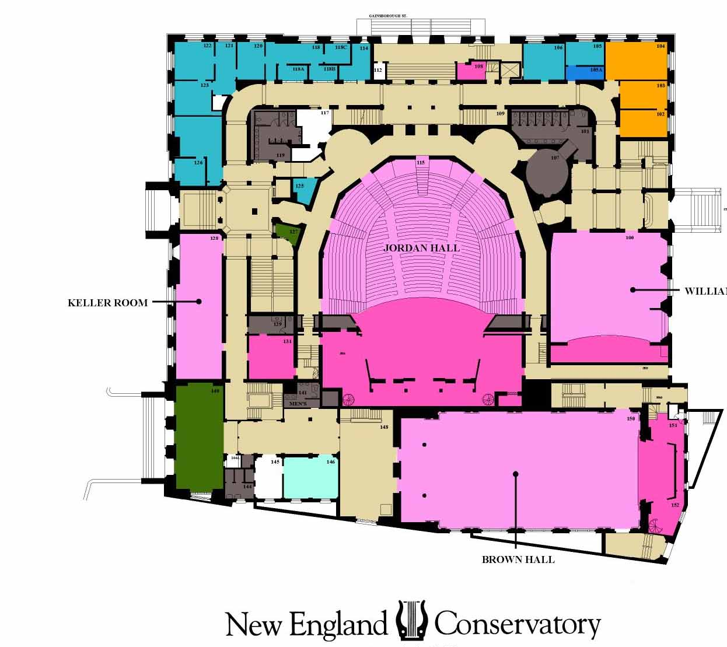
How Much Space?
Why a Facility Inventory?
You Can’t Manage What You Haven’t Measured
Basic Planning Data
Facility Management
Cost Recovery
Utilization Studies
Space Allocation Planning
Capital Budget Planning

Slide 37
How Much Space?
Facility Inventory
Building
Room
Department
Space Type
Space Type Code
Stations
Net Assignable Sq. Ft.
% Research
Occupant
Condition
Age
Technology
Ownership
Responsible PI
Special Equipment

Slide 38
How Much Space?
Facility Inventory – Who’s Responsible?
Institutional Research?
Physical Plant?
VP Research?
Planning Office?
Requires Staffing
Must be kept up-to-date
Annual space audit

Slide 39
Does it Meet Standards?
The nice thing about standards is that there are so many of them to choose from. Andres S. Tannenbaum

Slide 40
Does it Meet Standards?
Space Standards: Faculty Office
State Standards: 100 NSF - 180 NSF per Person
WICHE: 110 NSF – 130 NSF per Person
THEC: 150 NSF per Person
Allocation Models: 130 NSF – 160 NSF per Person
DLM Database 153 NSF per Person (Univ.)
DLM Database 141 NSF per Person (Col.)
Below 100 NSF is Substandard

Slide 41
Faculty Office
12ft 5 00in
15ft 0 00in
12ft 0 00in
12ft 0 00in
120 NASF
150 NASF
180 NASF

Slide 42
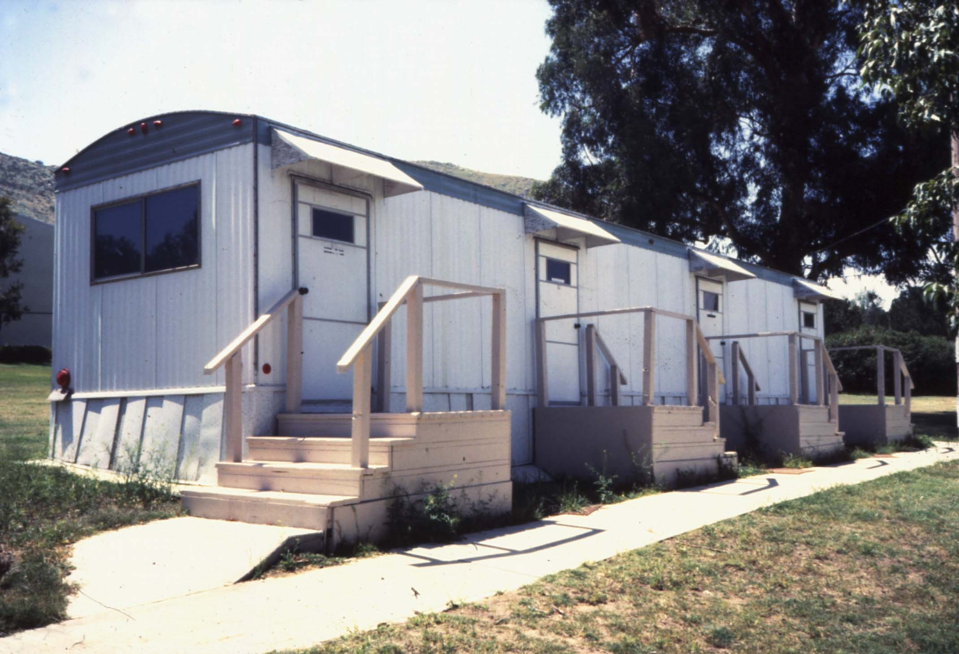


Slide 43
How Does it Compare to Peers?
35 Universities: NSF per Faculty

Slide 44
How Does it Compare to Peers?
36 Public Universities – NSF per Student

Slide 45
How Does it Compare to Peers?
NASF /FTE Student
8,108
11,561
18,116
7,325
9,118
16,443
As Reported to THEC – 2016 Data for all the universities

Slide 46
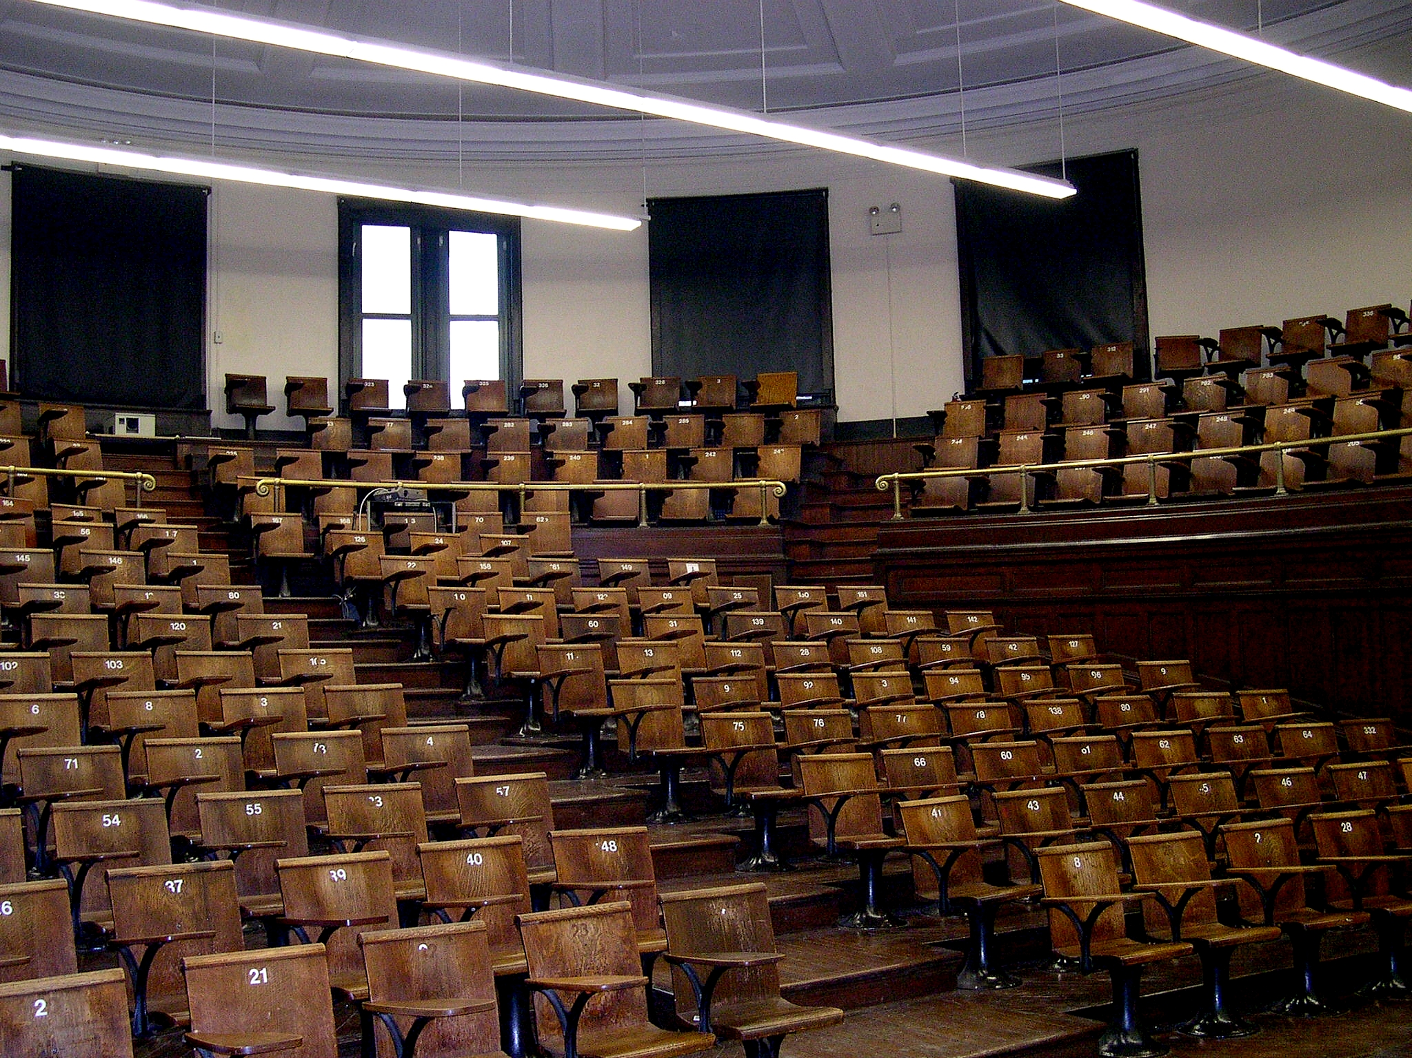
How is it Being Used?
Classroom Utilization
a. Room Utilization
Hours per week
b. Seat Utilization
% Seats Used
c. Square Feet/Seat
Square Feet/Seat
d. Correlations of Day
and Time

Slide 47
How is it Being Used?
Classroom Utilization
a. Room Utilization
Target:
30 hours per week for day program
Time for meetings, study, unscheduled events, group activities, maintenance

Slide 48
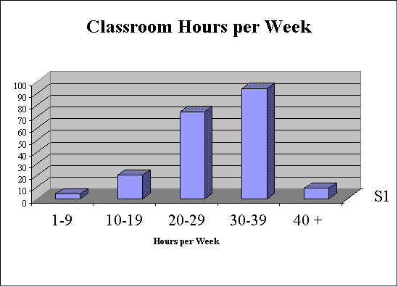
How is it Being Used?
Target 30 Hrs/Wk
Number of Classrooms
Boston University

Slide 49
How is it Being Used?
Percent of Classroom in Use
Boston University

Slide 50
How is it Being Used?
What affects Classroom Utilization?
Control: Registrar or Department
Location
Condition
Sight Lines
HVAC/Noise
Furniture
Technology

Slide 51
How is it Being Used?
Classroom Utilization
a. Room Utilization
b. Seat Utilization
Target:
Seats filled to 60% to
of capacity

Slide 52
How is it Being Used?
75%
Percent of Sections or Rooms
25%
Boston University

Slide 53
How is it Being Used?
Classroom Utilization
a. Room Utilization
b. Seat Utilization
c. Square Feet/Student

Slide 54
How is it Being Used?
20 Seat Classroom
430 NSF
21 NSF/Seat
12 Seat Classroom
430 NSF
36 NSF/Seat

Slide 55
How is it Being Used?
Number of Students | NSF/Student Tables & Chairs | NSF/Student Tablet-arm Chair
10-19 | 25-35 | 20-22
20-29 | 25-35 | 18-20
30-39 | 20-25 | 16-18
40-49 | 18-22 | 14-16
50-59 | 18-22 | 14-16
60-99 | 18-22 | 14-15
100-149 | 16-20 | 12-14

Slide 56
How is it Being Used?
Number of Students | NSF/Student Tables & Chairs | NSF/Student Tablet-arm Chair
10-19 | 25-35 | 20-22
20-29 | 25-35 | 18-20
30-39 | 20-25 | 16-18
40-49 | 18-22 | 14-16
50-59 | 18-22 | 14-16
60-99 | 18-22 | 14-15
100-149 | 16-20 | 12-14
Square Feet per Student
Number of students

Slide 57
POLICY CHOICE EXAMPLES
Agreement on space standards
Agreement on classroom, studio, and laboratory utilization standards
Agreement on who gets an individual office and who shares
Agreement on which facility resources are made available to grad students

Slide 58
POLICY CHOICE EXAMPLES
Agreement on percentage of students to house in institutional housing
Office space for University Assistants?
Policies needed to rationalize planning process – responsibilities, planning committee structure, database creation, and management

Slide 59
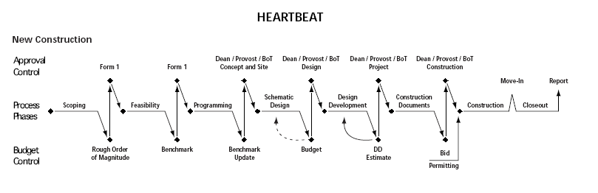
Project Planning and Implementation
Stanford University’s Heartbeat
Cpm.stanford.edu/pdp

Slide 60
Soft Costs
Architectural Fees – 6% to 15% of construction
Contingency – 10% of Construction
Equipment – 10% of Construction
Telecommunications – 3% to 5% of construction
Department of Public Works – 3% of construction
Commissioning – 3 to 5% of construction
Green Building Design – depends on type of building
Art 1% of construction
Construction Administrator – 3% of construction

Slide 61
The Importance of Building Efficiency
The Net-to-Gross Ratio
Net Square Footage | 88,635 | Efficiency | Construction Cost at $383/SF
Gross Square Footage | 126,621 | 70% | $ 48,496,007
 | 136,362 | 65% | $ 52,226,469
 | 147,725 | 60% | $ 56,578,675
 | 161,155 | 55% | $ 61,722,191

Slide 62
The Importance of Communication

Slide 63
Have Fun ….

Slide 64
How Much Space?
100 Classroom and Support
200 Laboratory and Support
300 Office and Support
400 Library/Reading and Support
500 Special and Support
600 General and Support
700 Support
800 Health Services Support
900 Residential and Support
xxx Vacant, under renovation
Corridors, Stairs, Restrooms, Elevators, Lobby,
Mechanical Rooms, Ducts, Janitor Closets
Structure and Walls
Net Square Feet
Net Usable Square Feet
Gross Square Feet

Slide 65
How Much Space?
Net and Gross Square Feet
10 x 10
10 x 10
10 x 10
10 x 10
20 x 20
400 / 441 91%
5 x 40
400 / 600
67%
10 x 10
10 x 10
5 x 20
80%
400 / 500
10 x 10
10 x 10

Slide 66

How Much Space?
Space Type Code
100 Classroom
200 Laboratory
300 Office
400 Library/Study
500 Special
600 General
700 Support
800 Health
900 Residential

Slide 67
How Much Space?
Space Type Code
100 Classroom
200 Laboratory
300 Office
400 Library/Study
500 Special
600 General
700 Support
800 Health
900 Residential
210 Class Laboratory
215 Class Laboratory Service
220 Open Laboratory
225 Open Laboratory Service
250 Research Laboratory
255 Research Laboratory Service

Slide 68
How Much Space?
Space Type Code
100 Classroom
200 Laboratory
300 Office
400 Library/Study
500 Special
600 General
700 Support
800 Health
900 Residential
610 Assembly
620 Exhibition
630 Food Facility
640 Day Care
650 Lounge
660 Merchandising
670 Recreation
680 Meeting Room

