Slide 1
SBC/OSA Processes LGI Training 3/21/2018
Ann McGauran, State Architect
and Chloe Shafer, Director of Compliance
Office of the State Architect

Slide 2
Agenda
SBC Policy Update - January 2018
Including delegations
Land Transactions Policy and Procedures Refresher
Leasing Policy and Procedures Refresher
Items Requiring OSA Signature/Approval

Slide 3
SBC policy Update jan 2018

Slide 4
Purpose of the Update
Incorporate new SPAs
Clearly define the authority of the Commission
Make the policy easier to follow:
Defined terms and consistency in use of terms
Add delegations
Require status updates
Begin the process of regular updates
(also simplified the Requested Actions)

Slide 5
I-3 Purpose of the Commission
As a statutorily- created body, the Commission seeks to ensure that actions and decisions affecting real property in which the State has an interest are made in the best interest of the State. This role includes promoting quality in design and construction, sound fiscal management, fair competition for work, and proactive planning and decision making.
When SPAs are performing tasks on behalf of the Commission, this becomes the role of the SPA.

Slide 6
Capital Improvement
The construction or erection of new buildings or Structures, including the prefabricated and modular buildings and Structures that are or will be attached to a permanent foundation
The demolition of any building or structure
A Renovation
A project funded in an Appropriations Bill or Bond Bill passed by the Legislature with outlay dollars, or a project funded with residual funds.
“Renovation” means the change in the functional use or operation of space in existing buildings or structures on State Property such that its occupancy changes for building code, insurance, funding, or bond purposes.
“Structure” means any monument or construction attached to State Property having health, safety, and welfare regulatory considerations; requiring State Fire Marshal approval; or designed to accommodate eight or more people.

Slide 7
Capital Maintenance
Major Maintenance
Maintenance or construction in a single building or structure, within a six (6) month period or less, and having a Total Project Cost, taking into account all contracts pursuant to which the work was performed, in excess of $100,000 funded by sources other than capital appropriations
A project funded in an Appropriations Bill or Bond Bill passed by the Legislature with maintenance dollars, or a project funded with residual funds
Major Maintenance means the repair or renovation that is being funded by direct appropriations for “major maintenance” or that is estimated to have a Total Project Cost in excess of $100,000

Slide 8
Capital Grant
An agreement whereby the State agrees to provide funds to any entity in order to fulfill an appropriation set forth in an annual Appropriations Bill or Bond Bill passed by the Legislature for capital outlay or capital maintenance.

Slide 9
Higher Education Institution
University of Tennessee,
Tennessee Board of Regents,
Austin Peay State University,
East Tennessee State University,
Middle Tennessee State University,
Tennessee State University,
Tennessee Technological University,
University of Memphis,
or a campus or institution of one of the aforementioned.
Head of the Higher Education Institution means: (i) as to the Tennessee Board of Regents and any institution thereunder, the Chancellor, and (ii) as to any other Higher Education Institution, the President.

Slide 10
Head of an SPA
As to STREAM, the Deputy Commissioner of the Department of General Services for STREAM;
As to the University of Tennessee, the Executive Director of the Office of Capital Projects;
As to Tennessee Board of Regents, the Executive Director of the Department of Facilities Development;
As to East Tennessee State University, the Associate Vice President for the Office of Facilities Management, Planning, and Construction; and
As to Austin Peay State University, the Director of the Office of University Design and Construction.

Slide 11
Capital Projects Delegations

Slide 12
Capital Projects Back-up Documents
Lead Sheet
SBC-1

Slide 13
Capital Projects Back-up Documents
Lead Sheet
SBC-1
Need to match
Project Description should not be your RFQ or Designer Scope

Slide 14
Capital Projects Back-up Documents
Lead Sheet
SBC-1
Comment gives additional information- rationale for request, helpful information, etc. Be consistent and concise

Slide 15
Capital Projects Back-up Documents
Lead Sheet
Simplified Requested Actions
Before: Approval of a project, budget, scope, funding and source(s) of funding, and proceeding with the process to select a designer
Now: Approval of a project and proceeding with the process to select a designer

Slide 16
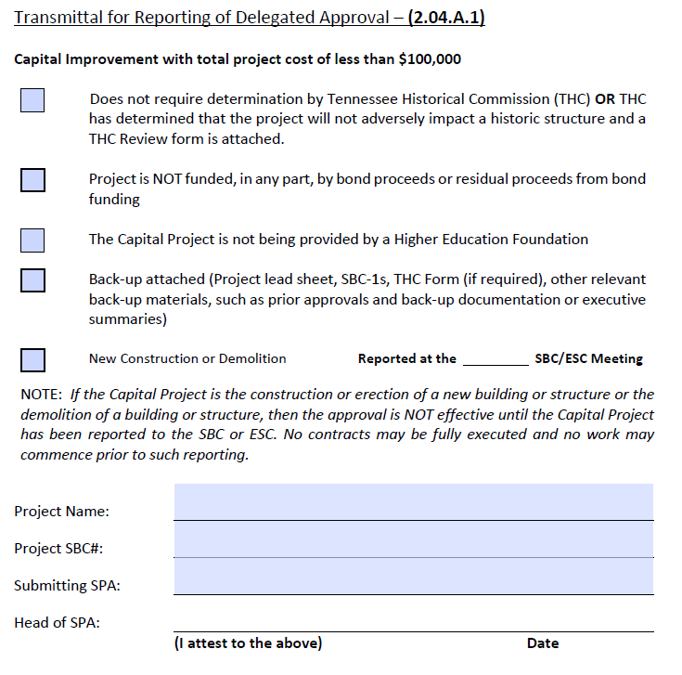
Only for Capitol Improvements <$100K
OSA will hold New Construction and Demolition projects until reported
Head of the SPA is the only “approver”

Slide 17
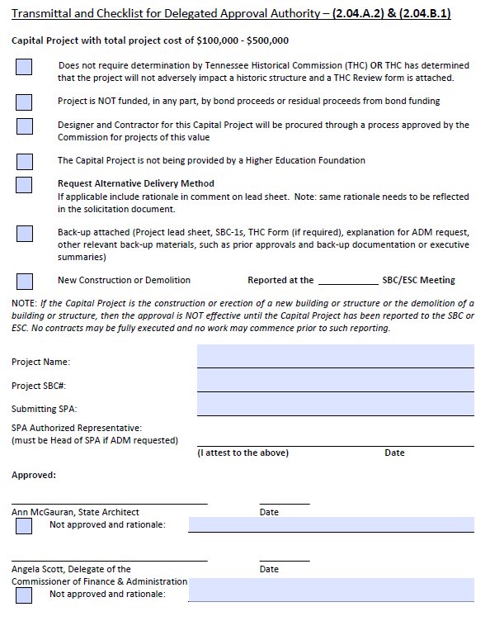
For all projects between $100K and $500K
OSA will hold New Construction and Demolition projects until reported
Can also request ADM for design or construction on same form, however, this requires Head of SPA to approve

Slide 18
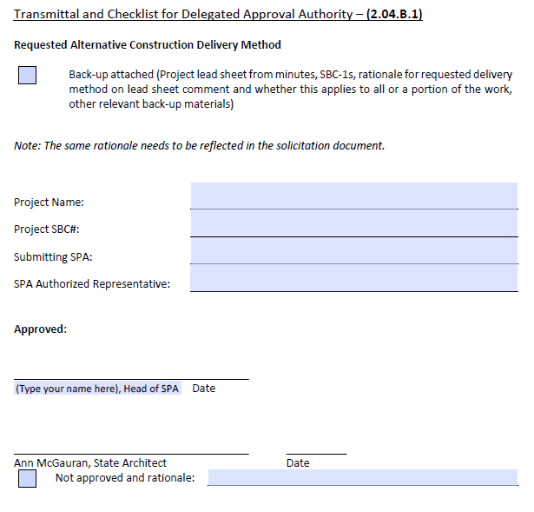
Requesting ADM for an existing project
Includes Construction alternatives (i.e., Best Value, CM/GC, IDIQ, JOC, Gift in Place, Agency Resources, use of CPO, etc.)
Requires Head of the SPA to approve
This form may also be used to change design delivery for a previously approved project

Slide 19
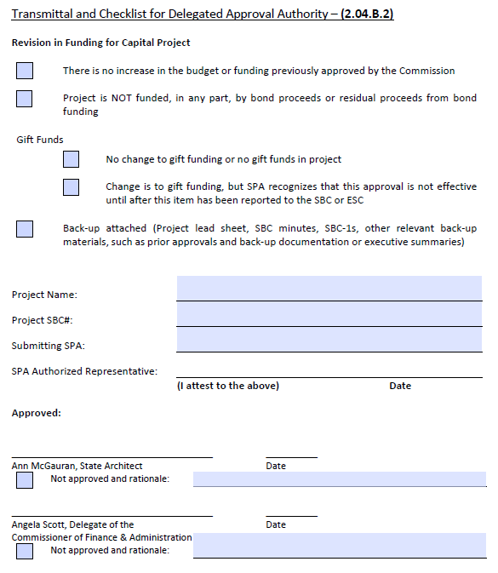
Requesting revision in funding (not budget) for an existing project
Allows for change in funding sources (i.e., replacing plant funds with gifts or agency funds with project funds)
SPA signature affirms that the scope can still be completed within the total project budget

Slide 20
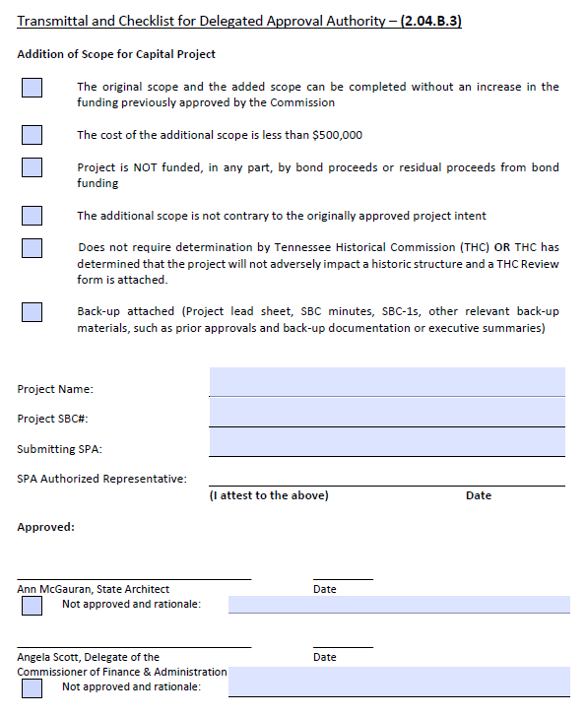
Requesting revision in scope for an existing project (i.e., project description)
Only to add scope
Added scope needs to be in keeping with the original scope
SPA signature affirms that the scope can still be completed within the total project budget

Slide 21
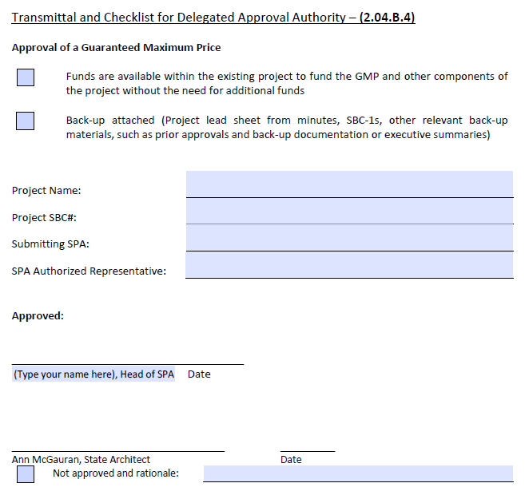
Requesting revision in the GMP above the MACC for an existing project
Requires signature by the Head of the SPA affirming that the scope can still be completed in the total project budget

Slide 22
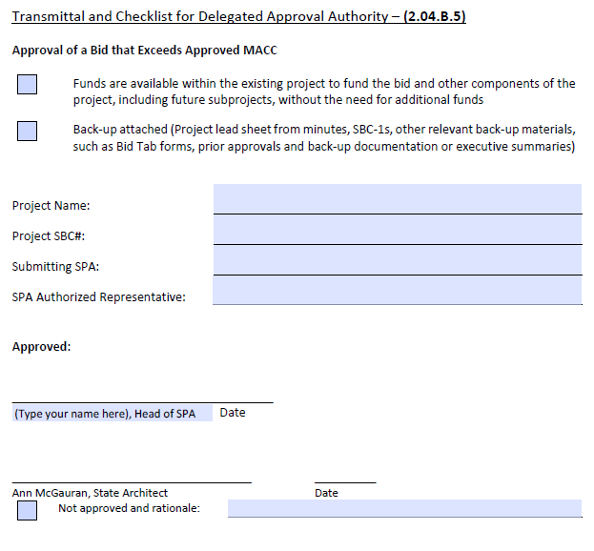
Approval of Bid that exceeds the MACC
Requesting revision in budget allocation, not funding
Bid Tab is required
Requires signature by the Head of the SPA affirming that the total project can still be completed within the existing total project budget

Slide 23
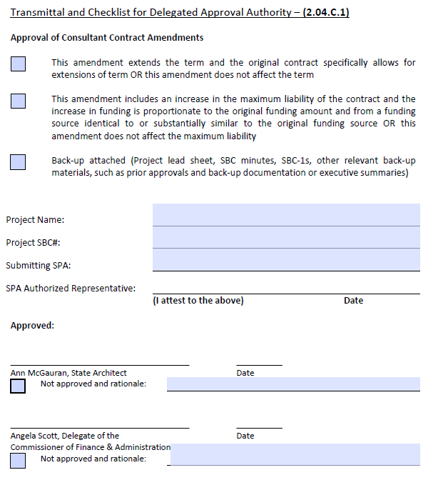
Approval of Consultant Contract Amendments
To add additional years and funding, if needed, to a contract that includes extension options or has received an additional appropriation
Funding source for additional funds must be similar to existing funding, if adding funds

Slide 24
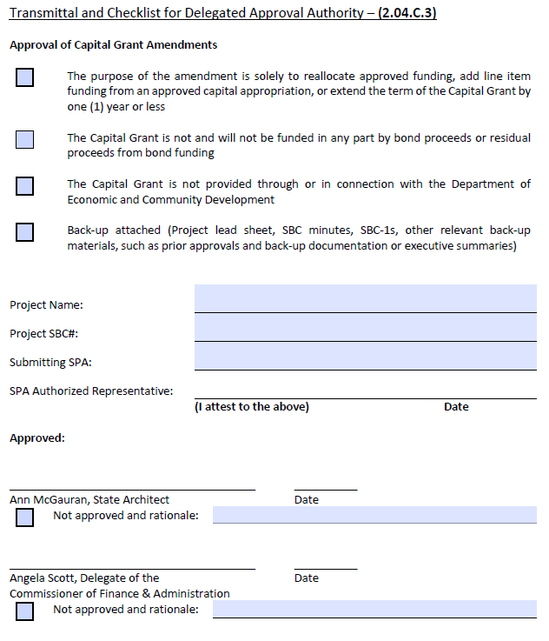
Approval of Capital Grant Amendments
To approve a reallocation of grant line item funding;
To add additional appropriations; or
To an additional year to the term (to allow completion of scope)
Cannot be used for ECD grants

Slide 25
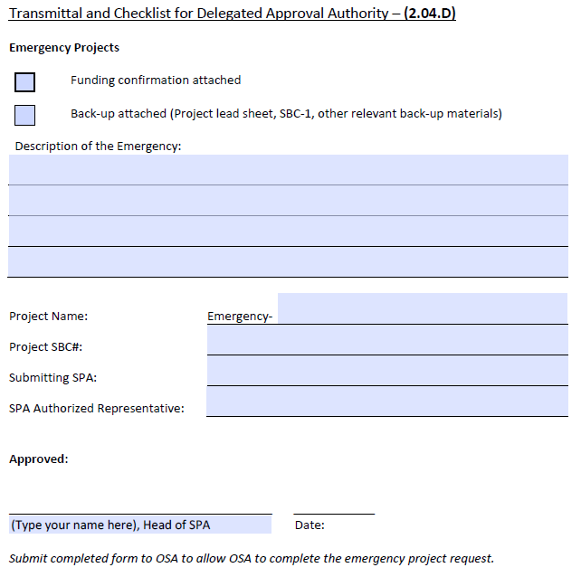
Emergency Project
To be used for projects over $500K that need work to start sooner then the next SBC meeting
Upon receipt, OSA will handle needed approvals from F&A and a Constitutional Officer

Slide 26
Land Transactions Policy and Procedures

Slide 27
Land Transactions
Managed by STREAM on behalf of all State agencies and institutions
Includes:
Acquisitions in Fee or by Easement
Disposals of Any Interest in Real Property (fee, easement or leasehold)

Slide 28
Land Transactions Essentials
Executive Summary- a paragraph or so that sets forth the request, why it should be approved, and any other relevant information
Include Maps, if helpful
Lead Sheet Draft
Completed RPM-1 Form

Slide 29
Land Transactions Next Steps
The Executive Summary will help STREAM identify any other needed information and concerns to be addressed
STREAM Contacts:
Taylor Passons, 615-741-1286, Taylor.Passons@tn.gov
Vickie Medley, Vickie.Medley@tn.gov
Approval can occur:
Under delegated authority,
ESC consent agenda, or
ESC presentation (ie lead sheet not on the consent agenda)
Presentations to the ESC are made by someone from the Higher Education Institution (not required to be the President)

Slide 30
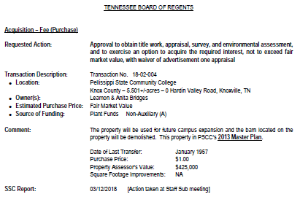
Land Back-Up Documents
Lead Sheet
From STREAM
RPM-1
Executive Summary
Map
Deed

Slide 31
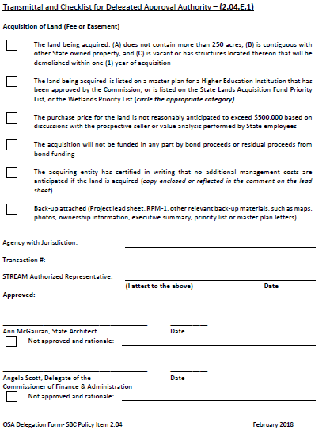
Land Acquisition
<250 acres
<$500,000
Contiguous with State property
No structures or structures that will be demolished in <1 year
Included on your SBC approved Masterplan
No bond funding

Slide 32
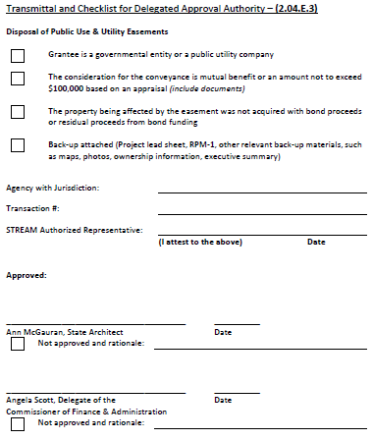
Disposal for Public Use and Utility Easements
Grantee is a governmental entity or public utility company
Mutual benefit or <$100,000
Land was not purchased with Bonds

Slide 33
Leasing Policy and Procedures Refresher

Slide 34
Disposal Leases (Land Transaction)
Leases where the State is the landlord
In SBC Policy Item 7 as of January 2018 but still handled by STREAM as a land transaction
Agreements with other State entities occupying space are not leases from the SBC perspective
Calling a document something other than a lease does not exempt it from policy or statute
Housing rentals to faculty, staff, and students not covered by leasing policy
All Disposal Leases are signed by DGS Commissioner, Attorney General, and Governor

Slide 35
Acquisition Leases
Leases where the State entity is the Tenant
Approved only by the ESC, not approvable under a delegated approval authority
Applicable Statutes: TCA 4-15-102, 12-2-114 and 12-2-115
SBC Policy Item 7 discusses Acquisition Lease procedures and requirements

Slide 36
Acquisition Leases Essentials
Identify a Leasing Coordinator
Document Procedures and Prepare Forms
General Counsel Review (forms, policies, procedures and legal role)
Have Forms, and any required Policies and Procedures, approved by ESC

Slide 37
Acquisition Leases Advertising
Policy Item 7.01D discusses advertising requirements
No advertising required if:
Annual Rent < $50k/year
Government Entity Landlord
Special and Unique Space
Term of 1 Year or Less

Slide 38
Acquisition Leases requiring ESC Approval
ESC Approval Needed if:
Term > 5 years or
Rent > $150k/yr or
Requesting Exception to Statute or Policy
Forward documents to OSA in advance
Best if there are 2-4 days to review ahead of prep call for a normal procurement (more if there are issues)

Slide 39
Acquisition Leases Other Items Refresher
Certification of Funds – Policy Item 7.03
Inter-agency/Inter-institution Agreements are NOT leases
A Space Use Agreement or a License can still be a lease; title of the document is not determinative
Do NOT move in or do work in the space until you have a fully executed lease

Slide 40
Acquisition Leases Next Steps
Executive Summary- a paragraph or so that sets forth the request, why it should be approved, and any other relevant information
Include Maps & Photos, if helpful
Include Summary of Procurement Results, if any
Lead Sheet Draft
Draft Lease with deviations from approved form of lease highlighted
Required Documentation, if any policy deviations are requested, like waiving advertisement

Slide 41
Acquisition Leases Final Steps
Lease approved and executed
File executed lease with Secretary of State
Record lease with Register of Deeds for county where the property is located

Slide 42
Land and Lease Transactions Keys to Success
Establish a process and procedures
Follow the process and procedures
Confirm you achieved the “right” result
Call STREAM or OSA if you have questions

Slide 43
Items requiring OSA signature/approval

Slide 44
Gift in Place Projects
Requested with the initial project approval
Include GIP Justification Form with back up
Form is on OSA website: https://www.tn.gov/content/dam/tn/statearchitect/documents/GiftPlaceJustificationForm.pdf
Once project is approved, OSA issues memo to SPA stipulating required submittals
OSA reviews submittals and issues final approval BEFORE construction commences.

Slide 45
Designer Agreements
Contract
Designer fee calculation sheet
Signature by Designer
Signature by University. (Minimally the Head of the SPA)
Copy(s) of Insurance Certificate
Current approved SBC-1 (SBC/ESC/OSA)
Copy of ESC meeting minutes reflecting approval of designer selection for this particular project
Copy of most current SBC meeting minutes reflecting project approval or revision.
Copy of any documents/correspondence that would help explain any anomalies (i.e. notification from designer workers comp is not required, etc.)

Slide 46
Consultant Contracts
Contract
Signature by Consultant
Signature by University. (Minimally the Head of the SPA)
Copy(s) of Insurance Certificate
Current approved SBC-1 (SBC/ESC/OSA)
Copy of ESC meeting minutes reflecting approval of consultant selection for this particular project
Copy of most current SBC meeting minutes reflecting approval or revision.
Copy of any documents/correspondence that would help explain any anomalies (i.e. notification from consultant workers comp is not required, etc.)

Slide 47
Grant Contracts
Contract
Signature(s) appropriate parties
Copy(s) of Insurance Certificate; if applicable
Current approved SBC-1 (SBC/ESC/OSA)
Copy of most current SBC meeting minutes reflecting grant approval or revision.
Copy of any documents/correspondence that would help explain any anomalies (i.e. notification from designer workers comp is not required, etc.)
If any grant is funded with bonds, then grantee is required to issue the grant attachment titled Cash Flow Projections along with each reimbursement request.

Slide 48
Construction Agreements
Contract
Signature by Contractor
Signature by University. (Minimally the Head of the SPA)
Designer’s DDP / CDP construction cost estimate
Designer’s recommendation letter
Bid Tab
Copy(s) of Insurance Certificate
Current approved SBC-1 (SBC/ESC/OSA)
Copy of most current SBC meeting minutes reflecting project approval or revision.
Copy of any documents/correspondence that would help explain any anomalies.

Slide 49
CM/GC Contracts
Contract (These contracts will be broken into 2 phases of services: Preconstruction Phase Services and Construction Services Agreement)
Signature by Contractor
Signature by University. (Minimally the Head of the SPA)
Designer’s recommendation letter
Copy(s) of Insurance Certificate
Current approved SBC-1 (SBC/ESC/OSA)
Copy of most current SBC meeting minutes reflecting project approval or revision.
Copy of any documents/correspondence that would help explain any anomalies.
These type contracts typically are broken into packages. We want to see the estimated cost of each package along with the GMP established for each.

Slide 50
General Information
Email all delegation forms with back up to state.architect@tn.gov
Email subject line needs to start with the word “Delegation”
Get your fillable forms from the OSA website https://www.tn.gov/content/tn/osa.html to make sure you have the most current form
Checking the boxes is required

Slide 51
Questions
Chloe Shafer
Phone: 615-741-7721
Email: Chloe.Shafer@tn.gov
Ann McGauran
Phone: 615-741-4201
Email: Ann.McGauran@tn.gov

