Slide 1
Capital Budget Instructions
FY 2020-21
02.2019

Slide 2
Introduction
Review and approval by respective President’s and Governing Boards Spring, 2019
Due date for UT, TBR and 6 LGI’s capital budget submittals to THEC: July 1, 2019
Projects evaluated and scored, presented to THEC for action at November 7, 2019 meeting
Projects are evaluated by Governor as part of State Budget process, presented at State of the State January, 2020.
Final approval of projects funding and State FY2020-21 budget is by the State Legislature, late spring, 2020.
Notes:
Change in THEC review and scoring of Capital Budget beginning last year for FY 2018-19
THEC Committee Spring 2017 produced new scoring method to accommodate changes in reporting structure
FY2018-19 instructions focused on 5 primary categories and scoring matrix by institution type
2019-20 instructions modified to simplify overall submittal process while maintaining the core structure and intent of the scoring process

Slide 3
Introduction
Streamline instructions: standardize requested data, reduce narrative lengths, eliminate duplication in data
Projects that are most consistent with state goals, have greater impact on degree production or enhancing research/workforce development, are well planned (academic and facility planning), and demonstrate qualitative and quantitative need for the facility are most competitive.
Is the project specifically identified in the Master Plan?
Level of program and project development

Slide 4
Introduction
All project submittals must follow the FY2020-21 instructions including previously submitted projects.
Must resubmit projects if they are not funded this year.
Projects that are previously recommended are not guaranteed recommendation the following year.
Scoring is very competitive.

Slide 5
Remains the Same from FY2019-20 to FY2020-21:
5 Primary categories for assessment
Match/External Funding requirements
DB70 and Support Documentation, Movable Equipment
Description of Facilities Condition moved to Support Documentation
Space Needs, Tabulation of Affected Space, Funding Analysis (now called External Funding) with minor adjustments
Maintenance Instructions
Disclosure Instructions

Slide 6
Changes for FY2020-21
All documents are now in the excel workbook.
There is a project summary sheet in the front of the workbook.
Sections I (State Goals and Drive to 55) and II (Campus Master Plan) continue to be narrative formats, but are broken down into defined questions.
Allows specific points to be assigned to more specific subjects in the narrative
Assists SPA in defining the information THEC is requesting
Placed narrative Sections 1 and 2 into the excel workbook to keep all information in one place
Enrollment Data sheet placed in spreadsheet in Section 1; example included in instructions.

Slide 7
Changes for FY2020-21
Business Plan narrative:
Previously called First-Year Operating Costs
Overview of the financial plan associated with the operations
Summarize the annual net additional costs for programs, staffing, operations, utilities and maintenance costs
Financial efficiencies achieved with the project… Does this project represent a new “replacement building” that is no more than 10% more square feet than a building proposed to be demolished?
Revenue Sources, Fundraising and Partnerships:
Fundraising campaign or other community/industry partners that will be specifically associated with this project
Revenue sources expected to defray additional ongoing costs

Slide 8
Changes for FY2020-21
An appendix is provided for supplemental information.
Required Appendix Documents:
Institutional Mission Profile (Not required for TCAT’s)
THEC Space Allocation Guideline workbook (completed)
Applicable Facilities Survey Summary Sheets (PFIS)
Supplemental Support Documents, such as master plan drawings, plans and concept drawings
An architectural program is required.

Slide 9
Introduction
THEC Review Process
Project are evaluated on basis of materials submitted, and response to written instructions.
THEC reserves right to visit campus to review the project with campus constituents prior to final scoring, but not required.
Review team consists of cross-discipline THEC staff and advisors.
Letters of support will not be reviewed.
Strive to have fair and consistent review process based on both qualitative and quantitative elements, addressing balance of academic and facility needs

Slide 10
Submittal Requirements
Seven (7) hardcopies of Outlay, Two (2) hardcopies of Maintenance and Disclosure Projects
Email, jump drive, and deliver all hardcopy documents by July 1, 2019.
Please refer to project naming formats for electronic files.
Department of Finance & Administration Requirements –
Additional materials from SPA’s will be required by end of September, 2019, date to be confirmed (data entry into F&A Access)
Four (4) USB flash drives with all completed DB70 forms and data

Slide 11
Capital Outlay Out-Years
List in order of priority; priority may be modified from year-to-year.
UT and TBR do not need to include “banded” projects.
List estimated total project cost and source of funds
Total costs include hard construction costs, construction contingencies, soft costs such as feeds, FFE, AV equipment, owner testing, programming if required, commissioning, IT equipment/infrastructure if purchased separately, administrative costs.
Total costs listed in inflated projected costs as though funded in Budget Year 2020-21.

Slide 12
5 Criteria
Prioritization Criteria | All Universities, CC, and Nonformula Units | TCATS
State Goals & the Drive to 55 | 22 | 28
2. Strategic Plan and Campus Master Plan | 18 | 18
3. Project Description and Impact on Campus | 28 | 28
4. Space Needs | 24 | 26
5. External Funding | 8 | 0
TOTAL | 100 | 100

Slide 13
1. State Goals and Drive to 55
4 pages in workbook, 1.1, 1.2, 1.3, 1.4
Capital projects are linked to state goals and the Drive to 55, including:
Increasing degree production, particularly at the undergraduate level;
Enhancing research and/or workforce development;
Emphasizing focus populations, as identified in the outcomes-based funding formula; and
Identifying and addressing education and workforce needs of local and regional economies.

Slide 14
1. State Goals and Drive to 55
THEC 2015-2025 Master Plan
“The overriding function of the Plan is to direct higher education to be accountable for increasing the educational attainment levels of Tennesseans, while also: addressing the state’s economic development, workforce development, and research needs.…”
“Although this Plan places certificate training and undergraduate education at the center of the state’s college completion policy agenda for the decade 2015-2025, the state continues to acknowledge the critical need for academic programs of distinction at the graduate and professional level to fully address Tennessee’s economic development, workforce, and research needs.”

Slide 15
2. Campus Master Plan and Project Development
2.1 A - Master Plan Project Description, Goals, Links to Master Plan
2.1 B - Master Plan Priority
2.1 C - Master Plan Space Needs and Facility Conditions
2.2. D - Project Development since Master Plan
2.2 E - Architectural Program and Planning, Status, Progress (Full Program Required Y/N)
2.2 F - Alternatives Considered to Meet Objective

Slide 16
3. Project Description and Impact on Campus
Provides an overview of the project,
Confirmation of the Governing Board’s understanding of the project, and
Confirms the level of pre-planning conducted in advance of the submittal.
DB70 family of sheets, modified

Slide 17
3. Project Description and Impact on Campus
3.1 DB70 Form – Project Request
3.2 Project Support Documentation -1
3.3 Project Support Documentation – 2
3.4 Schedule of Movable Equipment
3.5 Business Plan (Previously “First- Year Operating Costs”)
Operations Overview
Revenue Sources, Fundraising and Partnerships
Eliminated: Bond Questionnaire

Slide 18
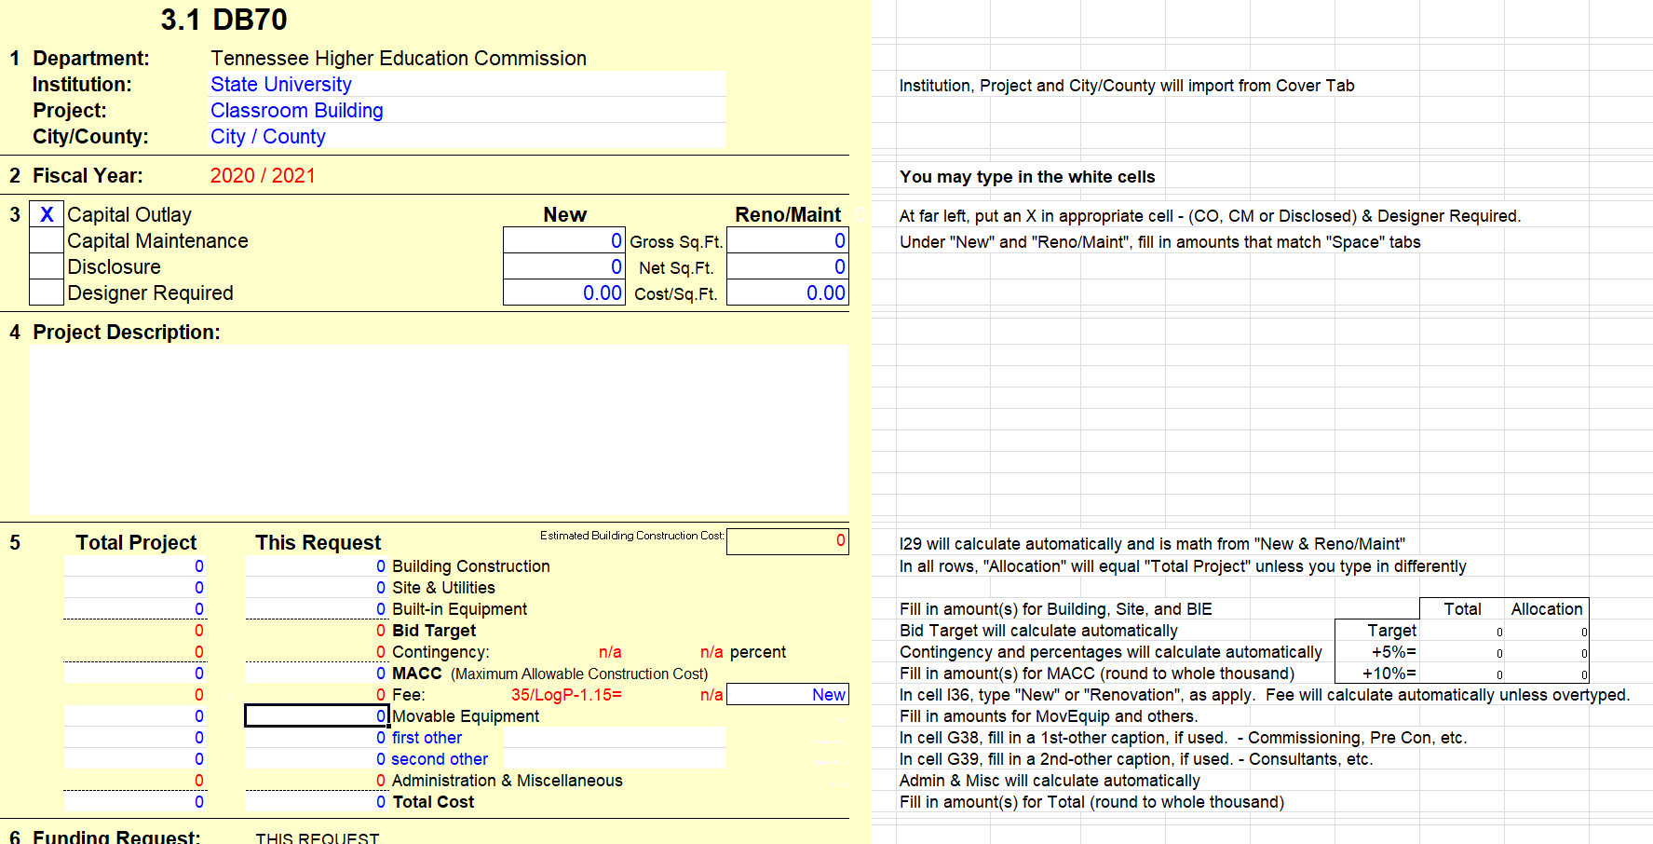
3. Project Description and Impact on Campus – DB70

Slide 19
3. Project Description and Impact on Campus – Project Support Doc 1
3.2 A - Program Scope – Describe the scope of work included in the project
3.2 B - Evidence of Physical Facility Need – Describe deficiency being remedied by the project, whether lack of space for growing demand, poor repair, etc.
3.2 C - Historical Profile – Related history of the facility and program. For existing structures, specify dates of construction, additions and renovations, etc.
3.2 D - Summary Results and Date of Physical Facilities Survey

Slide 20
3. Project Description and Impact on Campus – Project Support Doc 2
3.3 E - Cost Information – Basis for SF cost estimates, support for construction cost and methods for determining the estimate, equipment, AV, IT costs. Provide information on similar projects in the region recently bid if available.
3.3 F - Project Schedule – Milestone dates and project sequence or phasing
3.3 G - Other Campus or Program Impact – Direct or indirect impact of the project

Slide 21
3. Project Description and Impact on Campus – Schedule of Movable Equipment
3.4 A - List of equipment by category, i.e. furnishings for office, classroom loose equipment, AV, IT (describe what is included), site furnishings, signage, contingency
3.4 B - Explanation of equipment costs – method of determining costs, i.e. based on detailed itemization, or per s.f. costs of similar projects, etc.

Slide 22
3.5 Business Plan
3.5 A – Operations Overview
3.5 B – Revenue Sources, Fundraising and Partnerships

Slide 23
4. Space Needs
THEC Space Guideline Calculations
Consistent with Schedule D areas, Fall 2018
E&G space
Note any variance from Schedule D totals
Formula space
TBR and LGI’s continue input into Physical Facilities Inventory database, and Physical Facilities Survey database at TBR
Central database will continue in future years

Slide 24
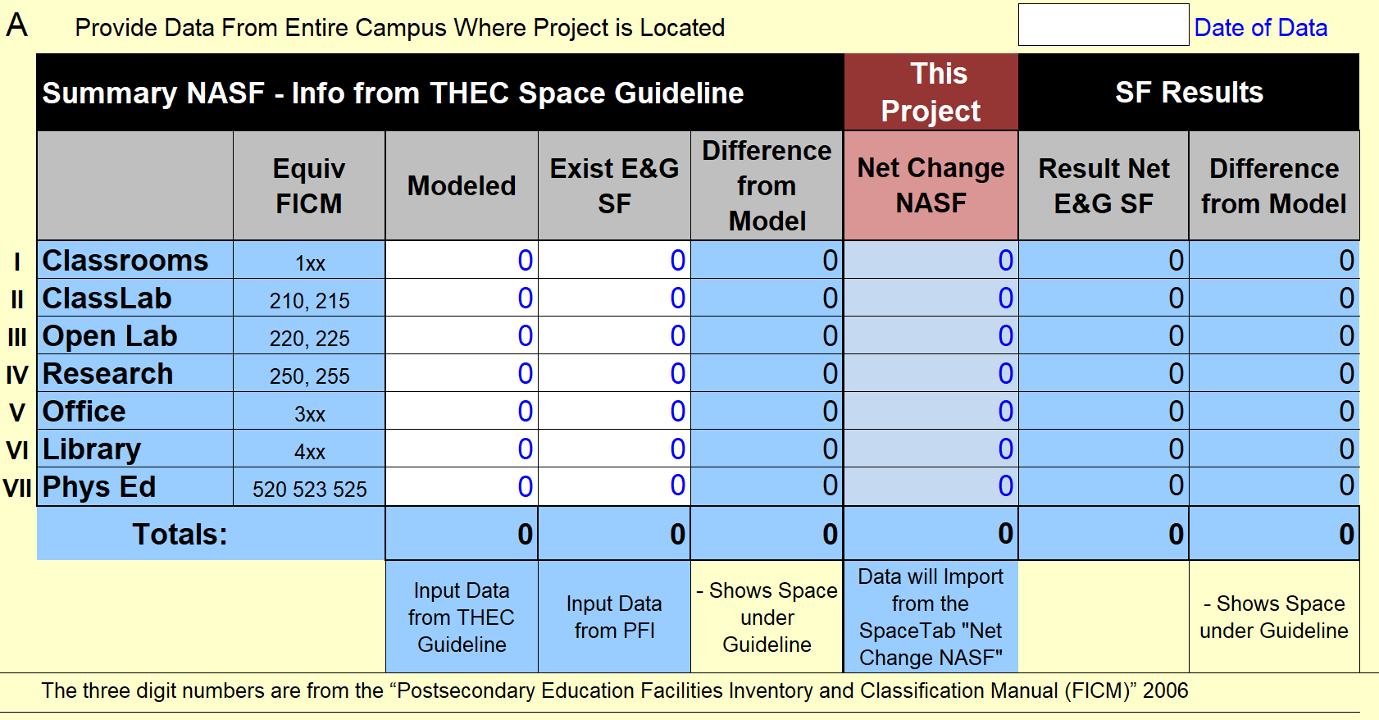
4.1 Space Needs

Slide 25
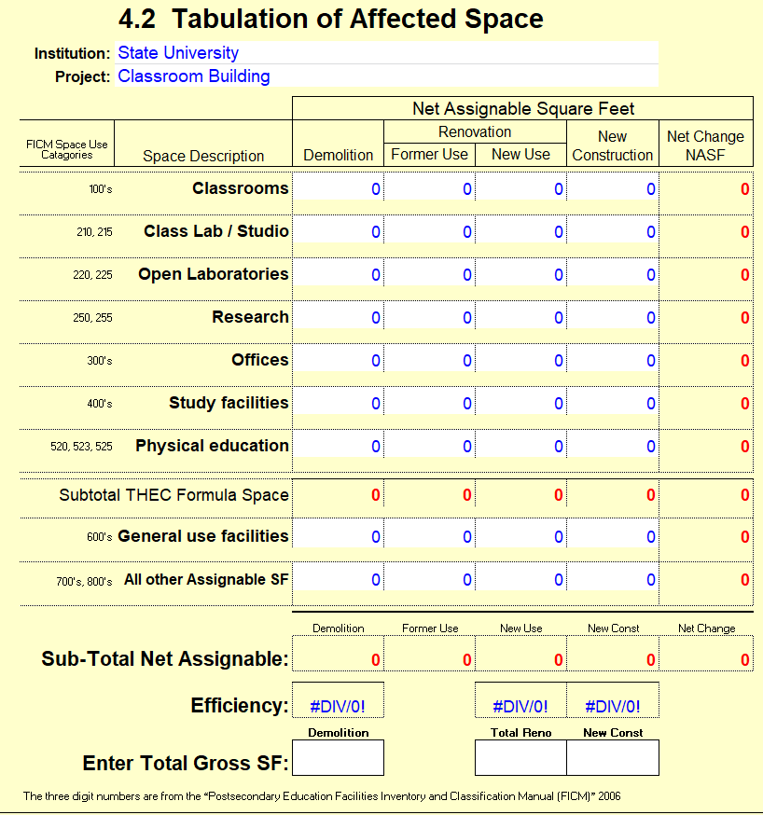
4.2 Space Needs – Tabulation of Affected Space

Slide 26
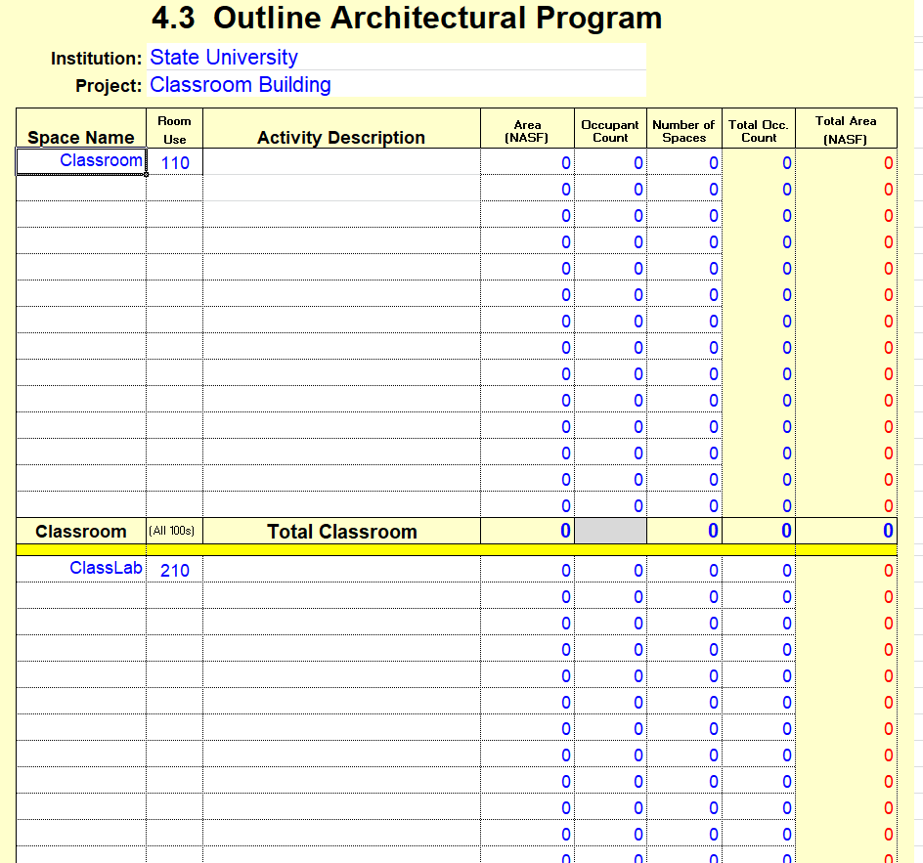
4.3 Space Needs – Space Detail Information (Program Summary)

Slide 27
5.1 External Funding
Total possible points for maximum match
8 of 100 for both new construction and renovations
No minimum gift component for renovations
The match component for new construction projects only shall consist of gifts to the institution in the following percentage of the total pledged match:
30% for all Community Colleges, and Nonformula Units
40% for Moderate Research and Masters Universities
50% for Doctoral Higher and Highest Research (University of Memphis and UT Knoxville)
No more than one-third (1/3) of the total pledged institutional match shall consist of Tennessee State School Bond Authority financing, the term of which shall not exceed five (5) years.

Slide 28
5.1 External Funding

Slide 29
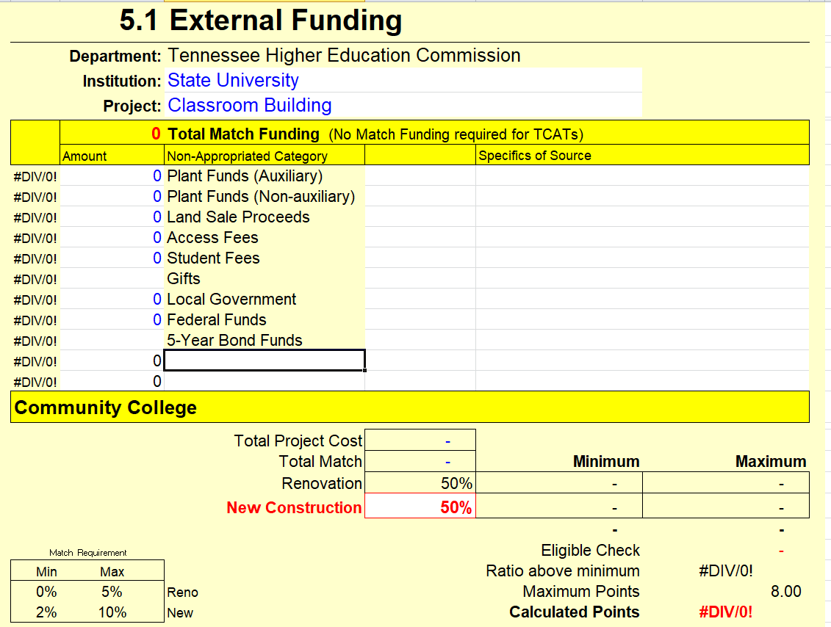
5.1 External Funding

Slide 30
Capital Maintenance
Each governing board is allocated proportion of the total higher education capital maintenance request based on Sherman-Dergis Formula.
THEC FY 2019-20 maintenance pool request will be $150,000,000.
Any variance from THEC’s $150,000,000 request will be changed on pro rata basis.
Project totals may need to be modified to correspond to actual request.

Slide 31
Capital Disclosures
All anticipated capital projects that are funded from sources other than state appropriations
New buildings or space
Change in function
In excess of $100,000
Maintenance projects in excess of $500,000
Disclosure of major projects, new construction, bonded projects required July 1 for following FY
Quarterly submittals of projects expected to proceed during the current fiscal year
Emergency Projects implemented to avoid immediate danger:
Governing boards may initiate the project but must disclose it in the subsequent quarterly submission
Subject to appropriate SBC, F&A and other State Policies

Slide 32
Capital Planning and Master Plans
Emphasis on long range planning
Review every 2 years
Master Plan SBC Review and approval at least every 10 years
Amendments may fine-tune development of the plan
Preplanning of the project encouraged to support long-range success of the project
Academic Plan and Strategic Plan
Master Plan built on Academic Plan
Project development

Slide 33
THANK YOU
Patti Miller
Architect
Chief of Facilities Planning
Patti.Miller@tn.gov

