Slide 1
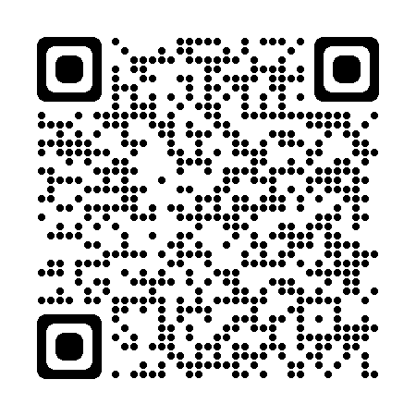
TDOT Utilities Website
Notes:
The Chapter 86 policy spells out which projects are qualified.

Slide 2
Introduction
By: Regional Personnel

Slide 3
Regional & Headquarters Utility Staff
Regional Utility Managers
  Region 1 : Macario Reyes
  Region 2 : Andrew Miller
  Region 3 : Jon Zirkle
  Region 4 : Branden Garcia
  Headquarters
  Utility Agreements & Encroachment Manager : Michael Horlacher
  Statewide Technical Specialist Regions 1 & 2 : Christopher Johnston
  Statewide Technical Specialist Regions 3 & 4 : Monica Cromer
Notes:
The Chapter 86 policy spells out which projects are qualified.

Slide 4
Restructured Divisions
Utility Estimates : Ben Greeson
Railroads: Jay Lanius
Notes:
The Chapter 86 policy spells out which projects are qualified.

Slide 5
Restructured Divisions
HQ Utility Estimate Office:
Kim Bean Regions 1 & 2
615.770.5322 kim.bean@tn.gov
Eric Flora Regions 3 & 4
615.253.1683 eric.flora@tn.gov
Notes:
The Chapter 86 policy spells out which projects are qualified.

Slide 6
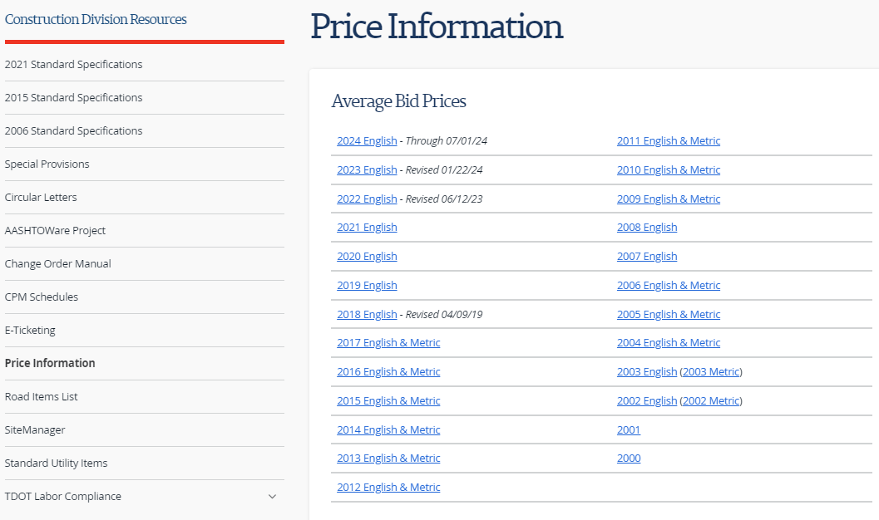
Restructured Divisions
Publicly Available AUP Data:
Price Information (tn.gov)
Notes:
The Chapter 86 policy spells out which projects are qualified.

Slide 7
Chapter 86 Policy
Overview & Changes
By: Michael Horlacher
Utilities TDOT Manager

Slide 8
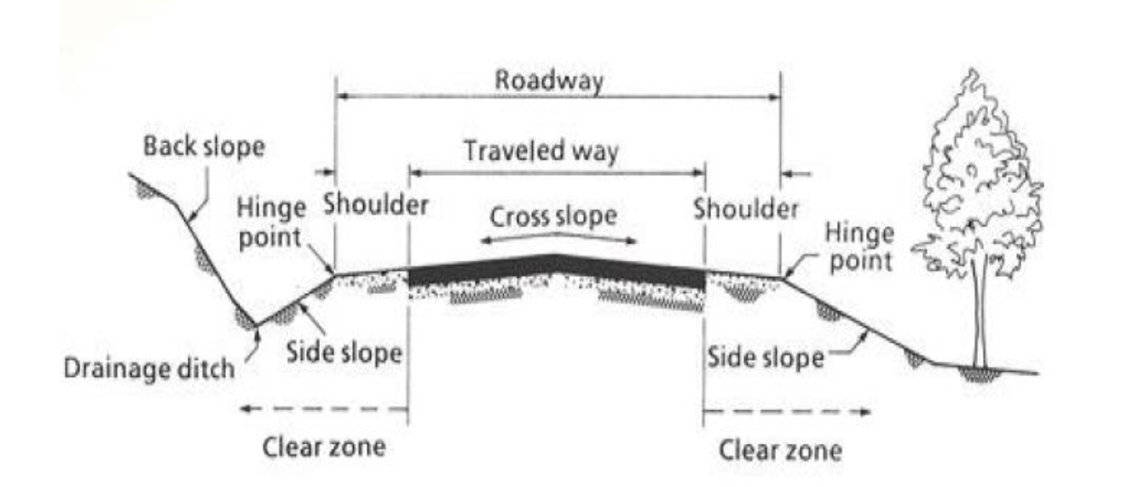
Utility Relocation Reimbursement Types
Property Rights
  Mandatory (5th & 14th Amendment)
Chapter 86
  Permissive (by policy)
  Only applies to public ROW
Notes:
This slide was trying to illustrate what ROW is. Any utility relocations required by a TDOT project on utilities off the ROW are paid for by TDOT. Relocations required for utilities on ROW are only reimbursable if it’s a Chapter 86 project.

Slide 9
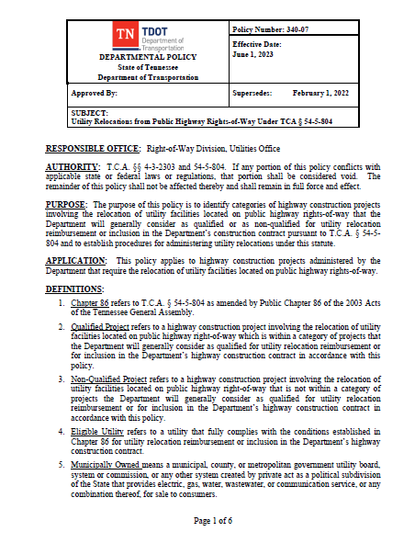
Creation of “Chapter 86”
Chapter 86 refers to T.C.A. § 54-5-804
  (as amended by Public Chapter 86 of the 2003 Acts of the Tennessee General Assembly.)
Policy was first created in 2005
Notes:
This is the actual TDOT policy, that was made possible by the 2003 legislation.

Slide 10
Chapter 86 Qualified Projects
Bridge Replacements on State Highway System
Grade and Drainage projects w/ROW acquisition
Projects identified by the Commissioner
Examples of “minor” non-qualified projects
  Resurfacing Projects
  Safety Projects
  State Industrial Access (SIA) Projects
Notes:
The Chapter 86 policy spells out which projects are qualified.

Slide 11
Utility Eligibility Requirements
Possess a valid permit
Respond within 120 days (45 more days for revisions)
Enter into written relocation agreement
  Move Prior to Letting (Move Prior)
  Move In State Construction Contract (Move In State)
Notes:
These are the requirements that a utility must meet in order to receive Chapter 86 money.

Slide 12
Submittals
A-Date Package
  Color Coded Relocation Plans (Rainbows)
  Estimate of Cost
  Schedule of Calendar Days
  Due 120 days after ROW Plans sent out (165 for revisions)
B-Date Package (only for MIS relocations)
  Stamped Construction Plans
  Specifications
  Quantities
  Deposit (if req’d)
  Due no later than 26 weeks prior to letting
Notes:
We are getting in the weeds here, I’d omit this slide.

Slide 13
Other Key Historical Dates
2007 – $1.75M reimbursed cap implemented by policy
2014 – Move Prior reimbursement reduced by 50%
  For Profits receive 75% on MIS and 25% on MP
  Non-Profits receive 100% on MIS and 50% on MP
2021 – One-call compliance added (TN 811 “call before you dig”)
2023 – B-date deadline extended from 16 to 28 weeks prior to letting
Notes:
These are the changes from the original 2005 Chapter 86 Policy.

Slide 14
February 14, 2024 Policy Changes!!
Applies to projects distributed after February 14, 2024
Raised cap from $1.75m to $2.5m
Incentivizes Utilities to move prior
  100 % not for profit companies
  75% for Profit
B-date deadline changed again from 28 weeks to 26 weeks prior to letting
Notes:
These are the changes from the original 2005 Chapter 86 Policy.

Slide 15
Chapter 86 Contract Types
Move Prior
  Conflicts must be removed by letting!
  Work done by:
    Force Account
    Low Bid (don’t forget to get concurrence!)
    Continuing Contract
    Combination
Move In State
  Stamped plans required.
  Work done by TDOT’s contractor.

Slide 16
Non-Chapter 86 Contract Types
Public/Private (Percent)
  Traditional
  Move In State
Pipeline
Move Again
Replacement Easement
  Recorded
  Prescriptive
Move In State w/Exceptions
  Material
  Negotiated Labor (AT&T)

Slide 17
Utility Coordination key updates
Early Coordination is essential
We must identify and incorporate appropriate SUE services
The whole team must engage in ongoing Utility Deconfliction
Increase constructability reviews through out
Utility Construction Documents in greater detail
Eliminate the handoff at letting, Utility CEI
Utility Data Management, as-builts

Slide 18
Utility Investigation (SUE) updates
Good utility information leads to good project decisions
The earlier the good utility information the better
Sometimes good-enough utility information is all you need
Utility information is iterated throughout project development
FUN FACTS
The “E” in SUE stands for Engineering, not Excavation or Exploration
SUE as in “A Boy Named SUE,” not as in “Here Piggy”

Slide 19
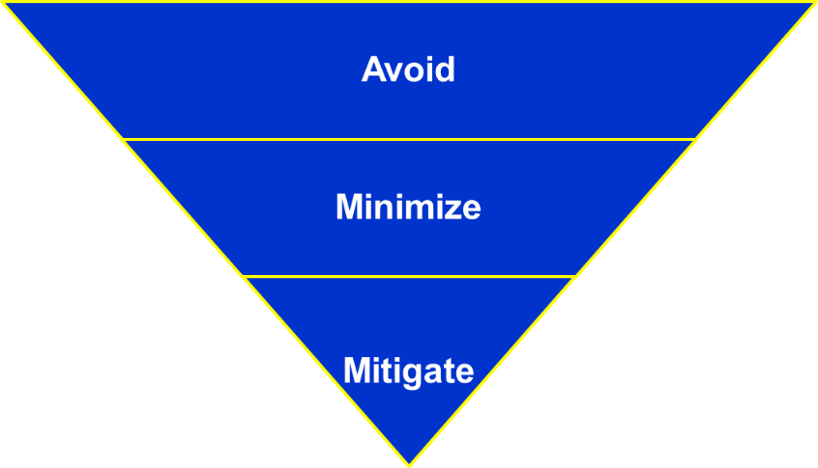
This is the ultimate key message:

Slide 20
Questions?
Info for Broadband Providers…
3-year plan (https://www.tn.gov/tdot/program-development-and-administration-home/program-development-and-administration-state-programs.html)
What to add to the 2025 Utility Training?

Slide 21
Buy America/Build
America
By: Macario Reyes,
Region 1 Utility Manager
Brian Egan,
Construction Division Director

Slide 22

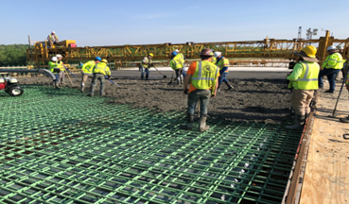
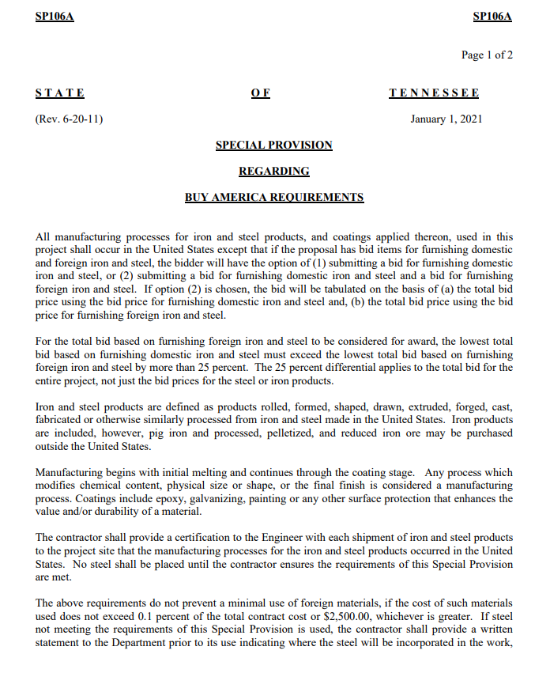
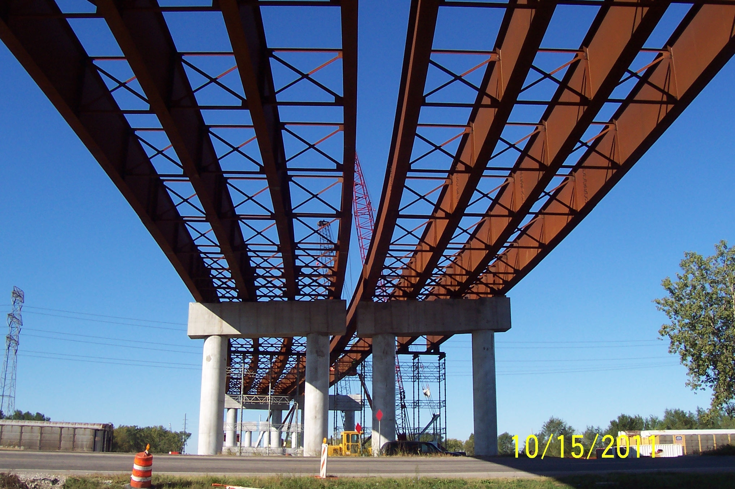
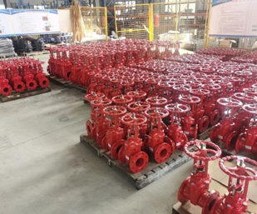
Buy America- SP106A and 106BA
SP
106A- Buy America Requirements
All iron and steel used in the project are produced in the United States--this means all manufacturing processes, from the initial melting stage through the application of coatings, occurred in the United States;
Iron or Steel product- means articles, materials, or supplies that consist wholly or predominantly of iron or steel or a combination of both, predominantly of iron or steel or a combination of both means that the cost of the iron and steel content exceeds 50 percent of the total cost of all its components.
TDOT/Industry will continue to comply with SP106A. Compliance/certifications will not change and will remain the same.

Slide 23


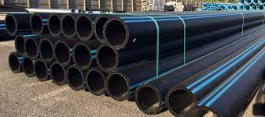
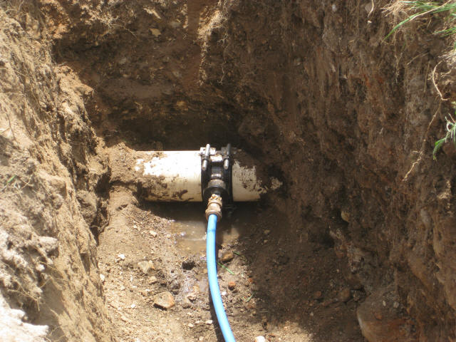
Buy America- SP106A and SP106BA
SP106BA- Build America, Buy America
Construction materials include an article, material or supply that must be “produced in the United States”; meaning all melting and manufacturing processes occurred in the USA
  Non-ferrous metals,
  Plastic and polymer-based products (including polyvinylchloride, composite building materials, and polymers used in fiber optic cables)
  Glass (including optic glass)
  Fiber optic cable (including drop cable)
  Optical fiber
  Lumber
  Engineered wood
  Drywall

Slide 24
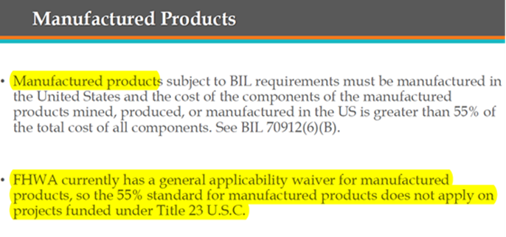
Buy America- SP106A and 106BA- Manufactured Products- What is proposed...
FHWA has proposed to discontinue the current WAIVER for manufactured products that has been effective since 1983
RFI posted (comments were due in May) for industry seeking "domestic availability for certain manufactured products commonly used on FHWA funded projects"
NPR/RFC posted (comments are due by May 13), for changes to 23 CFR 635.410 "Buy America Requirements", effective date TBD
  No Federal-aid highway construction project is to be authorized for advertisement or otherwise authorized to proceed unless the manufactured products used and permanently incorporated in such project are produced in the United States.

Slide 25
Buy America- SP106A and SP106BA— Manufactured Products -What is proposed
Manufactured products means articles, materials, or supplies that have been processed into a specific form and shape, or combined with other articles, materials, or supplies to create a product with different properties
Mixtures of concrete or asphalt delivered to a job site without final form for incorporation into a project are not a manufactured product.
Produced in the United States, in the case of manufactured products, means: (A) The product was manufactured in the United States; and (B) The cost of the components of the manufactured product that are mined, produced, or manufactured in the United States is greater than 55 percent of the total cost of all components of the manufactured product.

Slide 26
Buy America- SP106A and SP106BA- De Minimis Waiver
De Minimis Waiver (August 16, 2023) - *Steel & Iron remains 0.1% of the total contract cost or $2,500, whichever is greater
1) The total value of the noncompliant products is no more than the lesser of $1,000,000 or 5% of total applicable costs for the project; where the "total value of the non-compliant products" does not include the value of those products subject to a separate Buy America waiver. "Total applicable project costs" are defined as the cost of materials (including the cost of any manufactured products) used in the project that are subject to a domestic preference requirement, including materials that are within the scope of an existing waiver and the de minimis cost portion of the waiver does not apply to iron and steel subject to the requirements of 23 U.S.C. 313/ 23 CFR 635.410 (b)(4), or
2) The total amount of Federal financial assistance applied to the project, through awards or subawards, is below $500,000 but this does not apply to iron, steel, and manufactured goods subject to the requirements of 49 U.S.C. 22905(a).

Slide 27
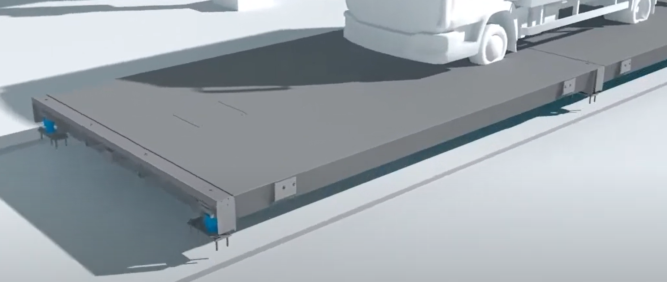

Project Development
It is critical that Utility designers/specifiers are aware of the BA/BABA requirements
During design is the time when we need to make sure we are compliant with the BA/BABA. Need to assure contractors can comply.
Example- I-65 Weigh Station
  Will need to use the Steel and Iron De- Minimis to meet Federal requirements

Slide 28

Buy America Issues to Consider for Utility Work on Projects with Federal-aid highway program (FAHP) Funding
Project Schedules
Material Leadtime’s
Utility Relocation Costs
https://www.fhwa.dot.gov/utilities/buyam.cfm

Slide 29
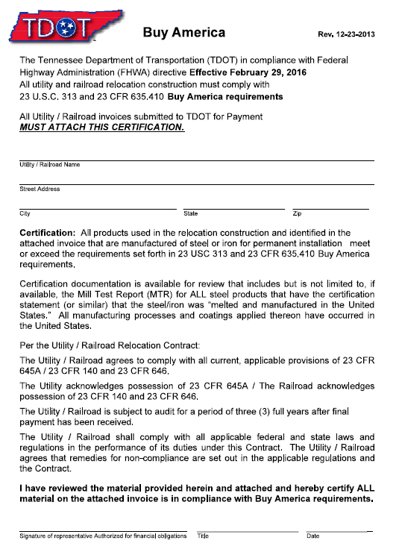
SP106A and SP106BA-Administration and Enforcement
Utility Owner’s and Contractor’s
  Utility Contracts- “Utility Reimbursements”
  TDOT awarded Contractor and Utility Owner is
  responsible for meeting all SP106A- Buy America
  and SP106BA- Build America, Buy America requirements

Slide 30
FHWA Buy America for Utilities Q&A
1) Do the Buy America requirements apply to utility work using FAHP funding? YES
2) For FAHP funded projects, do Buy America requirements apply to utility work accomplished using no FAHP funds? YES, Per MAP-21, all federally eligible utility work must meet Buy America requirements regardless of funding source. However, if state law or a legal contract between the utility and the state does not allow for reimbursement, Federally ineligible work is not subject to Buy America requirements
4) Can foreign steel be allowed in an FAHP funded project if the foreign items are made non-participating? NO
5) Do the Buy America requirements take precedence over the 23 CFR 645 requirements pertaining to the relocation or accommodation of utility facilities? YES

Slide 31
Permits
By: Jon Zirkle
Region 3 Utility Manager

Slide 32
TDOT Utility Permit Process
Initial Yearly Utility Coordination
  All Utility Owners receive a comprehensive listing of upcoming roadway and resurfacing projects.
  The listing is updated and distributed annually to reflect the approved 3‐year Comprehensive Multimodal Program and proposed regional resurfacing project schedules.
Utility Permit Submission
  Permit applications are sent to region utility or permits email box
  TDOT Utilities Office website has updated staff contact information.

Slide 33
TDOT Utility Permit Process
Permit Reviewed
  Permit supervisor assigns permit reviews from permits email box
  All permit applications are reviewed to ensure that a cover letter from a utility, plans, a traffic control letter, and all applicable forms are included.
  If utility is not a General Agreement holder, then a U&O form req’d.
  Plans are complete and reflecting the work proposed in the permit request
  Permit request meets the 1680 Rules for Accommodating Utilities on the ROW.
  Location of request is cross referenced with ROW phase projects, Active Construction, and future TDOT projects using PPRM, 3 Year Plan, Construction Job Box, ETrims, iTrip, etc.

Slide 34
TDOT Utility Permit Process
Utility Permit Database Entry
  Permit reviewer generates permit in IRIS
  Permit is stored electronically in IRIS and in Utility Office folder on server
  Permit location is entered in Google Earth KMZ or GIS file for quick reference and permit log for tracking purposes
Permit Distribution
  Permit is signed by permit reviewer and distributed for signatures. If higher level approvals are required, then Adobe Sign is used.
  Non-open cut permits are signed by reviewer and permit sup.

Slide 35
TDOT Utility Permit Process
Open Cut Approval
  Permit reviewer elevates open cut request with hardship justification to permit supervisor and utility office manager.
  Email including open cut request, hardship justification, and supporting plans and documents is forwarded to each.
  Information is reviewed to ensure additional options are not available. If justification does not consider other options then the application is put on hold for the utility to provide more information on alternatives considered or available.
  If open cut is justified and documented, then permit is sent for Region Director review and approval.

Slide 36
TDOT Utility Permit Process
Utility Owner Notification
  Approved utility permit is emailed back to the utility.
  If a contractor, consultant or developer compiled the application, they are copied on the distribution as appropriate.
  District Maintenance personnel are copied on the permit distribution for coordination and inspection purposes.
  Work hours, any special conditions, and repair details are provided in the permit.
  A copy of the permit has to be on the job site at all times for inspection purposes.
  If the site overlaps a TDOT project, then the contact info for project engineer is provided.

Slide 37
TDOT Utility Permit Process
Utility Permit Inspection
  Utility contacts TDOT Maintenance to begin work or project engineer if work overlaps a TDOT project.
  Utility must have traffic control installed properly according to MUTCD.
  Utility is responsible for maintaining traffic and safe work zone during allowed working hours and intermittently if project spans multiple days.
  No equipment or materials can be stored on the shoulder or travel lanes when no work is occurring or overnight.
  Backfill, repair work, and final paving is completed according to permit repair detail and TDOT Standard Specifications for Road and Bridge Construction.

Slide 38
TDOT Utility Permit Process
Utility Permit Closing
  Utility contacts TDOT Maintenance and/or Utility Office notifying that work is complete and requests bond to be released if applicable.
  Final inspection of permitted site is performed.
  Utility bond is released if no further repairs are needed.

Slide 39
TDOT UTILITIES PERMIT
The appropriate forms will need to accompany the request… Under Ground Encroachment Form (Communications, Fiber, Electric, etc.), Pipeline Encroachment form (Water, Sewer, Gas), Aerial Encroachment form (Communication, Fiber, Electric, etc.)
11x17 Drawings (Sketched Drawings in PDF, CADD Drawings, etc.) We have to know where the utility will be on TDOT ROW. We will always push to be as close to edge of right of way as possible since our number one concern is the motoring public. We need distances from edge of asphalt to ROW and edge of asphalt to where the utility is located.
Utilities Forms are on the TDOT Utilities website - Utilities Division (tn.gov)

Slide 45
TDOT UTILITIES
LANE CLOSURES
All shoulder and lane closures are required to be on an approved lane closure report that is compiled on Monday morning before 10 AM.
It is read to our Region Director and construction personnel on Wednesday mornings.
Then it goes to TDOT Commissioner’s office for their review.
After all reviews, the most critical are put out through TDOT communications office to make motoring public aware of when, where, and why lanes will be shutdown and an expected timeframe.

Slide 46
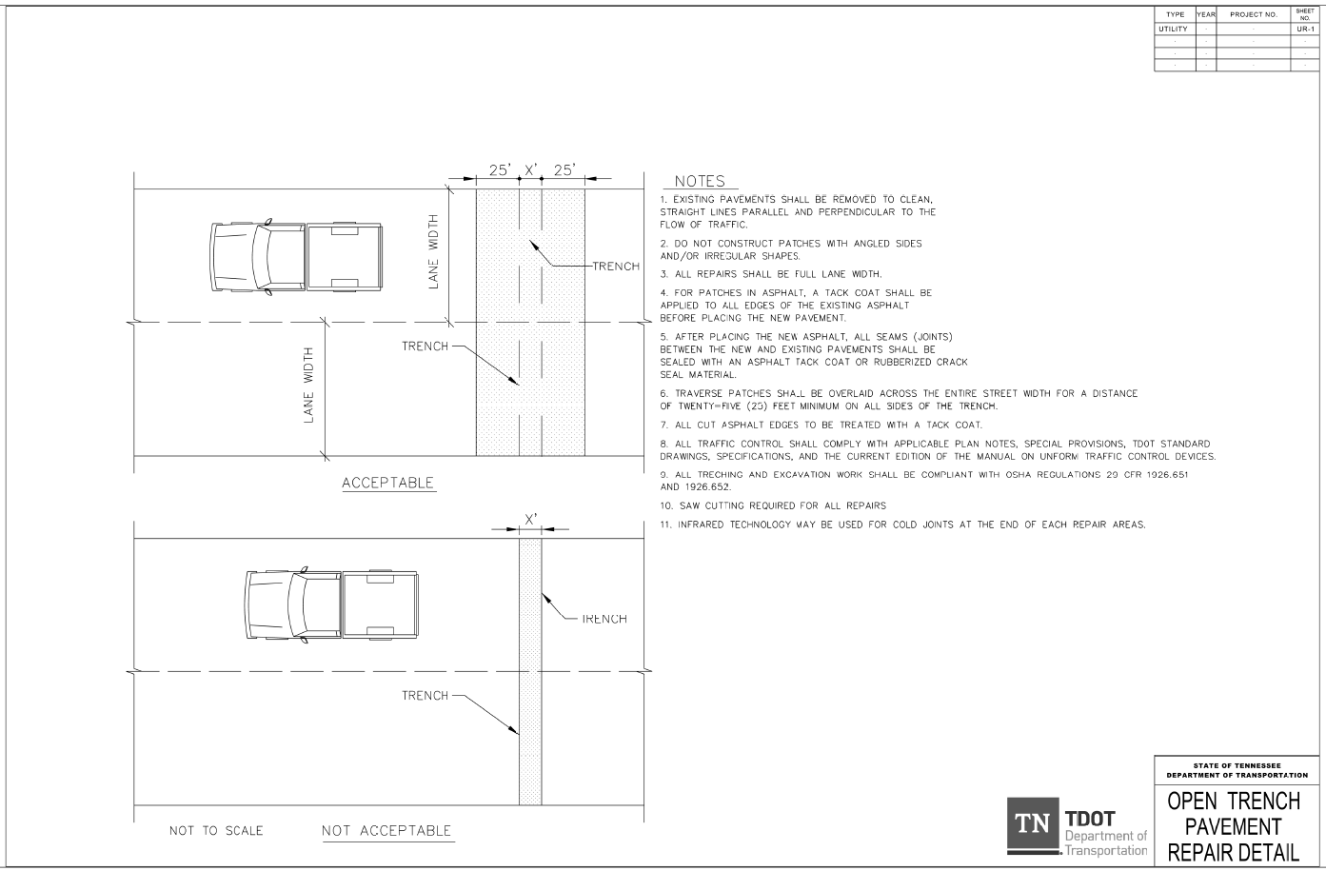
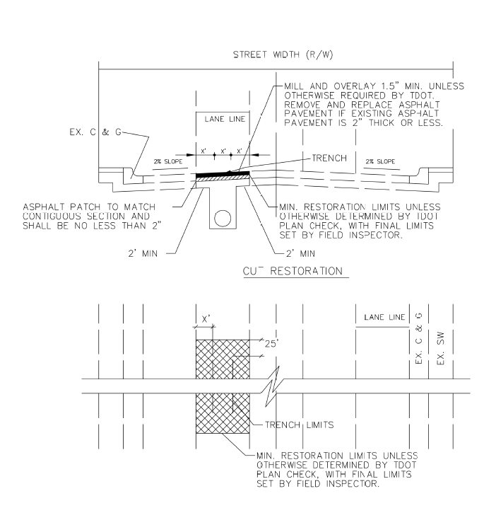
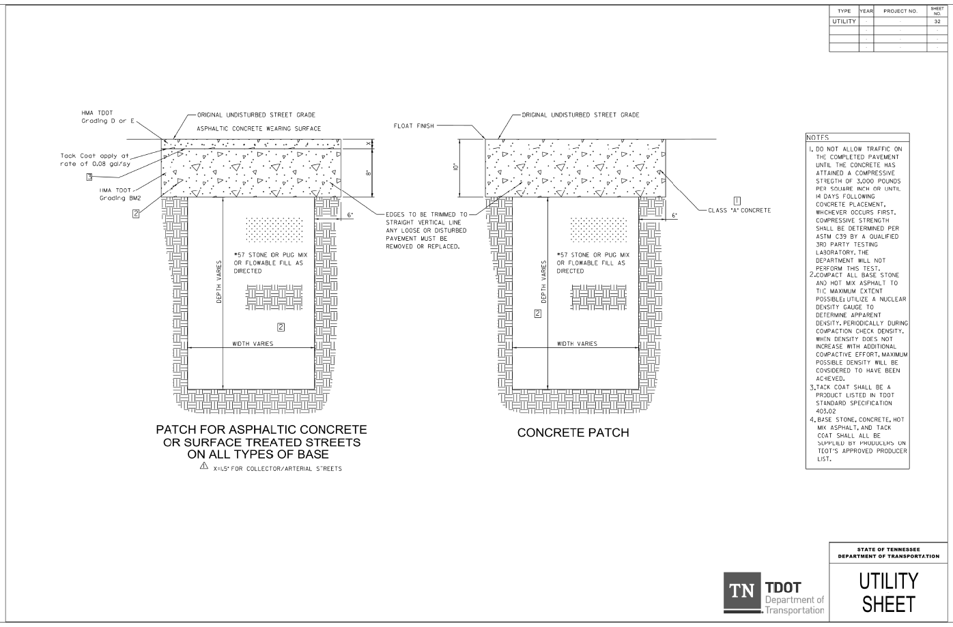
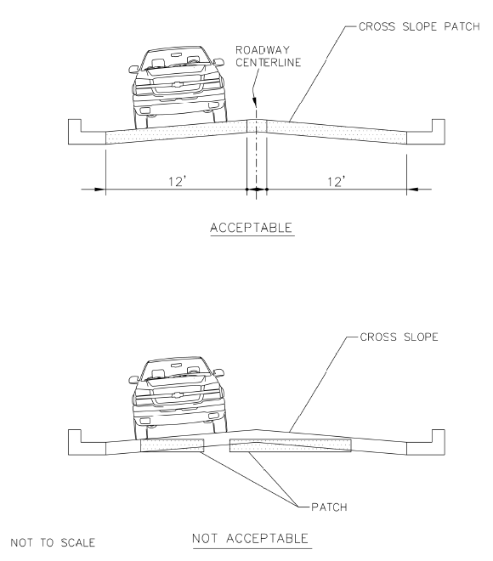
TDOT Standard Repair Details and Notes
TDOT Website

Slide 47

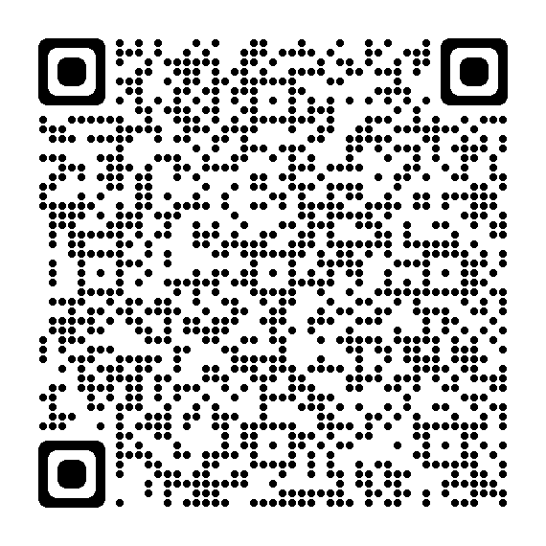
TDOT Construction Website –
2021 Standard Specifications (tn.gov)

Slide 48
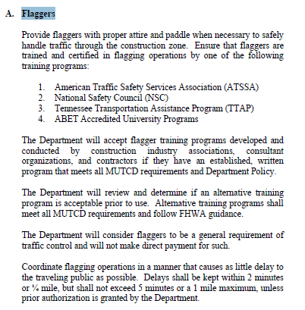
TDOT Spec Book - Page 735 Traffic Control

Slide 49
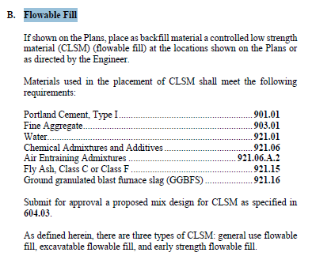
TDOT Spec Book - Page 156 Flowable Fill
Reminder: UG utilities cannot be abandoned on ROW. They must be Retired In Place with flowable fill.

Slide 50
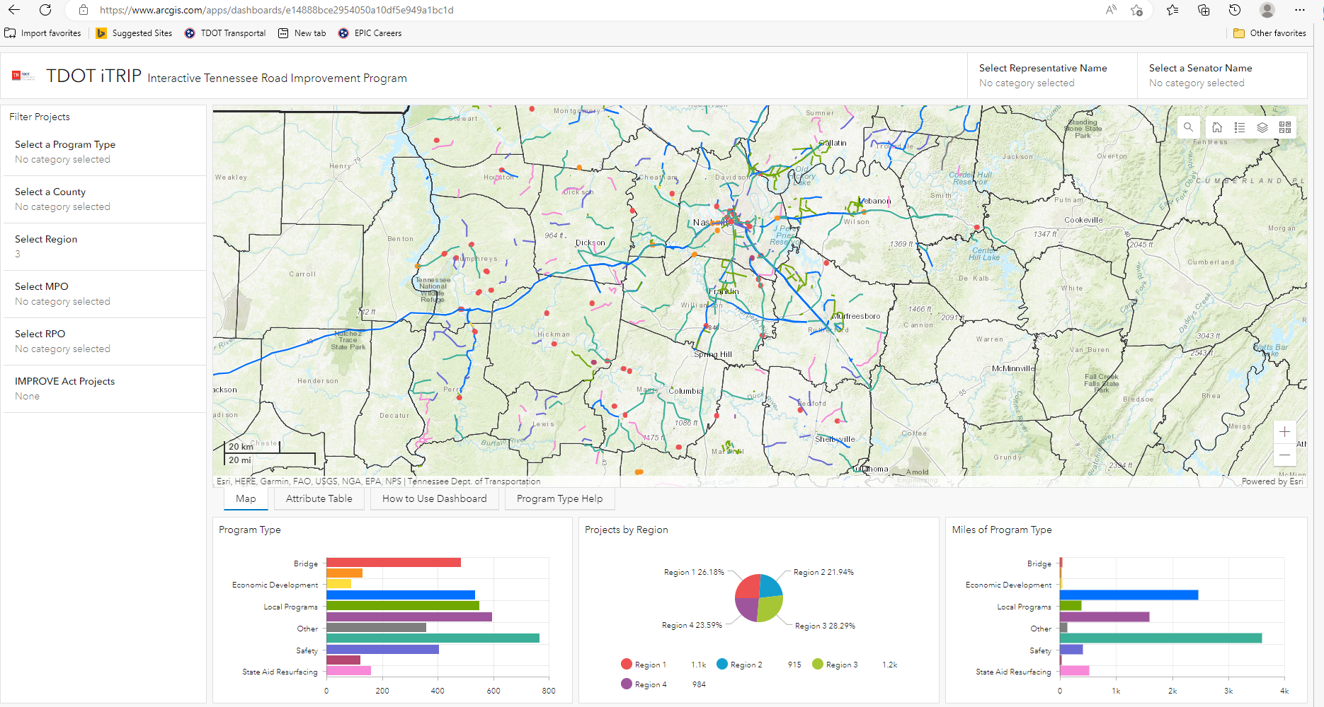
TDOT iTRIP Dashboard (arcgis.com)
TDOT iTrip Website

Slide 51
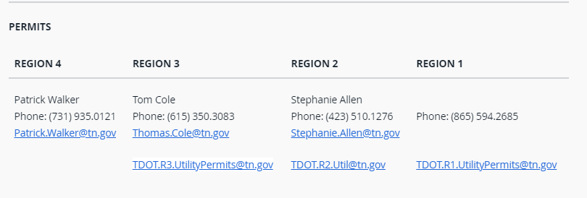
Permits Staff

Slide 52
INVOICING
By: Jon Zirkle
Region 3 Utility Manager

Slide 53
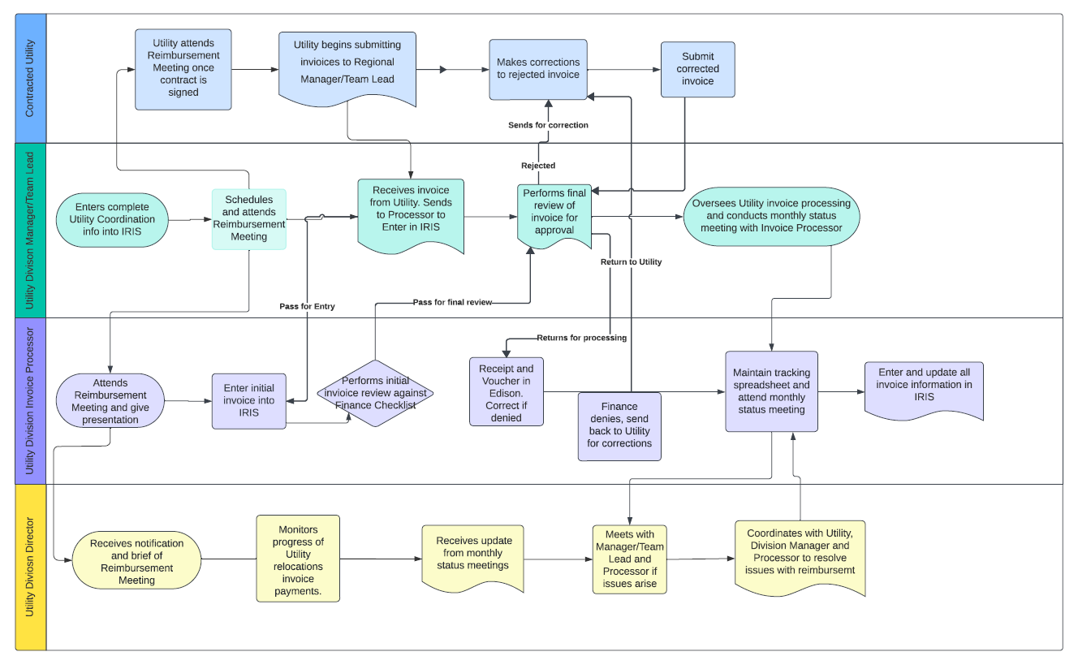
TDOT Utility Invoice Process

Slide 54
TDOT Utility Invoice Process
Regional Utility Manager / Team Lead
After execution of the Utility Contract, schedule a Reimbursement meeting (remote or in person) with the Utility Representatives and their Accounting Representatives.
Enter complete Utility Coordination information into IRIS.
Approve invoice for processing in Edison.
Oversee all Utility Invoice Processing and conduct monthly status meetings with the current Utility Processor(s).

Slide 55
TDOT Utility Invoice Process
Reimbursement packet to discuss at KO meeting
Copy of Utility Relocation Contract section regarding Reimbursement.
Outline of TDOT Utility Reimbursement process.
Copy of current Finance Utility Invoice Requirements checklist.
Copy of the current Overhead Rate Spreadsheet for Consultants.
Copy of the Standard and Expanded Utilities Invoice Spreadsheets.
Examples of Acceptable and Unacceptable forms of invoice submissions.
Copy of Notice for Periodic Submission of Reimbursement Invoice Letter.
Copy of Final Invoice Notice Letter.
Obtain from utility all necessary contact information for the Utility’s Accounts Receivable department.
Give a presentation outlining all items included in the reimbursement packet.

Slide 56
TDOT Utility Invoice Process
Utility Submits Invoice
  Utility submits invoice to utility or permits email box
Enter the initial submitted invoice information to IRIS.
Review all submitted invoices for completeness and adherence to the current
finance Utilities Relocation Invoice Requirements checklist.
Notify TDOT Finance to fund the purchase order.
Fully maintain all sections of invoice information in IRIS and upload paid invoice
attachments.
Send active Utilities a Notice to Submit Interim Billing letter by May 1st of the
current TDOT Fiscal year.

Slide 57
TDOT Utility Invoice Process
Regional Utility Invoice Processor
After execution of the Utility Contract, attend the Reimbursement meeting (remote or in person) with the Utility Representatives and their Accounting Representatives.
Perform invoice review against Finance invoice checklist.
Create receipt and voucher in Edison.
Coordinate corrections with utility if denied and resubmit.
Update invoice tracking spreadsheet.
Enter and update invoice information in IRIS

Slide 58

TDOT Utility Invoice Process
Common issues with invoice processing
Not making timely corrections to denied invoices.
Non-response to Utility inquiries.
Incorrect Utility addresses in Edison.
Incorrect service dates (fiscal years) in Edison.
Not removing PII (Personal Identifying Information) from the invoice and supporting
documents.
Incorrect mileage and travel rates.
Missing or illegible back up data and proofs of payment

Slide 59

TDOT Utility Invoice Process
References
23 CFR 645.117, 23 CFR Subpart 645A, 23 CFR 635.410
TCA 54-5-804
TDOT Policy 340-07
TDOT Invoice Processing SOP
TDOT / Utility contract
TDOT Invoice Templates
TDOT Invoice Checklist
TDOT Supplier Registration Vendor Maintenance instructions

Slide 60
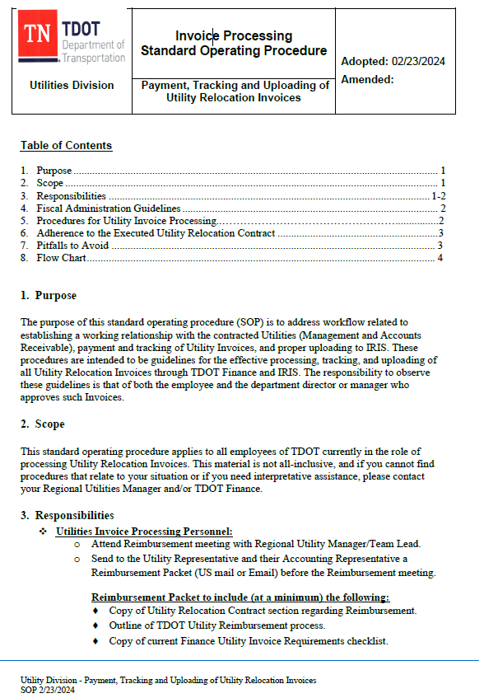
TDOT Invoice Processing SOP

Slide 61
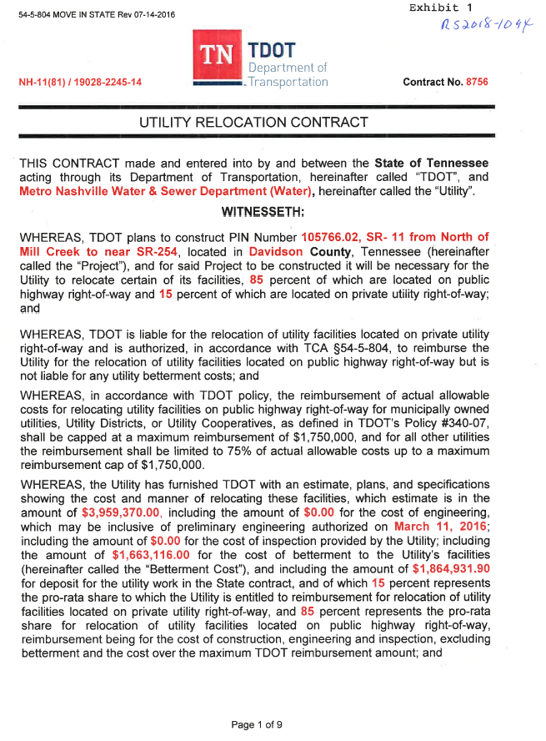
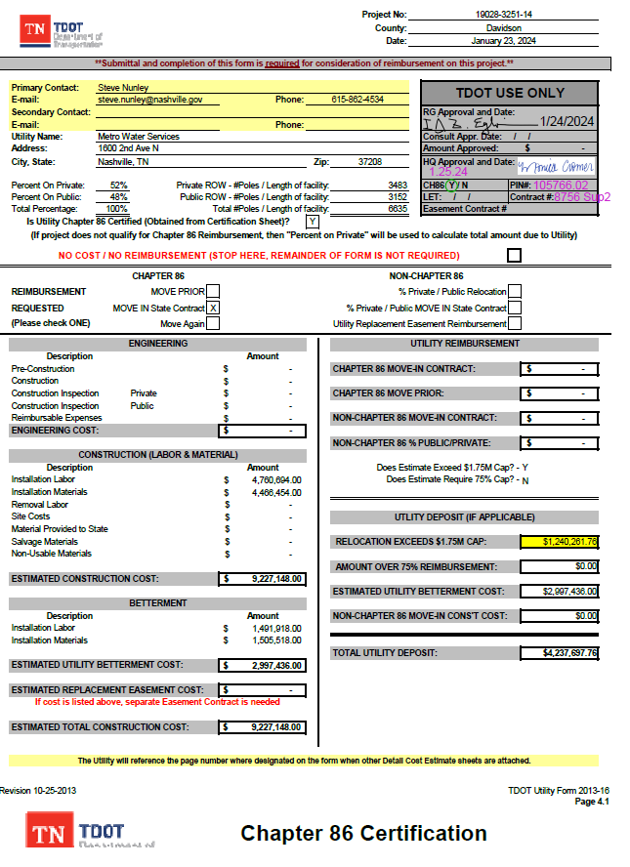
TDOT Utility Contract

Slide 62
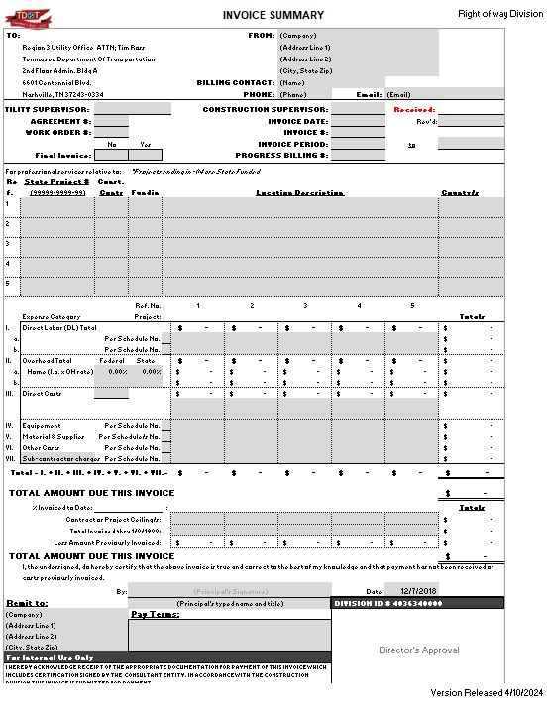
TDOT Invoice Templates

Slide 63

TDOT Invoice Checklist
Invoice should include:
Vendor Name
Vendor Contact Information
Remittance Address
TDOT State Project Number
Federal Project Number, if applicable
TDOT Contract Number/Work Order Number
Invoice Date
Invoice Number – should be unique and assigned by the vendor
Invoice must indicate whether it is a partial or final billing
Pay Terms
Total Amount Due
Billing Period/Service Period
Previously Invoiced Amount – if the vendor includes this amount on the invoice, this
amount must reflect the correct amount billed to date
Invoice must be signed by a company representative
The invoice must summarize by cost/expense category the total amount being billed and the documents that support a given cost category must accompany the invoice. The support should be collated to correspond to the cost category being billed and schedules can be used to summarize the expenses for each category.

Slide 64


TDOT Utility Invoice Process
End Results
Invoices are Paid!
Utility and/or consultants are
duly reimbursed!!
Project is completed.

Slide 65
