Slide 1
NEPA Public Hearing Southern Extension of State Route (SR) 186 and the US 45 Bypass From SR 1 (US 70/Airways Boulevard) to SR 5 (US 45/South Highland Avenue)
In cooperation with the City of Jackson and Madison County
Nichole Lawrence, Community Relations Officer
September 20, 2018

Slide 2
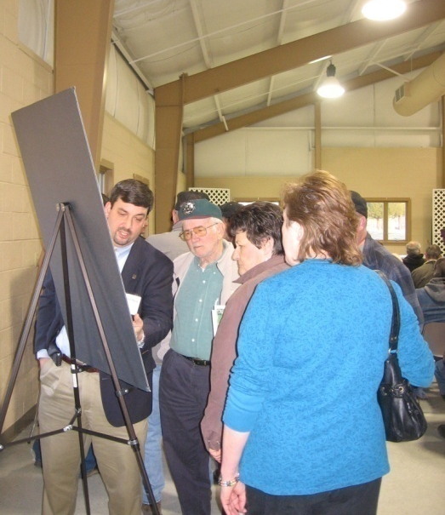
Purpose of this Meeting
Provide an update to the public of the project status
Show the public the proposed alignment and get input on the preferred connection option in the northern portion of the project
Provide the public with an opportunity to ask questions and provide written comments or verbal comments to the court reporter

Slide 3
Project Location

Slide 4
Project History
2005
$4 million of Federal funds become available for a southern bypass extension
2009
Transportation Planning Report (TPR) is approved by TDOT
2013
Environmental Assessment (EA) is approved by FHWA
2018
A Reevaluation of the EA is approved by FHWA in July 2018

Slide 5
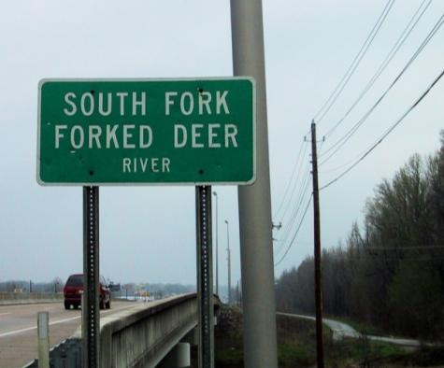
Transportation Needs Addressed by the Project
Inadequate crossings of the South Fork of the Forked Deer River;
Safety issues on the US 45 Bypass and US 45;
Improved system linkage to accommodate existing and projected traffic;

Slide 6
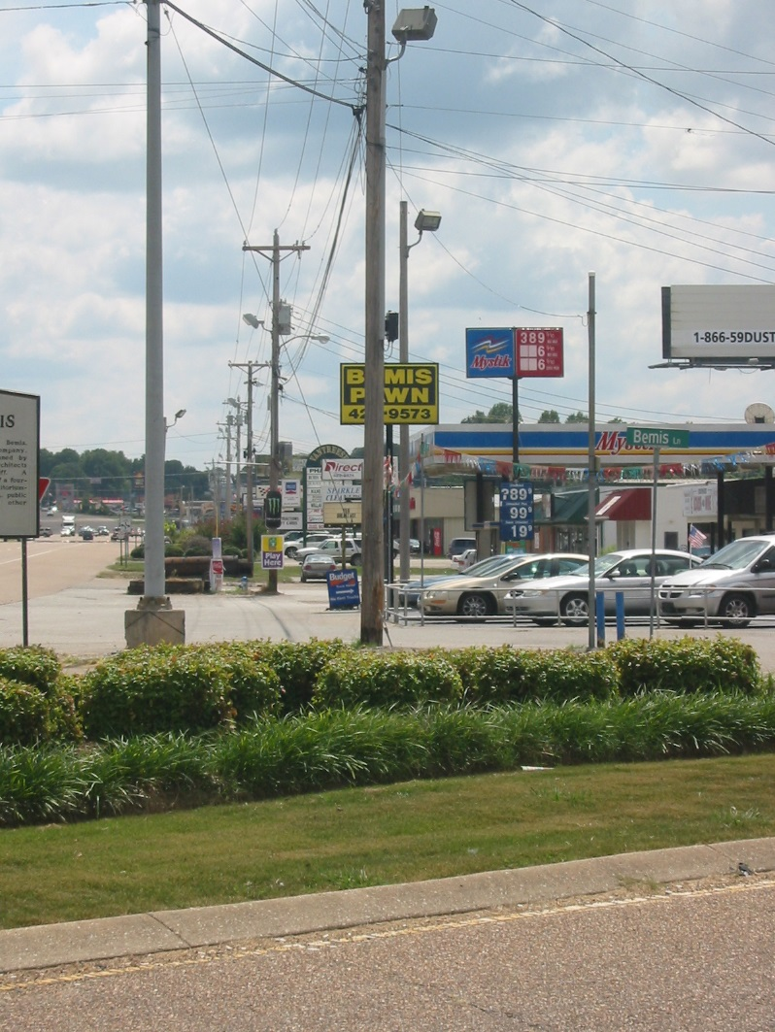
Transportation Needs Addressed by the Project
Inadequate infrastructure to accommodate growth and economic development; and
Fulfillment of a legislative mandate to develop an extension of the US 45 Bypass.

Slide 7
Project Description
Begins at a new interchange with US 45 north of Edwards Drive
Ends at Airways Boulevard (US 70 / SR 1)
Two optional alignments on the north end of the project
Includes a connector road to SR 18 in the vicinity of Raines Springs Road
Approximately 6.78 miles in length
Notes:
Description starts from south going north.

Slide 8
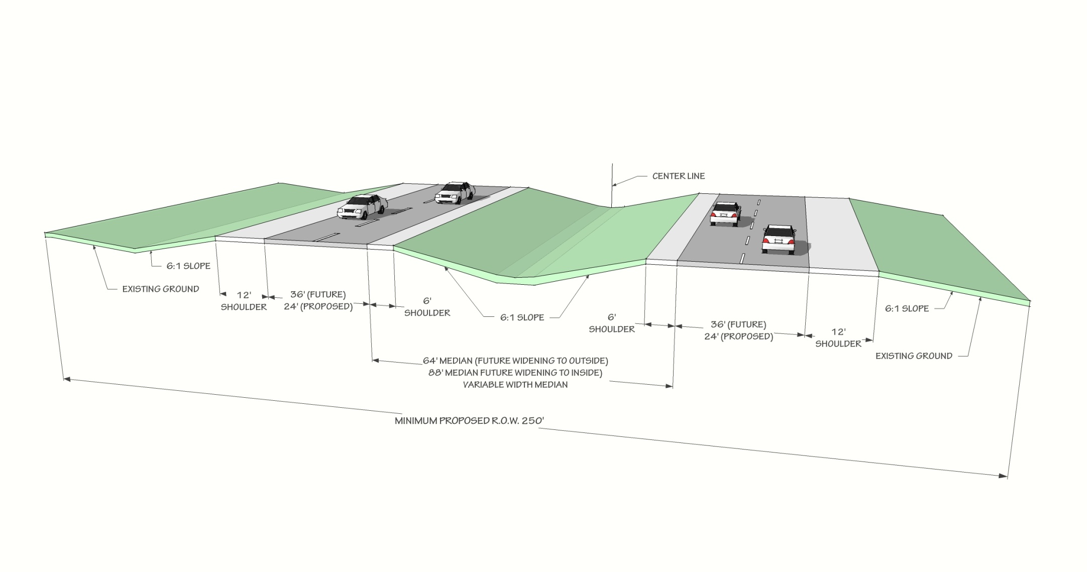
Typical Roadway Section (South)
Typical roadway section from US 45 / South Highland Avenue to south of Boone Lane will be divided with two-lanes in each direction, grassy median and paved shoulders.
Notes:
.

Slide 9
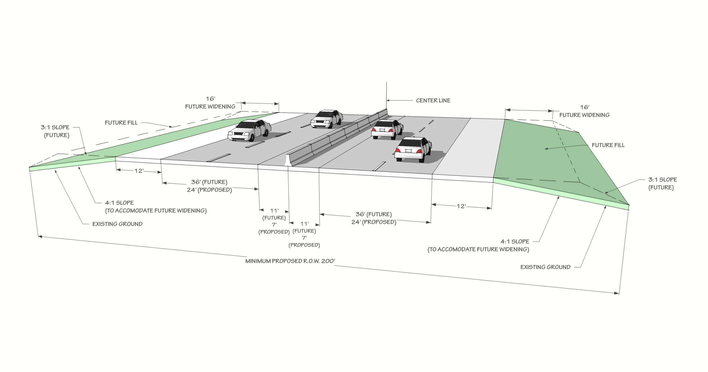
Typical Roadway Section (North)
Typical roadway section from south of Boone Lane to Airways Boulevard will be divided with two-lanes in each direction, center concrete barrier wall and paved shoulders.
Notes:
.

Slide 10
Access to the Bypass
Access to the Bypass will be limited to the following locations:
US 45 / South Highland Avenue
Riverside Drive (north of River)
Boone Lane
D Street / Steam Mill Ferry Road
Raines Springs Road
Existing US 45 Bypass

Slide 11
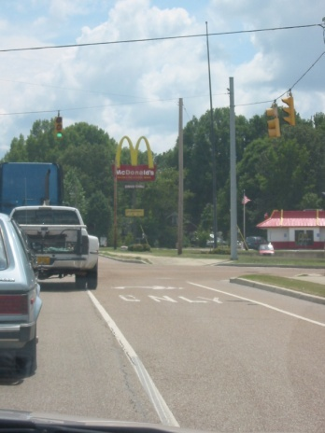
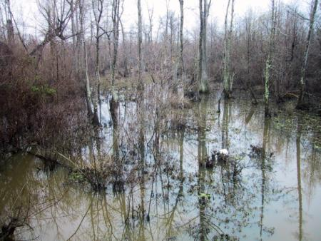
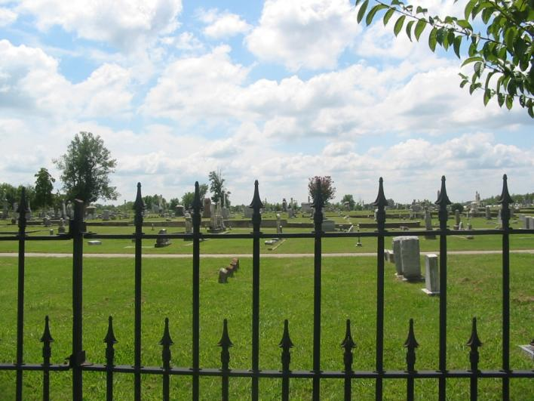
Studies Completed in Support of EA and Reevaluation
Ecology
Hazardous Materials
Archaeology
Historical Resources
Air Quality
Noise Impacts
Traffic
Community Impacts
Relocation Impacts

Slide 12
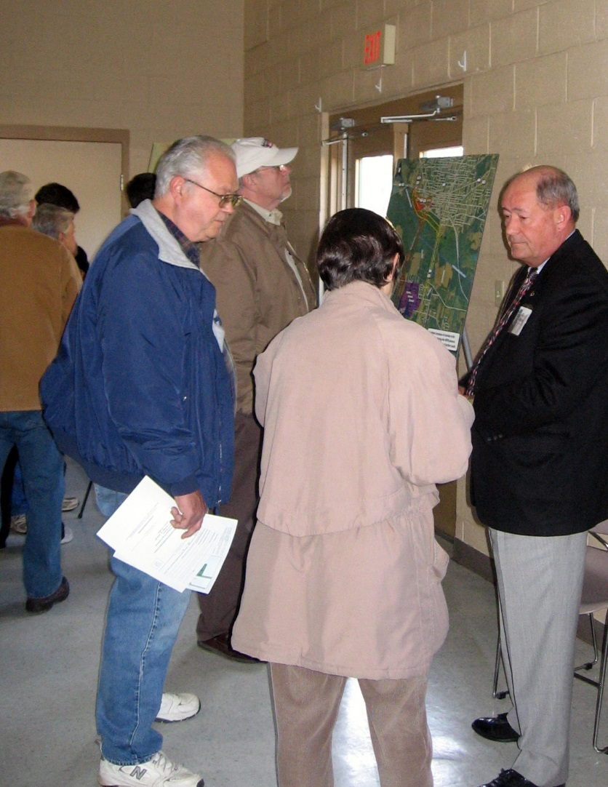
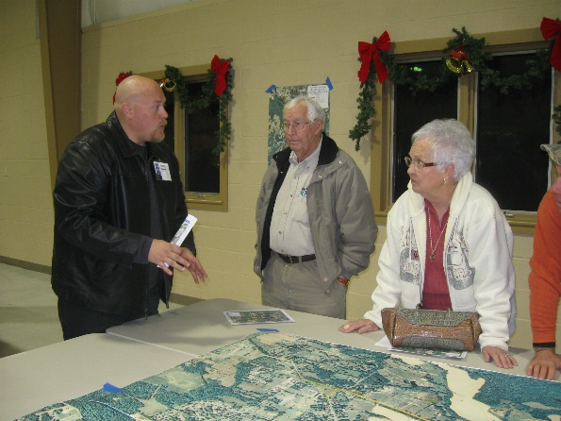
Public Involvement
Previous Public Meetings were held at the South Jackson Community Center on:
02/25/2010 – 213 attendees were present
12/14/2010 – 162 attendees were present

Slide 13
Next Steps
Selection of Preferred Alternative
Completion of the Final Environmental Document
Design Phase
Right-of-Way Phase
Construction Phase

Slide 14
How to Submit Comments
REMEMBER . . . Your comments are very important to us!
How to Comment:
You can fill out a comment card and submit it tonight or mail it to the address provided.
A Court Reporter will also be available to take your verbal comments.
All comments provided through the means listed above, which are received within 21 days of the meeting date (October 11, 2018), will be included in the official record.

Slide 15
Contact Information
For more information please contact:
Nichole Lawrence
Tennessee Department of Transportation
Community Relations Officer, Region 4
Phone: ?? Nichole-Is there a general email and phone #??
Email:
Project information is on the Web at:
www.tn.gov/tdot/projects/region-4/state-route-186-us-45-bypass-southern-extension

Slide 16
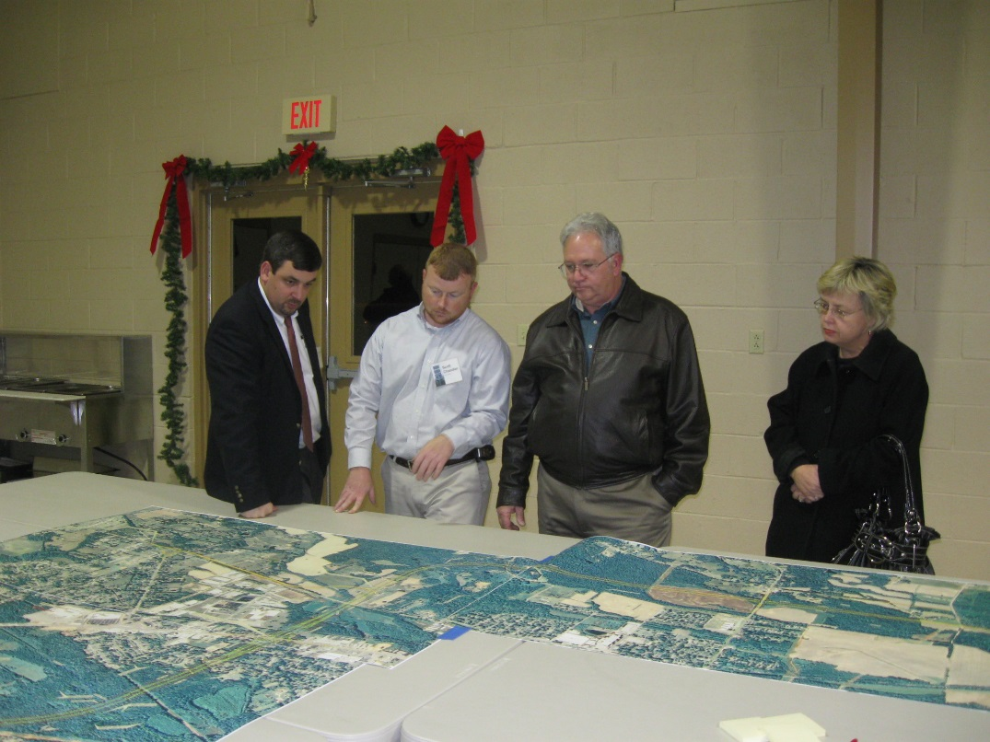
Thanks for attending tonight's meeting!
Please visit the displays around the room.
People with nametags can answer your questions.
Remember to provide comments.

