Slide 1
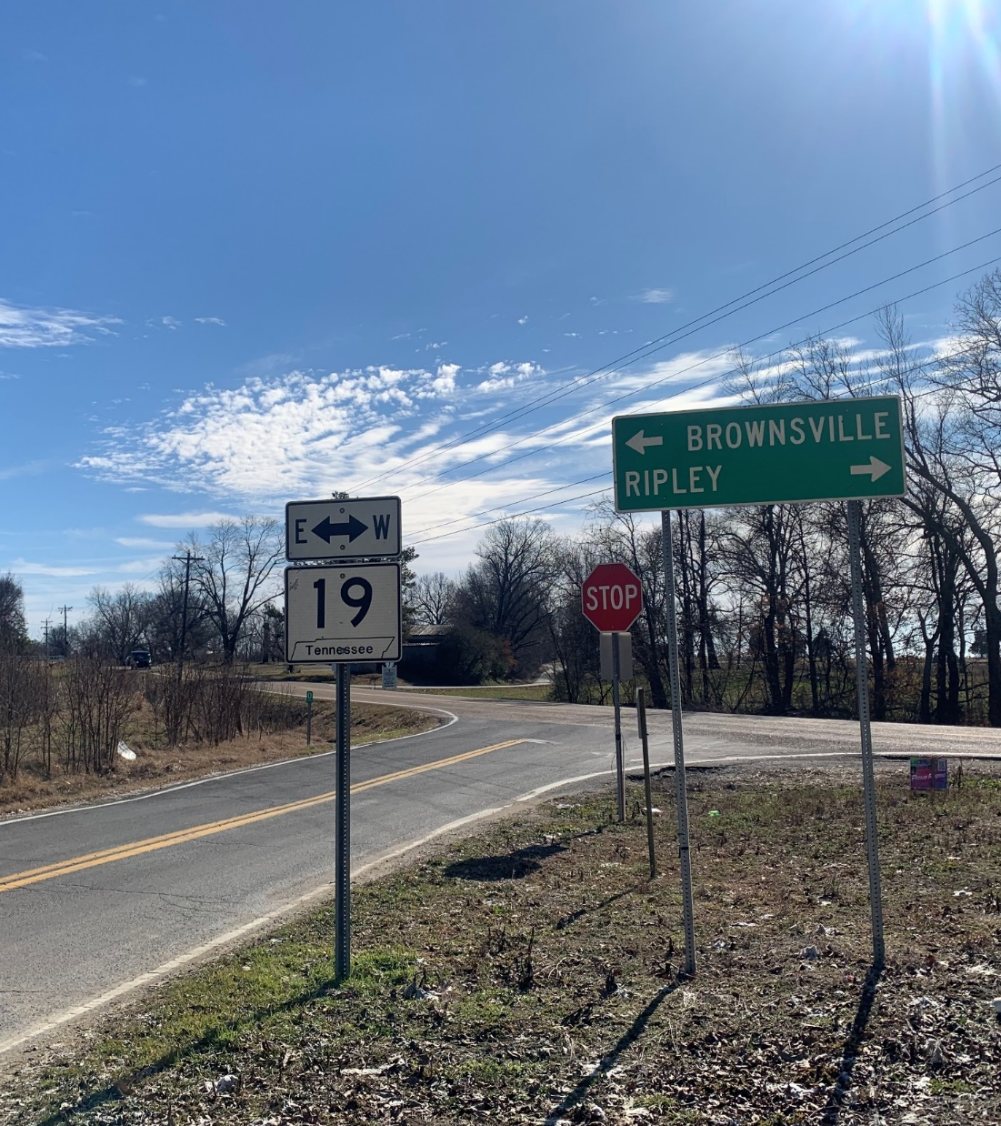
State Route 19 Improvements From East of Eastland Avenue in Lauderdale County to East of State Route 87 in Haywood County PIN 102251.00
NEPA Public Hearing
April 23, 2026
Notes:
Good evening and welcome to the public information meeting for the proposed State Route 19 project from east of Eastland Avenue in Lauderdale County to east of State Route 87 in Haywood County.

Slide 2
NEPA Public Hearing Agenda
5:00 – 5:15: Sign-In, Review Materials and Design Displays
5:15 – 5:30: TDOT Project Team Presentation
5:30 – 6:00: Formal Q&A Session
6:00 – 7:00: Open House
Notes:
The purpose of this meeting is to provide information on the proposed project, the anticipated project schedule, the purpose and need for the proposed project, and the alternatives being considered. The purpose of this meeting is also to gather feedback from you about the proposed project.

Slide 3
Presentation Agenda
Purpose of the Hearing
Project Overview
Environmental Assessment
Project Schedule
Right-of-Way Acquisition
Submitting Comments
Formal Q&A Session
Notes:
The purpose of this meeting is to provide information on the proposed project, the anticipated project schedule, the purpose and need for the proposed project, and the alternatives being considered. The purpose of this meeting is also to gather feedback from you about the proposed project.

Slide 4

Overview of the TDOT Project Development Process
Planning
2
Environmental
3
Design
4
Right-of-Way
5
Construction
Notes:
TDOT projects go through 5 phases during development:
Planning-this is first step in the development of a project. It is during this phase that the purpose and need for the project and potential solutions (alternatives) are identified
Environmental-after the purpose and need for the project and potential alternatives have been identified the alternatives are reviewed for their potential impacts on the natural and human environments. The proposed State Route 19 project is currently in this phase.
Design-upon completion of the environmental review process, the conceptual design of selected alternative is further refined and engineered.
Right-of-Way-during this phase, land necessary for construction of the project is acquired.
Construction-during this phase, the project is actually built.

Slide 5
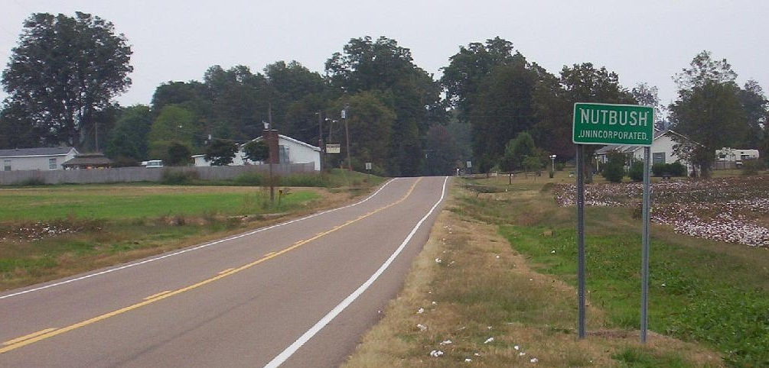
Project Overview
The Tennessee Department of Transportation (TDOT), in cooperation with the Federal Highway Administration (FHWA), proposes to improve State Route (SR) 19.
Project Termini
Begin Project: east of Eastland Ave. in Lauderdale County
End Project: east of SR-87 in Haywood County
Project Length
Total project length: 15.4 miles
Because the project uses federal-aid funds, it must comply with the National Environmental Policy Act (NEPA). TDOT and FHWA prepared an Environmental Assessment to evaluate the project’s environmental impacts and identify measures to minimize harm.
Notes:
The proposed State Route 19 project is approximately 15.2 miles long. It begins just east of Eastland Avenue in Ripley and ends just east of State Route 87 in Brownsville.

Slide 6
How to Review the Environmental Assessment (EA)
Physical and digital copies of the EA and associated technical appendices have been made available for public review at the following locations:
Public Hearing: On-site for review tonight.
Online: via the TDOT Project Website:
https://www.tn.gov/tdot/projects/region-4/state-route-19.html
Locally:
Haywood County Courthouse - 1 North Washington Avenue, Brownsville, TN 38012
Ripley City Hall – 110 South Washington Street, Ripley, TN 38063

Slide 7
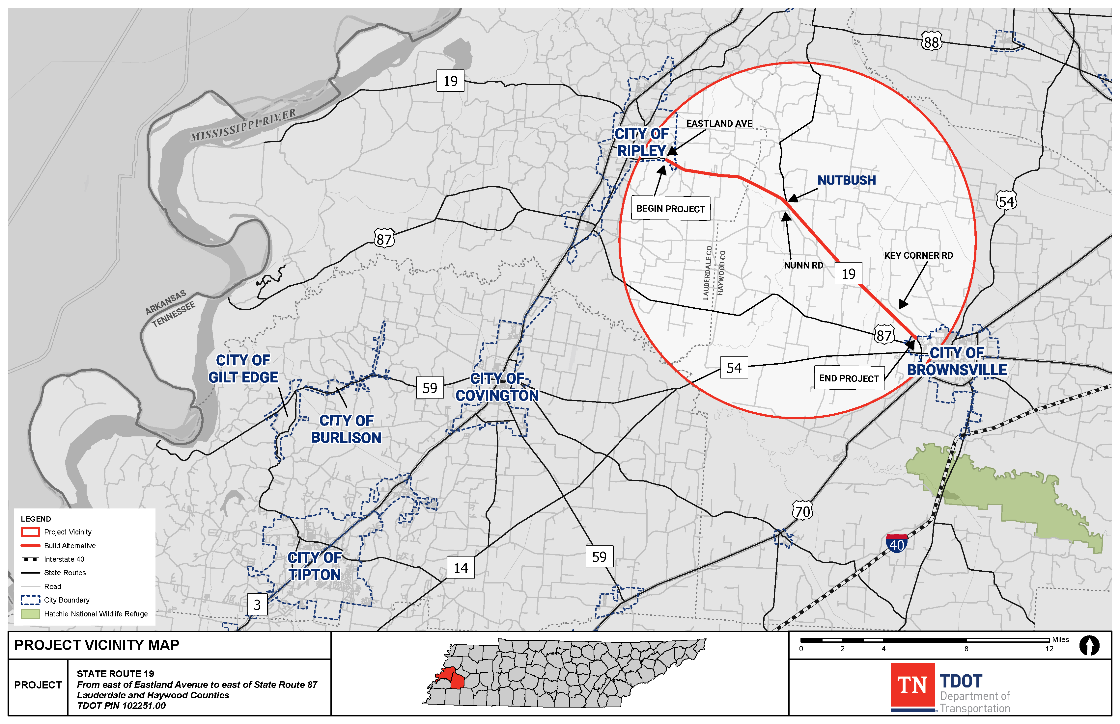
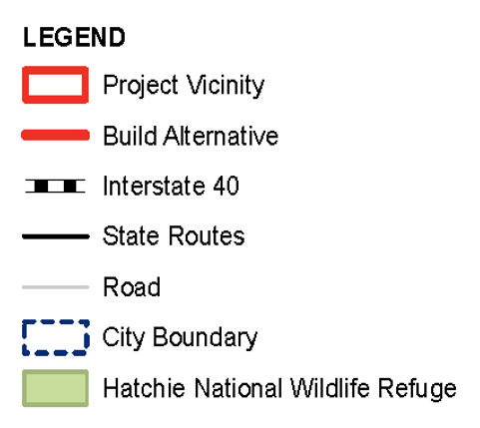
Project Location
Notes:
The proposed project is located in eastern Lauderdale County and western Haywood County.

Slide 8
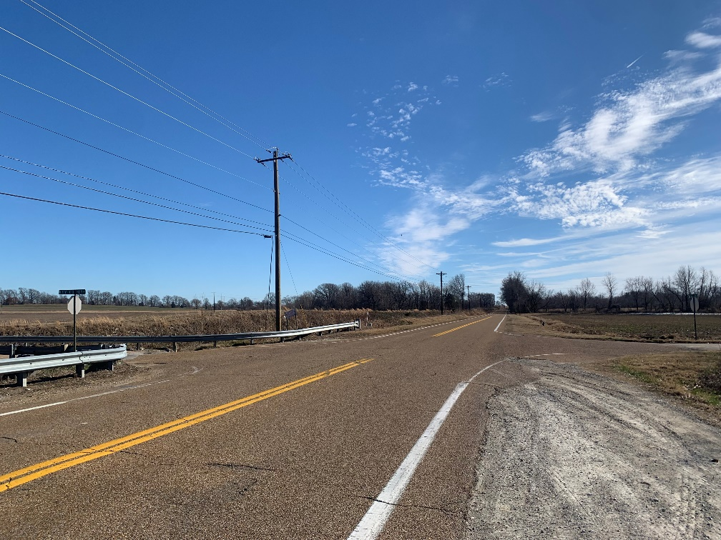
Project Purpose and Need
Need for proposed project:
Increased Percentage of Severe Crashes
Existing Roadway Geometric Deficiencies
Improve SR-19 to Meet the Legislative Intent of the “Improving Manufacturing, Public Roads, and Opportunities for a Vibrant Economy” (IMPROVE) Act and the Transportation Modernization Act (TMA)
Purpose of Proposed Project:
Reduce the Rate of Severe crashes
Improve Roadway Geometric Deficiencies to Meet Current TDOT Design Standards
Meet the Legislative Intent of the IMPROVE Act and the TMA.
Notes:
Initial studies indicate that the percentage of fatal and suspected serious injury crashes along State Route 19 in the project area is greater than the state-wide percentage. State Route 19 also has vertical deficiencies which affect sight distance.
The purpose of the proposed project is to reduce the severity of crashes and improve the roadway to meet current design standards.

Slide 9
Project History
1996 | TDOT Feasibility Study for improvements to SR-19
2003 | TDOT Advanced Planning Report (APR) recommends widening SR-19 to four lanes along entire project from Ripley to Brownsville.
2009 | TDOT Transportation Planning Report (TPR) prepared in response to public opposition to a four-lane roadway. TPR determined that localized improvements and increasing the lane widths of the existing travel lanes and shoulders in many areas along the project were warranted.
2018 | A D-List Categorical Exclusion (CE) was approved for the SR-19 project.
2024 | Design plans were developed for the proposed project. The Federal Highway Administration (FHWA) and TDOT initiated an Environmental Assessment (EA) based on anticipated number of relocations.
2026 | FHWA approved the Environmental Assessment on March 30, 2026.
Notes:
The proposed State Route 19 project was initiated by TDOT in the late 1990’s. In February 2018, the Federal Highway Administration or FHWA approved a D-List Categorical Exclusion (CE) for the proposed project. As design of the project progressed, it became evident that the number of relocations that would be required had increased. After further coordination with FHWA in 2024 regarding the number of potential relocations, an Environmental Assessment, or EA, was initiated.

Slide 10
Alternatives Evaluated in the Environmental Assessment
Two alternatives were evaluated in the EA:
No-Build Alternative
Build Alternative
No-Build Alternative:
Retain the existing roadway configuration except for other programmed improvements and routine maintenance and safety upgrades.
Notes:
There are two alternatives are currently being evaluated in the EA.
The No-Build Alternative would keep State Route 19 as it currently is except for any modifications identified in TDOT’s 25-Year Long Range Transportation Policy Plan, the State Transportation Improvement Program (STIP), and TDOT’s 10-Year Project Plan. It would allow for routine maintenance and safety upgrades.
The No-Build Alternative is required by federal regulation and serves as a benchmark for comparison with the Build Alternative.

Slide 11
Alternatives Evaluated in the Environmental Assessment
East of Eastland Avenue to west of Gill Brackin Road Widen to two 12-foot travel lanes with 10-foot shoulders (8-foot paved).
West of Gill Brackin Road to Nunn Road Mill and resurface the existing roadway.
Nunn Road to east of Jim Binford Lane Widen to two 12-foot travel lanes with 10-foot shoulders (8-foot paved).
East of Jim Binford Lane to east of SR-87 Mill and resurface the existing roadway.
Notes:
The Build Alternative proposes to widen the existing two 11-foot travel lanes of SR-19 from east of Eastland Avenue in Lauderdale County to west of Gill Brackin Road in Haywood County to two 12-foot travel lanes and widen the shoulders from 2-foot shoulders to 10-foot shoulders (8-foot paved). In order to widen the travel lanes in this section of the project, right-of-way would need to be acquired, and the travel lanes reconstructed primarily to the north side of the existing roadway in the Lauderdale County section and mostly to the south side of the roadway in Haywood County to west of Gill Brackin Rd. In this section of the project, the following intersections are proposed to be realigned:
Willie Paris Road
Ross Road/Gause Lane
Tall Oaks Cove
Sanford Road/Carney Road and
Springhill Road

Slide 12
Alternatives Evaluated in the Environmental Assessment
Build Alternative (cont’d):
Additional Improvements: Realign several intersections (listed below), correct geometric deficiencies, and address erosional/slope issues throughout the project area.
Willie Paris Road Ross Road/Gause Lane Tall Oaks Cove Sanford Road/Conner Whitefield Road Watson Road/Carney Road Springhill Road | Forked Deer Road (SR-180) Nunn Road Jim Binford Lane Small Road Woodlawn Road/Briar Creek Road Old SR-19
Notes:
From just west of Gill Brackin Road to the project end just east of State Route 87, the project would mill and resurface the existing 11-foot travel lanes and shoulders and would correct erosion/slope issues between Woodlawn Road and Old State Route 19 and between Patton Road and Westpointe Road. The following State Route 19 intersections are proposed to be realigned in this section of the project:
Forked Deer Road
Nunn Road
Jim Binford Lane
Small Road and
Old State Route 19

Slide 13
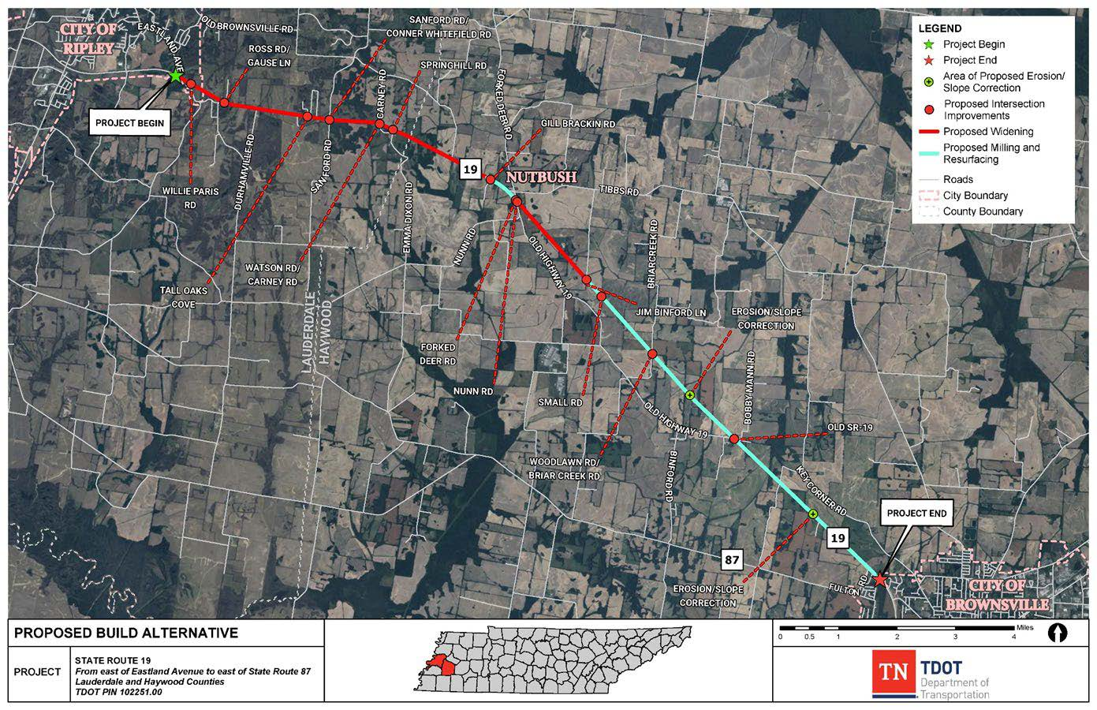
Notes:
From just west of Gill Brackin Road to the project end just east of State Route 87, the project would mill and resurface the existing 11-foot travel lanes and shoulders and would correct erosion/slope issues between Woodlawn Road and Old State Route 19 and between Patton Road and Westpointe Road. The following State Route 19 intersections are proposed to be realigned in this section of the project:
Forked Deer Road
Nunn Road
Jim Binford Lane
Small Road and
Old State Route 19

Slide 14
The Preferred Alternative
TDOT has identified the Build Alternative as the Recommended Preferred Alternative
As described in the sections above, the No-Build Alternative does not meet the purpose and need for the proposed project.
Based on the ability of the Build Alternative to meet the purpose and need for the proposed project, it has been designated as the Recommended Preferred Alternative

Slide 15
Resources Analyzed in an Environmental Assessment
Traffic and Safety
Land Use, Farmland, and Transportation Infrastructure
Community Impact, Relocations, and Economic Resources
Air Quality
Noise Impacts
Recreational Resources (Section 4(f) and Section 6(f))
Cultural Resources (Historic Architecture, Archaeology, and Native American Consultation)
Natural Resources
Hazardous Materials
Visual Impacts
Notes:
As part of the EA, potential impacts of the proposed project on a number of environmental and human resources will be analyzed. The results of these studies will be presented in the EA.

Slide 16
Environmental Impacts
Impact Category | No-Build Alternative | Build Alternative
Land Use | No Effect | Approx. 98.8 acres of Right-of-Way and easements to be acquired; No impacts on existing/future land uses; consistent with zoning, legislation, and local/regional planning goals and recommendations
Farmland | No Effect | Small portion of farmland would be converted to transportation use; no impacts to farming operations or employment
Transportation Infrastructure | No Effect | Improve safety and roadway geometry throughout the corridor; improve operations at strategic intersections; provide 10-foot shoulders (8-foot paved) along portions of the project that would accommodate bicyclists and pedestrians
Community and Socioeconomic Resources | No Effect | Approximately 26 residential and 2 business relocations; no impacts to community cohesion and economic conditions
Aquatic Resources | No Effect | Impacts to 82 wet-weather conveyances, 6 perennial streams, 28 intermittent streams, 16 wetlands, and 8 ponds; Impacts to five 303(d) listed streams
Protected Species | No Effect | Not Likely to Adversely Affect any state or federally listed species
Floodplains, Soils, and Geology | No Effect | Impacts to approximately 3.6 acres of 100-yr FEMA designated floodplains; Impacts to geology and drainage due to rock cuts and other construction related activities
Visual Impacts | No Effect | Neutral effect on the visual quality and character of the area; minimal impacts anticipated
Hazardous Materials | No Effect | No impacts to hazardous material sites
Air Quality | No Effect | Lauderdale and Haywood counties are in attainment for all regulated criteria pollutants; would not create adverse MSAT effects; temporary construction related air quality impacts are anticipated
Noise | No Effect | Type III project (per 23 CFR 772); therefore, no noise analysis or abatement considerations are required
Cultural Resources | No Effect | No impacts to National Register of Historic Places (NRHP) listed or eligible historic or archaeological sites

Slide 17
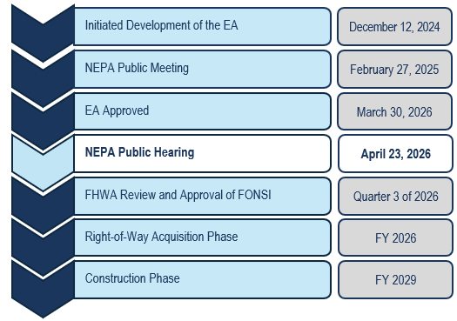
Anticipated Schedule
Quarter 1: January through March Quarter 2: April through June Quarter 3: July through September Quarter 4: October through December *All proposed dates are subject to change
Notes:
Based on the current schedule, approval of the EA and the public hearing for it are anticipated to occur late in quarter 3 of 2025. Approval of the final environmental document and identification of the selected alternative is anticipated to start late in quarter 4 of 2025. Please note that these dates are subject to change. The ROW phase is scheduled to start in FY 2026. Construction is scheduled to start in FY 2028.

Slide 18
Right-of-Way Acquisition
The Tennessee Department of Transportation (TDOT) follows a federally mandated process to acquire property, which includes:
Notice to property owners
Independent Third-Party Conducted Appraisals
Fair Market Value offered for proposed acquisitions
Relocation Assistance Program for eligible affected property owners including residences, businesses, farm operations, non-profit organizations, and those requiring special services or assistance.
Full details of TDOT’s Right-of-Way Acquisition process can be found in the TDOT ROW Manual at: www.tn.gov/content/dam/tn/tdot/right-of-way-division/ROW_Procedures_Manual.pdf
If you have a question regarding the TDOT Right-of-Way Acquisition and Relocation process, speak to a TDOT ROW Representative tonight or contact:
Mr. Erick Hunt-Hawkins
TDOT Environmental Division, NEPA Team Lead
Email: Erick.Hunt-Hawkins@tn.gov | Phone: (615) 253-5163
Notes:
TDOT follows a federally mandated process for acquiring property. Full details on TDOT’s right-of-way acquisition process can be found at the internet address on the screen. If you have questions about the right-of-way process speak to one of the TDOT right-of-way representatives here tonight or contact Sally Norville.

Slide 19

How to Submit Comments
Fill out a Comment Card and leave it in the comment box at the sign-in station tonight.
Submit Comment Card or
letter by email to: TDOT.Comments@tn.gov
(use subject line “SR-19 Project”)
Or by mail to:
NEPA Public Hearing
Attn: State Route 19
Tennessee Department of Transportation
Tennessee Tower, 14th Floor
312 Rosa L. Parks Ave.
Nashville, TN 37243
Leave a verbal comment with the Court Reporter tonight or by calling
(615) 253-5163
and leaving a voicemail.
Complete an online comment form by visiting the project website at:
https://www.tn.gov/tdot/projects/region-4/state-route-19.html
Or by scanning the QR Code below
Ask a TDOT representative during the public hearing to help you submit your comment.
Comments received or postmarked by May 14th, 2026, will be included in the official summary of the public hearing.
Notes:
TDOT would like to hear from you about the proposed project. There are several ways to submit your comments.
You can complete the comment card that you received at this meeting and drop it in the box at the sign-in table.
You mail your comment card or letter to the address on the screen-please make sure that it is post marked by March 20, 2025 to be included in the official summary of the public meeting.

Slide 20
For More Information
Mr. Ben Webb, PE, PMP
TDOT Region 4 Project Manager
Benjamin.Webb@tn.gov
731-747-5006
Mr. Erick Hunt-Hawkins
TDOT NEPA Team Lead
Erick.Hunt-Hawkins@tn.gov
615-253-5163
Notes:
For more information on the project contact Mr. Ben Webb, the TDOT project manager. For questions about the environmental process contact Mr. Erick Hunt-Hawkins.

Slide 21
Formal Question and Answer Session
Notes:
Good evening and welcome to the public information meeting for the proposed State Route 19 project from east of Eastland Avenue in Lauderdale County to east of State Route 87 in Haywood County.

