Slide 1
STATE ROUTE 54
HENRY COUNTY
DESIGN PUBLIC MEETING
April 6, 2023

Slide 2


Project Team Represented Tonight
TDOT Region 4 Project Development
TDOT Right-of-Way Division
TDOT Community Relations Division
Palmer Engineering – Design Engineers

Slide 3
Project Status
Planning
Preliminary Engineering
Phase
Environmental
Design
Project Currently in the Design Phase
Right-of-way Phase
Right-of-Way
Construction Phase
Construction

Slide 4
Purpose of Meeting
Provide preliminary plans for public review of the improvements to SR 54 – From near Howard Road to the Kentucky State Line
Receive input from the public
  Comment cards
  Court reporter
Answer questions and address concerns

Slide 5
Next Steps
Address Public Comments
Finalize Design for Right of Way
Right of Way Appraisal and Acquisition
Schedule for Construction

Slide 6
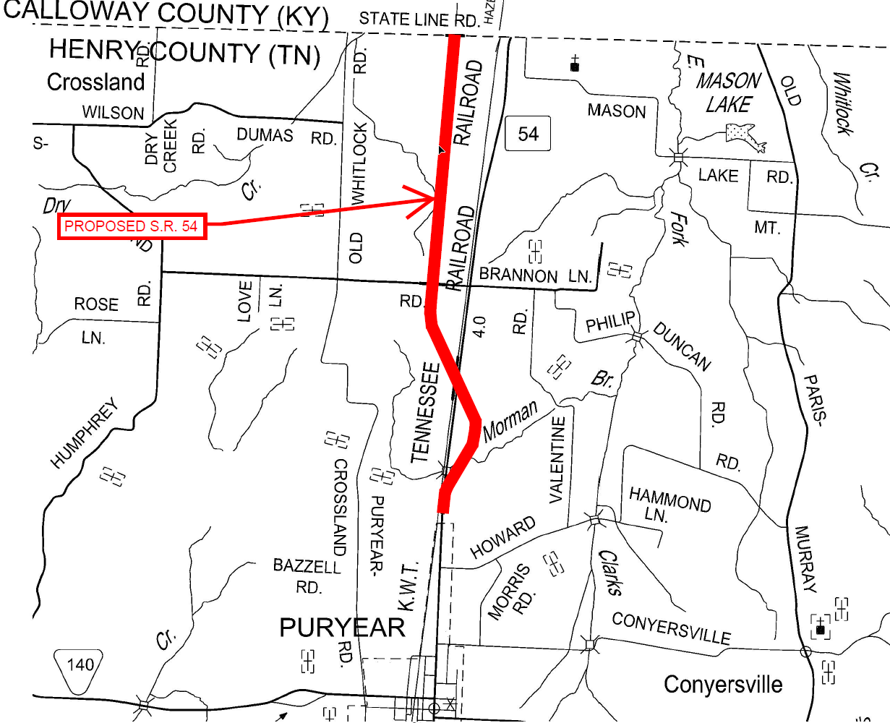
Project Location
Notes:
6.3 mile project length

Slide 7
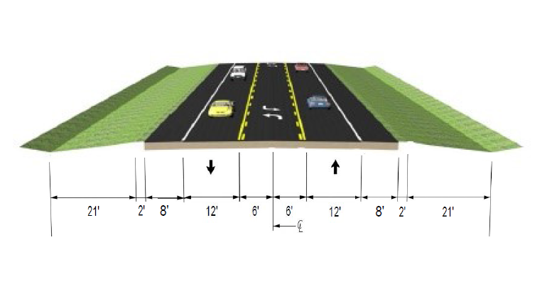
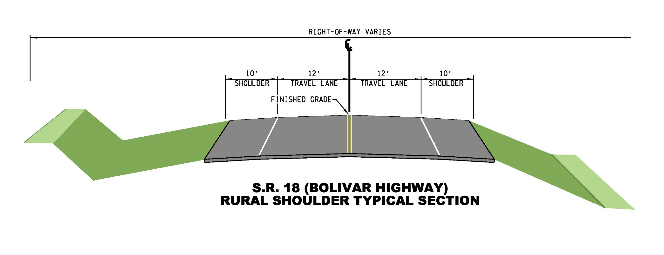
Proposed Improvements
3-Lane Typical Section
SR-54 From near Howard Road
to the Kentucky State Line

Slide 8
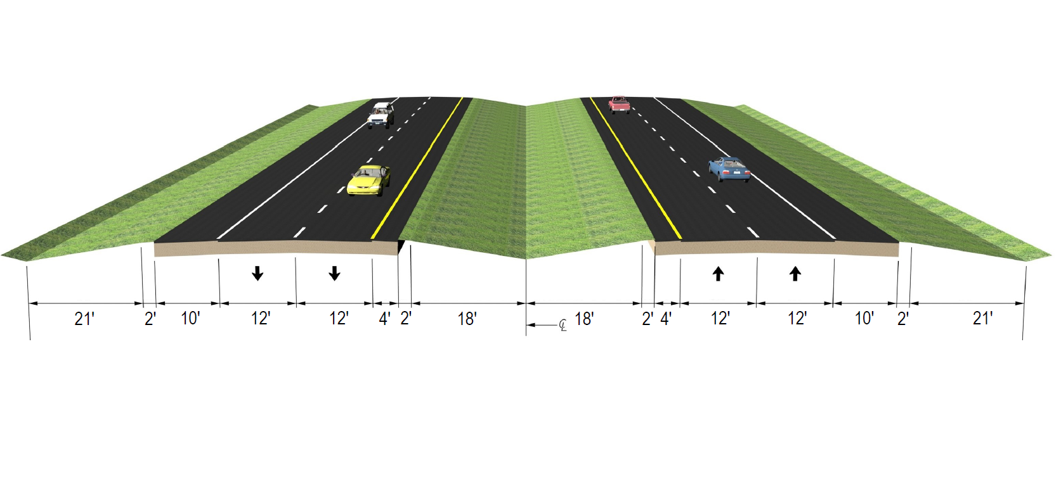
Proposed Improvements
4-Lane Divided Highway Typical Section
SR-54 From near Howard Road
to the Kentucky State Line

Slide 9
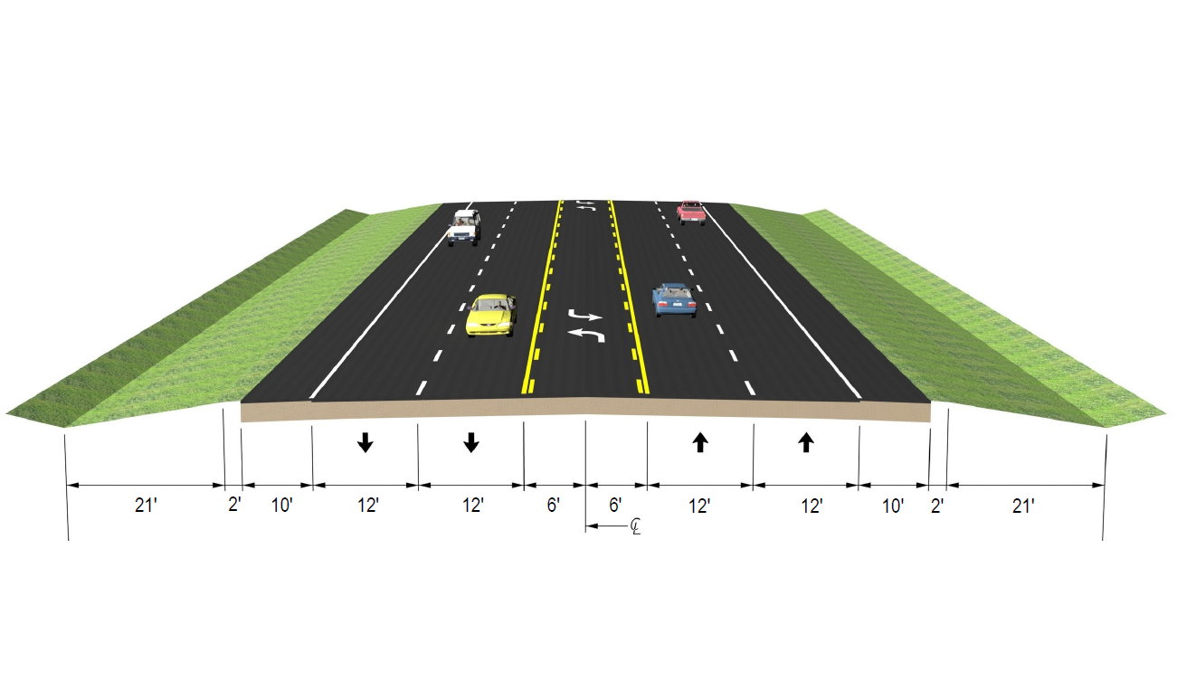
Proposed Improvements
Future 5-Lane Typical Section
SR-54 From near Howard Road
to the Kentucky State Line

Slide 10
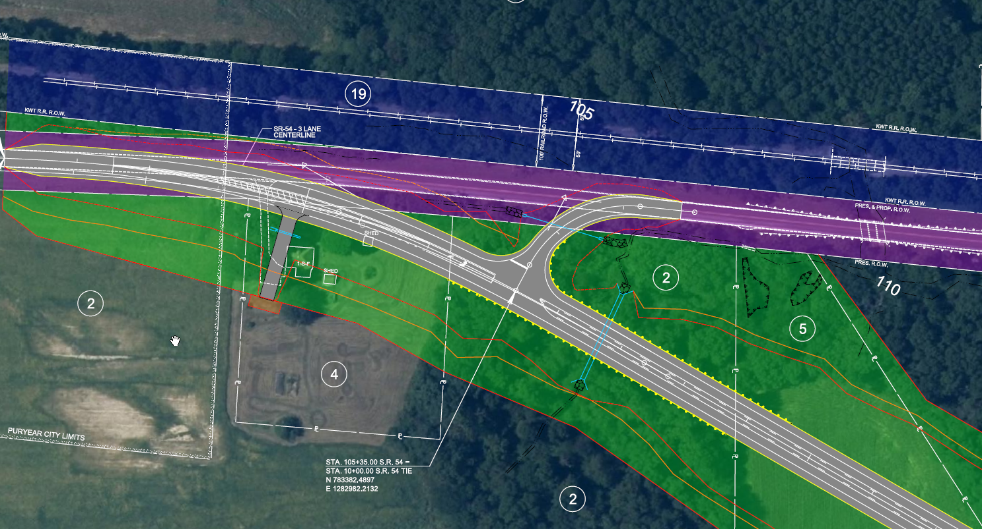

Project Display
SR-54 TIE
BEGIN PROJECT
SR-54 TIE TO EXISTING ROADWAY

Slide 11
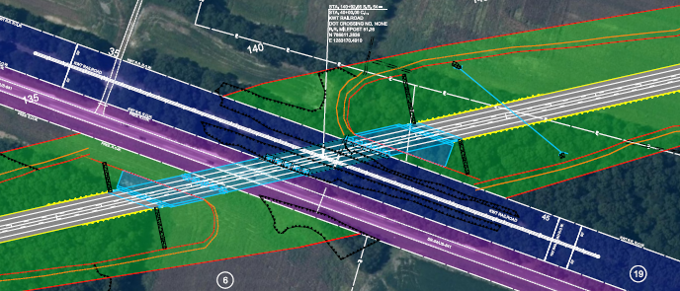
Project Display
SR-54 at Bridge over Existing SR-54

Slide 12
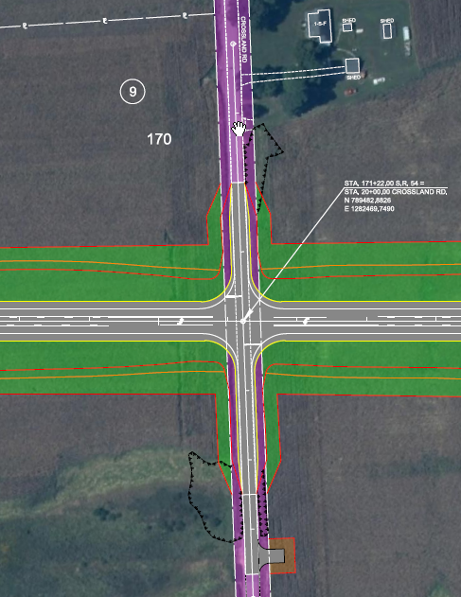

Project Display
SR-54 at Crossland Road

Slide 13
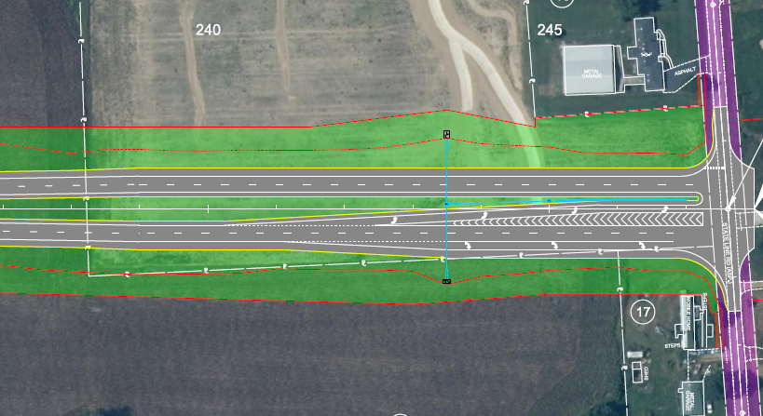

Project Display
SR-54 End of Project
at State Line Road

Slide 14
Your Comments are Important to Us
Submit written comments on the provided comment cards
  Drop comment cards off tonight
  Mail-in comment cards within 21 days, due June 2, 2023
Provide verbal comments to the court reporter

Slide 15
Thank you
Thank You
for your attendance and participation in the
SR 54 Design Public Meeting
Contacts
Gary Scruggs, P.E., Director
TDOT Region 4 Project Development
PH: (731) 935-0149
Gary.scruggs@tn.gov
Seth M. Hendren, P.E., C.E. Manager 1 TDOT Region 4 Project Development
PH: (731) 935-0143
seth.hendren@tn.gov

