Slide 1



Henry County SR-54 (US-641) Design Public Meeting
March 26, 2026

Slide 2


Purpose of Meeting
Provide an update on the project status
Allow the public to view the current proposed project
Allow the public to speak one on one with project representatives to ask questions and address concerns
Allow the public to provide written or verbal comments

Slide 3
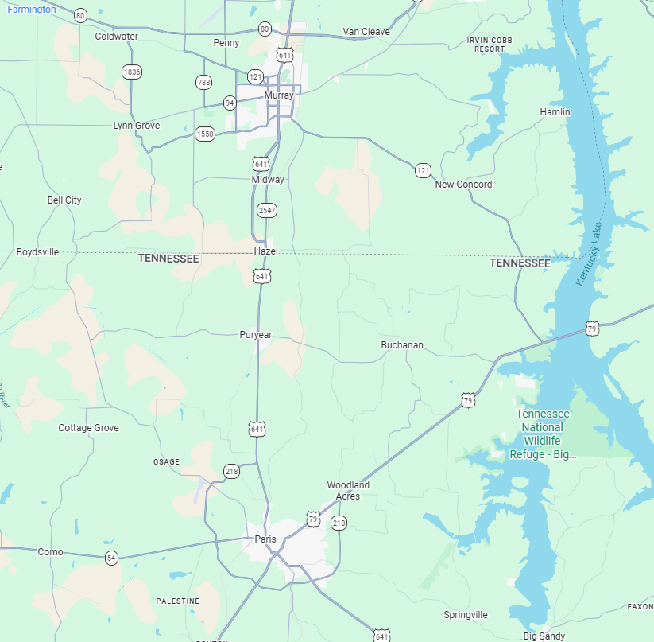
Project Overview
Project is on SR-54 also called US-641
Project begins near Smith Road (north of Paris, TN)
Project ends near Howard Road (north of Puryear, TN)
Project Length – 8.4 miles (approx.)
Widening existing 2-lane roadway to 5-lanes
New bridges over the north fork of the Obion River and Rowe Creek
New traffic signals at SR-218 and Main Street
State Line
Project End
Project Begin

Slide 4
Project History/Background
Previous public meetings/hearings held in 2002, 2003, 2009, and 2011
Original corridor environmental document approved by Federal Highway Administration in 2011
2 alternatives were considered:
following the existing alignment and bypassing Puryear to the east
following the existing alignment throughout project limits
Following existing alignment throughout was selected due to support from the public and local officials, lessened impacts, and lower cost
A reevaluation of the environmental document completed in 2022, new reevaluation scheduled for 2026
Project listed in TDOT’s 10-year plan and authorized by the Transportation Modernization Act (TMA) in 2023
Survey was completed in Winter 2024
Preliminary design work began in Spring 2025

Slide 5
Project Goals
Correct geometric and operational deficiencies
Increase capacity along SR-54 (US 641)
Complete a multilane corridor between Paris, TN and Murray, KY.
Improve side road alignment with SR-54 (US 641)
Improve pedestrian access in Puryear with the addition of sidewalks, curb ramps, and cross walks
Promote economic growth in Henry County

Slide 6
Project Schedule
Current Status:
Preliminary/Right-of-Way Plans Development
Upcoming Activities:
Fall 2026 – Finalize Right-of-Way Plans
Winter 2026 – Right-of-Way acquisition phase begins
Fall 2029 – Finalize Construction Plans
Fiscal Year 2030 – Construction begins

Slide 7
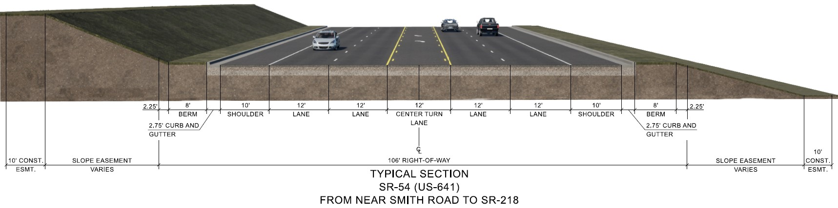
Typical Roadway Section
Note: Subject to change

Slide 8
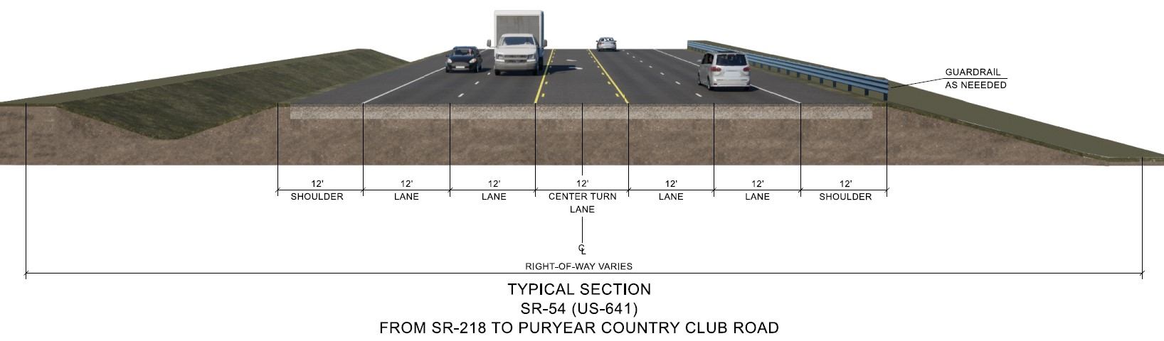
Typical Roadway Section
Note: Subject to change

Slide 9
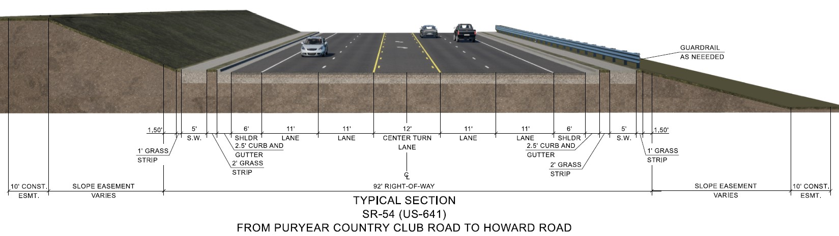
Typical Roadway Section
Note: Subject to change

Slide 10
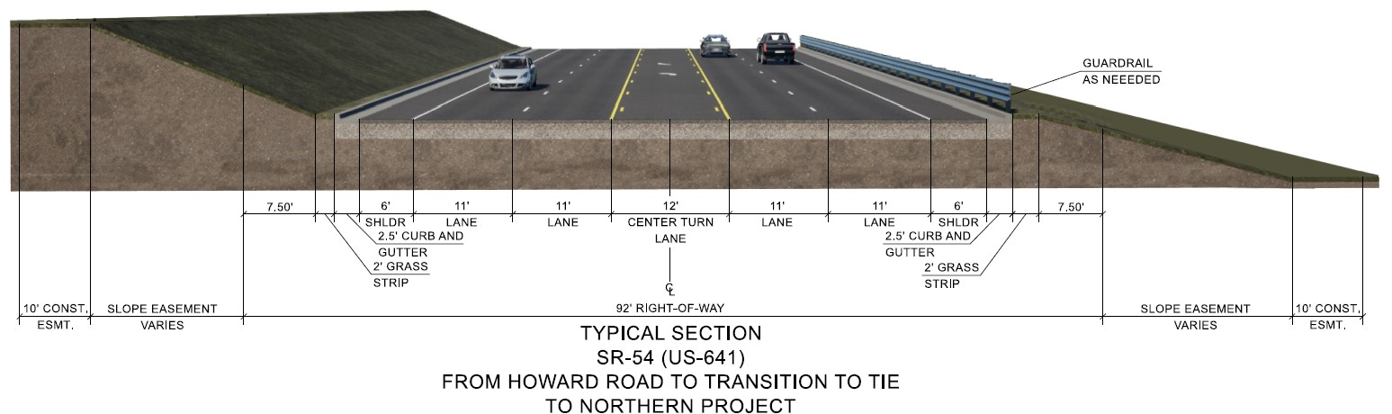

Typical Roadway Section
Note: Subject to change

Slide 11
We Want to Hear from You!
How to submit your comments?
A court reporter is available to take your verbal comments
Fill out the comment card
Submit tonight
Submit by mail to the address provided
You have 21 days to submit comments (by 04/16/2026)

Slide 12






How to Stay Engaged
Nichole Lawrence,
TDOT Regional Communications Officer
Nicholas Stephens,
TDOT Project Manager – Highway Program
@
Nichole.Lawrence@tn.gov
Nicholas.Stephens@tn.gov

Slide 13
Thank you for attending tonight’s meeting
Please visit the displays around the gym
Project representatives with nametags are available throughout the gym to answer your questions about the project.

