Slide 1
Walton Ferry/Old Shackle Island @ SR 6
Sumner County
Public Meeting
January 22, 2025

Slide 2
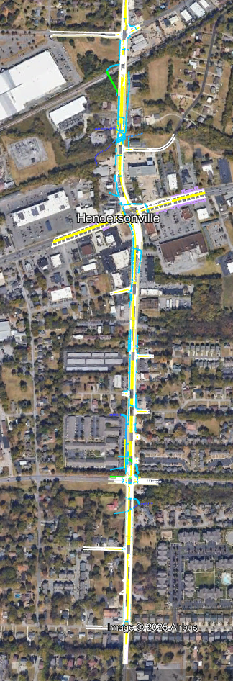
Project Overview
Beginning of Project:
Nokes Drive
End of Project:
Volunteer Drive
Project length:
1.056 Miles
Construction Start Date: February 3, 2025
Construction Completion Date: May 31, 2027
Contract Amount: $20,746,853.25

Slide 3
Purpose of Project
Current Conditions:
2 lane highway
2024 Average Daily Traffic: 12,900
Future Conditions:
2 travel lanes in each direction, center turn lane, bike lanes, and sidewalks
2044 Average Daily Traffic: 16,510
Project Elements:
Realign the intersection at SR6 (W Main St) to improve traffic movements
Addition of bike lanes and sidewalk to improve pedestrian movements
1 Box culvert replacement
Roadway Lighting / Signalization

Slide 4
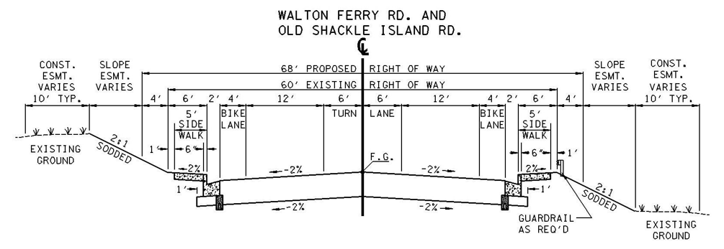
Proposed Roadway Cross Section

Slide 5
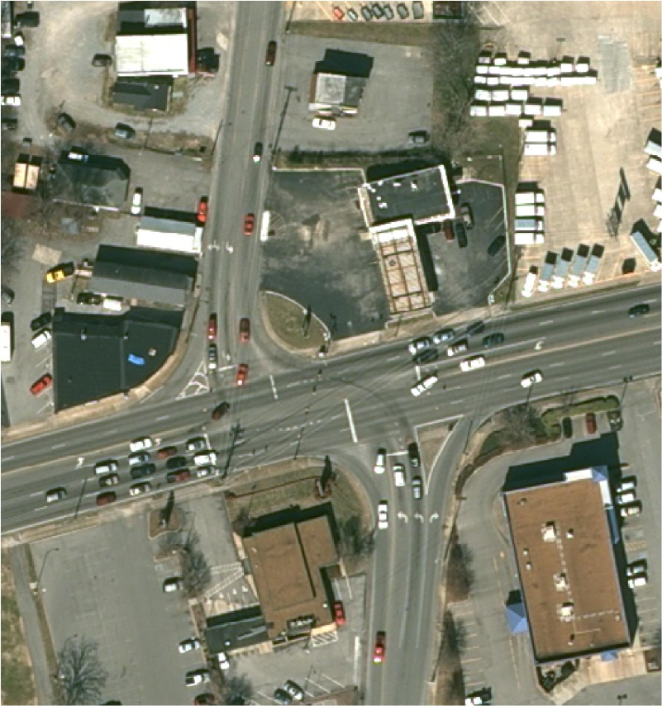
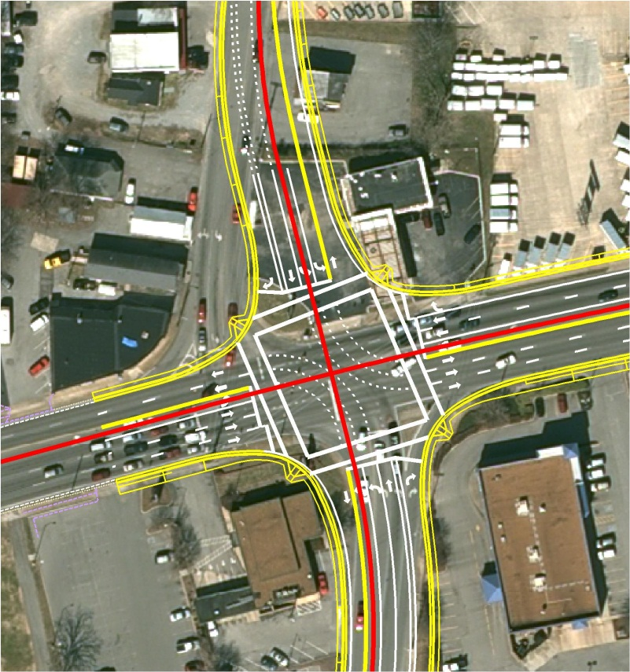
Intersection improvements at w. main street.
REALIGN THE INTERSECTION OF WALTON FERRY ROAD AND OLD SHACKLE ISLAND ROAD WITH WEST MAIN STREET (SR-6).
IMPROVE INTERSECTION OPERATION, EFFICIENCY AND CAPACITY.
PRESENT LAYOUT
PROPOSED LAYOUT

Slide 6

Project Safety
Please drive safely and non-distracted to promote a safe project.
A safe project for the construction personnel and traveling public is the
#1 Priority

Slide 7





Traffic Control
Some side road closures will occur throughout the life of the project.
Expect temporary lane closures and flagging operations for some construction activities.
Detours will be implemented as needed.

Slide 8
Lane Closures
Temporary lane closures on SR-6 will be allowed from 8:00 PM to 5:00 AM.
Temporary lane closures on Walton Ferry Rd and Old Shackle Island Rd. will be allowed from 9:00 AM to 3:00 PM.
Temporary closures and flagging operations may be needed on side streets to complete construction during some traffic phases.

Slide 9
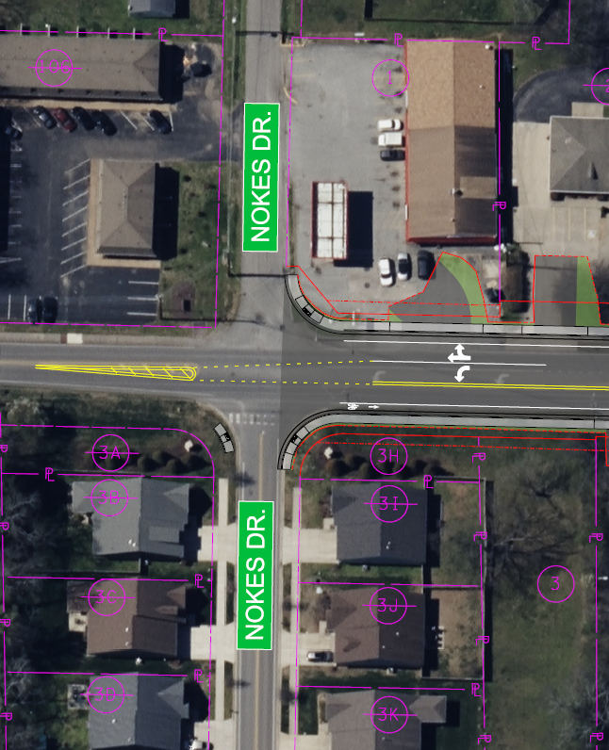
Intersection @ Nokes Drive

Slide 10
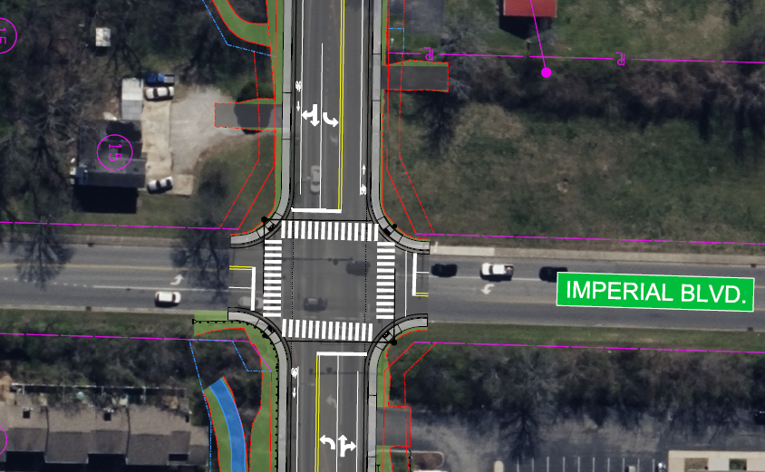
Intersection @ Imperial Drive

Slide 11
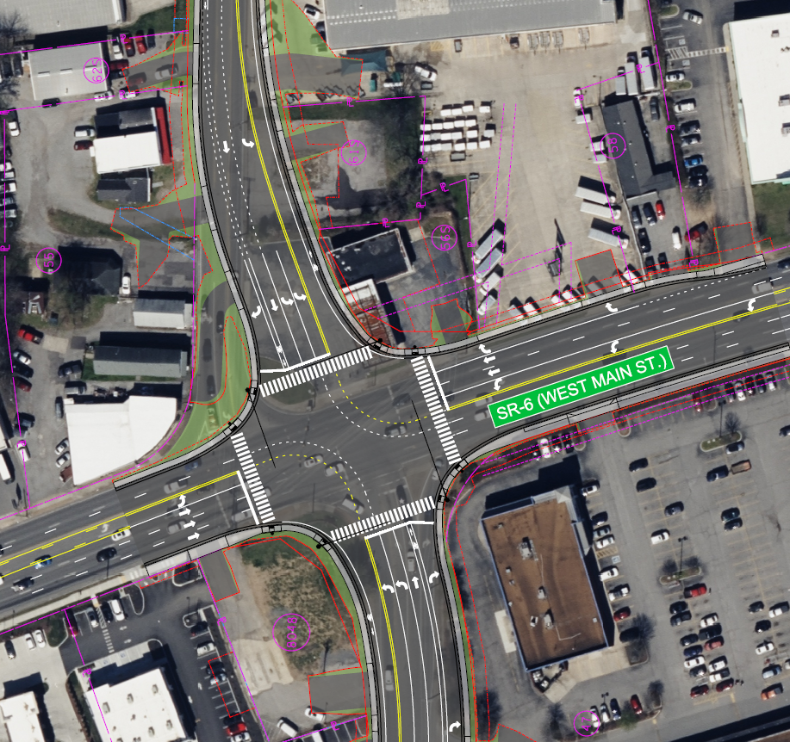
Intersection @ SR 6 (W Main St)

Slide 12
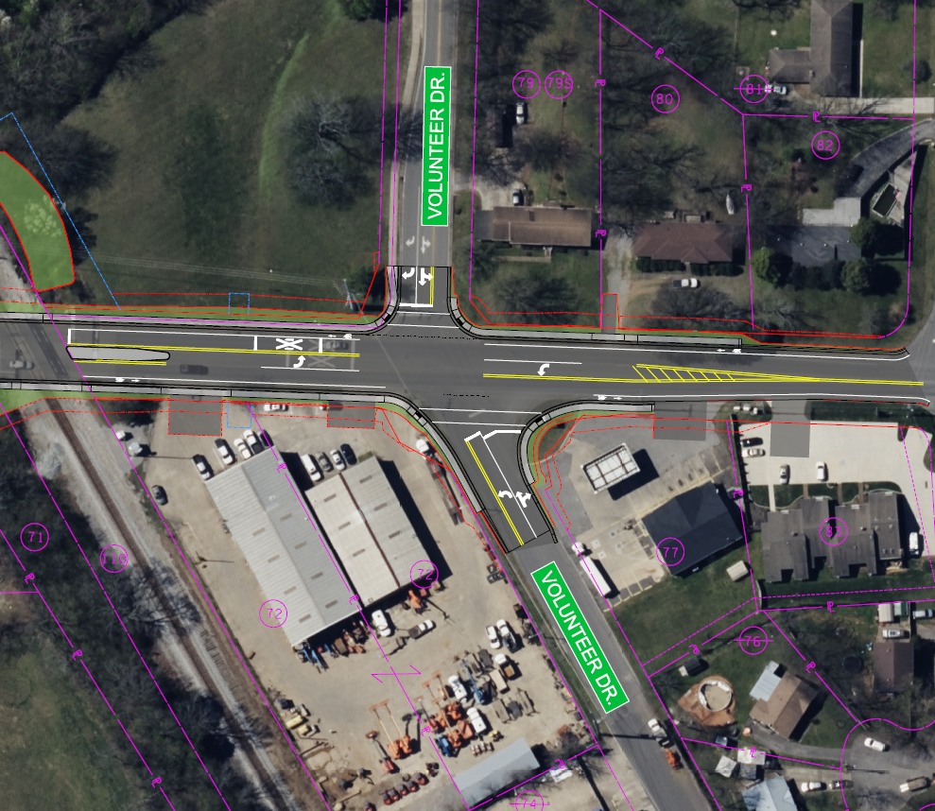
Intersection @ Volunteer Drive

Slide 13
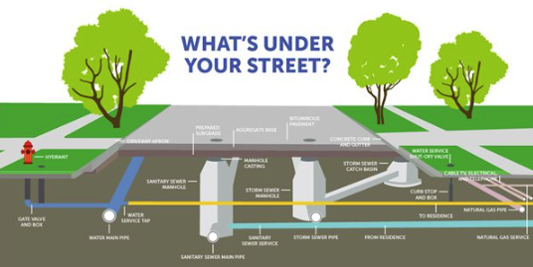
Utilities Involved
Hendersonville Water and Sewer
NES – Nashville Electric Service
Piedmont Natural Gas
Qwest Commun.
AT&T
XO Verizon
Comcast
Lumen

Slide 14

Prime Contractor
Rogers Group Inc.
Project Manager: TBD
Superintendent: Patrick Hester

Slide 15
TDOT Contacts
Project Supervisor
- Jacob Cole
- Phone: 615.451.5825
- Email: Jacob.Cole@tn.gov
Community Relations Officer
- Erin Zeigler
- Phone: 629.277.2458
- Email: Erin.Zeigler@tn.gov
Project Website
- https://www.tn.gov/tdot/projects/region-3/walton- ferry-road-old-shackle-island-road.html

Slide 16
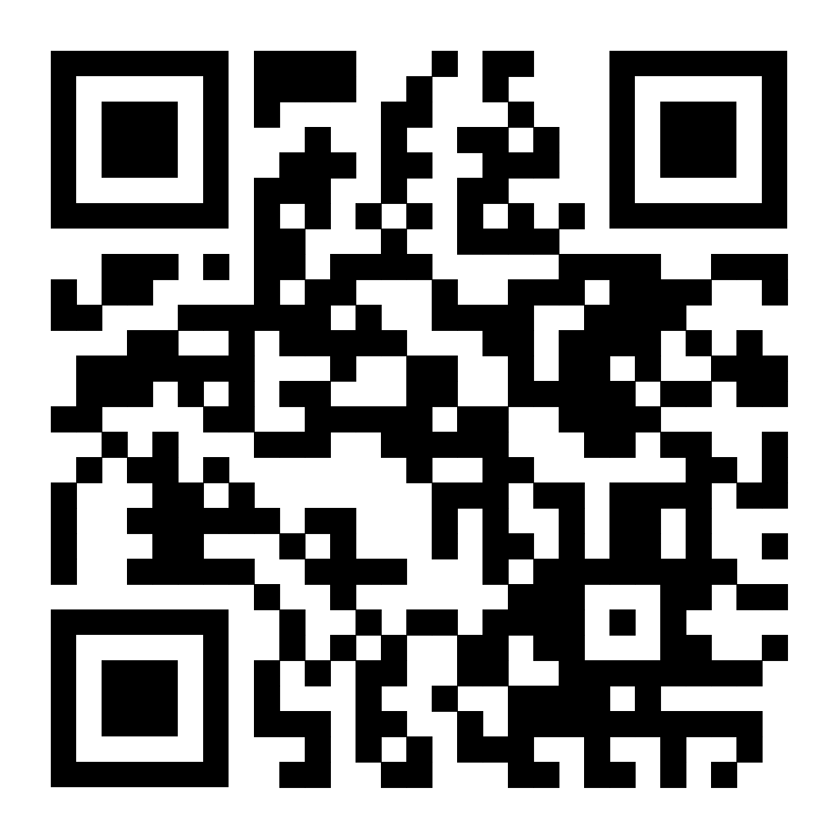
Project Website
Project Website
- https://www.tn.gov/tdot/projects/region-3/walton-ferry-road-old-shackle-island-road.html
SCAN ME

