Slide 1
DESIGN PUBLIC MEETING
WALTON FERRY RD./OLD SHACKLE ISLAND RD.
FROM IMPERIAL BLVD. TO VOLUNTEER DRIVE
HENDERSONVILLE
SUMNER COUNTY
PROJECT NO.
STP-M-9307(12)
April 18, 2011
5:00 p.m. to 7:00 p.m.

Slide 2
WELCOME & THANK YOU FOR ATTENDING
INTRODUCTION OF TDOT REPRESENTATIVES AND DESIGN CONSULTANTS
DESCRIPTION OF THE PROJECT
LOCATION OF DISPLAYS AND ACQUISITION TABLES
KEY POINTS TO REMEMBER AND MAKING STATEMENTS TO THE COURT REPORTER
GENERAL QUESTIONS ABOUT THE PROJECT

Slide 3
Purpose of project
REALIGN THE INTERSECTION OF WALTON FERRY ROAD AND OLD SHACKLE ISLAND ROAD WITH WEST MAIN STREET (SR-6).
IMPROVE ACCESS TO BUSINESSES THAT ARE AFFECTED BY THE EXISTING GEOMETRY DURING PEAK TRAFFIC HOURS.
CREATE SAFE, EFFICIENT MOVEMENT AND ACCESS ALONG THE PROPOSED ROUTE.
IMPROVE TRAFFIC FLOW AND REDUCE DELAY.
PROVIDE SAFE ACCESS FOR BICYCLISTS & PEDESTRIANS.

Slide 4
Project location, length & IMPROVEMENTS
BEGINS AT IMPERIAL BOULEVARD AND ENDS AT VOLUNTEER DRIVE.
APPROXIMATE LENGTH OF PROJECT IS 0.74 MILES
DESIGN REQUIRES A MINIMUM R.O.W. OF 68’.
WILL ALSO UTILIZE SLOPE, CONSTRUCTION AND PERMANENT DRAINAGE EASEMENTS.

Slide 5
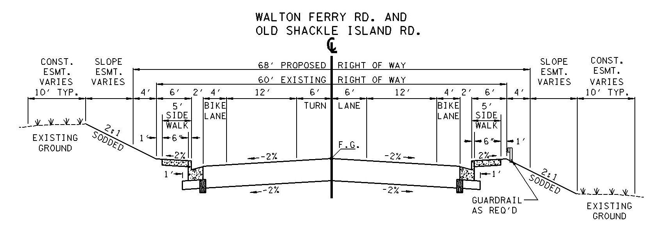
TYPICAL SECTION

Slide 6
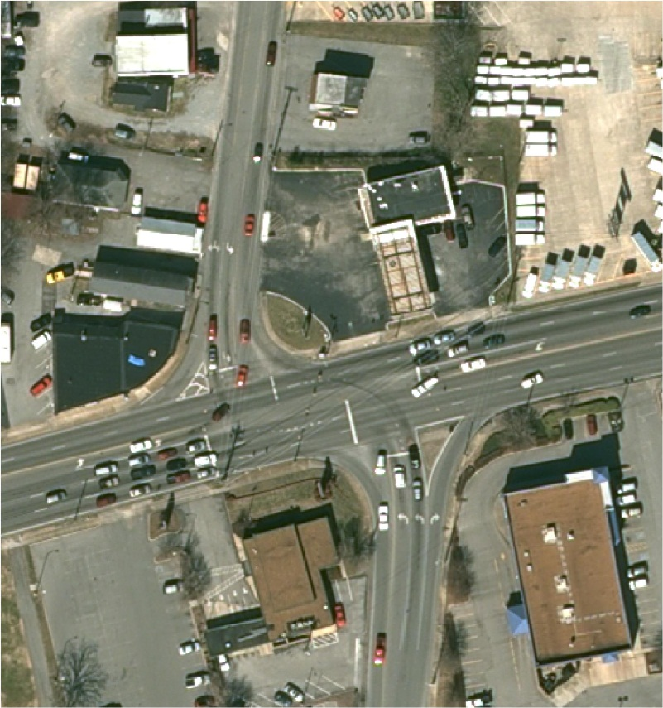
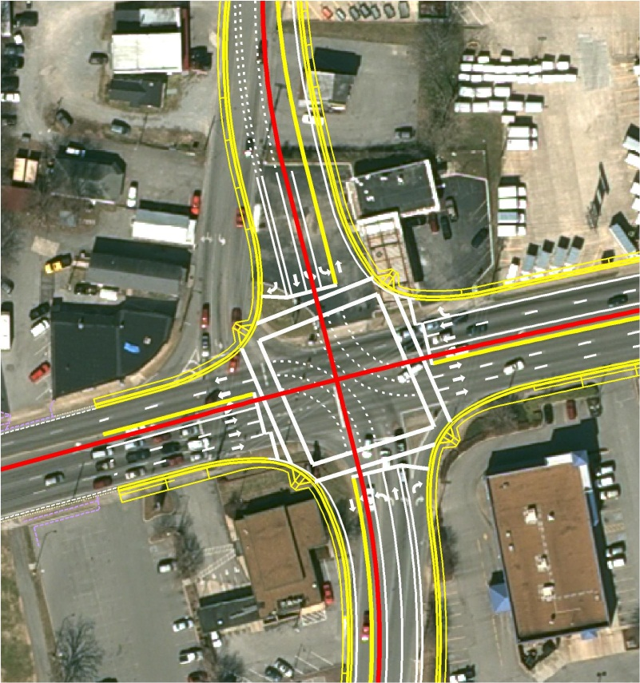
Intersection improvements at w. main street.
REALIGN THE INTERSECTION OF WALTON FERRY ROAD AND OLD SHACKLE ISLAND ROAD WITH WEST MAIN STREET (SR-6).
IMPROVE INTERSECTION OPERATION, EFFICIENCY AND CAPACITY.
PRESENT LAYOUT
PROPOSED LAYOUT

Slide 7
R.O.W. ACQUISITION AND RELOCATION
APPRAISAL PROCESS AND FAIR MARKET VALUE
NOTIFICATION OF ACQUISITION AND TIMELINE
RELOCATION ASSISTANCE AND PAYMENT
OWNER/TENANT COMPENSATION AND REIMBURSEMENT
DISPLACEMENT OF BUSINESSES AND REESTABLISHMENT

Slide 8
PROJECT SUMMARY
PROPOSED DESIGN AND SCOPE
PURPOSE OF THE PROJECT
LOCATION OF DISPLAYS AND ACQUISITION INFORMATION
R.O.W. ACQUISITION AND RELOCATION INFORMATION
LOCATION OF COURT REPORTER FOR STATEMENTS CONCERNING PROJECT
IDENTIFICATION OF DESIGN CONSULTANTS AND TDOT REPRESENTATIVES

Slide 9
PROJECT TIMELINE (PRELIMINARY)
SUBJECT TO FUNDING AVAILABILITY
DESIGN PUBLIC MEETING
RIGHT OF WAY PLANS
PURCHASE RIGHT OF WAY
CONSTRUCTION PLANS
AWARD CONSTRUCTION CONTRACT
APRIL 2011
SPRING 2012
2012
2013
2013

Slide 10
QUESTIONS & COMMENTS
OPTIONS FOR PUBLIC COMMENTS
WALL DISPLAYS & PRELIMINARY PLAN SETS
TDOT REPRESENTATIVES FROM DESIGN AND RIGHT OF WAY & TDOT DESIGN CONSULTANT REPRESENTATIVES WILL BE AVAILABLE FOR THE DURATION OF THE MEETING
GENERAL QUESTIONS OR COMMENTS

