Slide 1
CMGC04
Broadway Bridge

Slide 2
Project Overview
Project Status Update
Broadway Full Closure
Detour Routes
Renderings

Slide 3
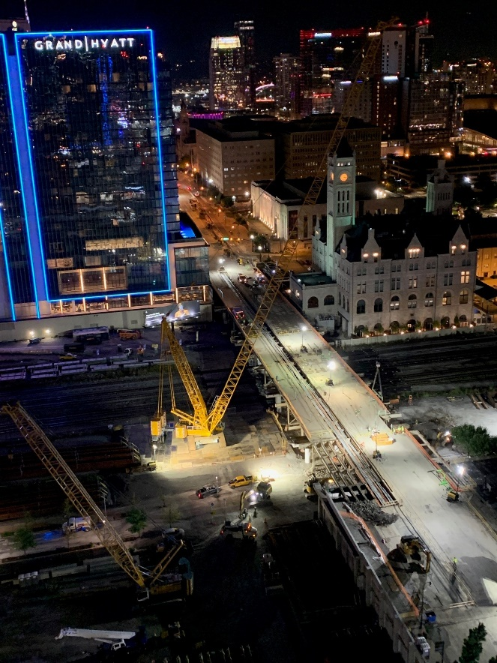
Project Status
Schedule
Currently trending on schedule
Adjusted closure date to September 8th
Construction
Setting bridge deck panels
Beam/diaphragm bolt up
Drainage on Broadway

Slide 4
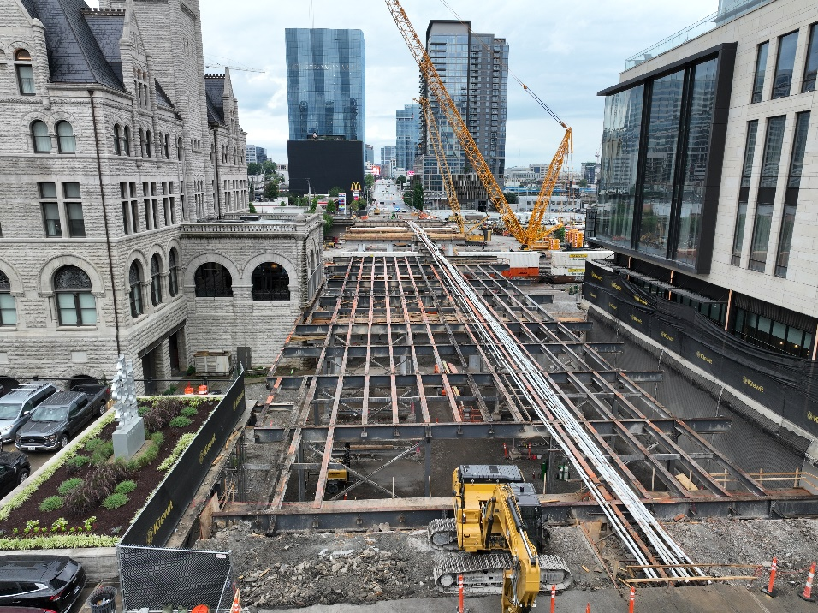
Project Pictures

Slide 5
Current Progress Picture

Slide 6
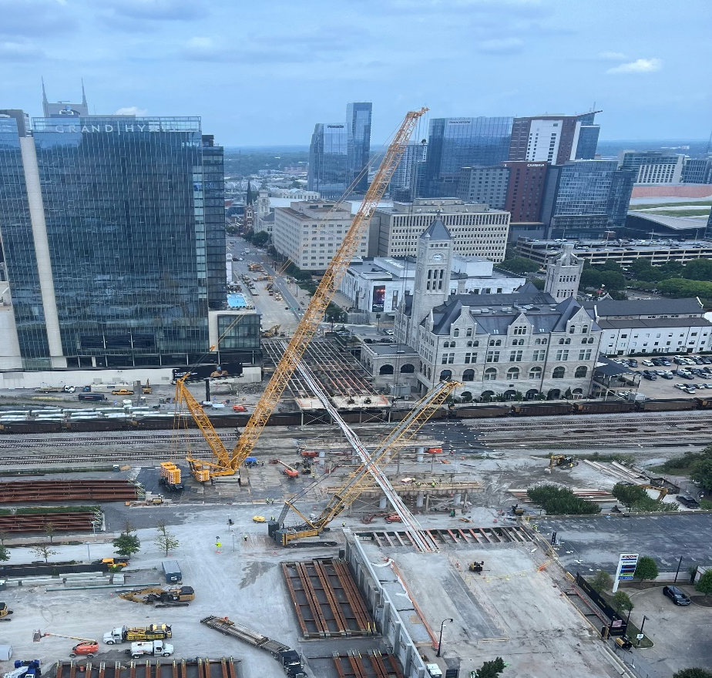
Remaining Work
Concrete closure pours
Drainage
Paving
Parapets/Fencing
Sidewalk
Lighting

Slide 7
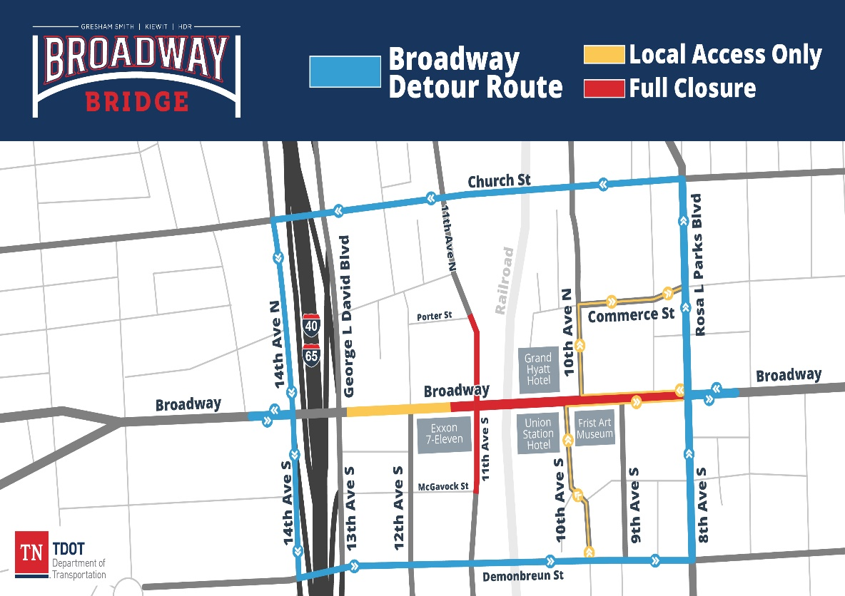
Closure Details
An 8-week full closure
Detour Routes
Maintain access to adjacent businesses
At the end of the closure, at least two lanes in each direction (4 lanes total) must be opened to traffic

Slide 8
Traffic Management Adjustments
BlueTOAD (camera and CCTV)
Signal timing
Increased signage
Modified detour on Porter and 11th Ave.
Additional security presence
DMS utilization and local message boards

Slide 9
Schedule – Post Closure Construction
Post Closure Work (September 2023 – October 2023)
Maintain four (4) lanes traffic
Erect sidewalks, fencing, lighting and parapets
Project Complete: October 31, 2023

Slide 11
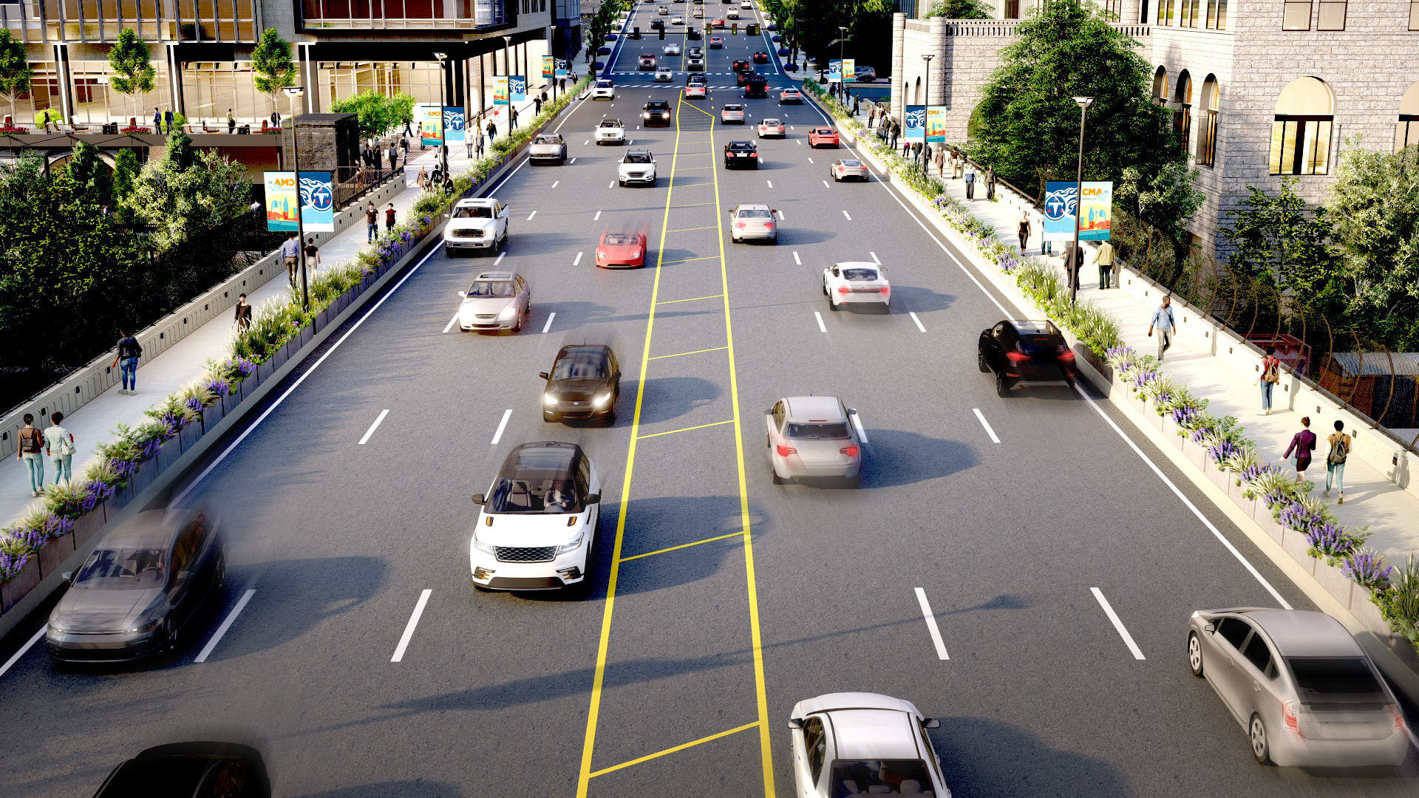

Slide 12
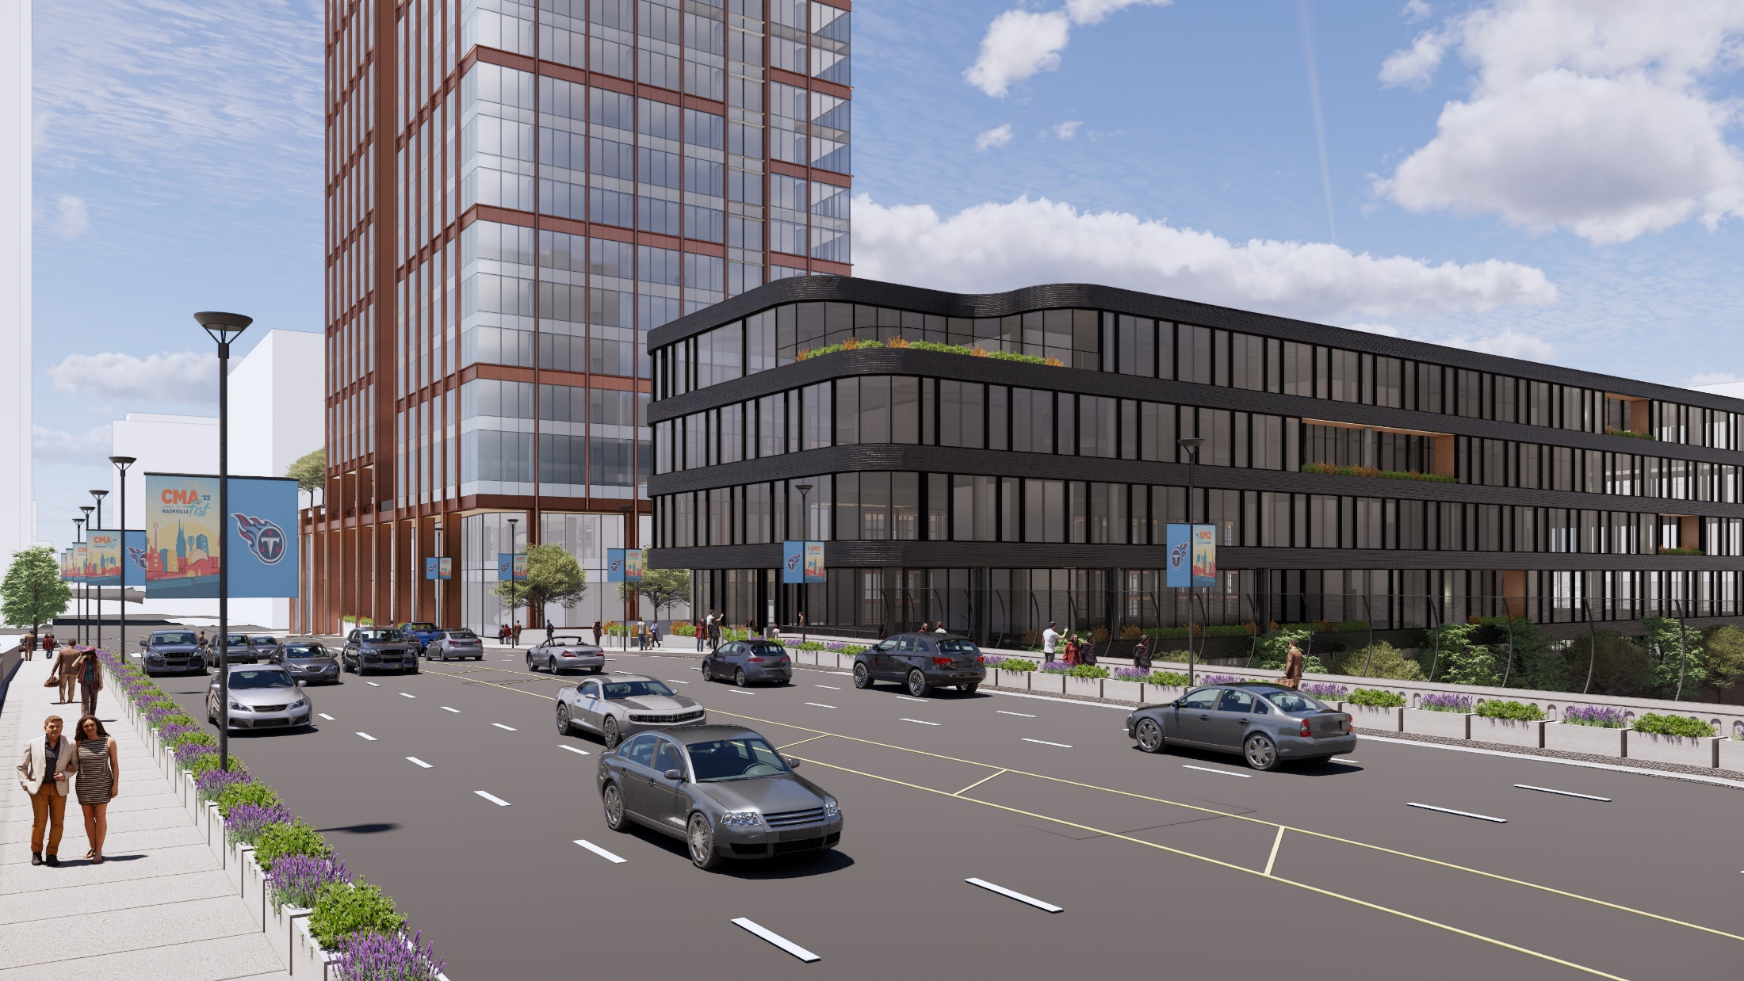

Slide 13
Stay Connected
Project Website
Email Newsletter Signup
Rebekah Hammonds Contact

Slide 14
Comments and Questions?
https://www.tn.gov/tdot/projects/region-3/nashville-broadway-viaduct.html

