Slide 1
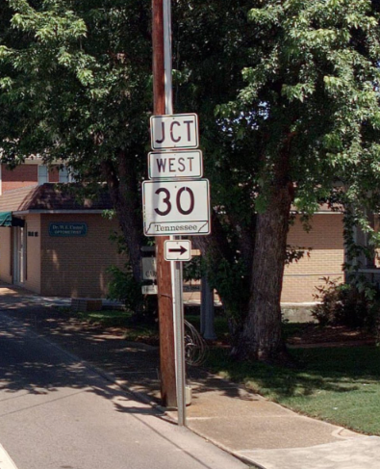

State Route 30 Improvements State Route (SR) 30 Roadway Improvements Project in Rhea County from near SR 29 (US-27) to west of New Union Road/White Oak Road PIN 109410.03
Public Meeting
November 18, 2025
Notes:
Hello, and welcome to the Public Meeting for the State Route 30 Roadway Improvements

Slide 2
Purpose of Tonight’s Public Meeting
To provide information on:
Project Overview
Purpose and Need
Range of Alternatives Under Consideration
Environmental Review
Project Schedule and Next Steps
To answer your questions and gather your feedback
Notes:
The purpose of this meeting is to provide information on the proposed project, the anticipated project schedule, the purpose and need for the proposed project, and the alternatives being considered. The purpose of this meeting is also to gather feedback from you about the proposed project.

Slide 3

Overview of the TDOT Project Development Process
Planning
2
Environmental
3
Design
4
Right-of-Way
5
Construction
Notes:
TDOT projects go through 5 phases during development:
Planning-this is first step in the development of a project. It is during this phase that the purpose and need for the project and potential solutions (alternatives) are identified
Environmental-after the purpose and need for the project and potential alternatives have been identified the alternatives are reviewed for their potential impacts on the natural and human environments. The proposed State Route 30 project is currently in this phase.
Design-upon completion of the environmental review process, the conceptual design of selected alternative is further refined and engineered.
Right-of-Way-during this phase, land necessary for construction of the project is acquired.
Construction-during this phase, the project is actually built.

Slide 4
Project Overview
Project Termini
Begin Project: Near State Route 29 (US-27)
End Project: West of New Union Road/White Oak Road
Project Length
Total project length: 3.26 miles
Notes:
The proposed project would begin near State Route 29, also known as US-27 and end West of New Union Road and White Oak Road. The total project length is 3.26 miles.

Slide 5
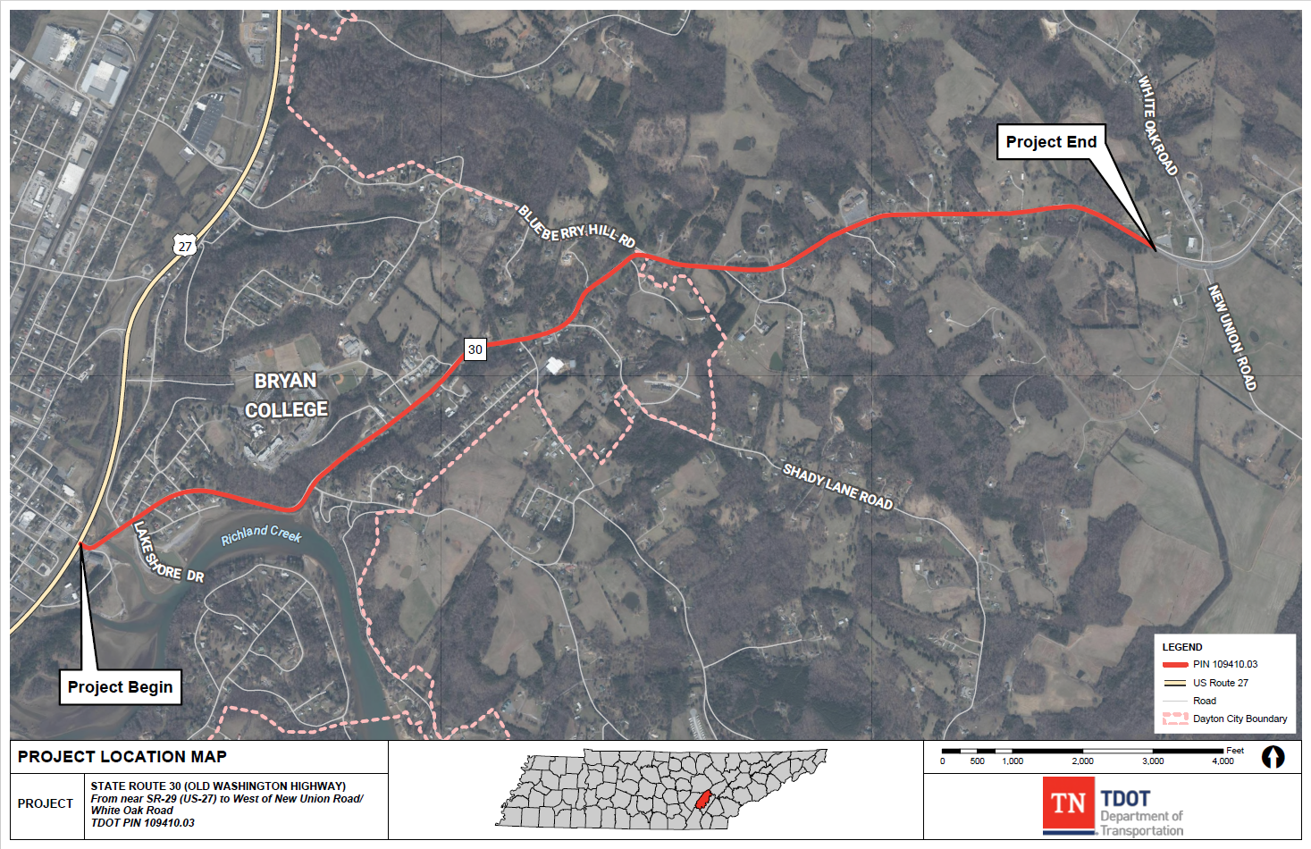
Project Location

Slide 6
Project History
2008 | TDOT Transportation Planning Report prepared for the SR-30 corridor from SR-29 to west of the Tennessee River.
2011 | Tennessee Environmental Streamlining Agreement (TESA) field reviews held and TDOT continues to evaluate the project for feasibility, constructability and to further revise the proposed project scope.
2016 | The original project is divided into four separate design segments. The proposed project is to evaluate Segment 3 (SR-30 from SR-29 to West of New Union/White Oak Road).
2024 | Project is included in the Transportation Modernization Act (TMA) as programmed project TDOT’s 10-Year Plan. TDOT begins to develop updated concept design for Segment 3.
2025 | Design Plans are in the preliminary engineering phase for Segment 3. TDOT initiates NEPA April 2025 with the intent to develop an Environmental Assessment (EA). The Federal Highway Administration (FHWA) and TDOT move the project forward as an EA based on anticipated number of relocations.
Notes:
The proposed State Route 30 project was initiated by TDOT in 2008. In 2011, the TN Environmental Streamlining Agreement (or TESA) conducted field reviews and TDOT continued to evaluate the project in order to revise the proposed project scope. As design of the project progressed the project was divided into four separate segments in 2016. In 2024, as design work on Segment 3 began, it became evident that a number of relocations would be needed. Because of those potential relocations identified within the preliminary engineering phase, TDOT initiated NEPA in April of 2025 with the intent to develop an EA.

Slide 7
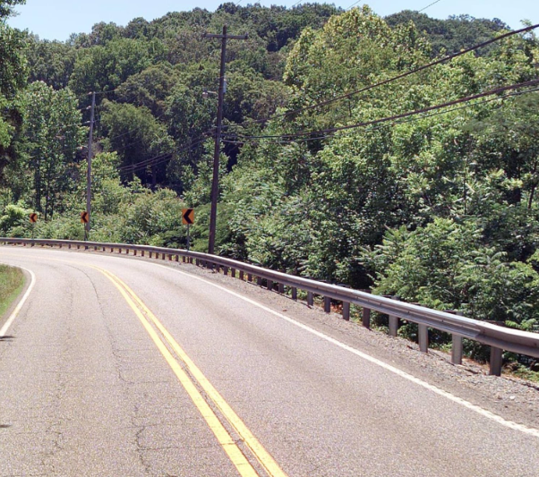
Preliminary Purpose and Need
Preliminary Need:
High severe crash rates;
Existing geometric deficiencies; and
Meet the legislative intent of the Improving Manufacturing, Public Roads, and Opportunities for a Vibrant Economy (IMPROVE) Act and the Transportation Modernization Act (TMA).
Preliminary Purpose:
Reduce the high severe crash rate;
Correct geometric deficiencies to satisfy current TDOT design standards; and
Meet the legislative intent of the IMPROVE Act and the TMA.
Notes:
Initial studies indicate that the percentage of suspected serious injury crashes along State Route 30 in the project area is greater than the state-wide percentage. State Route 30 also has geometric deficiencies that need correction.
The purpose of the proposed project is to reduce the severity of crashes and improve the roadway to meet current design standards.

Slide 8
Alternatives Being Evaluated in the Environmental Assessment
No-Build Alternative
Preserve the existing roadway configuration except for routine safety and maintenance upgrades and other programmed improvements.
Build Alternative
From near SR-29 (US-27) to Mulberry Ave.: Include two 11-foot travel lanes (one in each direction), a 12-foot center turn lane, curb and gutter, and a 10-foot multi-use path with a 2.5-foot grass strip on both sides of the roadway.
From Mulberry Ave. to west of Union Road/White Oak Road: Include two 11-foot travel lanes (one in each direction), a zero to 12-foot left turn lane, and six-foot shoulders (four foot paved), with guardrails where needed. The intersection at Blueberry Hill Rd. will include 12-foot turn lanes.
Notes:
There are two alternatives are currently being evaluated in the EA.
In accordance with regulations, the No-Build Alternative has been retained for detailed study and serves as a benchmark for comparison with the Build Alternative.
The No-Build Alternative would keep State Route 30 as it currently is except for any modifications identified in TDOT’s 25-Year Long Range Transportation Policy Plan, the State Transportation Improvement Program (STIP), and TDOT’s 10-Year Project Plan. It would allow for routine maintenance and safety upgrades.
The Build Alternative from near SR29 to Mulberry Ave. would include two 11-foot travel lanes, a 12-foot center turn lane, curb and gutter and a 10-foot multi-use path with a 2-and-a-half-foot grass strip on both sides of the roadway. From Mulberry Ave to west of Union/White Oak Rd would include two 11-foot travel lanes, a zero to 12 foot left turn land and six foot shoulders with guardrails where needed. The intersection at Blueberry Hill Rd. will include 12-ft turn lanes.

Slide 9
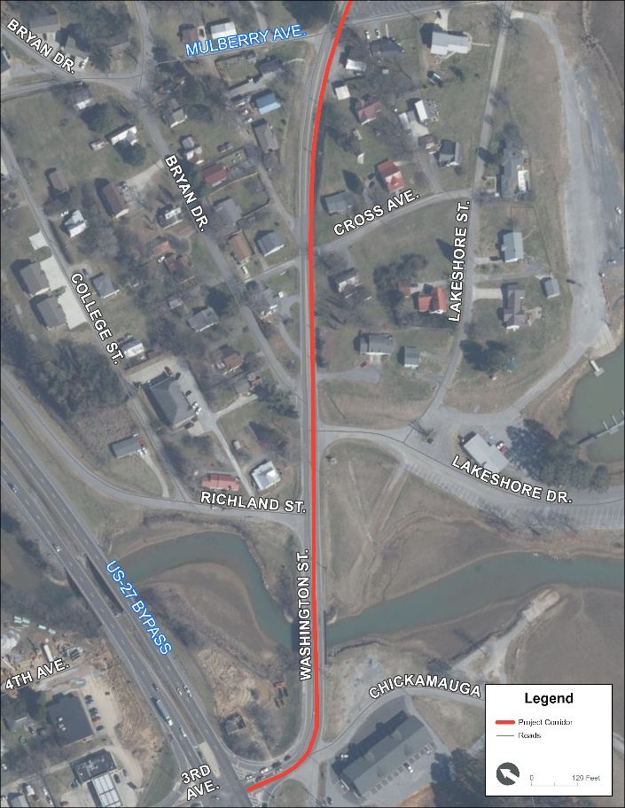
Alternatives Being Evaluated in the Environmental Assessment
Build Alternative:
From near SR-29 (US-27) to Mulberry Avenue:
Would include two 11-foot travel lanes (one in each direction), and a12-foot center turn lane, curb and gutter, and a 10-foot multi-use path with a 2.5 foot grass strip on both sides of the roadway.
Graphic Here
Notes:
The Build Alternative Would include two 11-foot travel lanes and a12-foot center turn lane, curb and gutter, and a 10-foot multi-use path with a 2.5 foot grass strip on both sides of the roadway from near SR-29 to Mulberry Ave.

Slide 10
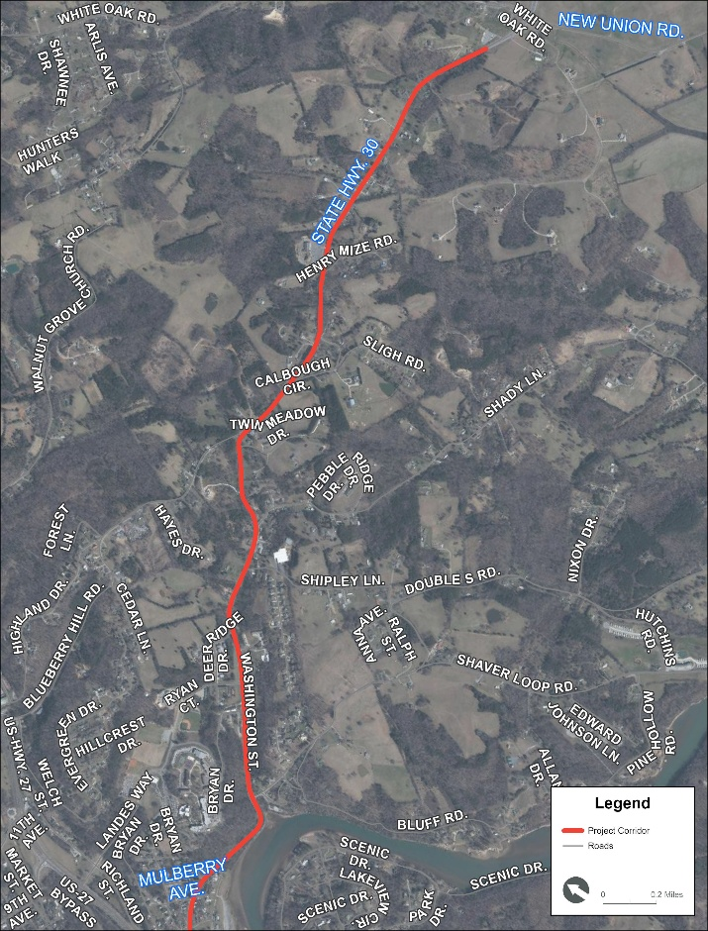
Alternatives Being Evaluated in the Environmental Assessment
Build Alternative:
From Mulberry Avenue to west of Union Road/White Oak Road:
Would include two 11-foot travel lanes (one in each direction),and 6-foot shoulders (four foot paved), with guardrails where needed.
The intersection at Blueberry Hill Rd will include 12-foot turn lanes.
Notes:
The Build Alternative Would include two 11-foot travel lanes , and 6-foot shoulders, with guardrails where needed, while the intersection at Blueberry Hill Rd will include 12-foot turn lanes from From Mulberry Avenue to west of Union Road/White Oak Road

Slide 11
Resources Analyzed in an Environmental Assessment
Land Use, Farmland, and Transportation
Socioeconomic Impacts
Community
Economic
Relocations
Cultural resources/Section 106 Resources
Historic and Archaeological Resources
Native American Consultation
Floodplains
Natural Resources
Streams and wetlands
Threatened and endangered species
Public Recreational Resources
Section 4(f)
Section 6(f)
Air quality and Noise
Hazardous materials
Visual resources
Notes:
As part of the EA, potential impacts of the proposed project on a number of environmental and human resources will be analyzed. The results of these studies will be presented in the EA.

Slide 12
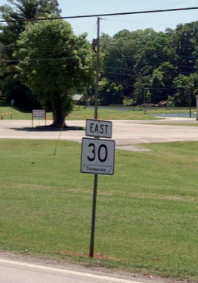
Next Steps
NEPA
Complete environmental technical studies and draft the EA.
Future Public Engagement
To further engage the public, following FHWA approval of the EA, TDOT will:
Make the approved EA available for public review (including the results of all technical studies).
Hold a public hearing to present the findings of the environmental technical studies.
Invite feedback and comments from the public on the EA.
Notes:
The next step in the project development process is to complete the technical studies and prepare the EA. Once the EA is completed, it will be made available for public review. TDOT will hold a public hearing to present the findings and will invite feedback and comments from the public.

Slide 13
Anticipated Schedule
Initial Early Coordination
Quarter 3 of 2025
Conduct Technical Studies
Through Quarter 4 of 2025
Public Meeting
November 18, 2025
Environmental Assessment Approval/ Notice of Availability
Quarter 1 of 2026
Hold Public NEPA Hearing
Quarter 2 of 2026
Approval of Final Environmental Document/Selection of Preferred Alternative*
Quarter 4 of 2026
Right-of-Way Acquisition Phase
FY 2027
Construction Phase
FY 2030
Quarter 1: January through March Quarter 2: April through June Quarter 3: July through September Quarter 4: October through December *Once the final environmental document is approved by FHWA, the Planning and Environmental Phase is complete
Notes:
Based on the current schedule, approval of the EA and the public hearing for it are anticipated to occur in quarter 1 and quarter 2 of 2026. Approval of the final environmental document and identification of the selected alternative is anticipated to start in quarter 4 of 2026. Please note that these dates are subject to change. The ROW phase is scheduled to start in FY 2027 and Construction is scheduled to begin in FY 2030.

Slide 14
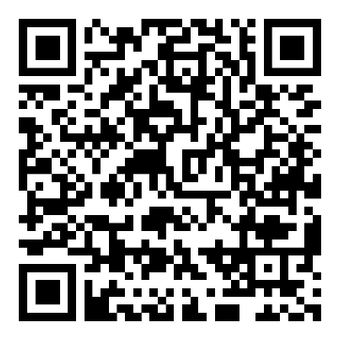
How to Submit Comments
By Comment Card:
Drop in the box or send by mail to:
NEPA Public Meeting
Attn: SR-30 Project
Tennessee Department of Transportation
Suite 700, James K. Polk Building
505 Deaderick Street
Nashville, TN 37243-0332
By Phone:
615-253-5163
By Email: TDOT.comments@tn.gov use the subject line State Route 30 Project
Online:
https://www.tn.gov/tdot/projects/region-2/state-route-30.html or by scanning the QR code:
Public comments received or postmarked by December 9, 2025, will be included in the official summary of the public meeting.
Notes:
TDOT would like to hear from you about the proposed project. There are several ways to submit your comments.
You can complete the comment card that you received at this meeting and drop it in the box at the sign-in table.
You can mail your comment card or letter to the address on the screen-please make sure that it is post marked by December 9, 2025 to be included in the official summary of the public meeting.

Slide 15
Right-of-Way Acquisition
The Tennessee Department of Transportation (TDOT) follows a federally mandated process to acquire property, which includes:
Notice to property owners
Independent Third-Party Conducted Appraisals
Fair Market Value offered for proposed acquisitions
Relocation Assistance Program for eligible affected property owners
Full details of TDOT’s Right-of-Way Acquisition process can be found in the TDOT ROW Manual at: www.tn.gov/content/dam/tn/tdot/right-of-way-division/ROW_Procedures_Manual.pdf
If you have a question regarding the TDOT Right-of-Way Acquisition and Relocation process, speak to a TDOT ROW Representative tonight or contact:
Brad Scott
TDOT Region 2
Email: Brad.Scott@tn.gov
Phone: 423-510-1227
Notes:
TDOT follows a federally mandated process for acquiring property. Full details on TDOT’s right-of-way acquisition process can be found at the internet address on the screen. If you have questions about the right-of-way process speak to one of the TDOT right-of-way representatives here tonight or contact Brad Scott.

Slide 16
For More Information
Ms. Erin Woodson
TDOT Region 2 Project Manager
Erin.Woodson@tn.gov
423-510-1227
Mr. Erick Hunt-Hawkins
TDOT NEPA Team Lead
Erick.Hunt-Hawkins@tn.gov
615-253-5163
Notes:
For more information on the project contact Ms. Erin Woodson, the TDOT project manager. For questions about the environmental process contact Mr. Erick Hunt-Hawkins.

