Slide 1
SR 8 / US 127 (Signal Mountain Boulevard)
Public Informational Meeting
Joe Deering
TDOT Region 2
Assistant Chief Engineer
Fritz Brogdon
Arcadis
Project Engineer
Rae Anne Bradley
TDOT Region 2
Community Relations Officer
August 25, 2022

Slide 2
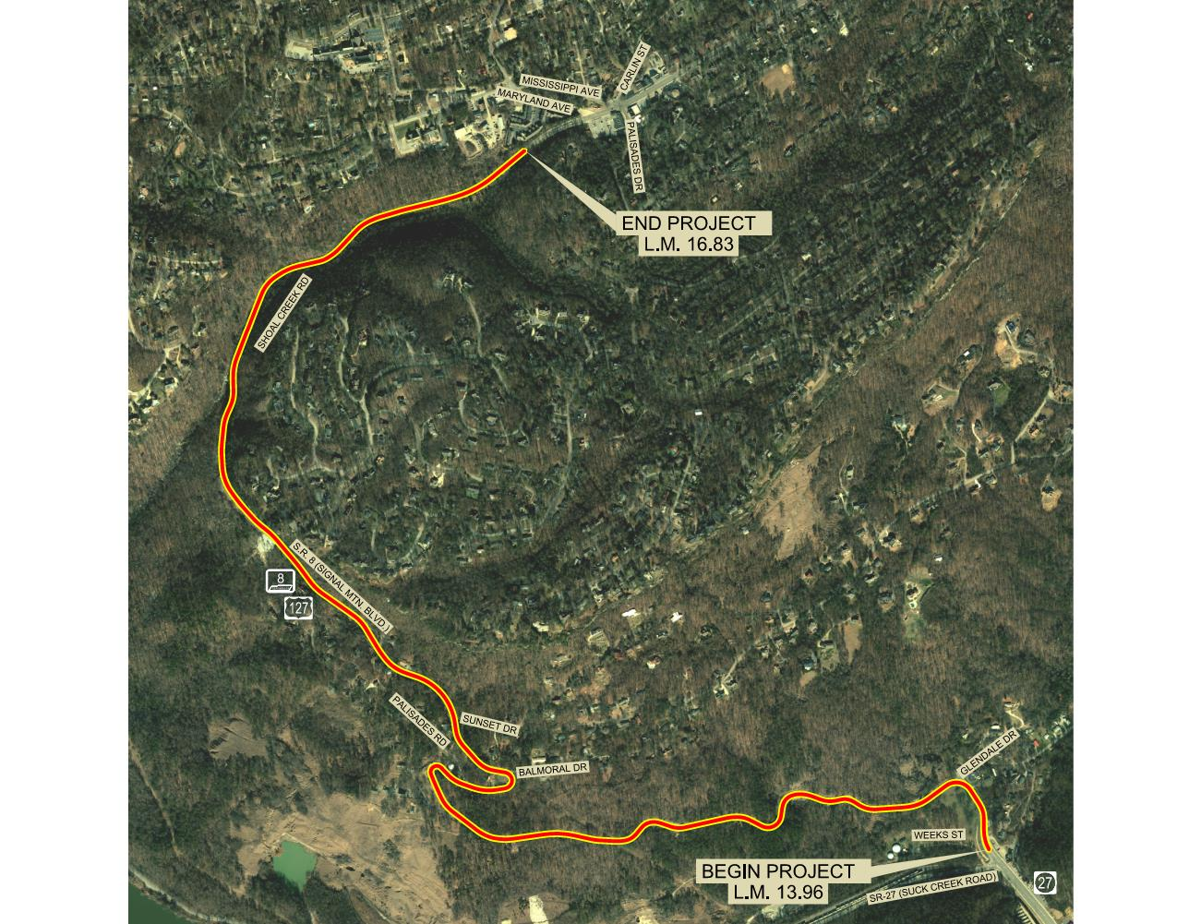
Project Area
Approximately 2.85 Miles
Speed Limit – 30 to 40 mph
Mountainous Topography
Urban Minor Arterial
11’ Lane Widths
2’ Shoulders
3-lane & 2-lane sections
NEED UPDATED MAP

Slide 3
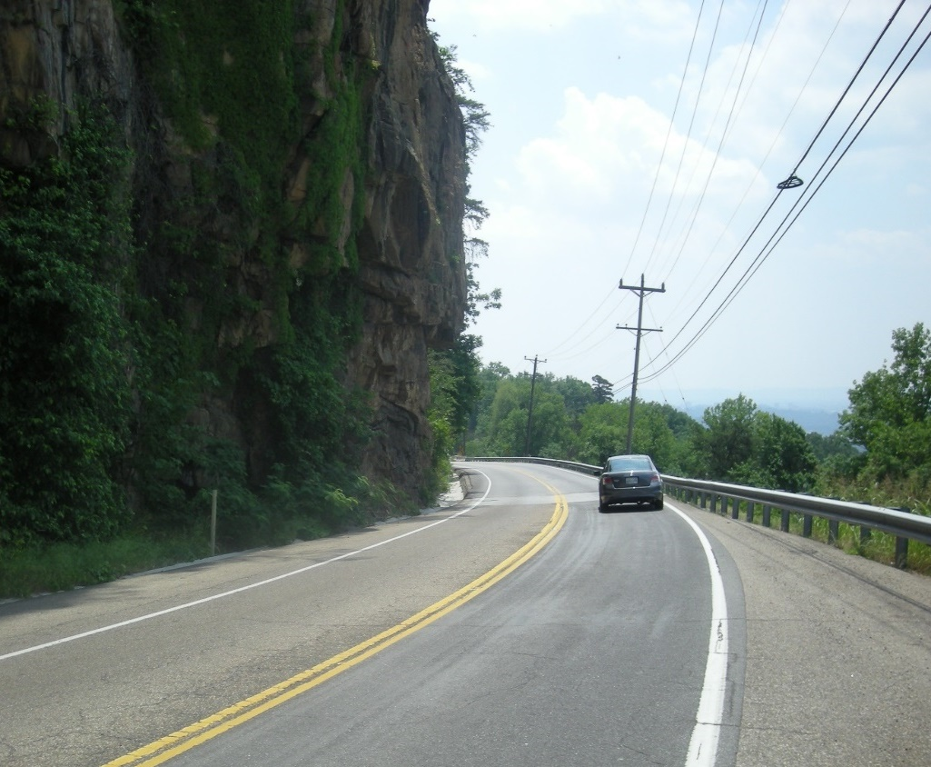
Purpose & Need
Improve Safety
Improve Reliability
Reduce Potential Roadway Failures
Improve Drainage

Slide 4
Project History
2018
SR 8 Rock Slide
Slope Stabilization Projects (2)
TDOT Updated Technical Report
2019
Slope Repair/ Retaining Wall Project (Design)
IMPROVE Act Project (Design)
Slope Stabilization Project (1)
2020
Slope Stabilization Project (1)
2022
2026
Slope Stabilization Project Let for Construction
IMPROVE Act Project (ROW Acquisition)
IMPROVE Act Project scheduled to Let for Construction

Slide 5
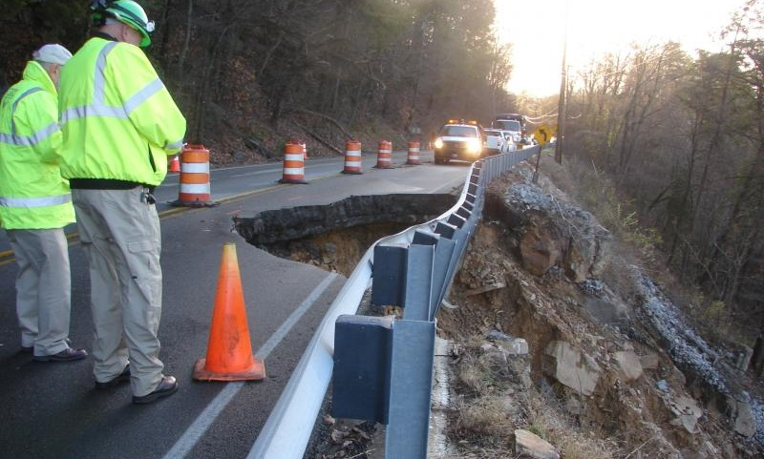
Project History – Rock Slides

Slide 6
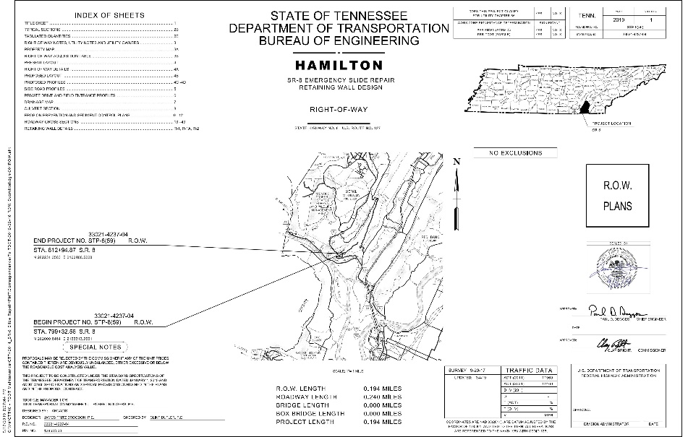
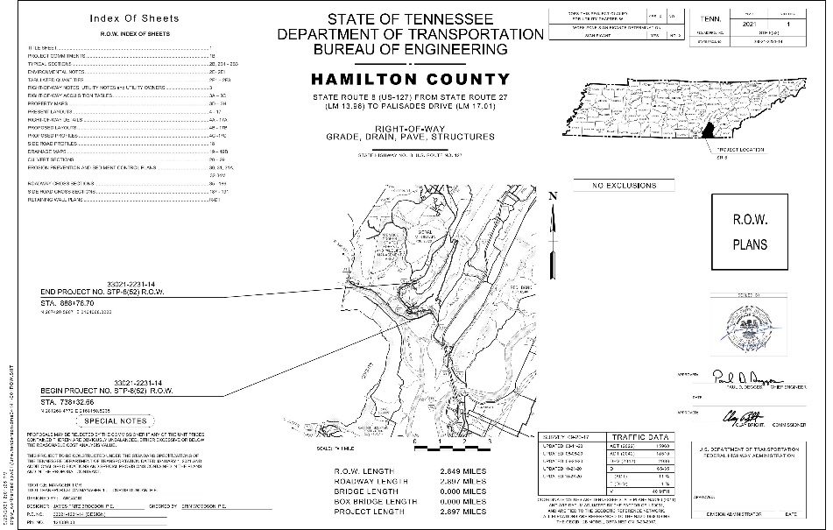
Current Projects
Slope Repair/ Retaining Wall
IMPROVE Act Project

Slide 7
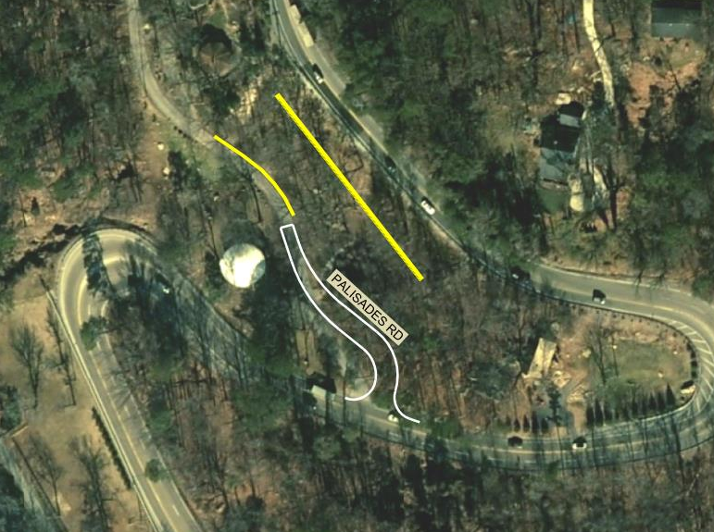
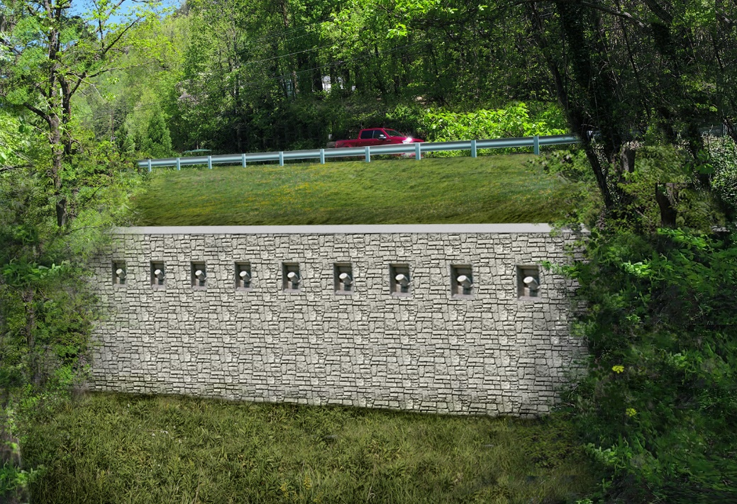
Slope Repair / Retaining Wall

Slide 8

IMPROVE Act Design Timeline
Preliminary Engineering Funding Approved – August 2017
Survey Complete – August 2018
Planning Document – Summer 2019
  Public Informational Meeting
Preliminary Plans – Summer 2020
Right-of-Way plans have been issued
  ROW Meeting Fall 2022
Public Information Meeting – August 2022
Construction Start – 2026

Slide 9
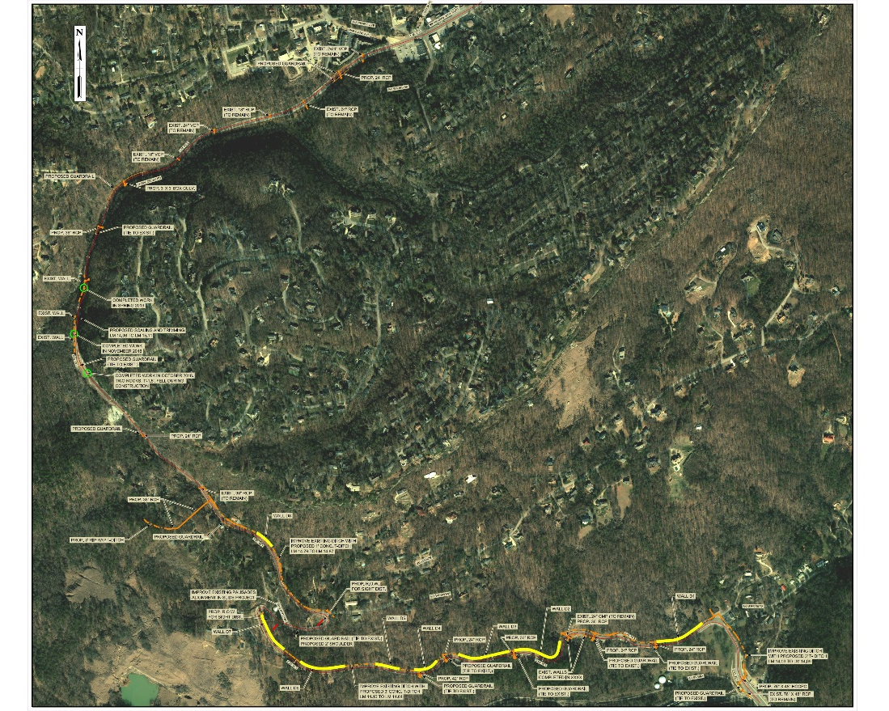
IMPROVE Act Project
Safety and Reliability Improvements
  Eight (8) Retaining Walls for Slope Stability/Drainage
  Proposed Drainage Improvements
  Proposed Right-of-Way at L.M. 15.3 for Sight Distance Improvements
  Rockfall Mitigation

Slide 10
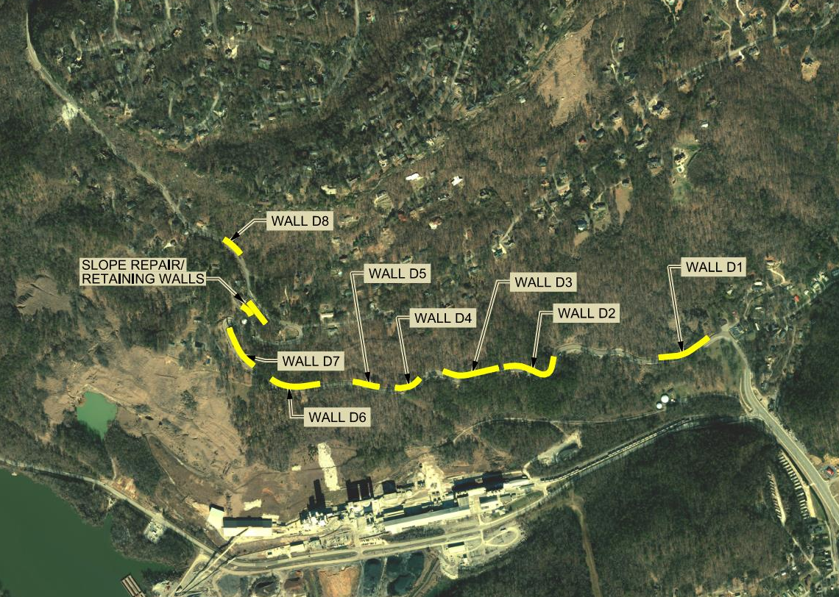
IMPROVE Act Project
Eight (8) Retaining Walls
  Wall D1 (L.M. 14.2)
  Wall D2 (L.M. 14.5)
  Wall D3 (L.M. 14.6)
  Wall D4 (L.M. 14.75)
  Wall D5 (L.M. 14.8)
  Wall D6 (L.M. 14.95)
  Wall D7 (L.M. 15.05)
  Wall D8 (L.M. 15.5)

Slide 11
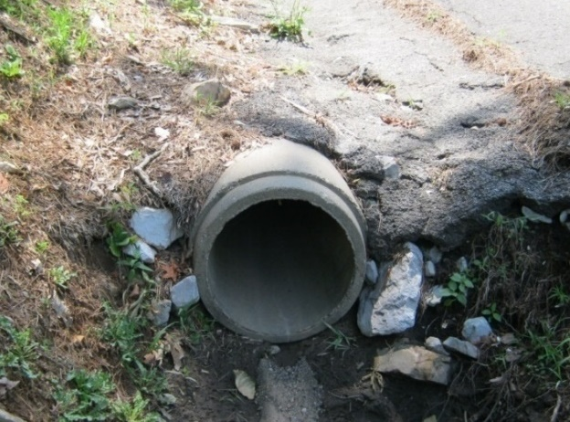
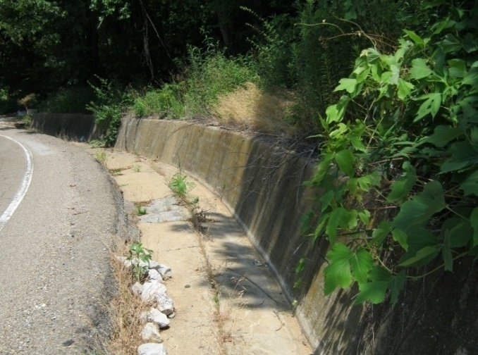
IMPROVE Act Project
Drainage Improvements
  Culvert Upgrades
  Ditch Improvements
  Additional Features at Critical Locations

Slide 12
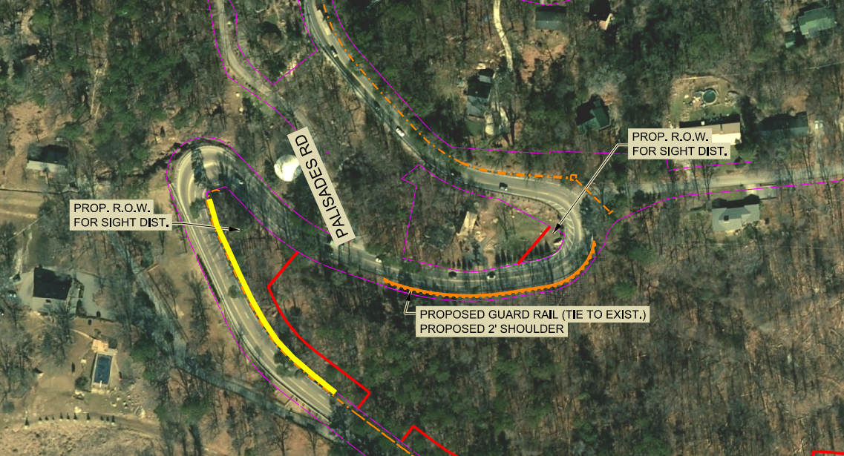
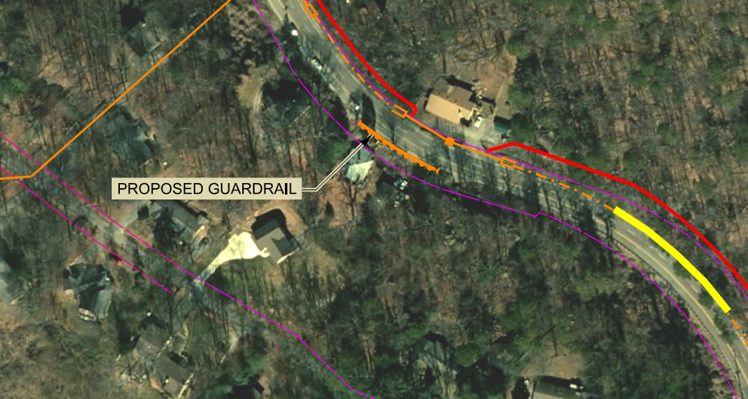
IMPROVE Act Project
Safety and Reliability Improvements
  Proposed ROW to Keep Trees Trimmed and Improve Sight Distance
  Guardrail
    L.M. 15.6

Slide 13
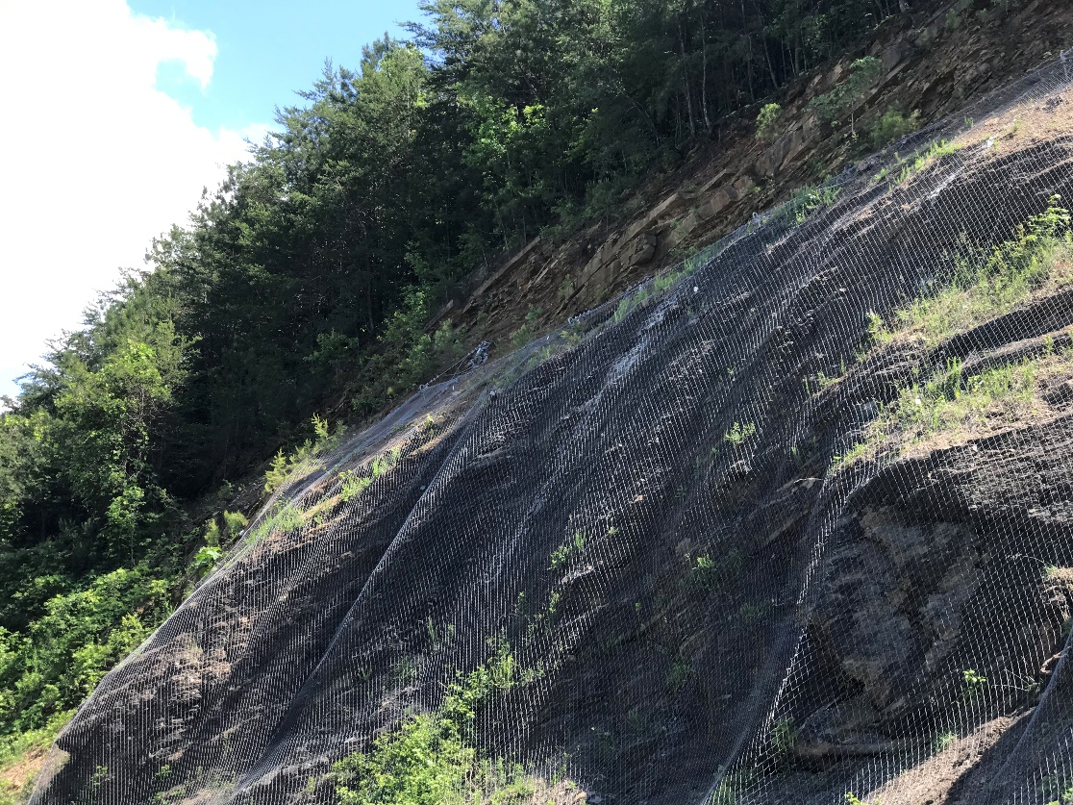
Rockfall Mitigation
Potential Areas Have Been Identified and Assessed
Improvements Include:
Scaling and Trimming
Slope Drapes

Slide 14
TDOT Commitments
No Closures during the World’s Longest Yard Sale
Coordination with Responders and Local Route Users During Planned Closures
Minimize Duration of Construction

Slide 15
Comments
Your comments are important to us!
  Email: TDOT.Comments@tn.gov
  Re: US-127/SR-8 Hamilton County Project
  Submit or mail-in comment cards
  Provide verbal comments to the court reporter

