Slide 1

Interstate 24
From Near I-59 to Near US-27
Dade County, GA & Hamilton County, TN
PIN 124072.00
July 2025

Slide 2





Design and NEPA Public Meeting
To provide information and gather feedback on:
Project
Status
Project
Schedule
Purpose
and Need
Alternatives
Considered
NEPA Review

Slide 3

TDOT Project Development Process
  Planning
2
  Environmental
3
  Design
4
  Right-of-Way
5
  Construction

Slide 4
I-24 Project Background
2012-14
I-24 Multimodal Corridor Study - identifies capacity project location
2017
  IMPROVE Act - state highway fund revenue increased
2018
Technical report - critical corridor; add lane
2023
Transportation Modernization Act (TMA) passes; increased funding
2024
TDOT 10-Year Project Plan - priority investment project

Slide 5
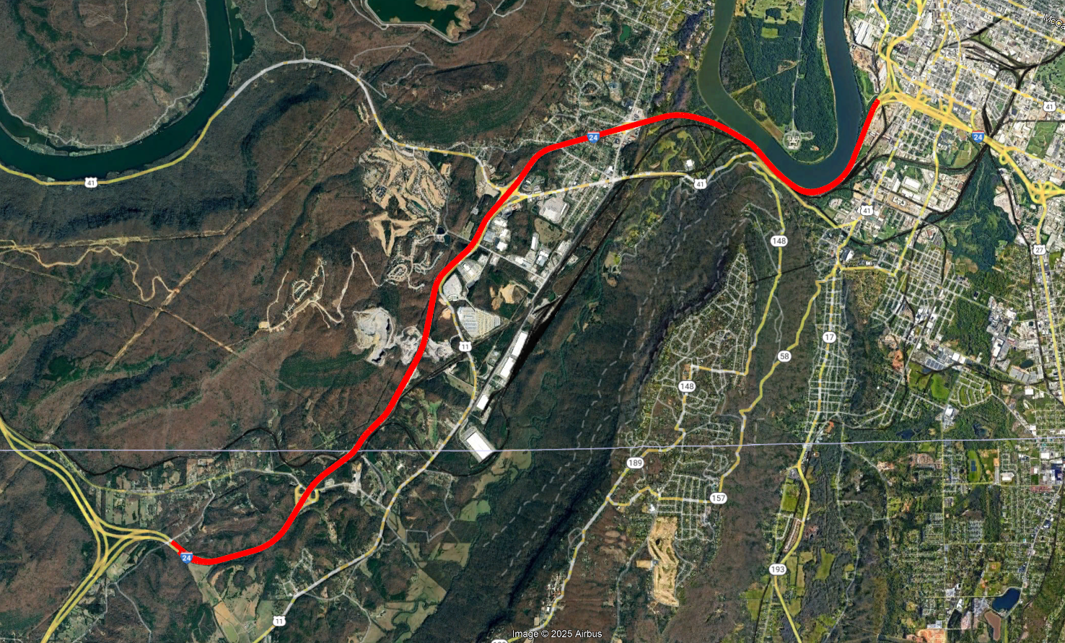



Project Location
Project End
N
Project Begin

Slide 6
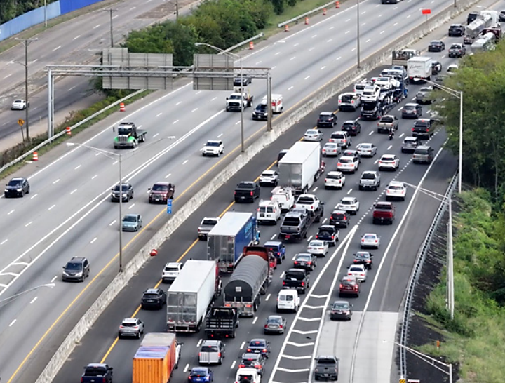
Preliminary Project Purpose and Need
PRELIMINARY NEED
  Operating at/near capacity
  Fair/poor bridge conditions
PRELIMINARY PURPOSE
  Reduce congestion
  Improve traffic operations
  Meet TDOT structural design standards
Notes:
Secondary benefits include:
Replacement and improvement of bridges
Improvement of Freight Movement

Slide 7
Alternatives Considered
  Two alternatives are currently being evaluated in the EA:
  No-Build Alternative
  Build Alternative
NO-BUILD
  In accordance with regulations, the No-Build Alternative has been retained for detailed study and serves as a benchmark for comparison with the Build Alternative.
  Would retain the existing roadway configuration except for any modifications identified in TDOT’s 25-Year Long Range Transportation Policy Plan, State Transportation Improvement Program (STIP), and the TDOT 10-Year Project Plan.​
  Would allow for routine maintenance
  Possible upgrades with other nearby projects
Notes:
12-foot shoulders
Segments 1 and 2 widen toward the existing median
Segment 3 widen towards the south
Guardrails and barrier walls
Segment 3 includes a retaining wall along the eastbound edge of the outside shoulder

Slide 8
Alternatives Considered
BUILD ALTERNATIVE
  Widen from 4-lanes to 6-lanes (three 12-foot travel lanes in each direction with a variable median and 12-foot outside shoulders)
  Guardrails, barrier walls, and retaining walls added as needed
  Replace twelve bridges (TN)
  Replace two bridges (GA)

Slide 9
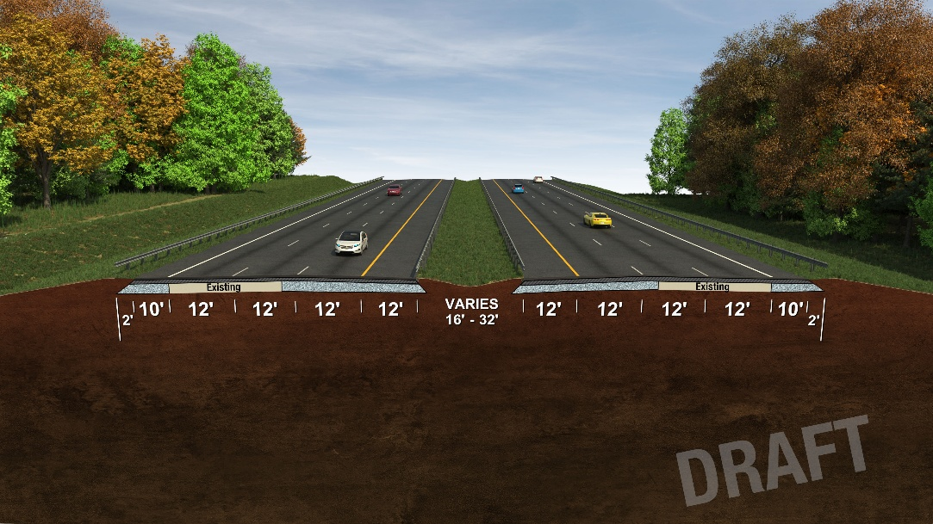
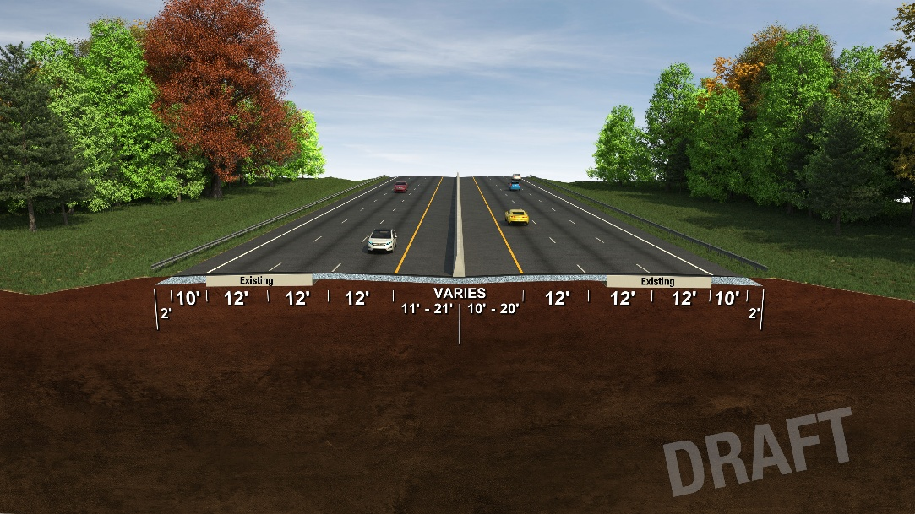
Build Alternative Typical Sections
Notes:
12-foot shoulders
Segments 1 and 2 widen toward the existing median
Segment 3 widen towards the south
Guardrails and barrier walls
Segment 3 includes a retaining wall along the eastbound edge of the outside shoulder

Slide 10
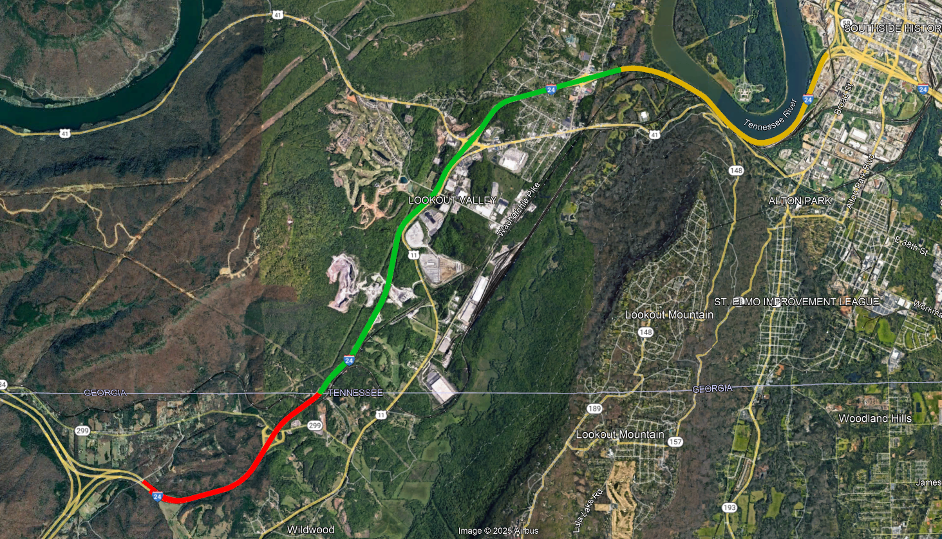
Design Elements
Project End
Three segments
Minimal right-of-way & no relocations anticipated
Alignment alterations - none
Segment 3
From East of Browns Ferry Road
To Near I-124 (US-27)
Segment 2
From TN/GA State Line
To East of Browns Ferry Road
Segment 1
From Near I-59
To TN/GA State Line
Project Begin
Notes:
Three segments
1 awaiting funding
2 & 3 future funding
Constructed in reverse order

Slide 11

Design Elements
Browns Ferry Rd
Project End
2 bridges to be replaced (GA )
12 bridges to be replaced (TN)
  INDICATES 2 BRIDGES
  PER LOCATION
Kellys Ferry Rd
US-41 Interchange
Lookout Creek
Cummings Rd
Chattanooga Creek
CSX Railroad
Project Begin
Notes:
Widen from 4-lanes to 6-lanes
Include 12-foot shoulders
Segments 1 and 2 widen toward the existing median
Segment 3 widen towards the south
Add guardrails and barrier walls
Segment 3 includes a retaining wall along the eastbound edge of the outside shoulder
Replace twelve bridges (TN)
Widen two bridges (GA)

Slide 12
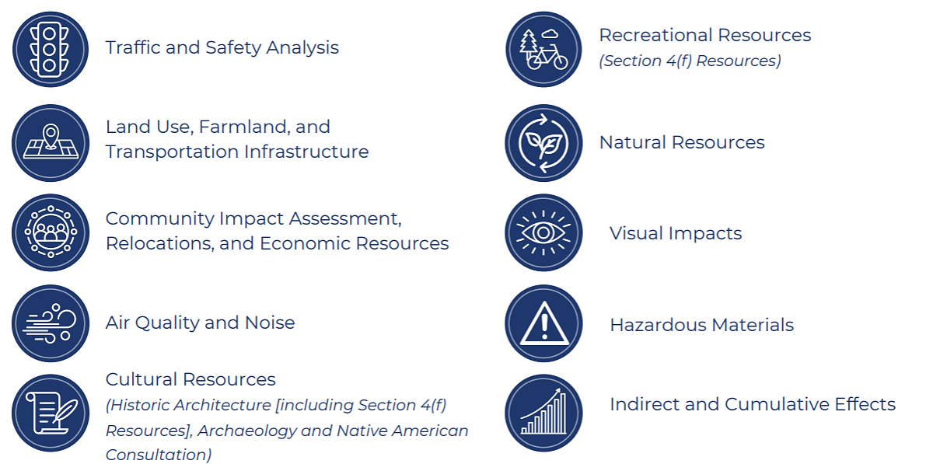
Resources Analyzed in an Environmental Assessment
Examples of technical studies underway as part of the environmental review:
  Traffic and Safety Analysis
  Air Quality and Noise
  Natural Resources
  Land Use, Farmland, and Transportation Infrastructure
  Cultural Resources
  Visual Impacts
  Social and Economic Resources
  Recreational Resources
  Hazardous Materials
Notes:
Cultural Resources includes:
Historic Architecture (including Section 4(f) Resources)
Archaeology
Native American Consultation
Recreation Resources includes Section 4(f) Resources

Slide 13
Anticipated Project Schedule
ACTIVITY
PROPOSED TIMELINE
Initiate Early Coordination
2024
Design & NEPA Public Meeting
July 2025
Preliminary Design
Next few months
Environmental Assessment (EA)
Late 2025/Early 2026
Public Hearings
Early 2026
Approved EA/Anticipated Finding of No Significant Impact
Early/Mid 2026
Right-of-Way
Late 2026
Note: Dates are subject to change.
Construction
2027

Slide 14
Next Steps
National Environmental Policy Act (NEPA)
  Complete environmental technical studies & EA
Future Public Engagement:
  To further engage the public, following FHWA approval of the EA, TDOT will:
    Make the approved EA available for public review (including the results of all technical studies).
    Hold a public hearing to present the findings of the environmental technical studies and the recommended Preferred Alternative.
    Invite feedback and comment from the public on the results of the EA.
Notes:
The National Environmental Policy Act (NEPA) was signed into law on January 1, 1970. NEPA requires federal agencies to assess the environmental effects of their proposed actions prior to making decisions. The range of actions covered by NEPA is broad and includes:
making decisions on permit applications,
adopting federal land management actions, and
constructing highways and other publicly-owned facilities.

Slide 15
Right-Of-Way Acquisition
TDOT will provide advance notification of proposed right-of-way acquisition.
TDOT follows a federally mandated process to acquire property, which includes:​
Notice to property owners​
Independent Third-Party Conducted Appraisals​
Fair Market Value offered for proposed acquisitions​
Relocation Assistance Program for eligible affected property owners​
Full details of TDOT’s Right-of-Way Acquisition process can be found in the ​ TDOT ROW Manual at:​ www.tn.gov/content/dam/tn/tdot/right-of-way-division/ROW_Procedures_Manual.pdf​
If you have a question regarding the TDOT Right-of-Way Acquisition process, contact:
Brad Scott
Regional ROW Manager
Email: brad.scott@tn.gov​
Phone: 423.510.1238

Slide 16




Your Comments are Important
Speak with a TDOT representative during this meeting or fill out a comment card
Email:
TDOT.Comments@tn.gov
with “TDOT I-24 Chattanooga Improvements Feedback” in the subject line
Make a verbal comment by calling:
1-855-925-2801
+ code 11638
Mail:
TDOT Project Comments
505 Deaderick Street
Suite 700, James K. Polk Building
Nashville, Tennessee 37243-033
Comments received by August 1, 2025, will be included in the official summary for this project.
Notes:
Received or postmarked deadline:
July 31, 2025

Slide 17

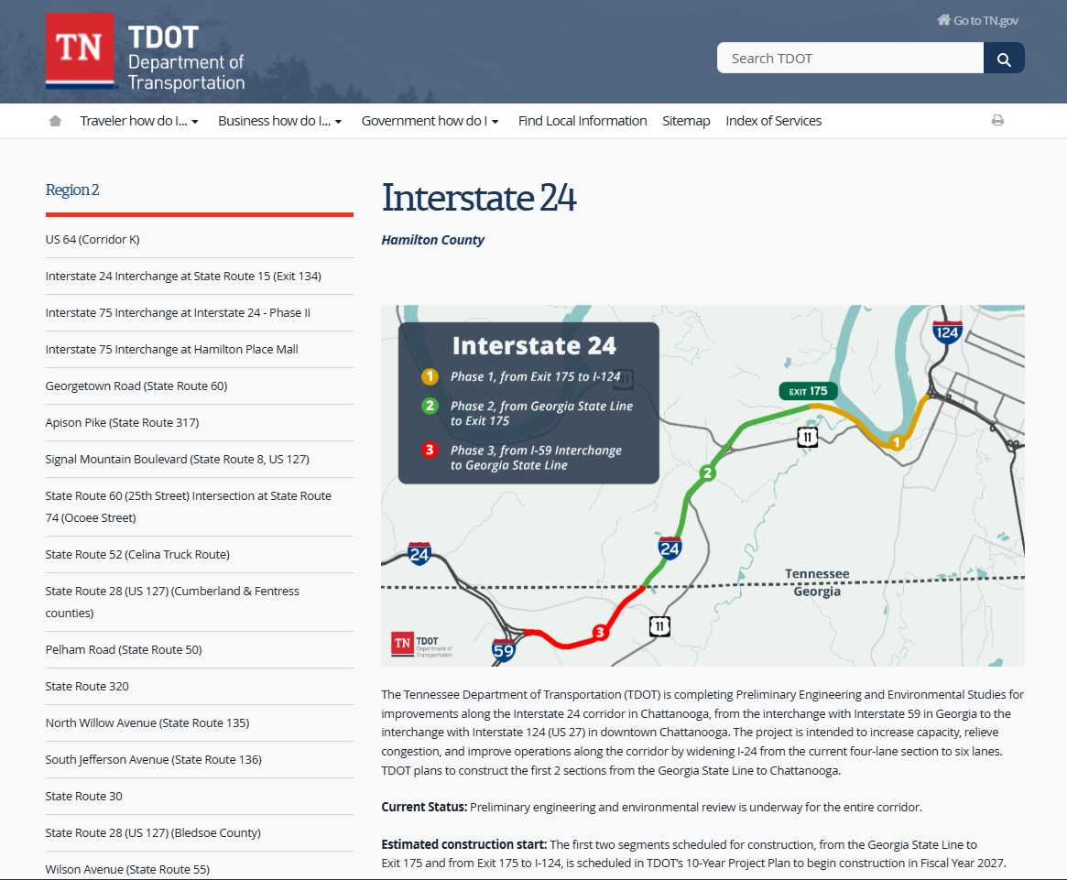
Visit the Project Website
Notes:
Fillable comment card on website??

Slide 18
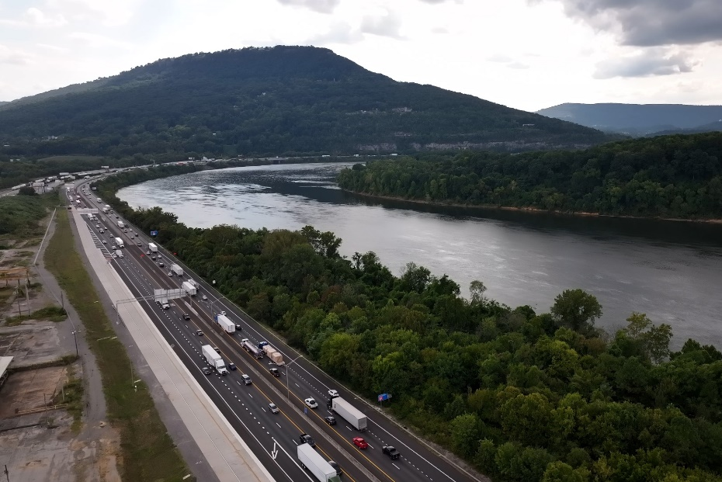


Thank You
PROJECT CONTACT:
Mr. Michael O’Donnell
TDOT Region 2 Project Management
Email: Michael.Odonnell@tn.gov
Phone: (423) 634-8622

