Slide 1
2024 TDOT Local Programs
Construction Phase Overview

Slide 2
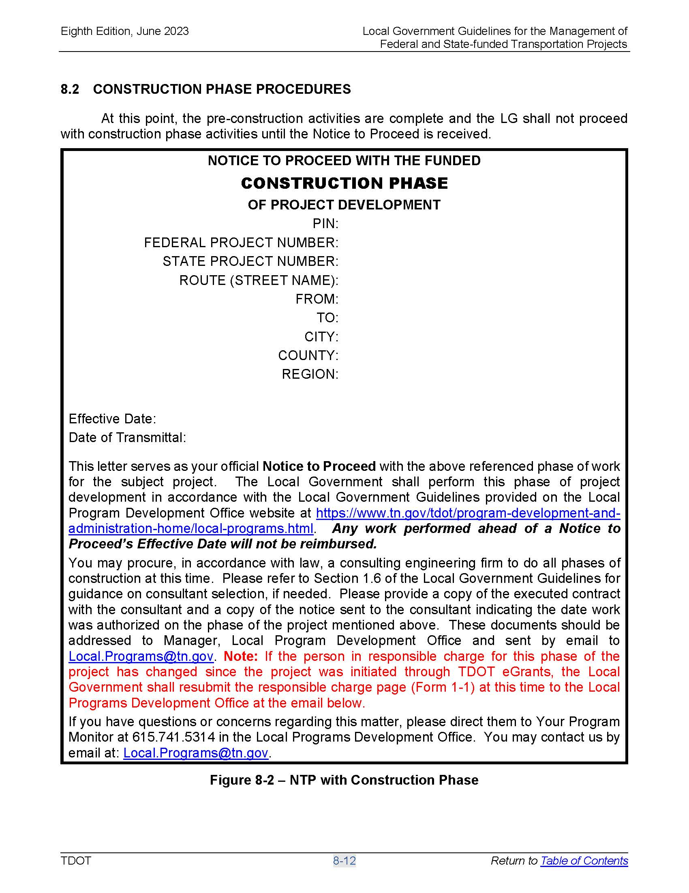
Important TDOT Approval Documents
Notice to Proceed with Construction Phase

Slide 3
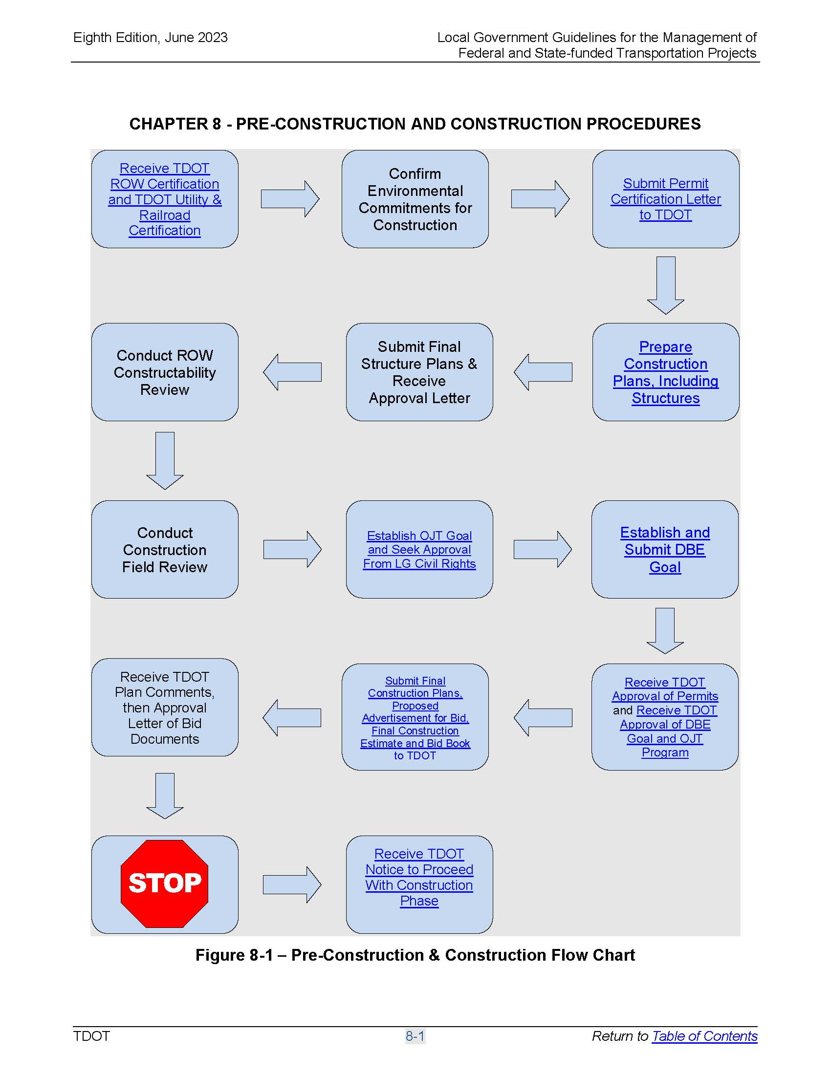
Pre-Construction and
Construction Procedures

Slide 4
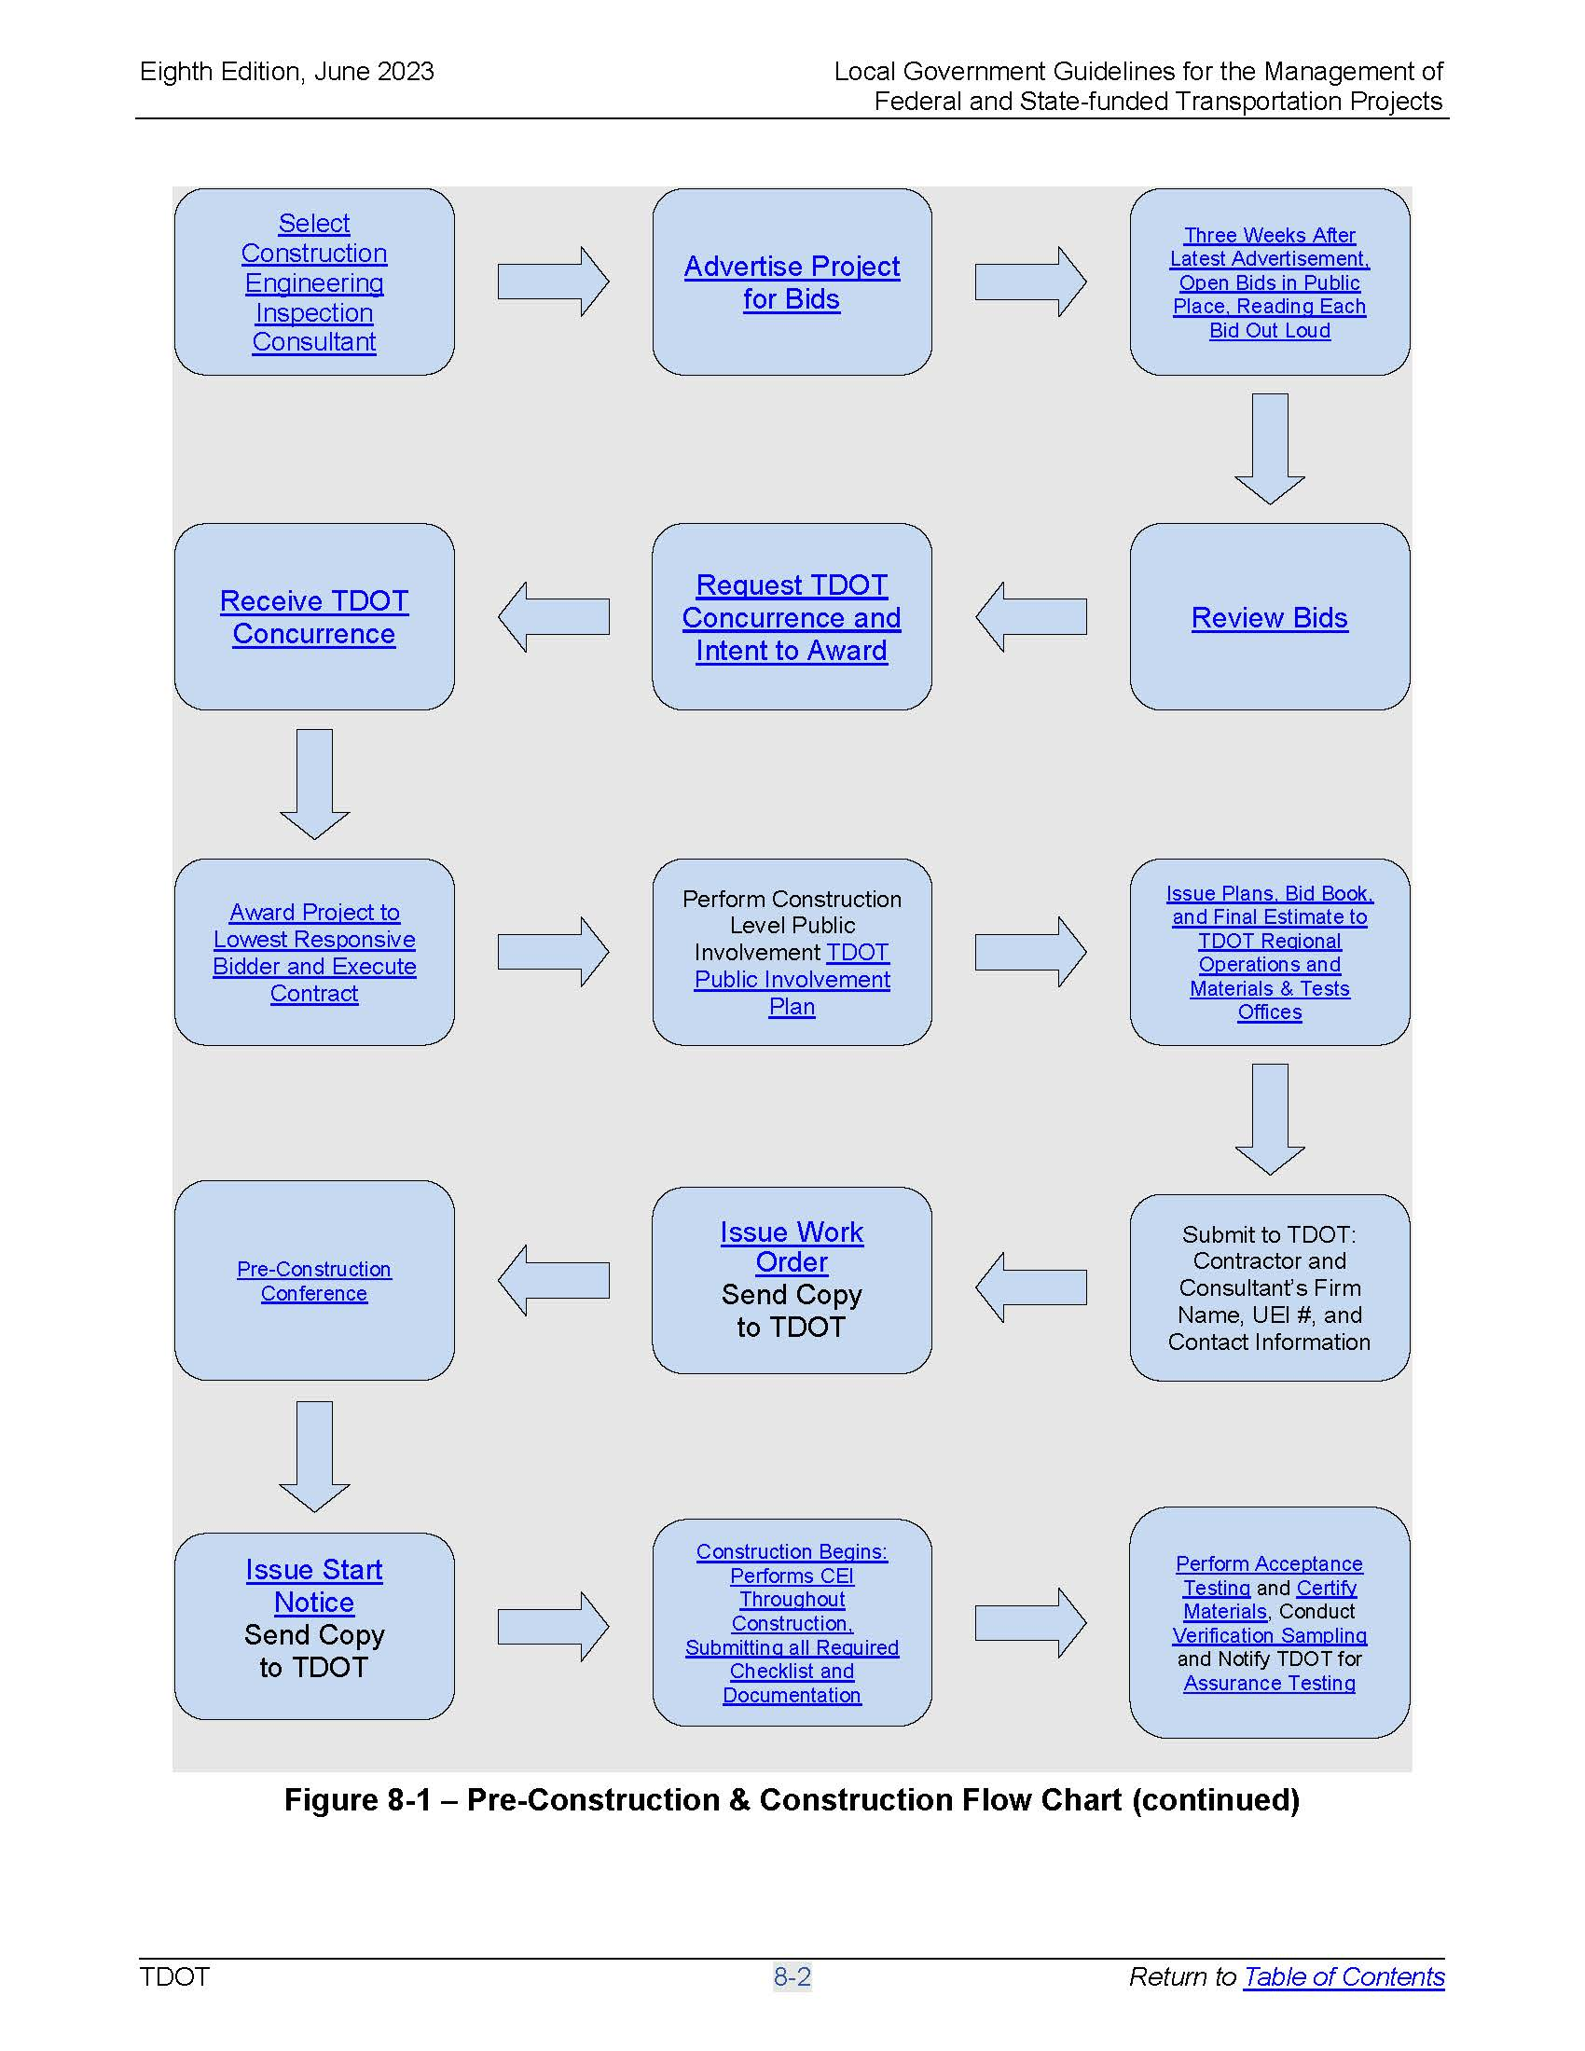
Pre-Construction and
Construction Procedures

Slide 5
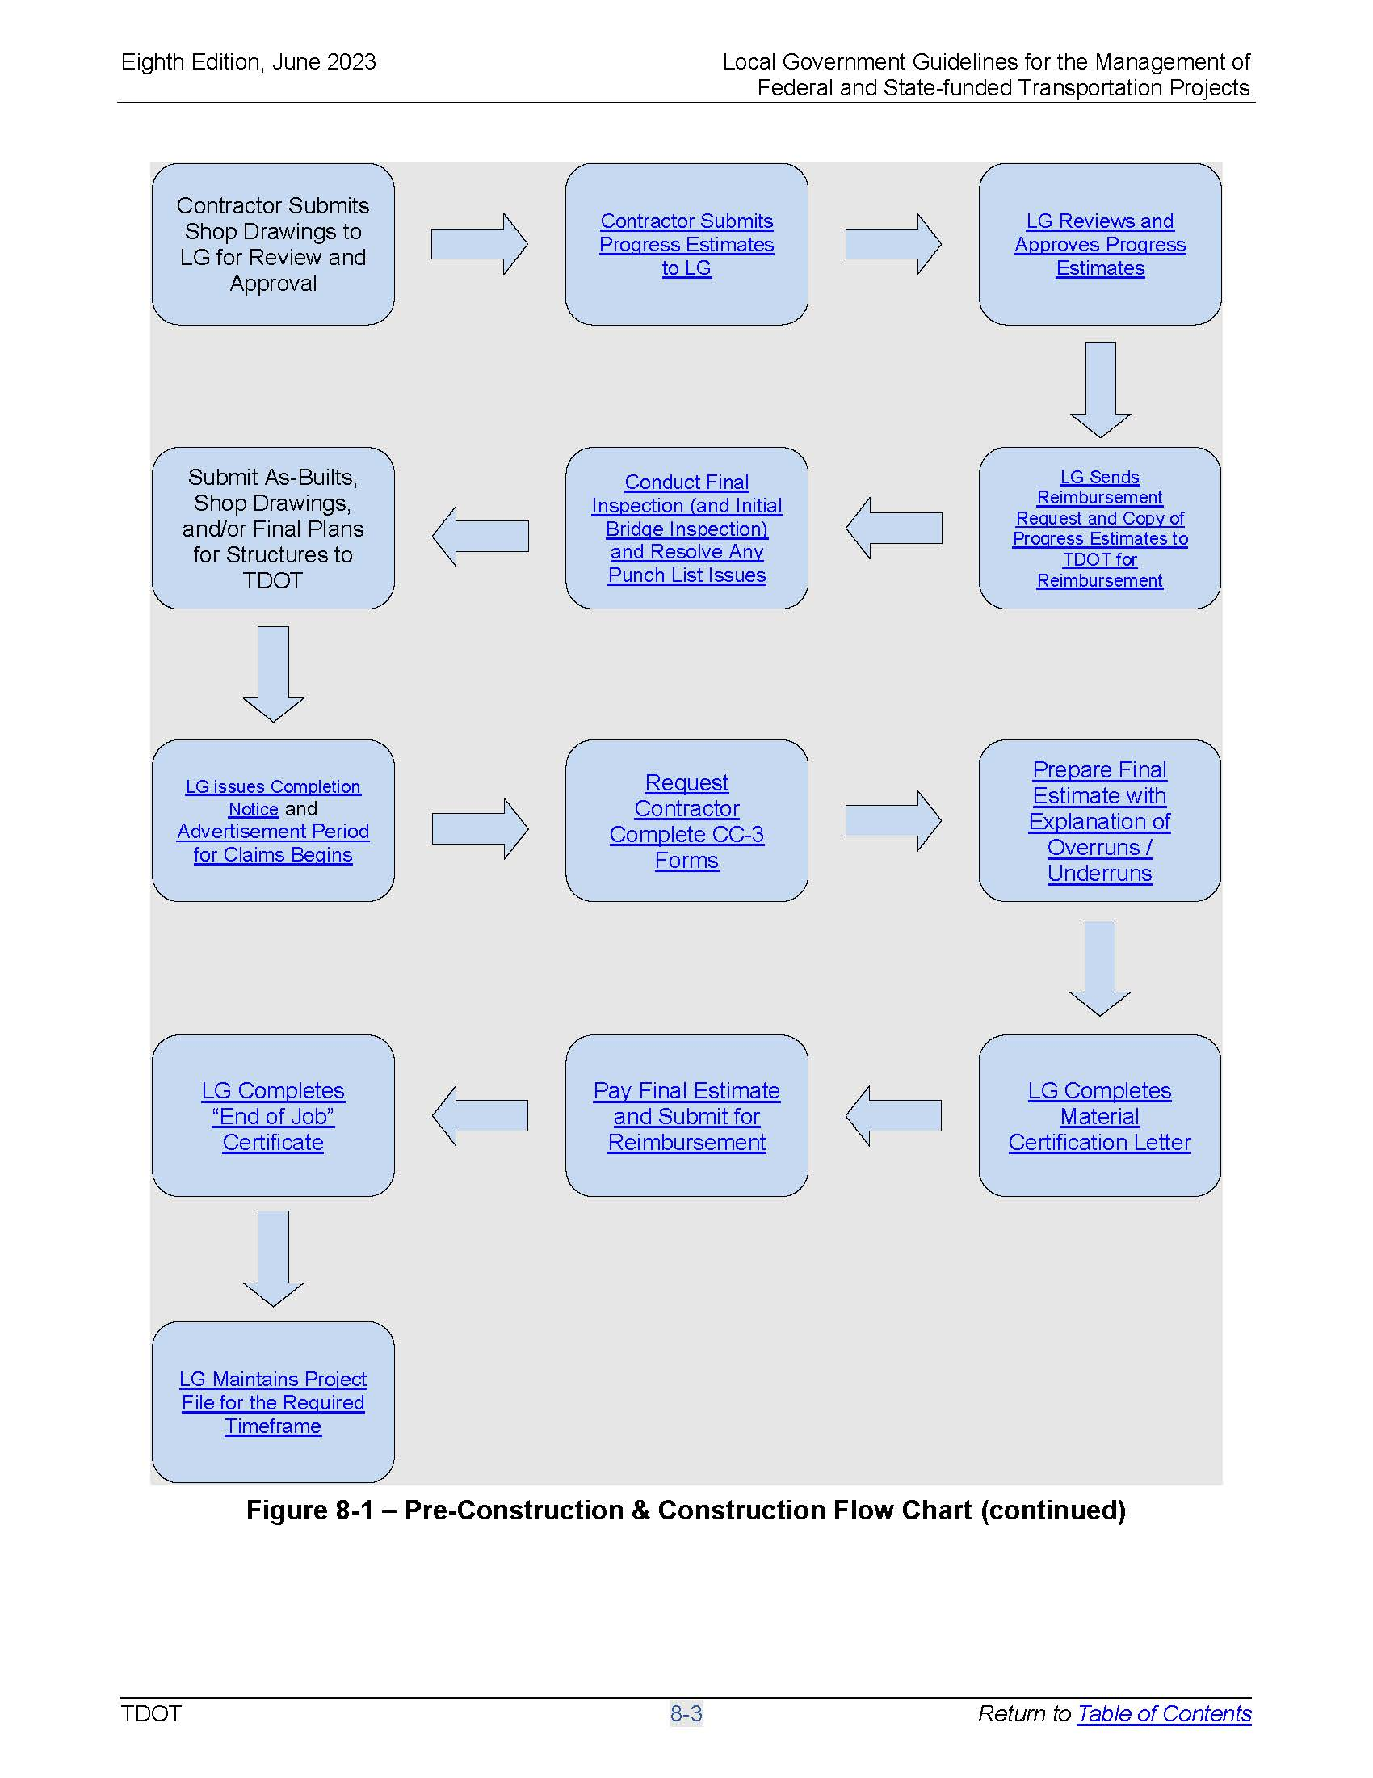
Pre-Construction and
Construction Procedures

Slide 6
Pre-Construction Procedures
RESPONSIBLE CHARGE
The Local Government (LG) must designate a Responsible Charge for the administration of the project, including, but not limited to: requesting authorization of funds, requesting award of contract, supervision of the CEI, authority to approve changes, and accountability for contract compliance (23 CFR 635.105) as outlined in Chapter 3: Getting Started.
The LG will act on the behalf of the Tennessee Department of Transportation (TDOT) for the administration of construction projects and that in accordance with federal regulations, funds may be withheld for non-compliance of federal rules and regulations (23 CFR 1.36):
  “If the Administrator determines that a Local Agency has violated or failed to comply with the Federal laws or the regulations in this part with respect to a project, he may withhold payment to the Local Agency of Federal funds on account of such project, withhold approval of further projects by the Local Agency, and take such other action that he deems appropriate under the circumstances, until compliance or remedial action has been accomplished by the Local Agency to the satisfaction of the Administrator.”

Slide 7
Pre-Construction and
Construction Procedures
FHWA “Big Five”
  DBE Requirements
  Buy America Provisions
  ADA Requirements
  Environmental Commitments
  Pay Item Documentation (Original Contract items or Change Orders)

Slide 8
Pre-Construction and
Construction Procedures
Refer to Section 1.6 for information regarding selection of a consultant for the CEI portion of the project.
A project shall be advertised one time at least 21 calendar days prior to the public bid opening (23 CFR 635.112). The advertisement shall describe the type of work to be performed and where, when, and by what time the sealed bids shall be received. The TDOT provided Bid Advertisement Template (Form 8-3) is available for the LG to use.
Any type of electronic bidding, including but not limited to, electronic distribution of plans and documents to full submittal of bid documents, must be approved by the LPDO prior to advertisement. The outlined process must be submitted in writing to the LPDO for review and approval. Please keep in mind that plans distributed electronically must be labeled as “information only not intended for bidding” or something similar unless otherwise approved.
The advertisement must be submitted to the LPDO to be placed on TDOT’s website for publication. The advertisement must be submitted by clicking on the ‘Local Programs Ad Submittal Form’ link on the bottom of this webpage: http://www.tn.gov/tdot/topic/local-programs-current-projects.
The Local Programs Ad Submittal Form, along with the bid advertisement (Form 8-3), must be submitted on the same email as an attachment and sent to Local.Programs@tn.gov at a minimum of 24 days prior to the bid opening date.

Slide 9
Pre-Construction and
Construction Procedures
For all projects, bidding opportunities on a nondiscriminatory basis shall be afforded to all qualified bidders regardless of state boundaries, race, sex, color, or national origin. The LG shall comply with the standard USDOT Title VI Assurances by inclusion of the following language in the solicitations for bids:
    The (Local Government) in accordance with Title VI of the Civil Rights Act of 1964, 78 Stat. 252, 42 U.S.C. 2000d to 2000d-4 and Title 49, Code of Federal Regulations, Department of Transportation, subtitle A, Office of the Secretary, Part 21, nondiscrimination in federally assisted programs of the Department of Transportation issued pursuant to such Act, hereby notifies all bidders that it will affirmatively insure that in any contract entered into pursuant to this advertisement, disadvantaged business enterprises will be afforded full opportunity to submit bids in response to this invitation and will not be discriminated against on the grounds of race, color or national origin in consideration for an award.”

Slide 10
Pre-Construction and
Construction Procedures
Who Can Bid?
Only prime contractors that have been prequalified in the appropriate TDOT work classification, relevant to the project, can be authorized to bid (23 CFR 635.110).
Prospective bidders must request authorization to bid by the LG. Prior to the issuance of a proposal contract, the LG shall evaluate the contractor submitting the bid authorization request and determine if the prospective bidder is prequalified by TDOT or within the prequalification renewal grace period.
Contractors must use and only use the name as shown on pre-qualification records
Bid book and bid form must be marked VOID if sold to non-prequalified contractors or those pending qualification
Contractors who are not prequalified with TDOT in the appropriate work classification(s) should not be authorized to bid (i.e., guardrail contractor would not be authorized to bid resurfacing project)
All subcontractors must be on TDOT’s pre-qualified list before beginning any work

Slide 11
Pre-Construction and
Construction Procedures
  Please be aware that TDOT requires all PRIME contractors (except mowing and litter removal contractors) to be licensed with the Tennessee Department of Commerce and Insurance, Board for Licensing Contractors.
  For Federally Funded Contracts, the Contractors will not be required to have a license to bid. However, prior to recommending award of the Contract, the Local Government will confirm that the lowest responsible bidder is licensed. The Contractor will be considered for award for twenty-one (21) days after the letting date (bid submittal). If the contractor does not have a license, on or before the 21 days, the contractor will be considered non-responsive, and the next lowest responsible bidder will be considered for award. For State Funded Contracts, the Local Government shall follow the requirements of
  TCA 62-6-119.
  For more information on obtaining a Contractor’s License please visit the Board for Licensing Contractors website at the following:
  https://www.tn.gov/commerce/regboards/contractors.html

Slide 12
Pre-Construction and
Construction Procedures
  Title 48 of Tenn. Code Ann. requires all contractors and subcontractors that are domestic or foreign Corporations, Limited Liability Companies, Limited Partnerships, or Limited Liability Partnerships to be in good standing with the Secretary of State. This includes being duly incorporated, authorized to transact business, and/or in compliance with other requirements as detailed by the Secretary of State. Please contact the Secretary of State should you have any questions at (615) 741-2286 or visit https://sos.tn.gov/business-services.
  TDOT will not execute any contracts or approve subcontracts with contractors that are domestic or foreign Corporations, Limited Liability Companies, Limited Partnerships, or Limited Liability Partnerships, who are not in good standing with the Secretary of State (i.e. have a valid Certificate of Existence/Authorization).

Slide 13
Pre-Construction and
Construction Procedures
Prior to opening bids, the Local Government shall review the Contractors to determine their prequalification and licensure status (non-federally funded only).
  Please note that the contractors have a 90 day grace period for renewal (for bidding purposes).
If a bidder is not currently prequalified or properly licensed (non-federally funded), the bid should remain sealed.
All bids are to be opened publicly and read aloud either item-by-item, or by total amount.
If a bid is not read, the bidder is to be identified and the reason for not reading the bid announced (23 CFR 635.113).

Slide 14
Pre-Construction and
Construction Procedures
A bid may only be awarded to the lowest responsive bidder (23 CFR 635.114). The “Construction Advertising and Award Checklist” (Form 8-4) shall be completed, signed, and submitted with the Local Government’s letter indicating its intent to award to the low bidder.
The Local Government shall review the apparent lowest responsive bidder’s proposal to ensure the bid is responsive and all applicable signatures and bonds are included. Bids shall be reviewed in accordance with the TDOT Policy No. 355-02 Awards of Construction Contracts. Additional FHWA guidance for reviewing bids can be found at: http://www.fhwa.dot.gov/programadmin/contracts/index.cfm

Slide 15
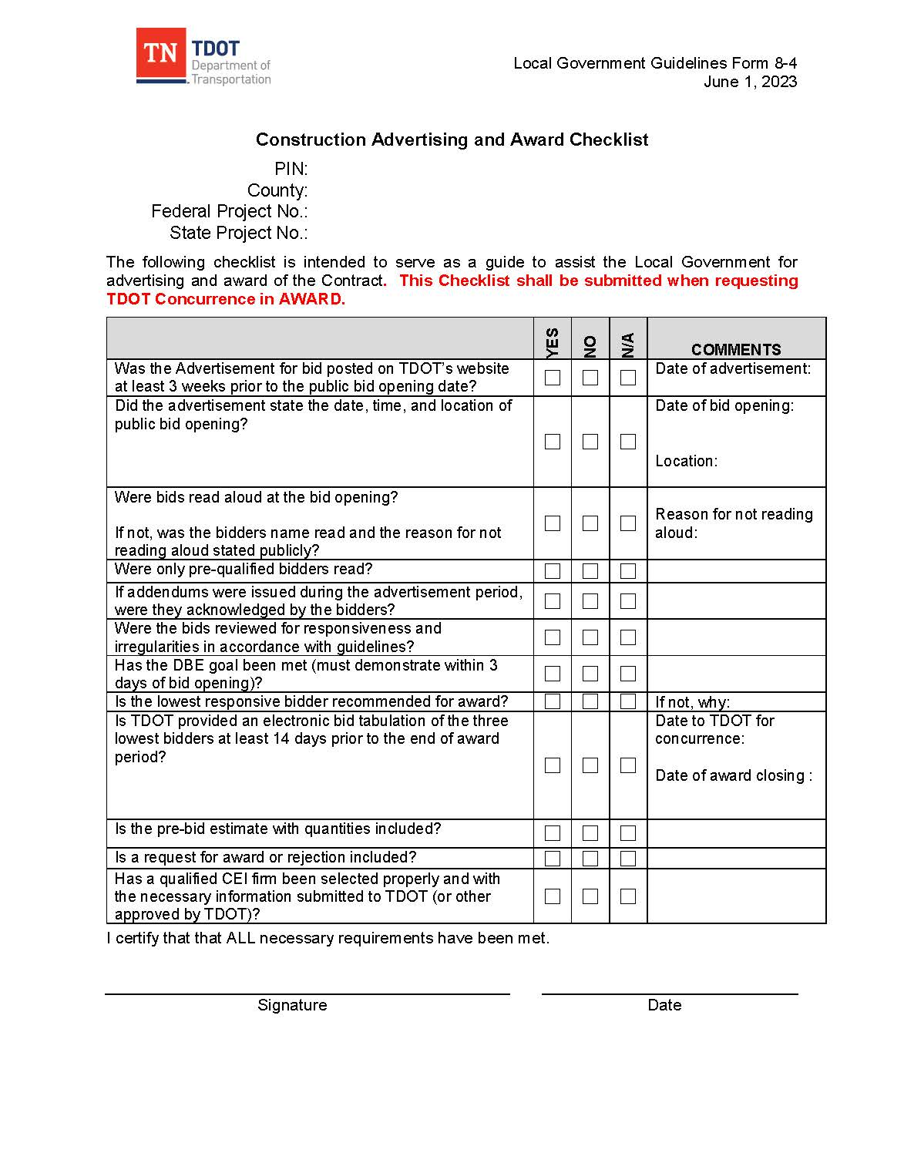
Pre-Construction and
Construction Procedures

Slide 16
Reasons for not Awarding a Bid
Failure to sign the bid by an authorized representative (proposal form, proposal certificate, proposal bond, Power of Attorney)
Failure to furnish the required bid bond and Power of Attorney, with the same dates
Omissions, alterations of form, additions, or conditions not called for
Unauthorized bids or irregularities
Failure to include a unit bid price for each item (must be an amount of zero or greater)
Units prices are mathematically unbalanced
Failure to submit a non-collusion affidavit
Failure to utilize the required forms approved by TDOT (Form 8-1 Federal or Form 8-1 State)
Failure to submit a bid within the original bound bid book or electronic bid information
Failure of bidder to acknowledge all addenda
Bidder not prequalified or not in good standing the day of the letting

Slide 17
Pre-Construction and
Construction Procedures
Reasons for not awarding a bid include the bid being unresponsive, often called an irregular bid, or if the bidder is determined to be “not responsible”. The difference between a responsive bid and responsible bidder is that:
  A responsive bid is one that meets all the requirements of the advertisement and proposal, while
  A responsible bidder is one who is physically organized and equipped with the financial wherewithal to undertake and complete the contract.

Slide 18
Pre-Construction and
Construction Procedures
The LG shall provide a list of ALL bidding companies/entities and their bid price, a bid tabulation of at least the three (3) lowest bidders (or all bids if fewer than three (3) are submitted), line-item by line-item, including the engineers estimate that matches the schedule of values for reviewing bids. When more than three bids are received, the total amount of all but the three lowest bids must be submitted. All bids shall be reviewed to determine if they are unbalanced, which is defined as:
  A mathematically unbalanced bid is a bid that contains lump sum or unit bid items that do not reasonably reflect the actual costs (plus reasonable profit, overhead costs, and other indirect costs) to construct the item;
  A materially unbalanced bid is a bid that generates reasonable doubt that award to that bidder would result in the lowest ultimate cost to the government.
FYI, the final engineer’s estimate can change, based on valid reasons, even after the project is advertised provided that it is revised prior to the receipt of bids and submitted to LPDO.

Slide 19
Unbalanced Bid Example
 | Original Bid
 |  |  |  |  | Estimate |  | Contractor A |  | Contractor B
 | Item No. | Item Description | Quantity | Unit | Unit Price | Extension | Unit Price | Extension | Unit Price | Extension
 | 201-01 | CLEARING AND GRUBBING | 1 | LS | $2,000.00 | $2,000.00 | $28,000.00 | $28,000.00 | $3,000.00 | $3,000.00
 | 203-01 | ROAD & DRAINAGE EXCAVATION (UNCLASSIFIED) | 100 | CY | $15.00 | $1,500.00 | $14.50 | $1,450.00 | $16.00 | $1,600.00
 | 303-01 | MINERAL AGGREGATE, TYPE A BASE, GRADING D | 1500 | TON | $20.00 | $30,000.00 | $2.00 | $3,000.00 | $19.00 | $28,500.00
 |  |  |  |  |  | $33,500.00 |  | $32,450.00 |  | $33,100.00
 | Corrected for Quantity Error
 |  |  |  |  | Estimate |  | Contractor A |  | Contractor B
 | Item No. | Item Description | Quantity | Unit | Unit Price | Extension | Unit Price | Extension | Unit Price | Extension
 | 201-01 | CLEARING AND GRUBBING | 1 | LS | $2,000.00 | $2,000.00 | $28,000.00 | $28,000.00 | $3,000.00 | $3,000.00
 | 203-01 | ROAD & DRAINAGE EXCAVATION (UNCLASSIFIED) | 100 | CY | $15.00 | $1,500.00 | $14.50 | $1,450.00 | $16.00 | $1,600.00
 | 303-01 | MINERAL AGGREGATE, TYPE A BASE, GRADING D | 750 | TON | $20.00 | $15,000.00 | $2.00 | $1,500.00 | $19.00 | $14,250.00
 |  |  |  |  |  | $18,500.00 |  | $30,950.00 |  | $18,850.00

Slide 20
Pre-Construction and
Construction Procedures
Other factors that a bid analysis may consider include:
  Number of bids received
  Distribution or range of the bids
  Identity and geographic location of the bidders
  Urgency of the project
  Current market conditions and workload
  Comparison of bid prices with similar projects recently let
  Justification for significant bid price differences
  Potential for savings if the project is re-advertised
  Other factors as warranted

Slide 21
Pre-Construction and
Construction Procedures
Once the Local Government has reviewed the bids, the Local Government Official shall submit all of the following documents to TDOT for review (TDOT will not review unless all documents are submitted):
  A completed Form 8-4
  An electronic copy of the bid tabulations (Excel™ spreadsheet comparing bids received)
  Documentation certifying that the bids have been reviewed and found responsive
  A letter requesting concurrence in the decision to award signed by the Local
  Government Official or to reject the bids including the necessary explanations for
  the request made
  A PDF of the proposal contract for the apparent low bidder
  DBE Award Information, if applicable (Form 8-5, including respective work items)
TDOT will not review the bid tabulations without the required checklist.
This information shall be submitted to the Local Programs Development Office by electronic means (Local.Programs@tn.gov).

Slide 22
Pre-Construction and
Construction Procedures
The TDOT Construction Office and TDOT Estimating and Bid Analysis Office will review the bid information and if acceptable, will concur in the intent to award the contract to the lowest responsive bidder. If the Local Government determines that it is not in the best interest of the public to award the job, it shall make such statement and request TDOT’s concurrence in its decision to reject all bids. Award or rejection of a contract must be within the time period specified in the proposal as complying with local requirements. The Local Government shall submit to TDOT the request to award or reject the bids at least twenty-one (21) calendar days prior to the local deadline for awarding the project.
In addition, if the Local Government elects to award the project, it shall submit with the bid tabulations the names and qualifications of the CEI firm and the individuals directly responsible for oversight and inspection of the actual construction of the project, including the Local Government Project Supervisor and all inspectors.

Slide 23
Pre-Construction and
Construction Procedures
If a contract proposal contains a DBE Goal (TDOT SP 1247LP), the contractor must submit with its bid, or within three (3) business days of the bid opening, the names, ethnicities, and genders of the TNUCP certified DBEs that will be used on the project, and the amount of subcontracts to be completed by the DBE (Form 8-5), or provide the necessary requirements for good faith efforts as specified in SP 1247LP. The LG must submit this form with their bid concurrence package to the LPDO and copy the TDOT Civil Rights Office. Failure to submit the required information within the specified time frame can result in the bid being rejected.
  If changes occur, form 8-5 must be resubmitted to the LPDO.
The award of the contract shall be in general accordance with Section 103 of the TDOT Standard Specifications.

Slide 24
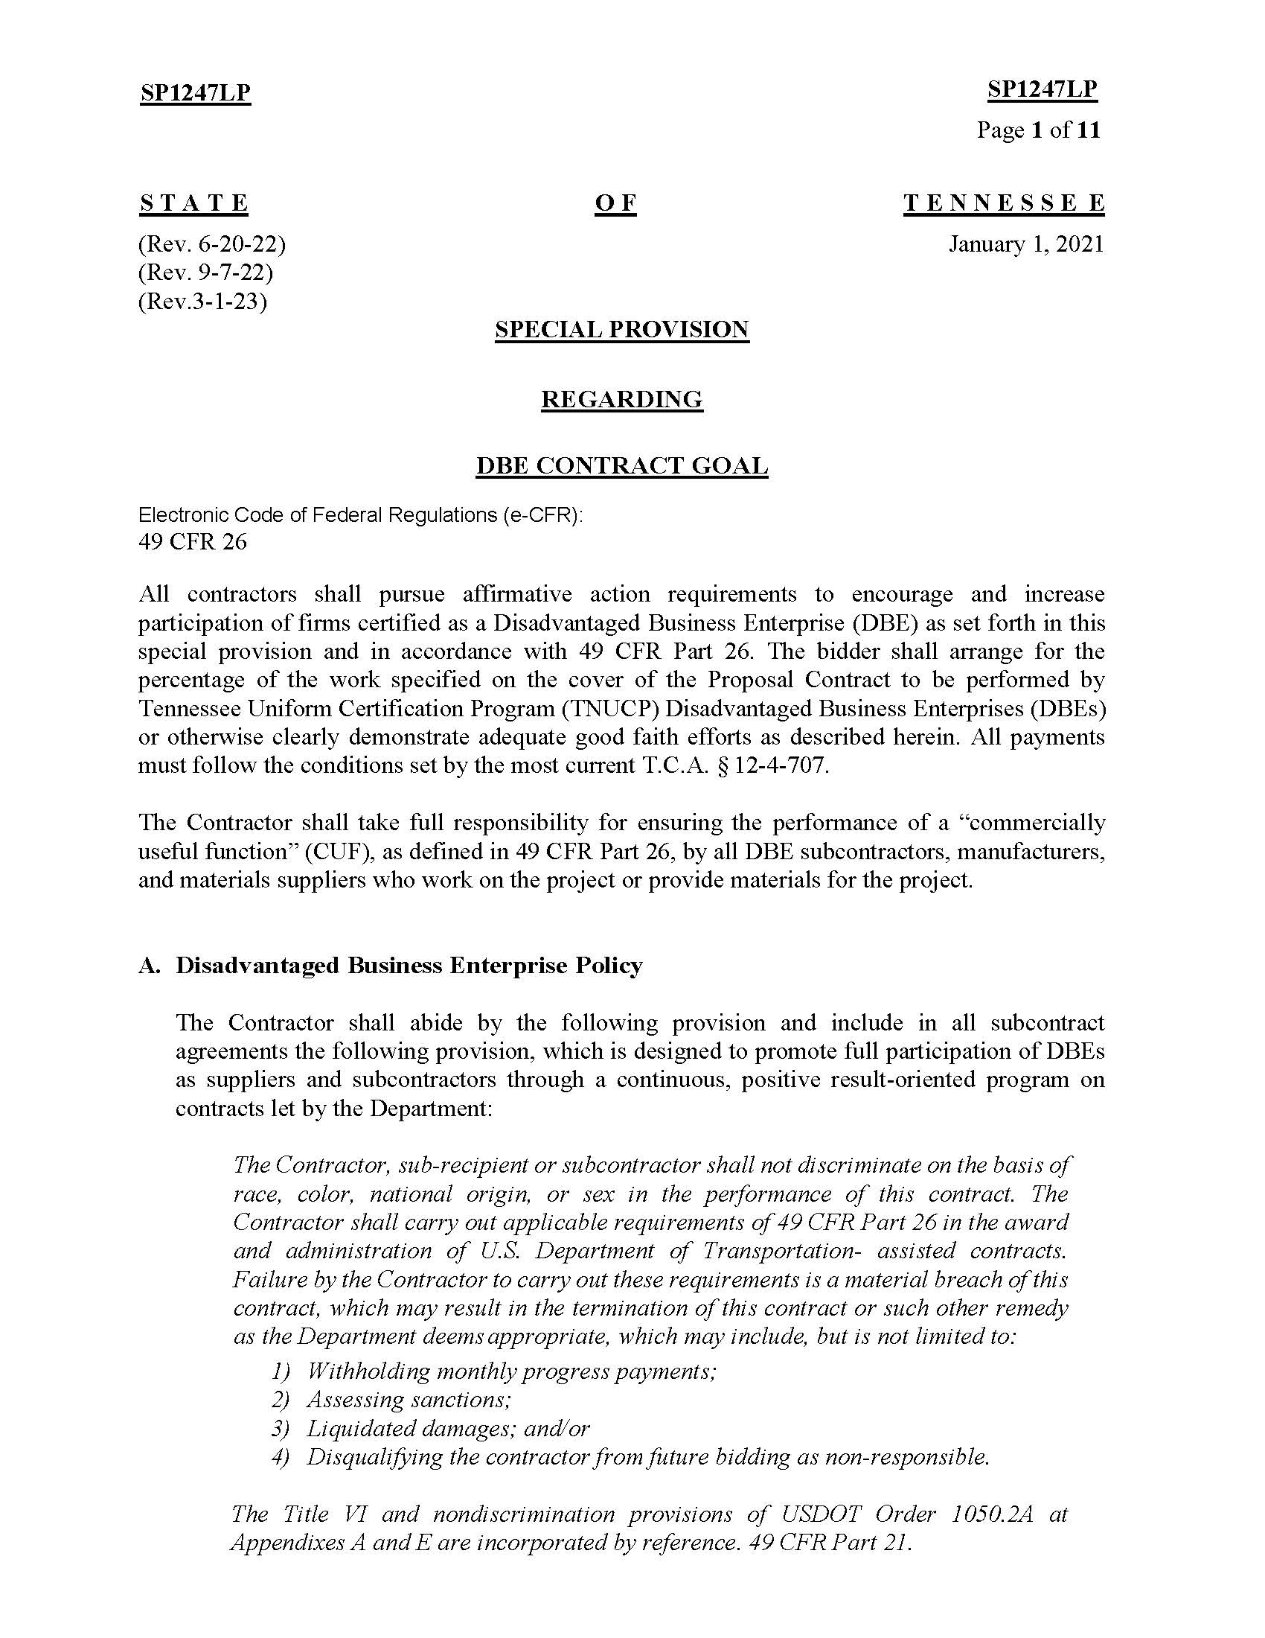
Pre-Construction and
Construction Procedures

Slide 25
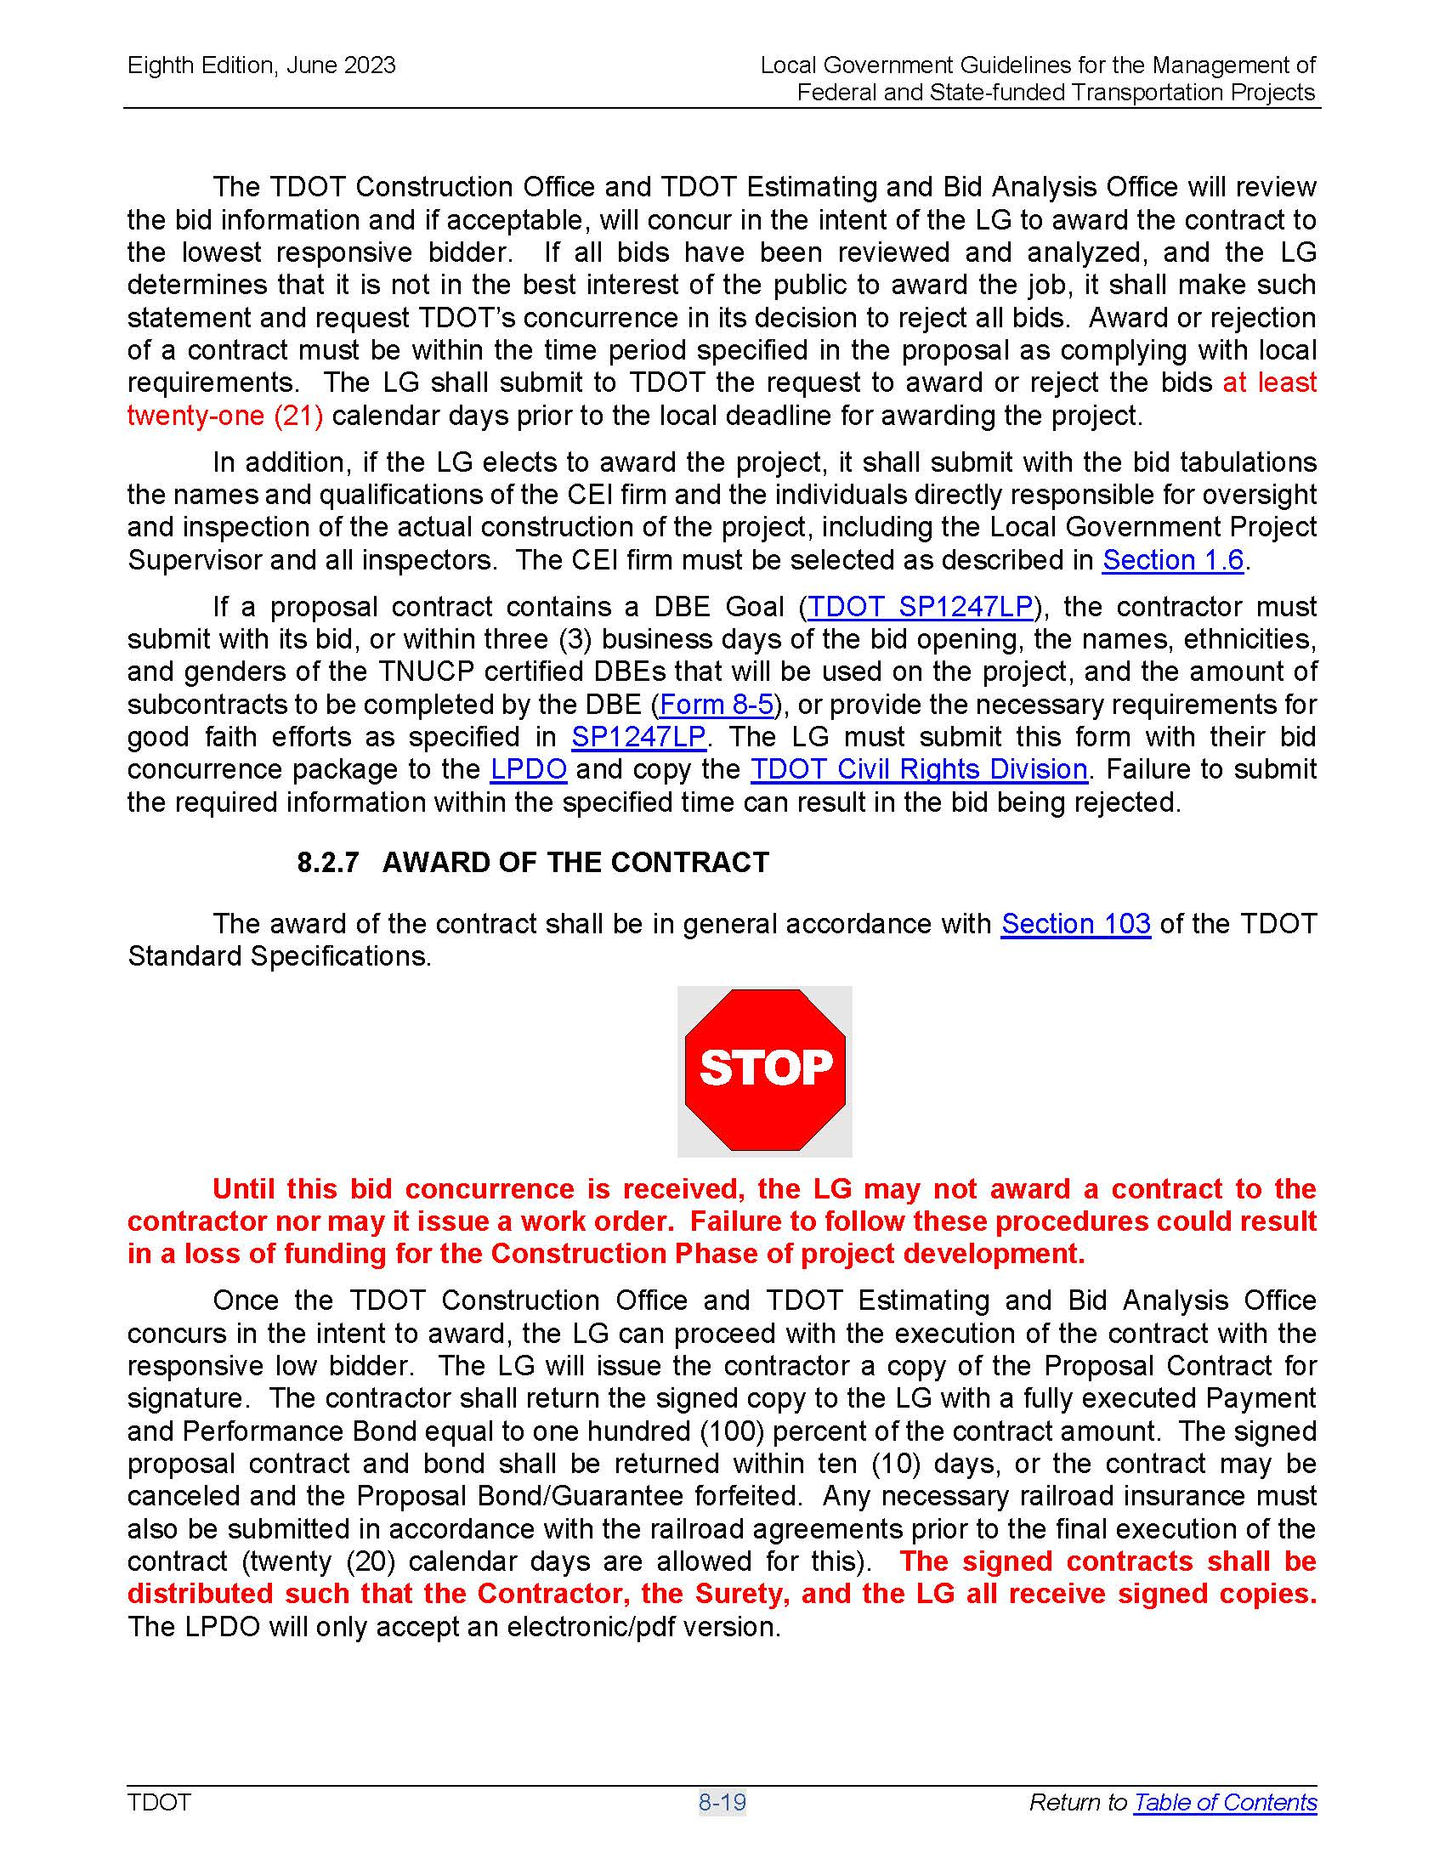
Important TDOT Approval Documents
Concurrence of Award of Construction Contract

Slide 26
Pre-Construction and
Construction Procedures
  The Local Government Guidelines describes a linear process, however many of these events could occur simultaneously or at a much later timeframe in the project process. Please be aware of the specific requirements for all processes in the construction phase relative to any approvals or submittals that are time sensitive. An example is a mix design, which will be discussed late in the presentation but it will be an item that will require approval near the start of construction.
Also, the guidelines outline the high level documentation process for the project and does not outline the specific inspection or testing requirements for individual items. Specific inspection requirements such as ADA requirements will be checked in the field.

Slide 27
When do you need Construction Inspection Services performed to TDOT standards?
The LG shall hire an independent consulting firm for Construction Engineering Inspection (CEI) services to monitor the project and complete all the necessary inspection and documentation as outlined in the TDOT Proposed Scope of Work for CEI. The LG may use the same consultant for both the design phase and CEI phase of the project for small size projects only. For mid-range and large size projects, the selected CEI consultant shall not be associated with any other aspect of the project. Please refer to Section 3.1 and to the Local Version of TDOT Consultant Selection Policy (Form 1-2) for further information on this important requirement. The selected CEI consultant shall be a pre-qualified consulting firm on the TDOT pre-qualified list. All CEI staff shall be qualified in accordance with TDOT requirements.
Depending on the type, amount, and difficulty of work, the Local Government may request that its own qualified forces be used to document and inspect the work in accordance with these guidelines. The use of local forces must be pre-approved by TDOT. Contact the LPDO for additional information.

Slide 28
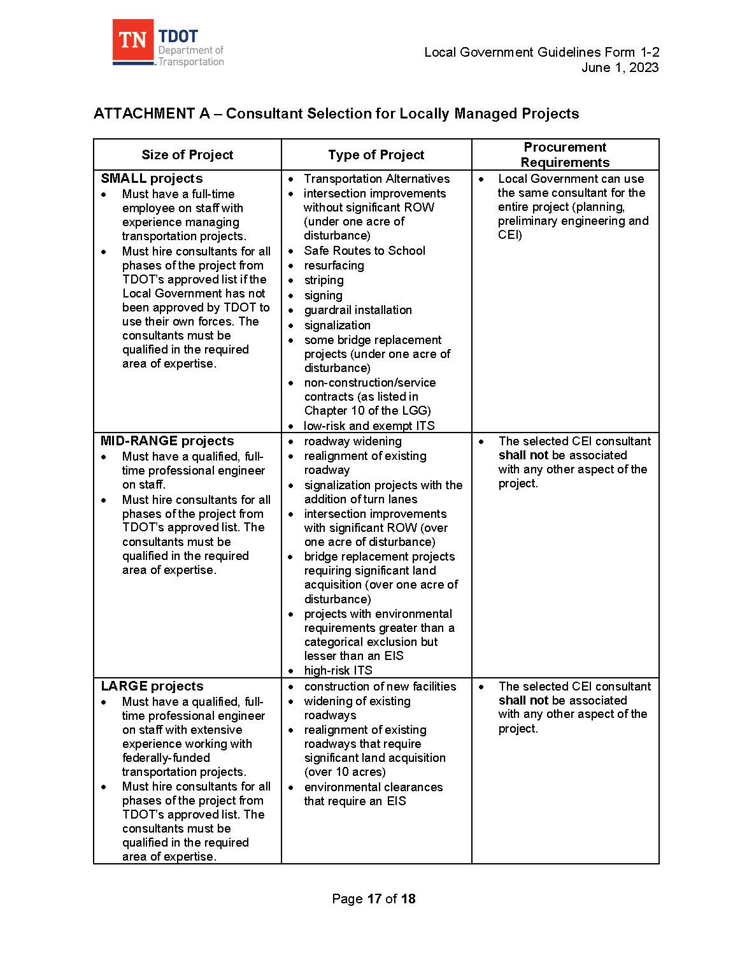
Criteria For Allowing Local Governments To
Manage Projects

Slide 29
Materials and Tests Charges for
Local Government Projects
The Tennessee Department of Transportation’s Material and Tests Division requires payment for any materials testing done on construction projects. As stated in the Local Government’s contract with TDOT, materials charges/department oversight charges are the responsibility of the Local Governments. Therefore, when a Local Government utilizes the TDOT laboratory or certified personnel as a third party for Acceptance Testing, Independent Assurance Testing, Verification Testing, or Mix Design Approval, an invoice will be sent to the Local Governments for payment for such testing/approval at the end of each month or upon completion of a project. The Local Government representative will be asked at the pre-construction meeting to complete an information sheet to ensure proper distribution for the respective testing invoices. This is a reimbursable cost.

Slide 30
Materials and Tests Charges for
Local Government Projects

Slide 31
Materials and Tests Billing
Notes:
Ill detail what the bill may include and attached is an example of what it will look like

Slide 32
Billing Procedures
Invoices must be sent by email as an attachment to lpd.invoices@tn.gov in PDF form
Includes all invoices for Local Programs, Transportation Alternative, and Safe Routes to School Projects
TDOT Local Government invoice cover sheet from https://www.tn.gov/tdot/program-development-and-administration-home/local-programs/reimbursement.html must accompany all reimbursement requests
All invoices without the correct TDOT invoice cover sheet will be returned
Reimbursement requests should be submitted in eGrants when applicable.
Notes:
Matt’s first slide – 20 mins

Slide 33
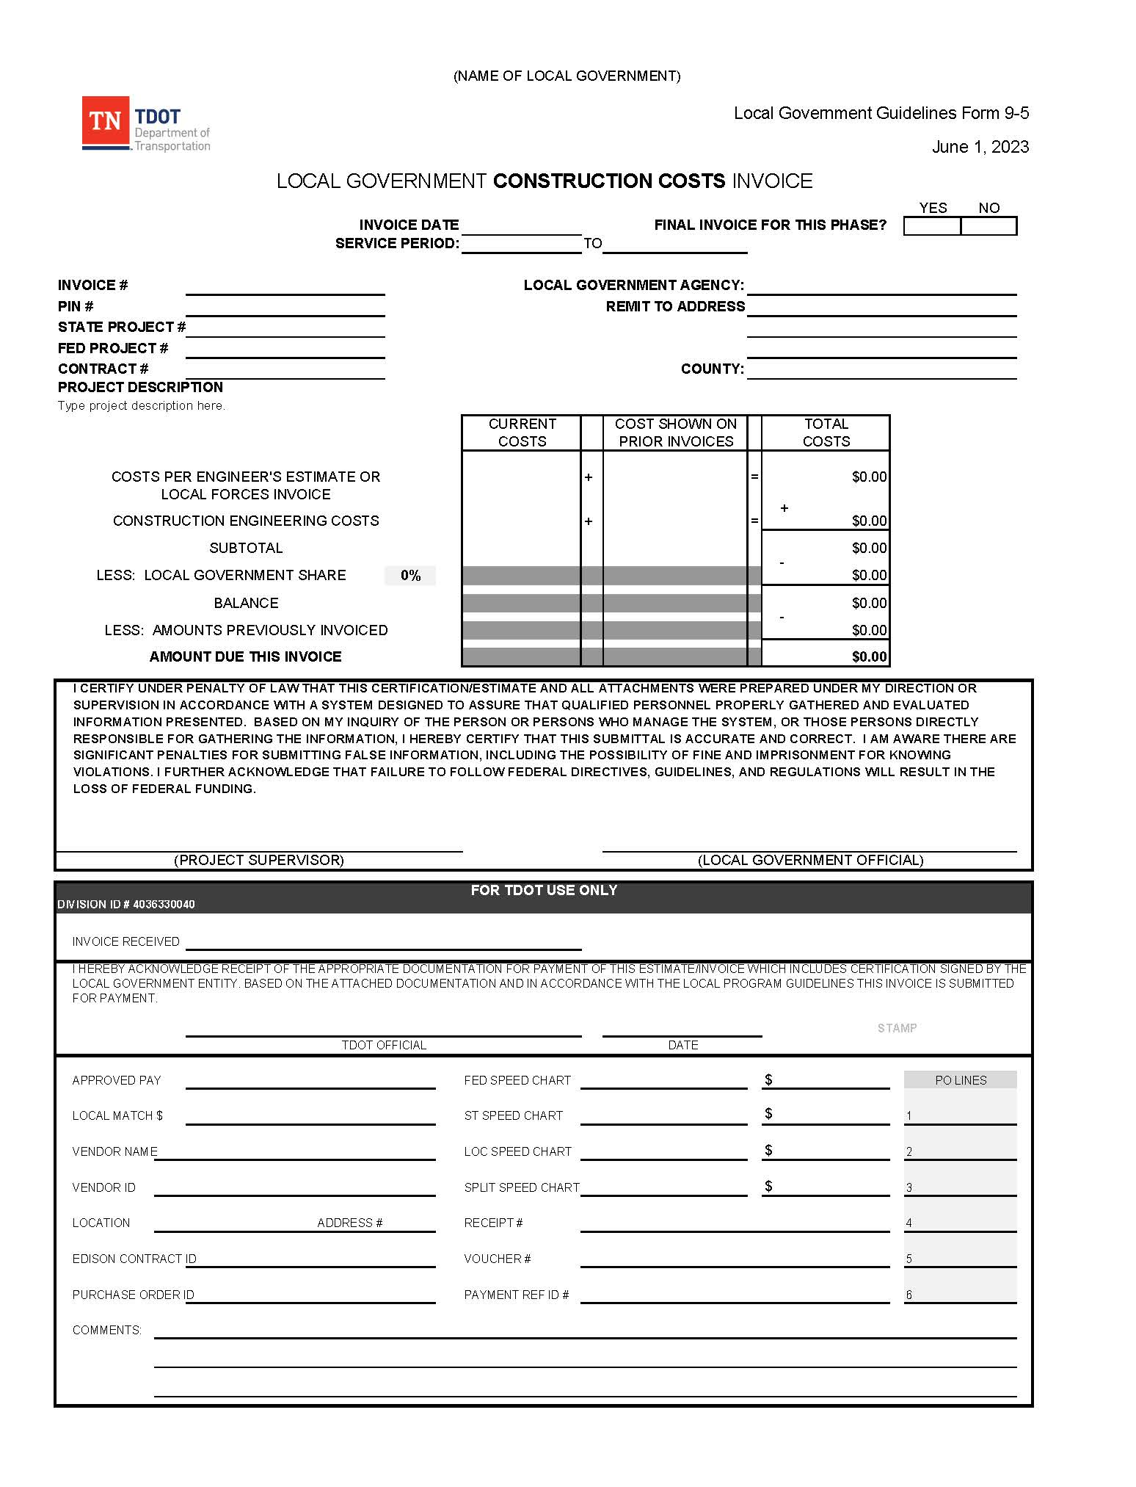
Sample: TDOT Construction Invoice Cover Sheet

Slide 34
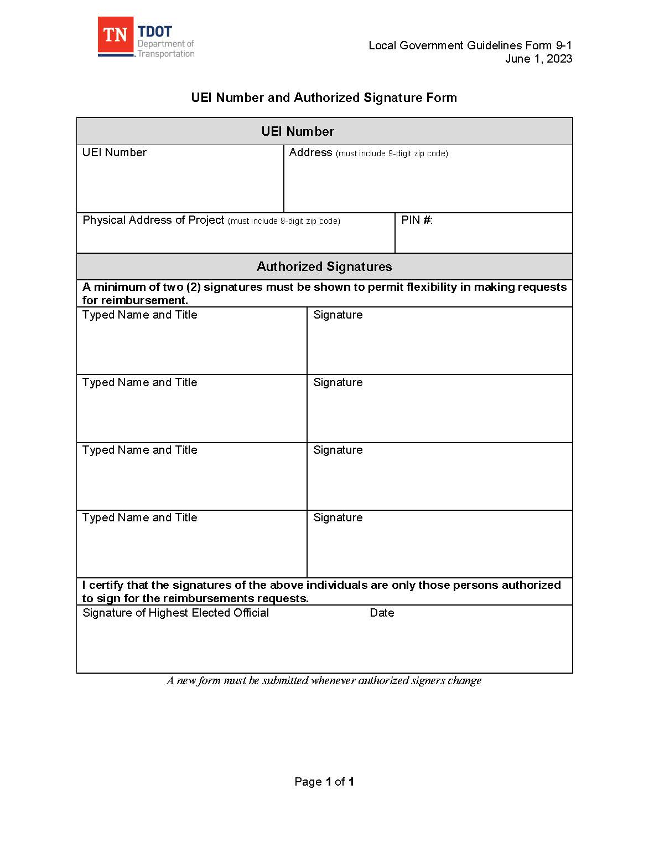
Sample: Authorized signature form
Notes:
Address here must match invoice. Do not date.

Slide 35
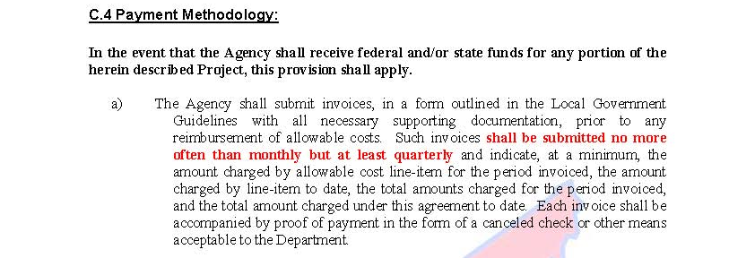
Billing Procedures
Invoice shall be submitted no more often than monthly, but at least quarterly, per project per phase to LPD.Invoices@tn.gov as a single PDF file, if possible. Emails must contain the PIN in the subject of the email as well as the attachment. Invoices for projects initiated through TDOT eGrants must be submitted in the eGrants system.
Will not issue Notice to Proceed for Construction Phase if not in compliance

Slide 36
Billing Procedures
Invoices will be returned for correction of errors
Each request must include:
    copies of paid invoices
    copies of canceled checks, or
    other acceptable proof of payment
    personal private information (PPI) removed from backup documentation
    approved submittal signature
Notes:
Matt’s last slide. Questions? Call Whitney up.

Slide 37

Construction Procedures
AWARD OF THE CONTRACT
The Local Government shall request TDOT concurrence in its intent to award the contract to the lowest responsive bidder. This request shall be sent to the Manager of the Local Program Development Office by electronic means (email at Local.Programs@tn.gov) who will forward it to the TDOT Construction. Until this concurrence is received, the Local Government may not enter into contract with the contractor nor may it issue a work order. Failure to follow these procedures could result in a loss of funding for the Construction Phase of project development.

Slide 38
Construction Procedures
Once the TDOT Construction Office and TDOT Estimating and Bid Analysis Office concurs in the intent to award, the LG can proceed with the execution of the contract with the responsive low bidder. The LG will issue the contractor a copy of the Proposal Contract for signature. The contractor shall return the signed copy to the LG with a fully executed Payment and Performance Bond equal to one hundred (100) percent of the contract amount. The signed proposal contract and bond shall be returned within ten (10) days or the contract may be canceled and the Proposal Bond/Guarantee forfeited. Any necessary railroad insurance must also be submitted in accordance with the railroad agreements prior to the final execution of the contract (twenty (20) calendar days are allowed for this). The signed contracts shall be distributed such the Contractor, the Surety, and the LG all receive signed copies. The LPDO will only accept an electronic/PDF version.

Slide 39
Construction Procedures
AWARD OF THE CONTRACT (CONT’D)
At least seven days prior to the pre-construction conference, the LG shall send, by electronic means, a set of plans, a copy of the bid book and final cost estimate to the TDOT District Operations Engineer/Manager and the TDOT Regional Materials and Tests Supervisor. A copy of this email shall be sent to Local.Programs@tn.gov. The preconstruction meeting may be held virtually if all requirements are met.
Once all the required signatures, bonds, and insurance have been submitted, the Local Government will provide the contractor with a work order (Notice to Proceed) identifying the effective Date of Construction. The effective date is typically 21 calendar days after the issuance of the work order. The LG shall also provide a copy of the work order via email to the TDOT District Operations Engineer/Manager and the LPDO.

Slide 40
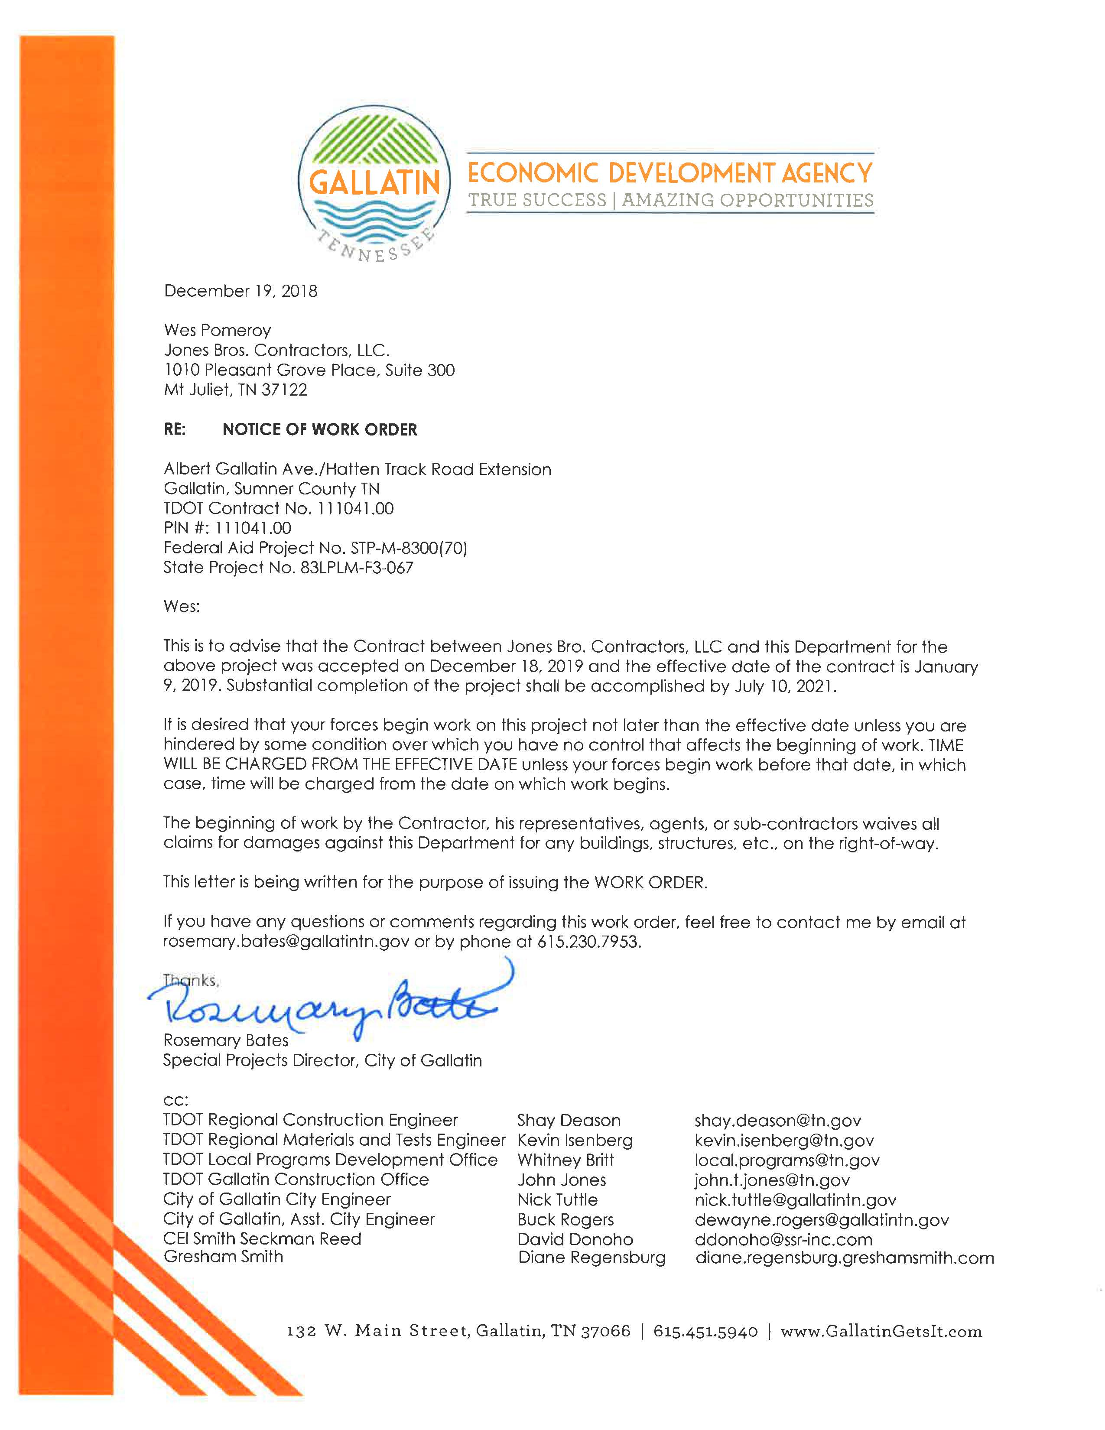
Work Order Example

Slide 41
Construction Procedures
Upon award of the contract, the LG shall fill out Form 7-2, Contractor Award Information, and submit it to the LPDO at Local.Programs@tn.gov.
This form contains important information necessary for reporting by TDOT, such as:
  Contractor Firm Name
  Street Address
  UEI Number
  Contact Person’s Information
  Subcontractor Information
This information will go to TDOT Civil Rights Division, for compliance with FHWA 1391 reporting, which is required per 23 CFR 230, Subpart A.
Form 7-2 shall be submitted on or before the preconstruction meeting. The form shall be signed with all information complete and contain all DBE subcontractors and the other known subcontractors.
The contractor shall resubmit Form 7-2 if any of the previous submitted information changes.

Slide 42
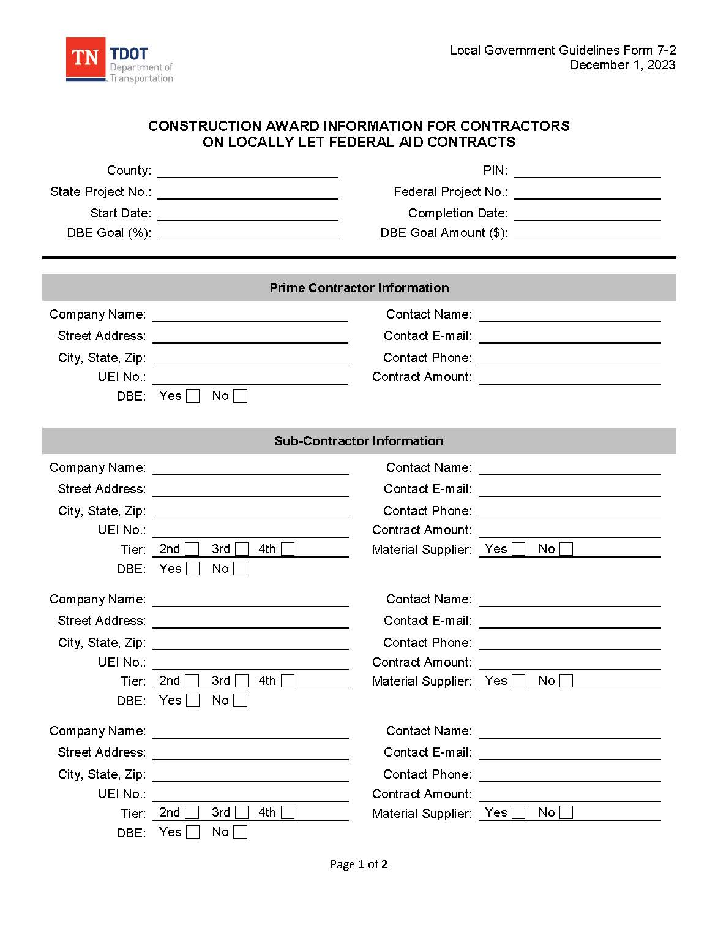
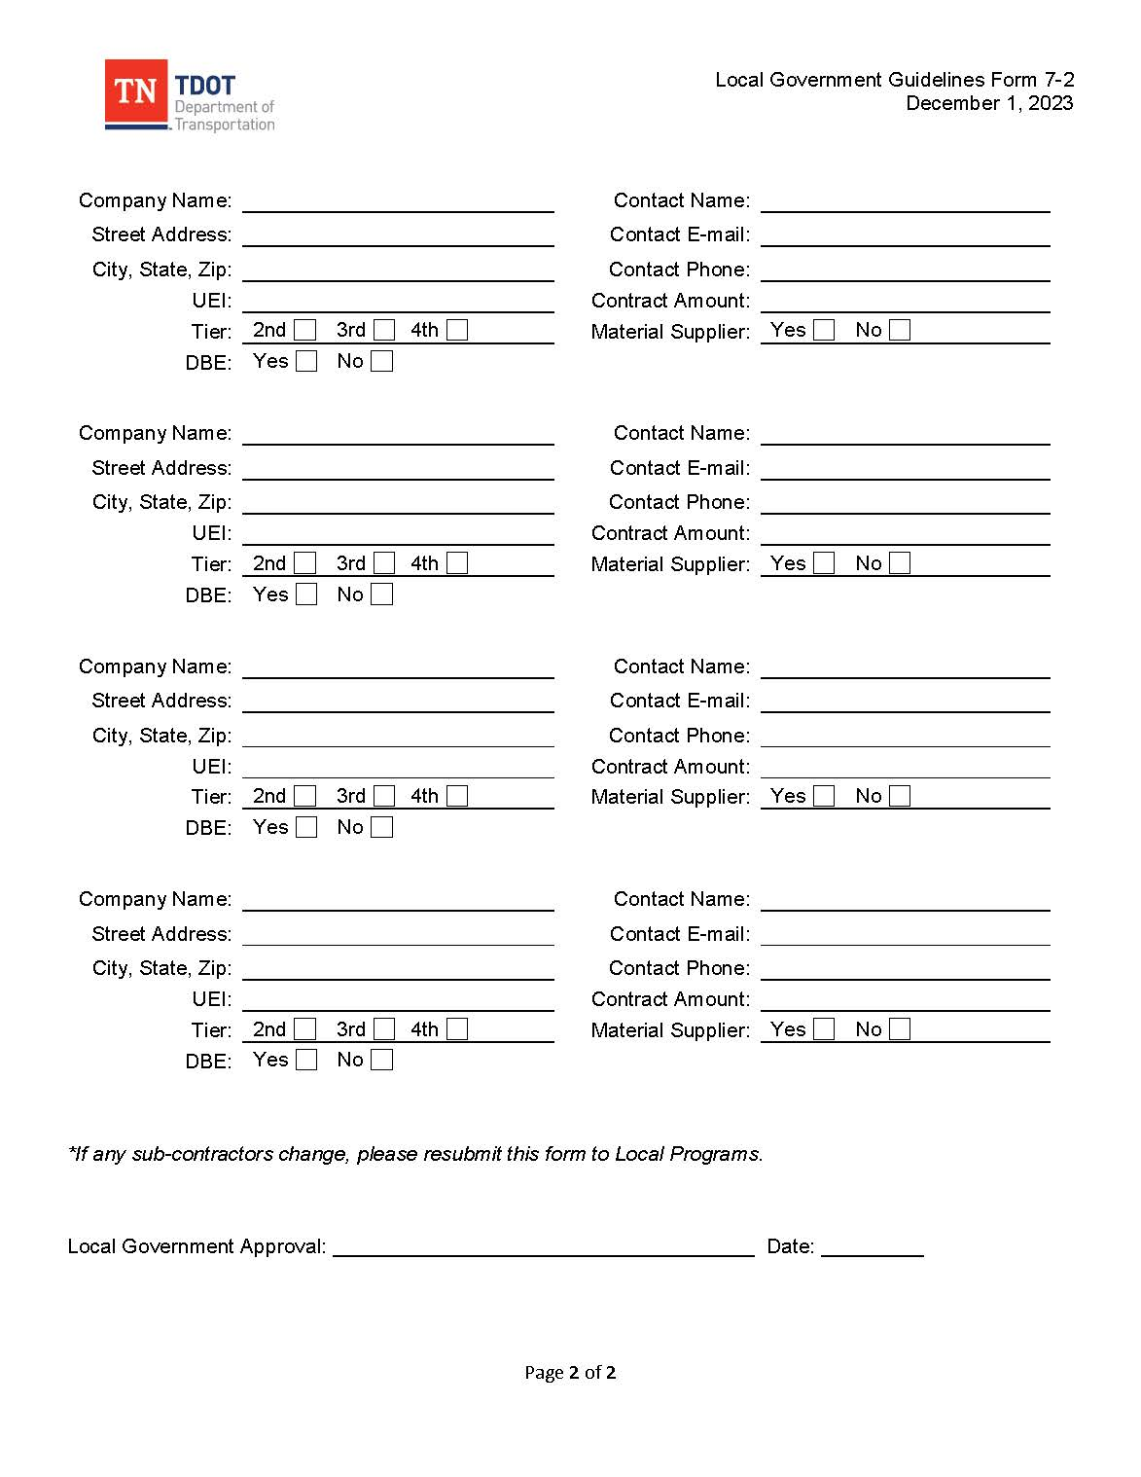
Construction Procedures

Slide 43
Construction Procedures
AWARD OF THE CONTRACT (CONT’D)
The Local Program Guidelines Manual and respective forms and example forms are located on the TDOT website at https://www.tn.gov/tdot/program-development-and-administration-home/local-programs/documents-and-forms-.html. These forms are in Microsoft Word format and easily downloadable. Please be advised that changes to TDOT circular letters may not be reflected in the referenced forms. In addition, other required TDOT forms not referenced will need to be obtained from your respective Regional TDOT office. Link to TDOT Circular Letters:
https://www.tn.gov/content/dam/tn/tdot/programdevelopment/localprograms/documents-and-forms/LP_Circular_Letters_Combined.pdf
A filing system for the construction phase of the project should be in place at this time. Project files shall consist of the contract applicable files as required by Form 8-6. Additional project files may be added as deemed necessary.

Slide 44
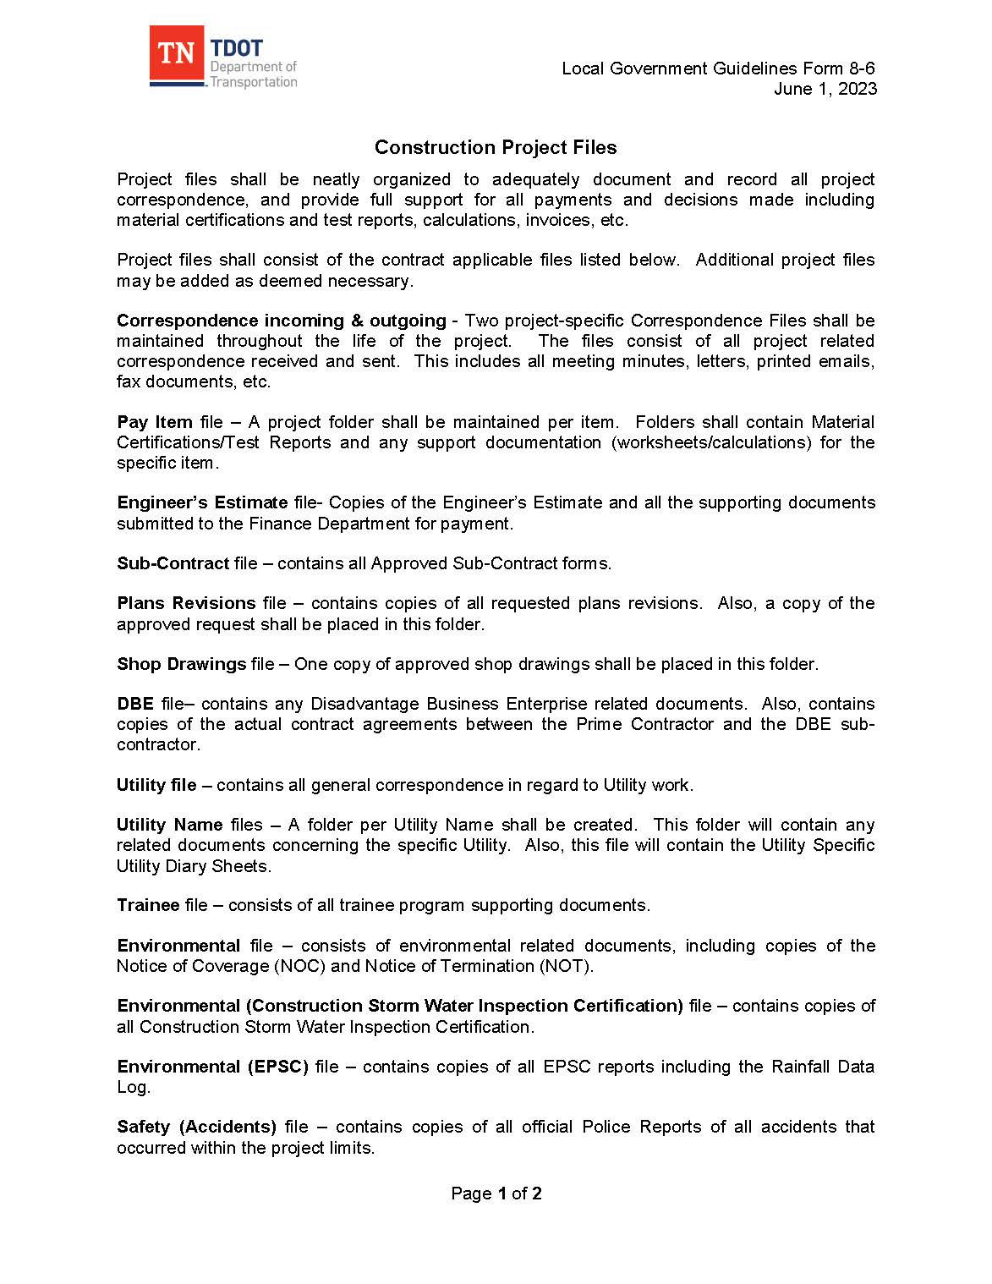
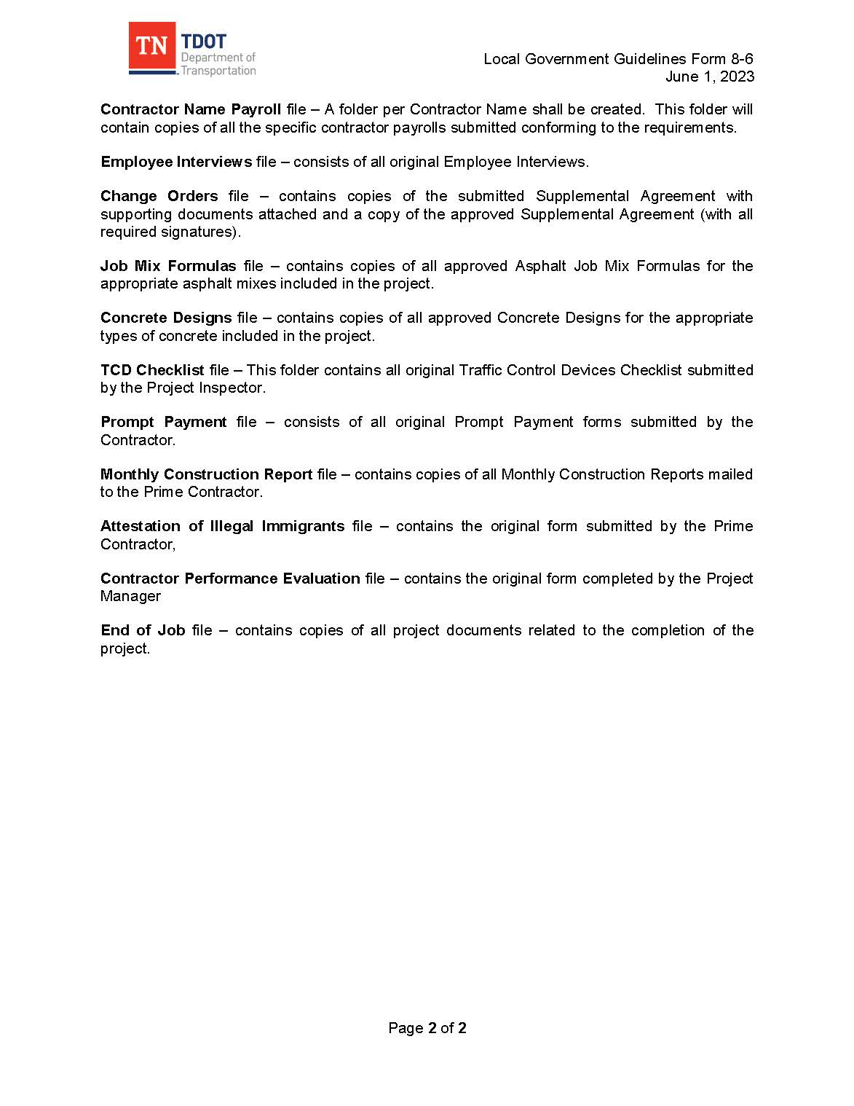
Construction Project File List

Slide 45
Construction Procedures
PUBLIC RELATIONS AND PUBLIC INFORMATION
The Local Government, with the CEI, should provide timely information to the local media regarding lane closures, construction updates, and general project information. It is suggested the Local Government establish an area on its website for such information.
Meetings or public hearings must be held in accessible locations. As needed, alternate form of communication needs shall be addressed. When communicating with the public, the LG shall coordinate with their LG ADA Coordinator to meet ADA accessibility needs.
Project specific information such as construction updates, lane closures or detours should be addressed at the appropriate time to make the motoring public aware of current conditions. Any closure or detour affecting a state route or major artery shall be coordinated with TDOT and the Local Agency.

Slide 46
Construction Procedures
SUBCONTRACTING OF WORK
The prime contractor may sub-let work in accordance with Section 108.01 of the TDOT Standard Specifications, as allowed in 23 CFR 635.116 (CL 108.01-01, CL 108.01-02). In no case shall the prime contractor sublet more than seventy (70) percent of the original contract amount excluding specialty items. All subcontractors must be pre-qualified in accordance with TDOT Standard Specifications (Section 102.01).

Slide 47
Construction Procedures
SUBCONTRACTING OF WORK
The LG shall approve all 1st, 2nd, or greater tier subcontracts. All approved subcontractors shall be on the TDOT Pre-Qualified Contractor List. An approved and executed subcontract form must be on file in the project records (Subcontract File) before a subcontractor can begin work. An approved and executed subcontract form bears all of the required signatures of the appropriate officials. The Prime Contractor shall submit to the LG completed subcontract forms after they have been collected from the subcontractors. Form 8-7a , Form 8-7b, and Form 8-7c are provided for 1st, 2nd, and 3rd tier subcontractors. Link to Prequalification : (https://www.tn.gov/tdot/tdot-construction-division/construction-contractor-prequalification.html)

Slide 48
Construction Procedures
SUBCONTRACTING OF WORK (CONT’D)
FHWA requires that all subcontracts at any tier be in writing, per 23 CFR, Section 635.116(b). This includes both contracts between the prime contractor and their subcontractors, and contracts between subcontractors and their agents. Each of these subcontracts shall physically contain the following documents. NONE OF THESE DOCUMENTS CAN BE INCLUDED BY REFERENCE ONLY:
  Form FHWA 1273 “Required Contract Provisions, Federal-Aid Construction Contracts,” and,
  The minimum wage rates for the contract as required by Tennessee Prevailing Wage Rate Act and 29 CFR.
It is the responsibility of the Local Government to ensure full compliance with all required provisions.
The subcontract forms shall contain all applicable information and be signed by the respective entities.

Slide 49
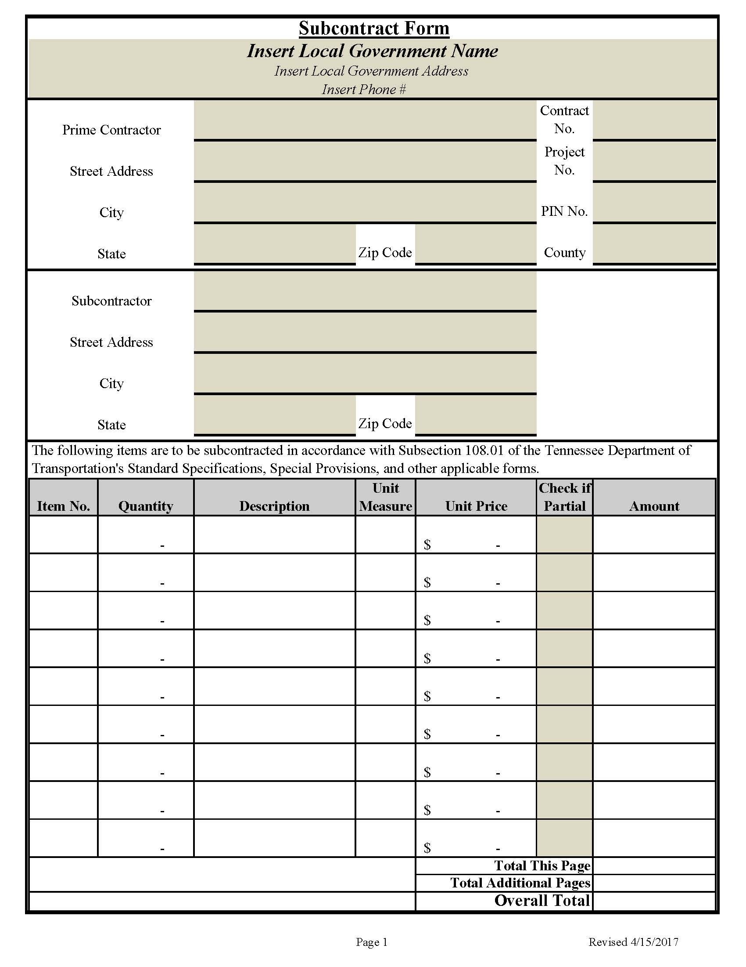
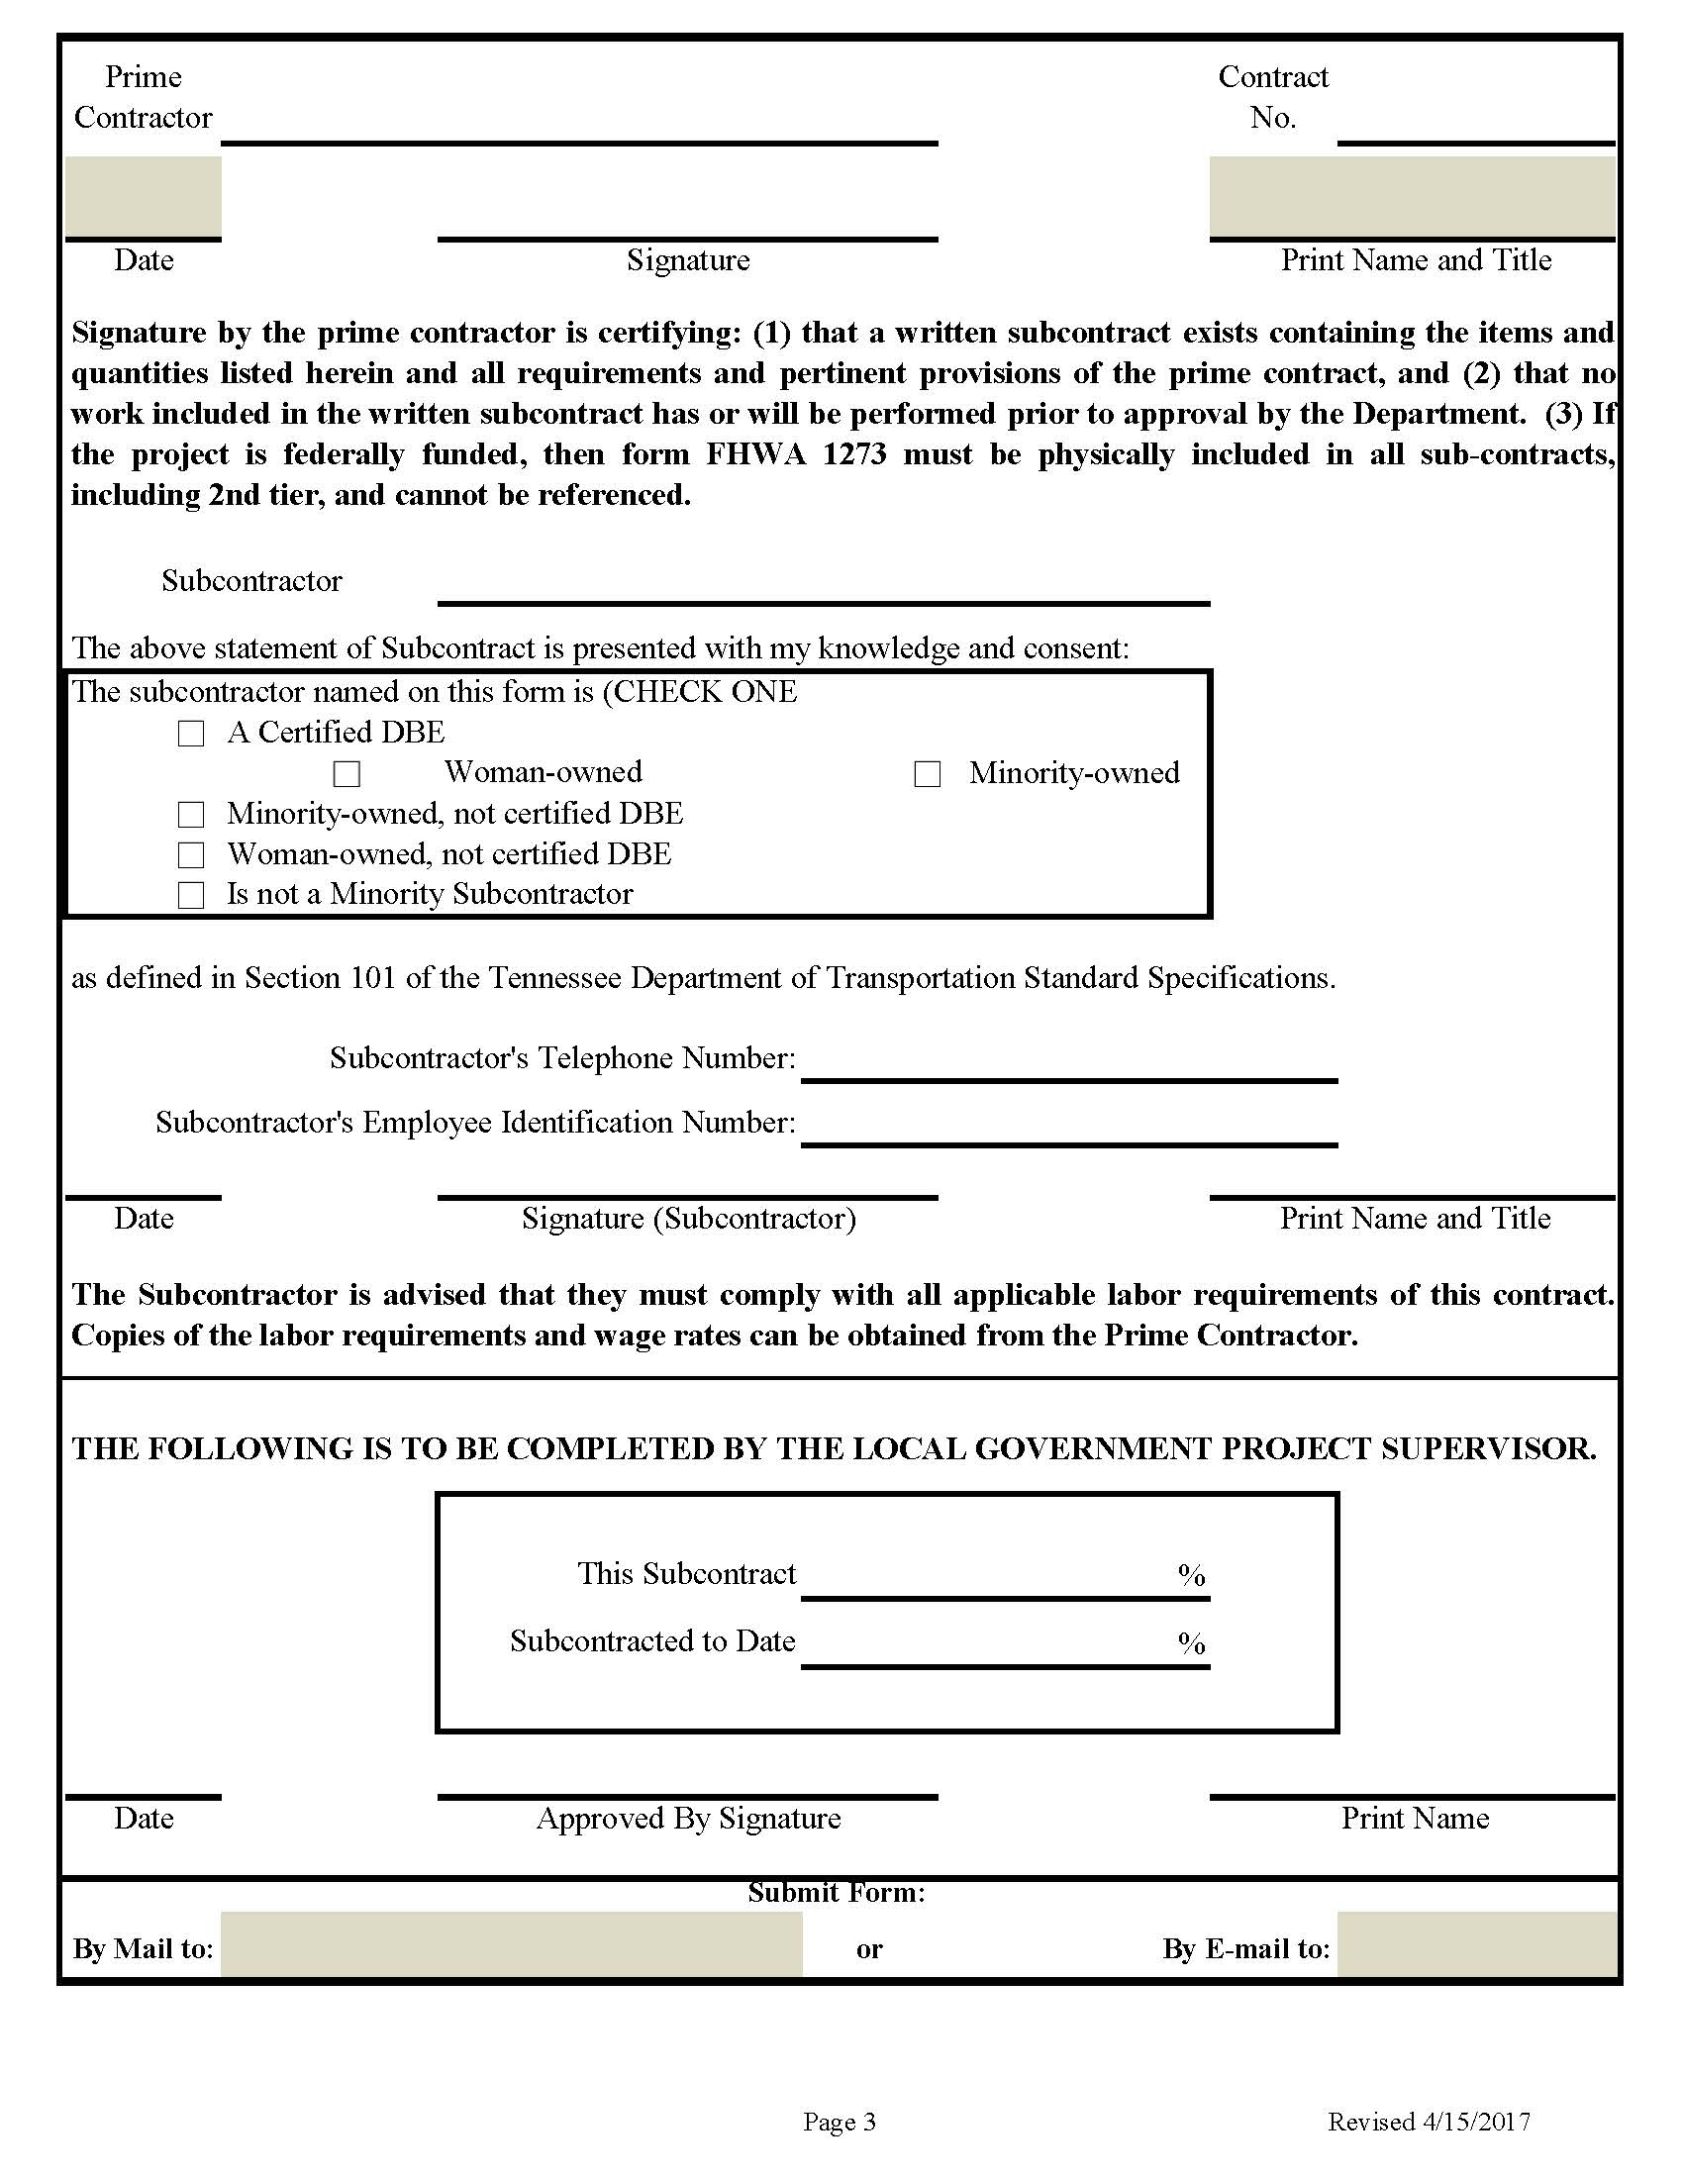
Subcontract Forms

Slide 50
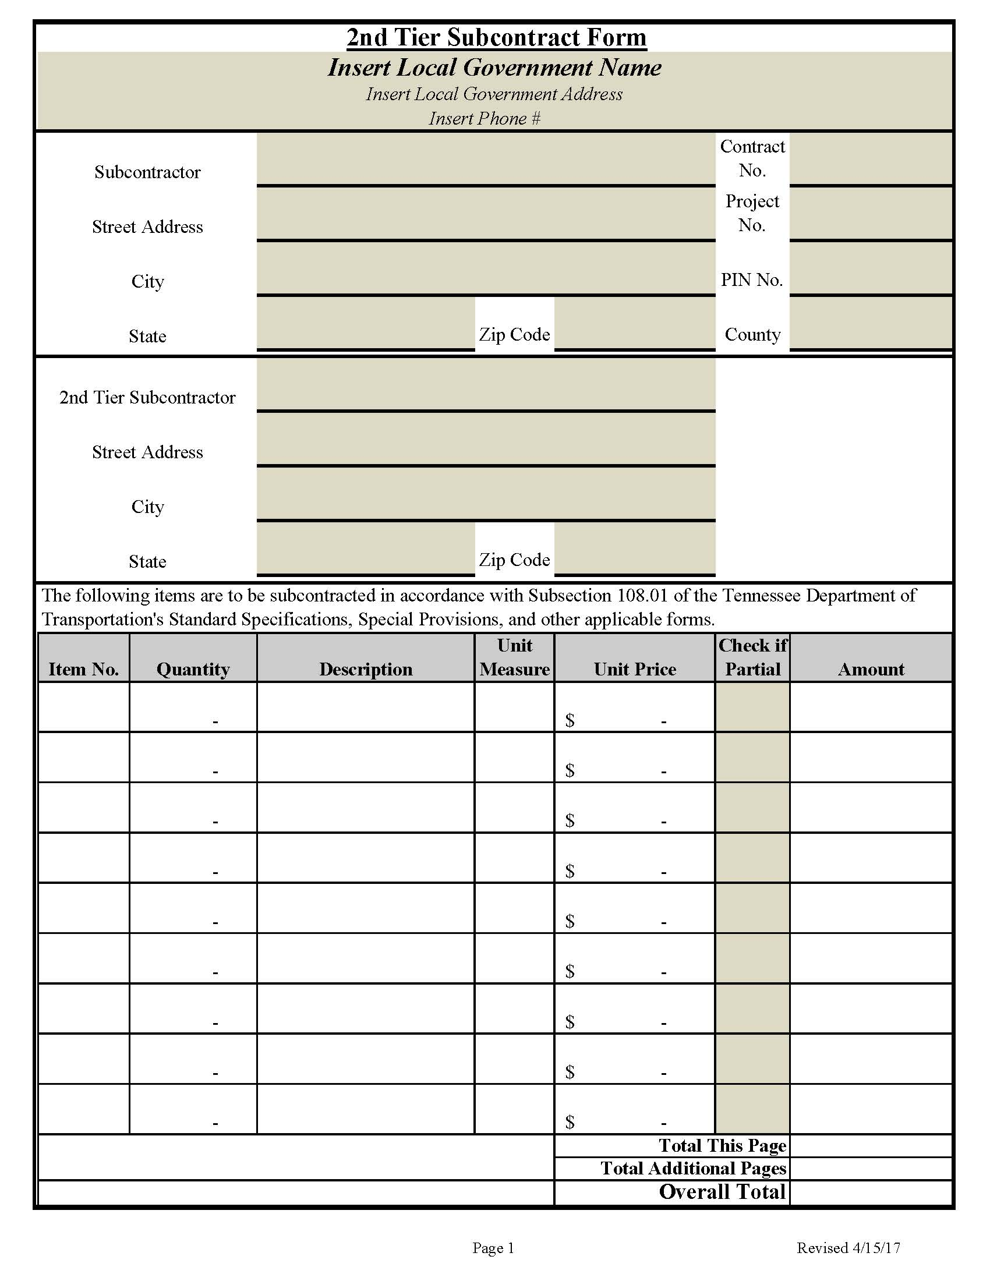
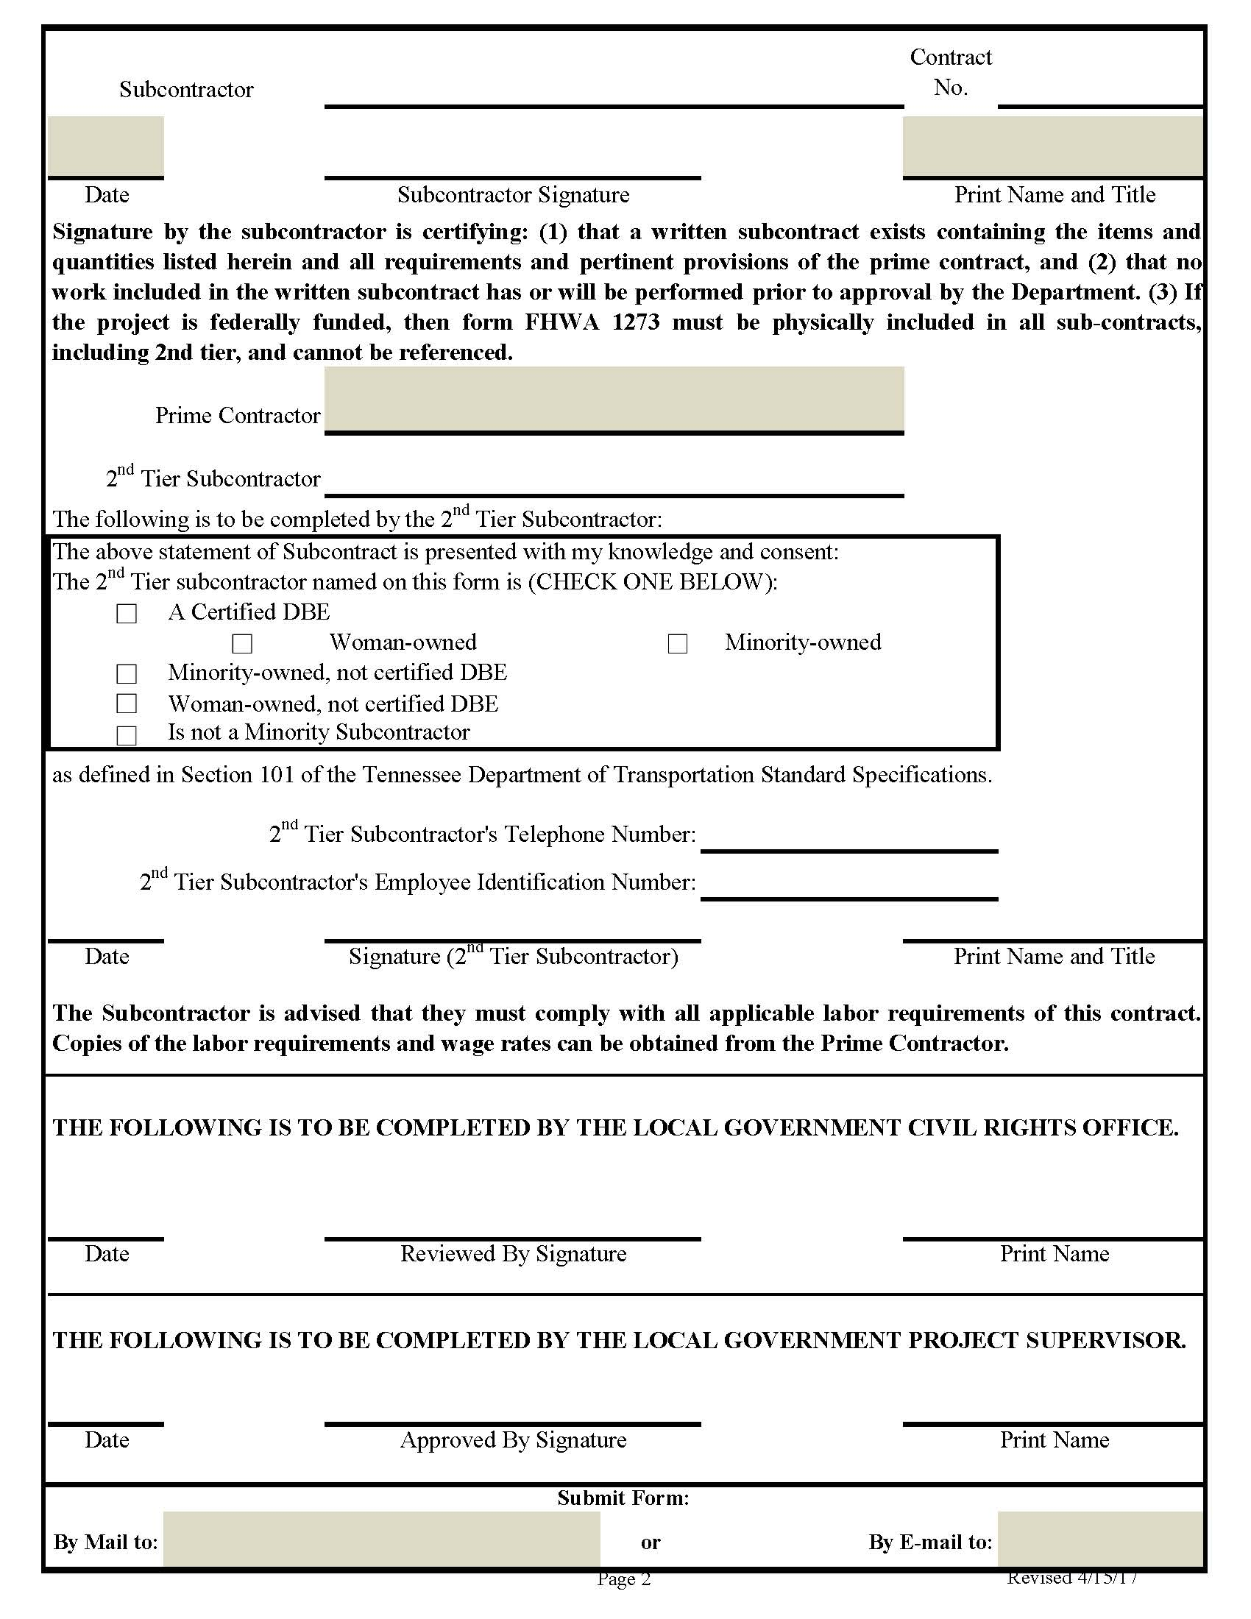
2nd Tier Subcontract Forms

Slide 51
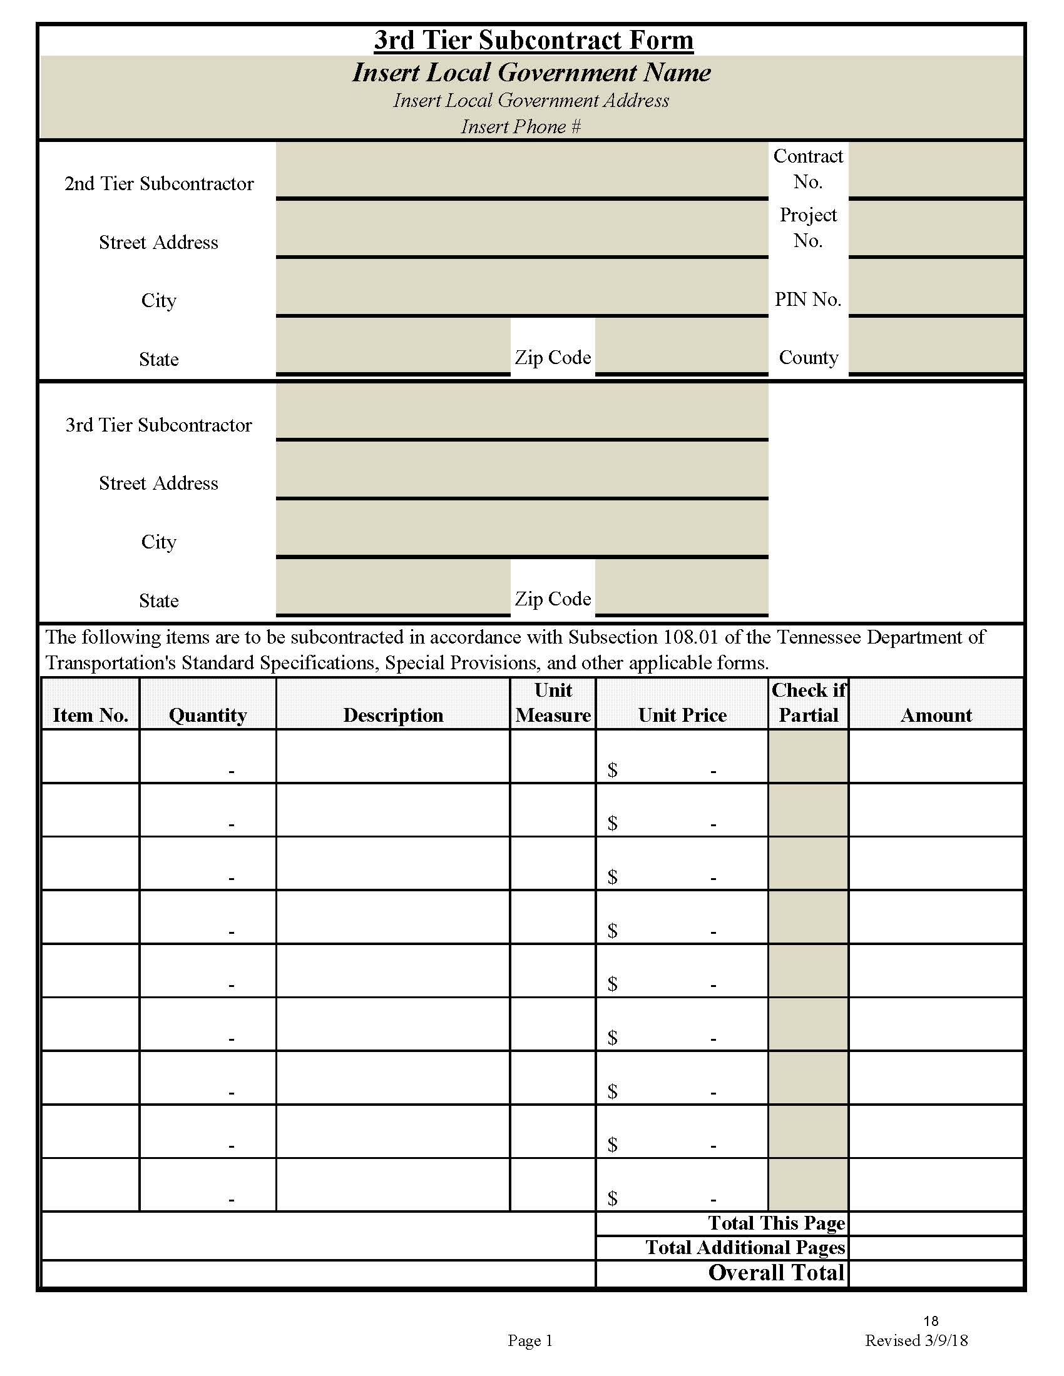
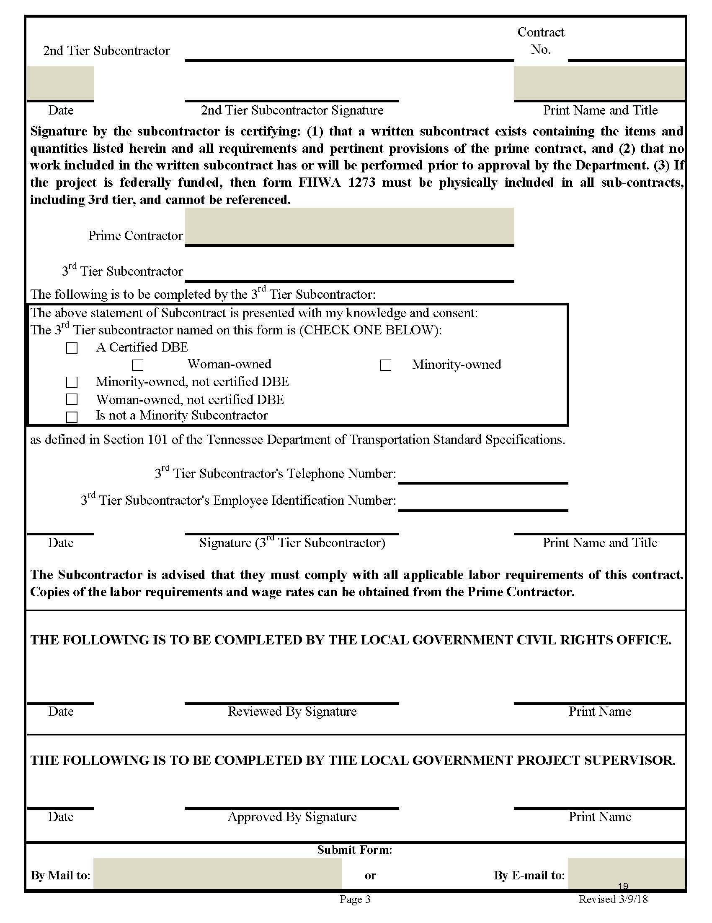
3RD Tier Subcontract Forms

Slide 52
Construction Procedures
DBE SUBCONTRACTS AND CIVIL RIGHTS CONTRACT COMPLIANCE
As soon as possible after the award of the contract, the Contractor shall submit to the Local Government Project Supervisor a copy of the actual signed contract agreement between the contractor and the DBE subcontractor for each DBE. The actual signed agreement(s) must be on file in the project records before the first progress estimate is paid.
If a DBE is unable to perform the work which they committed to at award, the prime contractor/consultant should notify the LG and the defaulting DBE is required to notify the TDOT Civil Rights Division immediately. Adequate effort should be made to replace the dollar amount of the lost DBE commitment. Please refer to TDOT Special Provision (SP) 1247LP and https://www.tn.gov/tdot/civil-rights/small-business-development-program.html. The DBE goal is a mandatory contractual obligation and shall be met or exceeded. The prime contractor shall replace the lost dollar amount of the DBE commitment with a DBE replacement approved by the TDOT Civil Rights Division. Refer to the Civil Rights Division Small Business Development Program’s website for more information on achieving DBE goals.
The TDOT Civil Rights Division may be contacted to obtain additional guidance on Good Faith Effort determinations. If a DBE is unable to perform the work which they committed to perform, the prime contractor/consultant should notify the LG. Adequate effort should be made to replace the dollar amount of the lost DBE commitment.

Slide 53
Construction Procedures
DBE SUBCONTRACTS AND CIVIL RIGHTS CONTRACT COMPLIANCE
(CONT’D)
If the contract has a DBE Goal, a copy of the signed subcontract agreement between the Prime Contractor and the DBE subcontractor must be in the project records (DBE file) before the first progress estimate can be paid. Additional information regarding Disadvantaged Business Enterprises is located in Chapter 7: Civil Rights Compliance.
At the Pre-Construction Conference, the Prime Contractor shall identify all DBE subcontractors indicating approximate dates for their appearance on the project.

Slide 54
Construction Procedures
DBE SUBCONTRACTS AND CIVIL RIGHTS CONTRACT COMPLIANCE
(CONT’D)
The DBE Company Profile (Form 8-8a) and DBE Material Supplier/Trucker Contract Certification (Form 8-8b) shall be completed in accordance with TDOT Circular Letter 1247-01 once the DBE contracts are in place as outlined in Section 7.2.9. Contact the Local Government DBE Liaison for a copy of the completed DBE Company Profile. A DBE Company Profile and the DBE Material Supplier/Trucker Contract Certification shall be completed for each DBE on the project and kept by the LG for records.

Slide 55
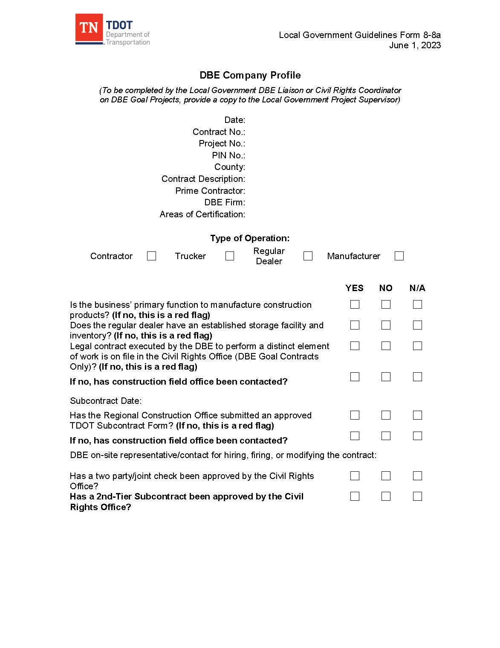
DBE Company Profile Example

Slide 56
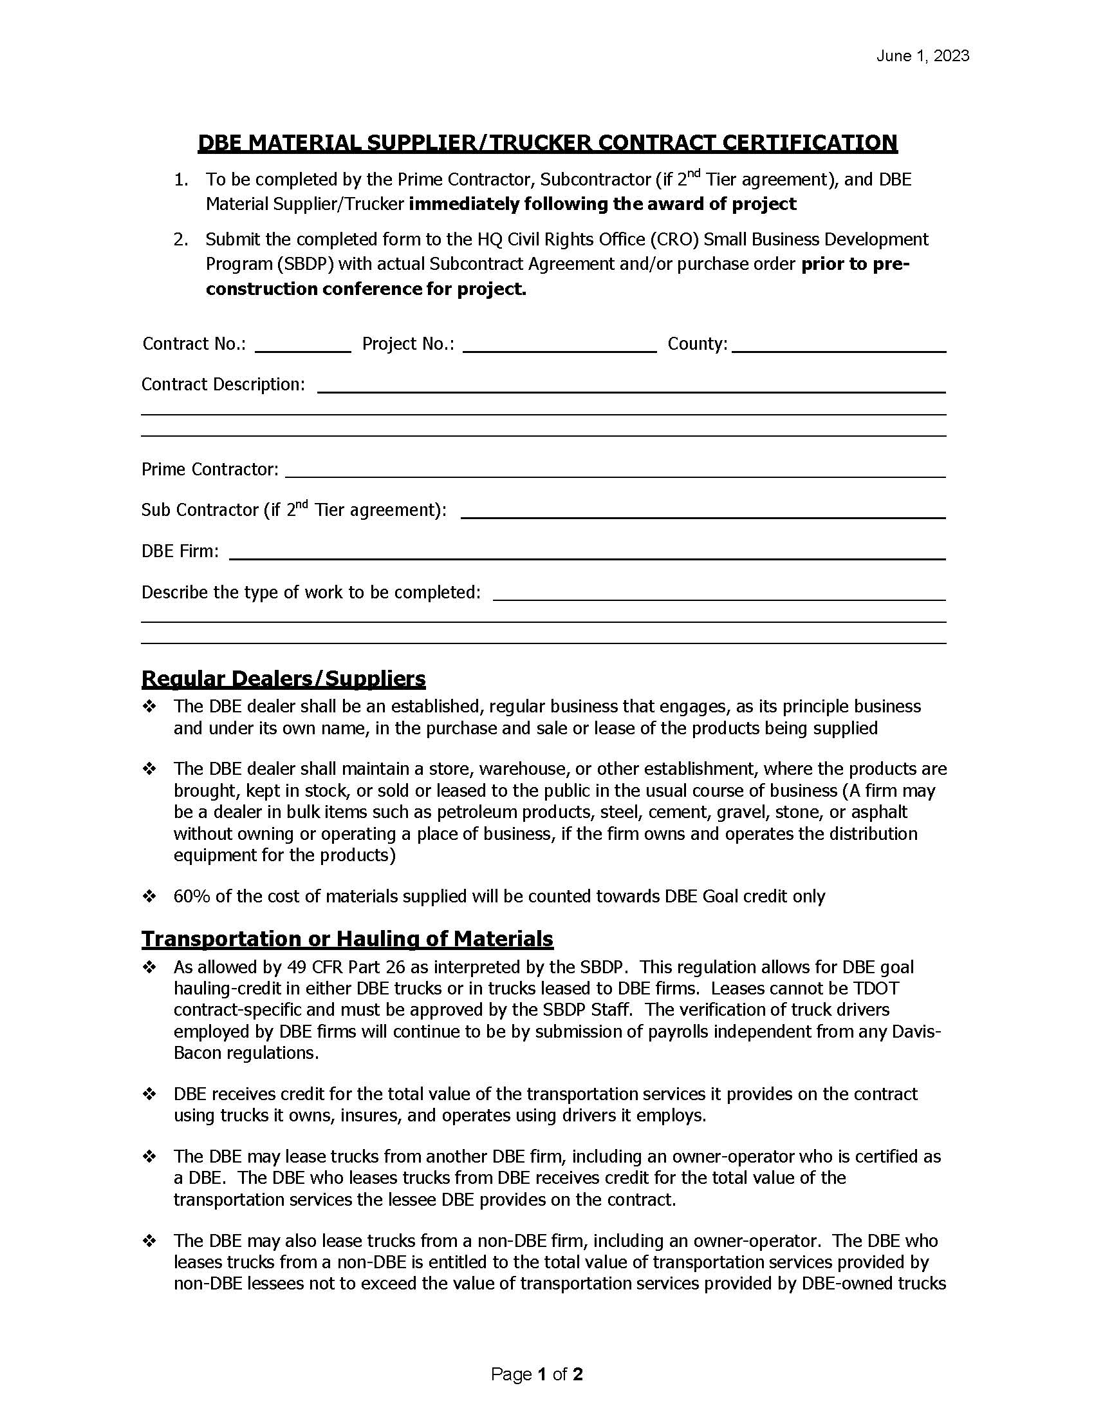
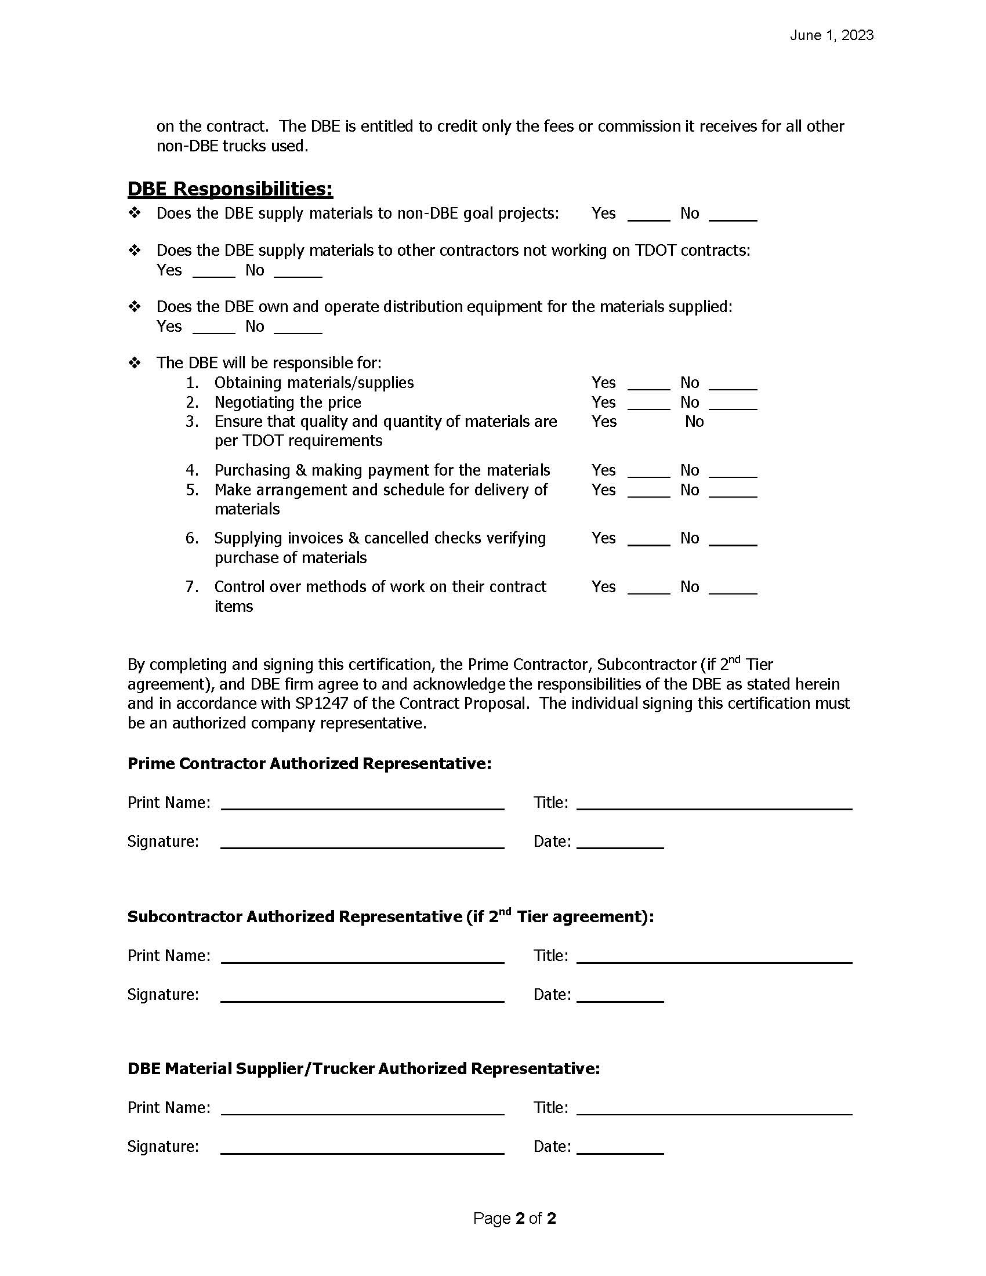
DBE Material Supplier/Trucker Contract Certification Example

Slide 57
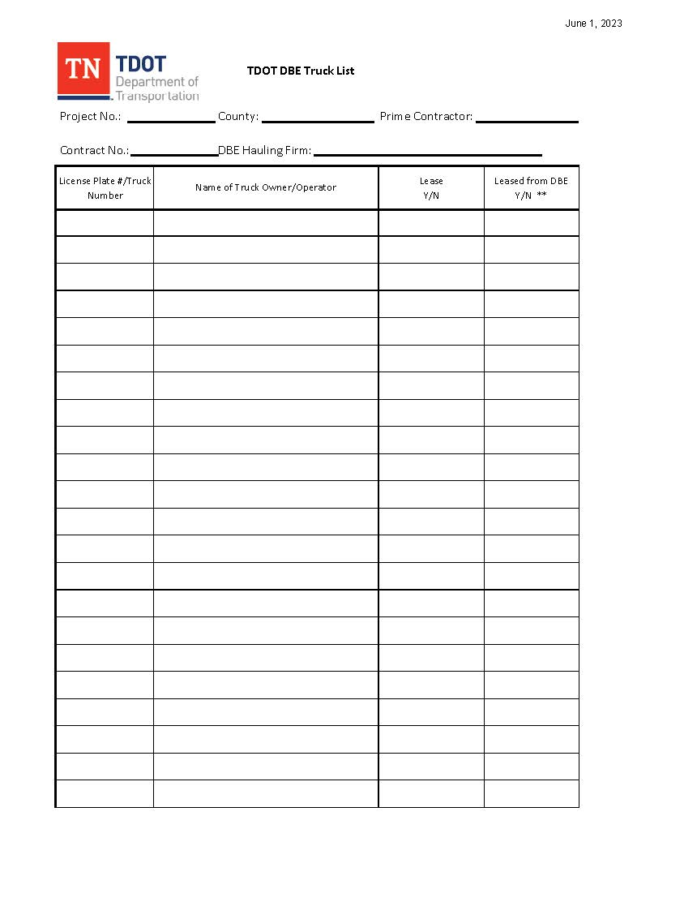
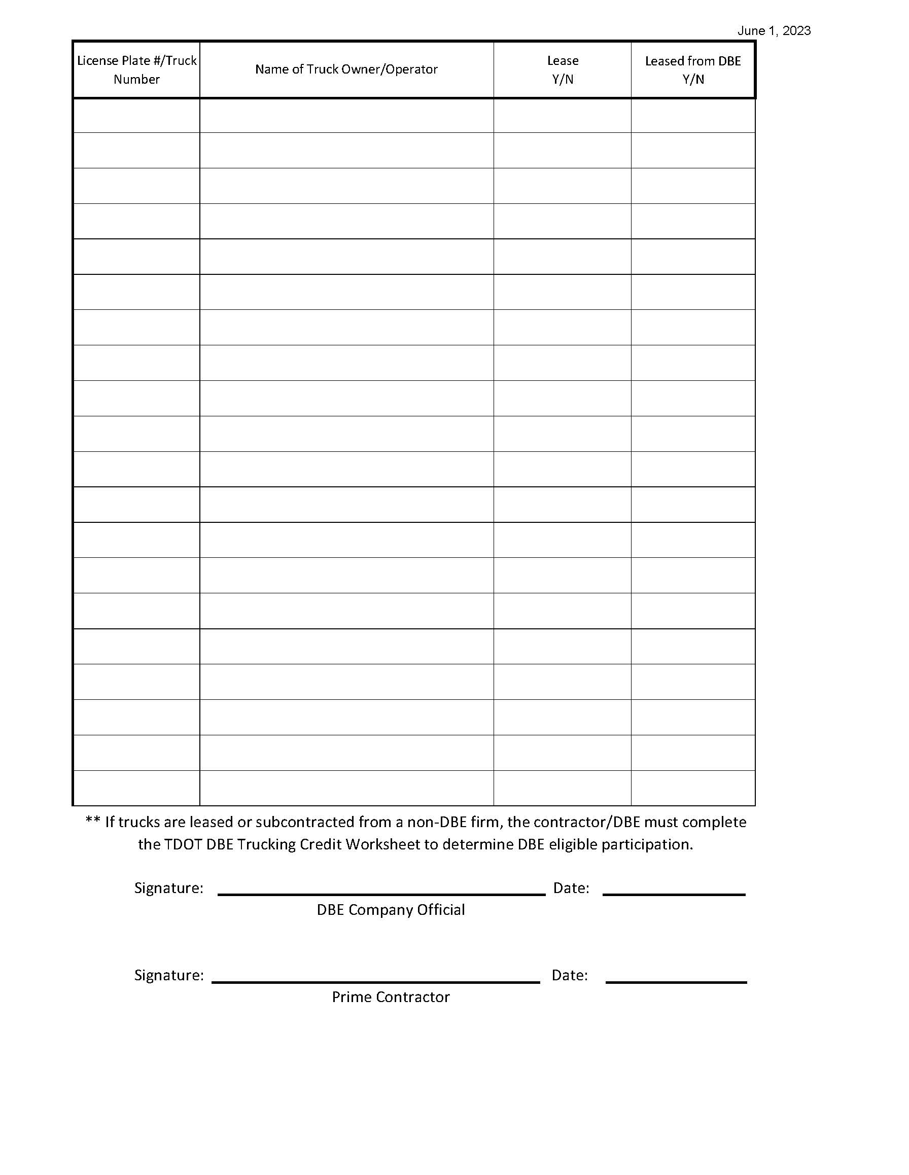
DBE Material Supplier/Trucker Contract Certification Example

Slide 58
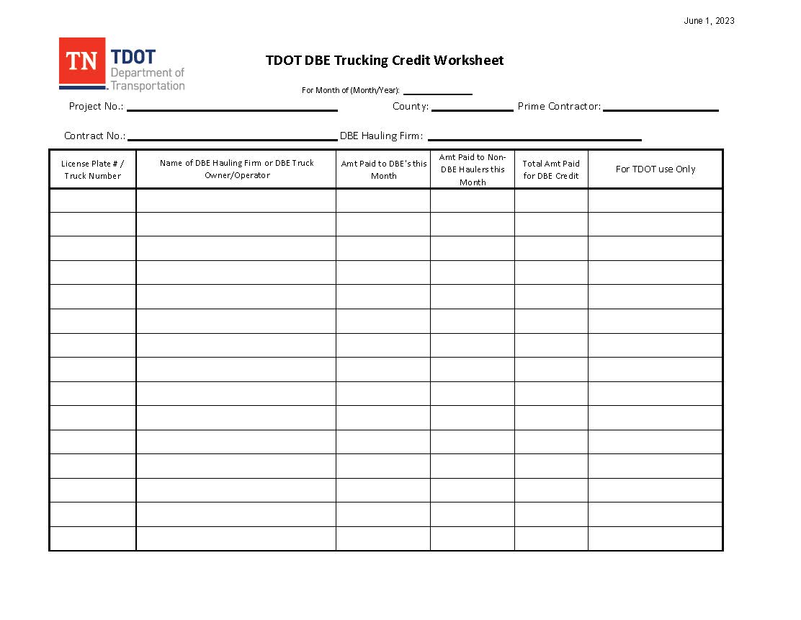
DBE Material Supplier/Trucker Contract Certification Example

Slide 59
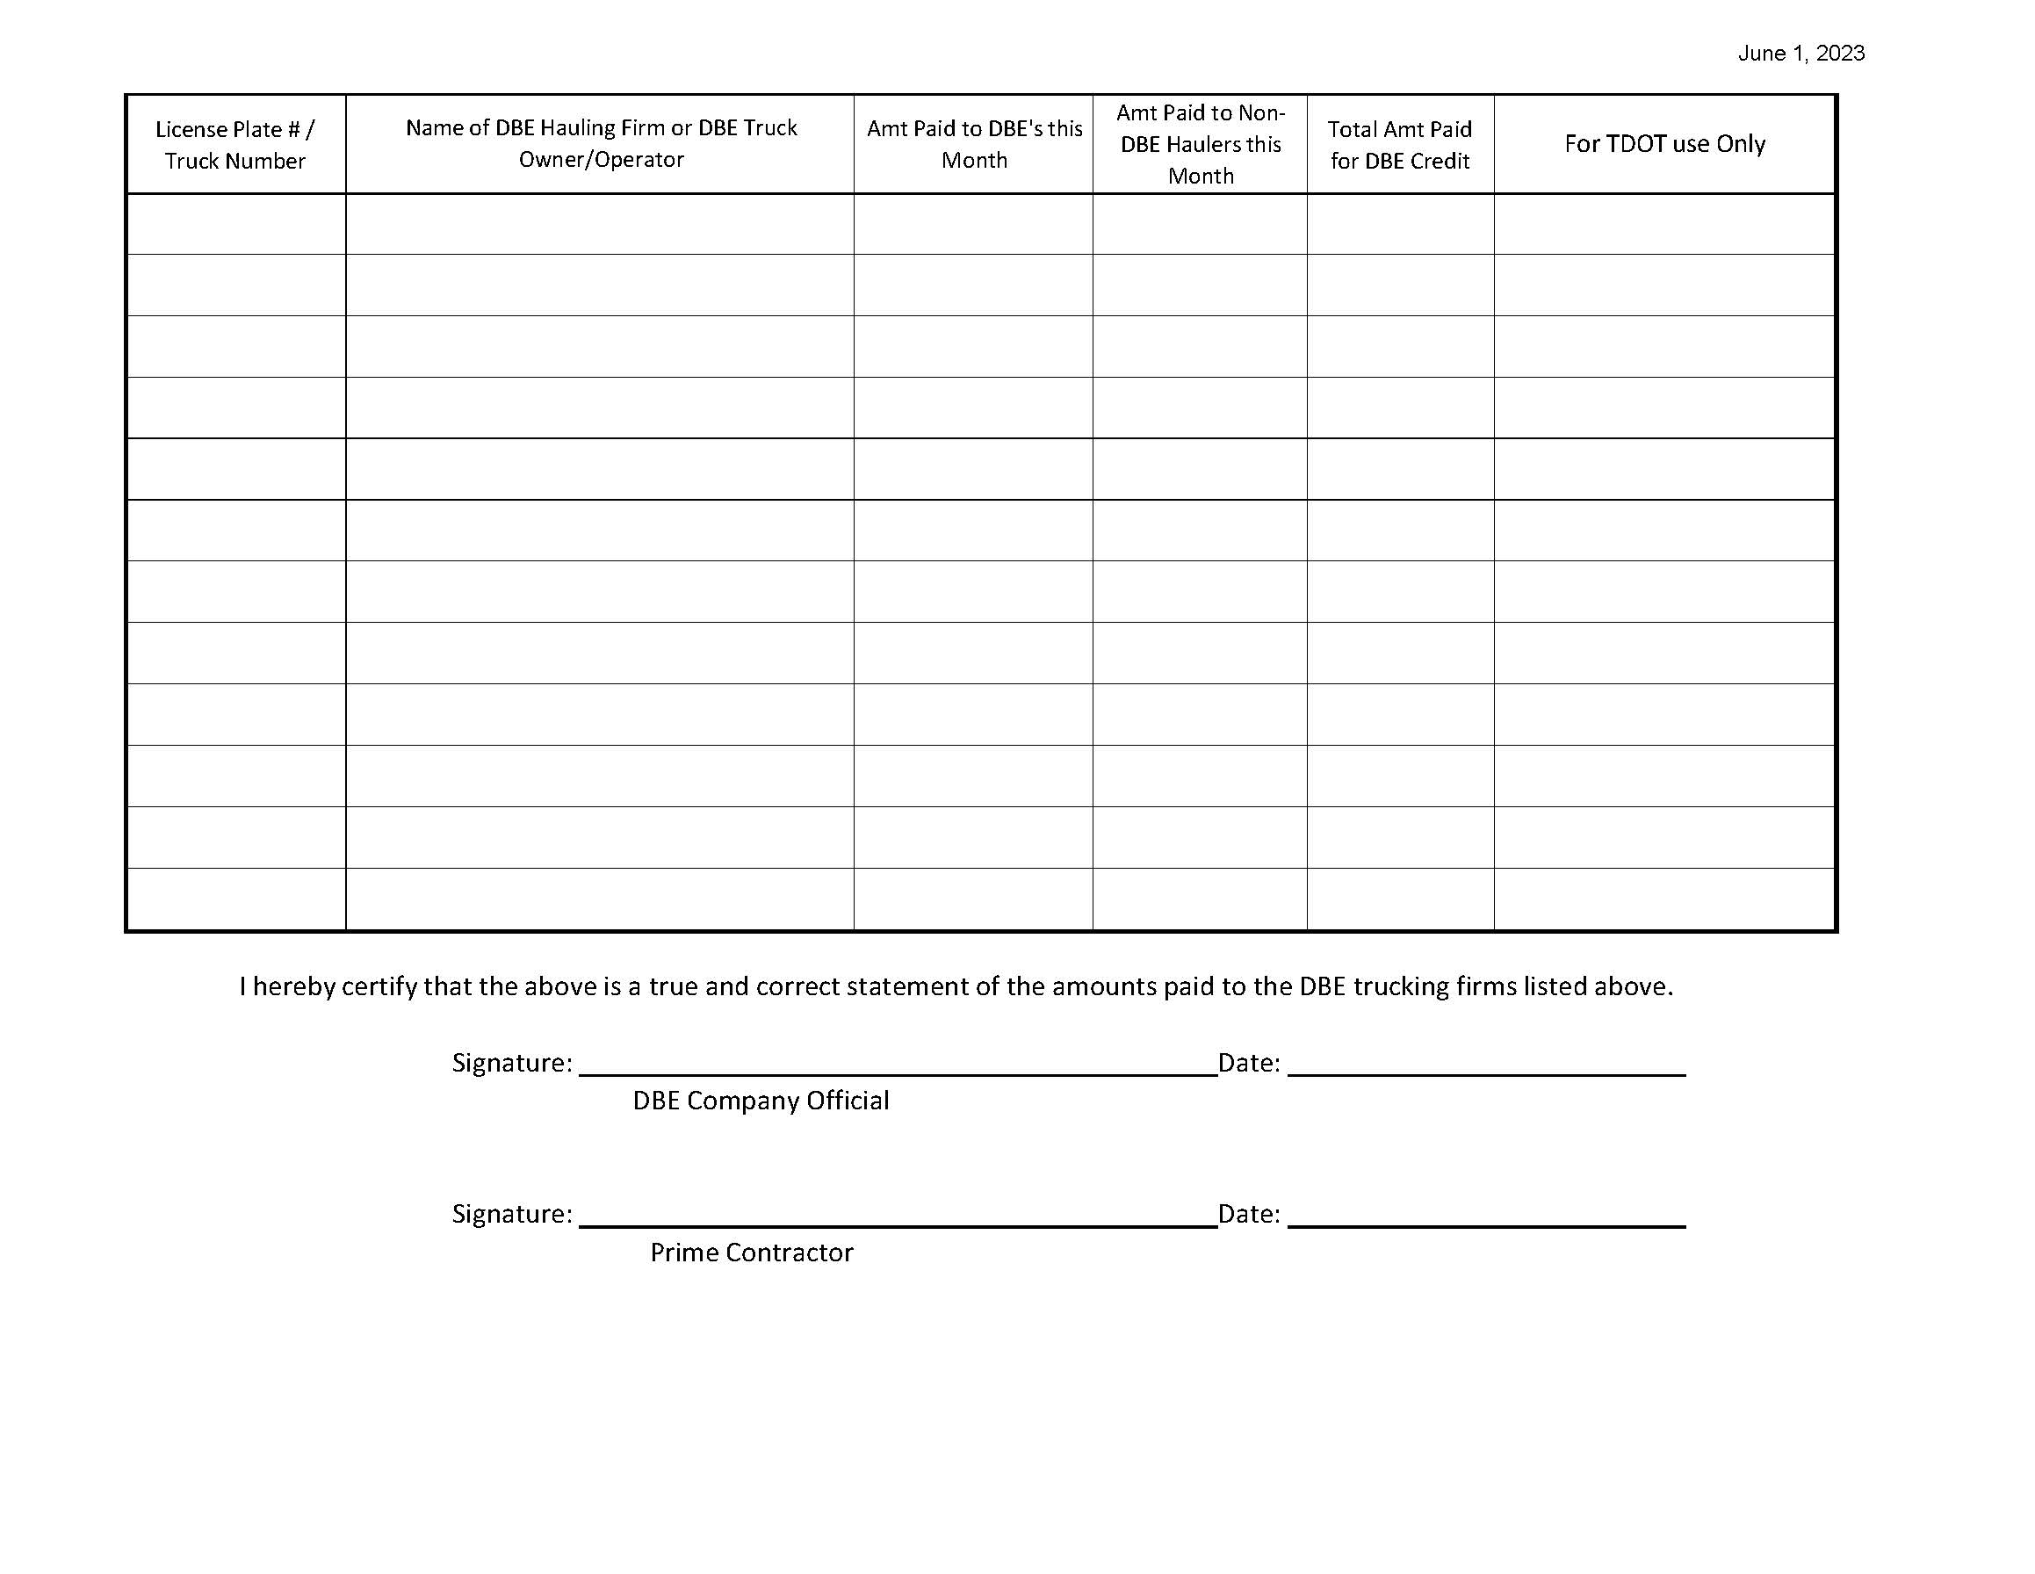
DBE Material Supplier/Trucker Contract Certification Example

Slide 60
Construction Procedures
DBE SUBCONTRACTS AND CIVIL RIGHTS CONTRACT COMPLIANCE
(CONT’D)
The Commercially Useful Function (CUF) Checklist (Form 8-9) shall be completed for every DBE on ALL projects and submitted to the TDOT Civil Rights Office via their web address (tdot.dbe.program@tn.gov). The Local Government Project Supervisor shall assume the responsibility of completing the CUF Checklist. The Project Inspector shall initiate the CUF Checklist as soon as the DBE starts work. The date on the CUF Checklist (Date of Review) should be the date the actual observation was made. The Project Supervisor shall send the original to the DBE Liaison. A copy of the completed DBE Company Profile and a copy of the CUF Checklist shall be sent to the TDOT Civil Rights Office with a copy provided to the LPDO.
All work activities performed by a DBE shall be monitored and documented to ensure compliance. All work performed by a DBE shall be documented separately in the Project Diary. The DBE name, equipment, labor, and the type of work performed shall be documented. The acronym DBE shall be written beside the DBE name to distinguish DBE status. The project inspector shall ensure the DBE is performing the work reflected on the subcontract.

Slide 61
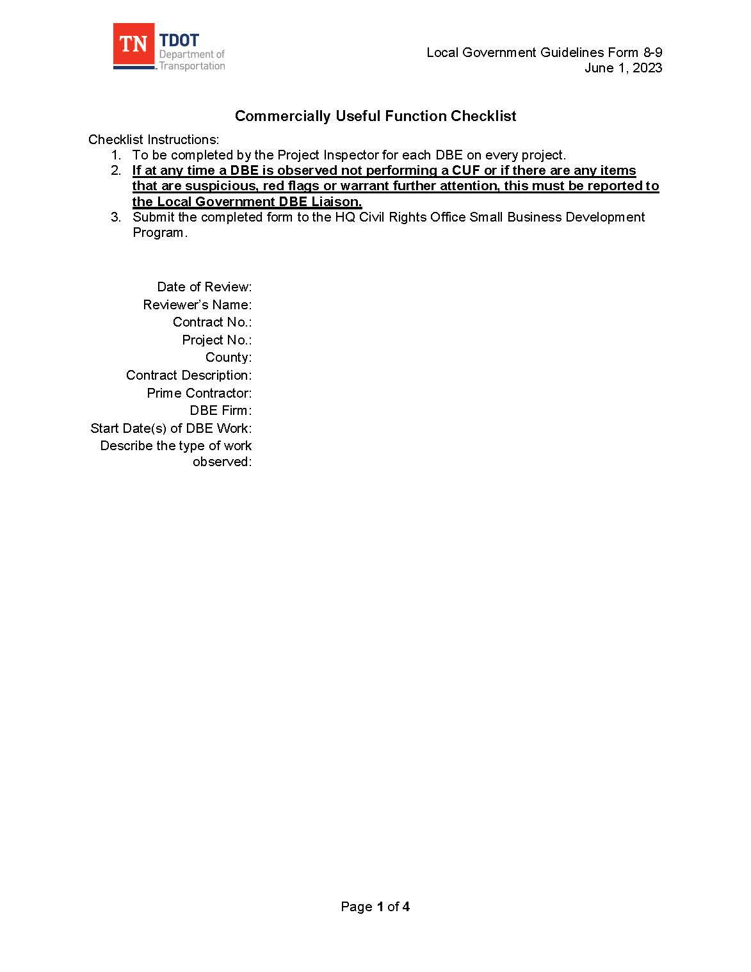
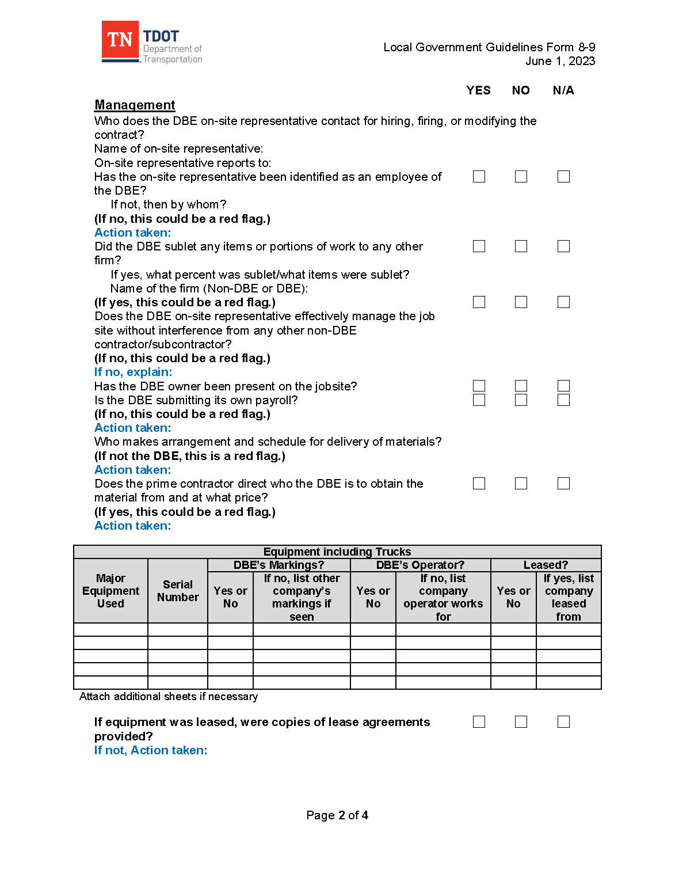
Commercially Useful Function Checklist Example

Slide 62
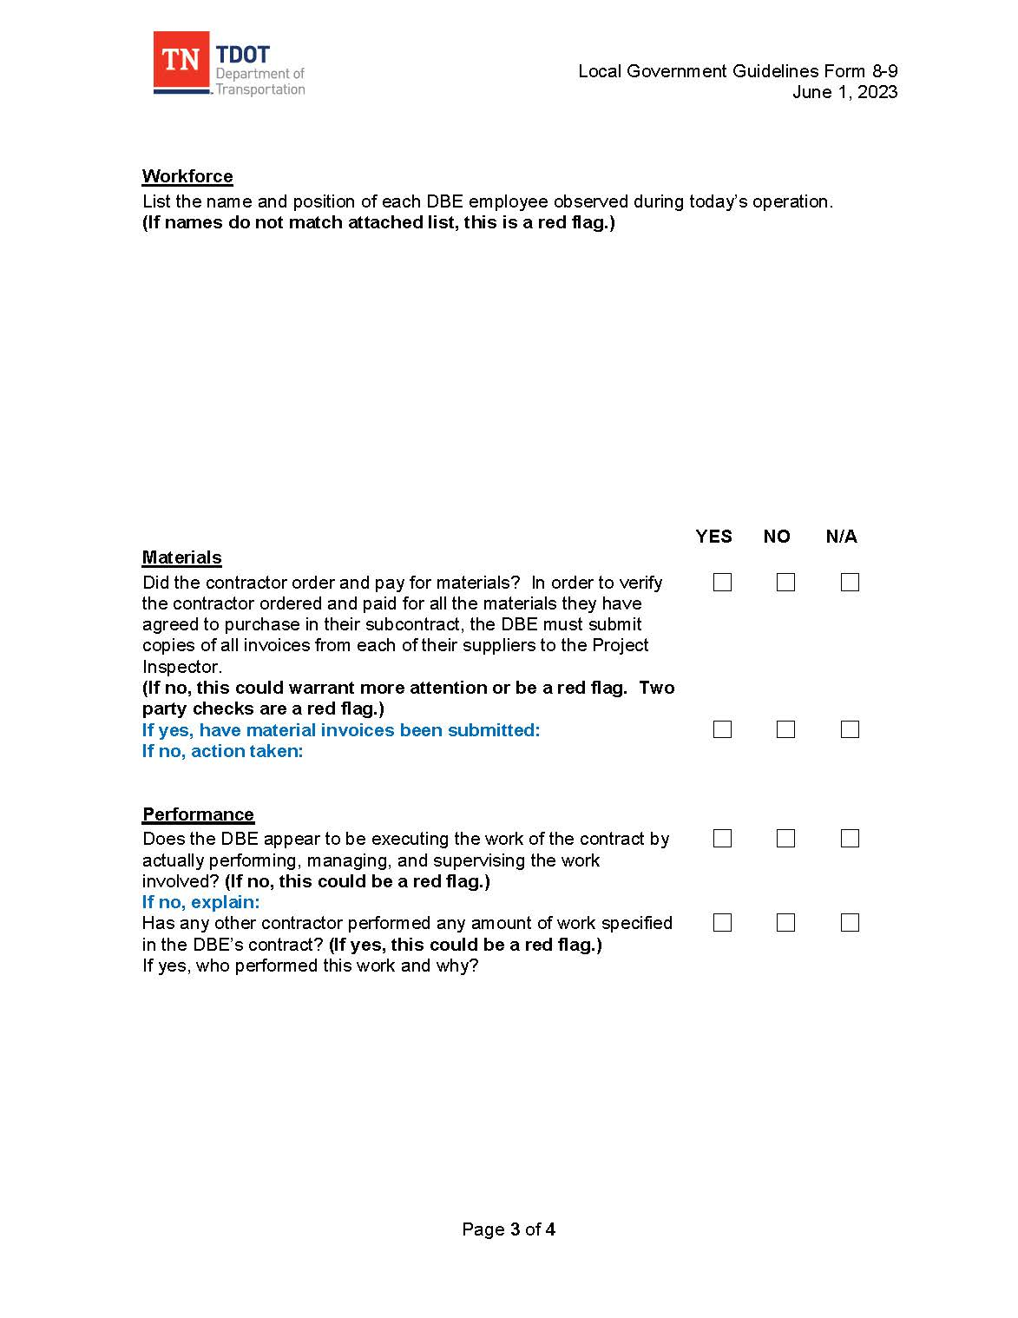
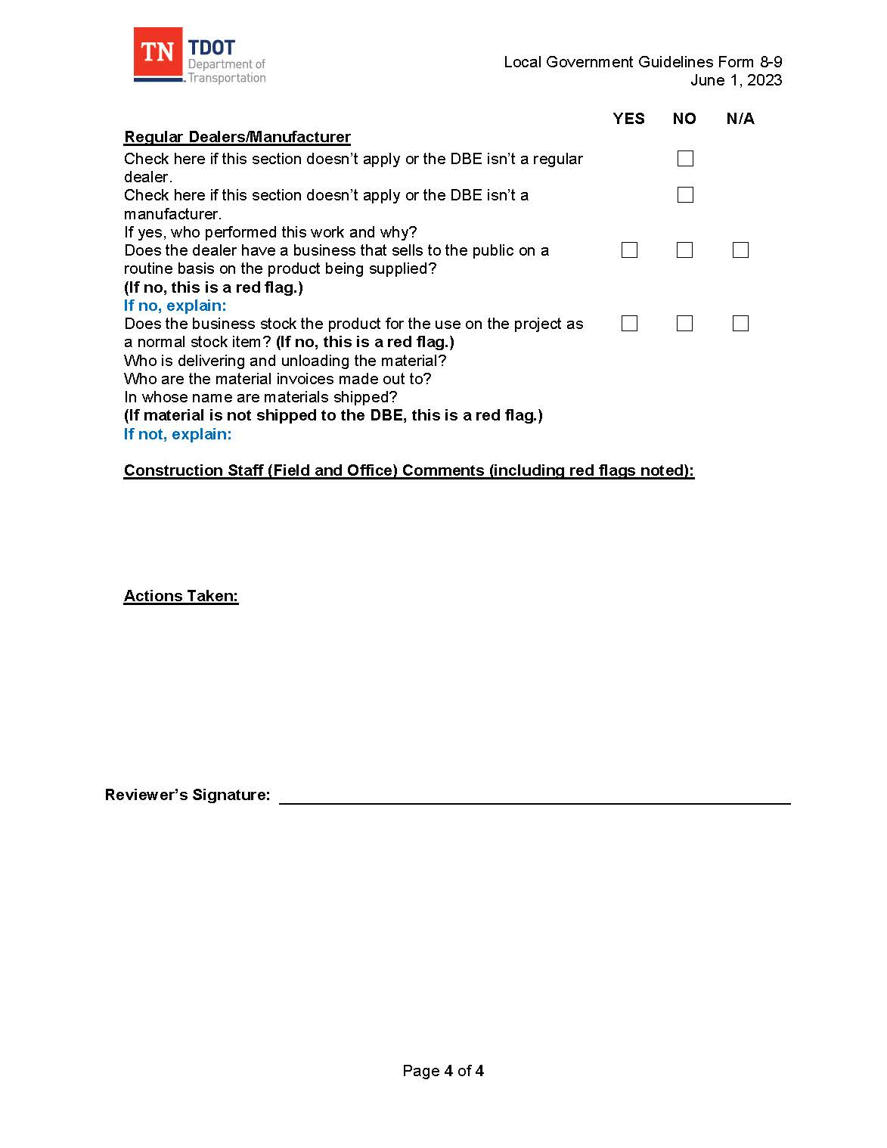
Commercially Useful Function Checklist Example

Slide 63
CONSTRUCTION CONTRACT ADMINISTRATION
CONSTRUCTION
All construction shall be completed in full compliance with the contract documents, including the Bid Book, TDOT Standard Specifications for Road and Bridge Construction, and TDOT Standard Drawings.
The TDOT Regional Construction Manager and Materials & Tests Manager will each assign a TDOT representative to participate in the project pre-construction conference. The TDOT Construction Representative will conduct routine project reviews (at designated intervals as described in Circular Letter 105.11-01), attend progress meetings, and participate in the final inspection.
For non-traditional projects, the LPDO may elect to utilize a consultant firm to conduct oversight reviews. The TDOT Regional office will need to verify with the LPDO if an oversight consultant firm will be used.

Slide 64
CONSTRUCTION CONTRACT ADMINISTRATION
CONSTRUCTION
The TDOT Operations’ Circular Letter File contains general guidance and requirements for the proper administration of projects. The Circular Letters can be found at: https://www.tn.gov/content/dam/tn/tdot/programdevelopment/localprograms/documents-and-forms/LP_Circular_Letters_Combined.pdf.
Reduced requirements for non-traditional projects can be found in Chapter 10: Non-Traditional Projects.

Slide 65
Contract Documents
TDOT Local Government Guidelines (LGG)
TDOT Standard Specifications for Road and Bridge Construction (2021) and Supplemental Specifications
TDOT Standard Drawings
Contract including Special Provisions
Plans
TDOT Circular Letters
Other referenced guidance (AASHTO, ASTM, MUTCD, ETC.)

Slide 66
Hierarchy of Contract Documents(§105.04)
  Special Provisions
  Plans
  Supplemental Specifications
  Standard Specifications

Slide 67
CONSTRUCTION CONTRACT ADMINISTRATION
PRE-CONSTRUCTION CONFERENCE
Before any work begins, a pre-construction conference shall be held (Standard Specifications, Section 105.06) by the Local Government’s Project Supervisor to discuss the contractor’s plan of operation, required contract provisions, environmental commitments if applicable, erosion control, traffic control/work zone safety, utility relocations, inspection, materials acceptance, independent assurance, quality control plans, certified payrolls, DBE/subcontractors (approximate mobilization dates), etc. Minutes (Pre-Construction Conference Minutes Form) shall be kept of this conference, including an attendance roster (Pre-Construction Conference Sign-in Sheet), and key decisions shall be fully documented. A copy of these minutes should be emailed to all attendees and to Local.Programs@tn.gov . The preconstruction meeting may be held virtually if all requirements are met.
A meeting announcement (Pre-Construction Conference Notice) (Circular Letter 105.06-01) (Form 8-10a) shall be sent 14 days in advance, to all parties with a vested interest in the project including, but not limited to: prime and subcontractors, material suppliers, permitting agencies, utility owners, the TDOT District Operations Engineer/Manager, TDOT Regional Materials and Tests Supervisor and other affected LGs. The preconstruction meeting shall not commence until the work order (notice to proceed) has been issued.

Slide 68
CONSTRUCTION CONTRACT ADMINISTRATION
PRE-CONSTRUCTION CONFERENCE (CONT’D)
TDOT Materials & Tests Office and TDOT District Operations Office representatives must be present at the Pre-Construction Conference. If both of these offices are not represented at the Pre-Construction conference, the Pre-Construction conference must be postponed until TDOT representatives can be present.
In the Pre-Construction Conference, the following documents will be required.
  • Pre-Construction Notice (Form 8-10a)
  • Pre-Construction Conference Meeting Minutes (Form 8-11a)
  • Pre-Construction Conference Sign-in Sheet (Form 8-12)
In the case that Erosion Control and/or Utility Conferences are necessary, refer to Section 8.2.14 and/or Section 8.2.15.

Slide 69
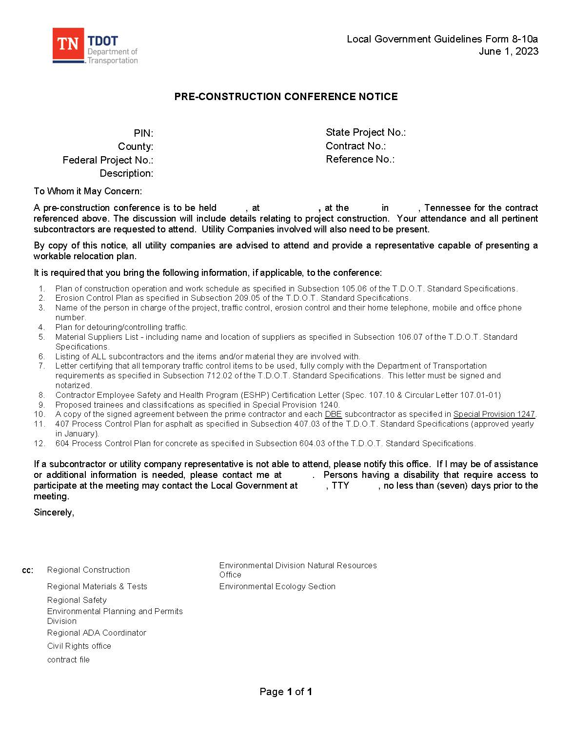
pre-construction Notice Example

Slide 70
Pre-construction Meeting Agenda
Items to be Discussed
AGENDA ITEMS
Plan of construction operation and work schedule as specified in Subsection
105.06 of the TDOT Standard Specifications.
2. Erosion Control Plan as specified in Subsection 209.05 of the T.D.O.T. Standard Specifications.
3. Name of the person in charge of the project, traffic control, erosion control and their home telephone, mobile number.
4. Plan for detouring/controlling traffic.
5. Material Suppliers List - including name and location of suppliers as specified in Subsection 106.07 of the TDOT Standard Specifications.
6. Listing of ALL subcontractors and the items and/or material they are involved with.
7. Letter certifying that all temporary traffic control items to be used, fully comply with the Department of Transportation requirements as specified in Subsection 712.02 of the TDOT Standard Specifications. This letter must be signed and notarized.

Slide 71
Pre-construction Meeting Agenda
Items to be Discussed
AGENDA ITEMS (CONT’D)
8. Contractor Employee Safety and Health Program (ESHP) Certification Letter (Special Provision 107SHP & Circular Letter 107.01-01)
9. Proposed trainees and classifications as specified in Special Provision 1240 if applicable.
10. A copy of the signed agreement between the prime contractor and each DBE subcontractor as specified in SP 1247LP to be presented.
11. 407 Process Control Plan for asphalt as specified in Subsection 407.03 of the TDOT Standard Specifications.
12. 604 Process Control Plan for concrete as specified in Subsection 604.03 of the TDOT Standard Specifications.

Slide 72
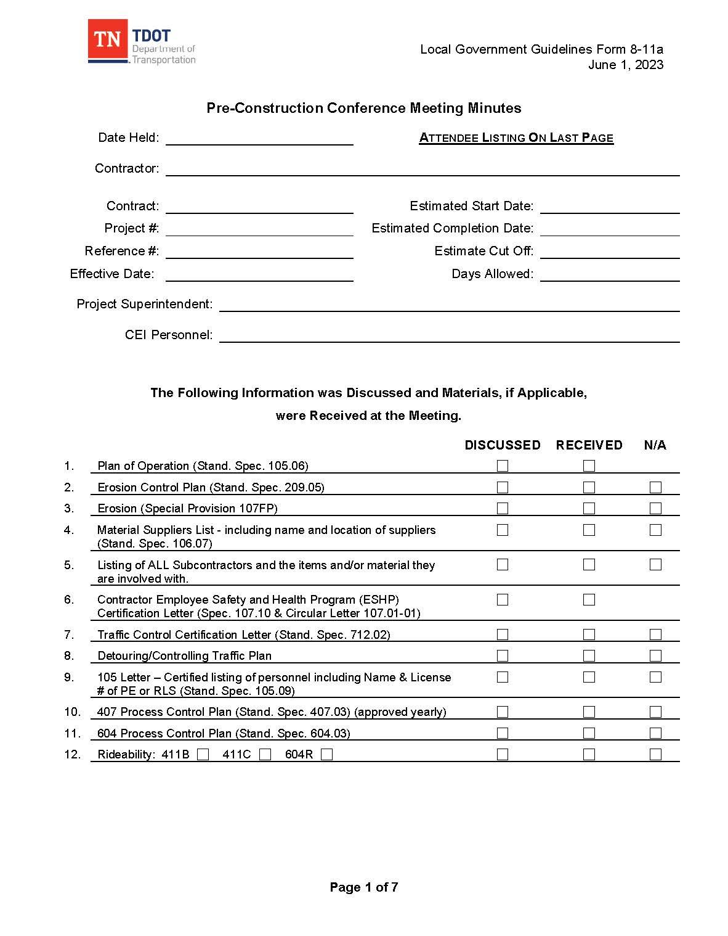
Pre-construction Conference Minutes Example

Slide 73
pre-construction Meeting Agenda
Items to be Discussed
AGENDA ITEMS (CONT’D)
1. Listing of contact personnel of contractor for Traffic Control, Erosion Control, Customer Service and Employee Safety.
A project site bulletin board is required on all federal aid projects. The bulletin board must display required posters as noted in Circular Letter 1273-01, Project Site Poster board.
The Department of Labor and Workforce Development lists on their website all the posters required by the Tennessee State Government and those required by the Federal Government for all Tennessee Employers. The posters may be downloaded off of the Department of Labor website and printed. The posters are located under the Online Services menu option under Posters. The following website can be used to obtain the required posters: https://www.tn.gov/workforce/general-resources/major-publications0/major-publications-redirect/posters-redirect/required-posters.html
4. The Civil Rights Division Regional Contract Compliance Officer can provide assistance in locating the posters / documents that are required in regard to DBEs, EEO, and Title VI.

Slide 74
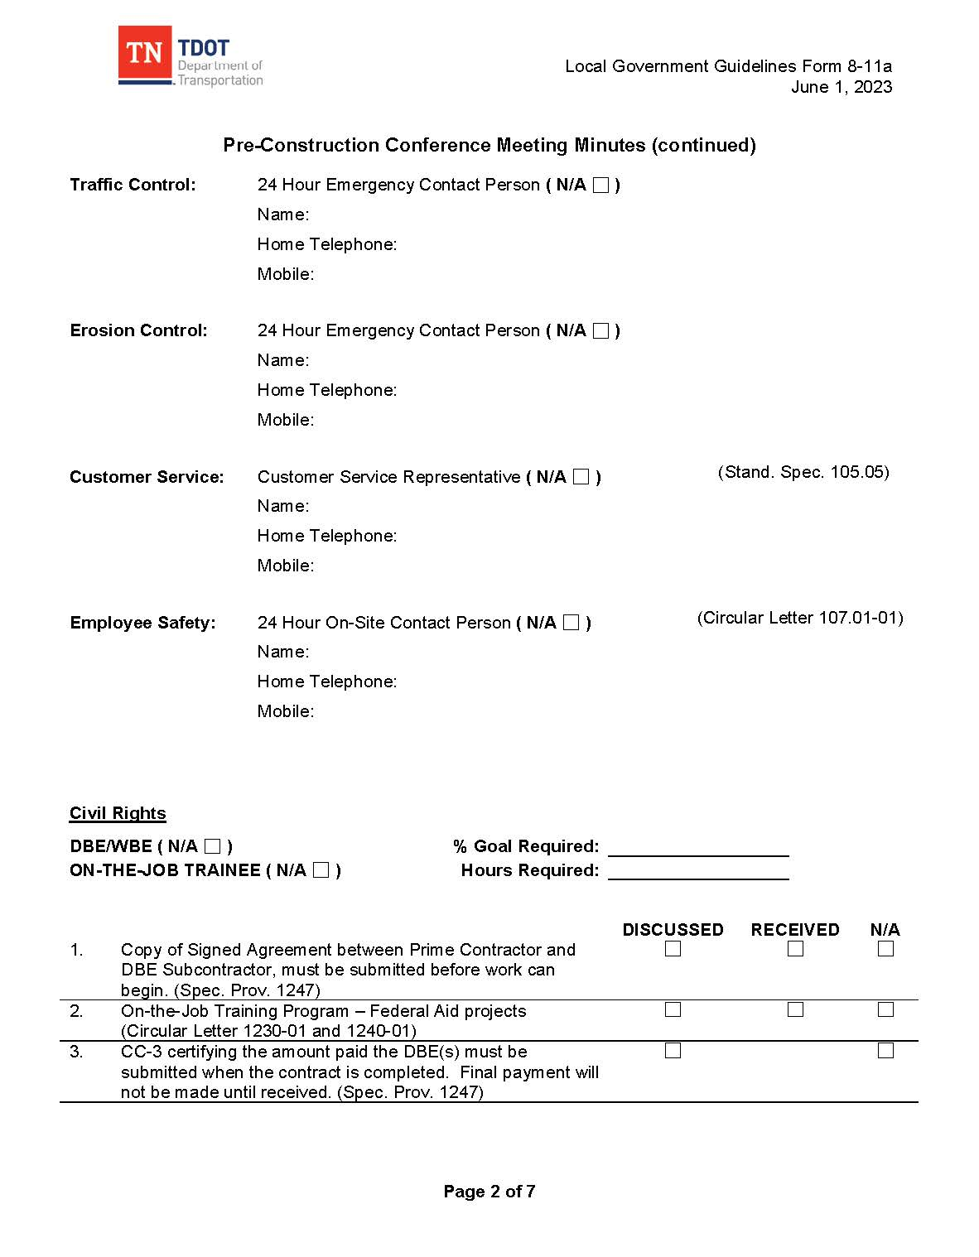
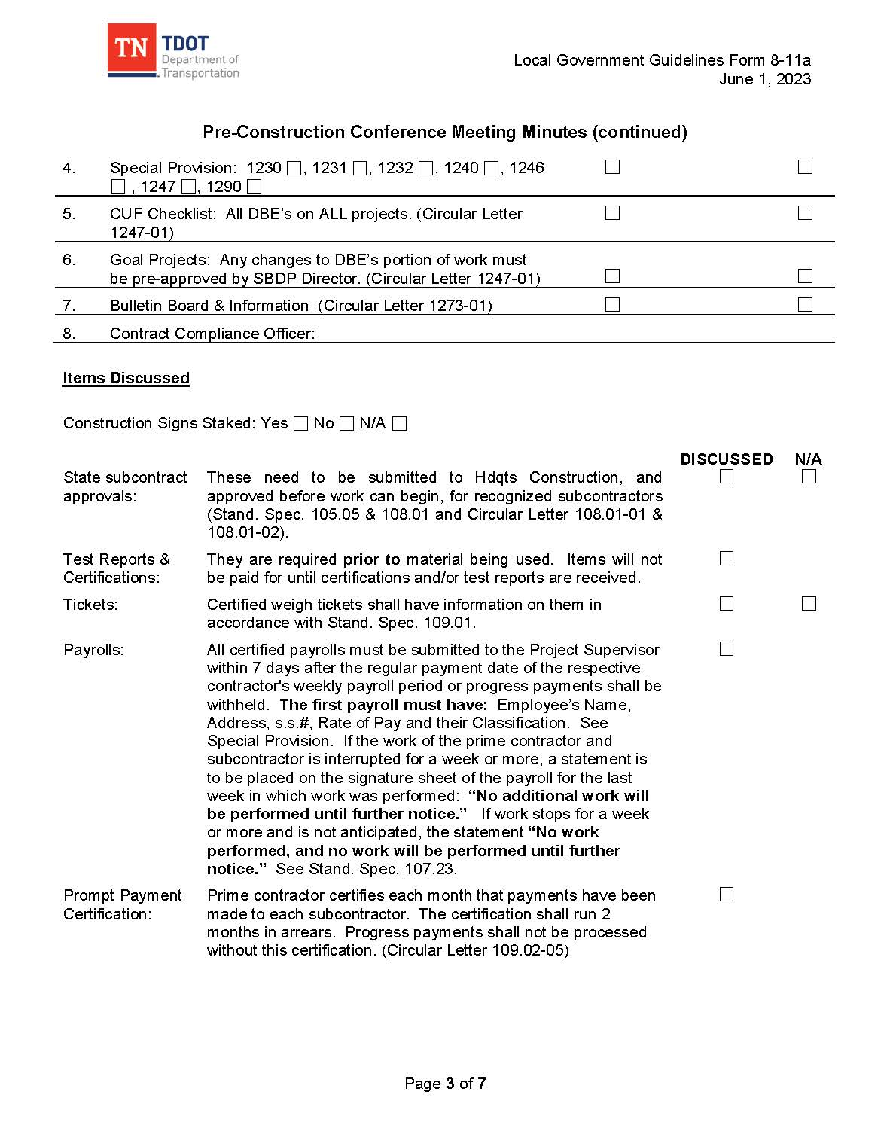
pre-construction Conference Minutes Example

Slide 75
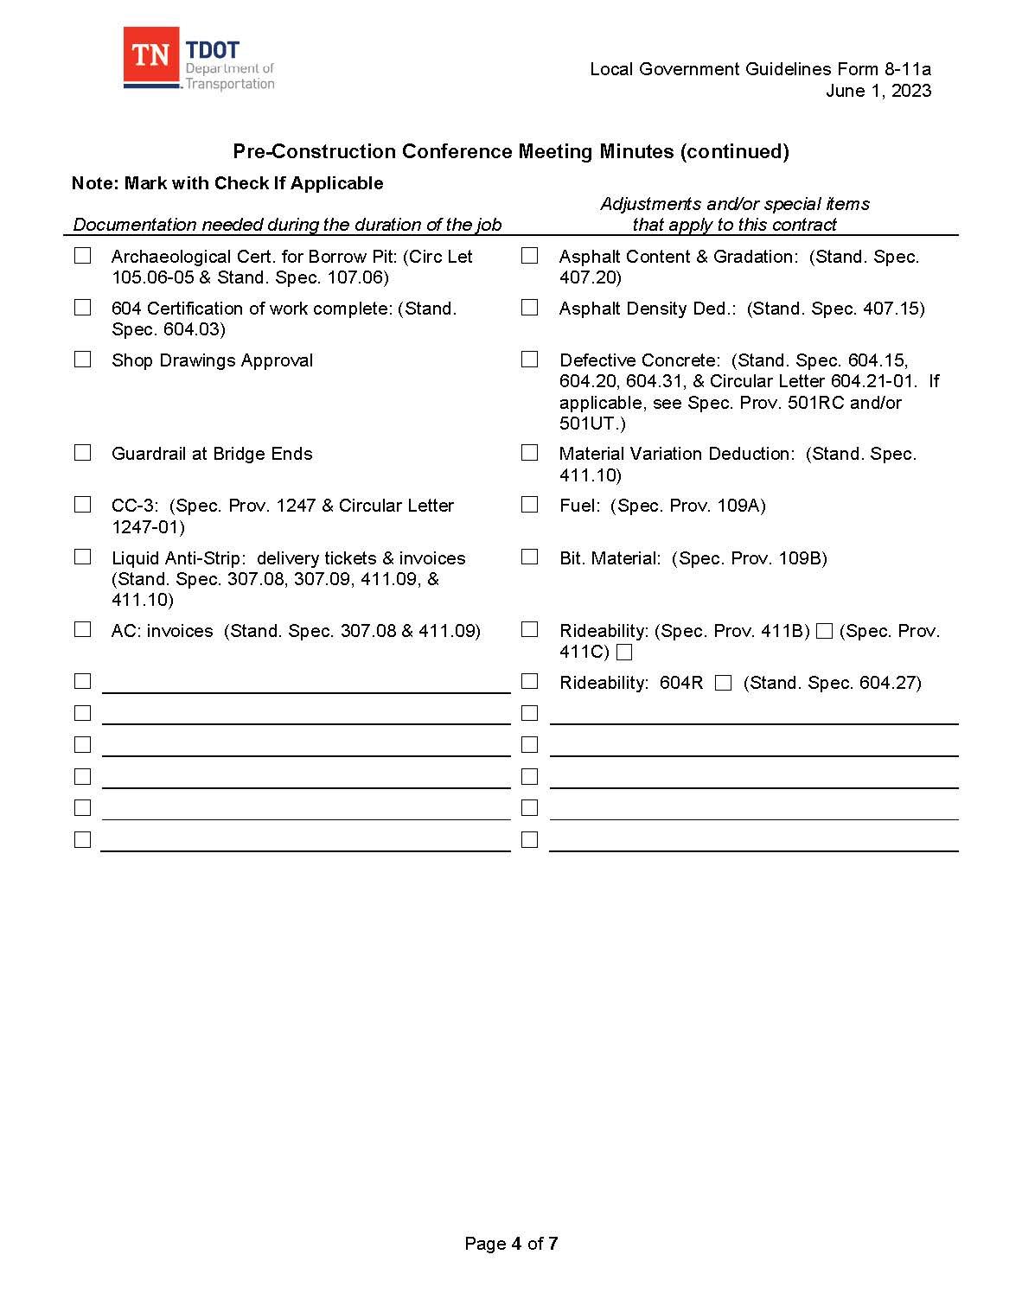
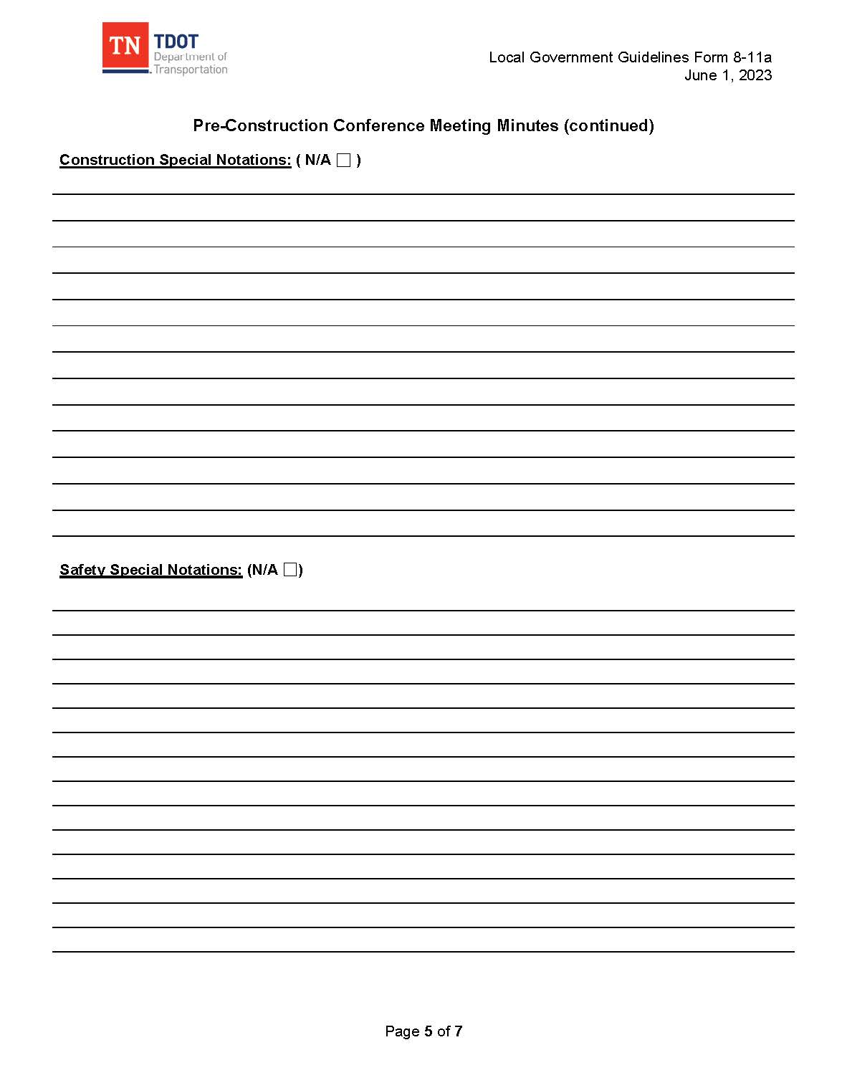
pre-construction Conference Minutes Example

Slide 76
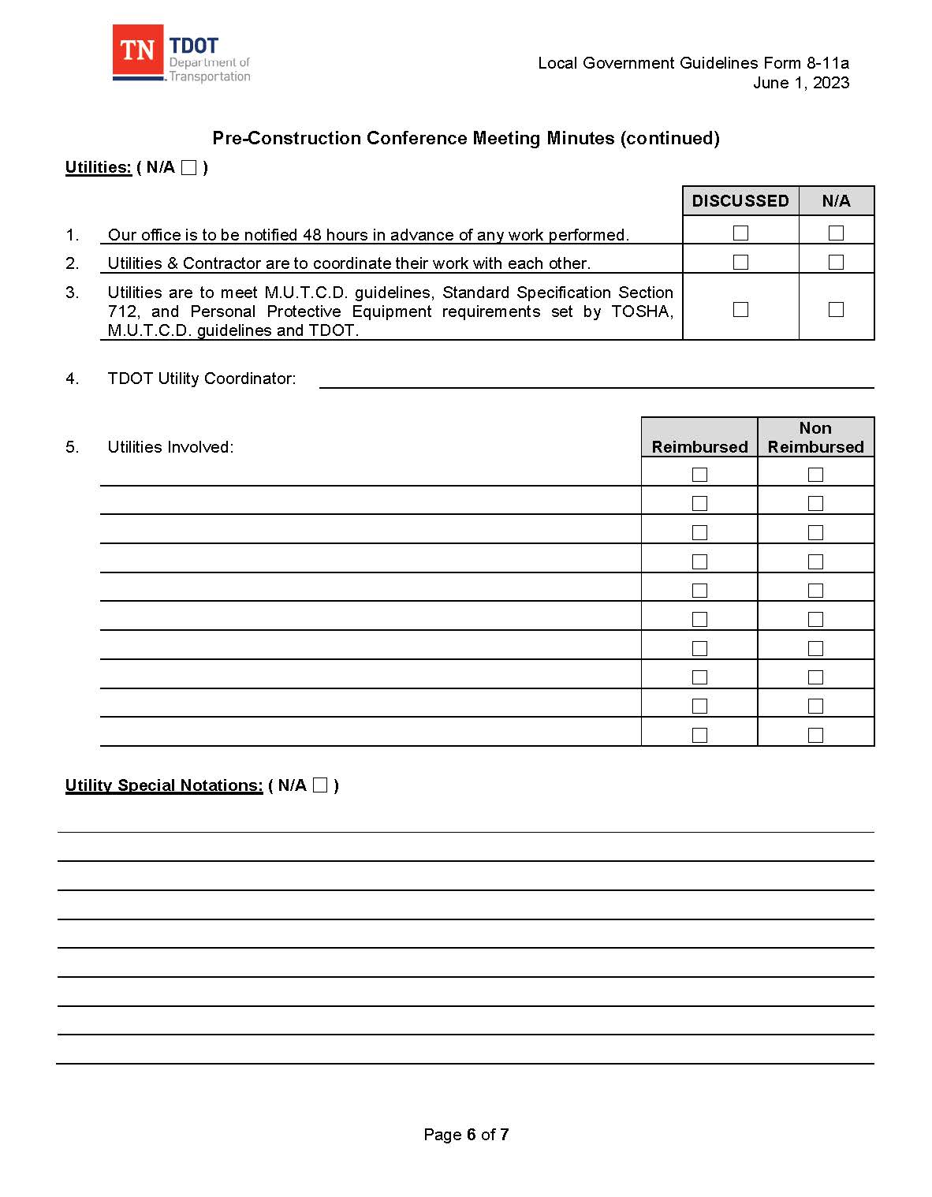
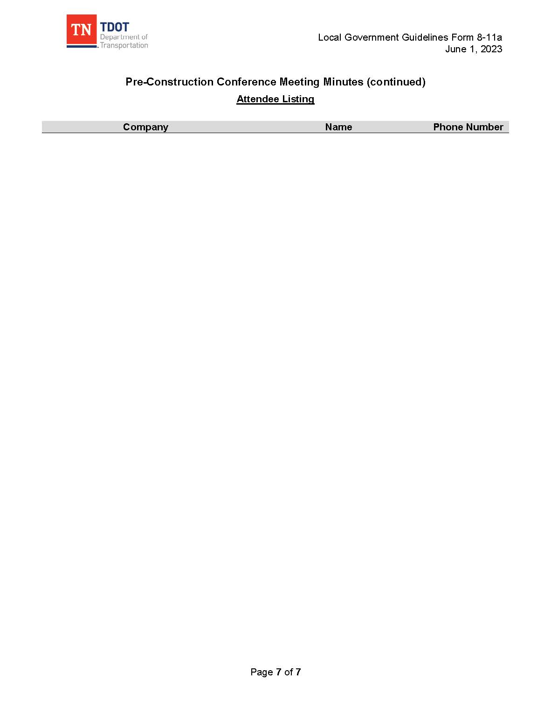
pre-construction Conference Minutes Example

Slide 77
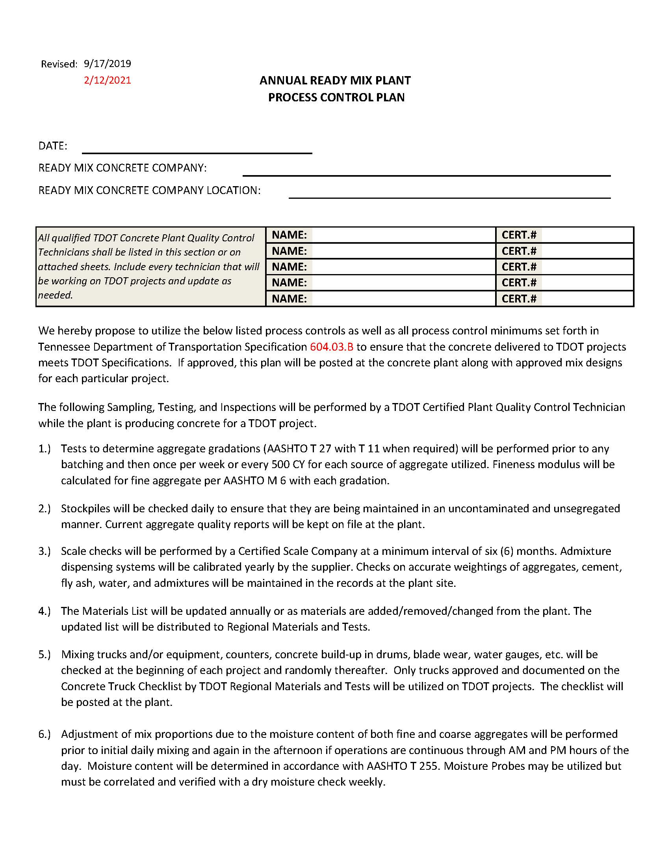
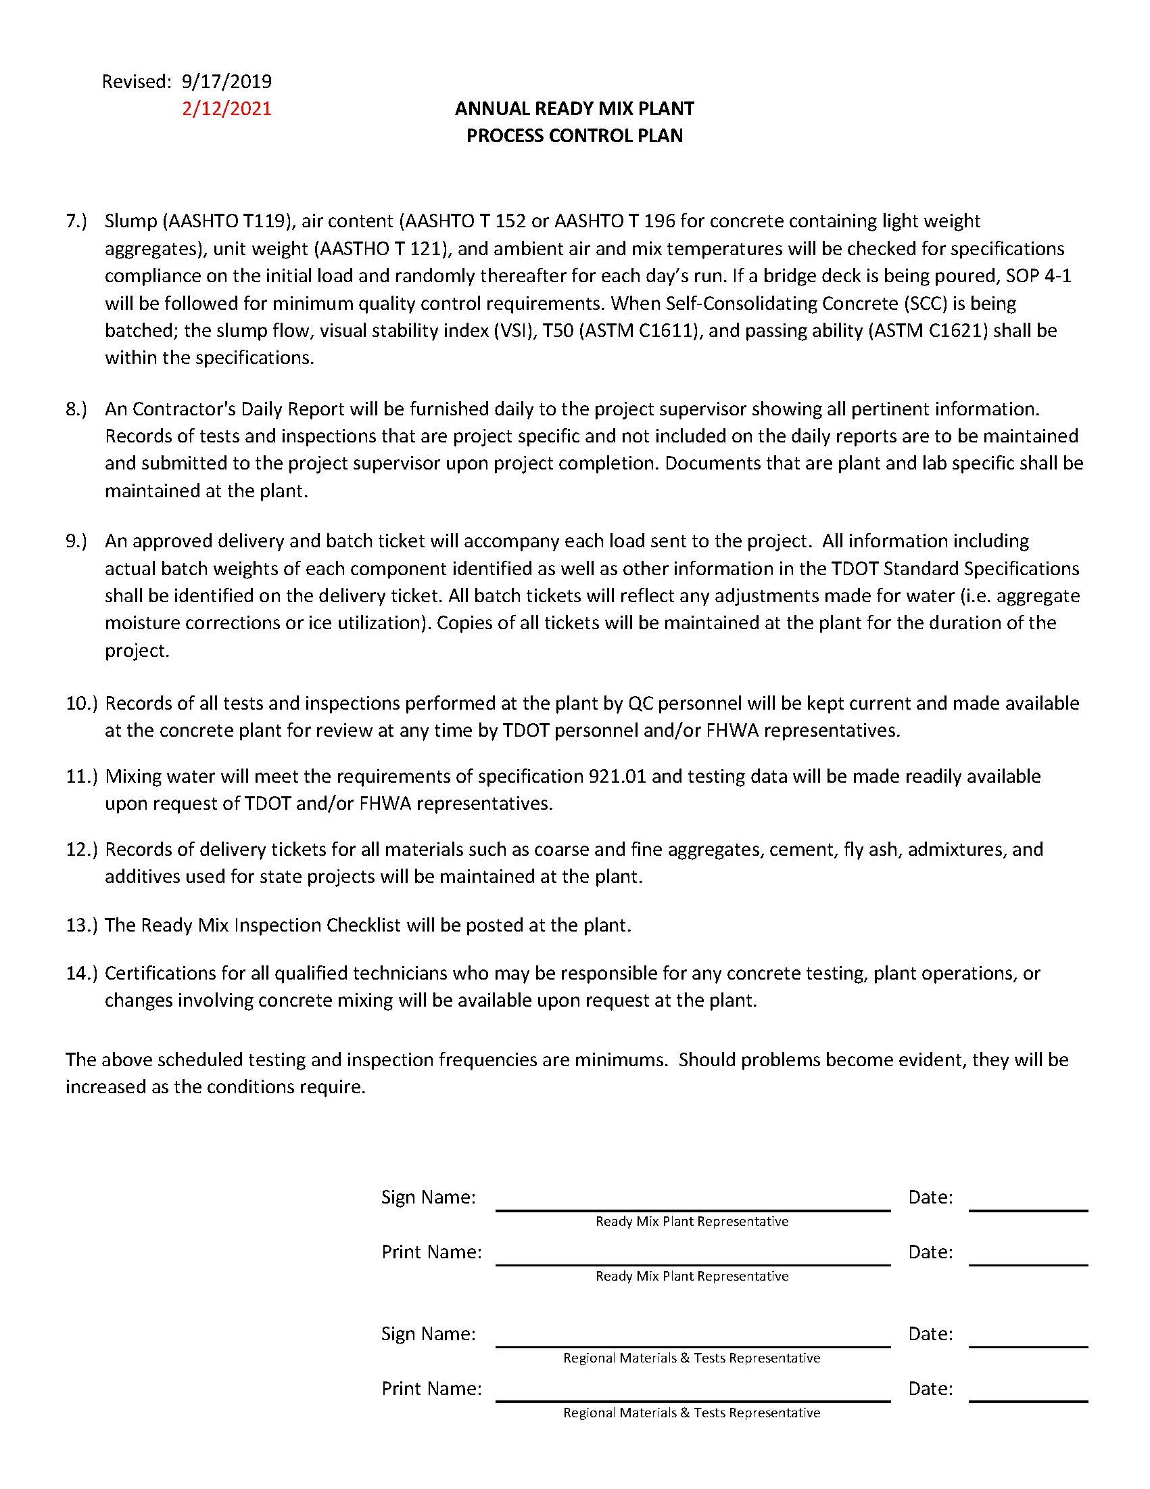
Process Control Plan Examples

Slide 78
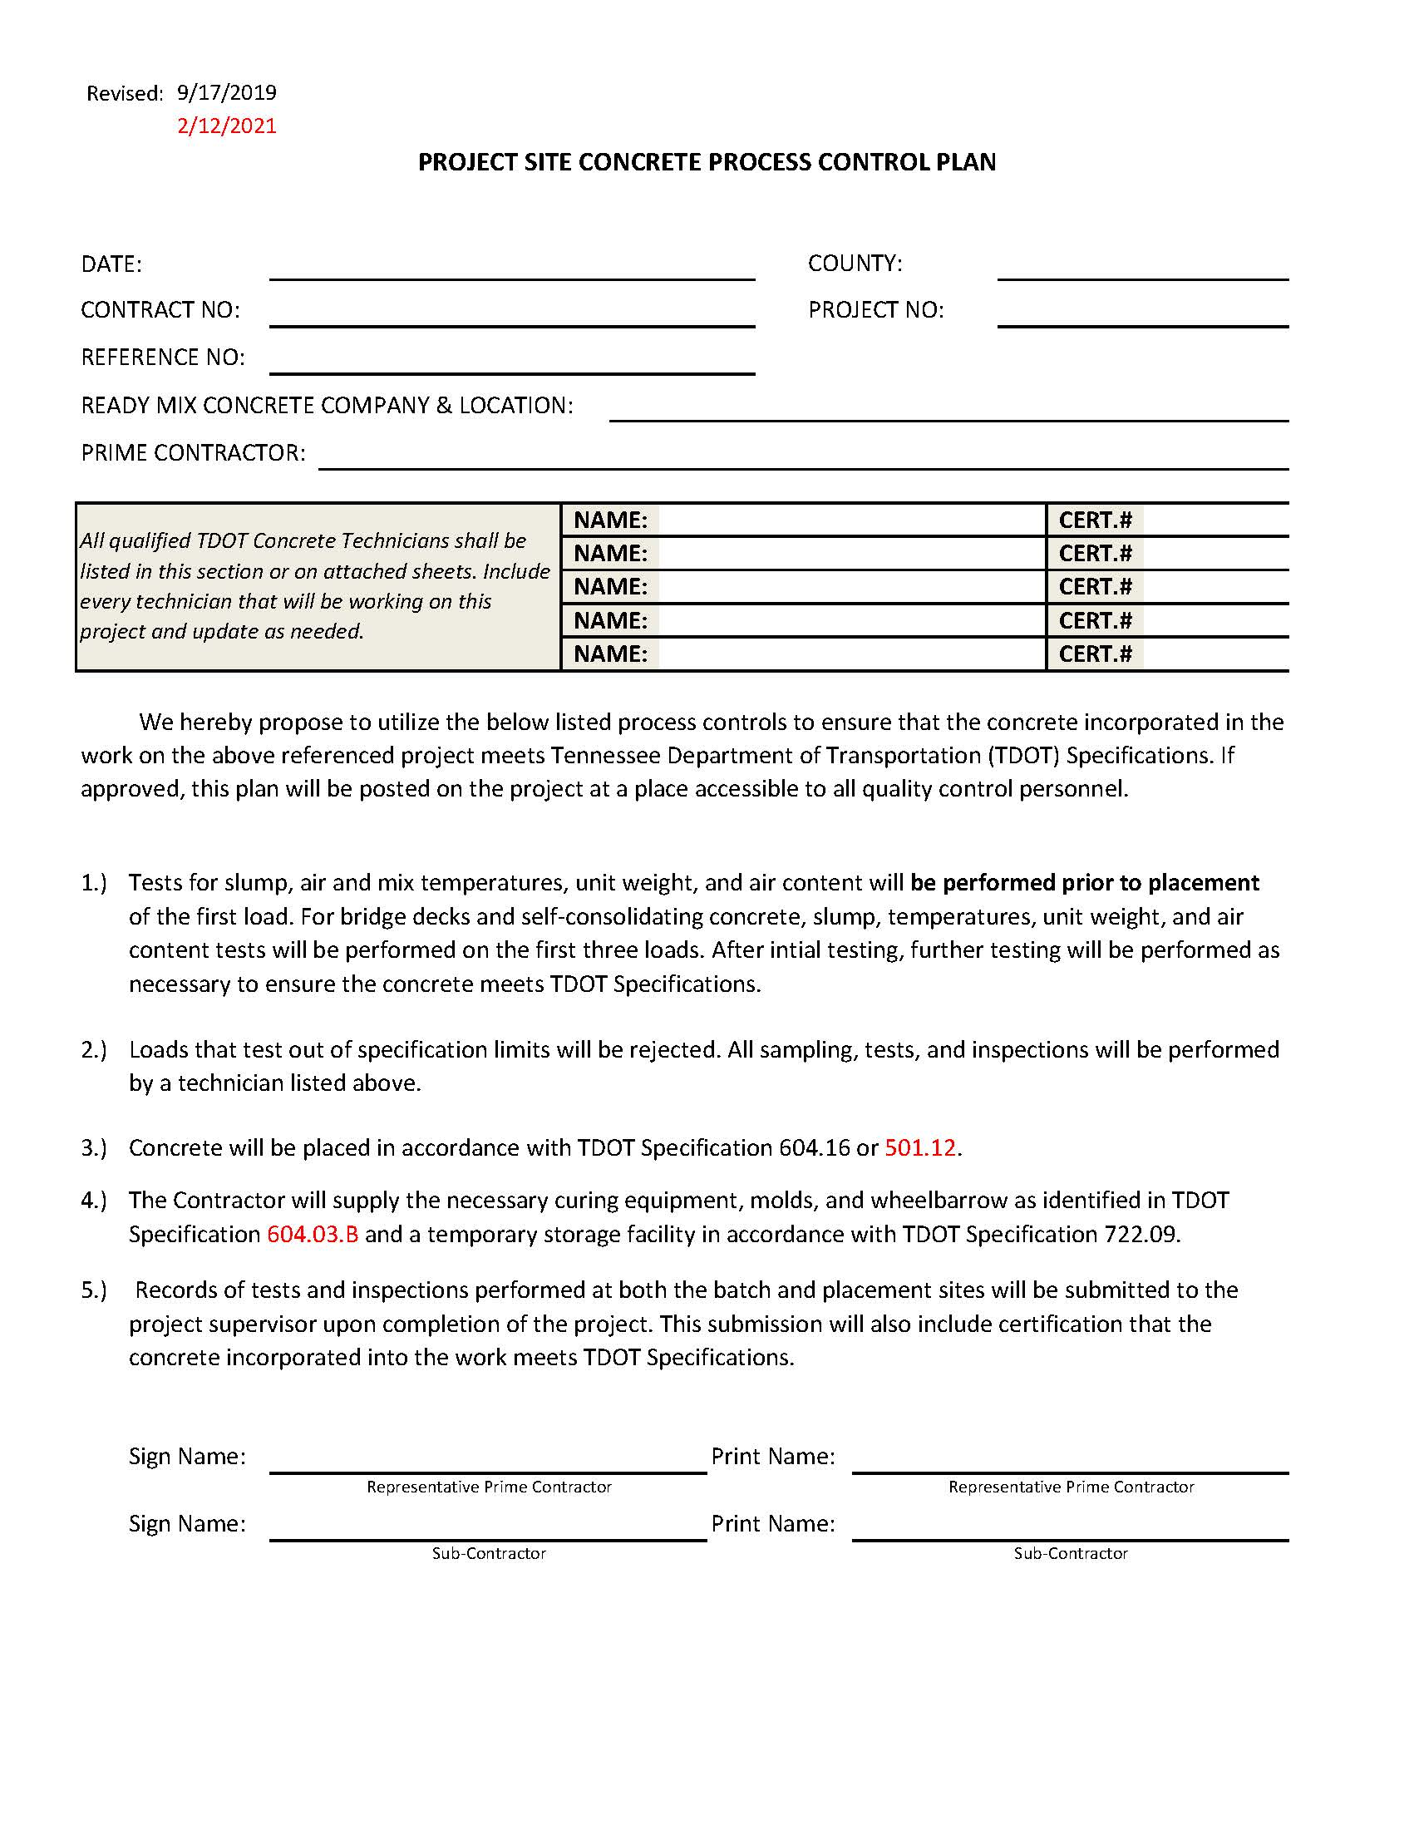
Process Control Plan Examples

Slide 79
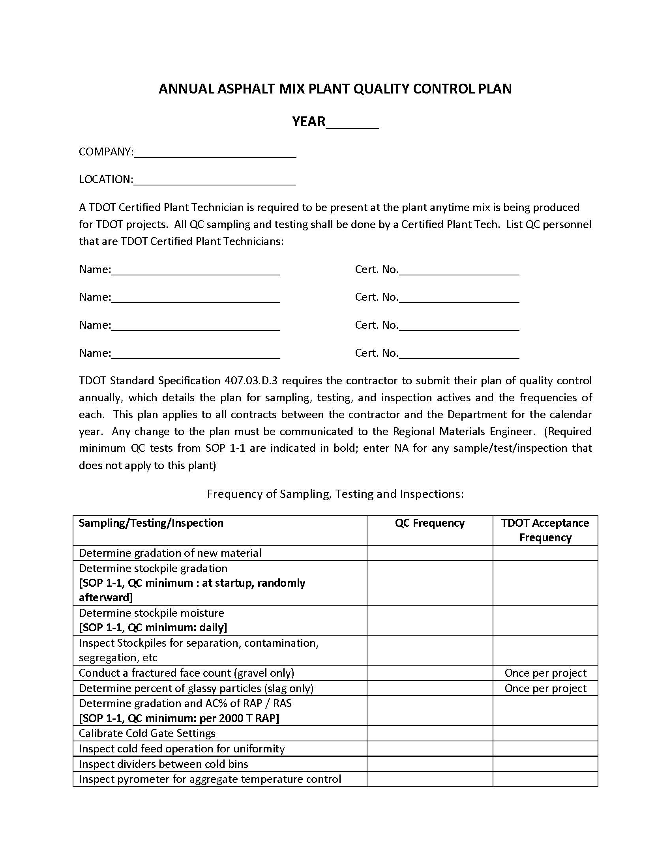
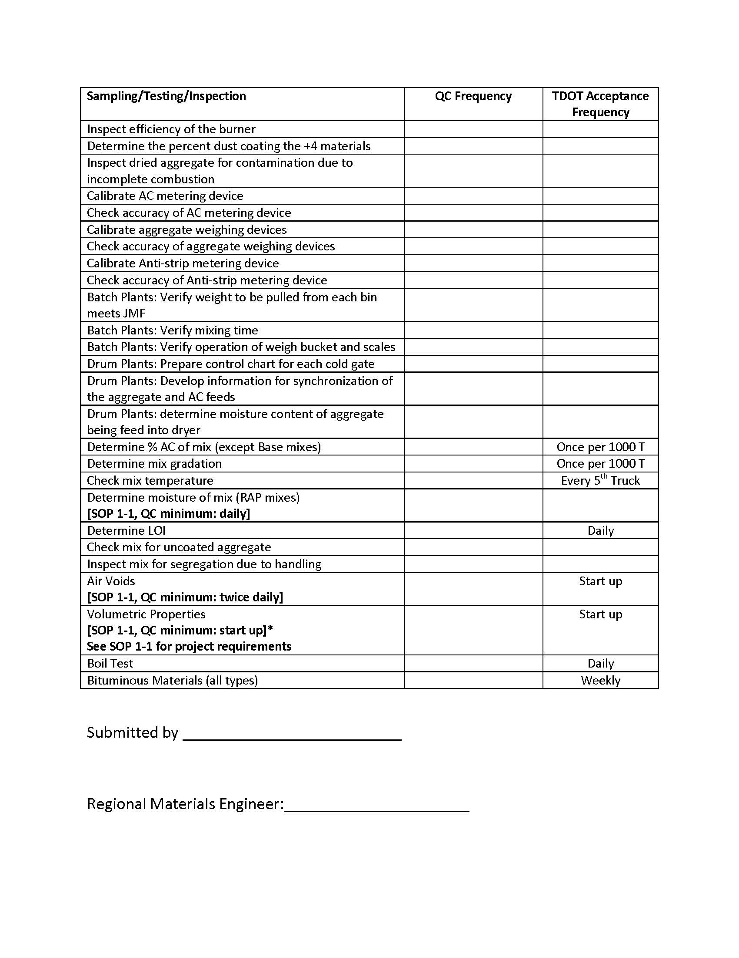
Process Control Plan Examples

Slide 80
pre-construction Conference
ENVIRONMENTAL (EROSION CONFERENCE)
An emphasis shall be placed on maintaining the construction project in regard to Environmental requirements. Construction projects require various permits to allow construction work to be performed. Refer to the Statewide Storm Water Management Plan (SSWMP).
The SWPPP, the erosion control plans, and all applicable environmental permits shall be adhered to on the project.
Various permits require routine inspections of erosion control measures, documentation of environmental issues that arise, and completion of various reports. The LG shall be responsible for compliance with all applicable environmental regulations, including reporting and records keeping (Circular Letter 209.01-02, Circular Letter 209.01-03, Circular Letter 209.01-04, Circular Letter 209.01-05, Circular Letter 209.06-01).
In the case that a separate Erosion Control Conference is necessary due to the magnitude of environmental work related to the contract, the following documents will be required.
  Erosion Control Conference Notice (Form 8-10b)
  Erosion Control Conference Meeting Minutes (Form 8-11b)
  Erosion Control Conference Sign-in Sheet (Form 8-12)

Slide 81
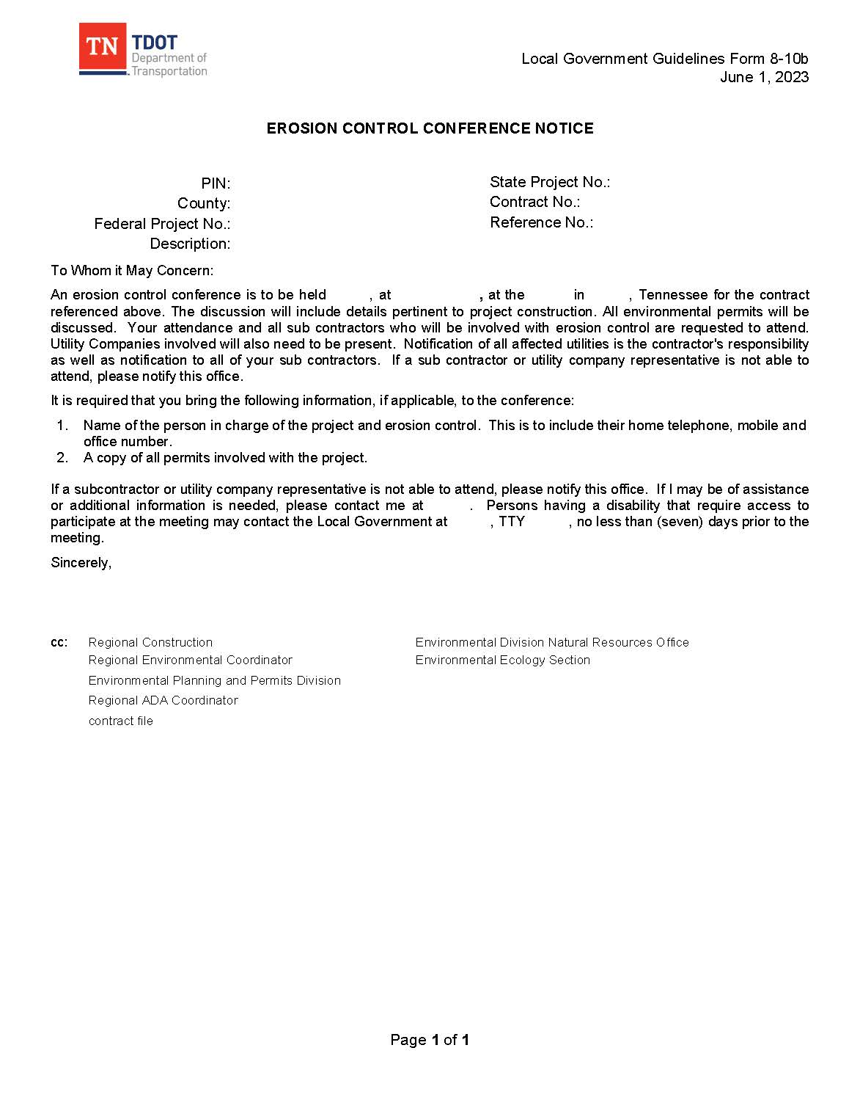
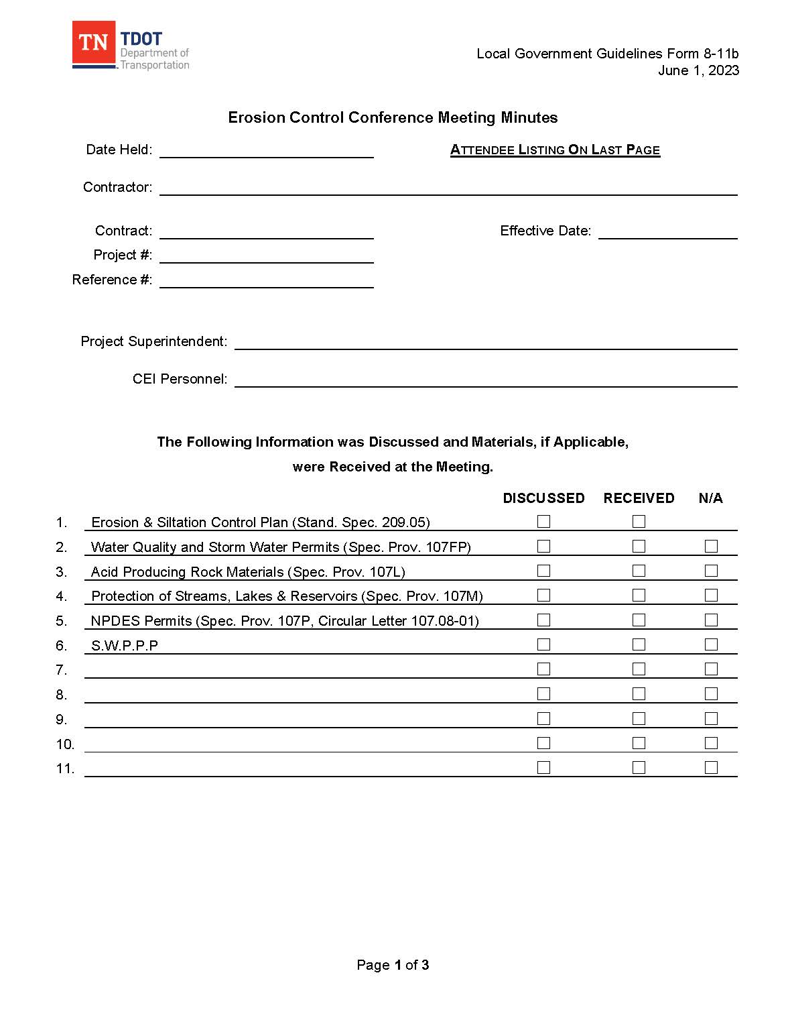
Erosion Control Conference Documents

Slide 82
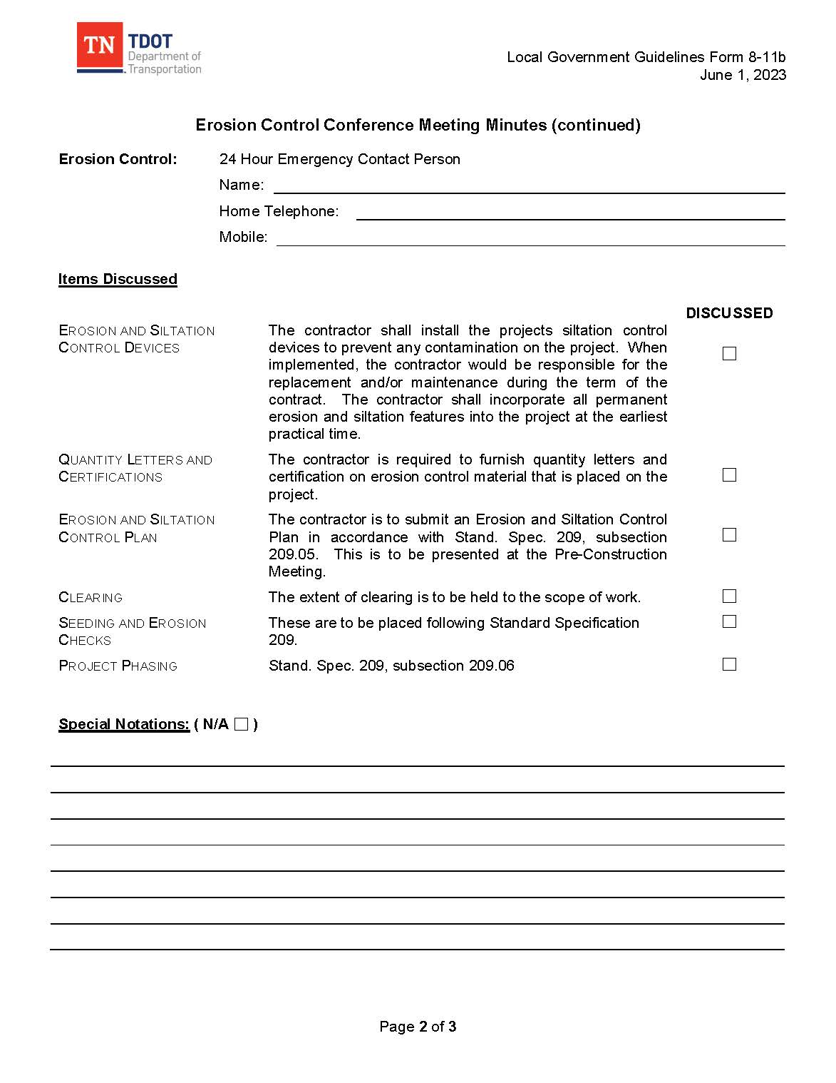

Erosion Control Conference Documents

Slide 83
pre-construction Conference
UTILITIES AND RAILROAD
For utility steps, flow charts, and details, refer to Chapter 6: Right-of-Way, Utility and Railroad Procedures.
Various highway projects require the adjustment of utility facilities to accommodate the activities of the highway contractor as well as meet the physical requirements to improve the section of the highway. Utility relocation work can be performed as part of the contract or prior to start of construction on the project. In either case, adequate documentation shall be maintained. In various circumstances the appropriate utility may be reimbursed for expenses incurred for the relocation. Reimbursement will be determined before utility work begins.
In the case that a separate Utility Conference is necessary due to the magnitude of utility work related to the contract, the following documents will be required:
  Utility Conference Notice (Form 8-10c)
  Utility Conference Sign-in Sheet (Form 8-12)

Slide 84
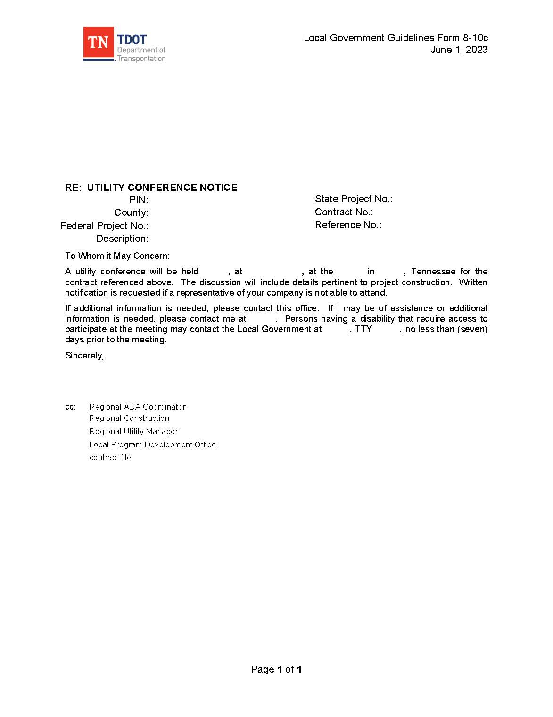
Utility Conference Documents

Slide 85

Utility Conference Documents

Slide 86

Construction Contract Administration

Slide 87
Construction Contract Administration
CONTRACT ADMINISTRATION (CONT’D)
Quality contract administration is a requirement to ensure that the construction project is built in accordance with the plans, specifications, and special provisions and is completed by the projected completion date. Refer to Form 8-16 for Local Government Construction Checklist.
File Management - Project files shall be neatly organized to adequately document and record all project correspondence, and provide full support for all payments and decisions made including material certifications and test reports, calculations, invoices, etc. in accordance with 23 CFR 635.123.
Project files shall consist of the contract applicable files as required by Form 8-6. Additional project files may be added as deemed necessary.

Slide 88


LGG Construction Checklist

Slide 89
Construction Contract Administration
CONTRACT ADMINISTRATION (CONT’D)
Proposal Contract Book - The executed Proposal Contract contains project information including contract items, item descriptions, unit prices, the total contract bid amount, special provisions, in addition to the required signatures to execute the contract.
Starting Notice - As soon as possible after work starts, the Local Government’s Project Supervisor or Local Government Official shall send a notice (Form 8-17) by email that work has started to the LPDO (Local.Programs@tn.gov) and all others copied on Form 8-17.

Slide 90

Starting Notice

Slide 91
Construction Contract Administration
CONTRACT ADMINISTRATION (CONT’D)
Project Meetings - Several project meetings are held throughout construction of the project.
Partnering, scheduling, and progress meetings are held during construction. Detailed meeting minutes shall be documented and kept in the project records “Correspondence File”. A meeting sign-in-sheet shall accompany the meeting minutes.
Progress meetings shall be held, at a minimum, quarterly to discuss the status of the project and other project issues. The Local Government’s Project Supervisor, Local Government Official and the TDOT representative shall be notified of the scheduled progress meetings.
Attestation of Illegal Immigrants (Circular Letter 102.01-02) (Form 8-18) -The Prime Contractor shall certify they are not knowingly utilizing the services of illegal immigrants in the performance of each contract.

Slide 92

Illegal Immigrant Attestation Form

Slide 93
Construction Contract Administration
PROJECT INSPECTION AND DOCUMENTATION
The LG/CEI shall maintain an adequate, qualified staff to administer the inspection and material sampling and testing in accordance with all circular letters, specifications, standard drawings, and contract documents. As previously noted, the services of a qualified CEI firm, unless otherwise approved by TDOT, shall be used for the inspection of work, the sampling and testing for acceptance (TDOT SOP 1-1), and proper and sufficient documentation of acceptance. The inspection staff shall be qualified and knowledgeable about the type of work taking place, be familiar with the contract documents, and certified in accordance with TDOT Standard Operating Procedures (TDOT SOP 1-3) when conducting sampling and testing of materials for acceptance.
The TDOT representative will conduct routine project reviews, attend progress meetings, and participate in the final inspection of the project. The Local Government Project Supervisor and the Local Government Official responsible for the project shall be present at project reviews and the final inspection. Refer to Circular Letter 105.11-01 for detailed information on the frequency of the project reviews. Any findings during the project reviews shall be responded to in writing by the Local Government Project Supervisor and the Local Government Official.

Slide 94


Construction Contract Administration

Slide 95
Construction Contract Administration
PROJECT INSPECTION AND DOCUMENTATION (CONT’D)
CEI SCOPE OF SERVICES SUMMARY
1. Erosion Control and pre-construction Conferences
2. Attend Weekly meetings
3. Project Administration
4. Provide Construction Inspection (Required Certifications)
  OSHA 10 Hour Safety Training Construction (All field personnel)
  Asphalt Roadway Paving Inspector - TDOT
  Asphalt Plant Technician - TDOT
  Class 1 Concrete Technician – TDOT or ACI
  Soils and Aggregate Technician - TDOT
  Nuclear Gauge Training
  EPSC TDEC Level I – TDEC
Certification from another State Highway Department, nationally recognized institution, or other approved agency may be acceptable in lieu of the TDOT certification. Prior approval is required.

Slide 96
Construction Contract Administration
PROJECT INSPECTION AND DOCUMENTATION (CONT’D)
CEI SCOPE OF SERVICES SUMMARY
5. Conduct Field Surveys
6. Supplemental Agreements/Construction Change, Force Account, VECP
7. Shop Drawings
8. Quality Assurance, Testing for Acceptance, and Training
9. Progress Payments
10. Revisions to the Contract Plans
11. Distribution of Correspondence

Slide 97
Construction Contract Administration
PROJECT INSPECTION AND DOCUMENTATION (CONT’D)
CEI SCOPE OF SERVICES SUMMARY
12. Inspection of Work:
  Provide inspection services for conformance to Plans and
  Observe, measure, and record all quantities for payment.
  Record field measurements for review by the Department or auditors.
  The records will be recorded on a standard form (fieldbook) supplied or defined by the Department and/or on field inspection forms to be submitted to the Department.
  Check traffic control daily, and additionally as required or requested.
  Notify the contractor of deficiencies or problems immediately.
  The consultant is not charged with the role of safety inspector, but expected to have unsafe issues corrected by the Prime Contractor.
  Document weekly (or as often as necessary) project traffic control and distribute reports as required.

Slide 98
Construction Contract Administration
PROJECT INSPECTION AND DOCUMENTATION (CONT’D)
CEI SCOPE OF SERVICES SUMMARY
12. Inspection of Work (cont):
  Inspect daily erosion control items for conformance to the plans as well as effectiveness in the field. Notify the contractor of deficiencies.
  Prepare to justify any and all pay quantities.
  Prepare an accurate daily diary signed by the inspector, consisting of:
    A record of the contractors on the project
    Their personnel (number and classification)
    Equipment (number and type or size)
    Location and work performed by each contractor or subcontractor
    Orders given the contractor
    Events of note on the project

Slide 99
Construction Contract Administration
PROJECT INSPECTION AND DOCUMENTATION (CONT’D)
CEI SCOPE OF SERVICES SUMMARY
12. Inspection of Work (cont):
  Prepare an accurate daily diary signed by the inspector, consisting of (cont):
    Accidents on the project w/(police report, fatalities, causes, time, etc.)
    Weather conditions, precipitation, temperature (AM, noon, PM)
    Days charged (if working day contract), with explanation if not charged
    Equipment arriving or leaving the project, idle equipment
    Any other details that may be important later in the project life

Slide 100
Construction Contract Administration
PROJECT INSPECTION AND DOCUMENTATION (CONT’D)
CEI SCOPE OF SERVICES SUMMARY
Inspection will be needed full time while the contractor is working. Project inspection crews will vary. You will always need a certified concrete inspector when placing concrete. You will need a certified roadway asphalt inspector and a certified asphalt plant technician when placing asphalt paving. Below is typical inspection crews needed for construction projects:
  Paving project: 1 field inspector, 1 plant inspector, 1 project engineer and records assistant
  Road Widening project: 1 field inspector, 1 project engineer and records assistant (concrete inspector, asphalt inspectors and EPSC inspector as needed)
  Bridge project: 1 field inspector, 1 project engineer and records assistant
  Signal replacement project: 1 manager/inspector and records assistant

Slide 101
Construction Contract Administration
PROJECT INSPECTION AND DOCUMENTATION (CONT’D)
The LG/CEI shall conduct all acceptance testing (TDOT SOP 1-1). A representative from TDOT Regional Materials and Tests shall conduct all verification and independent assurance testing for the local project in accordance with (TDOT SOP 1-2).
Various methods shall be used to document project activity. Daily activities are documented in the project diary, work item quantities are documented in the field book, adjustments/additions/deductions are calculated using worksheets, and specific reports and checklists are used to establish the quality of work. A Project Diary template and loose-leaf field book templates are available on the LPDO website.
The Local Government’s Project Supervisor, project office personnel, and inspectors are required to maintain accurate and complete records of all construction work. All records shall be made available for review at TDOT’s request.
It is of prime importance in the administration of a contract that measurements and calculations of contract item quantities are accurate, that records of such quantities are complete and detailed enough to sustain audit, and that records of all other activities pertaining to the contract contain sufficient details and are clear enough to be read and understood by anyone unfamiliar with the project.

Slide 102


Materials and Test Standard
Operating Procedures (SOP)

Slide 103
Construction Contract Administration
PROJECT INSPECTION AND DOCUMENTATION (CONT’D)
Project files shall be neatly organized to adequately document and record all project correspondence, and provide full support for all payments and decisions made including material certifications and test reports, calculations, invoices, etc. in accordance with 23 CFR 635.123.
Common types of documentation:
  Project Diary
  Item Documentation
    Field book documentation
    Item quantity tickets
    Work item quantities
    Cross-section quantities
  Bridge Foundation Information
  Item Adjustment Worksheets

Slide 104

Project Diary Example

Slide 105

Work Item Quantity Spreadsheet Example

Slide 106


Electronic Project Diary Example

Slide 107

Electronic Project Diary Example

Slide 108
Construction Contract Administration
  PROJECT INSPECTION AND DOCUMENTATION (CONT’D)
  Asphalt
  1. Hot Mix Asphalt Plant Inspector Checklist (Circular Letter 407.04-01) (Form 8-19)
  2. Hot Mix Asphalt Roadway Inspector Checklist (Circular Letter 407-14.01) (Form 8-20)
Bridge Deck
  1. Pre-Pour Checklist (Form 8-23)
  2. During Checklist (Form 8-24)
  3. Post Pour Checklist (Form 8-25)
Safety
  1. Work Zone Traffic Control Inspection Form (Circular Letter 712.07-01)(Form 8-21) (weekly)
Guardrail
  1. Guardrail and Guardrail Terminal Anchor Daily Field Report (Circular Letter 705.05.01) All guardrail shall be inspected at the time of installation. Guardrail end terminals shall be tagged using the appropriate Guardrail Decal.
  2. Guardrail Inspection Form for Deficient or Deviated Terminal Units – Deficient Guardrail found upon inspection shall be documented on the Guardrail Inspection Form for Deficient or Deviated Terminal Units
The Guardrail Decal and Guardrail Inspection Form for Deficient or Deviated Terminal Units are available from the Regional Materials and Tests Office.

Slide 109


Asphalt Plant Checklist

Slide 110


Asphalt Laydown Checklist

Slide 111


Asphalt Laydown Checklist

Slide 112

Asphalt Laydown Checklist

Slide 113


Traffic Control Checklist

Slide 114


Traffic Control Checklist

Slide 115


Traffic Control Checklist

Slide 116


Guardrail Checklist

Slide 117

Guardrail Inspection Form

Slide 118
Construction Contract Administration
CONSTRUCTION INSPECTION OF STRUCTURES
The requirements in Section 8.2.18 shall apply to construction inspection of structures in addition to the following requirements
The Bridge Construction Inspector’s Checklist (Form 8-22) shall be completed for each bridge on the project and forwarded to the Division of Structures at completion of the work along with an electronic copy of the contract drawings.
A qualified construction inspector shall be on site to view foundation conditions and substructure construction including but not limited to: driving of piles, concrete pours, girder erection, steel spacing and elevations, deck pouring operations (TDOT SOP 4-1), and other structural appurtenances as necessary. This inspector will be responsible for maintaining a daily diary. A certification from the Engineer of Record confirming compliance with TDOT standard construction procedures shall be required.

Slide 119
Construction Contract Administration
CONSTRUCTION INSPECTION OF STRUCTURES (CONT’D)
The Structures (Construction) Checklist (Form 8-22) shall also be submitted with the as-built plans.
A Pre-Pour Meeting shall be scheduled and conducted prior to any bridge deck pours (Circular Letter 604.17-01). The following forms are required when pouring a bridge deck.
  1. Bridge Deck Pre-Pour Checklist (Form 8-23)
  2. Bridge Deck During Pour Checklist (Form 8-24)
  3. Bridge Deck Post-Pour Checklist (Form 8-25)

Slide 120

Bridge Inspection Checklists

Slide 121


Bridge Deck Pre-Pour Checklist

Slide 122


Bridge Deck During Pour and
Post-Pour Checklist

Slide 123

Bridge Deck During Pour and
Post-Pour Checklist

Slide 124
Construction Contract Administration
CONSTRUCTION INSPECTION OF STRUCTURES (CONT’D)
Bridge Foundation Information
  For the bridge foundation, the following information must be documented for abutments, piers, etc.
    FOOTING ELEVATIONS
    PILE CUT-OFF ELEVATION
    PILE TIP ELEVATION
    IN PLACE PILE LENGTH
  This information shall be documented on the Field Book- Footing Table and the Field Book- Pile Data Table in the Field Book Sheets.
  After the bridge is completed to the satisfaction of the Local Government’s inspector, the Local Agency must contact the TDOT Regional Bridge Engineer to arrange an inspection prior to the contractor de-mobilizing. A minimum four-week notice should be provided for the TDOT Regional Bridge Engineer.

Slide 125
Construction Contract Administration
CONSTRUCTION INSPECTION OF STRUCTURES (CONT’D)
On new bridge construction as well as bridge repair projects, the Local Government Project Supervisor shall contact the TDOT Regional Bridge Engineer to request an initial acceptance inspection, that the bridge construction, not necessarily the whole project is complete. Even if the approach work is not already in place, the bridge inspectors can do their initial inspection of the structure and document any deficiencies they discover. Their inspection report, listing those deficiencies, can be copied to the Project Supervisor for the contractor to address before leaving the project.
The final closeout of contracts between the Local Government and TDOT cannot occur without a copy of the TDOT Bridge Inspector’s findings and resolution of any listed defects.
As-built drawings and final foundation type, including footing elevations and lengths of individual piles, along with all approved shop drawings, shall be electronically furnished to the Structures Division and copy LPDO. The Structures (Construction) Checklist (Form 8-26) shall also be submitted with the as-built plans.

Slide 126
Construction Contract Administration
PLANS AND WORKING DRAWINGS (SHOP DRAWINGS)
The construction plans, generally, will show sufficient details and dimensions to define the work. When additional details and dimensions are needed, the contractor shall prepare working drawings and submit them to the Engineer of Record for approval. In any case, the fabricator shall be construed to be an agent of the contractor and any changes from the construction plans submitted by the fabricator shall be considered as made by the contractor. All costs for changes will be at the expense of the contractor. Shop drawings for all types of structures shall be submitted by, or on behalf of the contractor, directly to the Engineer of Record unless noted otherwise in plans or specifications, for handling with the checking agency and for distribution. Proof of appropriate fabricator certification (as required by these specifications) for type of structure to be fabricated shall be submitted along with the shop drawings.

Slide 127
Construction Contract Administration
PLANS AND WORKING DRAWINGS (SHOP DRAWINGS) (CONT’D)
The following items require submittal of shop drawings by the contractor:
Structural Steel, Metal Bridge Rails, Bearing Devices (shop drawings not required for plain elastomeric bearing pads), Bridge Deck Drains (shop drawings not required if fabricated according to applicable Standard Drawing), Navigation Lighting Support Brackets, Precast Prestressed Concrete Beams, Precast Prestressed Concrete Deck Panels, Precast Reinforced Concrete Beams, Precast Reinforced Concrete Box Culverts, Post-tensioned Concrete, Roadway Expansion Devices, Steel Stay-In-Place forms, Energy Attenuation Devices, Overhead and Cantilever Sign Structures, Strain Poles, Street Lighting Poles, High Mast Poles with Accompanying Lowering Devices, Photometrics, Cofferdams and any other items when indicated on plans. Also required are erection drawings for steel structures, drawings of falsework, bracing, cofferdams, sheeting, bending of reinforcing steel and other supplementary plans called for by the Engineer of Record.

Slide 128
Construction Contract Administration
PLANS AND WORKING DRAWINGS (SHOP DRAWINGS) (CONT’D)
Each shop drawing sheet shall contain in the title block the following:
  Project number
  County
  Bridge name
  Bridge number (or structure type and number)
  Station
  Contract number
  The words “Locally Managed Project”
Shop drawings shall be submitted in sets with the drawing numbers running consecutively in each set, and, if more than 5 sheets in a set, shall be appropriately bound. Shop drawings marked “APPROVED” or “APPROVED AS NOTED” need not be resubmitted unless specifically instructed.

Slide 129
Construction Contract Administration
PLANS AND WORKING DRAWINGS (SHOP DRAWINGS) (CONT’D)
Shop drawings shall be a minimum of 8-1/2 x 11 inches in size. Legible half-size copies (11 x 17 inches) of full size drawings are acceptable for submittal. The minimum number of sets of shop drawings shown below shall be submitted for approval. Only one (1) set will be returned to the fabricator unless specifically requested and the additional set(s) requested to be returned is submitted along with those shown below. For consultant designs, an additional set is required. For railroad structures, three (3) additional sets are required. Copies should be kept in LG’s files.
  Two Sets: Structural Steel (Half-size sets shall be submitted for approval. Four (4) additional sets, two (2) full-size and two (2) half-size, will be required after final approval.)
  Four Sets: Energy Attenuation Devices, Overhead and Cantilever Sign Structures, Strain Poles, Street Lighting Poles, High Mast Poles with Accompanying Lowering Devices, Photometrics (Submit directly to Special Design Office, Structures Division), Cofferdams
  Six Sets: Metal Bridge Rails, Bearing Devices (shop drawings not required for plain elastomeric bearing pads), Bridge Deck Drains (shop drawings not required if fabricated according to applicable Standard Drawing), Navigation Lighting Support Brackets, Precast Prestressed Concrete Beams, Precast Prestressed Concrete Deck Panels, Precast Reinforced Concrete Beams, Precast Reinforced Concrete Box Culverts, Post-tensioned Concrete, Roadway Expansion Devices, Steel Stay-In- Place forms, and any other type of structural shop drawing not specifically listed.

Slide 130
Construction Contract Administration
PLANS AND WORKING DRAWINGS (SHOP DRAWINGS) (CONT’D)
All working drawings shall be approved by the Engineer of Record; such approval shall be general in nature and shall not operate to relieve the contractor of any of his responsibility under the contract for the successful completion of the work. In addition to such approval, working drawings involved in construction over or under railroad tracks will require approval of the railroad company before approval is granted by the Engineer of Record. The contractor shall submit four sets of plans for any cofferdams, sheeting and bracing details for bents or piers adjacent to a track, and falsework for erecting the spans over tracks, and the method of installation for the protection of the tracks, to the Engineer of Record. No work shall be started until these plans are approved by the LG and the Chief Engineer of the railroad. Approval of these plans will not relieve the contractor from liability. The above also applies in connection with the installation of pipes, culverts, etc. adjacent to or under railroad tracks. The cost of preparation of working drawings will not be paid for separately but shall be included in the prices of the respective contract items involved.

Slide 131
Construction Contract Administration
EROSION PREVENTION / SEDIMENT CONTROL (EPSC) INSPECTION
It is essential that the SWPPP and erosion control plans be followed and revised as needed to fully comply with the environmental permits on each project. The LG and the CEI shall conduct routine project inspections and document the findings to ensure that the SWPPP is being followed and that non-compliance is unlikely.
The Local Government is encouraged to acquire the services of an independent, certified professional in Erosion and Sediment Control (CPESC) certified erosion control consultant on projects with an NPDES or ARAP permit to conduct project inspections. The purpose of the inspections is to provide a “third party” independent review to ensure that the EPSC devices are installed and maintained as required, ensure the requirements of the permits are being documented and followed, and, if asked, provide recommendations. The inspections should be conducted monthly, or more frequent if violations or repeat non-conformances occur.

Slide 132
Construction Contract Administration
EROSION PREVENTION / SEDIMENT CONTROL (EPSC) INSPECTION
(CONT’D)
Erosion and Sediment Control Construction Inspection Report - This report shall be completed for the evaluation of erosion and sediment control measures on all projects that are subject to the requirements of the NPDES General Permit for Storm Water Discharges from Construction Activities. This report shall also be used to document Contractor compliance with erosion and sediment control requirements in conformance with ARAP, Corps of Engineers, and/or TVA permits. An Inspection Report template and sample, along with instructions, are noted in EPSC Inspection Manual. The fillable version of the report is available as Form 8-27 on the LPDO website. Check to see if stream credits are available.

Slide 133
Construction Contract Administration
EROSION PREVENTION / SEDIMENT CONTROL (EPSC) INSPECTION
(CONT’D)
Class V Underground Injection Control (UIC) Permit – Circular Letter 209.06-01 establishes the procedures for applying for a UIC Permit on an active construction project in the event that depressions (sinkholes with open throats) are encountered on or bordering the project site during construction activities.
Construction Related Sediment Removal – Circular Letter 209.01-03 establishes the procedures for removal and/or stabilization of sediment discharges caused by active construction projects to non-jurisdictional areas, as well as jurisdictional areas, within or beyond the project’s construction limits.
Waste/Borrow Site Weekly EPSC Inspection Review Report – This report shall be completed for the evaluation of approved project exclusive waste/borrow sites. The contractor is responsible for performing twice weekly EPSC inspections of the site and must have a certified EPSC inspector as required by the TDEC Construction General Permit. See the TDOT Waste and Borrow Procedures for further information and the Waste and Borrow Procedure Contractor’s Support Activities Certification form.

Slide 134
Construction Contract Administration
EROSION PREVENTION / SEDIMENT CONTROL (EPSC) INSPECTION
(CONT’D)
Notice of Termination (NOT) (TDEC CN-1175) – Storm Water Discharges Construction Activity (Circular Letter 107.08-01) (Form 8-28) - This form notifies the Tennessee Department of Environment and Conservation of the request to termination of coverage from the General NPDES Permit for Discharges of Storm Water Associated with Construction Activities. Instructions for completing the NOT form are noted in Circular Letter 107.08-01.
Upon concurrence of final stabilization by all involved parties, the NOT form shall be completed by the Local Government and submitted to the local Water Pollution Control (WPC) Environmental Field Office address indicated on the form. The NOT shall be signed by an authorized official of the Local Government.

Slide 135


Erosion and Sediment Control Construction Inspection Report

Slide 136

Erosion and Sediment Control Construction Inspection Report

Slide 137

Erosion and Sediment Control Construction Inspection Report

Slide 138

Construction Storm Water
Inspection Certification

Slide 139


Notice of Termination

Slide 140
Construction Contract Administration
CERTIFIED PAYROLL AND LABOR COMPLIANCE INTERVIEWS
As required in TDOT Special Provision 1273, Section V, (23 CFR 635.118) the contractor, and subcontractors, shall submit a weekly payroll of wages paid to each employee with a certification statement (refer to Sample Payroll). Circular Letter 1273-02 provides additional information. The Contractor is required to submit payrolls through the AASHTOWare Civil Right & Labor software on TDOT contracts. However, for Local Government contracts, the Contractor shall submit payrolls electronically to the Local Government/CEI administrator.
The CEI or LG shall conduct at least one (1) contractor employee interview monthly to verify that the payroll submitted is accurate and employees are being paid properly (hours and wages). Circular Letter 1273-03 provides additional guidance on the required employee interviews.

Slide 141

Construction Contract Administration

Slide 142

Payroll Example

Slide 143

Payroll Page 2 Example

Slide 144

Employee Interview

Slide 145
Construction Contract Administration
UTILITY RELOCATION NOT INCLUDED IN THE CONTRACT (NON-
REIMBURSABLE OR REIMBURSABLE)
There are contracts in which the utility relocation work is not included in the Local Government contract as bid items. The relocation work is performed before the construction work begins. The appropriate utility shall be directed to notify the Local Government’s Project Supervisor when a work begin date is determined. The Local Government shall provide authorization for the utility to go to work. The Utility shall then submit billings to the Local Government. Local Government inspects and certifies that relocation work bill is done in accordance with the approved plans and estimates. Local Government makes payment of invoices for contracted utility relocation.
The Project Utility Diary (DT-0667) (Circular Letter 105.07-04) (Form 8-13) is used to document the relocation work performed. The Project Utility Diary shall be used on all projects requiring utility relocations, to document the relocation work whether the work is reimbursable or not. The Project Utility Diary section “Description of Work Performed”: will be the only documentation required. However, the documentation shall note if the work is reimbursable or not. The work start date and work complete date shall be noted.

Slide 146
Construction Contract Administration
UTILITY RELOCATION INCLUDED IN THE CONTRACT
Utility relocation work included in the contract requires documentation of utility item installed quantities. The quantities are paid on the progress estimate.
The appropriate utility company shall provide an inspector to document and certify the items used in the utility relocation.
The following documentation is required for utility relocation work included in the contract:
  • Project Utility Diary (DT-0667)(Form 8-13)
  • Utility Item Certification / Final Acceptance (DT-1716)(Form 8-14)
  • Summary of Installed Utility Items

Slide 147

Project Utility Diary

Slide 148


Utility Item Certification

Slide 149
Construction Contract Administration
PROGRESS PAYMENTS
The Local Government shall make monthly partial progress payments to the contractor in general accordance with Section 109.06 of the TDOT specifications, 23 CFR 635.122, and Circular Letter 109.02-02.
Progress payment reimbursement requests submitted to TDOT shall contain all the necessary documentation and certifications as required in Chapter 9 of these guidelines.
Monthly Engineer’s Estimate - Item quantities paid on engineer’s estimates shall be supported by field documentation as directed in the Item Documentation instructions. Each item’s current estimate quantity documented in the Field Book shall be referenced to the respective engineer’s estimate number where payment was made. The reference shall be placed in the remarks field on the Field Book sheet.

Slide 150
Construction Contract Administration
PROGRESS PAYMENTS (CONT’D)
Material Certifications covering each item’s current estimate quantity shall be on file before payment may be processed. (Circular Letter 109-02.02)
Additional information documented on the progress estimate:
  Documented reason as to why Liquidated Damages are not being assessed on the current progress estimate when the contract days charged has overrun the original contract days allowed.
  Local Government Project Supervisor’s signature approving estimate payment also certifies that the required labor interview has been conducted.
  Local Government Project Supervisor’s signature certifies that the required material certifications are on file for each item’s current estimate quantity.
Monthly Construction Report - At the end of each estimate period a Monthly Construction Report is sent to the Contractor and a copy is sent to the Surety. The Monthly Construction Report documents the status of the project in regard to % of time used vs. % of contract amount paid. A 15% variance of time over amount shall be explained.

Slide 151

Progress Payment Example

Slide 152

Progress Payment Example

Slide 153

Progress Payment Example

Slide 154

Progress Payment Example

Slide 155

Monthly Construction Report

Slide 156
Construction Contract Administration
PROMPT PAYMENT AND RETAINAGE
The prime contractor shall pay each subcontractor no later than thirty (30) days after payment is received from the LG (T.C.A. 12-04-707). The Certification Regarding Prompt Payment to Subcontractors and Material Suppliers and DBE/SBE Payment Summary Form (Form 8-29) must be completed by the Prime Contractor to certify each month that payment has been made to the appropriate subcontractors and submitted monthly to the TDOT Civil Rights Office via their web address (DBE.runningtally@tn.gov). The prompt payment form will run two months in arrears (example: to pay the progress payment for March 2016 the prompt payment form for January 2016 must be on file). More information on certification of prompt payment can be found in Circular Letter 109.02-05 and Circular Letter 109.02-05.01 (for projects let prior to August 2018). Please refer to TDOT Special Provision SP1247LP and https://www.tn.gov/tdot/civil-rights/small-business-development-program.html for further guidance (NAICS Codes will be added to this form in upcoming revision). Form 8-29 also needs to be kept in project file and payment to the prime contractor from the LG should not be made if the form is not received from the contractor.
In addition, the LG may not withhold retainage on progress payments from the prime contractor and the prime contractor may not withhold retainage from their subcontractors.

Slide 157


Prompt Payment

Slide 158
Construction Contract Administration
ALTERATIONS AND EXTRA WORK (CHANGE ORDERS OR PLAN
REVISIONS)
The construction industry recognizes that it is unrealistic to expect that a construction project could be built without deviating from the project plans. Although project designers should be diligent and exercise due care in developing the plans, they are not omniscient. There are many peculiarities (e.g., unforeseen site conditions, utility conflicts, changes in the geology, etc.) that can arise during construction and virtually every project should expect changes. Only the construction engineer is in a position to judge the adequacy of project designs and respond to needed changes. The LG may initiate a Plans Revision.
Extra work shall be completed in accordance with subsections 104.02 and 104.03 of the TDOT Standard Specifications as outlined in 23 CFR 635.120. Any changes to the original proposal contract or plans must be documented by a Local Programs Change Order (Form 8-30) along with all supporting documentation for costs associated with the Change Order. The request must be submitted to the LPDO for funding eligibility approval prior to proceeding with the Change Order request.

Slide 159
Construction Contract Administration
ALTERATIONS AND EXTRA WORK (CHANGE ORDERS OR PLAN
REVISIONS) (CONT’D)
The following documentation is needed when submitting a Change Order for review and approval:
Provide a Memo to the Local Government. The Memo is to contain the following and will be included as backup to the Change Order:
  Description of Change Order (answer Why, What, When, Where).
  Summary, Including Items, Quantities, & Unit Pricing.
  Explanation of Why Items are needed.
  Original Bid Pay Items may only be revised as an increase or decrease of quantity. The Original Bid Unit Price is not permitted to be changed.

Slide 160
Construction Contract Administration
ALTERATIONS AND EXTRA WORK (CHANGE ORDERS OR PLAN
REVISIONS) (CONT’D)
  Change in original Scope of Work or Character of Work that warrants the addition of a new Pay Item that was included in the Original Bid Items may be added with a letter (i.e. “a” Example: 303-01a). The memo will clearly identify why the Scope of Work or Character of Work changed significantly from the Original Bid Pay Item to warrant a new pay item and not just an increase or decrease to the Original Bid Pay Item quantity at the Original Bid Unit Price.
  Clear justification for Participation or Non-Participation.
  Additional Contract Days (Time Extension) with full justification as supported by Daily Work Reports (DWR), Correspondence, etc.

Slide 161
Construction Contract Administration
ALTERATIONS AND EXTRA WORK (CHANGE ORDERS OR PLAN
REVISIONS) (CONT’D)
Change Order (Form 8-30). When processing, the Change Order Package will be submitted to the LPDO with the preparer signature ONLY on the “Recommended for Approval” line. No party of the “Contract” is to execute the Change Order until review and Approved by the LPDO.
Contractor Concurrence (email or Letter).
Owner Concurrence (email or Letter).
Contractor request or correspondence for CO, along with Unit Pricing Submittal.
Unit Pricing Backup / Justification.
Any DWR(s) indicating when issue(s) encountered.
Plan Revision(s) or Field Revision(s).

Slide 162
Construction Contract Administration
ALTERATIONS AND EXTRA WORK (CHANGE ORDERS OR PLAN
REVISIONS) (CONT’D)
After approval is received from the Local Programs Development Office, it can then be signed by the contractor, his surety, and Local Government Project Supervisor. An executed copy shall also be submitted to the Local Programs Development Office. The approved change order becomes part of the contract. In addition, a Summary Change Order shall be prepared and submitted to TDOT as outlined in Section 8.4.3.

Slide 163
Construction Contract Administration
ALTERATIONS AND EXTRA WORK (CHANGE ORDERS OR PLAN
REVISIONS) (CONT’D)
Upon receipt of a Plans Revision Request, a plans revision shall be made by the “Engineer of Record” to the plans when an error, omission, correction, or additional detail is needed. Plans revisions shall be documented by the following information:
  1. Revision Number – Revisions shall be numbered consecutively
  throughout the life of the project.
  2. Revision Date – The effective date of the revision.
  3. Brief Description – A brief description as to the basis of the revision.

Slide 164


Change Order

Slide 165
Materials and Tests Procedures
MATERIALS AND TESTS
The quality of materials on the project and tests performed must conform to all applicable TDOT Standard Specifications, Standard Operating Procedures and ASTM and/or AASHTO Standard Specifications for Transportation Materials and Methods of Sampling and Testing, most current edition.
The Local Government or CEI shall provide the TDOT Regional Materials Supervisor a set of plans and a copy of the bid book for each project prior to the Pre-Construction Conference as outlined in Section 8.2.7.
Asphalt and concrete mix designs shall meet TDOT specifications. All mix designs should be a TDOT preapproved plant specific design. In the event a non-standard design is called for, approval shall be the responsibility of the LG. These non-standard designs shall be submitted to the LG following the same submittal process as those submitted to TDOT and outlined within TDOT Standard Operating Procedures SOP 4-4 (Concrete) and SOP 3-4 (Asphalt).

Slide 166

Concrete Mix Design

Slide 167

Asphalt Job Mix Design

Slide 168
Materials and Tests Procedures
MATERIALS AND TESTS (CONT’D)
Construction Inspection and Approval must conform to Federal-Aid Policy Guide 23 CFR 637 subpart B – Quality Assurance Procedures for Construction.
The Quality Assurance Procedures for Construction as set forth in the federal policy generally consists of the following points:
  All materials used on the project must have test reports, material certifications and/or field testing by certified personnel to document that the material meets appropriate specifications.
  Testing shall be in accordance with a FHWA approved testing program which includes procedures for the sampling, testing and acceptance of materials and products. The source for each type of material must be on TDOT’s Qualified Product List or Producer List.

Slide 169
Materials and Tests Procedures
ACCEPTANCE TESTS
Acceptance samples and tests are used for determining the quality and acceptability of the material and workmanship which have been or are being incorporated in the project. The results of these tests are to be used by the Local Government to determine conformance to contract documents.
Local Government/CEI shall conduct Acceptance Sampling and Testing in accordance with TDOT SOP 1-1. Acceptance testing may be conducted by a 3rd party laboratory, accredited through the AASHTO Accreditation Program (AAP). The LG must have the 3rd party laboratory’s AASHTO Re:Source and/or Cement and Concrete Reference Laboratory (CCRL) accreditation on file prior to testing. A list of accredited laboratories can be found at the AASHTO Re:Source website.
TDOT Regional Materials & Tests shall conduct all verification and independent assurance testing for the local project in accordance with TDOT Standard Operating Procedures.
All materials incorporated in the construction of the project shall be approved regarding material requirements. Materials used on the project must have test reports, material certifications, and/or field testing by certified personnel to document that the materials meet appropriate specifications.

Slide 170
Materials and Tests Procedures
ACCEPTANCE TESTS (CONT’D)
Estimated item quantities shall not be paid without the proper material certification on file in the appropriate project file. Item payment shall be withheld until the proper approved material certification is in hand.
Materials delivered to the project site used in work shall be in compliance with TDOT Specifications, Qualified Products List or other contract documents when TDOT specifications are utilized
Materials accepted by certification require a T-2 form attached to the certification. Form 8-31 (DT-0044LP) is the Contractor Material Certification and/or Sampling & Testing Record. Material Certifications shall be date appropriate according to the date the material was used.
The Buy America requirements in Special Provision 106A regarding iron and steel products are applicable. The Build America, Buy America requirements in Special Provision 106BA are also applicable.

Slide 171


Special Provision 106A

Slide 172


Special Provision 106BA

Slide 173

Special Provision 106BA

Slide 174
Materials and Tests Procedures
ACCEPTANCE TESTS (CONT’D)
Materials not accepted on certification shall have daily reports documenting the actual test results.
The required forms for material certifications/test reports are located at https://www.tn.gov/tdot/materials-and-tests/field-operations/forms.html. Each form has an example completed form.
All Material Certifications/Test Reports shall be documented by the LG/CEI. There shall be a test report totals summary for every item that requires certification/test reports for materials used.

Slide 175

Materials Certification Form (T-2)

Slide 176
Materials and Tests Procedures
PROJECT MATERIALS ACCEPTANCE
Products delivered to the project site for use in the work shall be in compliance with TDOT Specifications, Qualified Products List, or other contract documents. Products accepted by certification shall have a materials certification attached to a completed Form 8-31, or similar, stating the TDOT test requirements and certified test results. Other products shall have daily reports showing actual test results. Progress payments should not be made on an item if there are insufficient certifications or test data for that item (Circular Letter 109.02-01).
All materials shall be accepted in accordance with this manual and TDOT Standard Operating Procedures (SOP).

Slide 177
Materials and Tests Procedures
VERIFICATION TESTS
Verification samples and tests are those used for validating the quality of a product accepted by certification which is being incorporated into the project. TDOT Materials & Tests shall conduct Verification Testing in accordance with TDOT SOP 1-1.
TDOT Regional Materials & Tests will collect verification samples for verification tests that are sampled at the source of production. LG or CEI shall be responsible for obtaining verification samples in accordance with TDOT SOP 1-1 and submitting to the TDOT Regional Materials & Tests Lab. The CEI or the LG shall notify the TDOT Regional Materials Supervisor at least 72 hours prior to the start of work requiring verification testing.

Slide 178
Materials and Tests Procedures
INDEPENDENT ASSURANCE TESTS
Independent assurance samples and tests are used for the purpose of making checks on the reliability of the results obtained in acceptance sampling and testing. An independent assurance technician will be responsible for observing the acceptance technician conduct the tests to ensure that the proper techniques and procedures are followed.
TDOT Materials & Tests shall conduct Independent Assurance Sampling and Testing in accordance with TDOT SOP 1-2. Independent Assurance testing is only required for projects on the National Highway System (NHS).
The CEI or the Local Government shall notify the TDOT Regional Materials Supervisor at least 72 hours prior to the start of work requiring Independent Assurance testing.
Independent assurance sampling shall be conducted at the minimum frequency established in TDOT SOP 1-2. A prompt comparison of acceptance test results with independent assurance test results will be made by the TDOT representative. This comparison must be documented in the project records. If the comparison indicates a problem either with the materials or with the testing methods, action must be taken immediately to resolve the problem.

Slide 179
Materials and Tests Procedures
PROJECT MATERIAL CERTIFICATION
At the completion of the project, the Local Programs Material and Tests Certification (DT-1696LP) with supplement form, including documentation for all failing material tests and the corrective action taken, shall be completed by the LG and submitted to the LPDO. This assures compliance with 23 CFR 637.207. The certification document shall be placed in the End of Job file. The intent of the material certification is to ensure that the quality of all materials incorporated into the project is in conformance with the plans and specifications.

Slide 180
Materials and Tests Procedures
PROJECT MATERIAL CERTIFICATION (CONT’D)
The certification from the Local Government or their CEI Representative must be based on an audit of the project records according to a certification check list stating that:
“The results of the test on acceptance samples indicate that the materials incorporated in the construction work, and the construction operations controlled by sampling and testing, were in conformity with the plans and specifications; and such results compare favorably with the results of the independent assurance sampling and testing. Exceptions to the plans and specifications are explained in the attachment.”

Slide 181


Materials and Tests
Certification Form

Slide 182
Construction Contract Administration
FINAL INSPECTION / ACCEPTANCE
When all work is complete, the Local Government’s Project Supervisor and the Local Government Official responsible for the administration of the project shall conduct a final inspection of the project along with the CEI and with TDOT’s participation, to determine the quality, completeness, acceptability, and ADA compliance of the work and to ensure that the authorized project was constructed in reasonable conformance with the contract requirements. Refer to Circular Letter 105.11-01 for additional information on resolving issues found during the inspection (Punch List items). Form 8-32 may be used as a template to document punch list items.
All local projects with bridges greater than or equal to 20 feet long shall receive an initial inspection by TDOT bridge inspectors to develop a punch list prior to acceptance. TDOT Standard Specifications 105.15 and 108.06 provide the general guidance to determine the acceptance date of the project. Final as-built information for structures shall be submitted as outlined in Section 8.2.19.

Slide 183
Final Inspection/Acceptance
FINAL INSPECTION / ACCEPTANCE (CONT’D)
Following the completion of project construction, the LG must send a Notice of Termination (NOT) to TDEC for the NPDES Construction Stormwater General Permit if applicable, and a separate NOT for any General Aquatic Resource Alteration Permit (ARAP) received. These forms notify TDEC that the work has been satisfactorily completed, and of the LG’s request to terminate coverage under those permits. TDEC assesses annual maintenance fees for all open NPDES Permits and General ARAPs, which will continue to be assessed until the NOTs are received and accepted by TDEC.
Notice of Termination (NOT) (TDEC CN-1175) – Storm Water Discharges Construction Activity (Circular Letter 107.08-01) (Form 8-28) - This form notifies the Tennessee Department of Environment and Conservation of the request to termination of coverage from the General NPDES Permit for Discharges of Storm Water Associated with Construction Activities. Instructions for completing the NOT form are noted in Circular Letter 107.08-01.

Slide 184
Final Inspection/Acceptance
FINAL INSPECTION / ACCEPTANCE (CONT’D)
Any work that has not been completed in accordance with the contract after the established contract completion date (or working days) shall be assessed liquidated damages (23 CFR 635.127).
Documents relating to the Final Inspection shall be included in the End of Job folder. The Final Inspection Date shall be documented in the project diary. Also, the attendees at the inspection shall be listed and if applicable, the work that must be performed to complete the project (Punch List).

Slide 185

Punch List Form

Slide 186
Final Inspection/Acceptance
COMPLETION NOTICE
The Local Government Project Supervisor shall send to the LPDO, TDOT Operations Representative, TDOT Regional Materials and Tests Supervisor, contractor, and surety a Completion Notice (Form 8-33) indicating that all items of work have been inspected and are complete. The notice shall be sent as soon as possible after all items are accepted as complete. The completion date is the date time charges are stopped. This notice shall be sent by email to Local.Programs@tn.gov.

Slide 187

Completion Notice

Slide 188
Final Inspection/Acceptance
FULL SETTLEMENT / CLAIMS
Full settlement shall be made in accordance with T.C.A. 54-05-122. The LG shall be required to provide the necessary notice in a newspaper of general circulation as stated in T.C.A. 54-05-122. The contractor shall also provide an affidavit (Form 8-34) as evidence that materials, labor, and payment comply with this statute.
Any claims against the LG should be made in accordance with Sections 105.16 and 107.19 of TDOT Standard Specifications and 23 CFR 635.124.
The Local Government will issue a Completion Notice to advertise the construction contract for claims. The LG shall have a request for the filing of claims published in an area press service (with the greatest coverage) for two consecutive weeks (one advertisement per week). The notices shall include a due date for claims that meets current T.C.A. guidance, currently at least 30 days from the last published date. The LG will mail copies of the request to the Prime Contractor, Surety Agent, and the LPDO.

Slide 189

Affidavit Example

Slide 190

Full Settlement/Claims Example

Slide 191
Final Inspection/Acceptance
FINAL ESTIMATE AND SUMMARY CHANGE ORDER (CONT’D)
Contract Finalization - Upon completion of the project, the quantities paid to date shall be compared to the documented final quantities. All differences shall be corrected on the Final Estimate (the presumed last progress estimate). A Summary Change Order must be prepared to adjust the contract amount to an amount that coincides with the final quantities. Provide a copy of this change order to the LPDO along with the End of Job Certificate.
The following materials are needed when submitting a final estimate and summary change order:
The final summary change order (FSCO) must not add any new pay items or add additional contract days (time extension). Any new Pay Items or added contract days (time extension) must be provided in a previous change order under Section 8.2.25.
Provide a Memo to the Local Government (Owner). The Memo is to Summarize the Contract Value and Final Contract Time summarized.

Slide 192
Final Inspection/Acceptance
FINAL ESTIMATE AND SUMMARY CHANGE ORDER (CONT’D)
Summary of Final Quantities
Final Progress Payment to be paid
Owner Concurrence (email or Letter)
Contractor Concurrence (email or Letter). If the Prime Contractor refuses to concur with the summary change order, backup is to be included in the summary change order showing what the Contractor does not agree with. Include review and justification why the Prime Contractor’s request is specifically incorrect per the Contract Documents (i.e. Addendum, Change Order, Technical Special Provision, Special Provision, Plans, specification(s), Standard Drawing, TDOT Circular Letter, etc.)

Slide 193
Final Inspection/Acceptance
FINAL ESTIMATE AND SUMMARY CHANGE ORDER (CONT’D)
  In the case of no concurrence provided by the Contractor, the summary change order will follow full processing. The summary change order will be provided to the Prime Contractor for Execution with a 30-calendar day Deadline. A list of the Final Documents outstanding from the Contractor are to be listed for submittal. It will be identified that Final Payment will be made to the Contractor without execution upon failure to submit the executed summary change order and Final Documents or submittal of Legal Action by the Deadline date. It will be identified that FHWA Funding will be released / limited to the identified value of the summary change order with NO possibility of future change.

Slide 194
Final Inspection/Acceptance
FINAL ESTIMATE AND SUMMARY CHANGE ORDER (CONT’D)
Explanations of Overruns/Underruns – All overruns/underruns shall be explained in accordance with Circular Letter 109.03-01. Explanations shall be attached to the Final Estimate and filed in the End of Job file.
Determination of Time based on Quantity Increase – Circular Letter 108.07-01 provides additional detail on the applicability and process for increasing contract working time based on the increase in quantities of the project.

Slide 195
Final Inspection/Acceptance
FINAL ESTIMATE AND SUMMARY CHANGE ORDER (CONT’D)
After the records have been checked by the LG, a document should be sent to the contractor displaying a comparison of the Original Quantities to the Final Quantities. Now is the appropriate time to attach a request to the Contractor for CC-3s (if applicable) and any deficient material certifications required to pay the Final Estimate.
Certification Regarding Money Paid to DBEs (CC-3) - As soon as possible after the project is completed; the contractor shall submit a CC-3 form (Form 8-35) for each DBE on the project to the Local Government. The CC-3 form certifies the amount of monies paid the DBE for this project. The Final Estimate shall not be processed until all the CC-3s have been received and are on file in the project records. Each original CC-3 shall be filed in the End of Job file. Once the contractor submits the CC-3’s, send a copy to the TDOT Civil Rights Office and the Local Programs Development Office via their web addresses (tdot.dbe.program@tn.gov and Local.Programs@tn.gov).

Slide 196
Final Inspection/Acceptance
FINAL ESTIMATE AND SUMMARY CHANGE ORDER (CONT’D)
After the records have been checked by the LG, a document should be sent to the contractor displaying a comparison of the Original Quantities to the Final Quantities. Now is the appropriate time to attach a request to the Contractor for CC-3s (if applicable) and any deficient material certifications required to pay the Final Estimate.
Certification Regarding Money Paid to DBEs (CC-3) - As soon as possible after the project is completed; the contractor shall submit a CC-3 form (Form 8-35) for each DBE on the project to the Local Government. The CC-3 form certifies the amount of monies paid the DBE for this project. The Final Estimate shall not be processed until all the CC-3s have been received and are on file in the project records. Each original CC-3 shall be filed in the End of Job file. Once the contractor submits the CC-3’s, send a copy to the TDOT Civil Rights Office and the Local Programs Development Office via their web addresses (tdot.dbe.program@tn.gov and Local.Programs@tn.gov).

Slide 197
Summary Change Order Example

Slide 198

Summary Change Order Example

Slide 199

Summary Change Order Example

Slide 200

Summary Change Order Example

Slide 201

Summary Change Order Example

Slide 202

CC-3 Example

Slide 203
Final Inspection/Acceptance
END OF JOB CERTIFICATE
The End of Job Certificate (Form 8-36) is completed and signed by the Local Government Project Supervisor upon the approval that the records have been checked and are a true representation of the work that was performed, the item final quantities are correct, and the final quantities are covered by the required material certifications. The Certificate shall be placed in the End of Job file of the Project Records. The End of Job Certificate shall be submitted to the Local Programs Development Office. This submission will close out the project at TDOT. No requests for reimbursement may be submitted after the End of Job Certificate is submitted. Ensure that all requests for reimbursement have been submitted and processed prior to submitting the certificate to TDOT.

Slide 204
Final Inspection/Acceptance
END OF JOB CERTIFICATE (CONT’D)
An “End of Job” folder shall be created to retain documents that pertain to events that occur at the completion of the project. The documents listed in this section shall be kept in the “End of Job” file of the project records.
  Final Inspection Documents
  Final Progress Estimate with Overrun/Underrun Explanations
  Form 8-33 Completion Notice
  Advertisement for Claims Letter
  Material Certification Letter
  FHWA 1391 Reports
  CC-3 Documentation
  Prompt Payment Forms
  End of Job Certificate

Slide 205

End of Job Certificate Example

Slide 206
Final Inspection/Acceptance
RETENTION OF RECORDS
The Local Government shall maintain the project records as follows:
  The Project Records shall be organized, indexed, and available for review on an as needed basis. An index shall be placed in the End of Job Folder. Boxes shall be numbered consecutively and labeled by Contract Number or Project Number, and County.
  All documents shall be kept for a minimum of seven (7) years after everything is closed and finalized with FHWA. These documents include, but are not limited to copies of the contract, starting notice/work order, correspondence, field books, diaries, material tickets, test reports, progress estimates, final record books, as-built drawings and specifications, contractor payrolls and certifications, field notes, and inspection reports, notice to contractors, estimates, correspondence for advertising and receiving bids, letting advertisements, bid tabulations, bid books (proposal contracts) completed by the contractor, project specifications and provisions, job estimate, contract and bond certificates. The TDOT LP office will notify the Local Government by letter advising when the period would end.

Slide 207
Final Inspection/Acceptance
MAINTENANCE OF FACILITY
The Local Government shall be responsible for the future maintenance of all facilities constructed under the local programs agreement with TDOT that utilize federal or state funds (23 CFR 1.27).

Slide 208
Questions?

