Slide 1
General Engineering Consultant (GEC)
Structures Division Contracts
Pre-submittal Meeting
9/9/2026

Slide 2
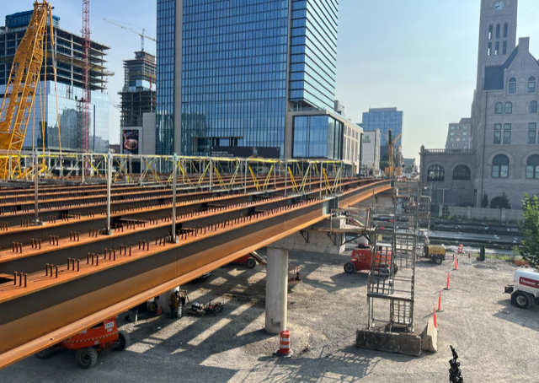
Agenda
Welcome and Introductions
Why GEC Contracts?
Advertisement Overview
Scoring Criteria
Advertisement Presentations
Questions/Discussion

Slide 3

Pre-Submittal Meeting
This meeting is mandatory for consultants submitting as the prime
  PLEASE SIGN-IN TO ENSURE THAT YOU ARE NOT EXCLUDED FOR MISSING THIS MEETING!

Slide 4

Key Contacts
Structures Division
  Wesley Peck, PE – Bridge Hydraulic Design
  Adam Price, PE – Bridge Design Section
  Brian Egli, PE – Bridge Preservation Section
  Rebeca Hayworth, PE – Bridge Performance Section
Professional Services Division
  Laura Doss (Laura.Doss@tn.gov)
  Charity Cox (Charity.Cox@tn.gov)
Notes:
All questions must go through professional services during the advertisement period.

Slide 5
Why GEC?
Predictable Work: A cohesive program of structural projects provides greater workload consistency and improves staffing forecasts.
Streamlined Coordination: A single point of contact simplifies communication, decision-making, and contract administration.
Better Workforce Utilization: Allows firms to balance resources across multiple assignments.
Improved Program Delivery: Less administrative burden, fewer meetings, faster response times, and more focus on delivering quality projects.
Notes:
The GEC model is intended to create a more stable, predictable workload while providing opportunities for both prime consultants and subconsultants to participate in delivering CEI and MEI services statewide. We wish to expand capacity and improve delivery not simply consolidate work.

Slide 6

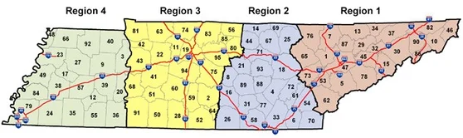
GEC Partnerships
Consultants are encouraged to form strong teams with complementary capabilities and experience for statewide coverage of project assignments.

Slide 7
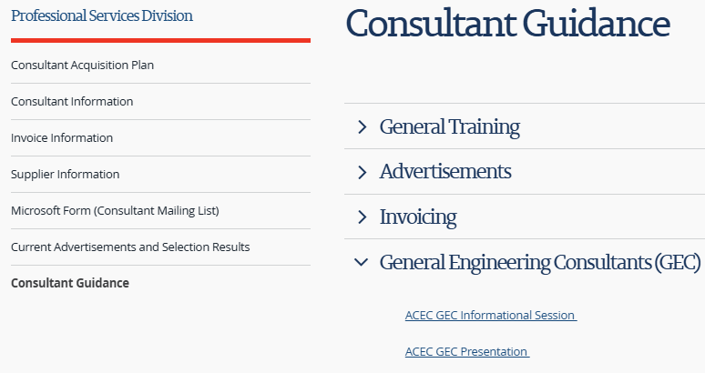

Professional Services and ACEC
ACEC previously hosted a Q & A session with Professional Services to cover the vision for switching to a GEC model
That presentation is available on YouTube and on the Professional Services webpage.

Slide 8
Advertisement Overview
Six (6) Statewide GEC Structures Focused Contracts
Services includes items to support structure project delivery
Contract Term: Five (5) years
  New work orders issued during first four years
Total Ceiling = $100M with $10M base amount per contract
Phase I Submission due September 16, 2026, by 2:00 PM CDT
  Limited to 3 pages

Slide 9
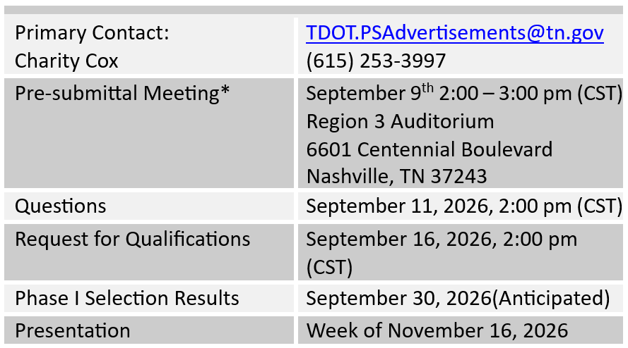
Advertisement Schedule

Slide 10
Advertisement Scope of Services
Full-Service hydraulic and hydrologic analysis & design with plan development and CAD support;
Surveying of road and streambed profiles, collecting typical floodplain info per the TDOT Survey Manual;
Hydrologic flow estimation and design (1-D and 2-D) modeling for design of bridges and culverts;
Ensuring compliance with National Floodplain Insurance Program (NFIP) requirements including preparation of CLOMR and LOMR applications;
Providing deck drain spread analysis;
Bridge scour and stream stability analyses including development of scour countermeasures;
scour assessments and evaluations including the development of scour Plans of Action (POA).
Underwater inspections including sounding around bridge foundations;
Quality assurance and quality control (QA/QC) reviews, general project management, and related administrative tasks.
Complete structural analysis, structural design, and structural plan preparations;
Detailing and preparation of structural designs for bridge preservation projects;
Bridge and Tunnel Inspections including NBIS and NTIS routine inspections, non-redundant steel tension member (NTSM) inspections, and special inspections;
Load rating of in-service bridges including preparing detailed draft load rating reports and delivering stamped final load rating reports;
Management and technical services related to the processing of structural bridge assessments related to the Over-Weight / Over-Dimension permit program;
Project support services including site investigations, site assessments, preparation of planning documents, bridge and approach surveying, utility coordination, right-of-way (ROW) services, roadway design, traffic design, and development of traffic control plans;

Slide 11
Scoring Criteria
Criteria | Weight
i. Team capability (Section C, D, & E of Part II of the DT-0330 form). (Include certifications for bridge inspection leads and other key staff) | 25 %
ii. Past work experience in the required disciplines (Section F & G of Part II of the DT-0330 form). | 10%
iii. Team Staffing Qualifications & Availability | 15%
iv. Technical approach for program support (as explained in Section I of Part II of the DT-0330 form). | 20%
v. Past performance evaluations on Structures Projects, if available. | 5%
vi. Presentation | 25%
Notes:
Fix roman numerals

Slide 12
Team Capability
Previously, we evaluated the individuals proposed for anticipated positions.
Under the GEC model, we're interested in understanding the firm's overall capability—how many qualified resources you have available, where they're located, and how you'll deploy them to support TDOT statewide.
Firm overall capability of how you will manage the team and resources the department requests.
  Highlight the experience of managing complex
  projects with multiple teams members.
25%

Slide 13
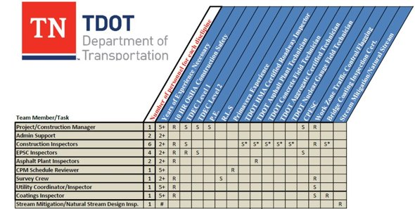
Staffing Matrix Or Visual Representation
In addition to the org chart, provide a visual representation of team capabilities
  Number of available personnel by discipline
  Relevant Certifications and Licenses
  Areas of technical expertise
Prime vs Sub Responsibilities
Regional Offices/Locations
Notes:
Consultant shall provide a staffing matrix demonstrating your firms' available resources

Slide 14
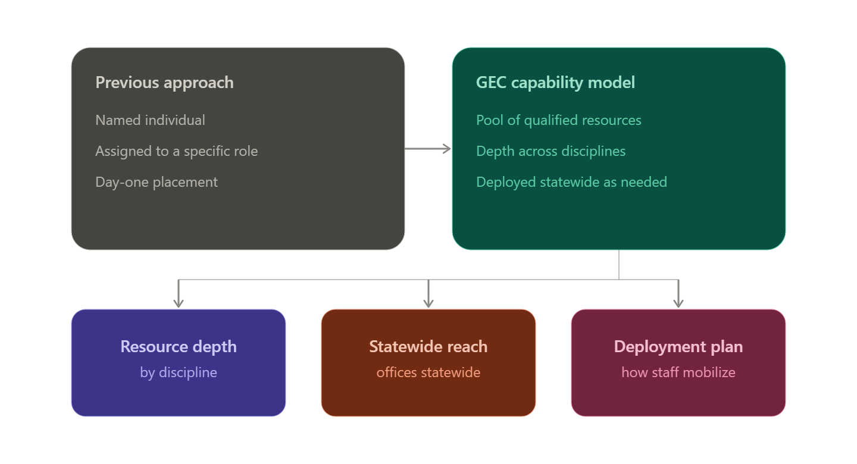
Technical Approach
Greater emphasis being placed on the technical approach brought to the table by each prime and team of subs
  Supported by a well thought out plan for subs meeting technical and staffing needs listed within scope of service
20%

Slide 15
Advertisement Presentations
Presentations tentatively scheduled for the week of November 16th,2026
Top ten (10) firms will be invited for presentation
  Held in Nashville, TN (Location TBD)
  30-minute formal presentation with 30-minute Q&A
  Limited to seven (7) team members
Presentation Panel
  Structures Division Staff
  One HQ PS representative (Advisory only)
25%

Slide 16
Questions?
Questions shall be submitted to professional services during the advertisement.
  TDOT.PSAdvertisements@tn.gov
Responses to questions/comments will be posted for all to view.

Slide 17
RFP – Considerations
Can TDOT allow for organizational charts to be presented on an 11x17 page? If so, will they still count as one page?
  Yes. An organizational chart may be presented on an 11" × 17" page, and it will count as one page toward the proposal page limit
Given the potential large size of teams, can TDOT allow for organizational charts to be presented on two pages?
  Yes. Organizational charts may be presented on two pages, provided the overall proposal does not exceed the maximum page limit of 60 pages

Slide 18
RFP – Considerations
Can Section F projects be more than one page as long as we submit no more than 10 projects?
    Yes. Individual Section F project descriptions may exceed one page, provided the total number of project is no more than 10 and the overall proposal does not exceed the maximum page limit of 60 pages.

Slide 19
RFP – Considerations
Are there any firms that are conflicted to responding to this RFP as a prime or a sub?
  No firms are currently identified as being conflicted from responding to this RFP.
  Any firm on TDOT's pre-qualified consultant list may submit as a prime consultant or a subconsultant.
  A firm may also submit a proposal as a prime consultant while simultaneously participating as a subconsultant on one or more other teams' proposals.

Slide 20
Pre-Submittal Meeting
This meeting is mandatory for consultants submitting as the prime
  PLEASE SIGN-IN TO ENSURE THAT YOU ARE NOT EXCLUDED FOR MISSING THIS MEETING!

Slide 21

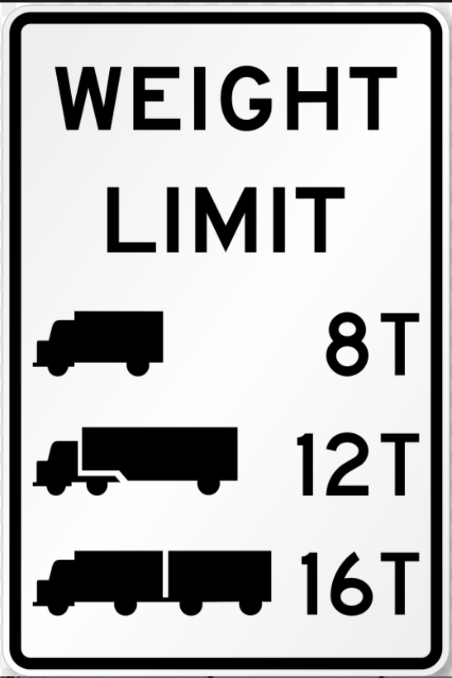



Questions & Discussion

