Slide 1
I-40 at State Route 53 Interchange Improvements Smith County PIN 133582.00 Advertisement Pre-Proposal Meeting

Slide 2
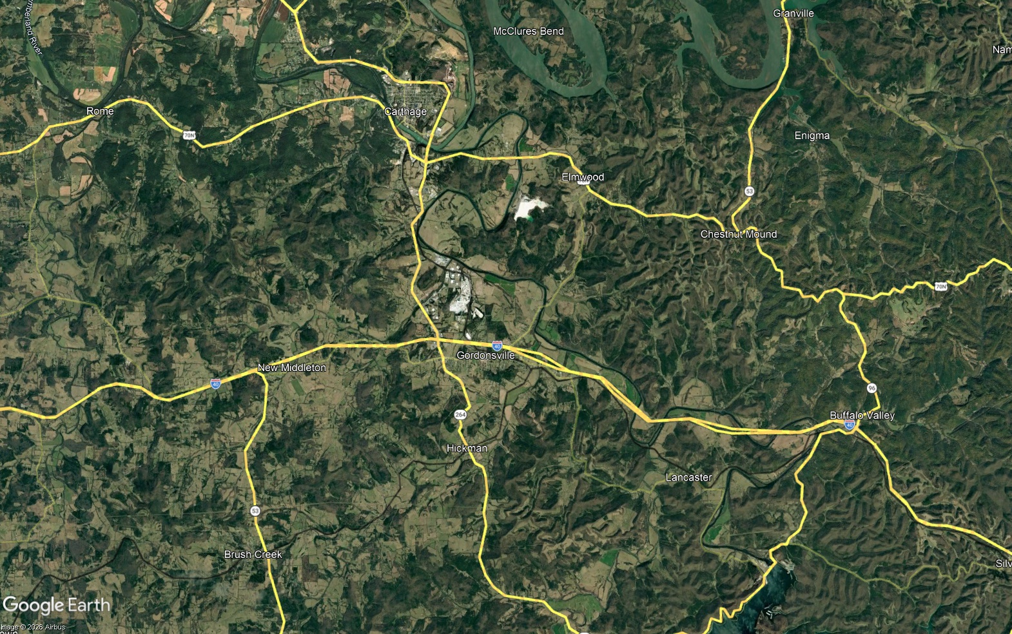
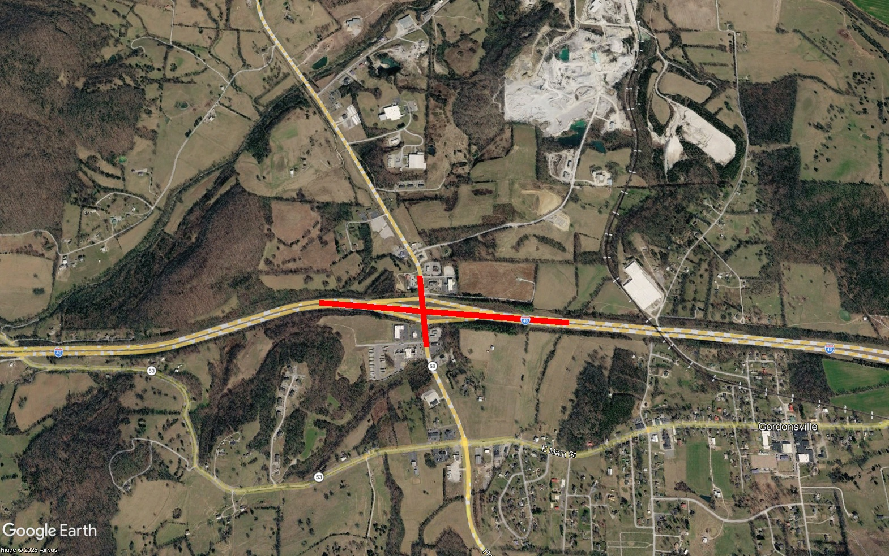

Project Location
Smith County
Project Location
Gordonsville
Gordonsville

Slide 3
Project Overview
Project will follow the TDOT Project Delivery Network (PDN)
Goal of project is to improve interchange to reduce congestion and help with truck traffic
PE – FY26, ROW – FY28, Construction – FY30
TMA Total Budget - $76.6 Million
Includes $2.2M for PE, $1.2M for ROW, and $73.2M for Construction

Slide 4
Known Issues
Heavy truck traffic at this interchange causes heavy congestion during peak times
Some existing ramp radii at intersection with SR-53 are undersized and do not offer a wide enough turning radius for truck traffic leading to delays
Delays for vehicles making left turning movements onto the I-40 EB and WB on-ramps from SR-53 due to heavy truck traffic
Trucks accessing the Pilot Truck Stop on Bradford Boulevard have caused damage to the curbing on the SE quadrant of the SR-53 and Bradford Boulevard intersection

Slide 5
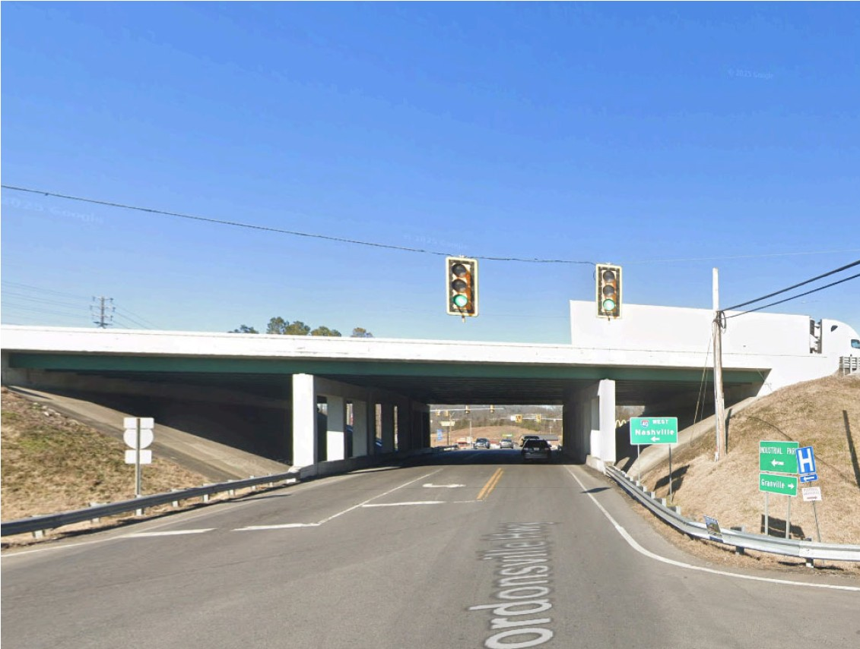
SR-53 Geometric Data
Exist. 3 @ 12’ Lanes
Minimum horizontal clearance = 43’ - 0”
Minimum Vertical Clearance = 17’ – 3”

Slide 6
Technical Disciplines
Traffic/Safety Analysis & Concepts
Barge Design Solutions procured through TDOT Concept Design
Barge will be scoped to do the traffic analysis, IAR, and concept development
Barge will remain on the team as a team member

Slide 7
Technical Disciplines
Field Work
Survey
Geotechnical
Utilities (Including coordination and deconfliction)
If ROW acquisition is needed, project will be Chapter 86 eligible
Design
Roadway
Structures
Project Management

Slide 8
Technical Disciplines
ROW
Must follow the Uniform Act and TDOT ROW Manual
ROW Pre-Acquisition Activities
Legal Description Preparation
Appraisal Valuation Services (Appraisal review will be done by TDOT)
Acquisition (Including negotiating through closing, some property management services, and relocation assistance)
Related Services (Including, but not limited to, title report preparation, deed preparation, lien releases/partial releases, and review of individual tract files)

Slide 9
Technical Disciplines
Environmental
Technical Studies
NEPA Decision Document
Mitigation and Permits

Slide 10
Other Information
Current Schedule
Preliminary Engineering – FY 26
Right-of-Way – FY 28
Construction – FY 30
Method of Payment
Cost Plus Fixed Fee
Federal Funds

Slide 11

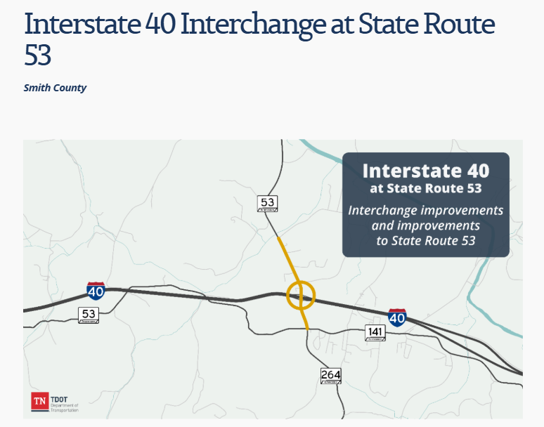
Other Information
Project Website
Interstate 40 Interchange at State Route 53

Slide 12
Advertisement Information
Contact Information
Natasha Whitfield – TDOT Professional Services
Email: TDOT.PSAdvertisements@tn.gov
Office: 615-253-3997

Slide 13
Advertisement Information
Phase I
Firm Overview
Project Fit
Qualification Type
Phase II
Team capability & work experience
Technical approach
Amount of work under contract (on file w/TDOT)

Slide 14
Questions?

