Slide 1
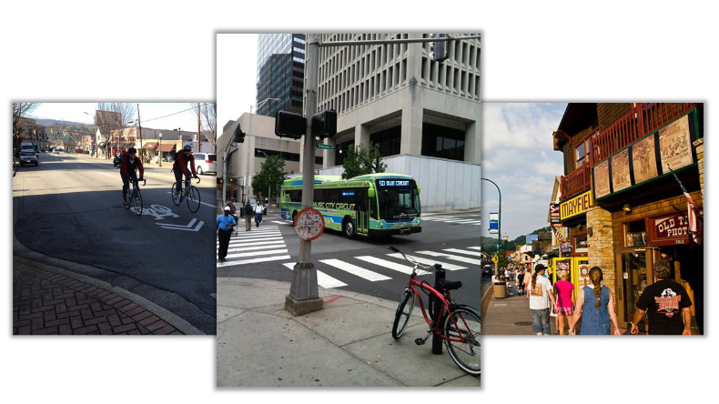
Multimodal Access Grant 2024 Applicants Webinar

Slide 2
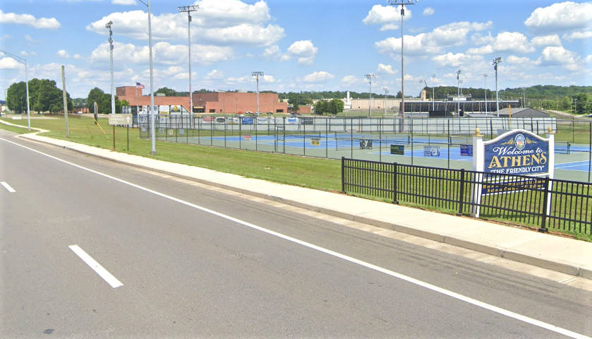
Program Overview
Purpose Support needs of pedestrians, bicyclists, and transit users through infrastructure projects on state routes.
Eligible Applicants TN Cities, Towns, and Counties
Award Amounts
Maximum eligible portion of project budget = $1.25 million
Distressed/At-Risk Counties: 95% State / 5% Local Match = Maximum $1,187,500 Award
All Other Counties: 90% State / 10% Local Match = Maximum $1,125,000 Award
Athens Multimodal Pedestrian Improvements –
https://www.tn.gov/rural/success-stories/athens-multimodal-pedestrian-improvements.html

Slide 3
Program Overview
Project Examples
Sidewalks
Pedestrian Crossing Improvements
Shared Use Paths
Bike lanes
Transit Stop Improvements
Pedestrian Lighting
ADA and Complete Street elements
Project Requirements
Located along a State Route
Primary purpose is transportation
Improvements for pedestrian, bicyclists, or transit users
Meet ADA/PROWAG standards

Slide 4
Program Timeline
April 10 – May 13 Notice of Intent (NOI) Open, via email Please submit applications to: TDOT.MultimodalPlanning@tn.gov
May 14 – May 27 TDOT NOI Review, then Invitation to Apply
May 28 – July 15 Full Applications Open, via eGrants
July 16 – Winter TDOT Feasibility Review, Scoring, and Award Recommendations
Winter 2024-25 Award Recipients Announced

Slide 5
Project Eligibility
Applicant Requirements
Lead Agency: Cities, Counties and Towns in Tennessee
Must sign agreement committing to match and maintenance
Must be current on payments owed to TDOT
Project Requirements
Contiguous and located along a State Route
Primary purpose is transportation
Improvements for pedestrian, bicycle or transit users
Meet ADA/PROWAG standards
Include construction as part of project

Slide 6
Project Eligibility
Eligible projects are infrastructure items that improve transportation access for pedestrians, bicyclists, and transit users along State Routes.
Eligible Project Examples
Sidewalks
Pedestrian crossing improvements
Shared use paths
Bike lanes
Transit stop improvements
Pedestrian lighting
ADA and Complete Street elements
Ineligible Project Examples
Road widenings
Turn lane additions
Operating costs
Rolling stock
Maintenance activities
Recreational trails
Trailheads
Park Improvements

Slide 7
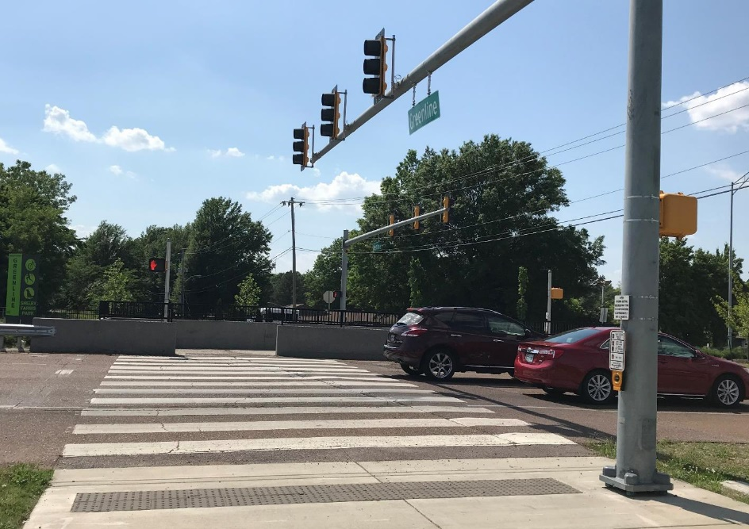
Selection process
Project Evaluation
1) Notice of Intent (NOI) Phase
Letters of Intent reviewed for eligibility
2) Feasibility Review
Full Applications reviewed for feasibility
3) Scoring Committee
Applications ranked by merit criteria
4) Award Recommendations
Applications recommended for Award
Shelby Farms Greenline Crossing in Memphis, TN

Slide 8
1) Notice of Intent (NOI) Phase
Eligibility Review
NOI does not need to be hi-res or polished for presentation
Questions for eligibility:
Is the applicant an eligible agency?
Is the project contiguous and along a state route?
Is the primary purpose transportation rather than recreation?
Does the project only benefit walking, cycling, and/or transit users?
Does the project only include eligible items?
Is the local agency in good financial standing with TDOT?
If all answers are yes, the agency will receive an invitation to submit a full application.
2024 NOI Instructions available on website:
https://www.tn.gov/tdot/multimodal-transportation-resources/bicycle-and-pedestrian-program/multimodal-access-grant.html

Slide 9
2) Feasibility Review
Feasibility Review Committee
The Feasibility Review Committee is comprised of staff from the following TDOT offices:
Strategic Transportation Investments Division (STID) – budget constraints and accuracy
Regional Engineering Offices – technical barriers and project plan
Local Programs Office – local project experience
Office of Community Transportation – local priority and political environment
Division/Office assigned questions specific to their expertise and region
Qualitative responses assigned numeric metrics
Notes and comments are recorded for each question
Projects with a high likelihood of successful and timely implementation will move to Full Scoring
Feasibility Scoring Criteria available in 2024 MMAG Guidelines on website:
https://www.tn.gov/tdot/multimodal-transportation-resources/bicycle-and-pedestrian-program/multimodal-access-grant.html

Slide 10
3) Scoring Committee
Merit Scoring Criteria | Points
Scoring Criteria | RPO | MPO
Safety | 30 | 30
Connectivity | 30 | 30
Local Priority | 15 | 25
Economic Impact | 25 | 15
Total | 100 | 100
Full Scoring Committee
HQ staff from Traffic Operations, Mobility and Accessible Transportation, and Roadway Design all took part last year
Scorers divide MPO and RPO applications between them; those areas are competing independently
Scorers notes and comments are recorded
MPO and RPO areas have different scoring metrics
Distressed and At-Risk counties automatically received full Economic Impact scoring
Full Scoring Criteria available in 2024 MMAG Guidelines at website:
https://www.tn.gov/tdot/multimodal-transportation-resources/bicycle-and-pedestrian-program/multimodal-access-grant.html

Slide 11
4) Recommended Project Selection
How are projects identified for recommendation?
Top scores - MPO and RPO areas ranked separately
High quality previous project applications may be scored more favorably
Geographic balance across the State of Tennessee
Applications by Year |  | Awarded | Success Rate
2014 | 36 | 13 | 36%
2015 | 36 | 14 | 39%
2016 | 35 | 14 | 40%
2019 | 51 | 16 | 31%
2019-20 | 61 | 18 | 30%
2020-21 | 64 | 23 | 36%
2021 | 70 | 26 | 37%
2022 | 43 | 27 | 63%
2023 | 37 | 12 | 32%
Total | 433 | 163 | 38%

Slide 12
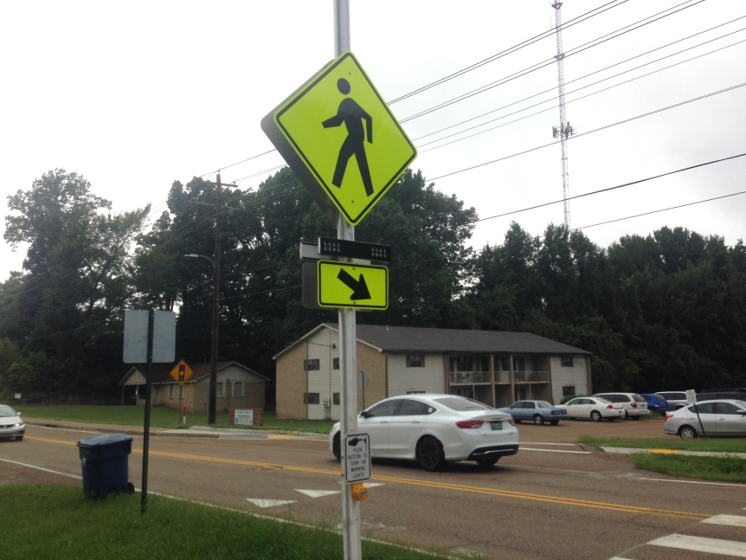
Questions?
Owen Knight
Transportation Program Monitor
Multimodal Planning Office
(615) 253-7691
Owen.knight@tn.gov
Crosswalk and Sidewalks in Munford, Tennessee

