Slide 1
PRE-BID CONFERENCE
Performance Based Maintenance Services
RFP 40100-51617 Region 4

Slide 2
SOLICITATION COORDINATOR
Mike Bentheimer
Department of Transportation
Procurement and Contract Division
5th Floor J.K. Polk Bldg.
505 Deaderick Street
Nashville, TN 37243
Michael.Bentheimer@tn.gov
p. 629-246-0632

Slide 3
Agenda
Notices
Schedule of Events
Overview of Solicitation process
Overview of RFP Attachments & Evaluation Models
Overview of Scope of Services
Questions

Slide 4
Notice
Scope overview will not cover all Scope items, and is only meant to be a brief overview
Responses given here today cannot be considered binding or official until put into writing by the State
Questions must be submitted in writing to the solicitation coordinator prior to the Written “Questions & Comments” Deadline to receive an official answer from the State. Deadline is on September 26, 2025, at 2:00 p.m. CT.
Please make sure to read all solicitation documents including attachments.
A respondent may not submit a response as the prime contractor and be a subcontractor in another’s response

Slide 5
Schedule of Events
Written “Questions & Comments” Deadline – September 26, 2025 @ 2:00 PM CT
State Response to Written Questions – October 10, 2025
Response Deadline – October 24, 2025
(State’s Discretion) Oral Presentations – November 12-14, 2025
State Completion of Technical Responses – November 18, 2025
State Opening & Scoring of Cost Proposals – November 19, 2025
(State’s Discretion) Best and Final Offer (BAFO) Initiated – November 20, 2025
BAFO Recommendations by Respondent – December 4, 2025
State Response to BAFO – December 11, 2025
Response to BAFO – December 18, 2025
Notice of Intent to Award / Contract Sent for Signature – December 22, 2025
Contractor Signature and Payment and Performance Deadline – January 5, 2025

Slide 6
Solicitation Process
Must be Prequalified through TDOT Construction Division
Link on the PBMC webpage to Contractor Prequalification page.
It will take 14 days to process once all information has been submitted

Slide 7
Solicitation Process
RFP Section 1.4.4. Questions and Comments
Respondents must use the prescribed template
Questions must address a single issue per question
Respondents must delineate whether their question is "Substantive" or a "Technical Correction" on the template.
A substantive issue raises a question or provides a comment about the substantive content of the document.
A technical correction relates only typographical errors, incorrect cross-references, clerical issues, or other minor and non-substantive issues.
Respondents are subject to a limit of thirty (30) questions but this limit does not apply to Technical Corrections
TDOT will disregard any questions in excess of the specified limit. TDOT may, in its sole discretion, amend the maximum limit of questions in future versions of the RFP or add additional opportunities for interested bidders to submit questions.

Slide 8
Solicitation Process
RFP Section 3 – Response Requirements
3.1 Response Form
General Qualifications and Experience
Mandatory Requirements (Section A)
Technical Qualifications, Experience & Approach (Section C)
Cost Proposal (Attachment 6.3)
3.2 Response Delivery Location
Mike Bentheimer
Department of Transportation
J.K. Polk Bldg., 5th floor
505 Deaderick Street
Nashville, TN 37243

Slide 9
Solicitation Process
RFP Section 3 - Response Requirements
Section 3.1.1.5. Bid Bonds are not eligible to be submitted digitally and must be submitted in a sealed envelope to the address found in Section 3.2.4.

Slide 10
Solicitation Process
3.2.5. Digital Submission
3.2.5.1. A Respondent may choose to request the opportunity to submit their response digitally via DropBox. If a Respondent elects to submit via Dropbox, the Respondent must make the request, to the solicitation coordinator via email, no later than one (1) week prior to the Response Deadline found in section 2.1 of this RFP. The Solicitation Coordinator will provide a unique link to each Respondent’s request for digital submission. Following submission, the Respondent must notify the solicitation coordinator via email identifying each of the following items:
Verification of completed submission of all documents
A listing of each item submitted, including exact titles and formats in which the items were submitted
3.2.5.2. Once the Respondent has completed their submission and provided written notification as required above, the Solicitation Coordinator will provide confirmation of receipt via email.
3.2.5.3. Should the Respondent require deletion or correction of items in their submission prior to the Response Deadline found in RFP Section 2.1. the Respondent shall submit to the solicitation coordinator a written request via email no later than twenty-four (24) hours prior to the Response Deadline found in RFP Section 2.1. The Solicitation Coordinator will confirm the deletion of any items in writing via email and the Respondent shall then use the same link previously provided to upload the correct items and notify the Solicitation Coordinator using the same steps found in RFP Section 3.2.5.1.a. and 3.2.5.1.b.
3.2.5.4. Should a Respondent not follow the steps outlined in Sections 3.2.5.1,, 3.2.5.2 and 3.2.5.3. Their response may be found non-responsive and/or may not be eligible for digital submission. A Respondent shall not be allowed to alter their proposal submission after the Response Deadline found in RFP Section 2.1. unless requested to do so by the Solicitation Coordinator through a clarification request, which is done at the State’s sole discretion.

Slide 11
Solicitation Process
RFP Section 3 - Response Requirements
3.1 Technical Response
A Technical Response should NOT exceed 50 pages in length
3.3 Response Prohibitions
Must not include alternate contract terms and conditions. If a response contains such terms and conditions, the State, at its sole discretion, may determine the response to be a non-responsive counteroffer and reject it.
Must not restrict the rights of the State or otherwise qualify the response
Must not provide alternative goods or services (i.e. services different from those requested and required in the RFP) unless expressly requested by the RFP.
Must not include cost proposals that involve any collusion among respondents
Must not include, for consideration in this procurement process or subsequent contract negotiations, incorrect information that the Respondent knew or should have known was materially incorrect;
Must not include more than one response, per Respondent;
Must not include any information concerning costs (in specific dollars or numbers) associated with the Technical Response;
The State shall not consider a response from an individual who is, or within the past six (6) months has been, a State Employee.

Slide 12
Solicitation Process
RFP Section 3 - Response Requirements
3.3 Response Prohibitions-Section 3.3.9
A respondent is required to Identify and disclose any Organizational Conflicts of Interest in accordance with this section. This includes and but is not limited to:
Any current contractual relationships with TDOT (by identifying the TDOT contract number and project manager);
present or planned contractual or employment relationships with any current TDOT employee;
Any current relationships between Key Personnel on other TDOT projects; and
Any other circumstances that might be considered to create a financial interest in the Contract by any current TDOT employee if the Respondent is awarded the Contract.
A Respondent must disclose this as part of their Technical Response on separate pages and detailing steps that have been or will be taken to avoid, neutralize, or mitigate any organizational conflicts of interest

Slide 13
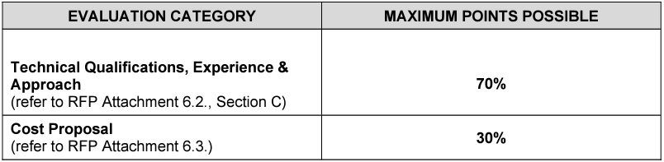
Solicitation Process
RFP Section 5 – Evaluation & Contract Award
Proposals will be evaluated with the following point totals

Slide 14
RFP Attachments & Evaluation Models
Attachment 6.1. Statement of Certification and Assurances must be signed without exception or qualification and MUST be signed by someone who has the legal authority to bind the Respondent.
If signed by someone other than the President or the Chief Executive Officer, you must attach evidence of the individual’s authority to bind the Respondent
Attachment 6.2. and Section 3.1.1.4 Response items
Column 1 – Response page numbers
Respondents complete
Immensely helpful to evaluators
General Qualifications & Experience Items (Section 3.1.1.4.)
Not scored. Per 5.2.1., Respondent may be deemed non-responsive or non-responsible, if State deems necessary

Slide 15
RFP Attachments & Evaluation Models
Mandatory Requirement Items (Section A)
Eleven (11) items that will need to be addressed
Pass/Fail – All lines must pass to move onto technical evaluations
Technical Qualifications, Experience and Approach Items (Section B and C– worth 70%)
Twelve (12) items, scored by each item against evaluation factors that reflect relative importance
Some items may require more detailed attention; please ensure that all aspects of these items are addressed
Oral Presentations (At State's Discretion)
Allows Respondents to explain their technical proposal.
Cost Proposal (Attachment 6.3.)
This Cost Proposal must be completed exactly as required

Slide 16
Cost Proposal
Cost Item Description | Proposed Cost
ROUTINE MAINTENANCE SERVICES | $ / MO.
MOBILIZATION (10% of first 12-month sum to be paid in 3 equal installments over the first 3 months) | $
****UNIT PRICE BIDS**** | ****
PERMANENT PAVEMENT REPAIR (TIER 2) | $ / TON
PERMANENT PAVEMENT REPAIR TIER 2 MOBILIZATION | /EA
TIER 2 PATCHING CONCRETE PAVEMENT | $ / SF
ADDITIONAL SWEEPING | $ / SHOULDER MILE
ADDITIONAL MOWING | $ / CYCLE
SPOT MOWING | $ / ACRE
ADDITIONAL LITTER | $ / CYCLE
SPOT LITTER | $ / C.L. MILE
SNOW & ICE REMOVAL (OPERATOR) | $ / HR
****PHASED MAINTENANCE SERVICES**** | *******
OBJECT MARKERS AND DELINEATORS | $ / Lump Sum.
MISC. DRAINAGE STRUCTURES | $ / Lump Sum
PAVED DITCH | $ / Lump Sum
PIPES | $ / Lump Sum
INLETS | $ / Lump Sum
PAVED LANES - ASPHALT | $ / Lump Sum

Slide 17
Limited Phased in Performance for Select Characteristics
Baseline PBMI assessment identified 5 characteristics not presently meeting minimum PBMI score.
Object Markers and Delineators
Misc. drainage structures
Paved ditch
Pipes
Inlets
Paved Lanes - Asphalt
A separate lump sum price for each characteristic to meet minimum standard. A percentage of which will be paid after the each quarterly PBMI.
PBMI scoring will be adjusted on those characteristics in the first 12 months.

Slide 18
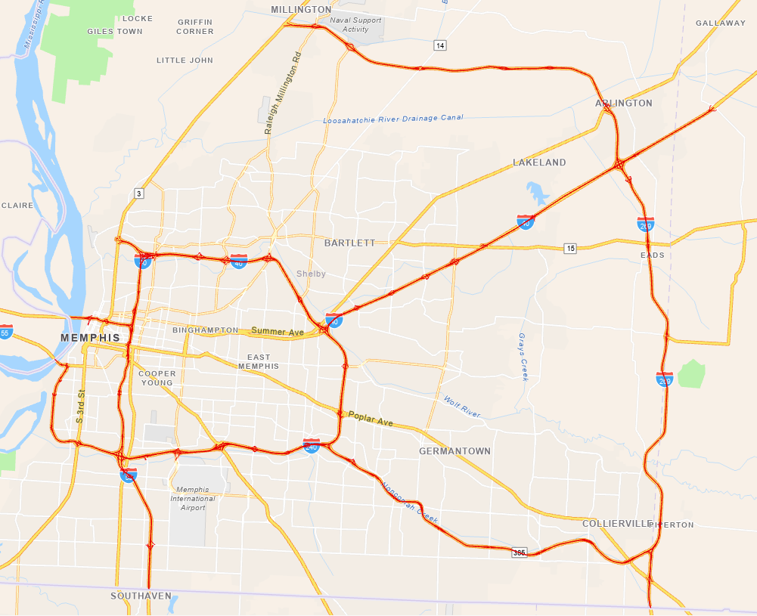
Contract Award Process
There shall be one performance-based maintenance contract awarded in TDOT Region 4.
Region 4 – Shelby and Fayette Counties

Slide 19
Scope of Services Overview
Please review ALL Scope of Services
The State is seeking to contract for performance-based maintenance services to:
The Contractor shall perform all activities associated with highway, drainage, structures, roadside, vegetation, traffic services, specialty items, emergency response, incident management activities, and winter operations support in accordance with the Contract, its Scope of Services, and the contract performance criteria detailed therein twenty-four (24) hours a day seven (7) days a week unless otherwise directed by the Department.
These comprehensive maintenance services shall include the management and performance of maintenance and repair activities of the interstate highways including all ramps, collector/distributor ramps and frontage roads, bridges, and all roadway appurtenances within the right of way in Shelby and Fayette Counties.

Slide 20
Scope of Services Overview cont.
Contract Period
The Start Date for the work to be performed under this contract is ninety (90) days from the effective date of the Contract (“Start Date”).
This Contract will extend for a period of sixty (60) months after the Start Date.
Renewal Options: At the discretion of the department, this Contract may be renewed for two (2) additional periods of twenty-four (24) months, contingent upon acceptable contract performance.
If the State decides to exercise renewal options, the State must notify the Contractor six (6) months in advance of renewal.
Contractor must respond in writing at least four months prior to renewal date to accept.

Slide 21
Clauses of Note
Bid Bond
Bid bond equal to no less than 5% of the total amount of the cost proposal must be submitted with response
Payment and Performance Bond
If awarded the Contract, Payment and Performance Bond must be submitted within ten (10) business days after notice of award in a sum equal to the first year’s annual Contract amount
Annually thereafter, no later than thirty (30) days prior to the contract anniversary date, provide to the Department a Payment and Performance Bond on a form prescribed by the Department in an amount equal to the corresponding sum of the twelve (12) -month period’s performance-based lump sum Routine Maintenance Services bid.
Insurance
Within 10 business days after receipt of the Contract award, provide documentation evidencing all required insurance to the Department

Slide 22
Emergency Response and Third-Party Damage
Response, inspection, repairs, and replacement required as a result of natural disaster, catastrophic or emergency response, collision to a TDOT asset, such as but not, limited to bridges, barriers, retaining walls, noise walls, and overhead sign structures will be considered part of the contract responsibilities.
The Contractor will not receive any additional compensation from the Department except:
Qualifying FHWA funds the Department receives as a result of the Contractor seeking qualifying FHWA reimbursement. It is the Contractor’s responsibility to provide all information needed to pursue such claims in a timely manner.
Pursuit of claims against the individual or entity which caused damages, or their insurers.
Contractor will not be responsible for declared ”Acts of Terrorism” beyond the reimbursable avenues listed above.

Slide 23
Emergency Response / Third-Party Damage Cap
For an emergency repair or replacement activity of a single asset or group of contiguous assets resulting from a single incident the Contractor financial risk for such repair is capped at $75,000.00 per repair and $ 225,000 per contract year of the reasonable non-reimbursable cost.
Any single-incident damage less than $40,000 shall not be additive to the annual non-reimbursable cap.
TDOT may, at the Department’s discretion, either authorize the Contractor to proceed and agree to pay the additional estimated amount or stop the Contractor from doing any further work and contract out the remaining work to a separate Contractor, or elect to self-perform the remaining work, or any combination thereof.

Slide 24
Snow and Ice Removal Requirements
The Contractor will supply seven (7) trucks equipped with operators, snowplows (12 foot minimum) and V-box spreaders, saddle tanks for pre-wetting, and AVL equipment with open API for data transfer and inclusion on TDOT’s dashboard.
The State will supply granular salt and chemicals required to perform the work.
The Contractor will be guaranteed a minimum payment of 3 hours per truck for each call-out. Hourly standby pay will be paid per truck for any time trucks are called out and are directed to be idle.
Snow routes are divided between interstate and primary state routes receiving equal initial attention. Field conditions will dictate snow route scheduling, which will be established by the authorized TDOT representative.

Slide 25
Available Supplemental Data
https://www.tn.gov/tdot/engineering-operations-division/pbmc.html
Region 4 Interstate Incident Management Plan
Link to TDOT Materials and Tests QPL and Producer List
Link to PBMI Baseline Data
GIS Map of Asset Inventory
TDOT PBMI Field Manual
R4 Lane Blockage Summary
Bridges in Shelby Co included within coverage area
Bridge Inventory and Appraisal Report
PBMI Map with failure photos
Statewide Work Request for the coverage area

Slide 26
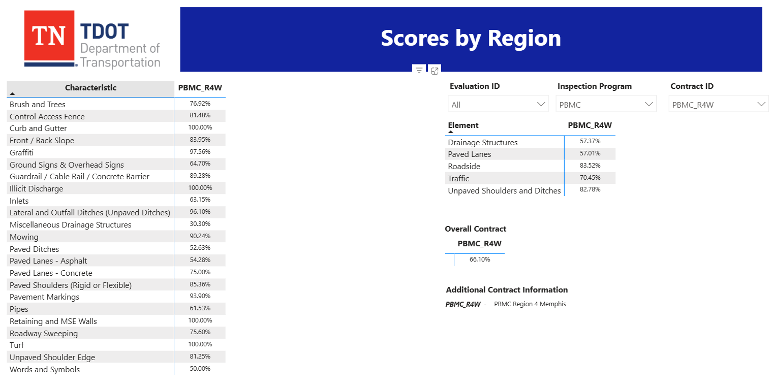
Baseline PBMI Scores

Slide 27
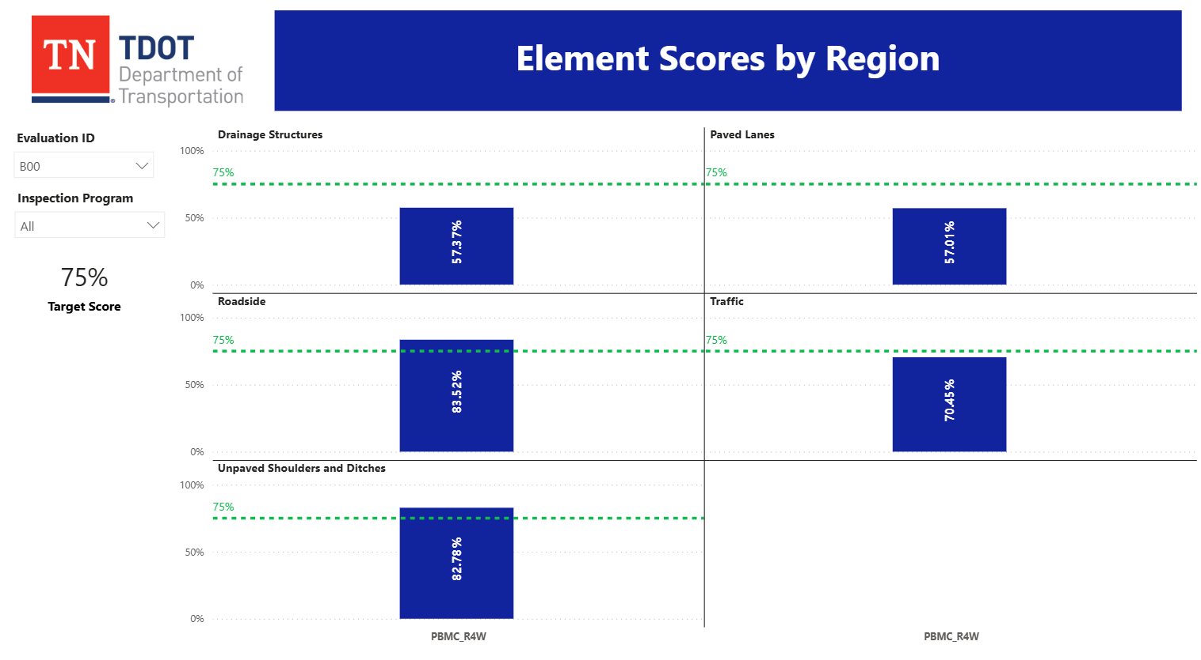
Baseline PBMI Scores

Slide 28
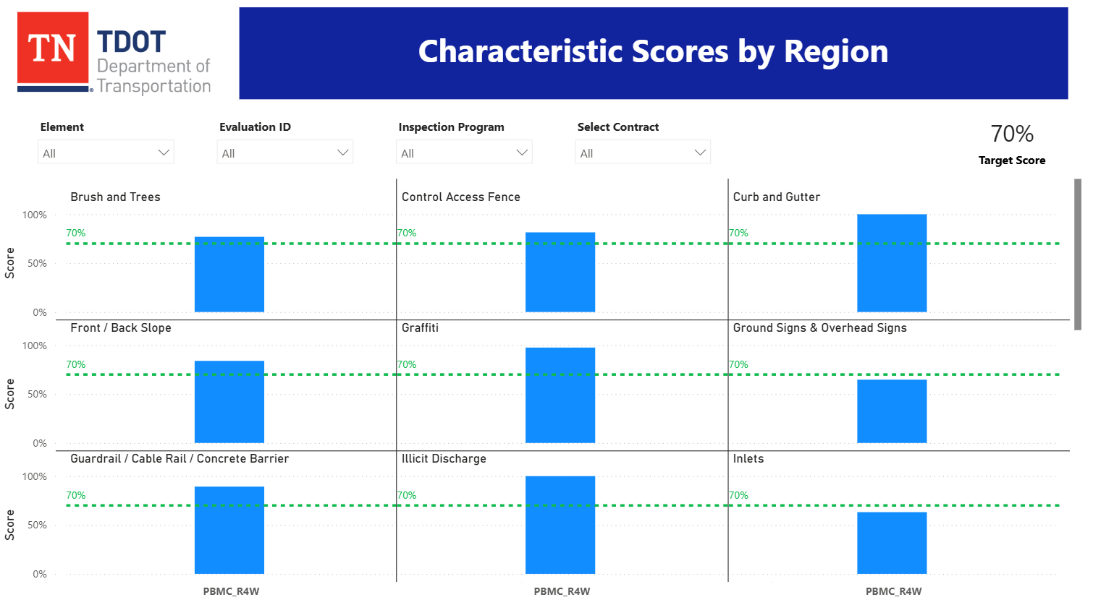
Baseline PBMI Scores

Slide 29
Questions
Solicitation Coordinator
Mike Bentheimer
Department of Transportation
J.K. Polk Bldg.
505 Deaderick Street
Nashville, TN 37243
Michael.Bentheimer@tn.gov
p. 629-246-0632
Questions & Comments Deadline September 26, 2025, at 2:00 p.m. CT.

Slide 30
Thank You!

