Slide 1
Sesión de Participación de las Partes Interesadas del Plan de Despliegue de la Infraestructura de Vehículos Eléctricos de Tennessee (TEVI) Abril 2022

Slide 2
Agenda
Visión general de la oportunidad de financiación del Programa NEVI
Antecedentes y estado actual de la electrificación del transporte en Tennessee
Consideraciones clave que deben incluirse en el Plan NEVI de TN
Próximos Pasos
Notes:
Disseminate worksheets (simplified version of the virtual survey) for attendees to respond to prompted questions/provide thoughts or feedback in writing. Also disseminate index cards for specific questions that will be answered following the presentation, during Q&A.

Slide 3
Visión General de la Oportunidad de Financiación del Programa NEVI
La Ley de Inversión en Infraestructuras y Empleo (IIJA) o Ley Bipartidista de Infraestructuras (BIL) incluye un total de 7.500 millones de dólares en financiación dedicada a ampliar la accesibilidad de los cargadores de vehículos eléctricos (EV) a todos los Estadounidenses.
Los 7.500 millones de dólares se componen de:
Programa de fórmula de 5.000 millones de dólares (Programa NEVI)
88 millones de dólares en 5 años a Tennessee
Programa de subvenciones discrecionales y competitivas de 2.500 millones de dólares
Notes:
National Electric Vehicle Infrastructure (NEVI) Formula Program. The $5 billion NEVI Formula Program will provide dedicated funding to States to strategically deploy EV charging infrastructure and establish an interconnected network to facilitate data collection, access, and reliability.
2. Discretionary Grant Program for Charging and Fueling Infrastructure. The $2.5 billion discretionary grant program is further divided into two distinct $1.25 billion grant programs to support alternative fuel and other EV charger deployment. These discretionary grant programs will ensure charger deployment meets the Biden-Harris Administration priorities such as supporting rural charging, building resilient infrastructure, climate change, and increasing EV charging access in underserved and overburdened communities (“disadvantaged communities”):
•Corridor Charging Grant Program. This program will strategically deploy publicly accessible EV charging infrastructure and hydrogen, propane, and natural gas fueling infrastructure along designated Alternative Fuel Corridors.
•Community Charging Grant Program. This program will strategically deploy publicly accessible EV charging infrastructure and hydrogen, propane, and natural gas fueling infrastructure in communities.

Slide 4
Financiación del NEVI para Construir Cargadores en los Corredores de Combustibles Alternativos
La financiación del programa NEVI se dirige inicialmente a los Corredores de Combustible Alternativo designados para los vehículos eléctricos con el fin de construir esta red nacional, especialmente a lo largo del Sistema de Autopistas Interestatales.
Cuando la red nacional esté totalmente construida, la financiación podrá utilizarse en cualquier vía pública o en otros lugares de acceso público.
Notes:
Initially, funding under this program is directed to designated Alternative Fuel Corridors for electric vehicles to build out this national network, particularly along the Interstate Highway System. When the national network is fully built out, funding may be used on any public road or in other publicly accessible locations. Ten percent of the NEVI Formula Program will be set-aside each fiscal year for the Secretary of Transportation to provide discretionary grants to help fill gaps in the national network. A separate process for these “gap-filling” grants will be established in future guidance.

Slide 5
Corredores de Combustible Alternativo Designados por la FHWA en TN
Notes:
I-40, I-75, I-24, I-65, I-81, I-26, US Hwy 64
May 2 – Kingston
May 3 – Kingsport
May 4 – Knoxville
May 9 – Nashville
May 10 – Hillsboro
May 11 – Chattanooga
May 16 – Memphis
May 17 – Fayetteville

Slide 6
Beneficios Potenciales de las Inversiones del NEVI
Mejorar el acceso al transporte limpio mediante la ubicación de cargadores;
Disminuir la carga del coste energético del transporte permitiendo un acceso fiable a una carga asequible;
Reducir la exposición ambiental a las emisiones del transporte;
Aumentar la paridad en el acceso y la adopción de tecnologías de energía limpia;
Aumentar el acceso a capital de bajo coste para incrementar la adopción equitativa de tecnologías energéticas limpias más costosas, como los vehículos eléctricos y los cargadores de vehículos;
Aumentar la fuente de empleo en energías limpias, la formación laboral y la creación de empresas en comunidades desfavorecidas;
Aumentar la resiliencia energética;
Proporcionar infraestructura de recarga para los vehículos de tránsito y de uso compartido;
Aumentar el acceso equitativo a la red eléctrica; y
Minimizar los desplazamientos inducidos por gentrificación como consecuencia de las nuevas infraestructuras de recarga de vehículos eléctricos.

Slide 7
Calendario del Programa de la Fórmula NEVI
Fecha | Entrega
10 de febrero de 2022 | La FHWA ha publicado orientaciones sobre el programa NEVI
13 de mayo de 2022 | La FHWA publicará los reglamentos completos y propuestos para las normas y requisitos mínimos del Programa de Fórmula NEVI
Para el 1 de agosto de 2022 | Cada estado debe presentar un Plan Estatal de Despliegue de Infraestructura de Vehículos Eléctricos (Plan) que describa la forma en que el Estado tiene la intención de utilizar los fondos asignados del Programa Fórmula NEVI Los Estados deben presentar sus Planes a la Oficina Conjunta de Energía y Transporte
Antes del 30 de septiembre de 2022 | La FHWA aprobará los planes elegibles

Slide 8
Antecedentes y Estado Actual de la Electrificación del Transporte en Tennessee

Slide 9
Estación de Carga 101
Nivel 1
Durante la noche (más de 12 horas)
~4 millas / hora
120V (12A – 16A)
Incluido en todos los nuevos vehículos eléctricos
Móvil, guárdalo en tu maletero
Nivel 2
Durante la comida (2-3 horas)
20 - 30 millas / hora
240V (32A – 80A)
Hogar, lugar de trabajo, comercio minorista
Instalado por un electricista
Cargador rápido de CC
(Nivel 3)*
Parada en boxes (10 - 45 minutos)
150 - 500+ millas / hora
480V (50 kW – 350 kW)
A lo largo de los corredores interestatales
*Las estaciones de recarga subvencionadas con fondos NEVI deben incluir al menos cuatro cargadores rápidos de corriente continua capaces de cargar simultáneamente cuatro vehículos eléctricos a 150 kW por enchufe.

Slide 10
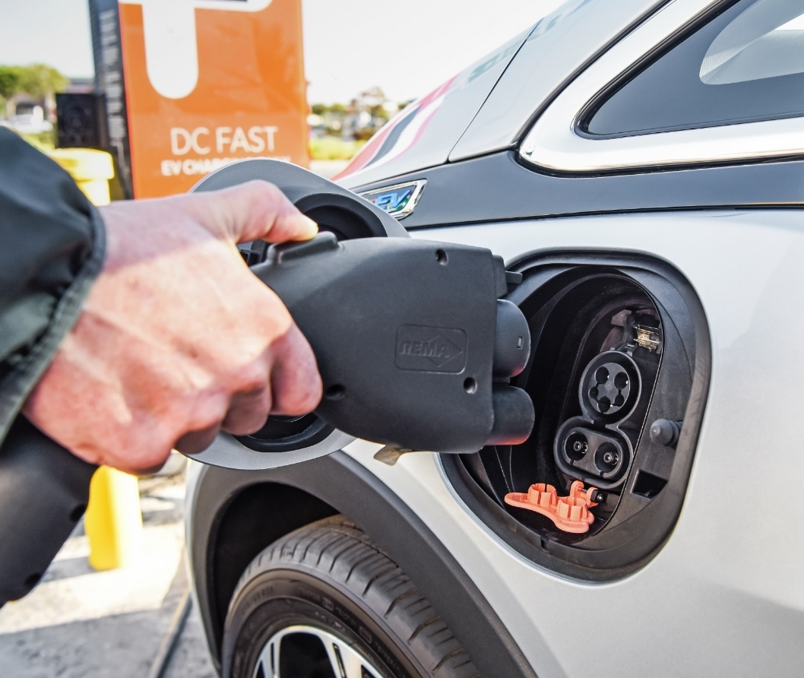
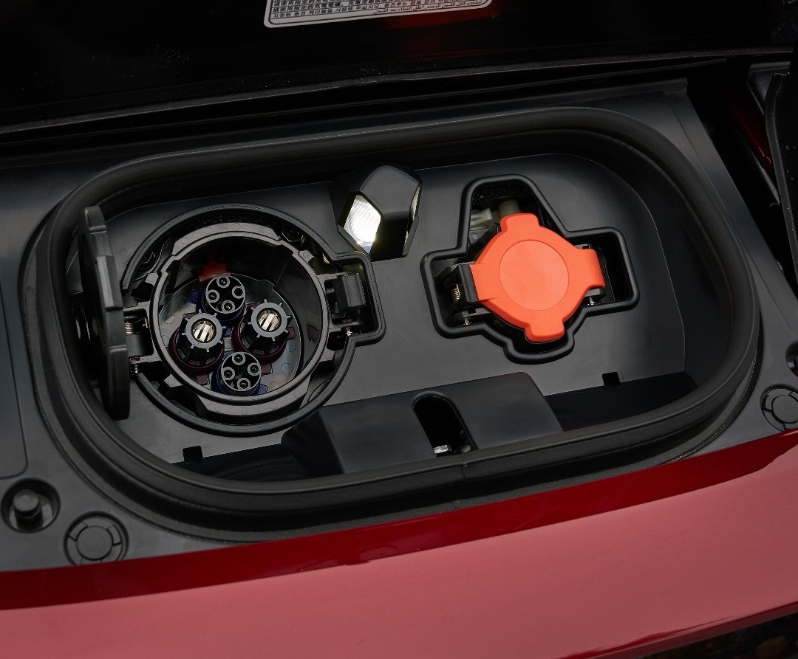
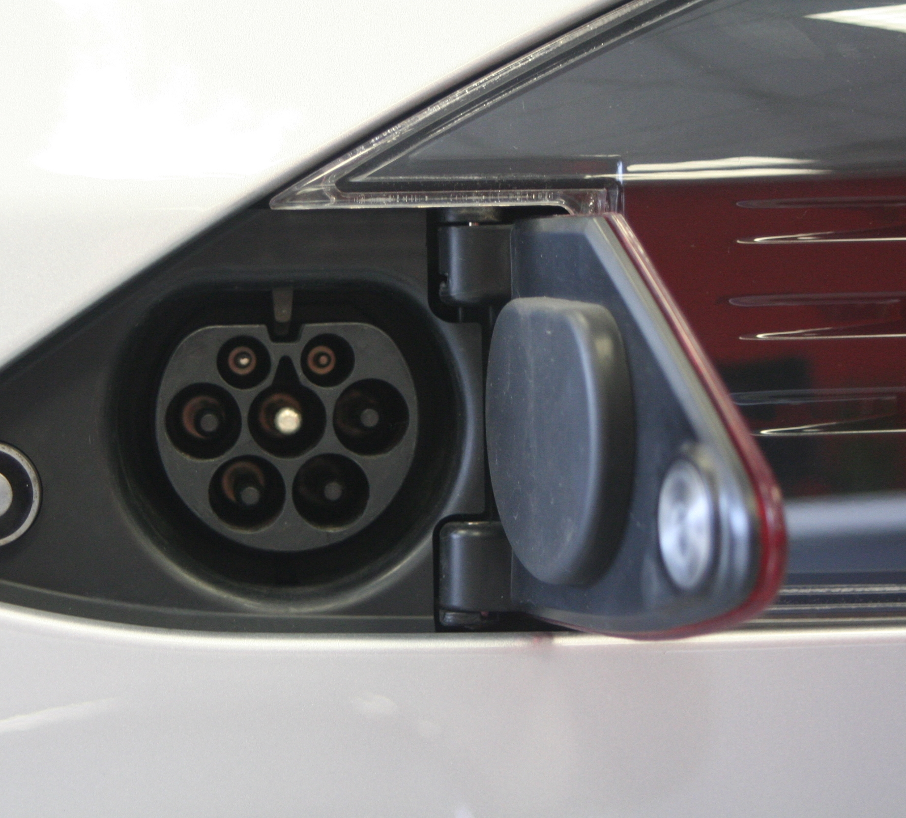
Tipos de Enchufes de la Estación de Carga Rápida de CC
Estándares de enchufes de estaciones de carga rápida disponibles actualmente:
CCS
CHAdeMO
Tesla (patentado)
puerto de carga Rápida
puerto de carga Estándar
Las estaciones de carga financiadas por el programa NEVI deben tener al menos cuatro puertos CCS
La mayoría de los próximos modelos de vehículos eléctricos en EE.UU. utilizan el estándar CCS

Slide 11
Electrificación del Transporte en Tennessee hasta finales de 2021
EMPLEO EN LA FABRICACIÓN
INVERSIÓN EN FABRICACIÓN
Vehículos eléctricos en la Carretera
DESPLIEGUE DE LA CARGA
Total: 1,590 puertos
Vehículos Eléctricos registrados: 16,902 (Objetivo de DriveElectric TN: 200.000 VE para 2028)
23% del total nacional
2.6 VE vendidos por cada 1,000 personas
64% de crecimiento en 2021
0.24 puertos por cada 1,000 personas
Trabajos: 9,600
Inversión: 12.400 millones de dólares
48% de crecimiento de las ventas en 2021
13% del total nacional
2.2% de cuota de mercado en 2021
Nota: Los vehículos eléctricos incluyen los vehículos eléctricos de batería y los vehículos eléctricos híbridos enchufables
Datos hasta 2021. Fuente: Panel de los Fabricantes de Automóviles - Atlas EV Hub

Slide 12
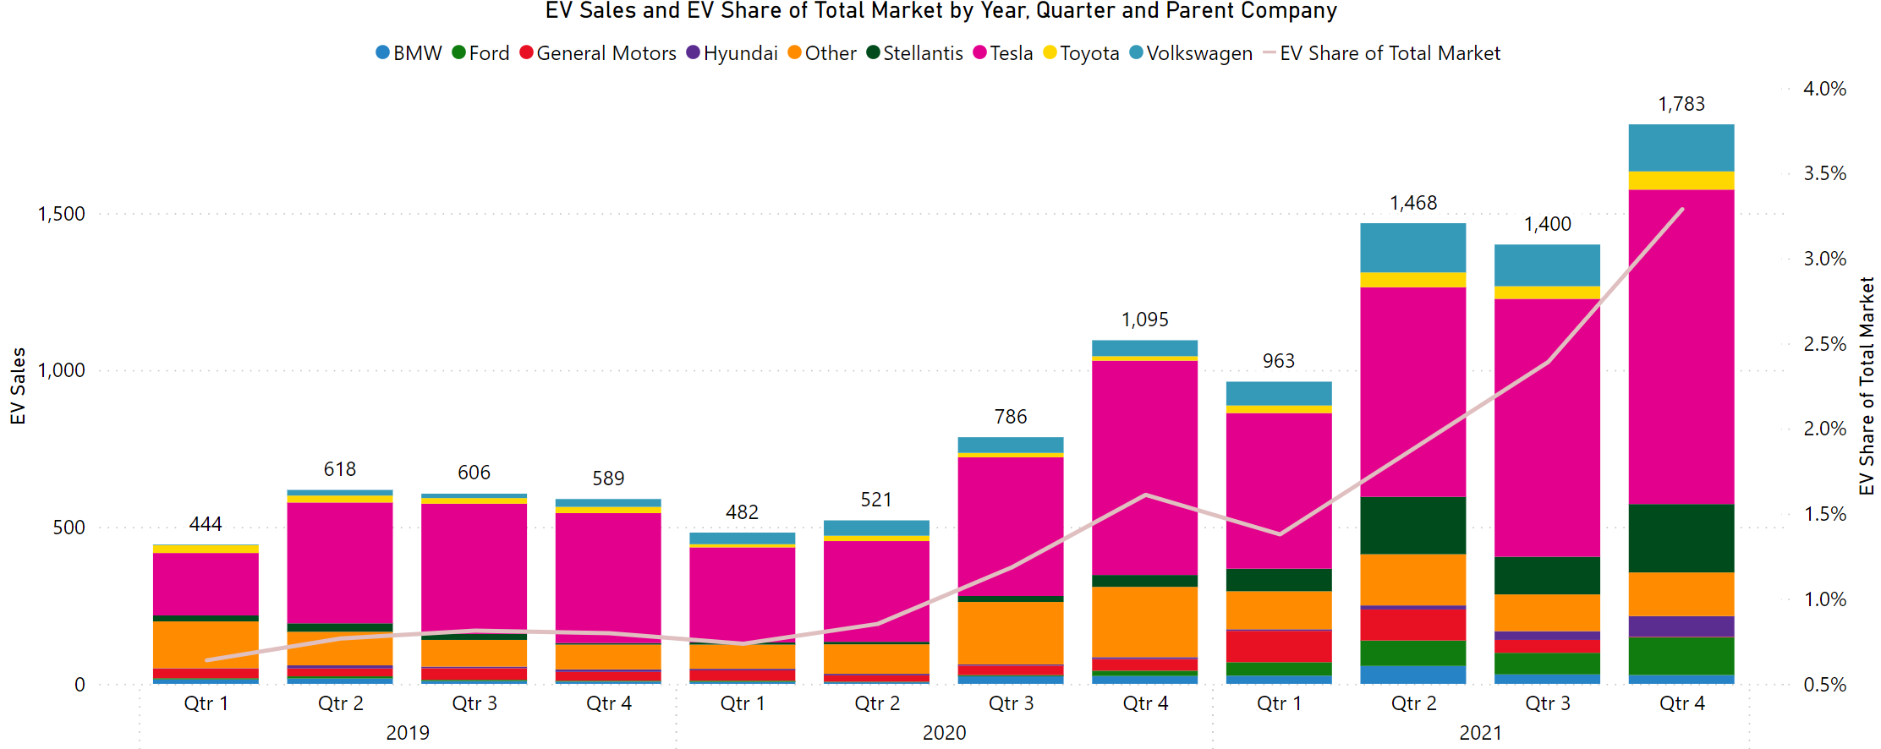
Cuota de Mercado del Vehículo Eléctrico
Datos hasta 2021. Fuente: Panel de los Fabricantes de Automóviles - Atlas EV Hub
Notes:
3.3% of Light-Duty Sales Were EVs in TN in Q4 2021

Slide 13
Drive Electric TN / Evaluación de Necesidades a Nivel Estatal
Formado en 2018, el consorcio Drive Electric Tennessee (DET) tiene el objetivo de aumentar la adopción de vehículos eléctricos en Tennessee de aproximadamente 17.000 vehículos eléctricos en el cuarto trimestre de 2021 a 200.000 vehículos en 2028.
El DET llevó a cabo una Evaluación de Necesidades de Infraestructura de Carga de Vehículos Eléctricos en todo el Estado a finales de 2019 para evaluar las necesidades de carga y las posibles ubicaciones geográficas para apoyar una mayor adopción de vehículos eléctricos.
La Evaluación de Necesidades determinó que los siguientes casos de uso de la infraestructura de tarificación eran los más adecuados para la inversión pública:
Carga en el corredor de la autopista, para conectar las zonas rurales y urbanas y aliviar la ansiedad por la autonomía; y
Otros sitios del mercado secundario, incluida la carga de destinos rurales,
cobro a la comunidad de ingresos limitados, etc.
Notes:
Throughout 2018, a core team of stakeholders—including State agencies (TDEC and TDOT), electric utilities (including the Tennessee Valley Authority), local governments, universities, EV manufacturers, businesses, and advocacy groups—worked together to develop a shared vision for electric transportation in the state of Tennessee. Together, these stakeholders comprise Drive Electric Tennessee (DET), whose goal is to increase electric vehicle adoption in Tennessee from approximately 17,000 EVs (both all-electric and plug-in hybrid) in 2021 to 200,000 vehicles by 2028.
DET conducted a Statewide Electric Vehicle Charging Infrastructure Needs Assessment in late 2019 to evaluate the condition of Tennessee’s current EV charging infrastructure and to identify charging needs and potential geographic locations to support increased EV adoption.
The Needs Assessment concluded that additional EV charging infrastructure was needed on highway corridors to relieve range anxiety and to connect rural and urban areas. Highway corridor charging was identified as the best candidate for public or utility investment, whereas other EV charging use cases (such as community charging, workplace charging, residential or multi-unit dwelling charging) were identified as good candidates for private or public-private investment based on market attractiveness and anticipated utilization.
By that same logic, other secondary market sites, including rural destination charging and limited income community charging, were also recommended for public investment.
TDEC has used the findings from the Needs Assessment to design and prioritize several EV charging infrastructure programs for the state, which we’ll talk about today.
BACKUP INFO: These two use cases were determined as the best candidates for public investment due to their perceived lower demand among EV infrastructure investors. This is because private investment will typically be concentrated in the largest EV markets with the most competitive site hosts and charging station utilization projections. The Needs Assessment recognized, though, that other charging needs in highway fast charging and secondary market sites (rural destination charging, limited income community charging) remained large barriers to EV adoption and accessibility for Tennesseans, and so those use cases were the ones best suited to public investment. It is our belief that the State’s investment in these types of charging infrastructure will create new opportunities for transportation electrification in communities across the state and will enable long-distance travel for both Tennesseans and visitors alike.

Slide 14
Red de TN de Carga Rápida
Notes:
In 2021, TDEC and the Tennessee Valley Authority (TVA) signed an agreement to collaborate and fund a statewide, publicly accessible light-duty EV fast charging network along interstates and select U.S. and State highways. With the first round of funding released for application late last year, TDEC and TVA will be supplementing existing public EV charging infrastructure to achieve what we are calling “Fast 50” designation on these corridors, such that non-proprietary fast charging sites will be located no more than 50 miles apart along a given corridor or route. This “Fast Charge TN Network” will add approximately 50 new charging locations along prioritized corridor infrastructure gaps, tripling Tennessee’s existing fast charging network. The estimated total project cost is approximately $20 million, split between TDEC, TVA, other program partners like TDOT, and program participant cost share. (BACKUP INFO: The State has committed 15%, the maximum allowable, of the State’s Volkswagen Diesel Settlement Environmental Mitigation Trust allocation to fund light-duty EV charging infrastructure. Approximately $5 million from this fund is expected to be allocated to fast charging infrastructure along corridors.)
Eligible applicants for the first round of funding included TVA-served Local Power Companies (LPCs) and other local utilities that distribute electricity in Tennessee whose service territory is located along prioritized corridor gaps. In total, TDEC and TVA have received 141 site proposals (including 53 primary sites and 88 alternate options) from 36 LPCs across the state. TDEC and TVA will be making announcements later this spring on the LPCs and proposed sites selected for funding under the Fast Charge TN Network. Later rounds of funding may expand applicant eligibility to include local governmental entities, private companies, and/or non-profits.
BACKUP INFO: For selected, eligible projects, the program will provide up to 80% of the cost to purchase, install, operate, and maintain eligible EV fast charging infrastructure that will be located within a prioritized corridor gap and made available to the public. This program will not support the purchase or rental of real estate, other capital costs (e.g., construction of buildings, parking facilities, etc.), or general maintenance (i.e., maintenance other than of the EV charging infrastructure). Program participants will be required to provide at least 20% of the total project cost through direct or in-kind cost share.
BACKUP INFO: This program will require selected projects to include at least two DC fast chargers at each location, with the option to request to install a maximum of four DC fast chargers per location. Additionally, requests for funding may not exceed $150,000 per fast charger to be installed. Program participants will be responsible for finding a suitable host site and purchasing, installing, owning, operating, and maintaining program-funded fast charging equipment for a period of no less than five years. The infrastructure will be non-proprietary, so that any EV capable of DC fast charging may utilize it.
The network will expand accessibility of critical light-duty EV charging for all Tennesseans and regional travelers. These fast chargers will be available from high density markets in urban areas to underserved markets in rural or economically distressed areas.
Onscreen is a snapshot of a Fast Charge Corridor Completeness Map, designed to help visualize prioritized corridor gaps for the installation of qualifying EV fast charging infrastructure.
BACKUP INFO: All of the lightning bolt symbols on the Corridor Completeness Map designate current locations of corridor fast charging infrastructure in Tennessee. Lightning bolt symbols in blue indicate current, non-proprietary fast charging locations that already meet the Minimum Technical Specifications outlined in the Fast Charge TN Network Program Guidelines (i.e., they have 120kW site power levels or higher for an individual vehicle as well as the ability to charge more than one vehicle at a time, including the ability to charge at least one CHAdeMO plug vehicle at 50kW and two simultaneous CCS vehicles at 50kW). The locations in blue are referenced when establishing current corridor completeness within the map. Lightning bolt symbols in gray indicate current, non-proprietary fast charging locations that as configured today do not meet the Minimum Technical Specifications outlined in the Fast Charge TN Network program for one reason or another (i.e., can only charge one vehicle at a time or have site power levels of 50kW or less, etc.). The locations in gray are provided for applicant reference to increase awareness of current fast charging availability, even if such locations do not yet count toward completeness of the Fast Charge TN Network.

Slide 15
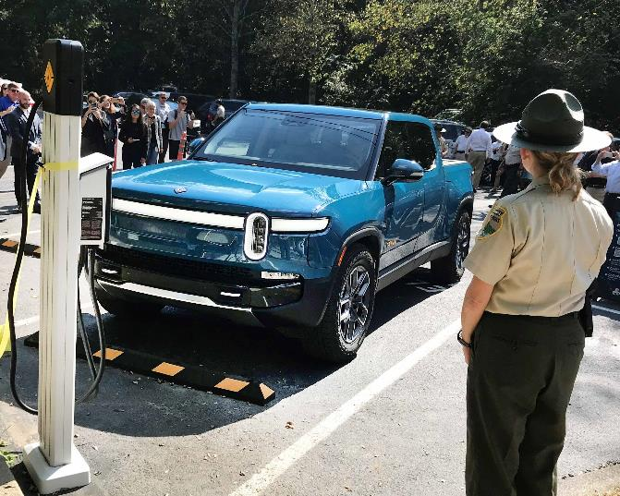
Parques Estatales de Rivian y Tennessee
En 2021, el TDEC anunció una asociación con Rivian para instalar estaciones de carga de nivel 2 en los parques estatales de Tennessee. El objetivo es disponer de estaciones de recarga en los 56 parques estatales de todo el sistema.
Además de supervisar el diseño y la instalación, Rivian proporcionará, sin coste alguno para el Estado:
cargadores
mejoras de los servicios públicos y otros costes de instalación
tarifas de acceso a la red
servicio de equipos
mantenimiento
Notes:
Also in 2021, TDEC announced a partnership with EV automaker and automotive technology company Rivian to install Rivian Waypoint Level 2 charging stations at Tennessee State Parks. The goal is to have charging stations available at all 56 state parks systemwide, depending on the availability of electricity and planned future park upgrades.
In addition to overseeing design and installation, Rivian will provide the chargers as well as any necessary utility upgrades associated with the charger installation at no cost to the state or taxpayers. Rivian will also cover all network access fees, equipment service, and maintenance for 10 years.
The chargers can provide up to 11.5 kW of power, enabling EV drivers to top up on miles while enjoying a day trip or an overnight campout. EV charging at Tennessee State Parks will initially be free. Any potential future cost to drivers may be dependent on systemwide utilization to recover electricity costs.
BACKUP INFO: The first year of charging at TSP locations will be provided to the public free of charge, much like other amenities such as wifi and camp site hookups. Beginning in year 2, TSP will evaluate the costs of electricity for the charging equipment and may design charging station fees to help recoup these costs. Should TSP begin collecting fees for the electricity dispensed by the charging stations, Rivian will also begin to collect an operations fee of 8% of all electricity costs from the TSP charging network, to cover their own costs of processing user payments with the equipment. Current estimates for the charging network investment by Rivian is between $2-4 million, depending on installation needs and ongoing upgrades/maintenance—all of which is being donated to the state to expand the accessibility of charging infrastructure in Tennessee. After all, every Tennessean is only an hour away from a State Park or natural area. With the completion of the Rivian charging station network, that means every Tennessean will be within an hour of electric vehicle charging.
BACKUP INFO: Estimating that electricity will cost $0.12 per kWh, and predicting an average annual growth of charging station utilization of around 30% year-over-year, we have calculated that electricity costs for this project will amount to an estimated $280,000 over a ten year period, across the 56 State Park network. TSP does intend to evaluate methods for recouping these costs at a later date.
BACKUP INFO: Networked charging infrastructure can generally be categorized as member-only access or open access. The former requires a network membership to use and pay for charging and gain full access to all the features and services of a given network. On the other hand, open access charging infrastructure—like the kind Rivian will provide—offers a way for non-members to access charging by calling a customer service center or paying onsite with a credit card.

Slide 16
Consideraciones Clave que deben Incluirse en el Plan NEVI de Tennessee

Slide 17
Proyectos Elegibles para el Programa de Fórmula NEVI
Cualquier infraestructura de recarga de vehículos eléctricos adquirida o instalada con Fondos del Programa de Fórmula NEVI deberá estar ubicada a lo largo de un Corredor de Combustible Alternativo designado hasta que todos los Corredores de Combustible Alternativo en el estado sean designados como "totalmente construidos" por el Secretario de Transporte
Un Corredor de Combustibles Alternativos se considerará "totalmente construido" sólo cuando se cumplan los siguientes criterios:
La infraestructura de carga se instala cada 50 millas
Cada lugar de carga incluye al menos cuatro cargadores rápidos de corriente continua (CC) de 150kW
Estos cuatro cargadores utilizan puertos del Sistema de Carga Combinada (CCS).
La estación puede cargar simultáneamente al menos cuatro vehículos eléctricos a 150 kW
Los cargadores no están más lejos de una milla de los corredores

Slide 18
Los Planes deben Cumplir con la Iniciativa Justicia40
Las zonas sombreadas identifican las comunidades desfavorecidas, según la definición provisional conjunta del USDOT y el US DOE
Fuente:
Herramienta de Mapa de la Justicia40 de Recarga de Vehículos Eléctricos: https://anl.maps.arcgis.com/apps/webappviewer/index.html?id=33f3e1fc30bf476099923224a1c1b3ee
Orientaciones Provisionales para la Implementación de la Iniciativa Justicia40: https://www.whitehouse.gov/wp-content/uploads/2021/07/M-21-28.pdf
Notes:
-States must spend NEVI Formula Program funds in compliance with the federal government’s Justice40 initiative
-Justice40 establishes a goal that ≥ 40% of the benefits of federal investments in climate and clean energy infrastructure are distributed to disadvantaged communities
-Note: This does not mean that 40% of all charging infrastructure funded under this program must be placed in disadvantaged communities.
-TDEC and TDOT are actively seeking input via public engagement sessions and a publicly-available survey on how best to benefit disadvantaged communities.
Consistent with the Justice40 Interim Guidance, U.S. Department of Transportation (DOT) and U.S. Department of Energy (DOE) developed a joint interim definition of disadvantaged communities (DACs) for the National Electric Vehicle Infrastructure (NEVI) Formula Program. The joint interim definition uses publicly available data sets that capture vulnerable populations, health, transportation access and burden, energy burden, fossil dependence, resilience, and environmental and climate hazards. The geographic area associated with these three DAC components can be viewed on the Electric Vehicle (EV) Charging Justice40 Map tool.

Slide 19
Consideraciones Clave que deben Abordarse en el Plan
Coordinación de las Agencias Estatales
Compromiso Público
Visión y Objetivos del Plan
Contratación
Análisis de las condiciones existentes y futuras
Despliegue de la Infraestructura de Recarga de Vehículos Eléctricos
Implementación
Derechos Civiles
Consideraciones sobre la Equidad
Consideraciones sobre la Mano de Obra y el Personal
Ciberseguridad
Evaluación del Programa
Excepciones Discrecionales
Notes:
Plans shall include the following:
Introduction. Discuss the Plan development process, the scope, the dates of the analysis, and the dates of adoption.
State Agency Coordination. Describe how the State DOT has coordinated with the State’s energy and/or environment department in the development and approval of the Plan. The Plan should address any steps the State’s DOT has taken or plans to take to maximize opportunities to utilize U.S.-made EV supply equipment.
Public Engagement. Discuss the involvement of particular stakeholder groups in the Plan’s development to include the general public, governmental entities, federally recognized Tribes, labor organizations, private sector/industry representatives, representatives of the transportation and freight logistics industries, state public transportation agencies, and urban, rural, and underserved or disadvantaged communities.
Plan Vision and Goals. Describe how the Plan supports a convenient, affordable, reliable, and equitable statewide and national EV network. The Plans should be updated on an annual basis to reflect the State funding Plans for that fiscal year. Each State should provide 5-year goals for the duration of the program that include at least one outcome-oriented goal with a quantitative target.
Contracting. FHWA anticipates that, in most instances, States will contract with private entities for the installation, operation, and/or maintenance of EV charging infrastructure funded in whole or in part through the NEVI Formula Program. The Plan should detail whether the State intends to contract with third-party entities, and if so, how the State will ensure that those entities deliver EV charging infrastructure in a manner that leads to efficient and effective deployment against Plan goals. This section should also include a strategy for achieving efficient delivery and deployment and ongoing operation and maintenance.
Existing and Future Conditions Analysis. Identify the existing conditions within the study area at the time of the Plan creation. Include info regarding the State’s geography and terrain as it pertains to its EV charger deployment vision and challenges, current and future temperature and precipitation patterns, industry/market conditions, public transportation needs, freight and other supply chain needs, grid capacity necessary to support additional EV charging infrastructure, electric utilities that service the study area, land use patterns, travel patterns, EV charging infrastructure, information dissemination about the EV charging station availability.
EV Charging Infrastructure Deployment. Discuss EV charging infrastructure installations and associated policies to meet the vision and goals of the Plan. The Plan does not need to include a list of exact EV charging infrastructure locations, but rather should include an overall strategy for installations along designated corridors that prioritizes build-out along the Interstate Highway System. Include information about planned new EV charging infrastructure deployment location types, as well as existing EV charging infrastructure locations planned for upgrade or expansion. Plans should also identify which utility’s territory the planned installations or upgrades are located in. The section should also include a map of the corridors that are planned for EV charging infrastructure installation or upgrade. Finally, this section should also identify the source of non-federal funding for EV charging infrastructure deployments.
Implementation. Discuss EV charging operations and maintenance programs as well as EV charging infrastructure data collection and sharing. The Plan should also demonstrate how the implementation will promote strong labor, safety, training, and installation standards as well as opportunities for the participation of small businesses; address emergency and evacuation needs, snow removal and seasonal needs, and ways for EV charging to support those needs; and describe strategies for resilience for operation during emergencies and extreme weather.
Civil Rights. Discuss how the State planning and implementation will ensure compliance with State and Federal civil rights laws, including Title VI of the Civil Rights Act and accompanying USDOT regulations, the American with Disabilities Act, and Section 504 of the Rehabilitation Act.
Equity Considerations. Develop through engagement with rural, underserved, and disadvantaged communities and stakeholders, including relevant suppliers and contractors.
Labor and Workforce Considerations. Consider the training, experience level, and diversity of the workforce that is installing and maintaining EV charging infrastructure.
Cybersecurity. Discuss how the State will address cybersecurity. The Plan should identify considerations when software updates are made to ensure the station or vehicle is not compromised by malicious code, or that a vehicle infects other stations during future charges.
Program Evaluation. Describe the State’s schedule and plan for evaluating performance in achieving its 5-year goals and vision. Evaluation should include monitoring performance metrics, such as EV charging infrastructure usage, EV charging infrastructure reliability, customer satisfaction, equitable distribution and access to EV charging infrastructure within the State, greenhouse gas emissions, or other metrics that support creating a national network.
Discretionary Exceptions. As part of the development and approval of State Plans, and in very limited circumstances, a State may submit a request for discretionary exceptions from the requirement that charging infrastructure is installed every 50 miles along that State’s portion of the Interstate Highway System within 1 travel mile of the Interstate, as provided in the Alternative Fuel Corridors request for nominations criteria. All approved exceptions will be supported by a reasoned justification from the State that demonstrates the exception will help support a convenient, affordable, reliable, and equitable national EV charging network. Exceptions must be clearly identified and justified in State plans. Additional coordination with FHWA and the Joint Office may be necessary before any exception is approved.

Slide 20
Participación de las Partes Interesadas
Los Departamentos agradecen los comentarios del público y de las partes interesadas sobre el proceso de planificación del Programa Fórmula NEVI.
Encuesta: El TDOT y el TDEC han desarrollado una encuesta virtual, accesible en http://www.tn.gov/evplan. Todas las respuestas a esta encuesta deben ser enviadas antes de las 5:00 PM CT del 31 de mayo de 2022 para que los comentarios sean considerados durante el desarrollo del plan.
Además, el TDEC y el TDOT organizarán ocho sesiones de escucha en persona en todo el Estado para solicitar opiniones y responder a preguntas sobre el programa de fórmula NEVI.
La Guía NEVI exige que los planes demuestren el compromiso con "las comunidades rurales, desatendidas y desfavorecidas para garantizar que se escuchen y se tengan en cuenta diversas opiniones a lo largo del proceso de planificación, y para garantizar que el despliegue, la instalación, el funcionamiento y el uso de la infraestructura de recarga de vehículos eléctricos logre una distribución equitativa y justa de los beneficios y servicios".
Notes:
TDEC and TDOT are now conducting stakeholder and public outreach to support the development of the plan. The Departments welcome feedback from the public and relevant stakeholders on the NEVI Formula Program planning process. TDOT and TDEC have developed a virtual survey. All responses to this survey must be submitted by 5:00 PM CT on May 31, 2022 in order for feedback to be considered by the State during plan development. In addition, TDEC and TDOT will host eight in-person listening sessions across the State to solicit feedback and answer questions on the NEVI formula program.

Slide 21
Ubicación de las Sesiones de Escucha en TN
Notes:
I-40, I-75, I-24, I-65, I-81, I-26, US Hwy 64
May 2 – Kingston
May 3 – Kingsport
May 4 – Knoxville
May 9 – Nashville
May 10 – Hillsboro
May 11 – Chattanooga
May 16 – Memphis
May 17 – Fayetteville

Slide 22
Próximos Pasos
Las opiniones recogidas en estas sesiones de escucha, junto con las enviadas a través de la encuesta en línea que se encuentra en www.tn.gov/evplan, se incorporarán a un proyecto de plan de infraestructuras para Tennessee.
El TDEC y el TDOT presentarán el plan final de TN, aprobado por el Comisionado del TDOT, al DOT de Estados Unidos antes del 1 de agosto de 2022.
Tras la aprobación del Plan (prevista para el 30 de septiembre de 2022), el TDEC y el TDOT publicarán una guía y un calendario establecido para la solicitud de proyectos, junto con información adicional sobre el diseño del programa, las consideraciones clave y la elegibilidad de los proyectos.

Slide 23
Obtenga más información en http://www.tn.gov/evplan
Alexa Voytek
Oficina de Programas de Energía del TDEC
Alexa.Voytek@tn.gov
615-613-1096
Matt Meservy
División de Planificación a Largo Plazo del TDOT
Matt.Meservy@tn.gov
615-686-3662

