Slide 1
Tonight’s Schedule
Introduction
Presentation
Question and Answer Session
Open House
Staff at displays to answer questions
Complete comment cards and/or provide verbal comments to court reporter
Adjourn

Slide 2
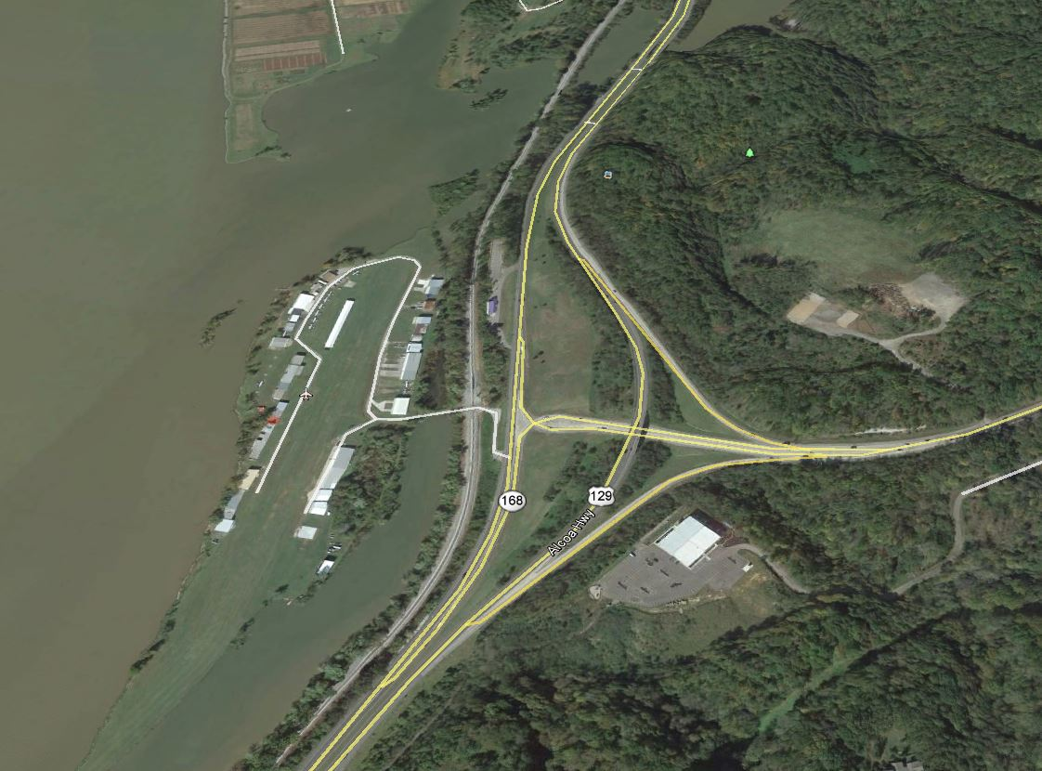
SR-115 (US 129, Alcoa Highway)
From North of the Little River at the Blount County line to Maloney Road
Design Public Meeting
December 8, 2015
Notes:
Remove the “From North of the Little River…”
Capitalize “Line” in Blount County Line

Slide 3
Project Team Introduction
TDOT Region 1 Project
Development
Robert G. Campbell and Associates
Knox County
Knox County Parks and Recreation

Slide 4
Purpose of Meeting
Discuss proposed improvements to SR 115 (US 129, Alcoa Highway) – From North of the Little River at the Blount County line to Maloney Road
Provide preliminary plans for public review
Receive public input
Provide assistance and address questions

Slide 5
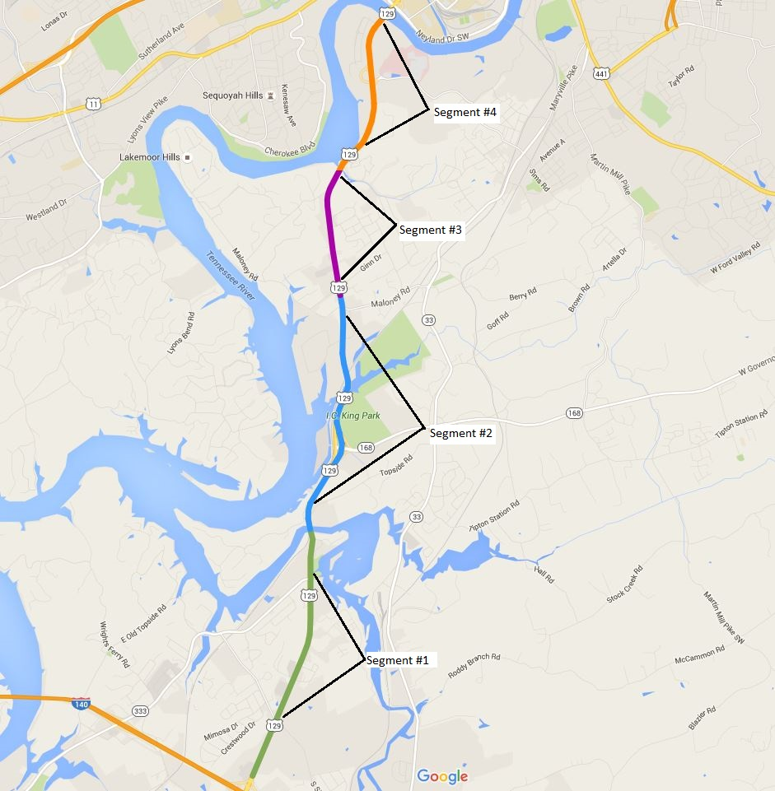
Corridor Limits
Segment #4
Knox County
From Woodson Drive
To North of Cherokee Trail
Segment #3
Knox County
From Maloney Road
To Woodson Drive
Segment #2
Knox County
From North of the Blount County line at the Little River
To Maloney Road
Segment #1
Blount County
From Pellissippi Parkway
To Blount County line at the Little River

Slide 6
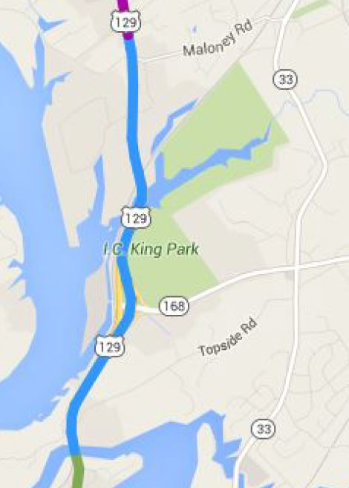
Project Limits
END PROJECT
BEGIN PROJECT

Slide 7
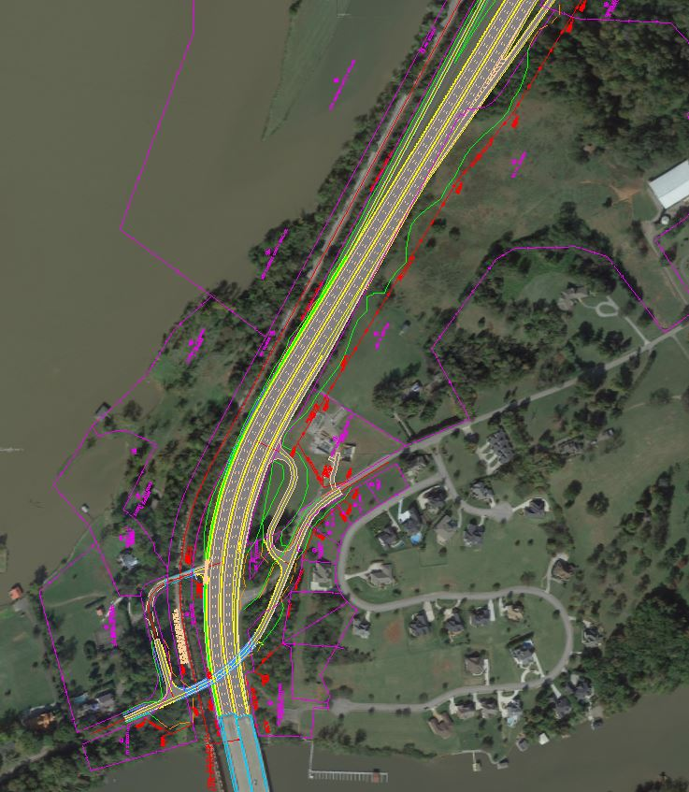
Section 1
North of the Little River to John Sevier Highway Interchange
END SECTION 1
BEGIN SECTION 1

Slide 8
Section 1
North of the Little River to South of the John Sevier Highway Intersection
12 ft. travel lanes, 3 in each direction
12 ft. greenway along Southbound lane
12 ft. Auxiliary lane Northbound
Concrete median barrier

Slide 9
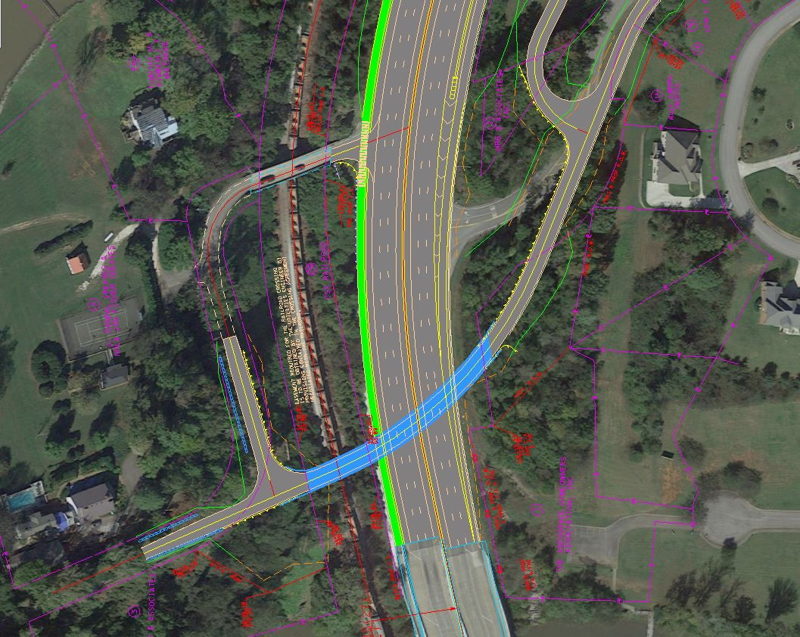
Topside Road and S.R. 115 Intersection

Slide 10
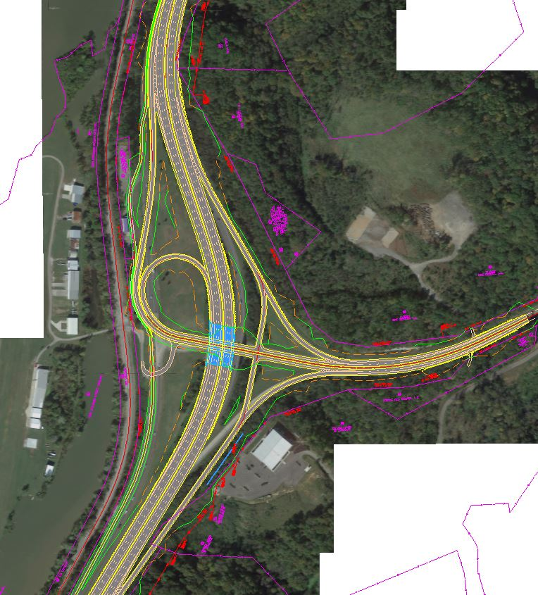
Section 2
John Sevier Highway Interchange
END SECTION 2
BEGIN SECTION 2

Slide 11
Section 2
John Sevier Highway Interchange
12 ft. travel lanes, 3 in each direction
Concrete median barrier

Slide 12
Section 3
North of the John Sevier Highway Interchange to Maloney Road
END SECTION 3
BEGIN SECTION 3

Slide 13
Section 3
North of the John Sevier Highway Interchange to Maloney Road
12 ft. travel lanes, 3 in each direction
12 ft. greenway along Southbound lane
12 ft. Auxiliary lane Northbound
Concrete median barrier

Slide 14
Project Status
Planning
Environmental
Design
Project is currently in the Design Phase
Right-of-Way
Construction

Slide 15
Comments
Your Comments are important to us!
Submit written comments on the provided comment sheets
Mail-in comment sheets within 21 days, December 29, 2015
Provide verbal comments to the court reporter

Slide 16
Thank You
For your attendance and participation in the State Route 115 Design Public Hearing
Contacts:
Daniel Oliver, P.E., R.L.S. | Director TDOT Region 1, Project Development Admin Bldg., 1st Floor 7345 Region Lane Knoxville, TN 37914 p. 865-594-2400 daniel.oliver@tn.gov | Eric Wilson, P.E. | Civil Engineering Manager 1 TDOT Region 1, Project Development Admin Bldg., 2nd Floor 7345 Region Lane Knoxville, TN 37914 p. 865-594-0719 eric.wilson@tn.gov

