Slide 1
State route 29 (US-27)
From Near Wolf Creek Road to Near State Route 63 Scott County, Tennessee
PIN Numbers: 101414.00 and 101414.03
Virtual public meeting
March 2021
Notes:
Good evening, welcome to the virtual public meeting for the SR 29 improvements project from near Wolf Creek Road to Near SR 63 in Scott County, Tennessee.

Slide 2
Tonight’s Agenda
7:00 p.m. – TDOT Welcome and Introductions
7:15 p.m. – PowerPoint Presentation delivered by the TDOT Project Team
7:45 p.m. – Question and Answer Session
Participants will have the opportunity to ask questions or give comments to the TDOT Project Team.
Note: Verbal comments and/or questions will be limited to three minutes per individual or five minutes if you are representing an organization.
Notes:
Tonight’s agenda starts with Welcome and Introductions by TDOT at 7 followed by a brief PowerPoint at 7:15 and a question and answer session at 7:45. You will have the opportunity to ask questions or give comments to the TDOT project team. We ask that you please limit your verbal comments or questions to three minutes for individuals or 5 minutes if you are representing an organization in order to give everyone an opportunity to participate.

Slide 3
Make a Comment or Ask a Question After the Meeting
Questions About the Project: Call 833.726.8826 (toll free) and leave a voicemail message with your name, phone number and question. A TDOT representative will respond within 7 business days.
If you have a question that needs to be answered before providing your official comment on the project, please make sure to call the number above by April 15, 2021, in order to allow TDOT 7 business days to respond to your question.
Verbal Comments: Call 833.726.8826 (toll free) and leave a voicemail message with your name, phone number and comment.
Public Comment Card: Download a pre-addressed comment card from the TDOT project website (www.tn.gov/tdot/projects/projects-region-1/state-route-29-us-27) and mail it to TDOT by May 3, 2021.
Email: Send an email to TDOT.comments@tn.gov by May 3, 2021.
Letter: Mail a written statement by May 3, 2021 to the following address:
NEPA Virtual Public Meetings
Attn: SR-29 (US-27) Project
Tennessee Department of Transportation
Suite 700, James K. Polk Building
505 Deaderick Street
Nashville, TN 37243-0332

Slide 4
Purpose of Meeting
Meet the intent and requirements of the National Environmental Policy Act of 1969 (NEPA)
Share updated information on the proposed State Route (SR) 29 (US-27) Improvement Project
Answer your questions and take your comments
Notes:
The purpose of tonight’s meeting is to meet the intent and requirements of the National Environmental Policy Act of 1969, otherwise known as NEPA. Also, we want to share updated information on the proposed SR 29 improvement project and provide you with the opportunity to ask questions or give comments.

Slide 5
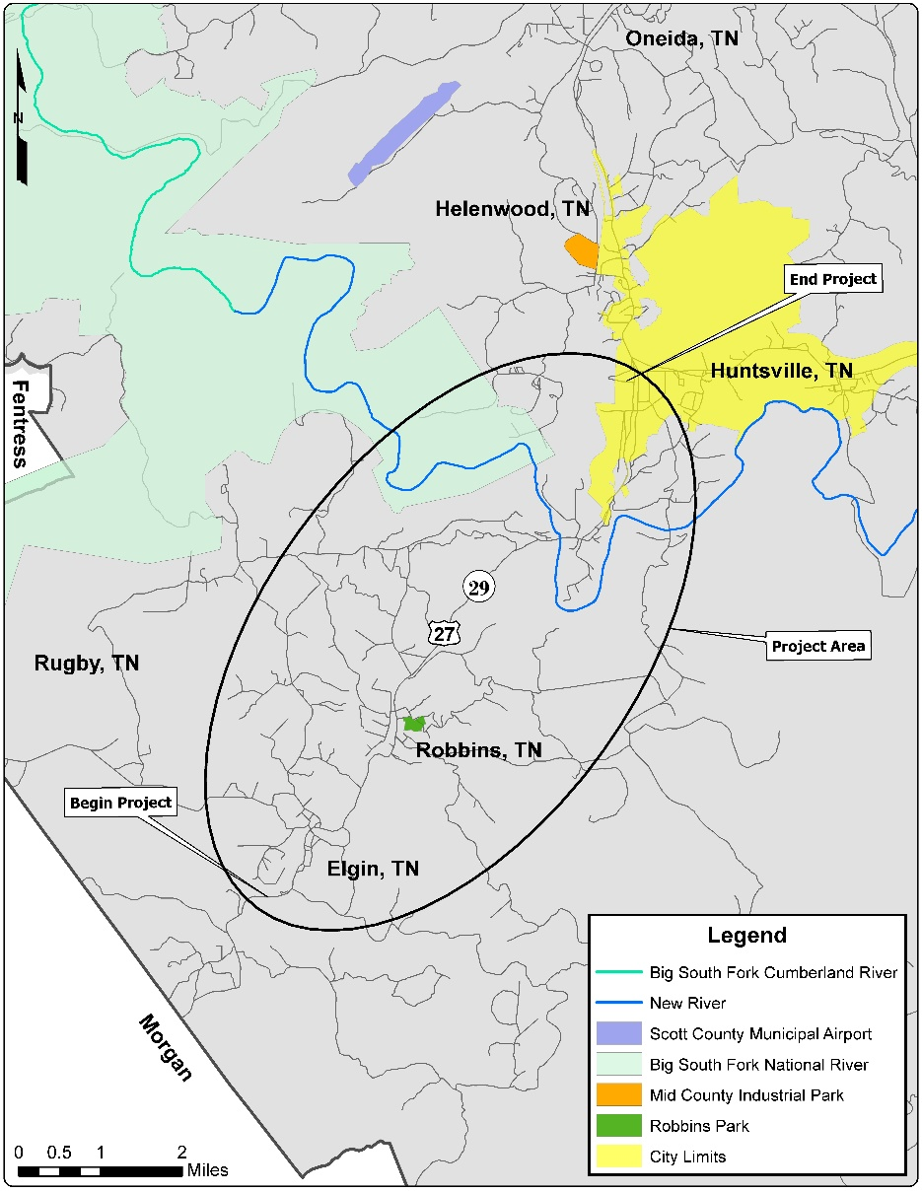
Project Location
Located in Scott County
Project Beginning: Near Wolf Creek Road
Project End: Near State Route 63
Approximately 9.1 miles in length
Project located in the western foothills of the Appalachian Mountains of northeastern Tennessee
Several nearby tourist destinations:
Big South Fork National River and Recreation Area
North Cumberland Wildlife Management Area
Pickett State Park
Frozen Head State Park
Brimstone Recreation Area
Daniel Boone National Forest in Kentucky
Notes:
The proposed SR 29 improvement project is located in Scott County, Tennessee. The project begins along SR 29 near Wolf Creek Road and ends near SR 63 in Huntsville, for a total distance of approximately 9.1 miles. The project is located in the western foothills of the Appalachian Mountains in northeastern Tennessee near several tourist destinations such as the Big South Fork National River and Recreation Area, the North Cumberland Wildlife Management Area, Pickett State Park, Frozen Head State Park, Brimstone Recreation Area, and Daniel Boone National Forest.

Slide 6
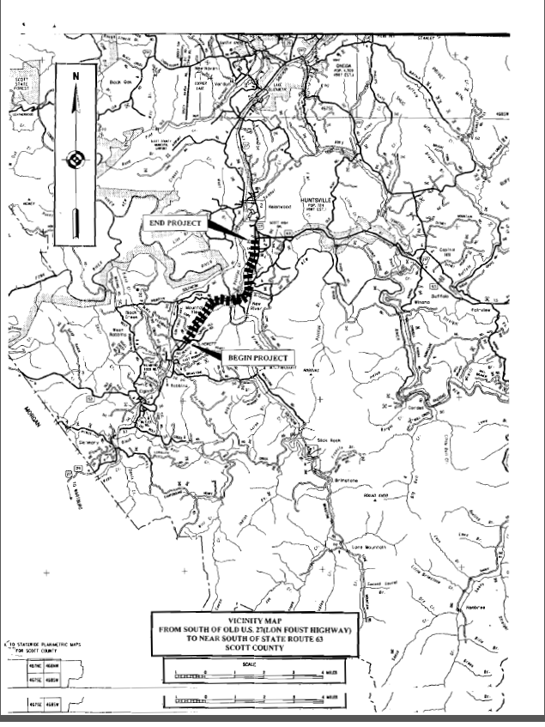
Project History
2013: Project put on hold for Expedited Project Delivery (EPD) review
1999: Project initiated by TDOT
Sept. 9, 2010: Public Information Meeting held
2000 2002 2004 2006 2008 2010 2012 2014 2016 2018 2020 2022
Dec. 7, 1999: Public Information Meeting held
March 2021: Virtual Public Information Meeting held
2011 – 2012: Updated environmental technical studies underway
2019: EPD review completed; NEPA process restarts
2002 – 2009: Environmental technical studies underway
2019: EPD review completed; NEPA process restarts
Notes:
The SR 29 improvements project was initiated by TDOT in 1999. and the first Public Information Meeting was held December 7,1999. From 2002 to 2009 environmental technical studies were conducted. On February 9, 2010, the project was introduced to the Tennessee Streamlining Agreement, otherwise known as TESA, agencies with adjustments to the Build Alternatives and a second public information meeting was held September 9, 2010. A field review with the TESA agencies took place November 3, 2010.

Slide 7
Project Need
Existing traffic operational efficiencies
SR-29 (US-27) is the only north-south connector route in Scott County. As a result, the existing highway is used by residents and regional commercial, industrial, and recreational travelers.
Lack of regional connectivity
SR-29 (US-27) serves as an important regional facility providing access to the communities of Robbins, Sunbright, and Wartburg (south; Morgan County) and Oneida and Winfield (north).
SR-29 (US-27) provides access to several tourist destinations.
Geometric deficiencies
Existing SR-29 (US-27) at many locations in the project area does not meet TDOT’s current minimum roadway design standards.
Meet the legislative intent of the IMPROVE Act
One of the main goals of the IMPROVE Act is to provide a safe, reliable, and debt-free transportation network. This portion of the SR-29 (US-27) project would meet the legislative intent of the IMPROVE Act by improving an important infrastructure facility in Scott County.
Support economic development opportunities
Scott County is one of Tennessee’s 15 distressed counties and is identified as economically distressed by the Appalachian Regional Commission.
Notes:
The SR 29 improvements project is needed for the following reasons:
Existing traffic operational efficiencies. With SR 29 being the only north-south connector route in Scott County, the existing highway is being used by residents and regional commercial, industrial and recreational travelers.
Lack of regional connectivity. SR 29 serves as an important regional facility which provides access the communities of Robbins, Sunbright, and Wartburg to the south and Oneida and Winfield to the north. SR 29 also provides access to several tourist destinations.
Geometric deficiencies. Existing SR 29, at many locations throughout the project area, does not currently meet TDOT’s minimum roadway design standards.
Meet the legislative intent of the IMRPOVE Act
And Support economic development opportunities. Scott county is one of Tennessee’s 15 distressed counties and is identified as economically distressed by the Appalachian Regional Commission.

Slide 8
Project Purpose
Improve the traffic operational efficiency
Correct existing operational deficiencies, such as the inability of traffic to reach/maintain the posted speed limit of 55 mph.
Add a dedicated truck climbing lane in certain locations.
Enhance regional transportation system linkages
Improvements to SR-29 (US-27) would better accommodate local traffic traveling within the more urbanized areas and would provide an improved route for regional destinations.
Improve roadway to meet current design standards
Correct the existing horizontal and vertical deficiencies.
Meet the legislative intent of the IMPROVE Act
One of the main goals of the IMPROVE Act is to provide a safe, reliable, and debt-free transportation network. This portion of the SR-29 (US-27) project would meet the legislative intent of the IMPROVE Act by improving an important infrastructure facility in Scott County.
Enhance economic development opportunities
Scott County’s industrial parks are located immediately adjacent to (or near) SR-29 (US-27).
Notes:
The purpose of the SR 29 improvements project is to:
Improve the traffic operational efficiency of SR 29, which would correct existing operational deficiencies such as the inability of traffic to travel 55 miles per hour and would add a dedicated truck climbing lane in certain locations.
Enhance regional transportation system linkages. The improvements to SR 29 would better accommodate local traffic traveling within the more urbanized areas and would provide an improved route for regional destinations.
Improve roadway to meet current design standards by correcting the existing horizontal and vertical deficiencies along SR 29.
Meet the legislative intent of the IMPROVE Act
Enhance economic development opportunities. Scott County’s industrial parks are located immediately adjacent to (or near) SR 29.

Slide 9
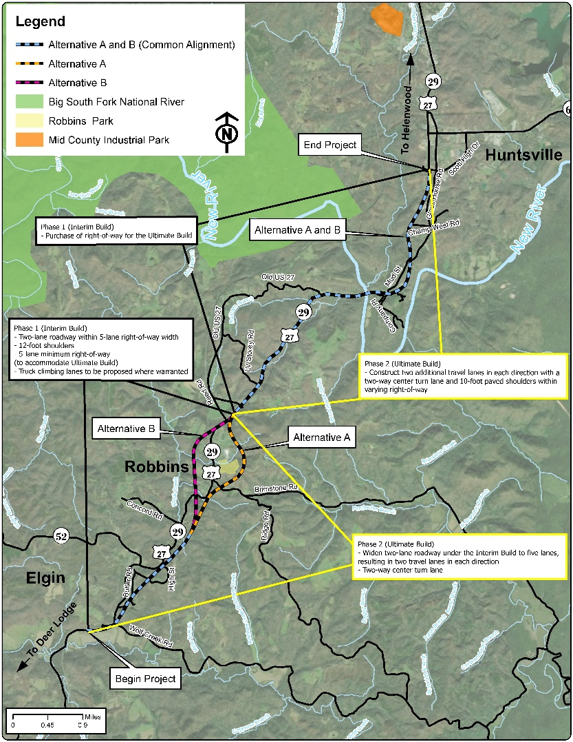
Alternatives Under Consideration
No-Build Alternative
Two Build Alternatives:
Build Alternative A
Build Alternative B
Notes:
Three project alternatives are under consideration for the proposed project: The no-build alternative and two build alternatives, Build Alternative A and Build Alternative B. The No-Build Alternative would not improve SR-29 (US-27) and serves as a baseline against which to compare the other Build Alternatives.

Slide 10
Build Alternative A
Build Alternative A
Build Alternative A would follow a new location alignment south of existing SR-29 (US-27) from near Wolf Creek Road to near Concord Road.
From north of Concord Road, the Build Alternative A alignment would continue on new location to the northeast around the east side of Robbins, crossing Brimstone Road and School House Road.
After crossing School House Road, Build Alternative A would turn northwest, crossing Tunnel Hill Road and tying back into existing SR-29 (US-27) near Old US-27 north of Robbins.
From Old US-27, Build Alternative A would follow existing SR-29 (US-27) to its terminus near SR-63 in Huntsville.
Notes:
Read from slide

Slide 11
Build Alternative B
Build Alternative B
Build Alternative B would follow a new location alignment south of existing SR-29 (US-27) from near Wolf Creek Road to near Concord Road.
From north of Concord Road, the Build Alternative B alignment would continue on new location to the northwest around the west side of Robbins, crossing existing SR-29 (US-27), the Norfolk-Southern railroad, Boles Road, and Todd Road.
Build Alternative B would then turn northeast and cross Black Creek Road, Sims Road, and the Norfolk-Southern railroad before tying back into existing SR-29 (US-27) near Old US-27 north of Robbins.
From Old US-27, Build Alternative B would follow existing SR-29 (US-27) to its terminus near SR-63 in Huntsville.
Notes:
Read from Slide

Slide 12
Construction Phasing: PIN 101414.00
SR-29 (US-27) is broken down into two sections/Project Identification Numbers (PINs) due to funding considerations.
PIN 101414.00: From north of Wolf Creek Road to Old US-27 at Robbins
Phase 1 Construction (Interim Build): Includes construction of a two-lane roadway with 12-foot travel lanes and 12-foot shoulders on new location. Truck climbing lanes and turn lanes to be constructed where warranted. In addition, as part of Phase 1 Construction (Interim Build), approximately 250 feet of right-of-way (varies) would be purchased to accommodate Phase 2 Construction (Full Build).
Phase 2 Construction (Full Build): Includes construction of two additional 12-foot travel lanes, resulting in a five-lane roadway with two travel lanes in each direction, center turn lane and 10-foot paved shoulders. Right-of-way would vary but would generally be 250 feet.
Notes:
In addition to developing the two Build Alternatives, TDOT is currently proposing to construct the project in two separate segments and construction phases due to funding considerations. Each section of the project is associated with a project identification number, or PIN for short.
The first section of the project, also known as PIN 101414.00, is from north of Wolf Creek Road to Old US 27 in Robbins.

Slide 13
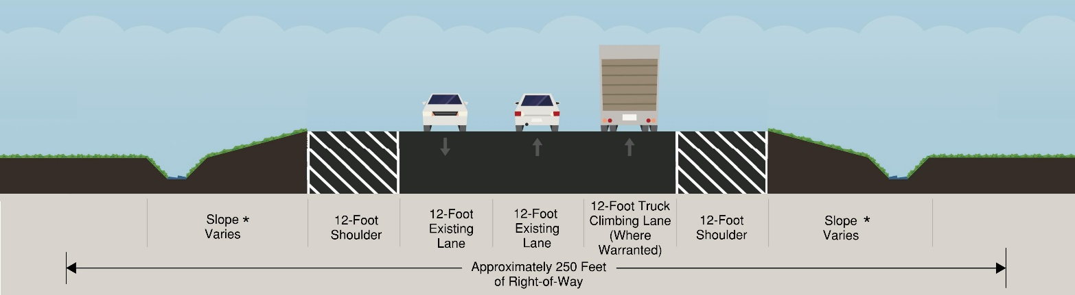
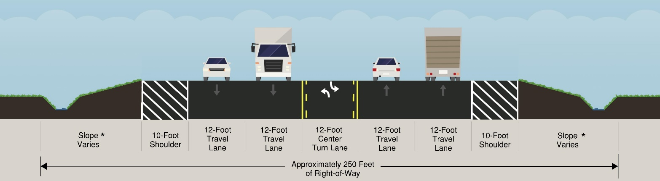
Construction Phasing: PIN 101414.00
Phase 1 Construction (Interim Build):
Phase 2 Construction (Full Build):
*Addition or removal of topography associated with road construction
Notes:
The proposed typical sections for the two construction phases of PIN 101414.00 are illustrated here.
Phase 1 Construction, or the interim Build, includes the construction of a two-lane roadway with 12-foot travel lanes and 12-foot shoulders on new location. Truck climbing lanes and turn lanes to be constructed where warranted. In addition, as part of the Phase 1 Construction, approximately 250 feet of right-of-way would be purchased, which would be enough to accommodate Phase 2 Construction.
Phase 2 Construction, or the Full Build, includes construction of two additional 12-foot travel lanes, which will result in a five-lane roadway with two travel lanes in each direction, center turn lane and 10-foot paved shoulders. Right-of-way would vary but would generally be 250 feet.
The typical sections identify an area called slope. Slope, in this instance

Slide 14
Construction Phasing: PIN 101414.03
SR-29 (US-27) is broken down into two sections/ Project Identification Numbers (PINs) due to funding considerations.
PIN 101414.03: From Old US-27 to south of SR-63
Phase 1 Construction (Interim Build): Includes purchase of 25-35 feet of right-of-way on either side of the roadway only for the construction of Phase 2 Construction (Full Build). No construction activities would occur during Phase 1 Construction (Interim Build) for TDOT PIN 101414.03.
Phase 2 Construction (Full Build): Includes construction of two additional 12-foot travel lanes, resulting in a five-lane roadway with two travel lanes in each direction, center turn lane and 10-foot paved shoulders within a varying right-of-way width of 150-860 feet.
Notes:
The seconThe second section of the project, also known as PIN 101414.03, is from Old US 27 to south of SR 63.
section of the project is from Old US 27 to south of SR 63.

Slide 15
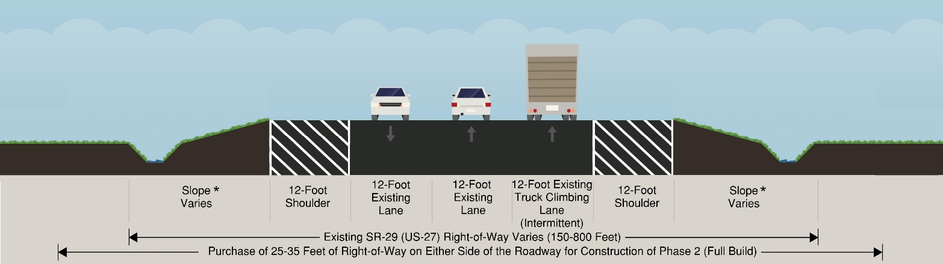
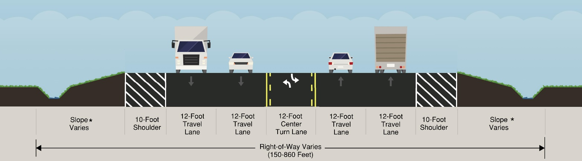
Construction Phasing: PIN 101414.03
Phase 1 Construction (Interim Build):
Phase 2 Construction (Full Build):
*Addition or removal of topography associated with road construction
Notes:
The proposed typical sections for the two construction phases of PIN 101414.03 are illustrated here.
Phase 1 Construction , or the Interim Build, only includes the purchase of 25-35 feet of right-of-way on either side of the roadway. This right-of-way would be used in the future for the construction of Phase 2 Construction, or the Full Build. No construction activities would occur during Phase 1 Construction for PIN 101414.03.
Phase 2 Construction, or the Full Build, Includes construction of two additional 12-foot travel lanes, which would result in a five-lane roadway with two travel lanes in each direction, a center turn lane, and 10-foot paved shoulders within a varying right-of-way width of 150-860 feet.
Just like in the previous construction segment, the typical sections identify an area called slope. Slope, in this instance, means addition or removal of topography associated with the construction of the road.

Slide 16
Preliminary Environmental Impacts
The following environmental technical studies are under development:
Air quality
Noise
Conceptual Stage Relocation Plan (Relocations)
National Historic Preservation Act Section 106: Historic Architecture and Archaeology
Environmental justice
Hazardous materials
Traffic and safety engineering studies
Natural resources: Threatened and endangered species, streams, wetlands, water quality and floodplains
Notes:
As part of the Environmental Assessment that is being prepared for the project, several environmental technical studies are current under development. These technical studies include Air Quality, Noise, Conceptual Stage Relocation Plan, History, Archaeology, Native American Coordination, Environmental Justice, Hazardous materials, Traffic and Safety engineering studies, and Natural resources, which include Threatened and Endangered Species, Streams, Wetlands, Water Quality, and Floodplains.

Slide 17
SR-29 (US-27) – Preliminary Environmental Impact Totals*
Impact Category |  | No-Build Alternative | Build Alternative A | Build Alternative B
Property Relocations** | Residential | No Impact | 29 | 22
 | Commercial | No Impact | 2 | 1
 | Non-Profit | No Impact | 2 | 3
Socioeconomic and Communities | Impacts to Low-Income Populations | No Impact | Low-income communities present within the project area. Studies currently underway to identify potential impacts. Results to be presented in the Environmental Assessment.
 | Impacts to Minority Populations | No Impact | No Impact | No Impact
Section 106 (Cultural Resources) | Archaeology | No Impact | Studies currently underway to identify potential impacts. Results to be presented in the Environmental Assessment.
 | Historic Architecture | No Impact | No Impact | No Impact
Wetlands (Acres) | Fill | No Impact | 10.6 | 11.3
Streams (Linear Feet) | Perennial/Intermittent | No Impact | 30,369 | 29,355
 | Ephemeral/Wet Weather Conveyance | No Impact | 8,792 | 9,480
Threatened and Endangered Species (Species found within a 1-4 miles radius of the project area) | Federally-Listed Species | No Impact | 3 federally-listed species identified. Studies currently underway to identify potential impacts. Results to be presented in the Environmental Assessment.
 | State-Listed Species | No Impact | 11 state-listed species identified. Studies currently underway to identify potential impacts. Results to be presented in the Environmental Assessment.
Hazardous Material Sites |  | No Impact | 9 | 7
Air Quality |  | No Impact | No Impact | No Impact
Noise (Noise sensitive receptors that exceed the Federal Highway Noise Abatement Criteria) |  | No Impact | 8 | 9
Farmland (Acres) |  | No Impact | Studies currently underway to identify potential impacts. Results to be presented in the Environmental Assessment.
*For the purposes of the Environmental Technical Studies, the project study area limits extend beyond the immediate area encompassed by the Build Alternatives described in the Project Design portion of the SR-29 (US-27) project website. The project study area limits are bounded by the limits of the Environmental Technical Study Area (ETSA). The ETSA for the project is based on conceptual level design plans and encompasses an area that is generally 250 feet on either side of the proposed centerline of the roadway, extends 300 feet from the project’s beginning and end points (termini), and extends 150 feet from intersections with side roads. These preliminary environmental impact totals presented offer a worst-case and will be further refined as the project progresses through the TDOT project development process (Design, Right-of-Way and Construction). ** Relocation numbers are for estimation purposes only.
Notes:
The following table shows the preliminary environmental impacts for the project. The preliminary impacts shown here are calculated using the Environmental Technical Study Area, or ETSA for short. The ETSA for the project is based on conceptual level design and offers a worst-case scenario that will be further refined as the project progresses through the TDOT project development process. Some of the studies are still underway, but preliminary impacts have been determined for the following categories.
For property relocations, there are 29 residential relocations for Build Alternative A and 22 for Build Alternative B, 2 Commercial relocations for Build Alternative A and 1 for Build Alternative B, and 2 non-profit relocations for Build Alternative A and 3 for Build Alternative B. These relocation numbers are for estimation purposes only and may change as the design progresses for the project.
For wetlands, there are 10.6 acres of wetland impacts under Build Alterative A and 11.3 acres under Build Alternative B.
For streams, there are 30,369 linear feet of perennial/intermittent stream impacts under Build Alternative A an 29,355 linear feet under Build Alternative B. Also, there are 8,792 linear feet of ephemeral stream/wet weather conveyance impacts under Build Alternative A and 9,480 linear feet under Build Alternative B.
For Threatened and endangered species, 3 federally listed and 11 state listed species were identified for both Build Alternative A and B.
9 hazardous material sites would be impacted under Build Alternative A, while 7 hazardous materials sites would be impacted under Build Alternative B.
There are 8 noise impacts under Build Alternative A and 9 noise impacts under Build Alternative B.

Slide 18
Project Schedule
SR-29 (US-27)- Anticipated Project Schedule
Milestone | Anticipated Time Frame for Completion*
Conduct Environmental Technical Studies | Spring/Summer 2021
Hold NEPA Public Virtual Meetings | Spring 2021
Environmental Assessment Approval | Fall 2021
Hold NEPA Public Hearing | Winter 2022
Approval of Final Environmental Document (Once the final environmental document is approved by the Federal Highway Administration, the Planning and Environmental Phase is complete.) | Fall 2022
Right-of-Way Phase | To Be Determined
Construction Phase | To Be Determined
* Forecasted dates are subject to change
Notes:
The current anticipated project schedule includes conducting the environmental technical studies in the spring and summer of 2021, holding the NEPA virtual public meetings in the spring of 2021, the Environmental Assessment being approved in the Fall of 2021, The NEPA Public hearing being held in the Winter of 2022, and the Approval of the Final Environmental document in the Fall of 2022. The approval of the final environmental document will complete the planning and environmental phase of the project. The timeline of the Right-of-Way and construction on phases of the project are currently to be determined.

Slide 19
Project Contact
Contact
Mrs. Amy Hume, Project Manager
TDOT Environmental Division, NEPA Special Projects
Email: Amy.Hume@tn.gov Phone: 615.253.2463
Website
www.tn.gov/tdot/projects/projects-region-1/state-route-29-us-27
OR
www.tn.gov/tdot
SEARCH: State Route 29
Notes:
For additional information on the project, please contact Mrs. Amy Hume with TDOT at 615-253-2463 or by email at amy.hume@tn.gov. Also, you can visit TDOT’s SR 29 website at the following address.

Slide 20
How to find your property on the TDOT Design Displays
Go to the SR-29 (US-27) Project Website and navigate to the Public Involvement Website.
On the SR-29 (US-27) Public Involvement Website, look for the Design Display download.
Notes:
In order to find where your property is located on the TDOT design displays, you will need to go to the TDOT’s SR 29 project website and navigate to the public involvement section. Once there, look for the design display download links which include Parts A, B and C.

Slide 21
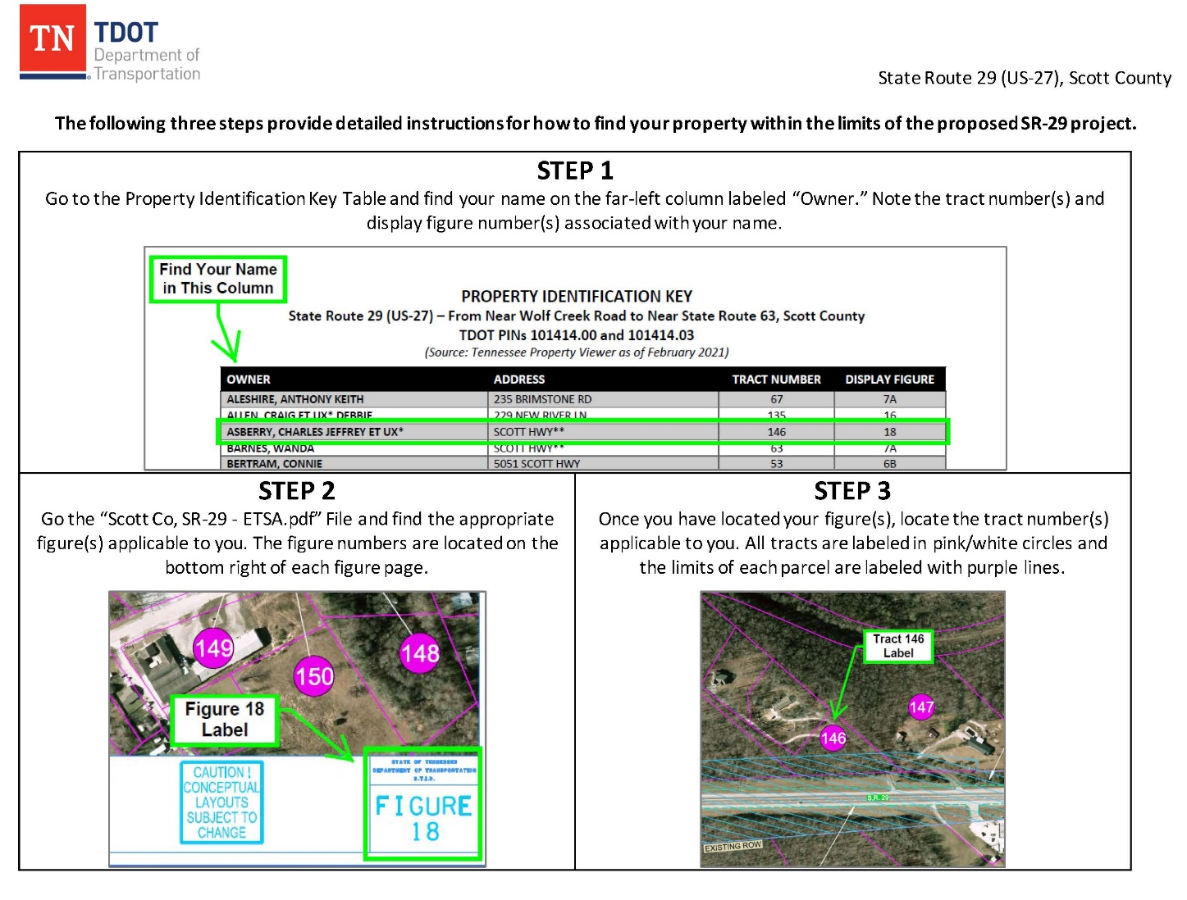
How to find your property on the TDOT Design Displays- Part A
Download Part A from the SR-29 (US-27) Public Involvement Website – This instruction guide will direct you on how to find your property.
Notes:
The instructions provided in download part A are illustrated here. These instructions will help guide you on using the displays to locate your property.

Slide 22
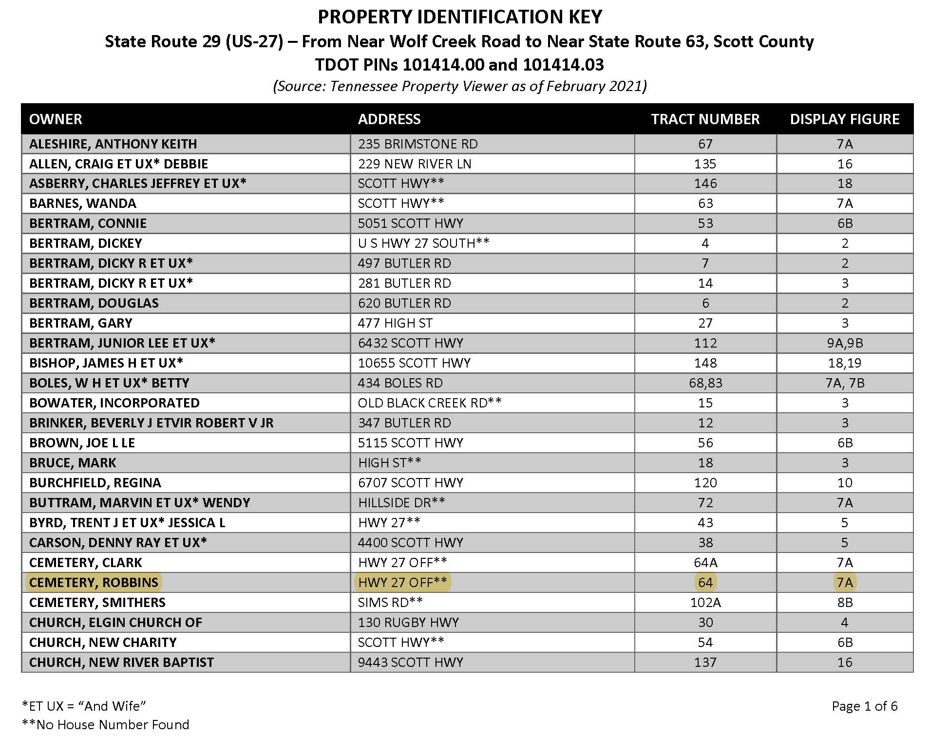
How to find your property on the TDOT Design Displays- Part B
Download Part B from the SR-29 (US-27) Public Involvement Website - Find your name on the table and take note of the Display Figure Page and the Tract Number for your property. For this example, we are using the Robbins Cemetery.
Notes:
Download Part B provides a property identification key that lists owner names, addresses, tract numbers, and display figure numbers. For an example of how to find property using the identification key, we will use Robbins Cemetery, which is highlighted in yellow on the table. You can see that Robbins Cemetery has a tract number of 64 and is on display figure 7A.

Slide 23
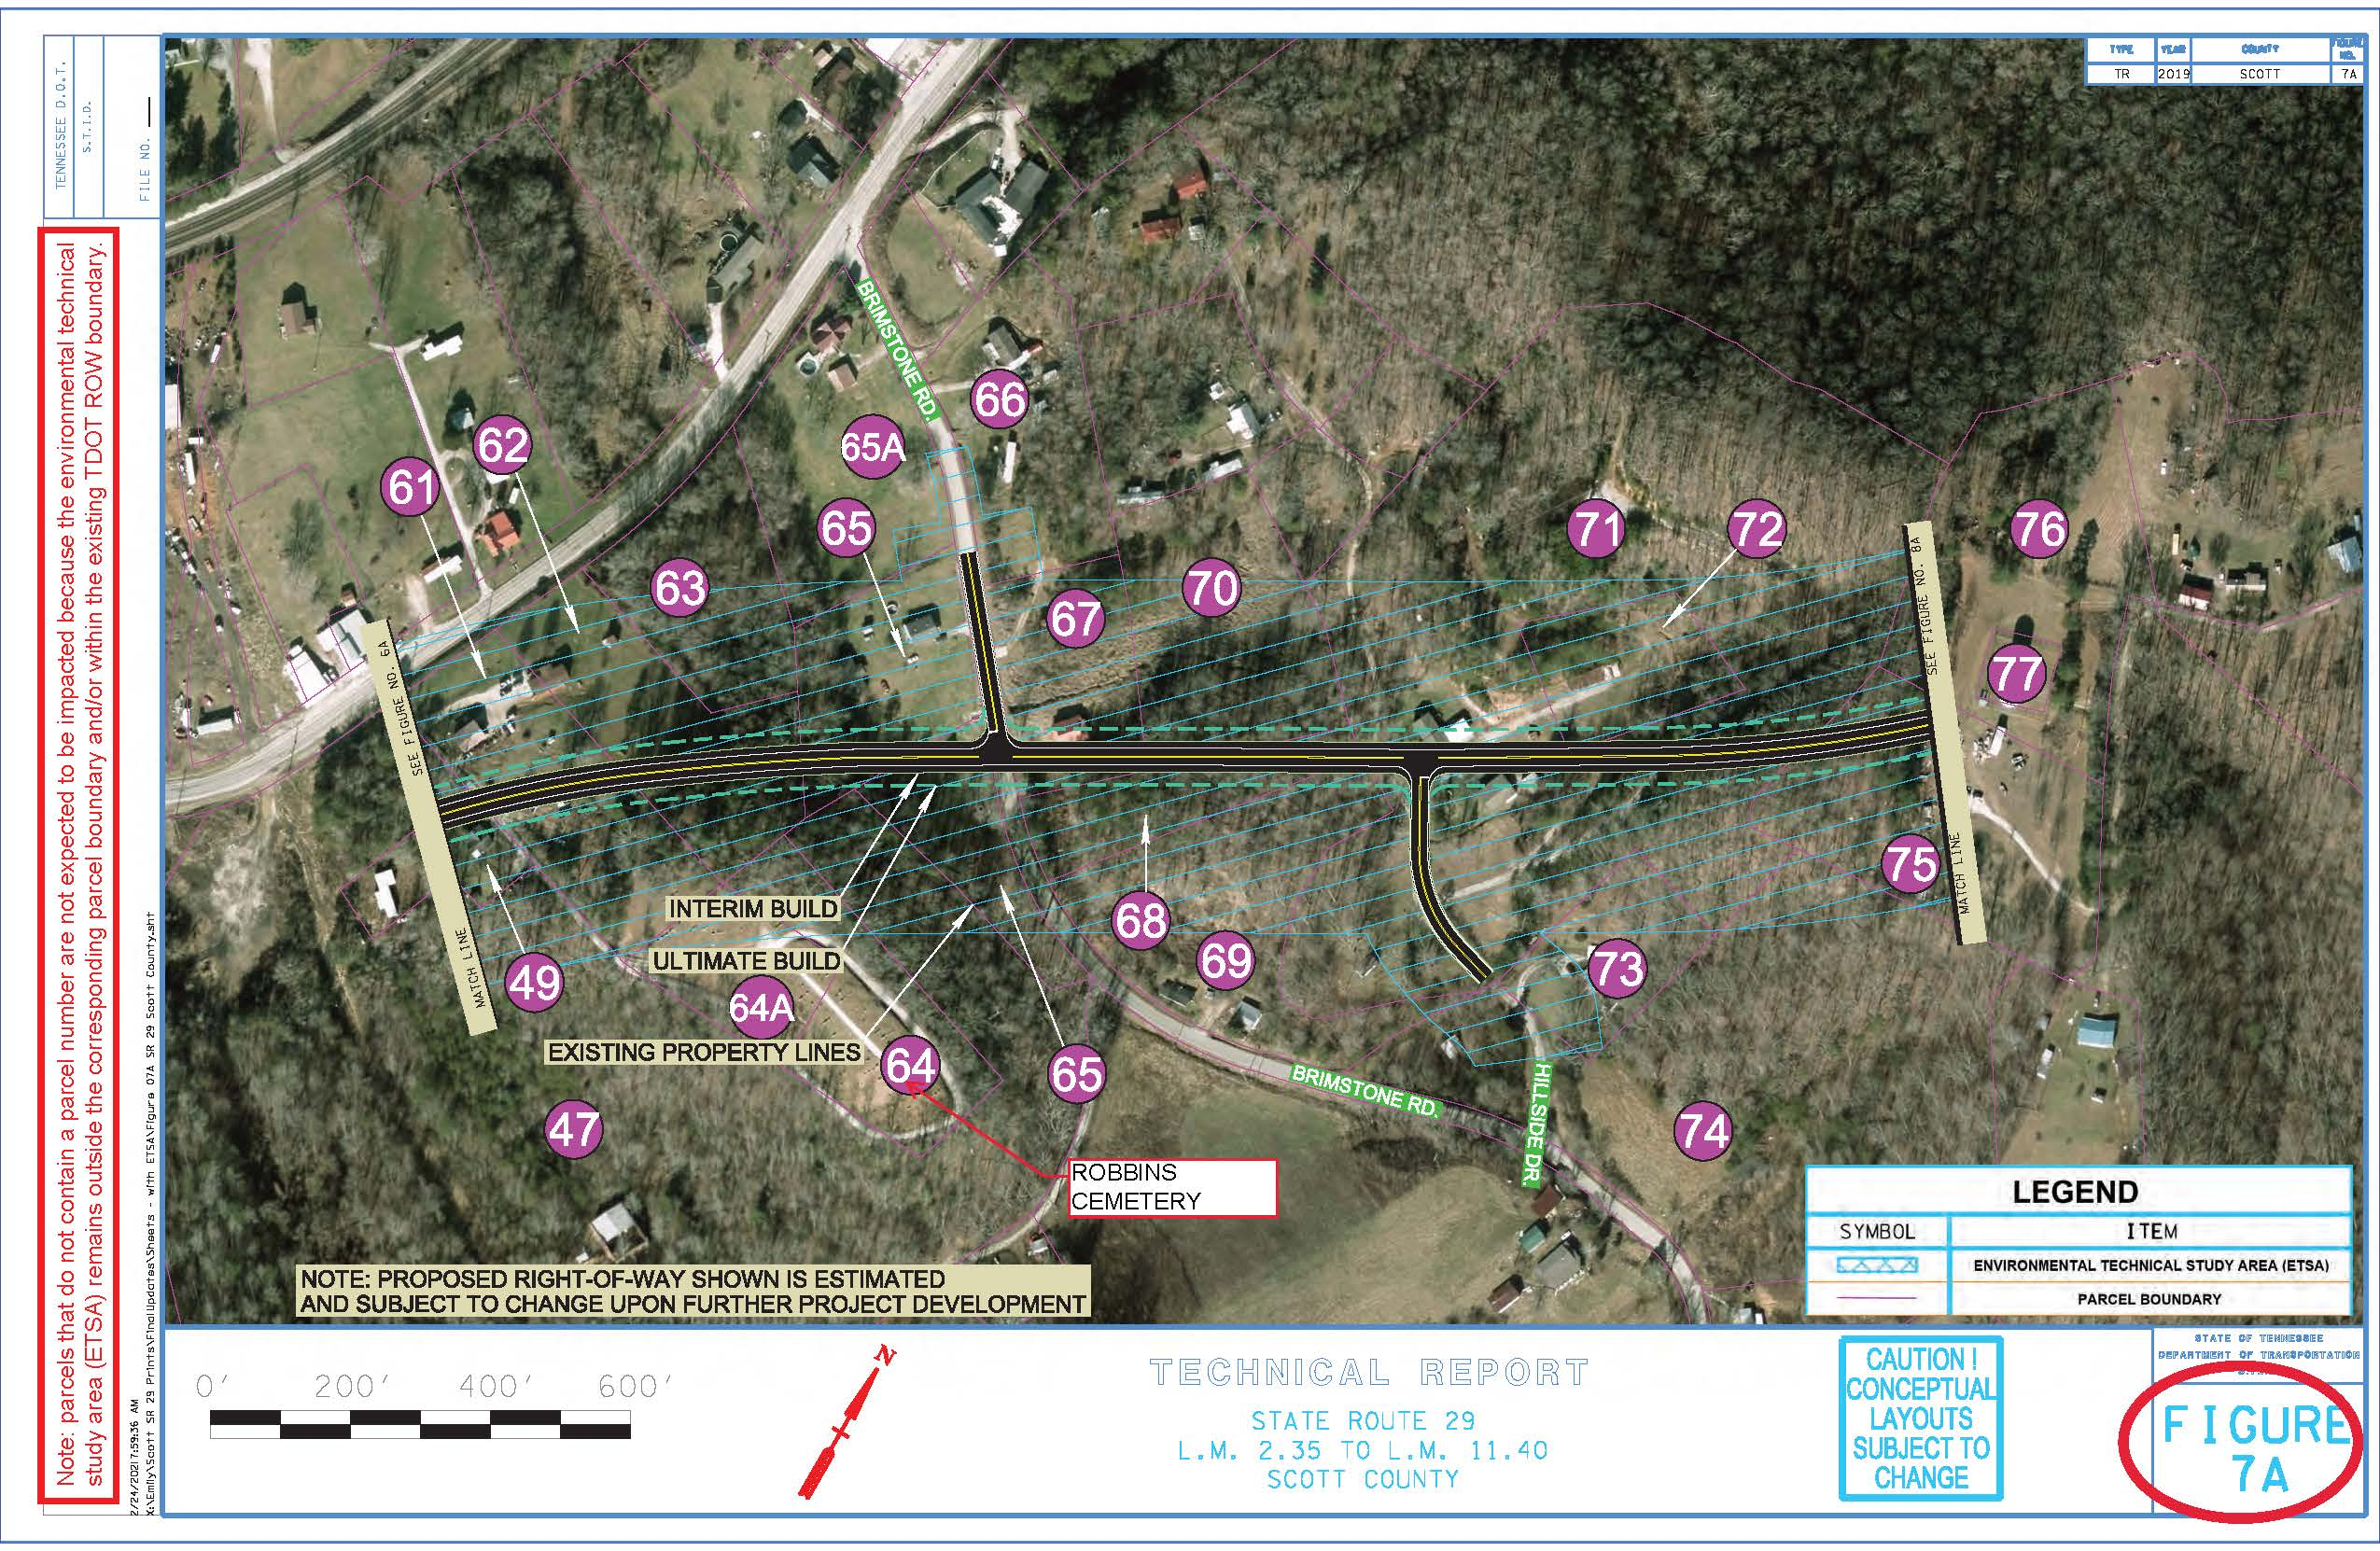
How to find your property on the TDOT Design Displays- Part C
Download Part C from the SR-29 (US-27) Public Involvement Website – Flip to the correct, Display Figure Page. The figure number can be found in the lower bottom right-hand corner. For the Robbins Cemetery, it is located on Display Figure 7A, Tract Number 64.
Notes:
Now that we know that Robbins Cemetery is on display figure 7A, we can find it in download part C, which contains maps of the project. The figure numbers are shown in the bottom right-hand corner of the maps. If you look at figure 7A, which is shown here, you can see tract 64, or Robbins Cemetery, illustrated.

Slide 24
Zoom Instructions for Making a Comment or Asking a Question
If you are joining via PC, Mac, iPad, iPhone or Android devices: In order to ask a question or make a comment, use the Zoom platform’s "Raise Your Hand" feature. The TDOT moderator will then call your name or phone number when it is your turn to speak. Please unmute your audio and state your name and comment/question.
If you are joining via cell phone or land line: Dial *9 on your phone to notify the TDOT moderator that you would like to give a verbal comment or question during the Question-and-Answer Session. The TDOT moderator will then announce your phone number when it is your turn to speak. You will be asked to unmute yourself by dialing *6 on your phone when the TDOT moderator states it is your turn.
* Verbal comments and/or questions will be limited to three minutes per individual or five minutes if you are representing an organization.
*The Zoom chat function will be disabled for all participants. Participants are encouraged to use the Zoom Question & Answer Box to ask questions of the TDOT Project Team. Questions will be answered in the order that they are received. Remember to include your name in your Q&A pod.
Notes:
We are now transitioning to the question-and-answer portion of the meeting. We ask that the first part of the question-and-answer session be limited to general project questions. Once these general project questions have been received, TDOT will begin answering questions about specific properties.
In order to ask a question or make a comment, use the Zoom platform’s "Raise Your Hand" feature. The TDOT moderator will then call your name or phone number when it is your turn to speak. Please unmute your audio and state your name and comment/question.
If you are joining by cell phone or land line, you can dial *9 on your phone to notify the TDOT moderator that you would like to give a verbal comment or question. The TDOT moderator will then announce your phone number when it is your turn to speak. When you are called on, you will need to unmute yourself by dialing *6.
As a reminder, we ask that verbal comments or questions be limited to three minutes per individual or five minutes if you are representing an organization.
The Zoom chat function will be disabled for all participants. We encourage you to use the Zoom Question & Answer Box to ask questions of the TDOT Project Team. Questions will be answered in the order that they are received. Remember to please include your name in your chat.

