Slide 1

Design Public Meeting
SR 31
Hawkins County
November 1, 2012

Slide 2
Agenda
Introduction by TDOT
Presentation of Project by Stantec
Question & Answer Session
Viewing of Preliminary Plans
7:00 pm – Adjourn

Slide 3
Meeting Purpose
Project information
Project history and update
Project schedule
How are you affected?
Comments

Slide 4
Comments
Verbal
  Court Reporter
Written
  Comment Forms
    Leave with us tonight
    Mail in later

Slide 5
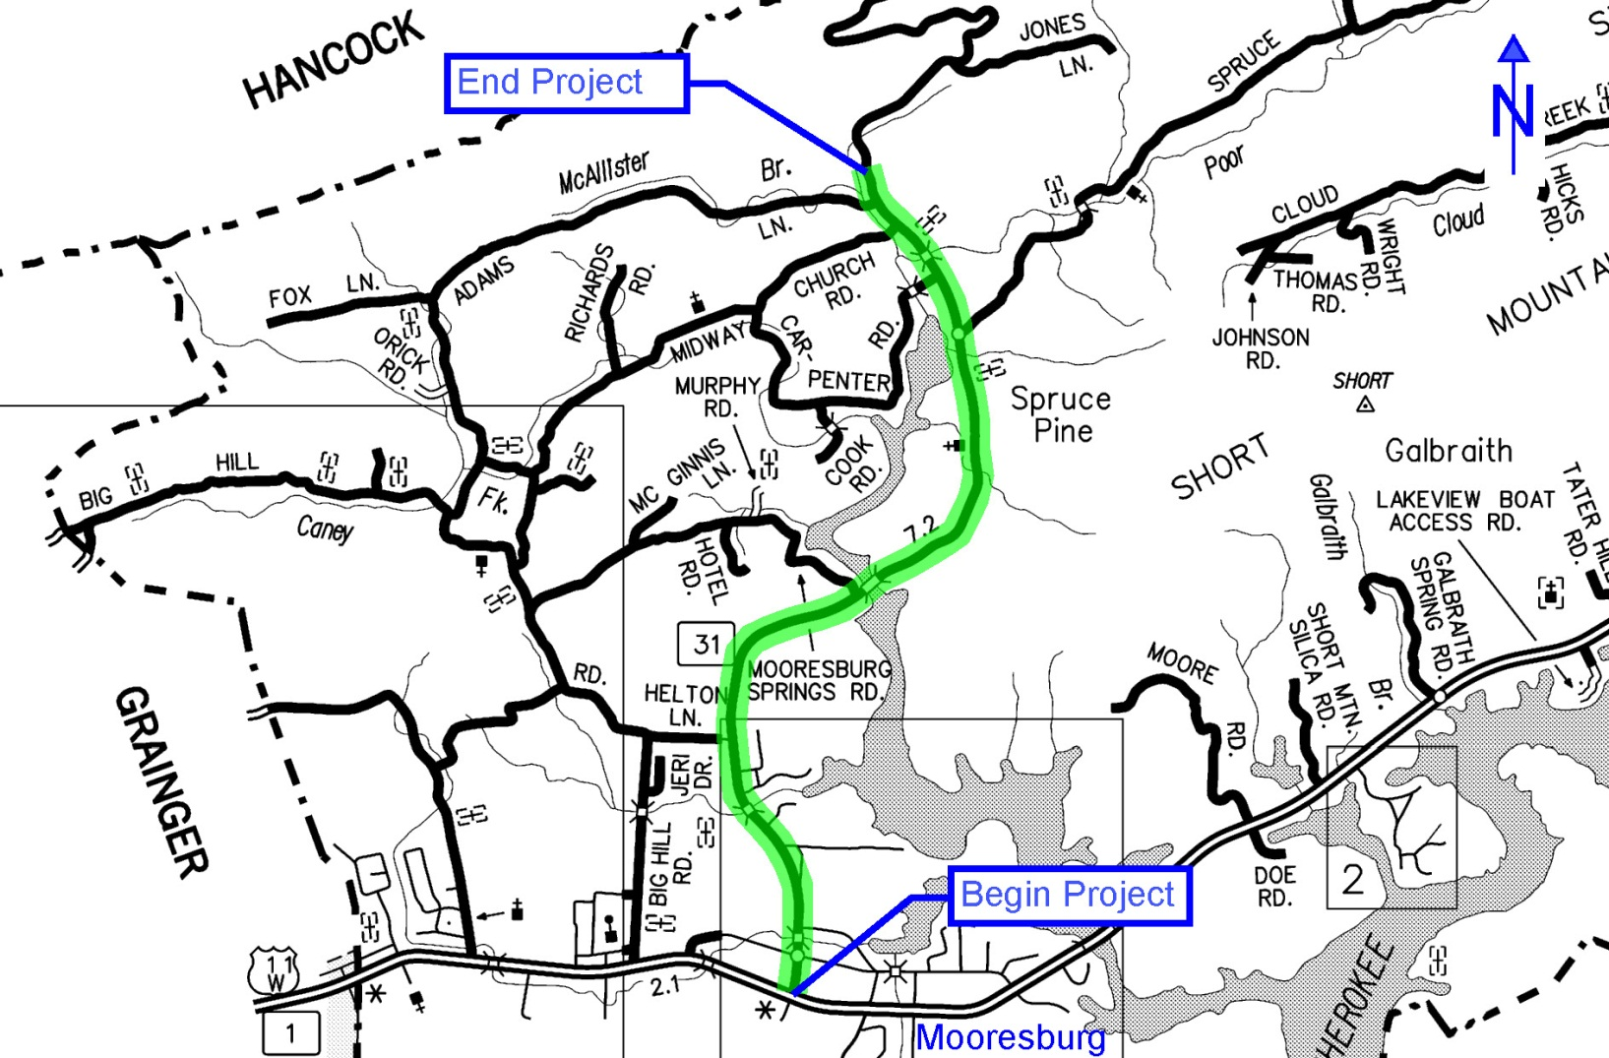
Project Location

Slide 6
Project Information
Purpose: Safety Improvements
  Horizontal alignment
  Vertical alignment
  Typical section
Length: 4.4 miles
Design Speed
  Urban: 45 mph
  Rural: 50 mph
Design Goals:
  Utilize existing ROW
  Minimize impacts to private property
    87% of new roadway follows existing alignment

Slide 7
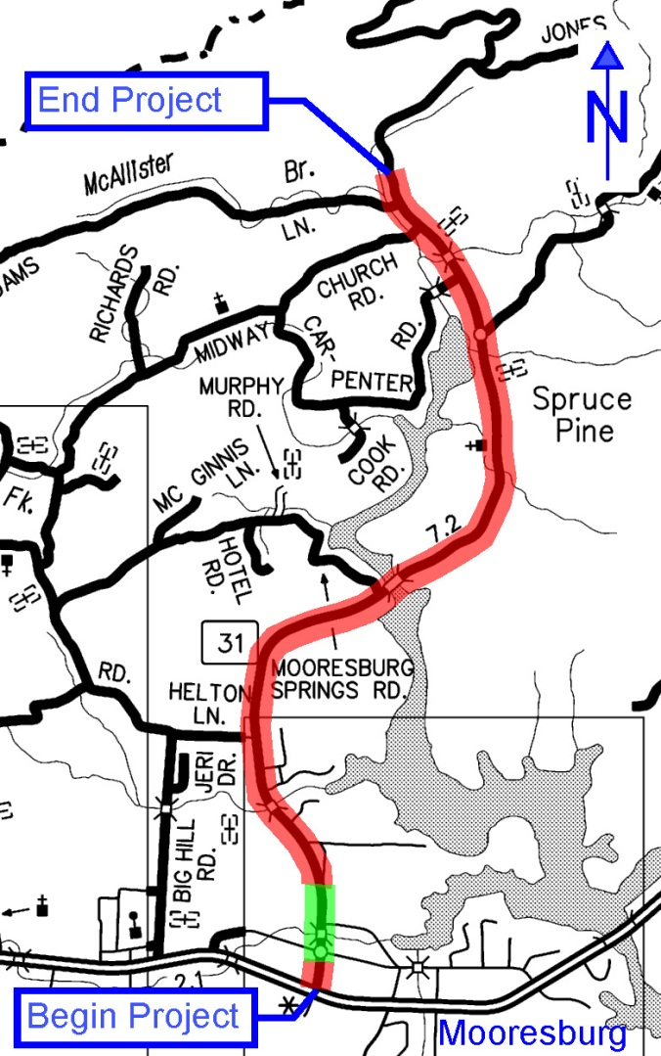
Typical Sections

Slide 8
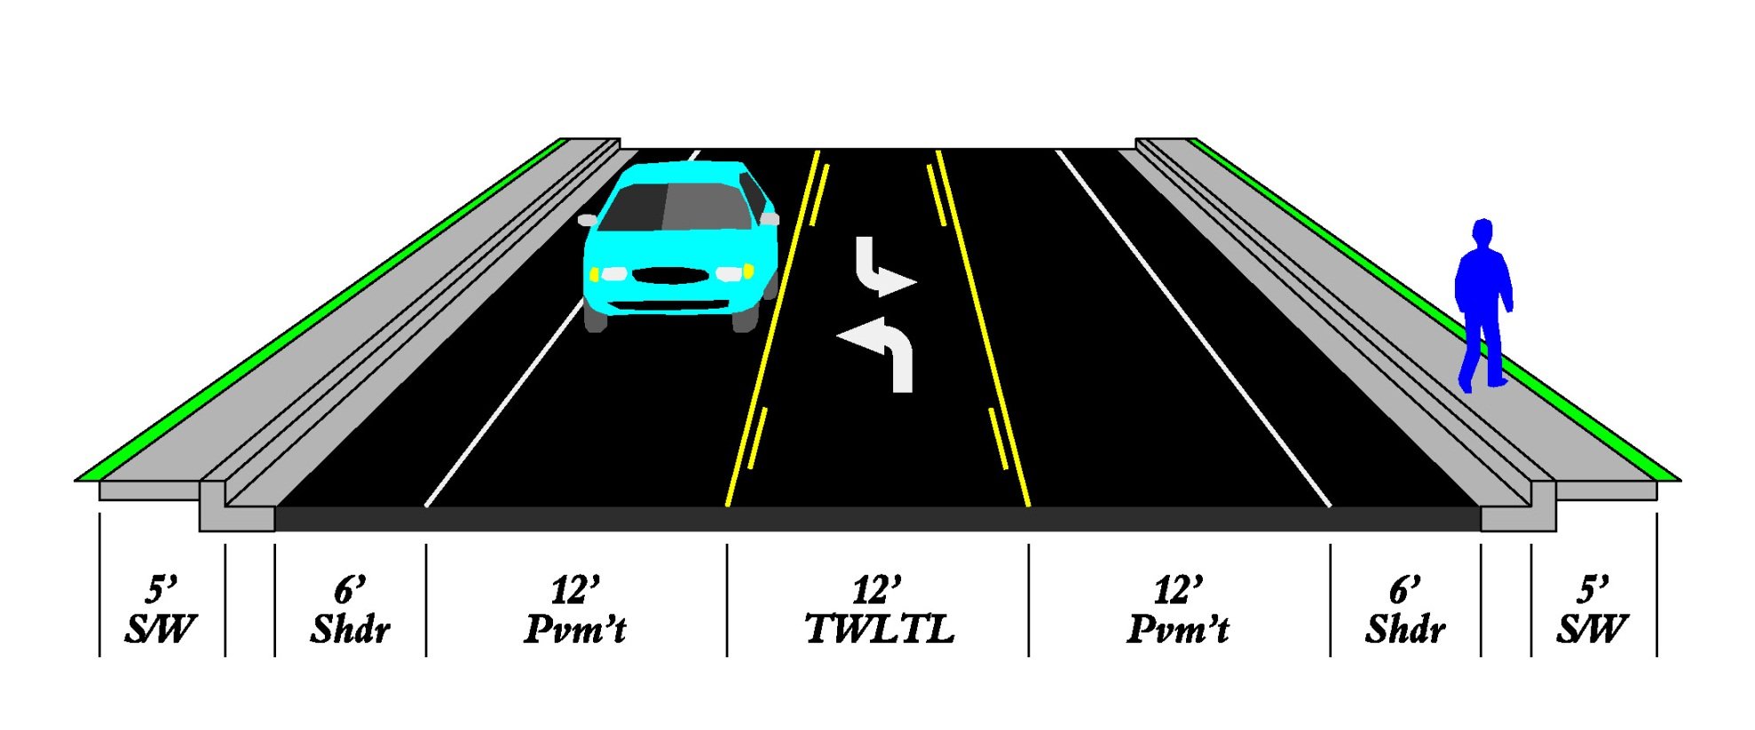
Urban Typical Section

Slide 9
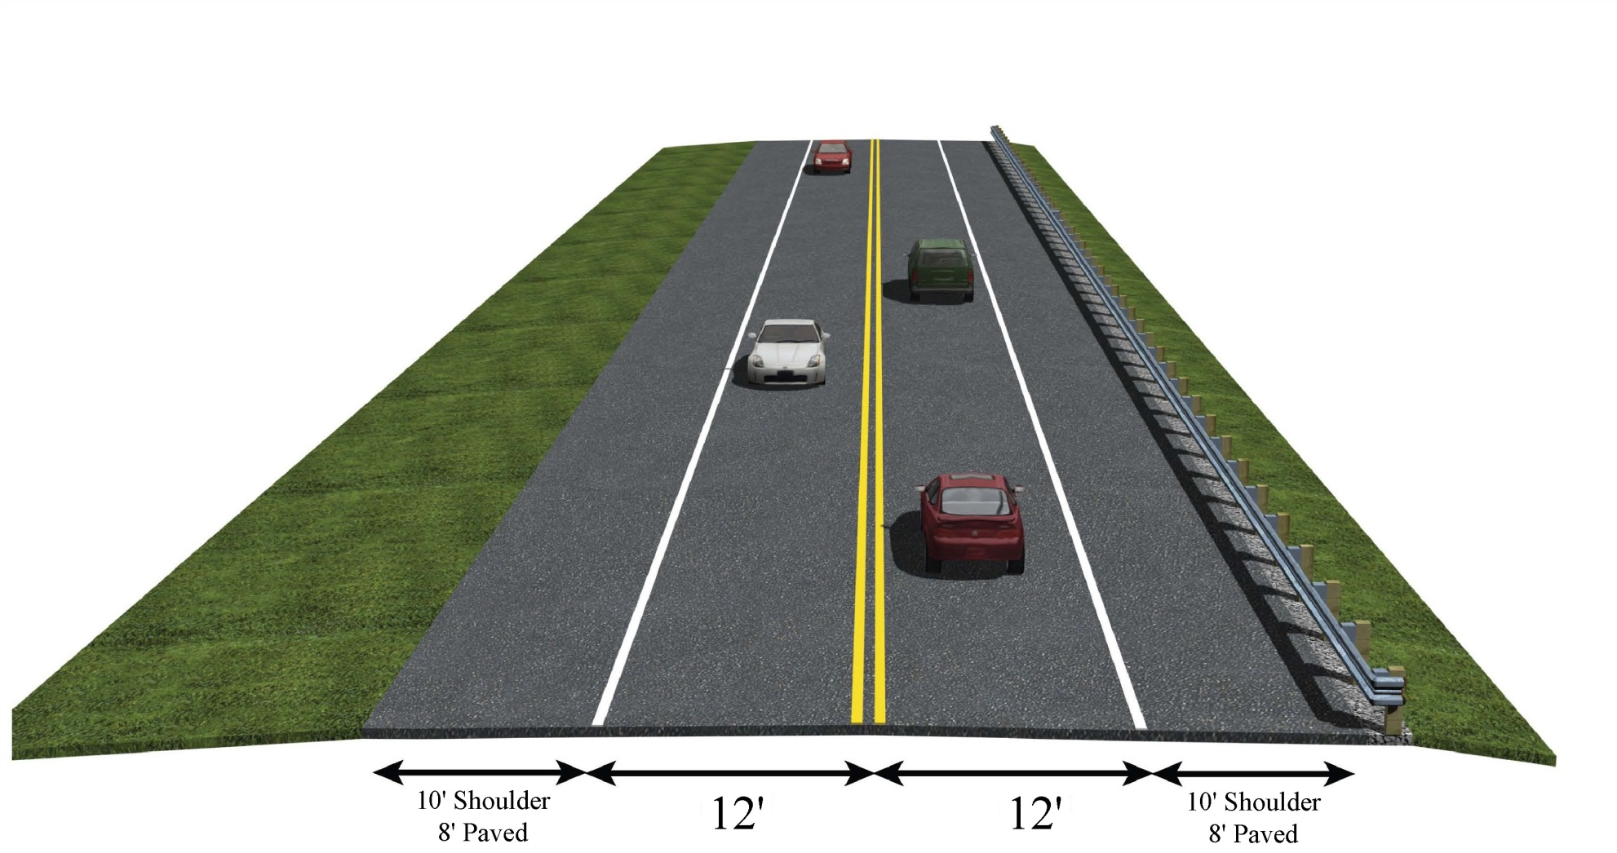
Rural Typical

Slide 10
History
Date
February 2001 | Begin Work
June 2002 | Preliminary Plans Complete (Initial Alignment)
September 2004 | Archaeological Sites Identified
October 2006 | Archaeological Report Completed
 | Alignment Revised
January 2009 | Public Hearing
October 2009 | NEPA Document Approved
April 2012 | Preliminary Plans Complete (Revised Alignment)
November 2012 | Public Meeting

Slide 11
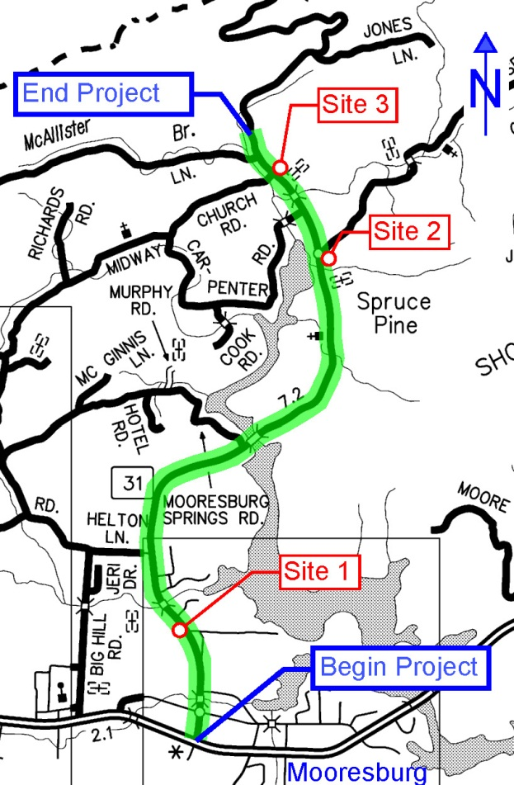
Archaeological Sites
Potentially eligible to be on the National Register of Historic Places
Site | Description
1 | Summers Well: supplied water to Wright-Hale Bottling Works in the late 19th and early 20th Centuries
2 | Early 20th Century Farmstead
3 | Late 19th Century Farmstead

Slide 12
Properties Affected
Type of Property | Affected | Relocations
Residential | 86 | 22
Businesses | 5 | 2
Churches | 0 | 0
Cemeteries | 0 | 0
Public Property
Schools | 1 | 0
Fire Depart | 1 | 0
TVA | 1 | 0

Slide 13
Project Development Process
Local
Request
We are here
Planning
Design
Right of Way
Construction

Slide 14
Schedule
No funds are currently available to proceed beyond the design phase

Slide 15
Right of Way
Tonight
  Right of Way Personnel available
  Right of Way Pamphlets available
During acquisition process
  Visit to explain process
  Appraisal
  Offer
  Negotiation

Slide 16
Community Relations Office
Region 1: (865) 594-0161
Nashville HQ: (615) 741-7736
or visit TDOT online at
www.tdot.state.tn.us

Slide 17
Questions ?
Following question/answer session
Preliminary plans available for viewing
Representatives available to assist you

Slide 18

The Tennessee Department of Transportation thanks you for your participation in this Design Public Meeting for SR-31

Slide 19
Thank you!
Contacts
Mike Russell
P.O. Box 58
Knoxville, TN 37901
(865) 594-2334
Freddy Miller
James K. Polk Bldg, Ste 1300
505 Deaderick Street
Nashville, TN
(615) 741-0835

