Slide 1
Recent Projects in PTRF
April 30, 2025
Dan Pallme, Asst Chief of Freight

Slide 2
Safety First
Work Zone Awareness Week – FL vs TN
Safety (fatalities) in 2024 vs 2023 – 1,191 vs 1,323 (10% decrease)
  Pedestrians – 172 vs 206 (15% decrease)
  42% are unrestrained
  Large Trucks and Bus – 170 vs 163 (4% increase)
  Motorcyclists, ATV and other – 183 vs 199 (8% decrease)
  Teen drivers (age 13 – 19) – 158 vs 137 (13% decrease)
  Senior drivers (age 65+) – 285 vs 262 (8% increase)

Slide 3
Freight Projects: Recently closed out
Memphis Freight Flows – WSP – Completion 2023
Bottleneck Analysis: Quarterly report
Water Research Project: University of Memphis, 2024
BlueOval Transit Study – November 2023
Return on Investment Short Line Project – December 2023
Truck Parking Project – U of M, 2024
State Freight Plan, 2024
Peer state review, 2024

Slide 4
Current Wins in Tennessee – Freight related
Federal grant wins with freight components
    CRISI – 42 bridge timber structures - $23.7 million
    Smith County Truck Parking Rest Area – MPDG award - $22.6 million
    America’s River Crossing – Bridge Investment Grant - $400 million
Weigh in Motion – Randall covered earlier
Last year - TMA Act – Tennessee state support
This year - $1 Billion – Preston to cover

Slide 5
Current Freight Projects
Federal grant applications leverage with IIJA or BIL funding
Return on Investment (rail) – UTK
State rail plan – HDR – Covered by Keith
Deep dive of waterway in Tennessee - UTK - why?
  Kentucky Lock – July 2029
  Chickamauga Lock – November 2027
  Wilson lock issue – July,2025
Moving weigh stations in Knoxville
Freight Advisory Committee – Twice a year
Corridor ID / FRA Long Distance Study

Slide 6
Concerns with Freight in Tennessee
Safety
Congestion
Truck Parking issues
Cost of projects
  Types of deliveries
  Accelerated construction
Competing interests for funding

Slide 7
Contact Information
Dan Pallme, Assistant Bureau Chief – Planning Bureau
Tennessee Department of Transportation
Daniel.Pallme@tn.gov
Personal cell: 901-553-2875

Slide 8
Introduction to TDOT’s
Passenger Transportation, Rail, and Freight Division
Erik Andersen, P.E.
Freight, Rail Safety & Engineering Manager
Freight Advisory Committee
April 30, 2025

Slide 9
Tennessee’s Highway System

Slide 10
Rail in Tennessee
6 Class I railroads (2,177 miles)
  BNSF, CNIC, CSX, CPKC, NS, and UP
No Class II (regional) railroads
19 Class III (shortline) railroads (763 miles)
2 Passenger lines
  Amtrak (Chicago – Memphis - New Orleans)
  WeGo Star (Nashville commuter)

Slide 11
Tennessee Railroad Crossings

Slide 12
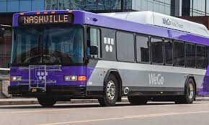
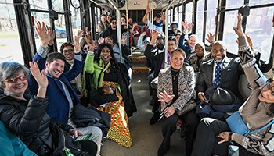
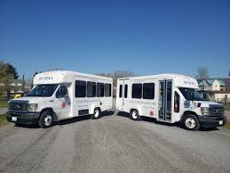
Public Transportation
Staff:
  Kaitlyn McClanahan, Manager
Primary Activities:
  Administer state and federal grant programs for public transportation
    Grant monitoring and compliance

Slide 13
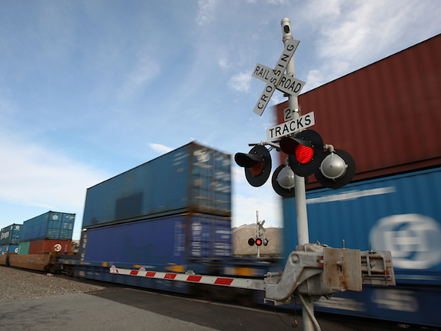
Rail Engineering
Staff:
  Vacant, Team Lead
  David Martin
  Niyonzima “Etienne”
  Clarence Langley
  Drew Daruka
Primary Activities:
  Section 130 Program (23 USC 130) railroad crossing safety
  23 CFR 646.214(b)(2) Recommendations
  Crashes and TCA 65-11-113 “Fatality law”
  TDOT Rule 16980-9-1 “Railroad grade crossing standards”
  Quiet Zones and 49 CFR Part 222 “Train Horn Rule”

Slide 14
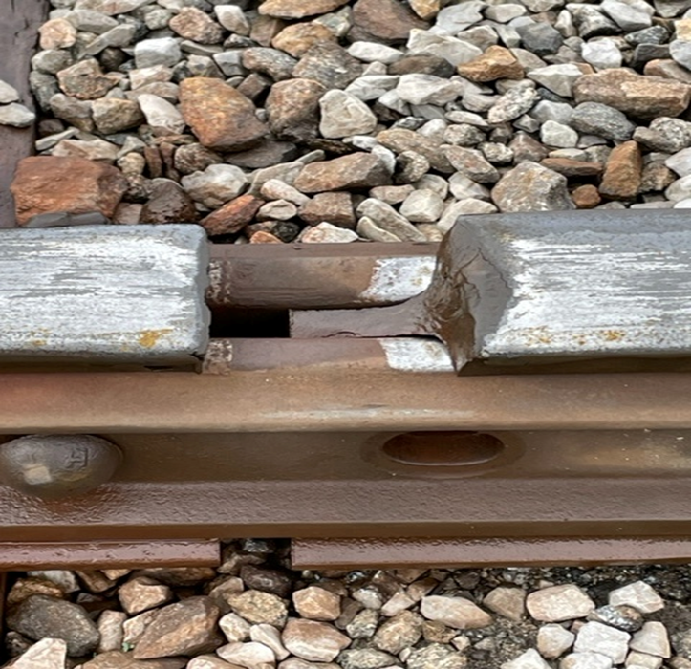
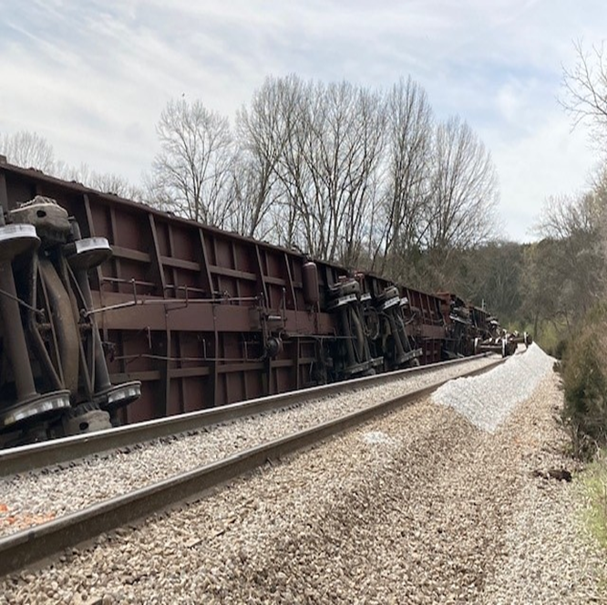
Rail Safety and Inspection
Staff:
  Taylor Ackerman, Team Lead
  Brian Roberts
  Gregory Tucker
  Wesley Salyers
  Vacant, Rail Safety Inspector
Primary Activities:
  Perform state crossing inspections
  Enforce state laws - walkways, clearances, and safety
  Perform federal inspections – FRA certified in track, signals, and operating practices
  Respond to complaints from citizens, railroad employees, and governmental agencies 24/7
  Liaison between citizens/local governments and the railroads

Slide 15
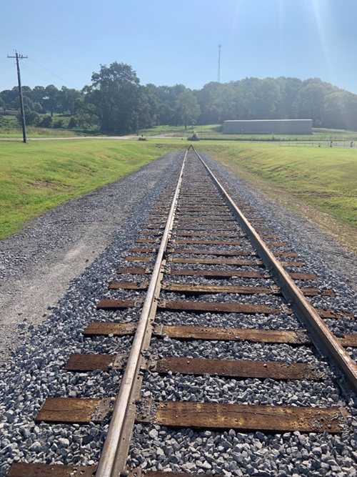
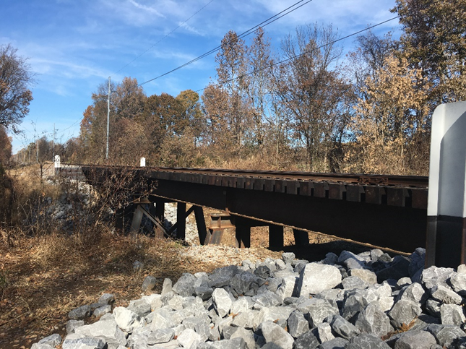
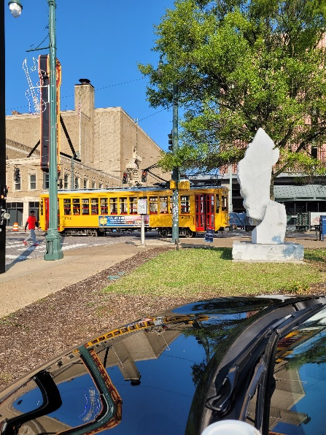
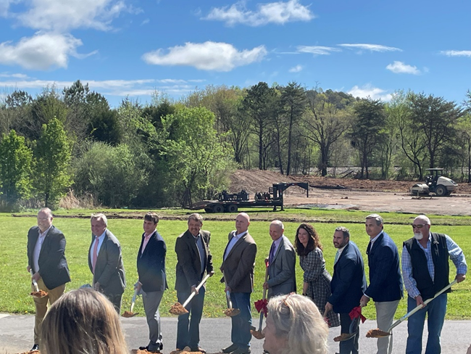
Freight Planning
Staff:
  Kathy Combs, Team Lead
  Adam Jaeckel
  Christopher Broach
Primary Activities:
  Applications for federal grants
  State Multimodal Freight Plan
  State Rail Plan
  Rail Preservation Grant Program
  State Safety Oversight (SSO) Program
    Memphis Area Transit Authority (MATA) Downtown Trolley
    Chattanooga Area Regional Transportation Authority (CARTA) Inclined Railway

Slide 16

Railroad Coordination
Staff:
  Jay Lanius, Manager
Primary Activities:
  Railroad coordination for federally-funded highway projects
    Facilitates railroad company review of design plans
    Crossing agreements with railroads
    Special Provisions for railroads in construction contracts
    Railroad coordination certification to FHWA

Slide 17
Questions?
Erik Andersen, P.E.
Freight, Rail Safety & Engineering Manager
TDOT Passenger Transportation, Rail, and Freight Division
Erik.Andersen@tn.gov
615.253.1043

Slide 18
FAC Update
FY26 Budget Request
Preston Elliott, Deputy Commissioner | Bureau of Planning
Notes:
18

Slide 19
Governor's Proposed FY26 Budget
 | Recurring | Non-Recurring | Total
Pavement Program Investment | $16,031,250 | $108,968,750 | $125,000,000
Bridge Program Investment | $16,031,250 | $58,968,750 | $75,000,000
Spot Safety Program Reinforcement | $12,825,000 | $7,175,000 | $20,000,000
State Infrastructure Fund | - | $50,000,000 | $50,000,000
Rural Service Patrol | $16,700,000 | - | $16,700,000
Mowing and Litter | $6,412,500 | - | $6,412,500
Pay for Performance | $12,000,000 | - | $12,000,000
Expedited Projects | - | $774,887,500 | $774,887,500
Air Carriers | - | $34,300,000 | $34,300,000
General Aviation | - | $1,000,000 | $1,000,000
Wilson County – Peyton Road | - | $3,200,000 | $3,200,000
Total | $80,000,000 | $1,038,500,000 | $1,118,500,000
Budget Hearings, FY 2026
Notes:
19

Slide 20
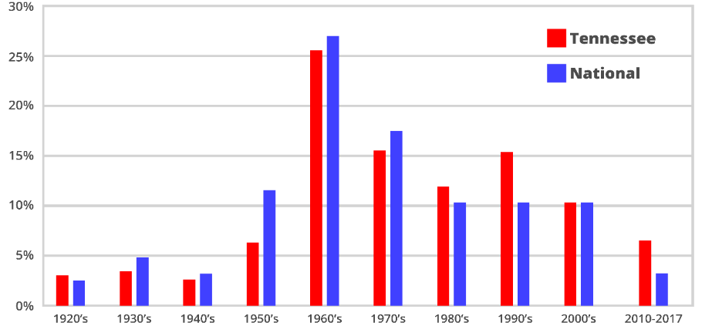
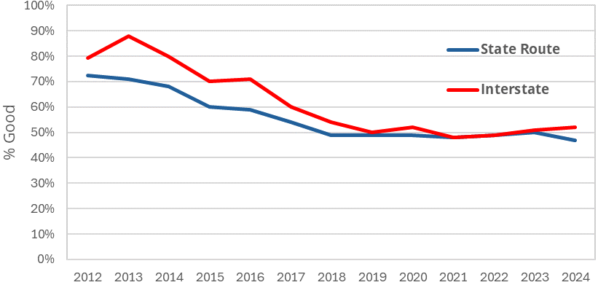
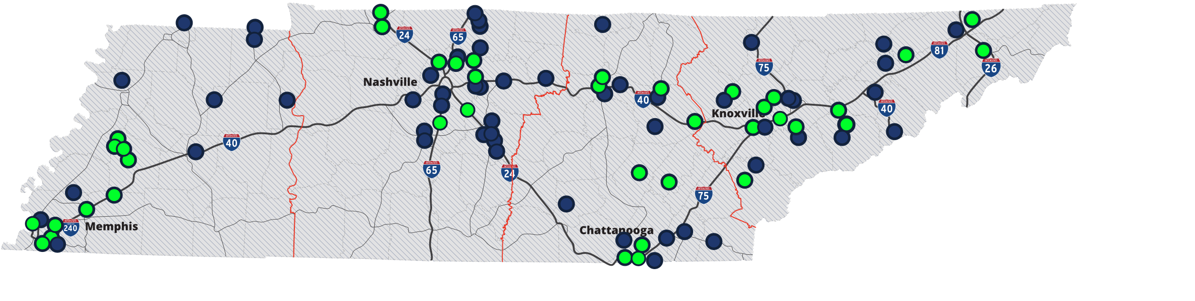



The Growing Need for Infrastructure Investment
$38B
Average Bridges by Decade Built
Need Statewide
$1.3B
TDOT Annual Program
+
$616M
New
Construction
Current Pavement Condition
FY24
$3 Billion
10-Year Plan
47 of 93 Projects Made Possible
Budget Hearings, FY 2026
Notes:
20

Slide 21
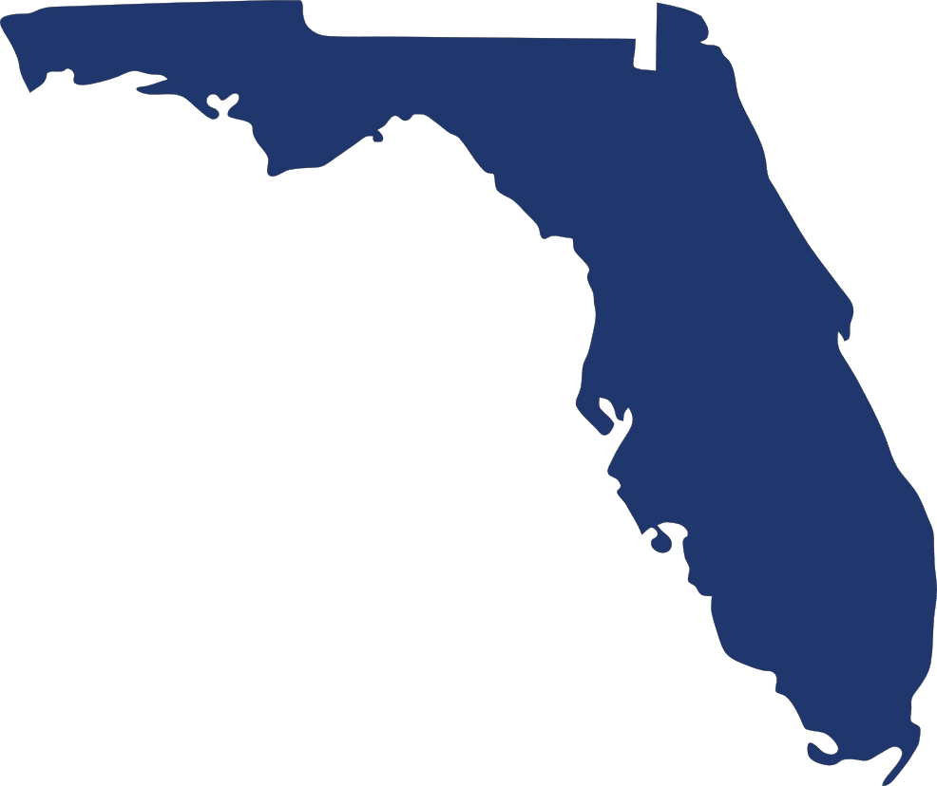


Tennessee vs. Peer States: Funding and Transportation Spend
FLORIDA
TEXAS
TENNESSEE
Percentage of Budget | 11.4% | 4.9% | 11.1%
Transportation Spending Rank (Highest to Lowest) | 9th | 40th | 10th
Fuel Tax Rank (Highest to Lowest) | 12th | 31st | 44th
Supplemental Revenue | Bonds – Tolls – Gas Tax Index | No Bonding – No Tolls – Non-Indexed Gas Tax | Bonds – Tolls
Report Card Grade | C+ | C | C
Budget Hearings, FY 2026
Source: USDOT, FDOT, TXDOT, Bureau of Transportation Statistics
Notes:
21

Slide 22
Revenue Analysis
Overall Budget Analysis
State User Fee Collections
 | FY21 | FY22 | FY23 | FY24 | FY25
Gas | $509 | $529 | $532 | $532 | $545
Diesel | $224 | $235 | $233 | $234 | $233
Special Petroleum | $36 | $39 | $39 | $39 | $39
Vehicle Registration | $298 | $309 | $215 | $313 | $307
Total | $1,067 | $1,112 | $1,019 | $1,118 | $1,124
% Change | 4% | 4% | 0%* | 0%* | 0%
 |  |  |  |  | Millions
 | FY25 Budget | FY26 Estimated | Variance
Federal | $1,473.8 | $1,497.6 | $23.8
State | $1,331.7 | $2,405.7 | $1,074.0
Local | $54.3 | $60.5 | $6.2
Total | $2,859.8 | $3,963.8 | $1,104.0
 |  |  | Millions
*Due to normalizing for vehicle tax registration holiday;
Results in $1,113 in FY23
Budget Hearings, FY 2026
Notes:
22

Slide 23
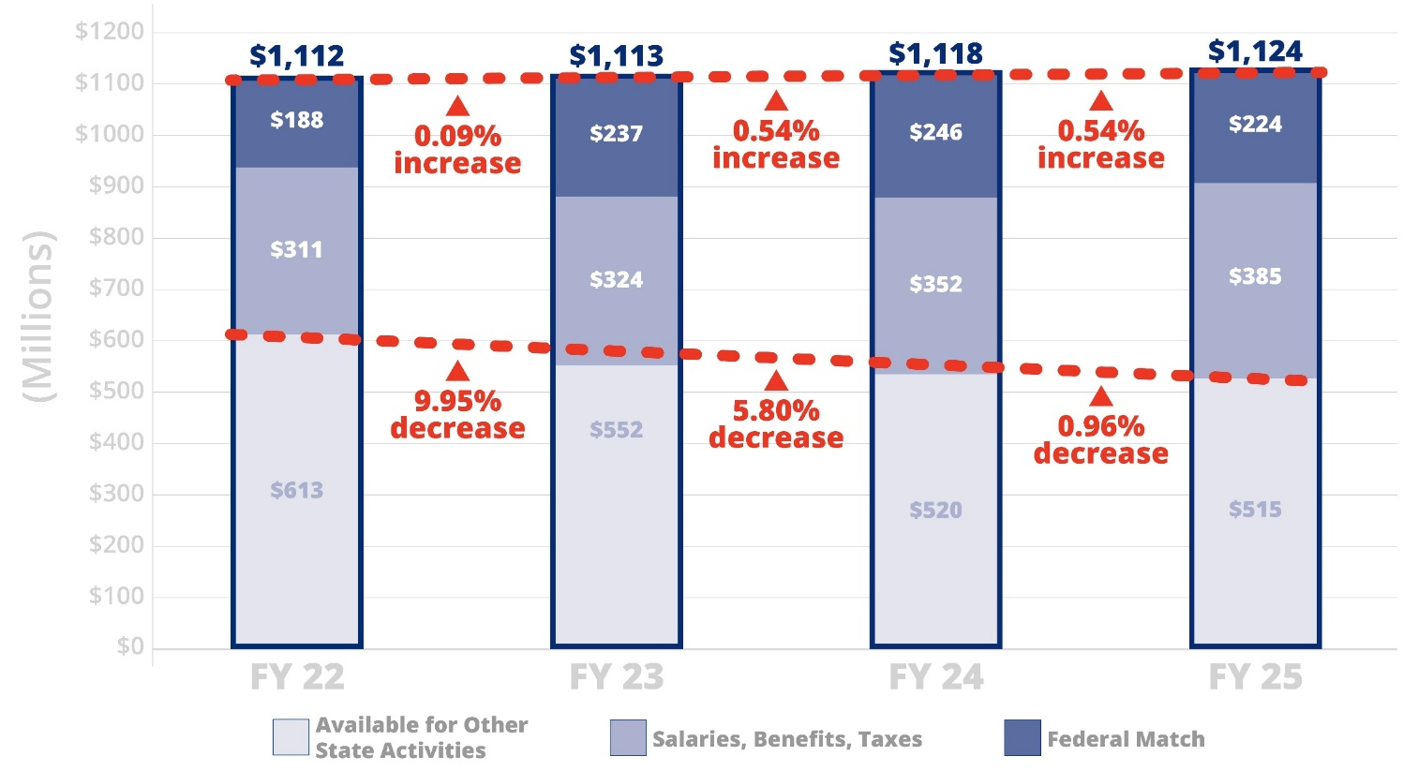
Flat User Fee Revenue vs. Increased Inflation
Total State User Fees vs. Costs
*
**
Average Cost Escalation Since FY19
Concrete Pipe | +101%
Guardrail | +80%
Concrete | +77%
Labor | +56%
Concrete Catch Basins | +55%
Steel | +55%
Aggregate | +49%
Hot Mix Asphalt | +47%
Earthwork | +45%
Pavement Markings | +39%
Budget Hearings, FY 2026
* Adjusted for FY23 State Tax holiday
** Estimated FY25 Salaries, Benefits, Taxes, and Budgeted User Fees
Notes:
23

Slide 24
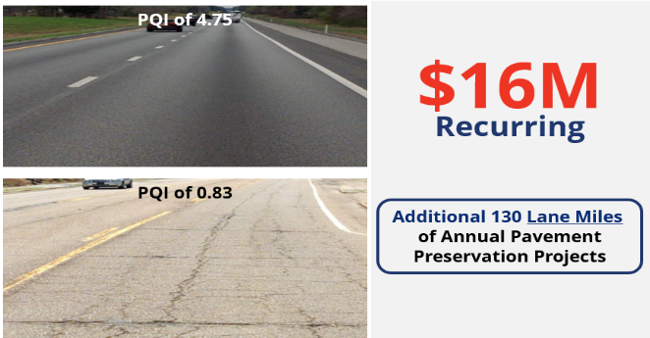
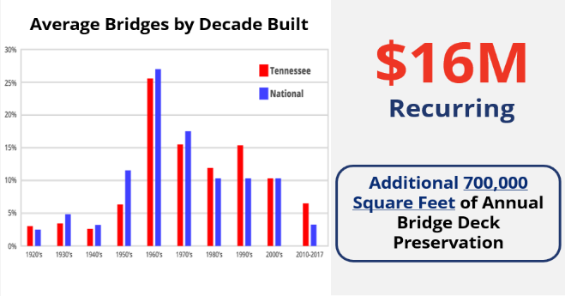
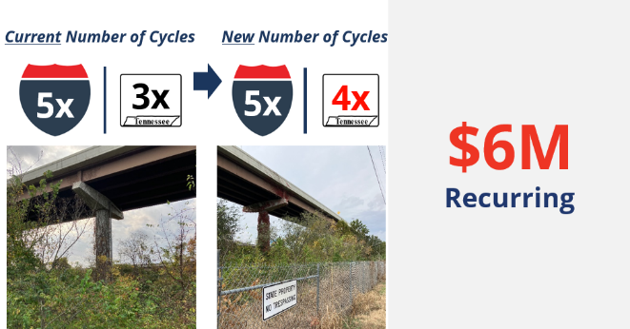
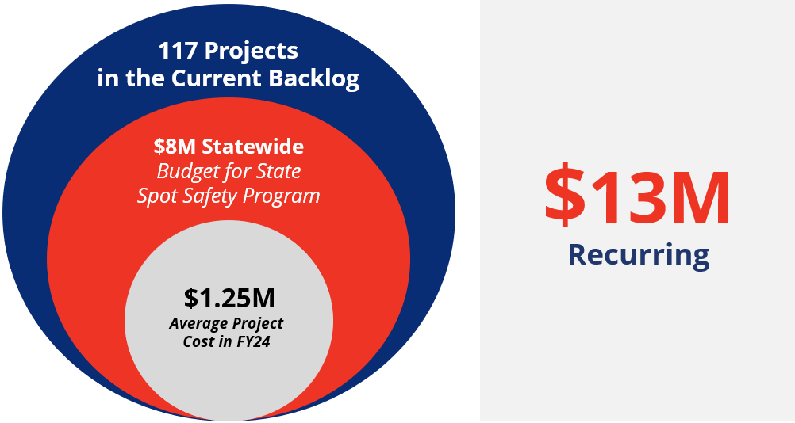
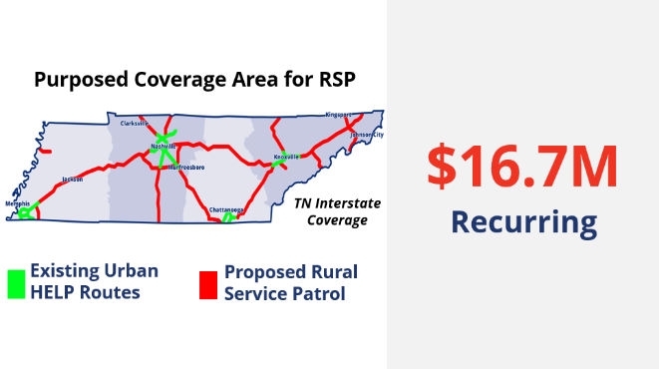
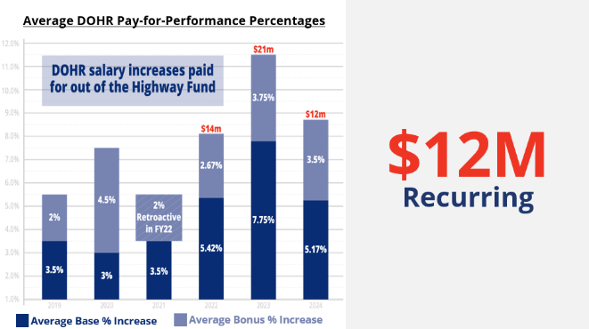
FY2026 Recurring Requests
Pavement Preservation
Bridge Preservation
Mowing and Litter
Spot Safety Program
Rural Service Patrol
Pay-for-Performance
Budget Hearings, FY 2026
Notes:
24

Slide 25
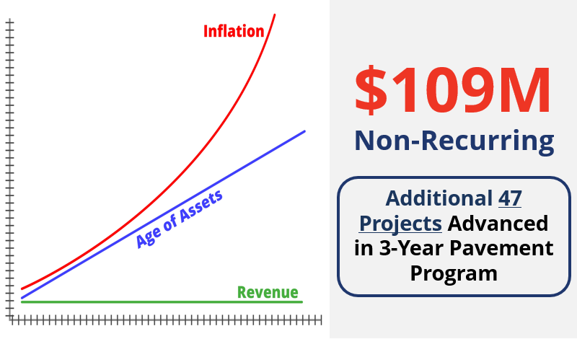
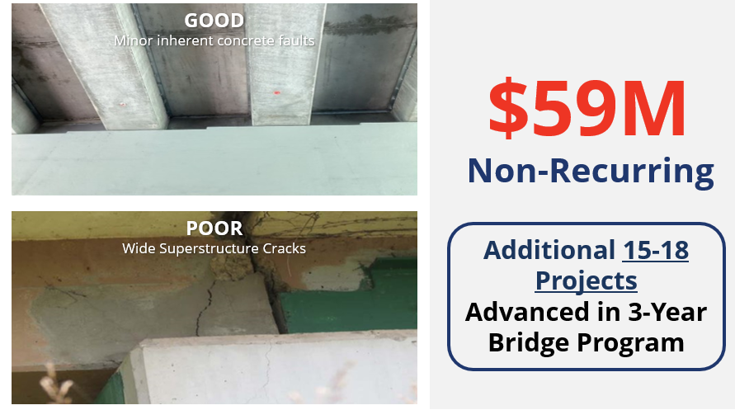
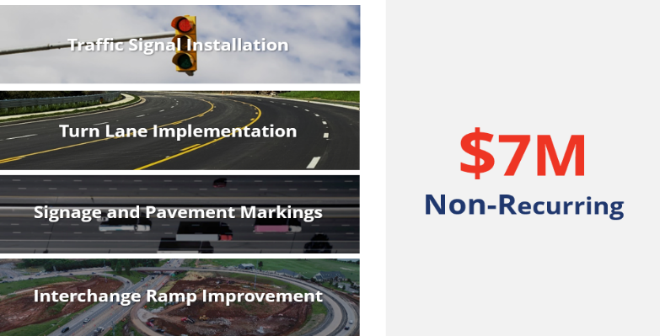
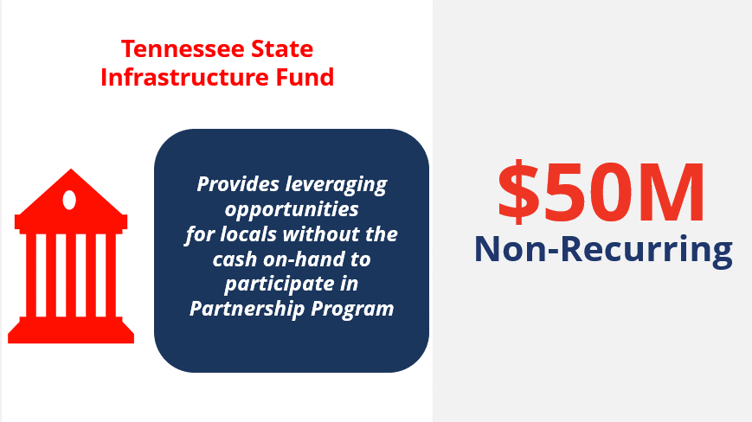
FY26 Non-Recurring Requests
Pavement Preservation
Bridge Preservation
Spot Safety Program
State Infrastructure Fund
Budget Hearings, FY 2026
Notes:
25

Slide 26



FY26 Non-Recurring Project Investment
Expedite 10-Year Plan Projects
$775M
Non-Recurring
Add Projects to the 10-Year Plan
Leverage Statewide Partnership Program Projects
Budget Hearings, FY 2026
Notes:
26

Slide 27




Transportation Modernization Fund Implementation Plan
May 2025
Augmented
10-Year Plan Release
$775M
BUDGET PASSES
Expedite
Add
Leverage
April
2025
May
2025
June
2025
Update 10-Year Plan with current funding
If appropriated, apply General Fund Dollars to expedite, add to, and leverage additional projects to the plan
Statewide Partnership Program Cycle Opens
for 2025, commencing FY26
Budget Hearings, FY 2026
Notes:
27

Slide 28
10-Year Plan Development
Notes:
28

Slide 29
TDOT Prioritization Criterion
Budget Hearings, FY 2026
Notes:
29

Slide 30

Challenge: Higher Delivery Reduces Maintenance Flexibility
Percentage of Projects Delivered Every Year
100
TDOT's "Finish what you Start" mentality has increased project delivery.
That commitment reduces costs over time but eliminates budgetary flexibility
to cover maintenance activities.
Project Delivery
State of Good Repair
TDOT BUDGET
TDOT's budget must be expanded if project delivery and state of good repair are to be balanced
in future fiscal years.
* Estimated FY24
Budget Hearings, FY 2026
Notes:
30

Slide 31
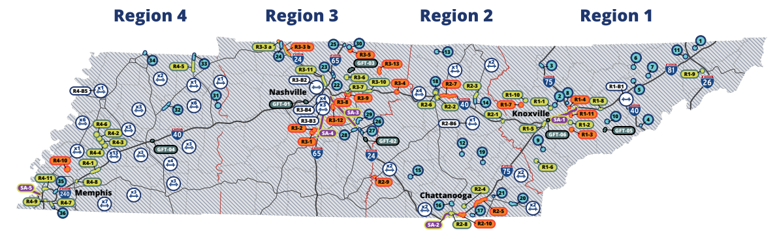
10-Year Plan Update
$211M+
Obligated by Highway Departments through the State Aid Program
74%
Delivery in Year 1
90%
On Track for Target Spend
Budget Hearings, FY 2026
Notes:
31

Slide 32
Transportation Modernization Fund Implementation Plan
May 2025
Augmented
10-Year Plan Release
$775M
BUDGET PASSES
Expedite
Add
Leverage
April
2025
May
2025
June
2025
Update 10-Year Plan with current funding
If appropriated, apply General Fund Dollars to expedite, add to, and leverage additional projects to the plan
Statewide Partnership Program Cycle Opens
for 2025, commencing FY26
Budget Hearings, FY 2026
Notes:
32

Slide 33

Notes:
33

Slide 34
Next Steps
Stay tuned – October meeting (virtual)
Other freight updates for future FAC’s: Smith County truck parking, America’s River Crossing, Legislative updates, data, MPO / RPO information, university research: waterways / return on investment, Choice Lanes, other ideas – Please let us know
Be safe
Thank you!

