Slide 1
Weigh In Motion
WIM
Randall Emilaire | TDOT Manager
Planning Data & Systems
April 30, 2025

Slide 2

Weigh In Motion Terminology
Prepass
WIM Maintenance
MEPDG
Drivewyze
Enforcement WIM
Traffic Monitoring Guide
Strain gauge sensor
Planning WIM
ASTM E1318-09 Type I,II,III Systems
Quartz Piezo Sensors
Axle correction Factor
Portland Concrete Cement
Kistler/ Intercomp
Long Term Pavement Performance
Vehicle Signatures
WIM as a Service

Slide 3
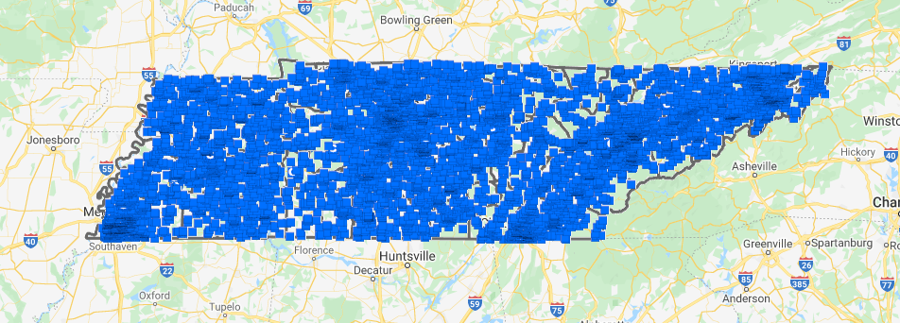
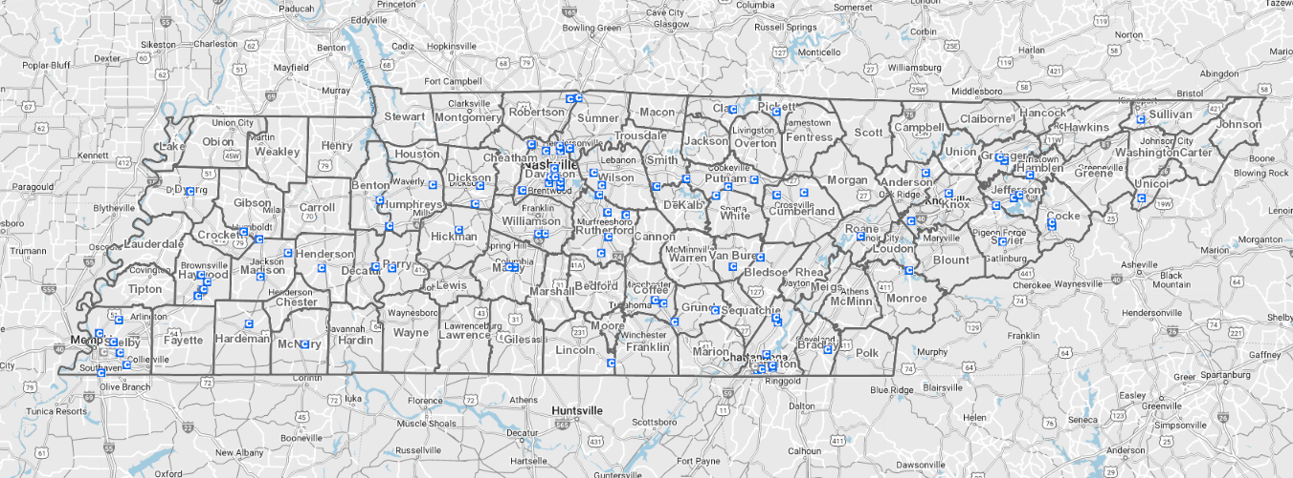
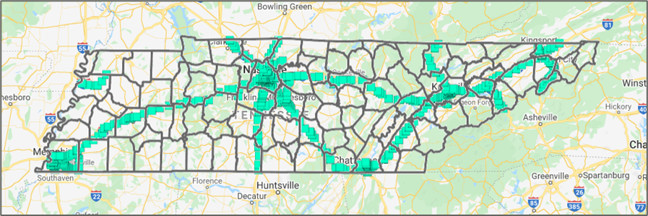
Data Collection Strategy

Slide 4
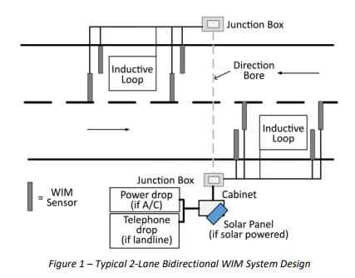

WIM facts
WIM - “the process of measuring the dynamic tire forces of a moving vehicle and estimating the corresponding tire loads of the static vehicle.”
ASTM E1318-09 WIM Types • Type I and Type II systems: Suitable for traffic data collection purposes, with Type I systems having slightly more stringent performance requirements. 10-80 MPH
Sensors include bending plate, load cell, quartz piezo, polymer piezo, and the strain gauge strip sensor.

Slide 5
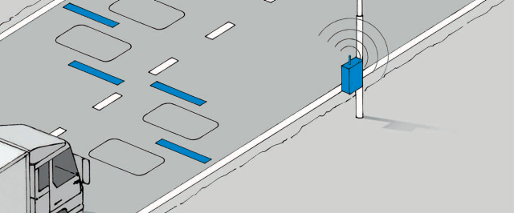
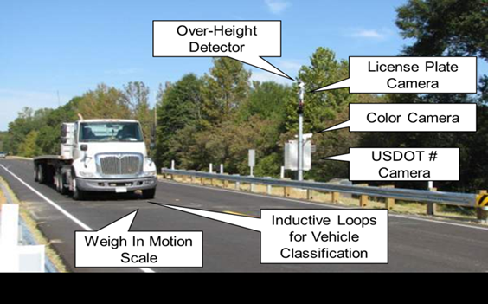
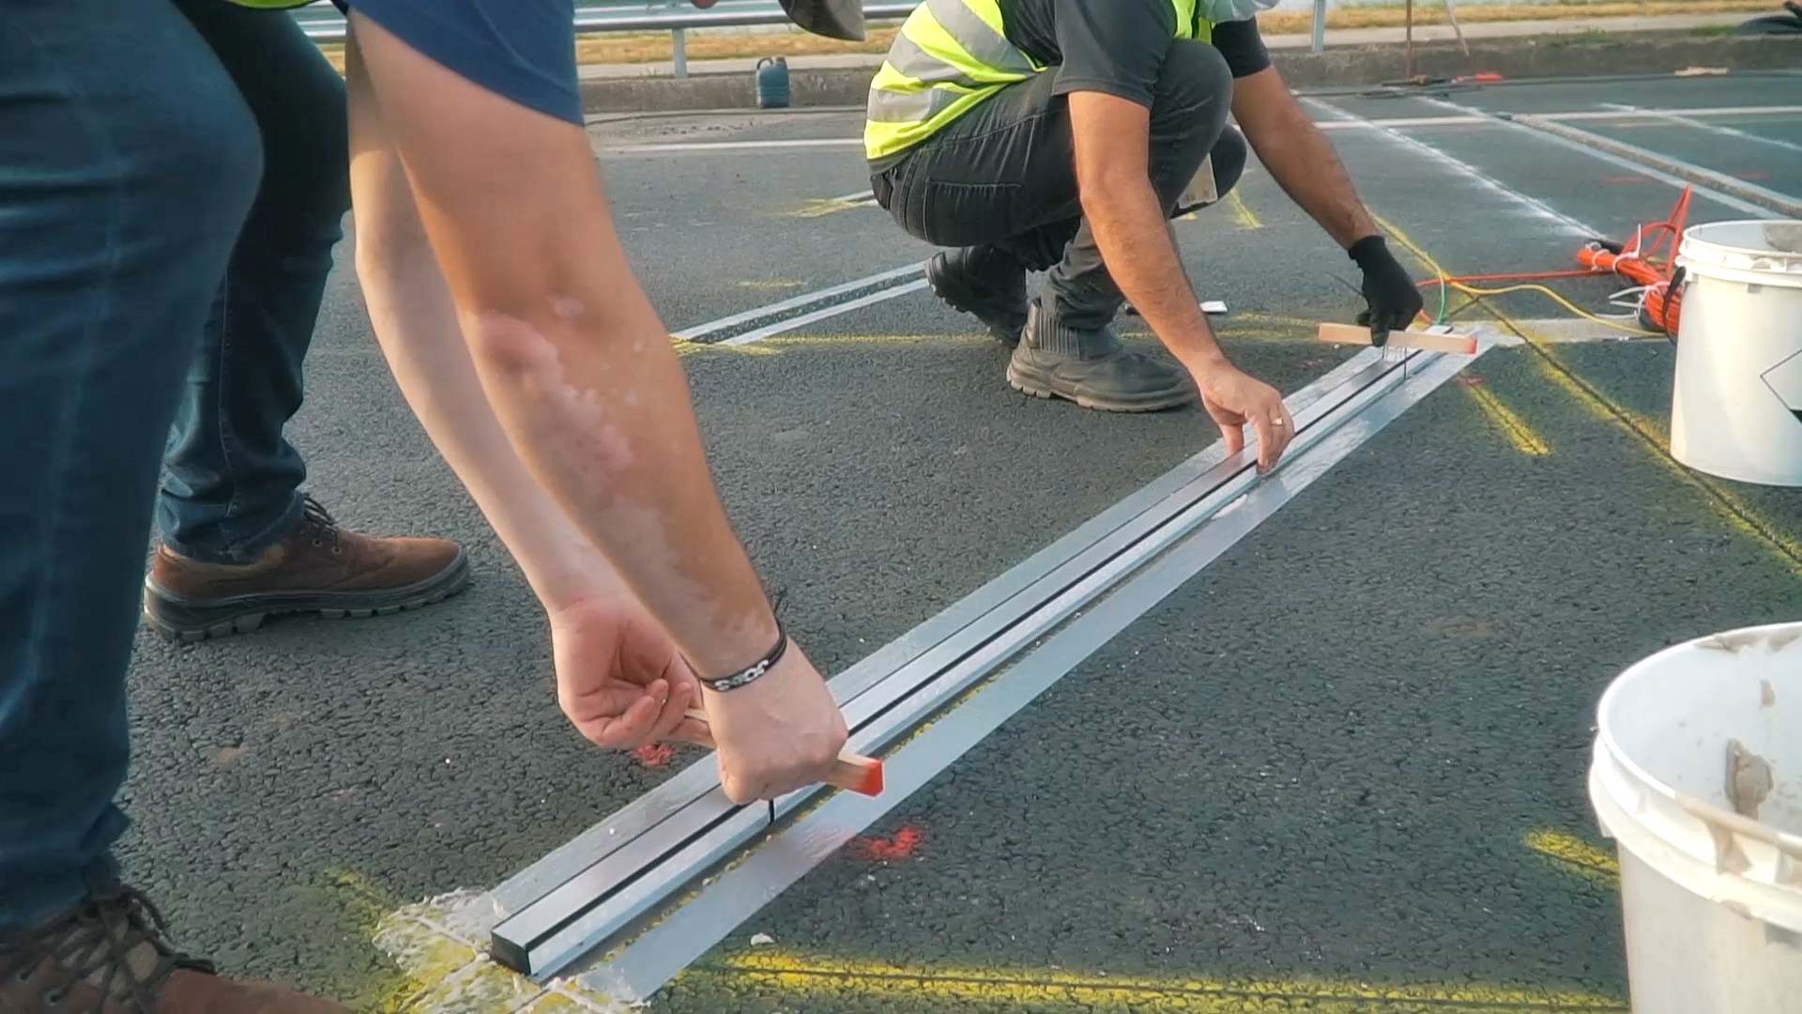
What is WIM?
Weigh-in-motion (WIM) is a primary technology used for monitoring vehicle weights and axle loads.
WIM devices collect traffic volume, axle spacings, vehicle classification, and speed data.
Highway planning, pavement and bridge design, freight movement studies, motor vehicle enforcement, and legislative and regulatory studies.
Enforcement officers use heavy truck axle load data to plan enforcement activities, as well as to screen and identify specific vehicles that violate weight limits during real time on-site monitoring.

Slide 6
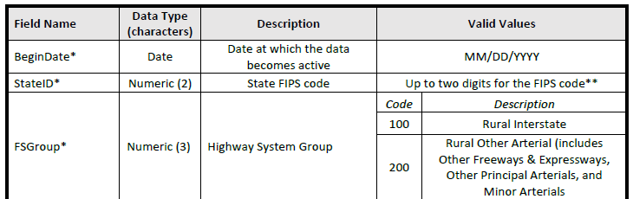
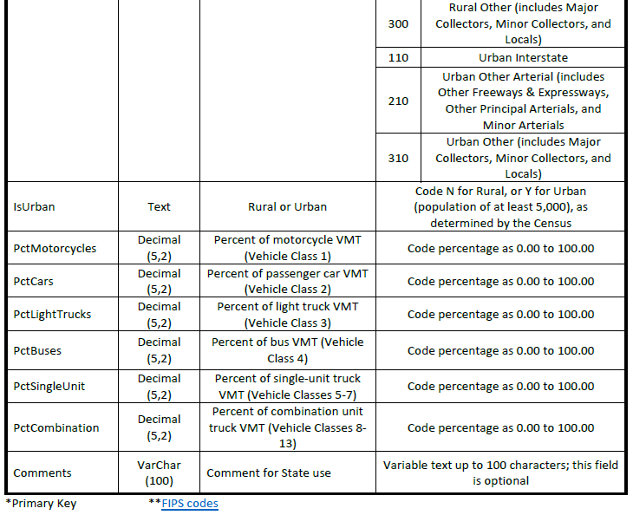
HPMS Traffic deliverables
AADT (Annual Average Daily Traffic)
AADT_SINGLE_UNIT (Single-Unit Truck and Bus AADT)
PCT_DH_SINGLE_UNIT (Percent Design Hour Single Unit Trucks and Buses)
AADT_COMBINATION (Combination Truck AADT)
PCT_DH_COMBINATION (Percent Design Hour Combination Trucks)
K_FACTOR (Design hour volume as a % of AADT)
DIR_FACTOR (% of design hour volume flowing in the higher volume direction
Future_AADT (Forecasted AADT)
Vehicle Summaries

Slide 7

Weigh In Motion in TN
15 WIM Sites statewide (30 stations)
Enforcement and Planning Sites
Installation phase
Assist THP, TDOT, stakeholders, partners
PD will meet HPMS data submission requirements
Weight, Volume, Class, Speed
Data will be autopolled into TNTIMES

Slide 8
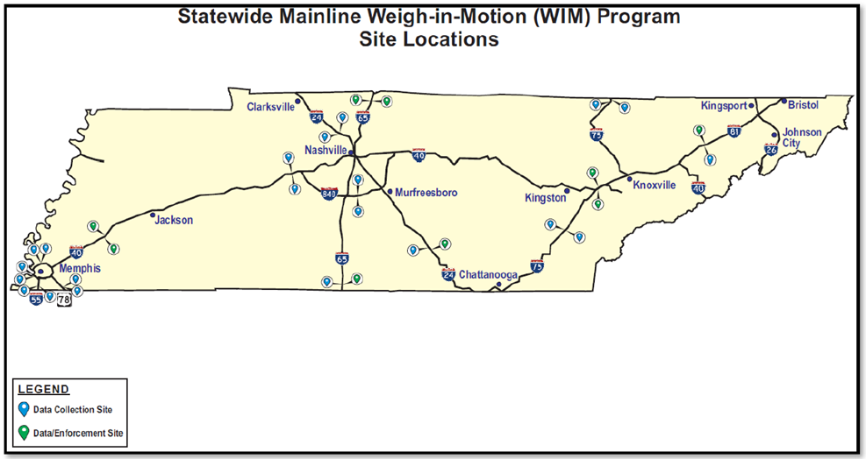
WIM locations Statewide
Source: RK&K Sear Report TDOT
21 Planning Sites / 9 Enforcement Sites to ATSM 1319 TYPE III Stds

Slide 9
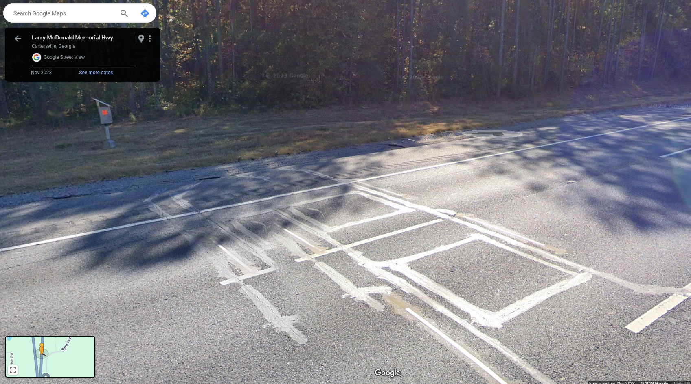
Georgia WIM example
Cabinet/solar
Panel
Inductive loop
WIM Sensor
Inductive loop
WIM Sensor
Georgia WIM

Slide 10
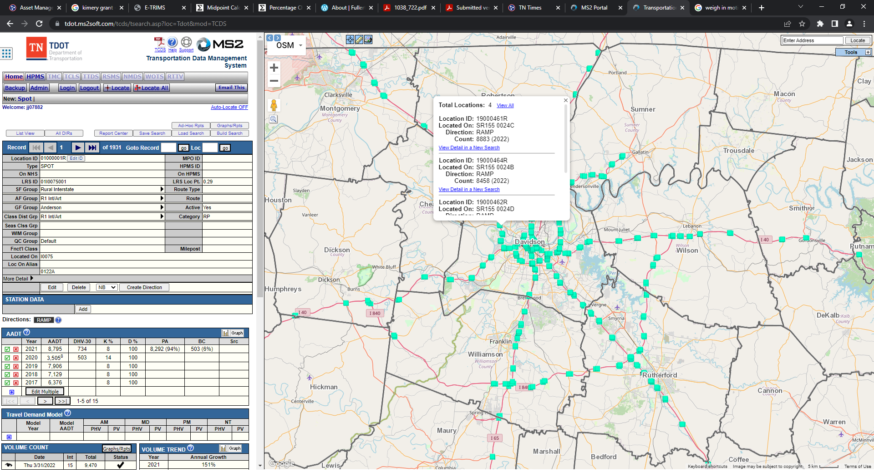
WIM Data Storage - TN-TIMES
TN TIMES
TN Traffic Information Management and Evaluation System
Storage of Traffic Data
  Volume
  Class
  Speed
  Weight
Reports/ Reporting tools
Graphs and Charts
Data downloads
Federal Reporting

Slide 11
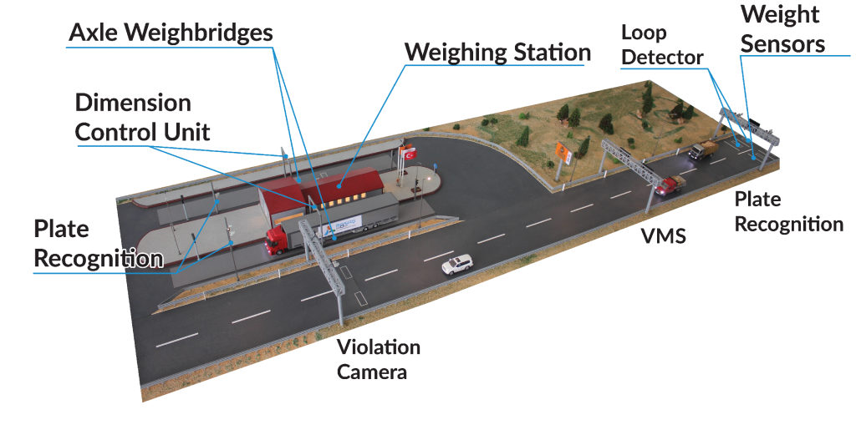
Enforcement Sites
YouTube Video Enforcement

Slide 12

WIM Installation Progress (to date)
Installation started in 2024
Potential completion 2026
28 sites – Interstate/ SR
WIM Sensors, conduit, cabinets, wires
Poles, Cabinets, Power
18 sensors installed (04/29/2025)
Connection to TNTIMES
Auto-polled Data
Calibration
Enforcement

Slide 13

Questions

