Slide 1
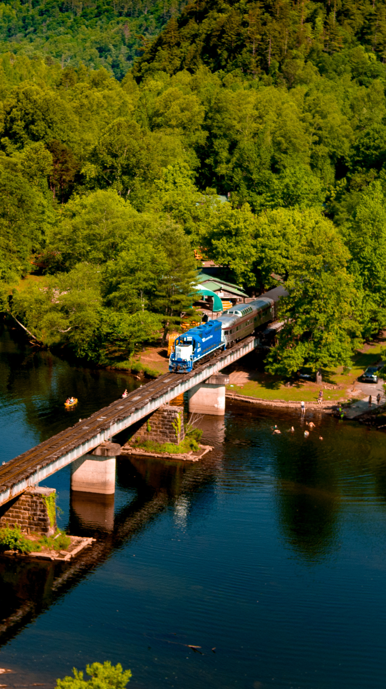
Tennessee State Rail Plan
Tennessee Short Line Railroads Meeting
Dan Pallme, TDOT Keith Bucklew, HDR
04/10/2025
Notes:
Add speakers, Dan and Keith to this slide

Slide 2
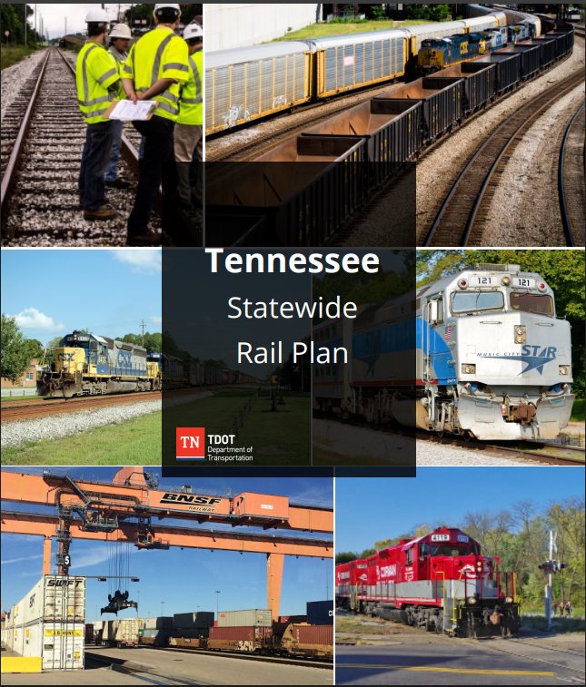

State Rail Plans (SRPs)
Published and presented to FRA
  Stand-alone document
  Combined with Statewide Freight Plan
  Element of the State Long-Range Transportation Plan
States must establish or designate a
State Rail Transportation Authority
Includes freight and passenger
(intercity and commuter) rail
Basis for federal and state rail investments
Notes:
Single Rail Photo here

Slide 3
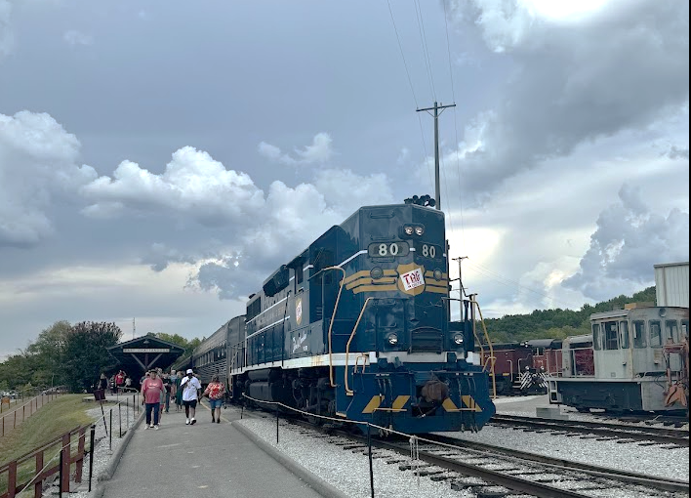
State Rail Plan
Establishing state policy involving freight and passenger rail transportation, including commuter rail operations, in the State
Establishing the period covered by the
State rail plan (four years);
Presenting priorities and strategies to enhance
rail service in the state that benefits the public
Includes projects to be eligible for federal funding from competitive discretionary grant programs
Serves as the basis for federal and state
rail investments
Under 49 U.S. Code Chapter 227, each state prepares and maintains a state rail plan as a means for

Slide 4
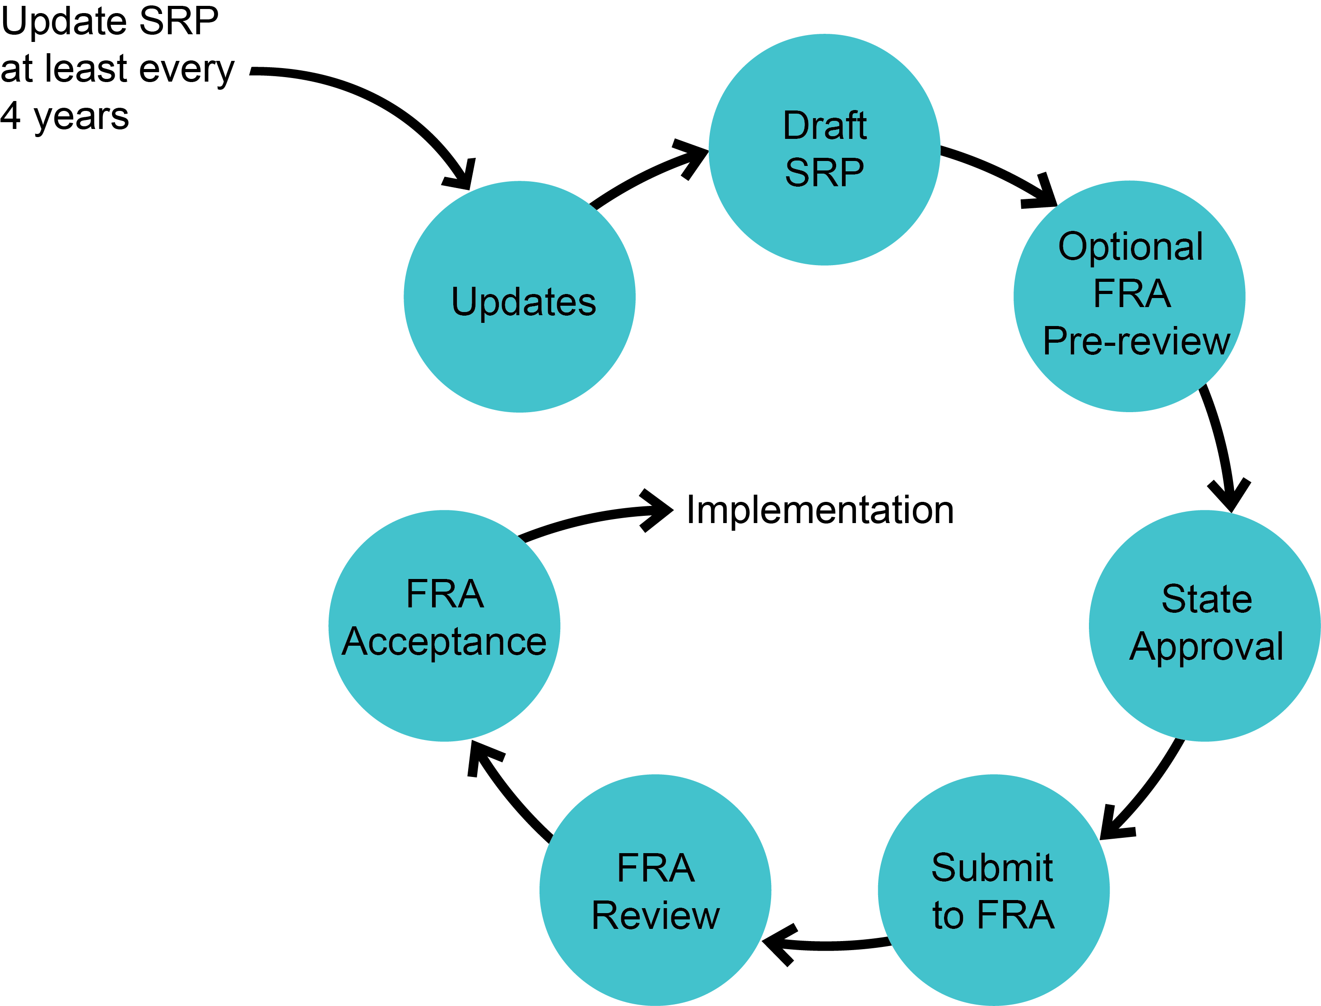
State Rail Plan Preparation Process

Slide 5
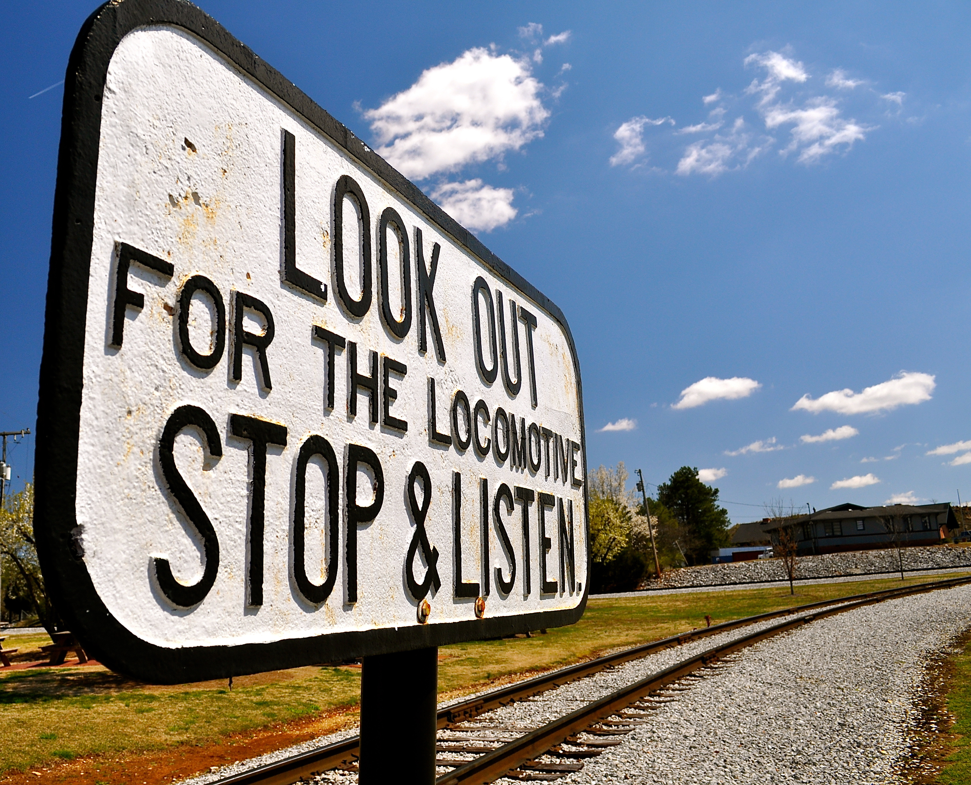
Required SRP Content
(per Final FRA SRP Guidance – 09/2013)
EX | Executive Summary
Ch. 1 | The Role of Rail in Statewide Transportation (Overview)
Ch. 2 | The State’s Existing Rail System Description and Inventory Trends & Forecasts Rail Service Needs & Opportunities
Ch. 3 | Proposed Passenger Rail Improvements & Investments
Ch. 4 | Proposed Freight Rail Improvements & Investments
Ch. 5 | The State’s Rail Service Investment Program
Ch. 6 | Coordination & Review
TA | Technical Appendix

Slide 6
Rail Plan Schedule
Task | 2025 |  |  |  |  |  |  |  |  |  |  |  | 2026
 | Jan | Feb | Mar | Apr | May | Jun | Jul | Aug | Sep | Oct | Nov | Dec | Jan | Feb
0. Project Management
1. State's Vision & Role in Rail
2. Existing Rail System
3. Impacts of Rail
4. Trends and Forecasts
5. Passenger Rail
6. Freight Rail
7. Rail Service/Investment
8. Coordination and Review
9. Final Report

Slide 7
Questions

Slide 8

State Policies
Which affect you positively?
Which affect you negatively?

Slide 9

State Programs
Which affect you positively?
Which affect you negatively?

Slide 10
What are your most immediate or pressing needs?
Infrastructure – Rehab/replace/preservation
Funding
Workforce
Connectivity –
Class I Rail, Trucking, other?
Safety –
At-grade crossings, blocking roadways, other?
Operational costs
Equipment availability
Notes:
Build out digital survey for feedback – Slido? Forms?

Slide 11

Business Forecast
What do you see as opportunities for growth?
What shippers and commodities are driving the increases?
What are the potential business losses?
Have you developed grant applications before?
Other comments?

