Slide 1
Payment Processing for Consultant Engineering Contracts
Finance Division

Slide 2
Project Specific and Continuing Consultants contracts

Slide 3
Introduction
Invoice Requirements
Checklist
Invoice Template

Slide 4
Invoice Requirements
1. Supplier Name
2. Supplier contact information
3. Supplier Remit to Address
4. TDOT State project number and PIN number- In case of Multiple Projects, the invoice has to specify the amount to charge against each project.
5. Federal Project number if applicable
Ex: STP-NHE-1(150)
6. TDOT Contract Number, and work order # if it is an “On Call” Contract
7. Invoice Date

Slide 5
Requirements Cont’d.
8. Unique Invoice number: Should be assigned by the Supplier.
9. Invoice must indicate whether it is a partial or final billing. If you are going to submit a Final Invoice, make sure that you have received Payment for all previous invoices.
10. Pay terms: If terms are stated on invoice, we will follow them; for example an invoice approved by Finance with Net 30 terms, payment will be released 30 days from the invoice date.

Slide 6
Requirements Cont’d.
11. Total Amount Due of Invoice.
12. Billing Period/Service Period: All Charges must be within the Contract Terms.
13. Previously Invoiced Amount: If the vendor includes the previously invoiced amount on the invoice, this amount should reflect the correct amount billed to date net of any disallowance.
14. Invoice must be signed by a company representative.

Slide 7
Personal Identifying Information
2 CFR 200.82: All personal identifying information (PII) must be removed from invoices.
2016 PC 722 adds paragraph 28 to TCA 10-7-504 as follows (effective July 1, 2016)
(C) For purposes of this subdivision (28), “personally identifying information” means:
(i) Social Security Numbers
(ii) Official state or government issued driver licenses or identification numbers
(iii) Alien registration numbers or passport numbers
(iv) Employer or taxpayer identification numbers
(v) Unique biometric data, such as fingerprints, voice prints, retina or iris images,
or other unique physical representations
(vi) Unique electronic identification numbers, addresses, routing codes or other
personal identifying data which enables an individual to obtain merchandise
or service or to otherwise financially encumber the legitimate possessor of the identifying data.

Slide 8
Supporting Documentation
15. The invoice must summarize by cost/expense category the total amount being billed and the documents that support a given cost category must accompany the invoice.

Slide 9
Supporting Documentation
Our templates provide the minimum amount of information required for invoices to be approved. Independent schedules and logs may be substituted for the templates, as long as they provide the required information.

Slide 10
Invoice Summary Page

Slide 11
Cost/Expense Categories
16. Labor Schedule – employee name and/ or employee ID, title, rate of pay, number of hours, date(s) worked, and total.
Note: Overtime( premium Labor) should be listed as a direct cost and not labor charges.
17. Burden Benefits – itemized reports from payroll or accounting systems.

Slide 12
Direct Labor Summary

Slide 13
Direct Labor Log

Slide 14
Cost/Expense Categories
18. Equipment – logs or summaries of equipment usage that includes the date, description of equipment, usage rate, and total. If rental equipment is utilized, then invoices must accompany the log.

Slide 15
Cost/Expense Categories
19. Materials & Supplies –Itemized statements detailing the items purchased or used.
A. If materials/supplies/minor materials are supplied from company stores, then an itemized statement detailing the part, unit cost, quantity, and date are needed.
B. If materials/supplies/minor materials are purchased for a project, then copies of invoices for materials are needed.

Slide 16
Cost/Expense Categories
20. Business Expenses – copies of receipts are needed. Travel expenses or phone charges should not be included here.
21. Phone Charges- copy of bill/receipt and purpose, if the charges are not included in overhead costs.

Slide 17
Cost/Expense Categories
22. Overhead – Consulting engineer
The rate used and/or the method of allocation must be stated on the invoice and the overhead rate used must be in effect as of the date of the invoice.

Slide 18
Overhead Rate
23 CFR 172.11(b)(1)
(1) Indirect cost rates. (i) Indirect cost rates shall be updated on an annual basis in accordance with the consultant’s annual accounting period and in compliance with the Federal cost principles.
23 USC 112(b)(2)(D)
A. Application of Rates.- Once a firm's indirect cost rates are accepted under this paragraph, the recipient of the funds shall apply such rates for the purpose of contract estimation, negotiation, administration, reporting, and contract payment and shall not be limited by administrative ceilings of any kind.

Slide 19
Overhead Rate
Indirect cost rate will be validated by the TDOT division before approving the invoice for payment.
Unlimited Prequalification Status
Requires Annual Audited Rate Approved by TDOT
Federal Funds in Contract – Use Federally Funded Rate
100% State Funds – Capped at 145%
Limited (Contracts of $150,000) Prequalification Status
Requires Self-Certified Annual Rate Prepared in Accordance with AASHTO Guidelines
Maximum Rate of 125%

Slide 20
Cost/Expense Categories
23. Net Fee: The Formula used to calculate the Net Fee must be shown on the invoice. TDOT will not process an invoice billed on Net fee out of Cost.
24. Subcontractor Invoices: costs shall be listed on a separate schedule and not included in the Direct Costs schedule. Also the same level of detail must be provided on the copy of Sub- Consultant invoices.

Slide 21
Subcontractor Invoices

Slide 22
Mileage, Travel Expenses, & Meals
25. Check the updated travel rates using the State of TN Comprehensive Travel Regulations.
The Department of Finance and Administration’s Comprehensive Travel Regulations:
https://www.tn.gov/content/dam/tn/finance/documents/fa_policies/policy8.pdf

Slide 23
Mileage, Travel Expenses, & Meals
State of Tennessee Comprehensive Travel Regulations define guidelines for:
Lodging
Travel with personally owned automobile
Parking
Per Diem Rates for Meals/Incidentals
Per Diem Rates for three-fourths Calculations
Other Travel Related Items

Slide 24
Mileage, Travel Expenses, & Meals
26. Mileage logs
Employee name
Date(s) of travel
Beginning and ending location
Number of miles
Rate
Purpose of travel
Note: The travel regulation would state the approved mileage rate that can be charged, but the log must be included.

Slide 25
Direct Costs

Slide 26
Mileage Log

Slide 27
Mileage, Travel Expenses, & Meals
27. Travel expenses (meals, per diem, hotel rates, etc.) must be in accordance with the State travel regulations. An example of support could be a detailed expense report or copies of lodging and meal receipts. All travel charges have to be incurred.
28. If a subcontractor has travel expenses, reimbursement will be according to State of TN Travel Regulations.
29. Do Not include Personal Private Information (ssn, tax information, bank or credit card info, etc.)
30. All supporting documentation must be legible. No “highlighting” that may result in copies not being legible.

Slide 28
Vendor Contact Information
All new vendors must complete a W-9 form. We need this information to set up an account on our database.
Vendors may choose to be paid by check or ACH (electronically). An ACH payment is directly deposited into the vendor bank account and it is a faster, more secure, and the preferred method of payment.
Notify the Finance division immediately of changes in the remittance address or banking information. Incorrect information can result in “cancel and reissue” payments. This is a complicated process and delays payments for several weeks.

Slide 29
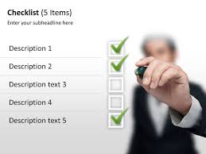
Summary
Check all addition and mathematical calculations.
Our office will use the industry standard in regard to “rounding” being three decimals (i.e. $1,080.927 will be considered $1,080.93)
Supporting documentation should be validated per invoicing requirements

Slide 30
Summary
The division should not mark invoices up, with the exception of pennies for rounding differences. If significant changes are necessary, an updated invoice should be requested from the vendor.
Do not alter an invoice number- Invoice numbers can only be used once. A rejected number indicates that it has been entered before. Edison will not allow to re-use the same invoice # for the same vendor.
Check the updated invoice template.

Slide 31
Conclusion
Our goal is to get invoices paid correctly and in a timely manner which can be achieved by a collective team effort between Suppliers, TDOT Program areas, and Finance Division.

Slide 32
OMB Uniform Guidance 2 CFR Part 200
2 CFR Part 200 states “To be allowable under Federal awards, costs must meet the following general criteria:
1. Be necessary and reasonable for proper and efficient performance and administration of Federal awards.
2. Be allocable to Federal awards under the provisions of this Circular.
3. Be authorized or not prohibited under State or local laws or regulations.

Slide 33
OMB Uniform Guidance 2 CFR Part 200
4. Conform to any limitations or exclusions set forth in these principles, Federal laws, terms and conditions of the Federal award, or other governing regulations as to types or amounts of cost items.
5. Be consistent with policies, regulations, and procedures that apply uniformly to both Federal awards and other activities of the governmental unit.

Slide 34
OMB Uniform Guidance 2 CFR Part 200
6. Be accorded consistent treatment. A cost may not be assigned to a Federal award as a direct cost if any other cost incurred for the same purpose in like circumstances has been allocated to the Federal award as an indirect cost.
7. Except as otherwise provided for in this Circular, be determined in accordance with generally accepted accounting principles.

Slide 35
OMB Uniform Guidance 2 CFR Part 200
8. Not be included as a cost or used to meet cost sharing or matching requirements of any other Federal award in either the current or a prior period, except as specifically provided by Federal law or regulation.
9. Be the net of all applicable credits.
10. Be adequately documented.

Slide 36
2 CFR § 200.53: Improper Payment
Any payment that should not have been made or that was made in an incorrect amount (including overpayments and underpayments) under statutory, contractual, administrative, or other legally applicable requirements
Any payment to an ineligible party
Any payment for an ineligible good or service
Any duplicate payment
Any payment for a good or service not received (except for payments where authorized by law)
Any payment that does not account for credit for applicable discounts
Any payment where insufficient or lack of documentation prevents a reviewer from discerning whether a payment was proper.

Slide 37
Consultant Services
Consultant services are funded in whole, or in part, with Federal aid
Highway program funds shall be procured and administered in accordance with the requirements of Uniform Administrative Requirements, Cost Principles, and Audit Requirements for Federal Awards (2 CFR 200.)
In addition, contracts for engineering and design related services which utilize Federal-aid highway program funds and are directly related to a planned construction project must also comply with the requirements established in 23 U.S.C. §112 and 23 CFR 172.
This website provides the statutory and regulatory framework, Federal Highway Administration (FHWA) policies, and supporting guidance and resources.
https://www.fhwa.dot.gov/programadmin/consultant.cfm

Slide 38
Questions

Slide 39
Audit Overview
TDOT External Audit Staff
Types of Audits
TDOT Overhead Rate Approval Process

Slide 40
External Audit Staff
Andrea Lucado
Carla Spann
Dorota Sek
Gabrielle McGurr
Medhat Eldahaby
Victoria Haendel

Slide 41
Types of Audits
Contract Compliance Audits
Field Audit
Desk Review
Indirect Cost Rate (Overhead) Audits
Field Audit
Desk Review
Review of CPA Audit / CPA Workpapers

Slide 42
Overhead Rate Approval Process
Out of State Firms
Current Indirect Cost Rate Auditors Report Including Indirect Cost Schedule Prepared in Accordance with AASHTO Guidelines
Current Internal Control Questionnaire
Complete FHWA Contractor Certification of Costs
A Cognizant Letter, If One Was Provided
Dollar Amount of Direct Overtime Premium And Location on Schedule (Template Available)
Note – Indirect Cost Rates Expire on June 30th.

Slide 43
Overhead Rate Approval Process
In-State Firms – CPA Audit
Current Indirect Cost Rate Auditors Report Including Indirect Cost Schedule Prepared in Accordance with AASHTO Guidelines
Current Internal Control Questionnaire
Complete FHWA Contractor Certification of Costs
Dollar Amount of Direct Overtime Premium And Location on Schedule (Template Available)
If Cognizant Letter is Needed – CPA Workpaper Review Program
Note – Indirect Cost Rates Expire on June 30th.

Slide 44
Overhead Rate Approval Process
In-State Firms – TDOT Audit
January/February – TDOT Develops Audit Plan and Makes Initial Contact
Submit Pre-Audit Package - March 31st
Assigned to Auditor
Auditor Proceeds With Desk Review or Field Audit
Field Audits Scheduled Starting in April
Field Audits – 4/5 Days On-Site
Final Report with TDOT Approval Letter Issued
Indirect Cost Rates Expire on June 30th

Slide 45
Overhead Rate Approval Process
Pre-Audit Package
Pre-Audit Template
Internal Control Questionnaire
Depreciation Schedules
Form 941/Quarterly Labor Reports
W-3
Year End Payroll Summary
Trial Balance
Chart of Accounts
Sample of Completed Timesheets
Policies for Vacation and Sick Leave
Job Cost Labor Report and Labor Utilization Report
Yearly Statements for Employee Insurance Coverage
Compensation Plan for Owners
Listing of All Jobs
General Ledger
Income Statement
Statement of Cash Flows
Written Bonus Policy
Written Accounting Policies

Slide 46
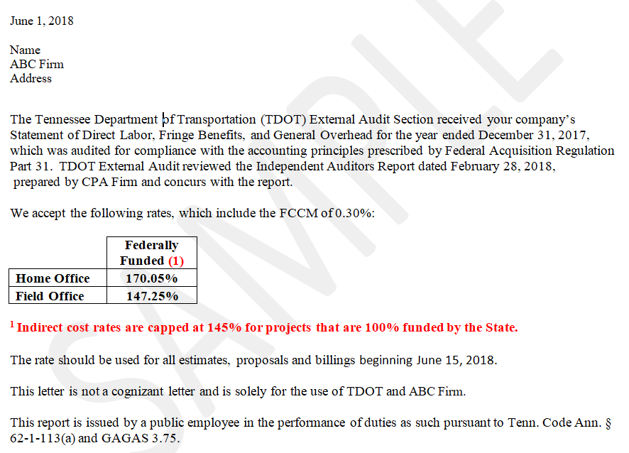
Overhead Approval Letter

Slide 47
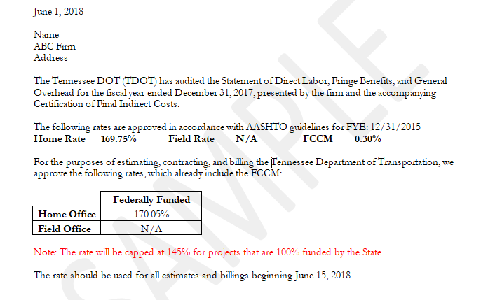
Overhead Approval Letter

Slide 48
Questions

