Slide 1
ROW Engineering Training
Hosted by Region 3
January 14th, 2026

Slide 2

TRAINING GOALS
To provide a high-level understanding of the ROW and Design delivery processes.
To provide a more detailed understanding of how a ROW Engineer functions within the ROW and Design delivery processes.

Slide 3
TRAINING AGENDA ITEMS
Review Essential Responsibilities
Overview of the PDN and Overall Delivery Processes
Line and Grade
Reviewing Plans
Checking Title Reports
Functional Design
ROW Exhibits
Legal Descriptions
Plan Revisions
Plan-in-Hand, PS&E
Excess Land Revisions

Slide 4
Housekeeping
Breaks to be provided, as necessary.
Please hold questions for designated Q/A.

Slide 5
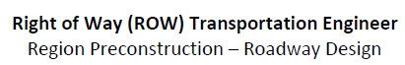

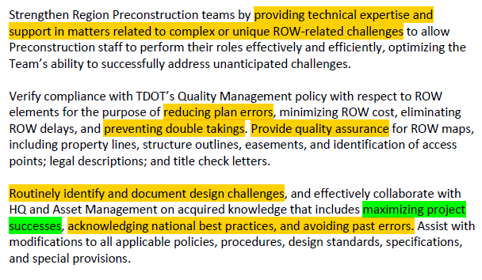
Position Responsibilities

Slide 6
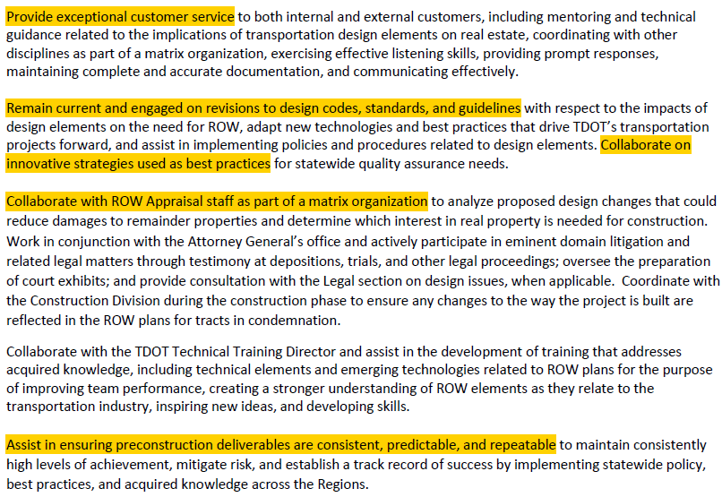
Position Qualities

Slide 7
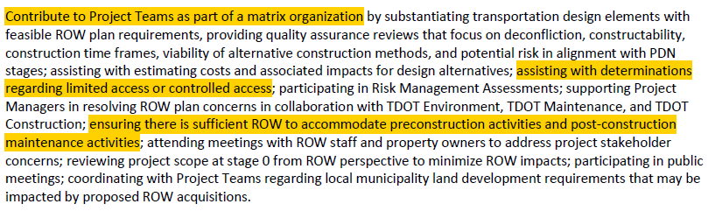
Position Qualities
“Ensure projects have sufficient proposed ROW while identifying and mitigating ROW risks.”

Slide 8
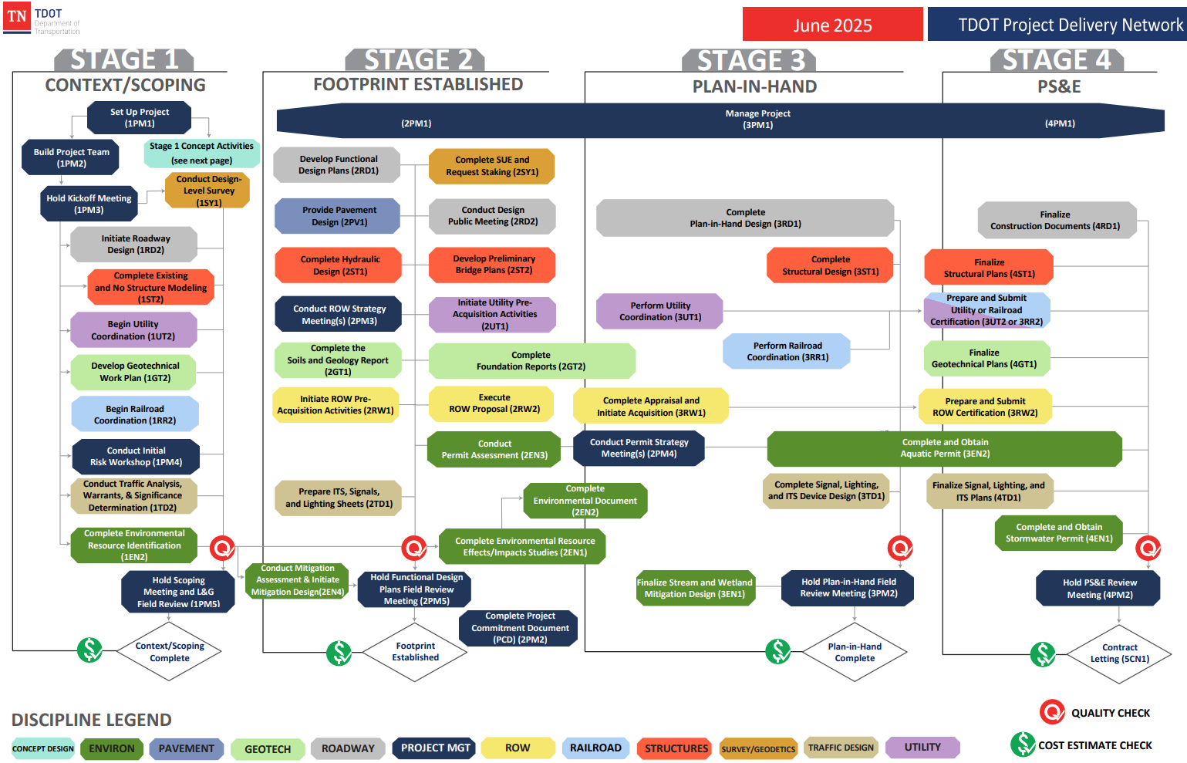
PROJECT DELIVERY NETWORK
Project Delivery Network (PDN)

Slide 9
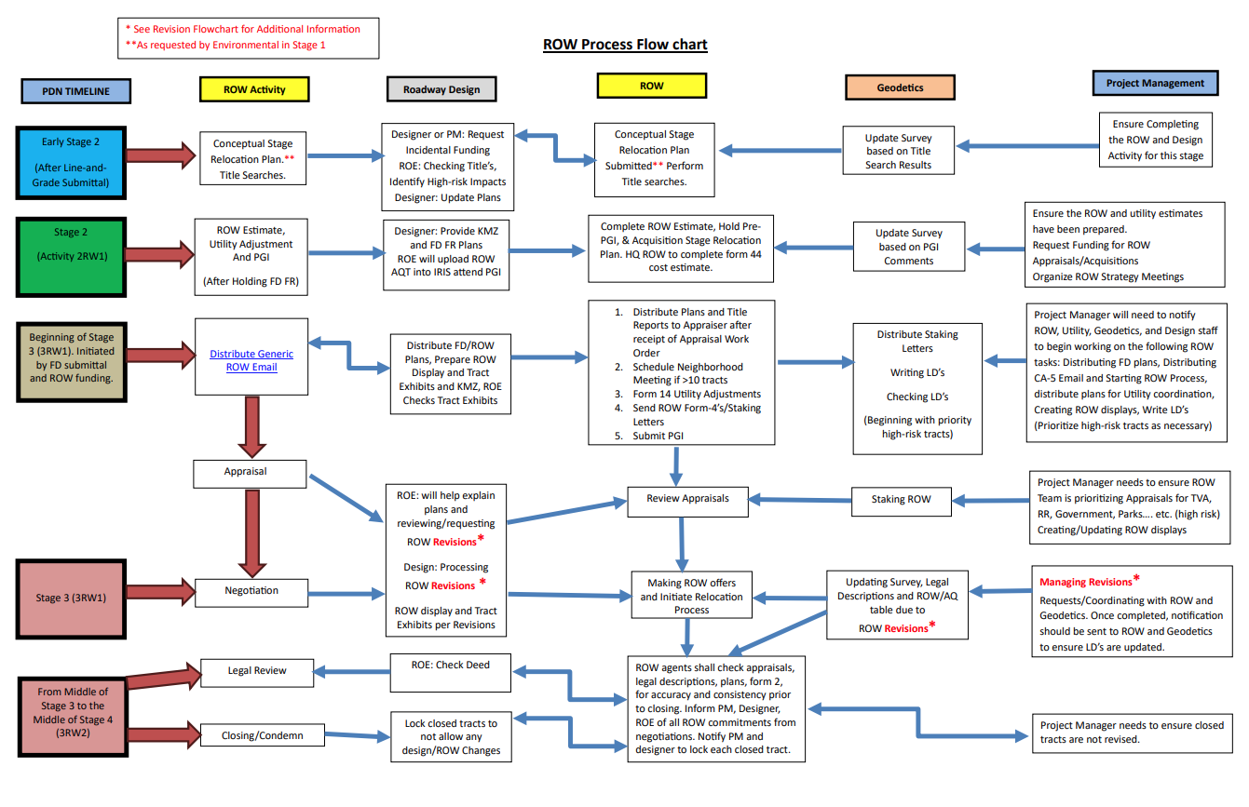
ROW PROCESS FLOWCHART
Design Guidelines - PDN

Slide 10
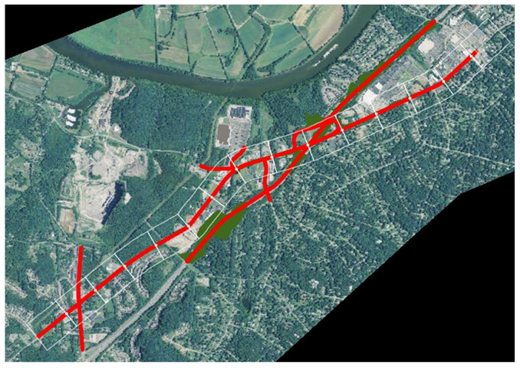
Line and Grade

Slide 11
ROW Engineer’s Goals (L&G)
Help the project team establish the ROW footprint for the project.
Identifying ROW impact risks and high-risk tracts
Reviewing access management
Reviewing constructability
Ensuring properties are shown in their most current conditions.
Property boundaries
Improvements
Septic Systems

Slide 12
ROW Engineer’s Goals (L&G)
Help keep the project within:
Scope
Schedule
Budget

Slide 13
ROW Engineering Resources
TDOT Standard Drawings
TDOT Design Guidelines
TDOT Highway Safety Access Manual
TDOT Driveway Manual
TDOT Standard Spec Book for Road and Bridge Construction
TDOT Design Checklists
AASHTO Greenbook and AASHTO Roadside Design Guide
PROWAG
Tennessee Property Viewer Website and other County Websites

Slide 14

REVIEWING PLANS AS A ROW ENGINEER

Slide 15
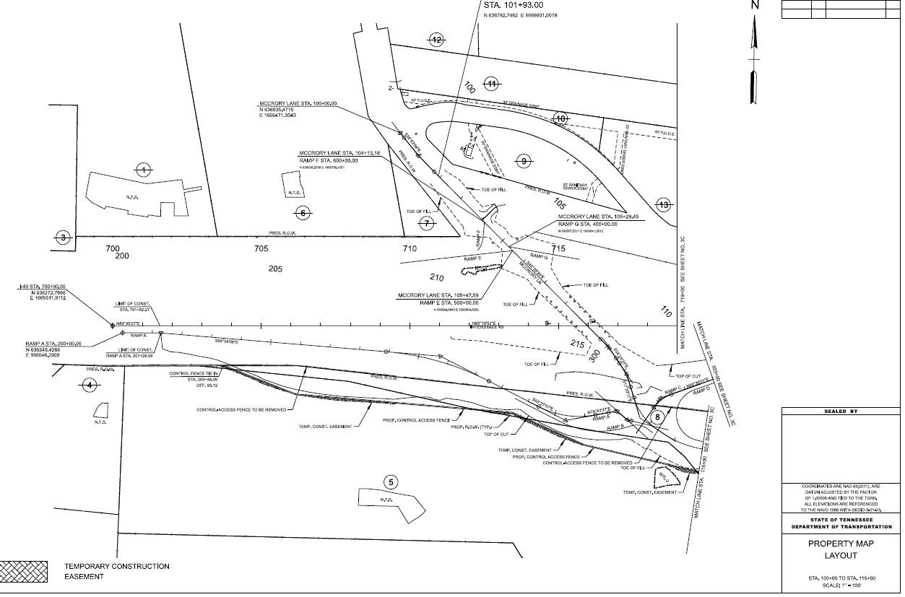
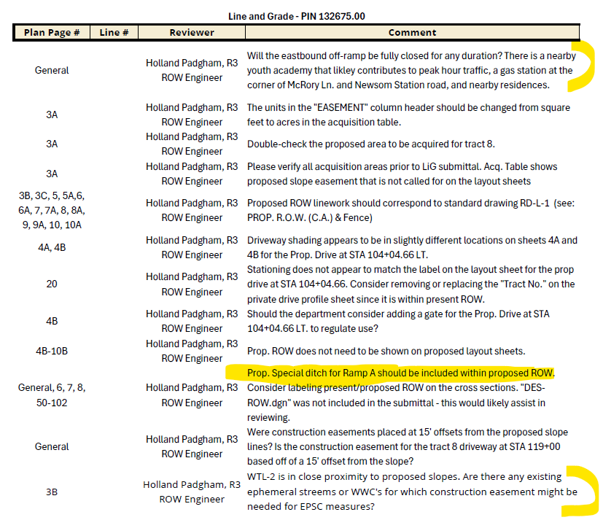
Example of Review Item
RD11TS3A.pdf
RD11TS4.pdf

Slide 16
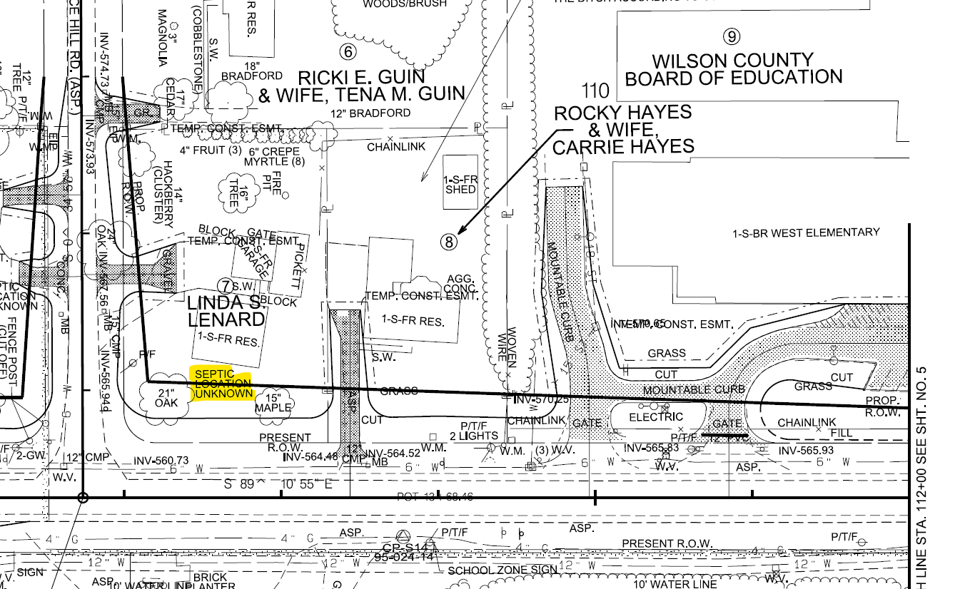
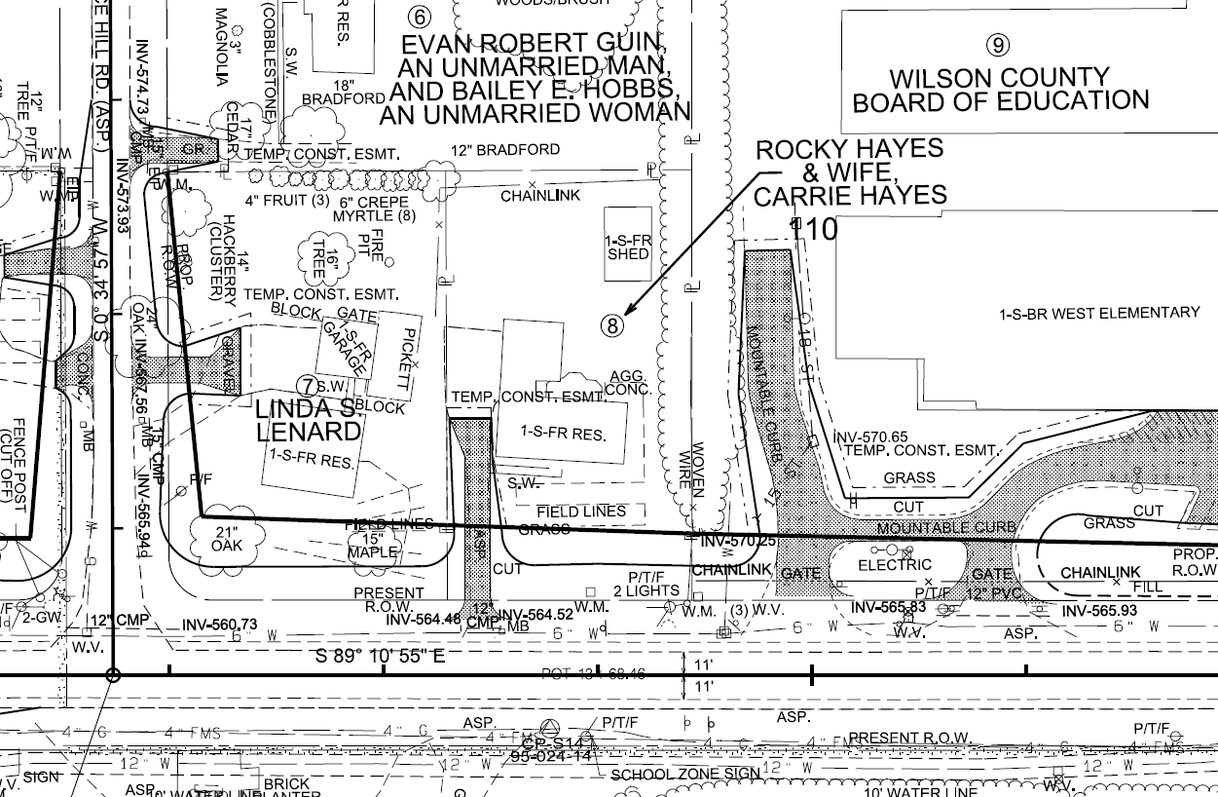
Example of Review Item
SEPTIC SYSTEMS SHOULD BE LOCATED. HIGH RISK IMPACT.

Slide 17
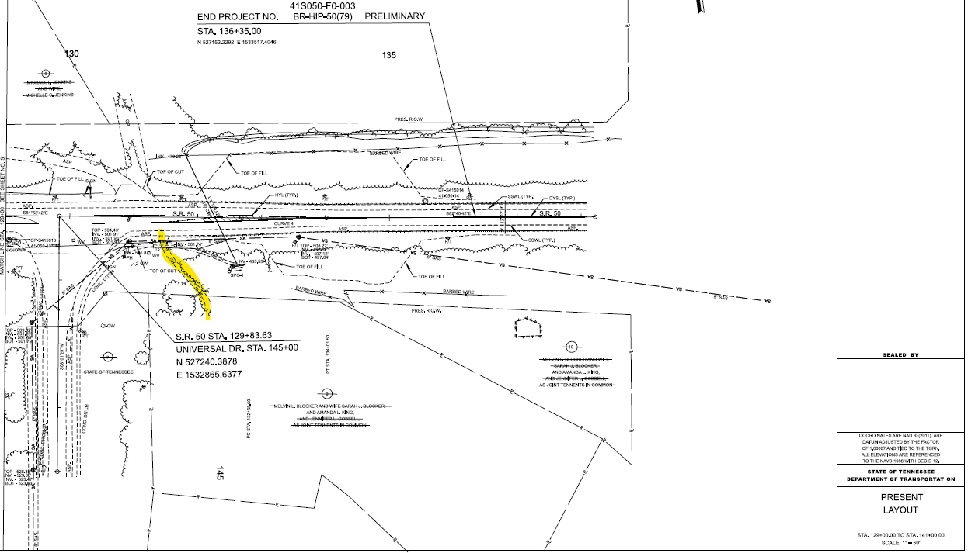
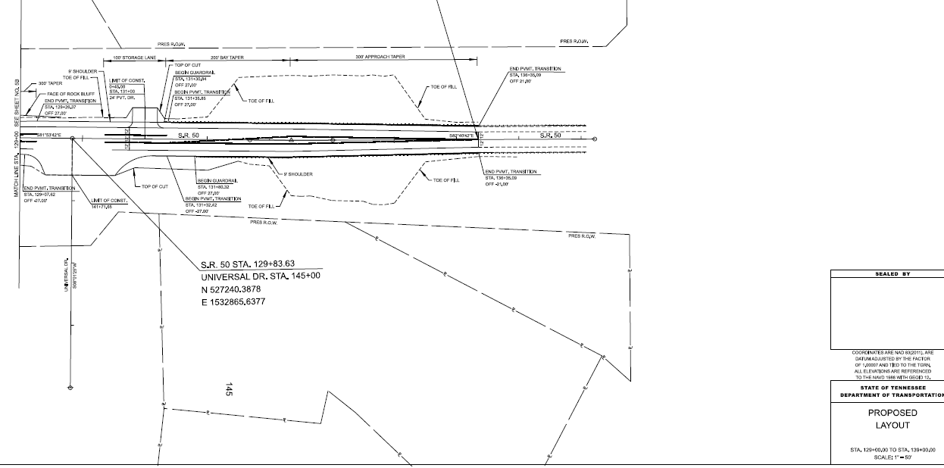
Example of Review Item
STUDY ACCESS MANAGEMENT

Slide 18
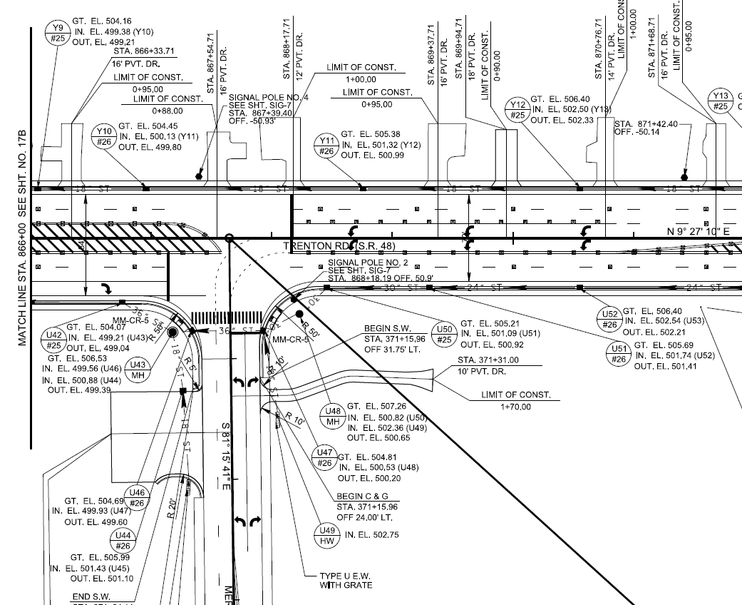
Example of Review Item
STUDY ACCESS MANAGEMENT

Slide 19
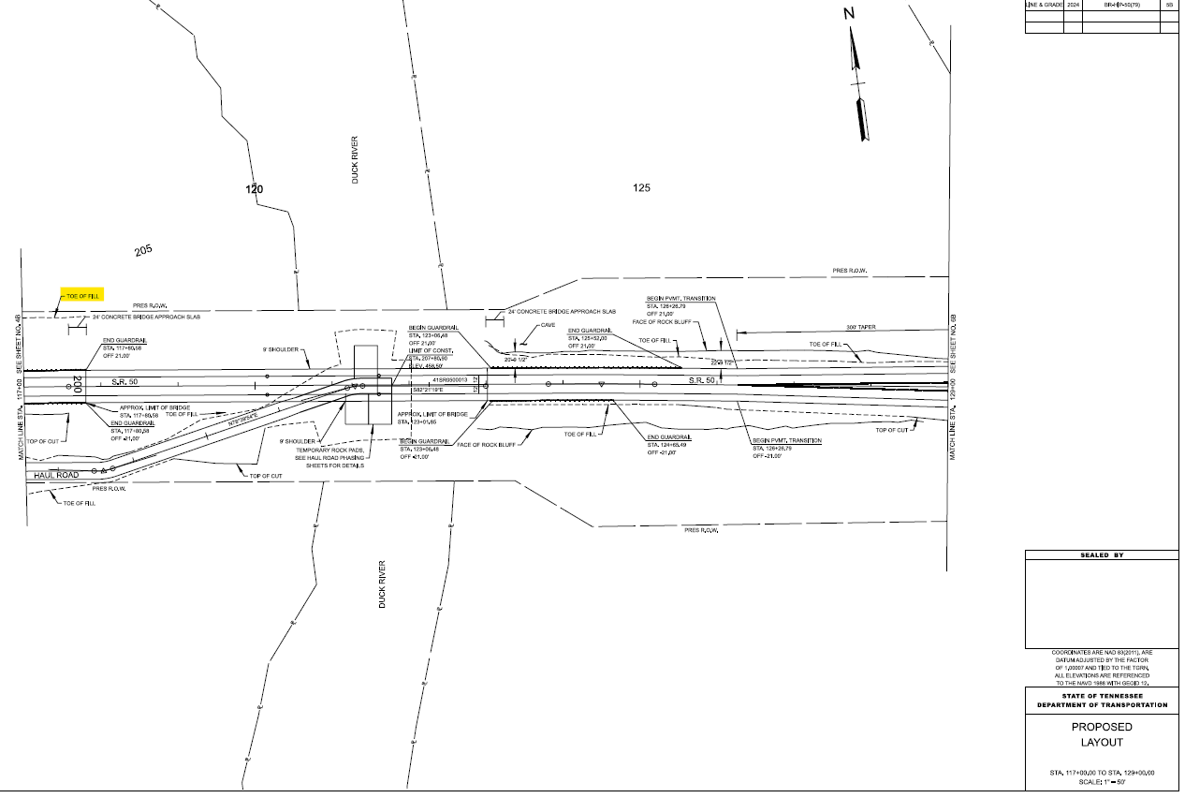
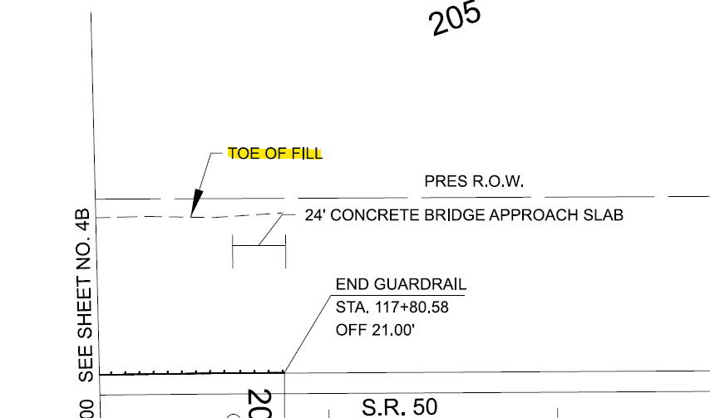
Example of Review Item
NEED FOR PROP. ROW FOR PROP BRIDGE ABUTMENT.

Slide 20
Checking Title Reports
The most current owner name and deed reference for each tract should be included in the roadway plans.
It’s important to check the title reports for:
Plats
Existing Easements (need to be shown in the plans!)
ROW Dedications
Other documents which might affect acquisition

Slide 21
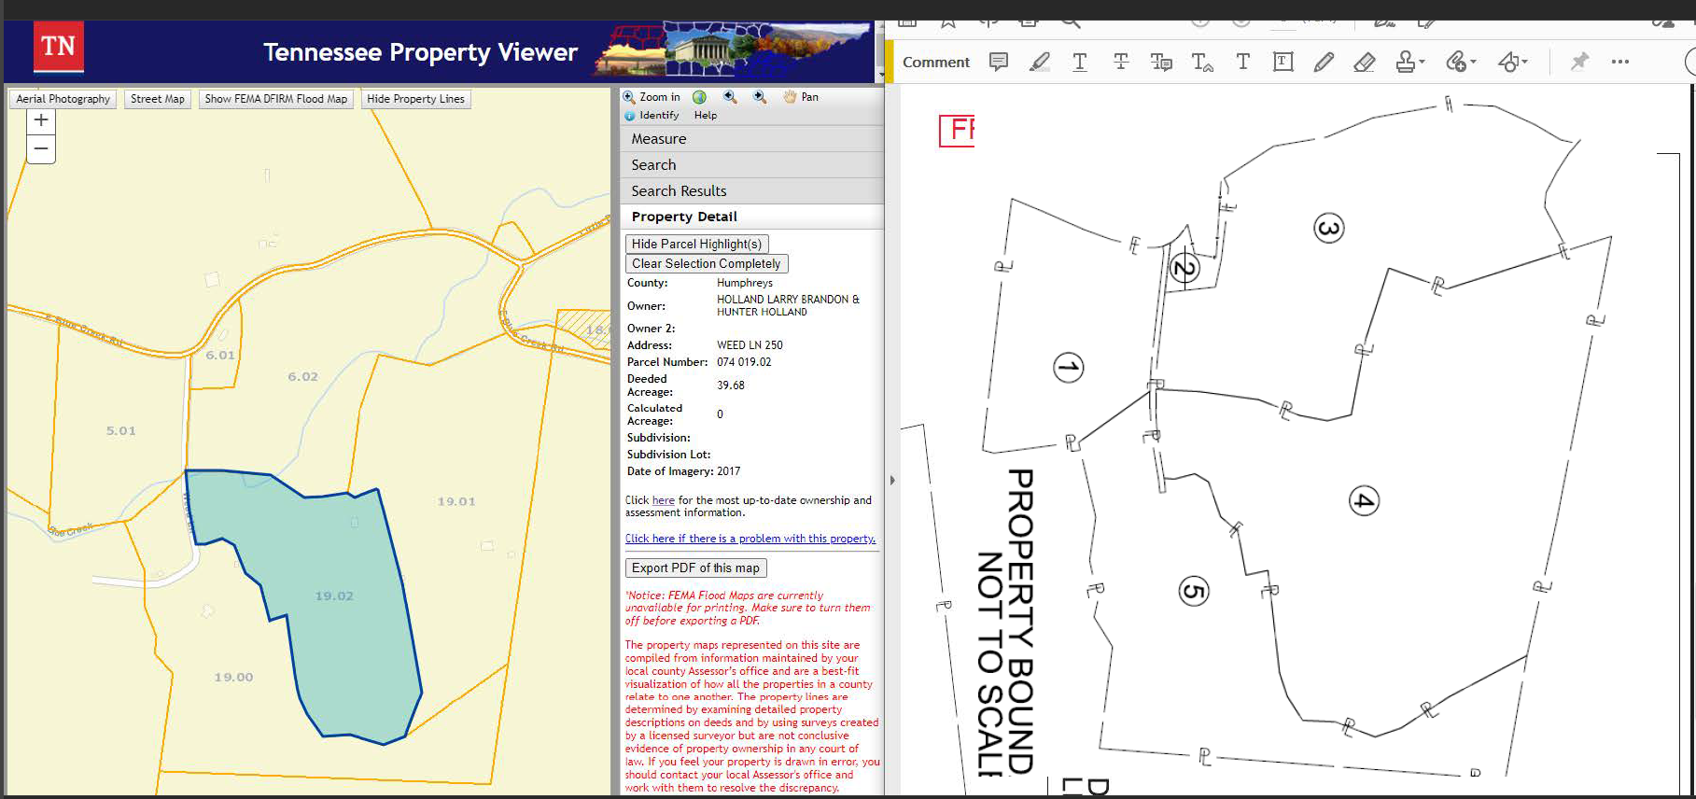
Checking Title Reports
COUNTY WEBSITES AND THE TN PROPERTY VIEWER AID IN CHECKING PROPERTY BOUNDARIES

Slide 22
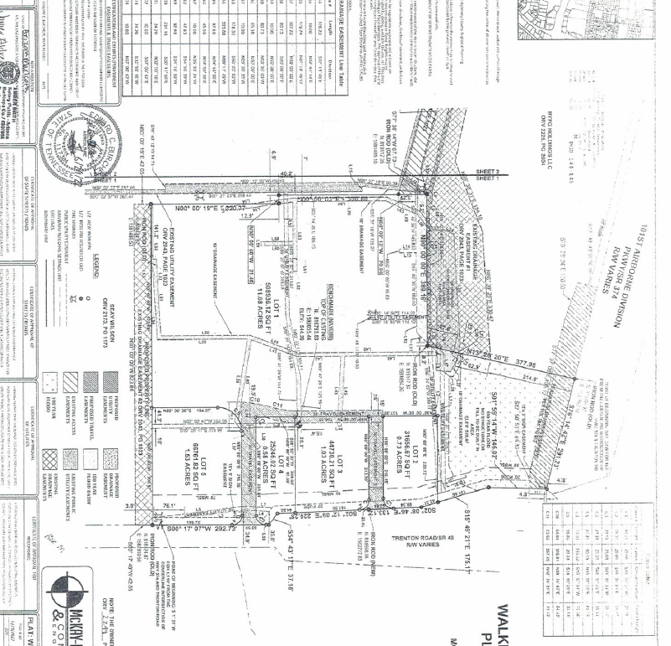
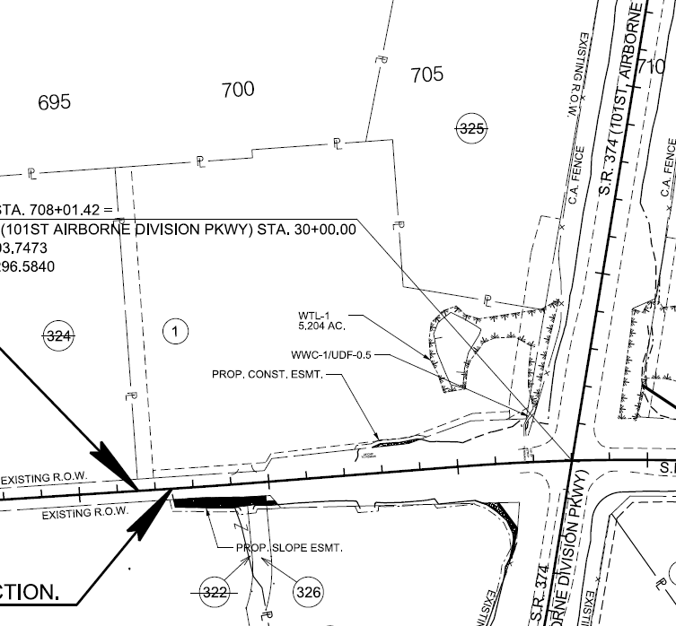
Checking Title Reports
PLANS (LEFT) VS. PLAT (RIGHT) – SURVEY UPDATE REQUIRED

Slide 23
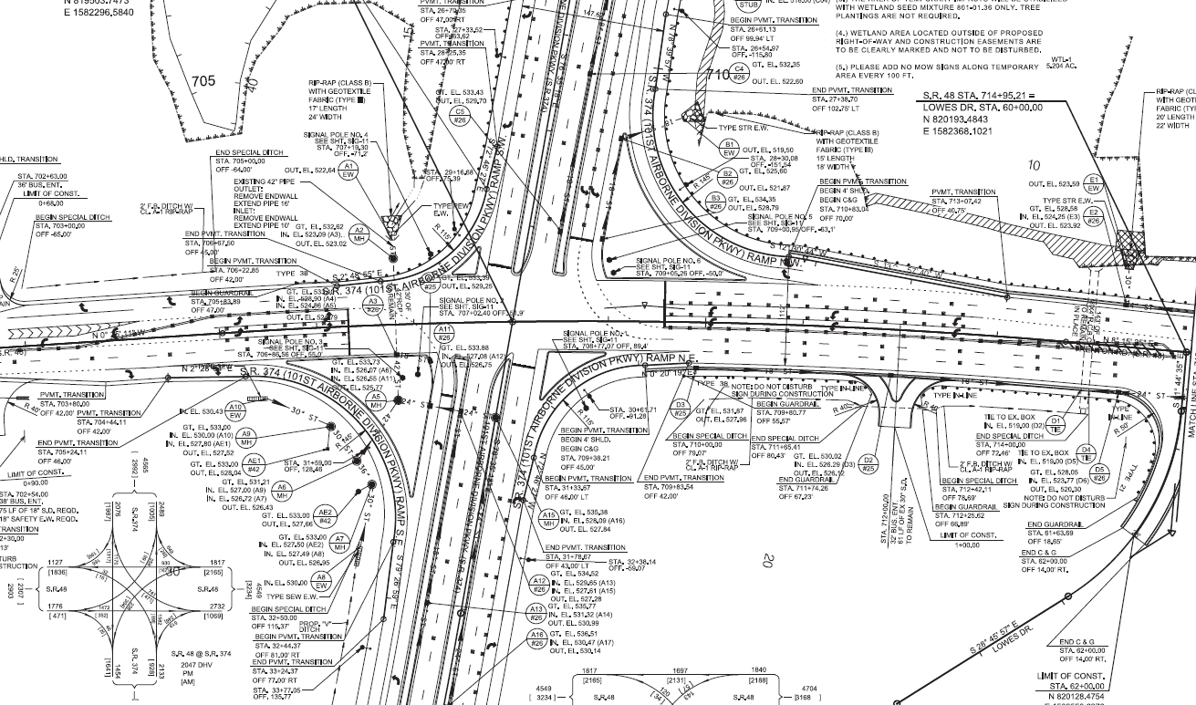
Functional Design
Functional Design

Slide 24
Functional Design
Project Delivery Network (PDN)

Slide 25
ROW Engineer’s Goals (FD)
Ensure ROW acquisition is appropriate for the project.
Identifying ROW impact risks and high-risk tracts
Reviewing access management
Reviewing constructability
Ensuring properties are shown in their most current conditions.
Ownership Information Matches the Title Reports
Property boundaries
Improvements

Slide 26
ROW Engineer’s Goals (FD)
Help keep the project within:
Scope
Schedule
Budget

Slide 27
Reviewing Functional Design Plans
Design Should be Completed
More focused review of ROW impacts on each tract
Checking for sufficient ROW for
EPSC
Traffic Control
Constructability
Drainage

Slide 28
Reviewing Functional Design Plans
(See HP checklist)

Slide 29
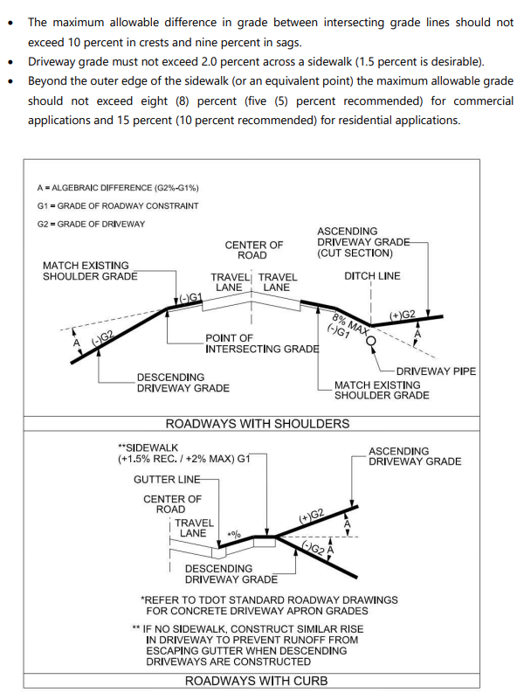
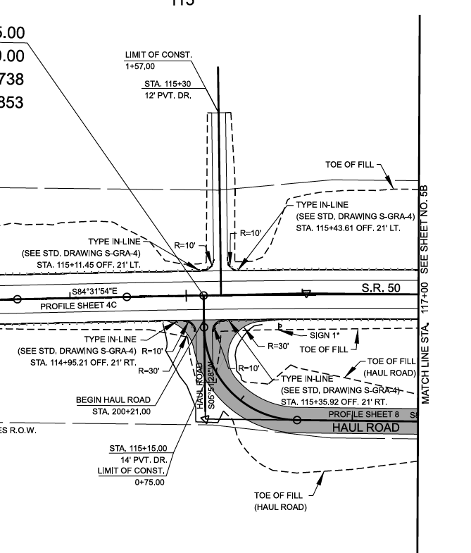
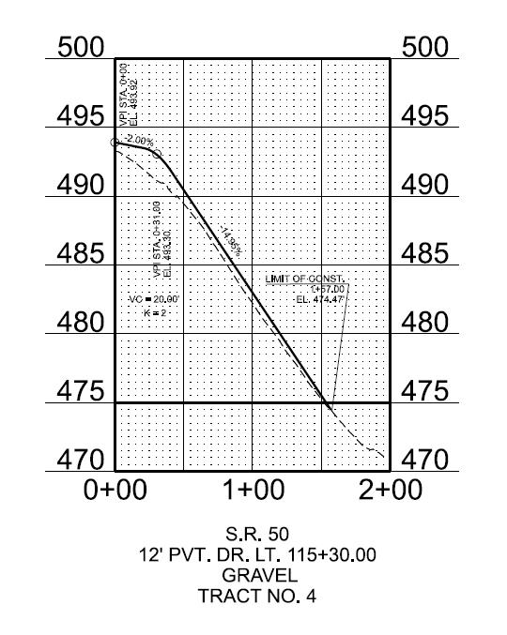
Example of Review Item
FROM HSAM
CONTEXTUAL ENTRANCE DESIGN

Slide 30
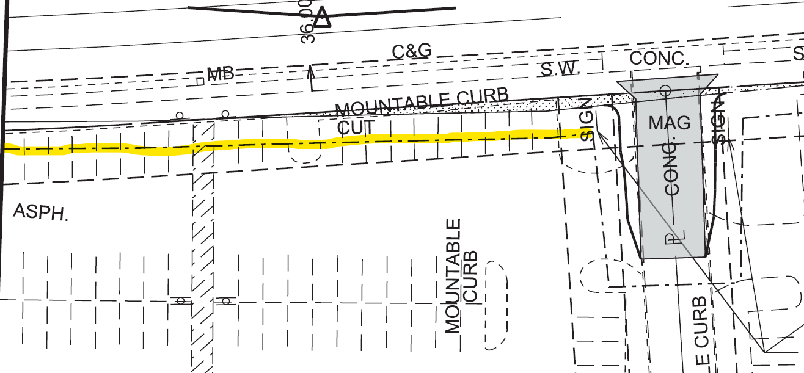
Example of Review Item
SMALL GRAVITY RETAINING WALL (STD. DWG. W-SG-1) COULD PREVENT IMPACTS
WSG1.pdf

Slide 31
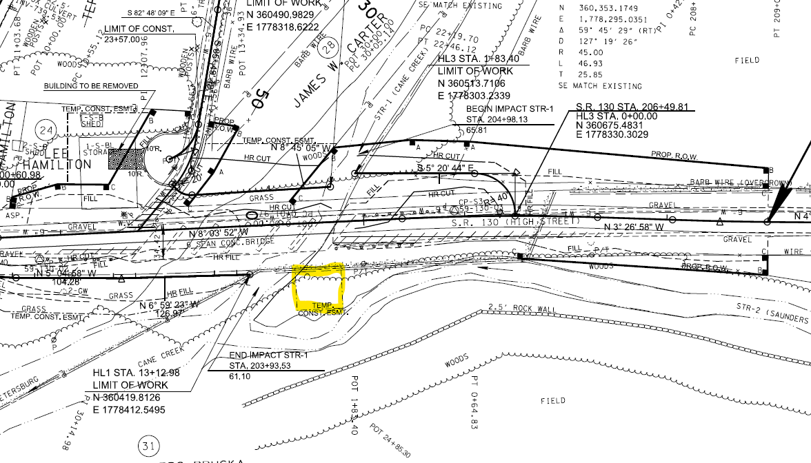
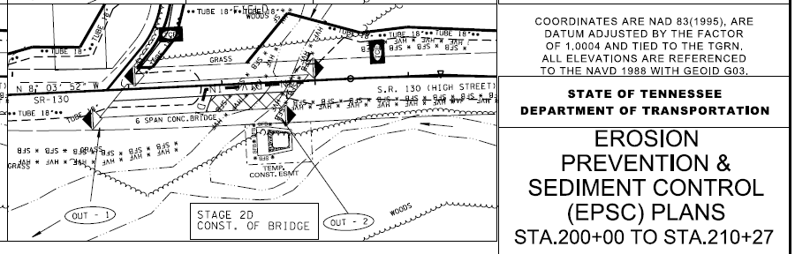
Example of Review Item
ENSURE SUFFICIENT CONST. ESMT FOR EPSC

Slide 32
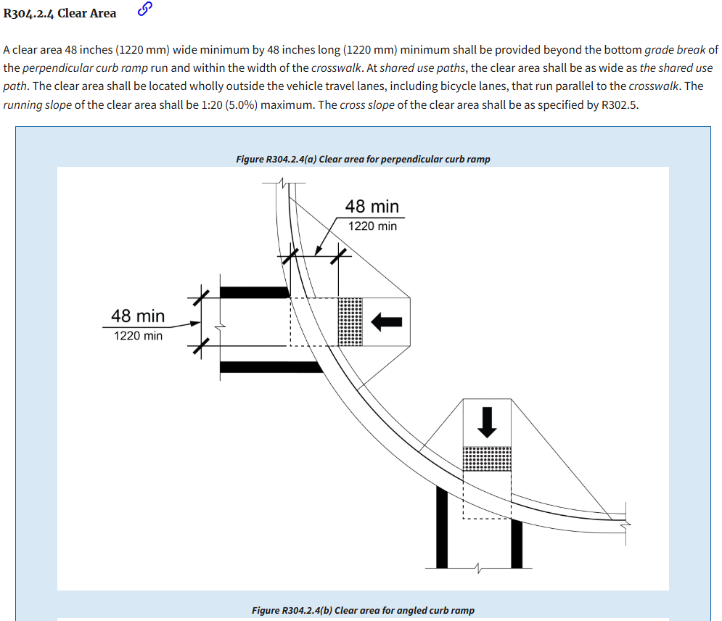
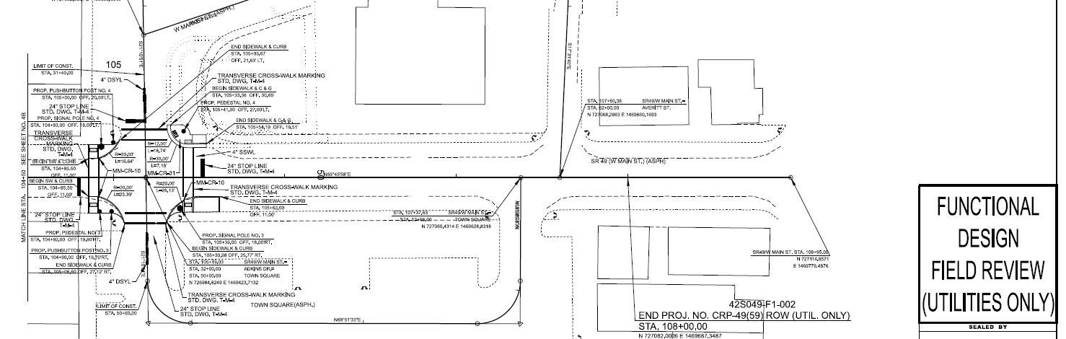
Example of Review Item
(From PROWAG)
PROJECTS WITHOUT ROW ACQUISITION SHOULD STILL BE REVIEWED FOR ROW IMPACTS (DRAINAGE) AND DESIGN COMPLIANCE

Slide 33
ADDITIONAL FUNCTIONAL DESIGN ACTIVITIES
Uploading the ROW Acquisition table to IRIS
Attend Preliminary Group Inspection (PGI)
Visit the project with the ROW team and assist appraisers in developing their PGI report
Recommend hosting a Pre-PGI meeting to review a KMZ of the project before going out in the field
Attend public meetings

Slide 34
ROW Exhibits
Per IB 25-10, TDOT design guidelines contain guidance for ROW Exhibit creation on ORD
Guidance is available for MicroStation at R3
ROW Engineer is to provide Quality Control checks on ROW Exhibits

Slide 35
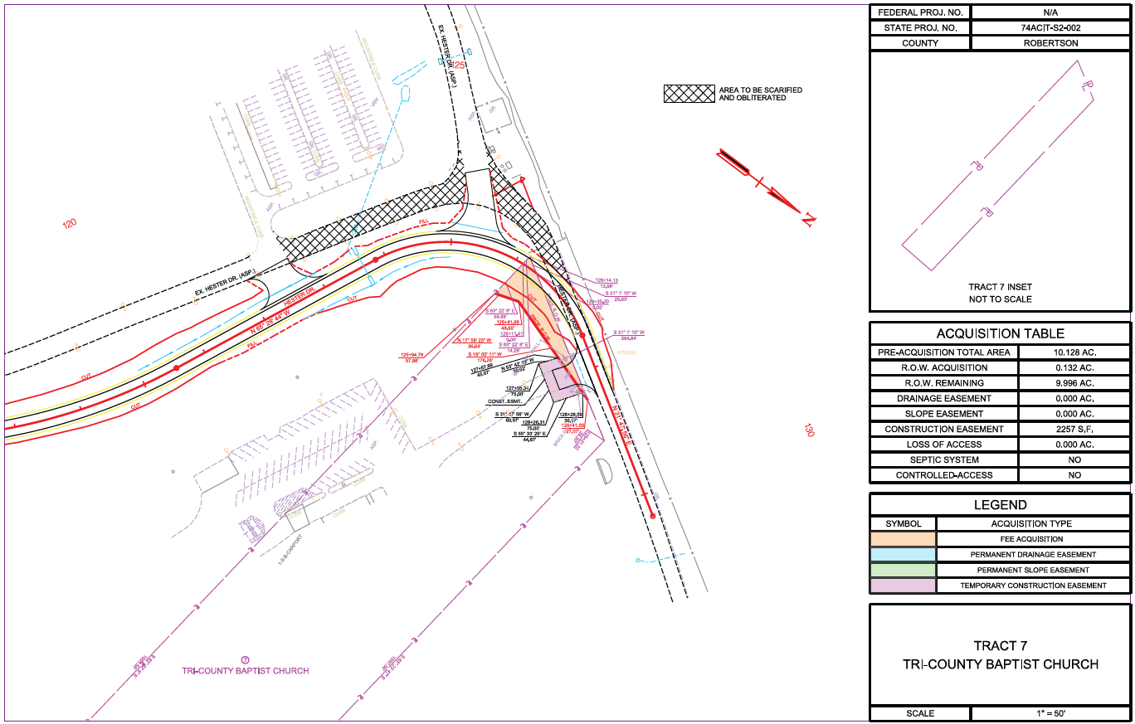
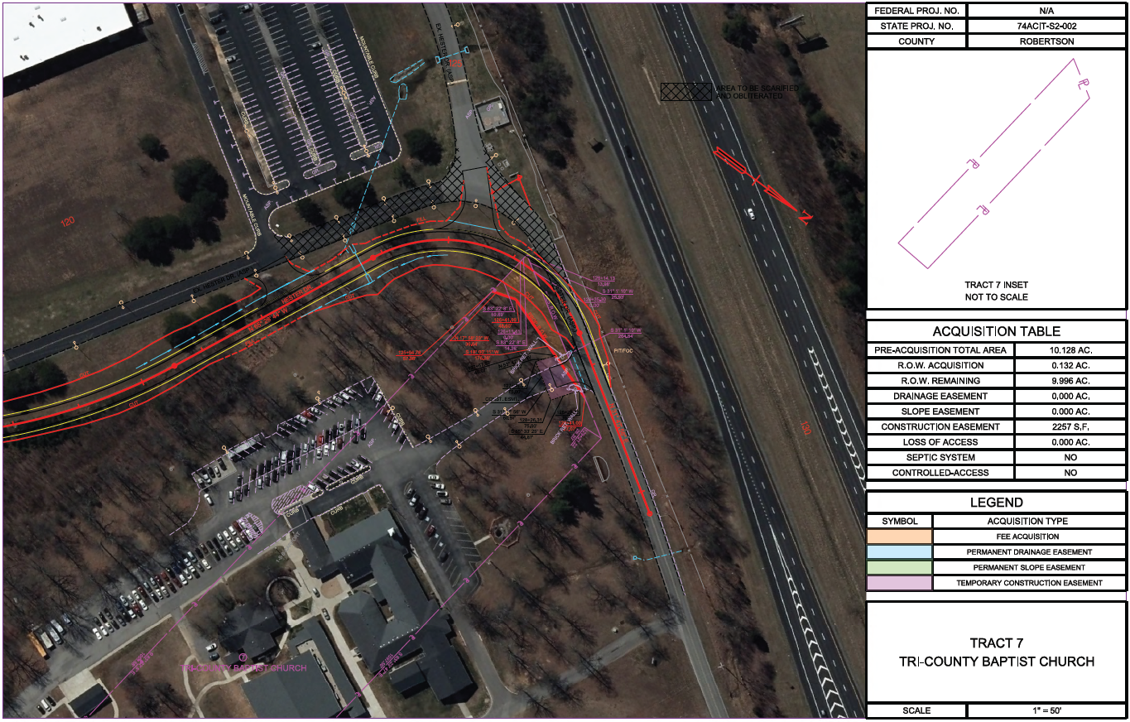
ROW Exhibits
(Review Example)

Slide 36
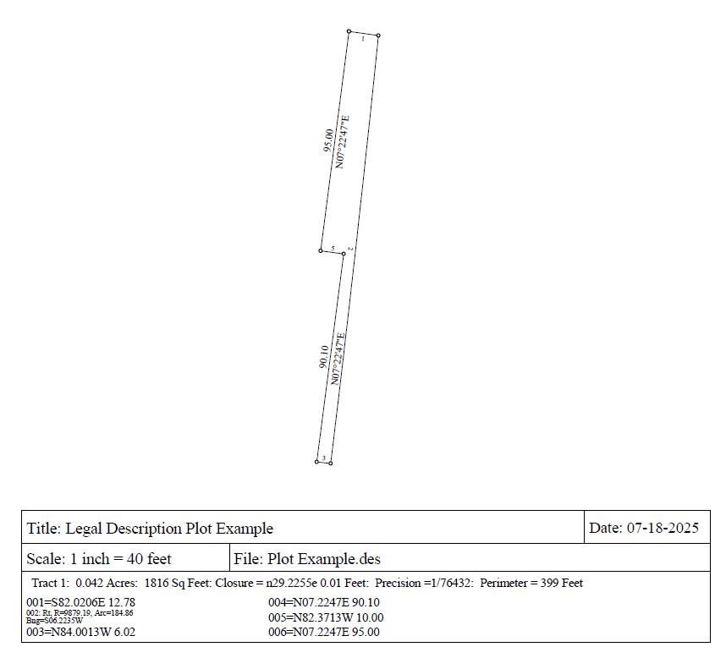
LEGAL DESCRIPTIONS
ROW Engineer is to provide QA checks on legal descriptions prior to closing/condemnation
Recommend using a plotting software such as Map98
Map98 is free, and a tutorial video is available

Slide 37
LEGAL DESCRIPTIONS
QA of Legal Descriptions should involve
Checking the descriptions for closure
Checking against the most current plans
Revisions should be accounted for!
Checking to see appropriate legal clauses are included and formatting follows the correct template
Possible Examples:
Demolition Easements
Access Control Rights
Uneconomic Remnants

Slide 38
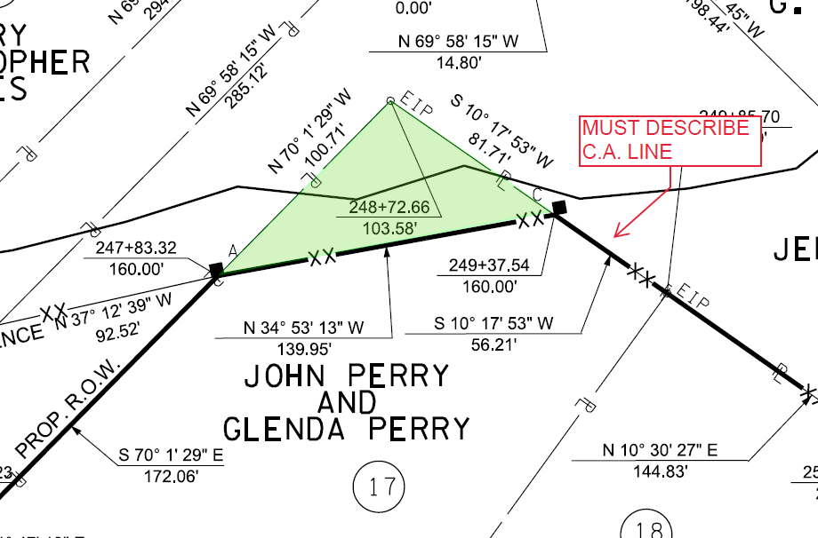
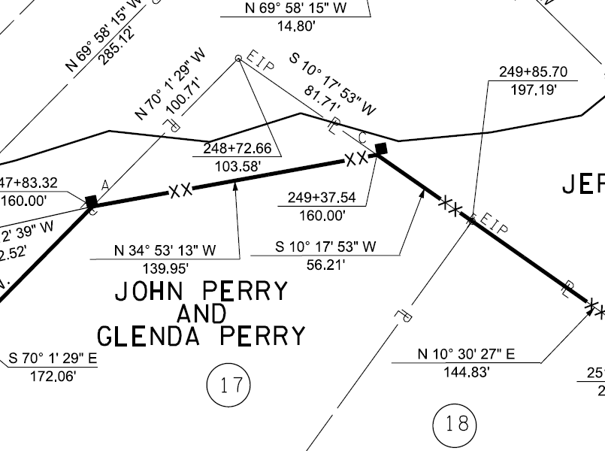
LEGAL DESCRIPTIONS
Controlled Access

Slide 39
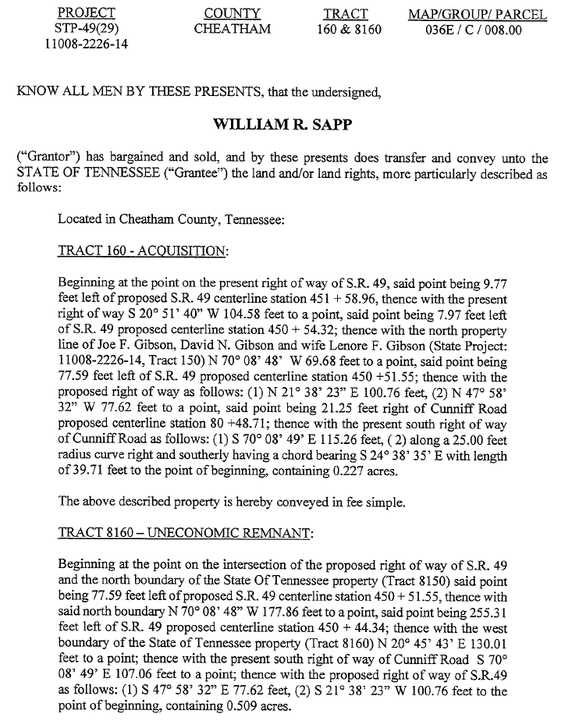
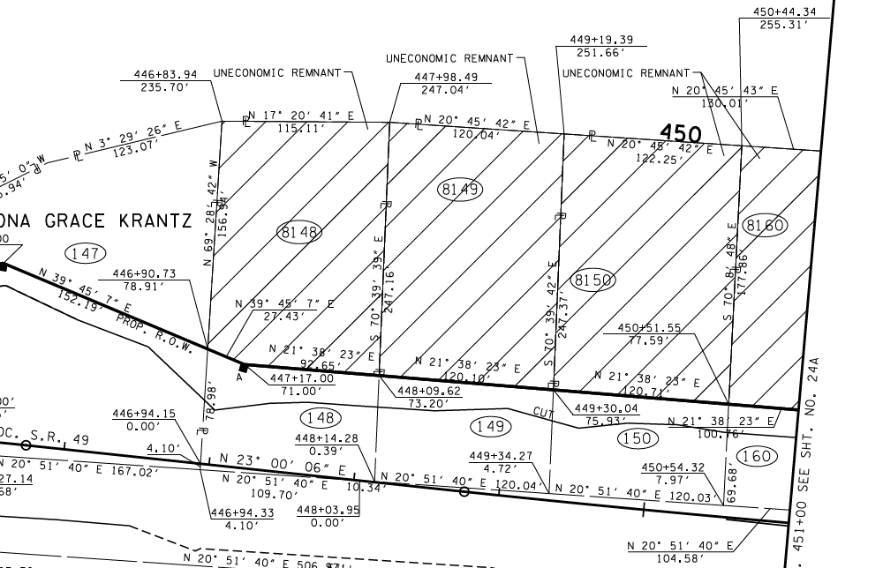
LEGAL DESCRIPTIONS
Uneconomic Remnants

Slide 40
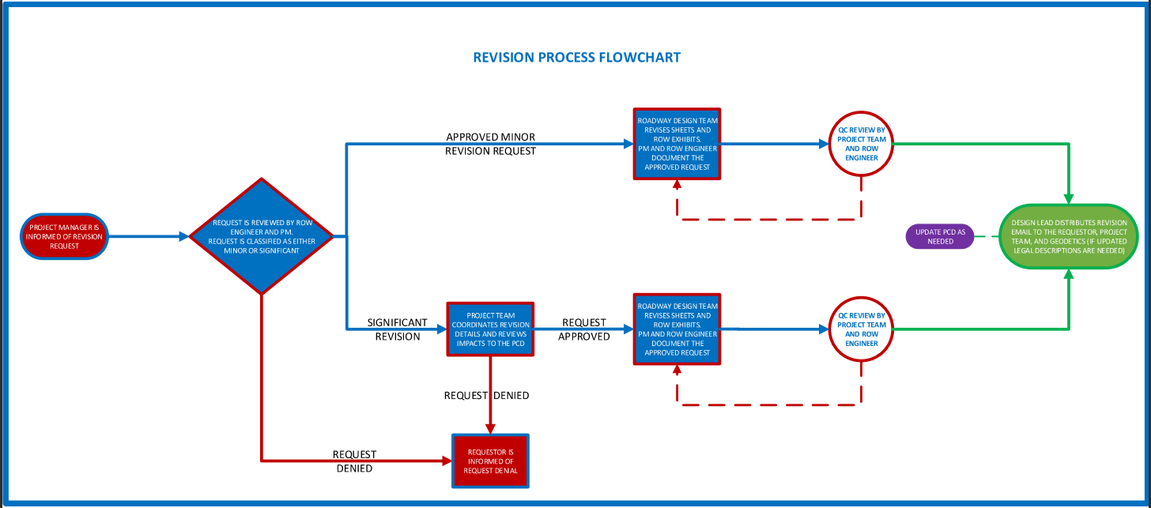
PLAN REVISIONS
ROW Engineer should review and document plan revisions as part of the project team.

Slide 41
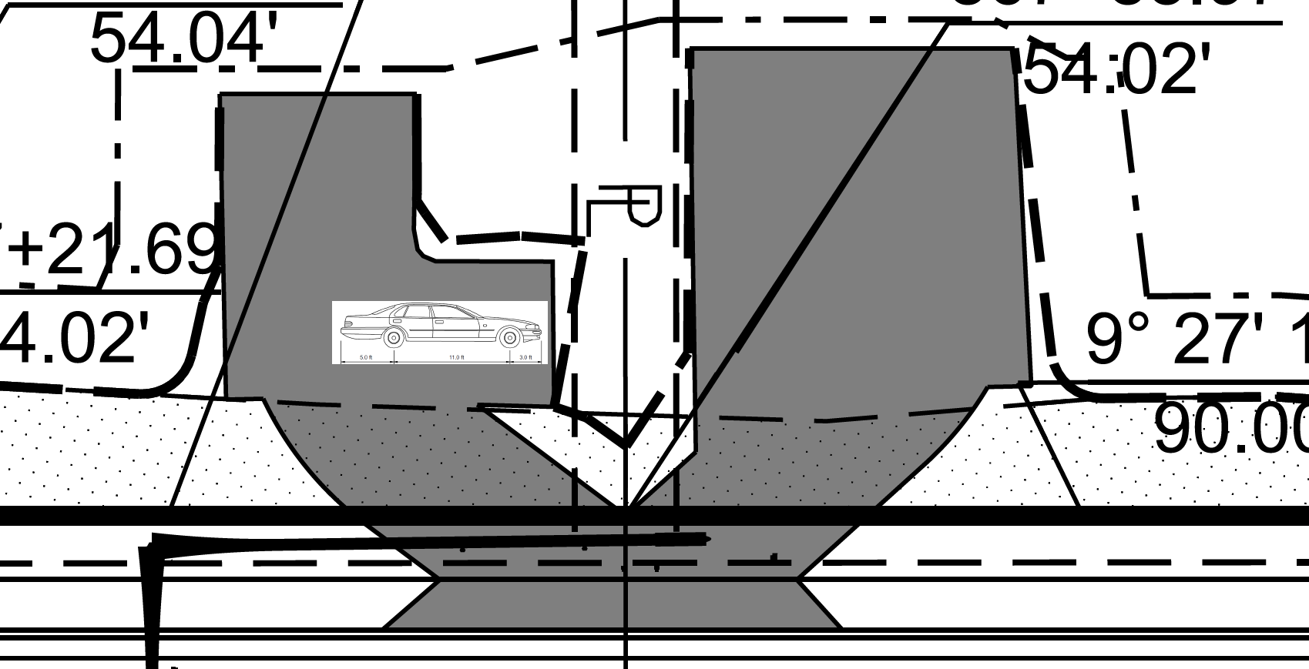
Example of Review Item
STUDY ACCESS MANAGEMENT

Slide 42
Plan In Hand, PS&E
ROW Engineer should check the Plan in Hand and PS&E plans to ensure any revised items have been kept in the plan set.

Slide 43
PROJECT DELIVERY NETWORK
Project Delivery Network (PDN)

Slide 44
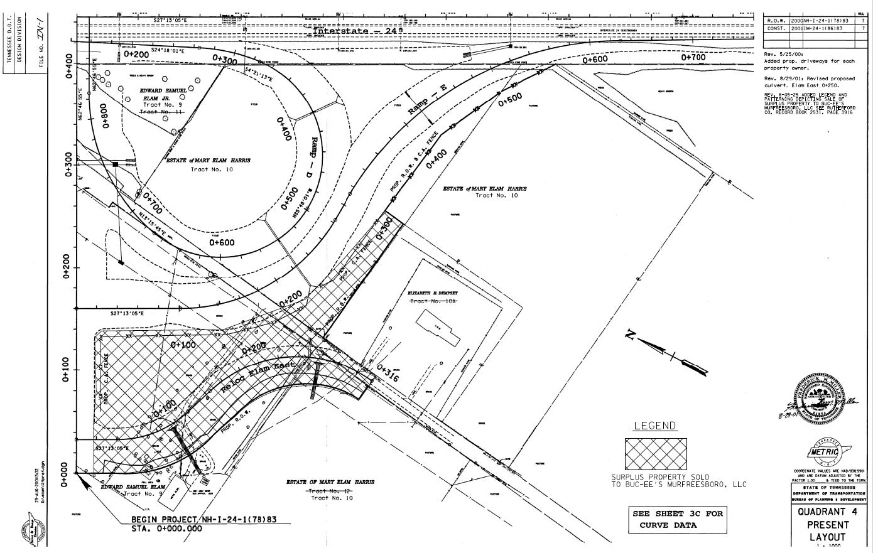
Excess Land Revisions
Revising plans per excess land sales as requested by the excess land coordinator.
Submitted to TDOT design file room.

Slide 45
Questions?
Questions or Concerns?

Slide 46
THANK YOU

