Slide 1

Airports GIS Consultant
Panel Discussion
PANELISTS
Jamal R. Stovall, GISP
Community Planner
FAA Memphis ADO
Paul Perry
Transportation Program Monitor 2
TDOT Aeronautics
Eric Risner, PS, IAM, PMP
Associate,
Project Manager – Aviation Services
Woolpert, Inc.
Bob Vander Meer, VP
Quantum Spatial
Randy Hudgings, PE
Moderator
VP, Director Aviation Services
BWSC, Inc.

Slide 2
Jamal R. Stovall, GISP
COMMUNITY PLANNER
FAA MEMPHIS ADO

Slide 3
Airports Southern Region
Airports GIS
29th Annual Tennessee Airports Conference
Jamal R. Stovall, GISP, Community Planner
FAA Memphis ADO
03/22/2016

Slide 4

Overview
Why AGIS?
FAA/Airport Sponsor Roles
Applicability
AGIS Workflow/Next Steps
Modification of Standards (MoS) Tool
Electronic Airport Layout Plan (eALP)
Training and Resources

Slide 5
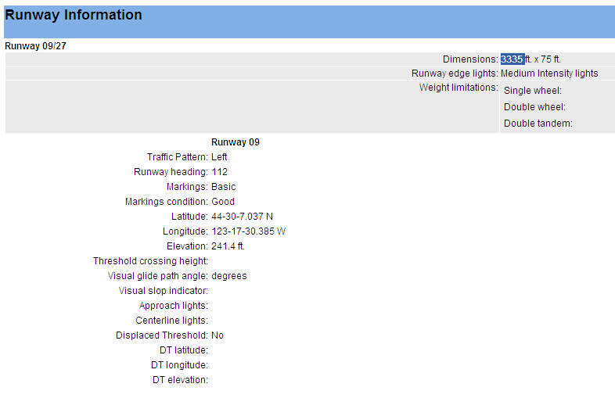
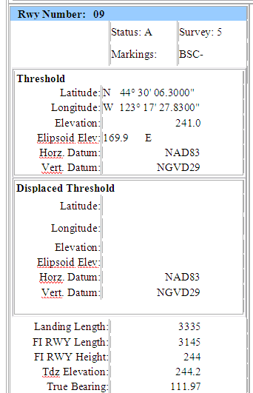
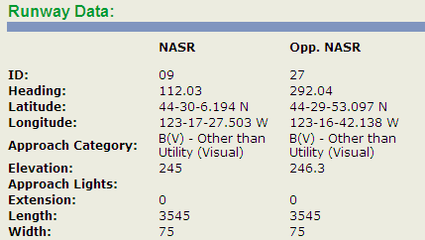
Why AGIS?
Conceived to address data accuracy, standardization and redundancy issues
  FAAO 5010.4 makes the Office of Airports the authoritative source for all airport data
  Advisory Circulars 150/5300-16, -17 and -18 – guidance on airport data collection and management
  Mechanism to collect, manage, and disseminate data for instrument procedure development (over 19,000 procedures at more than 5,000 airports)
  Data standardization and accuracy
  Efficiency -- single web-based database for airport data
NFDC | NASR data
NFPG data
?
Which data is correct?!
?
iOEAAA data
?
Notes:
Coordinated effort between AIM and Airports conceived in 2006 to address redundancy issues; multiple databases with data that don’t always match
ACs published in 2006; -16 (Geodetic Control), -17 (Imagery), and -18 (Surveys)
- Eliminates redundancy and addresses discrepancies between various sources of aeronautical data
Data standardization: -18 features and attributes
Data accuracy: Geodetic control requires tieing survey data to the NSRS; safety critical data verified by NGS
Efficiency: single one-stop shop for aeronautical data; no multiple databases – still working toward that goal
From airports perspective it also allows for development of planning and engineering tools to streamline our processes

Slide 6
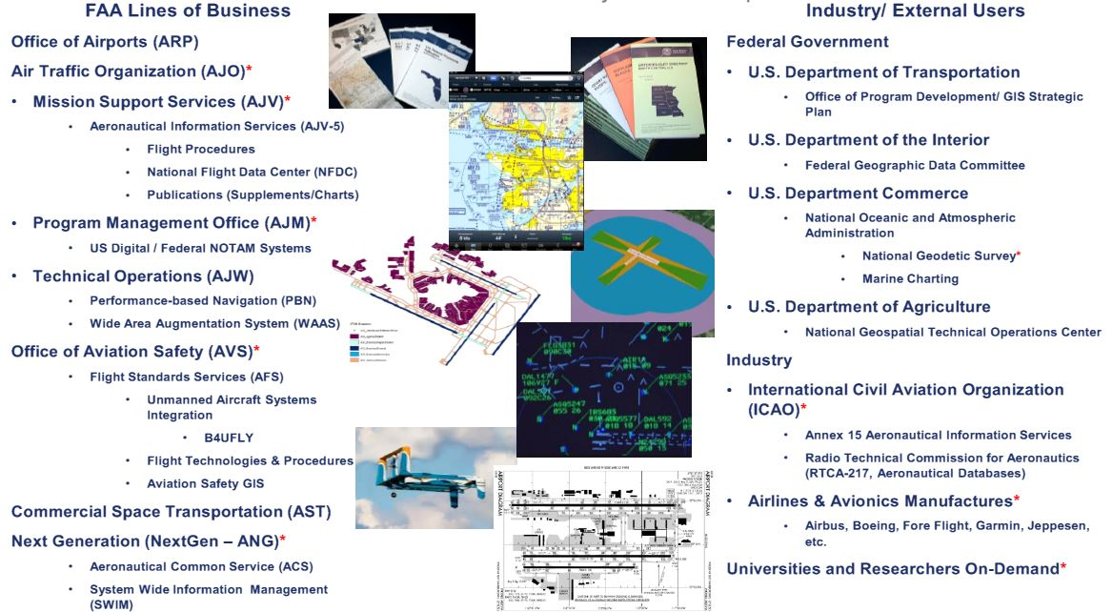
Airport Data Users
Notes:
Overview of the numerous internal and external airport data users.

Slide 7
FAA/Airport Sponsor Roles
FAA Region/ADO
  Familiarize sponsors with AGIS requirements and funding eligibility
  Include AGIS in grant offer transmittal letters/special conditions
  Review and approve AGIS Statements of Work
  Review and approve eALPs (when implemented)
Airport Sponsors
  Issue RFQ and select AGIS consultant IAW AC 150/4100-14D
  Discuss data collection and project scope with consultant
  Request FAA review and approval of AGIS Statements of Work, Geodetic Control Plans, Survey and Quality Control Plans, and Imagery Plans
  Submit survey data via AGIS in accordance with AC 150/5300-18
Notes:
Overview of Region/ADO and airport sponsor responsibilities
Region/ADO
Help sponsors identify those projects requiring AGIS survey activity; AGIS AIP eligible if project requiring AGIS is AIP eligible; no stand-alone AGIS projects eligible for AIP funding
Review and approved AGIS SOWs
Mention that the Geodetic Control, Survey and Quality Control, and Imagery Plans are reviewed by HQ/NGS....may take several weeks for reviews; regions can request expedited processing in special circumstances if required
Airport Sponsors
RFQ template is available as an appendix in the AGIS Implementation Guidance document
Submit AGIS data as required by transition policy
Request FAA review/approval of the SOW and plans (in practice, the consultant does this)

Slide 8
Which Airports Are Subject to AGIS?
(Safety Critical Data)
All NPIAS airports are required to comply with AGIS as follows:
  Obstruction surveys used for the development of new/changed instrument approach procedures
  Surveys for projects that change safety-critical data. Common examples of safety-critical data are:
    Extend/shorten runway or relocate runway end
    Modify runway profile
    Install/relocate NAVAID
    Obstructions
    Add/modify stopway or EMAS
    Other data (see AC 150/5300-18B, Para 4.1.3 and Transition Policy Table 1)
Notes:
AGIS implementation requirements is delineated by the type of data being collected
All NPIAS airports are subject to AGIS requirements for changes to safety-critical data. Basically, safety critical data is:
- obstruction surveys supporting development of new or changes to instrument procedures
- airport data in the runway environment
- changes to the runway (length, width, profile, runway ends)
- NAVAID siting or relocation
- adding/modifying stopway, clearway, or EMAS
- more detailed list contained in -18B and the transition policy

Slide 9
Which Airports Are Subject to AGIS?
(Non-Safety Critical Data)
Basic Rule of Thumb for non-safety critical data: Does the project affect data on the ALP?
  Construct/reconstruct apron
  Building construction
  Install fencing
  Install/replace jet bridge
  AIP-funded wetlands, wildlife habitat, or other environmental mapping
  Other (See AC 150/5300-18B and Transition Policy, Table 2)

Slide 10
Which Airports Are Subject to AGIS?
(Non-Safety Critical Data)
AGIS required for projects involving only non-safety critical data submitted as as-built or existing data projects – no NGS verification:
  Large/Medium/Small/Non Hub Airport
  Non-primary airports certified under Part 139 or with an ATCT
  Nashville Int’l (BNA) Chattanooga Love Field (CHA)
  Tri-Cities Regional (TRI) Memphis Int’l (MEM)
  McGhee Tyson (TYS) McKellar-Sipes Regional (MKL)
  Smyrna (MQY) Millington Regional Jetport (NQA)
Notes:
Primary airports, Part 139 airports, and airports with an ATCT are required to comply with AGIS requirements for non-safety critical data
All others are exempt with the exception of safety critical data
The airports listed here are the airport in the state of Tennessee that are required to collect and submit data via AGIS for projects involving only non-safety critical data.

Slide 11
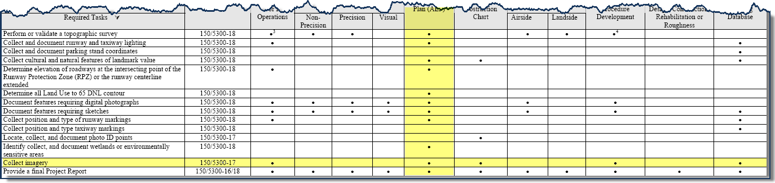
Imagery Requirements
Not required for all projects - imagery generally collected for safety-critical data projects involving new or modified instrument procedures; obstruction surveys; ALP updates
Previously collected imagery may be used for 6 months (12 months with ADO/region approval)
Must be collected in “leaf-on” conditions
Use AC150/5300-18, Table 2-1 as a guide
Notes:
When airports think AGIS they often equate AGIS with a full survey with imagery. However, generally speaking imagery is required only for those projects or changes to safety critical data that affect instrument procedures.
AC 150/5300-18 Table 2-1 provides a guide for AGIS collection requirements for different types of projects. The horizontal line shows that imagery required only for the different types of projects:
The main point here is that the majority of AGIS projects (i.e. airside construction, NAVAID siting, pavement rehab) do not necessarily require imagery.
Consideration being given to longer use of imagery for design projects

Slide 12
AGIS – Next Steps
Improve accessibility of the system – My Access
Airports GIS Help Desk web form implementation to improve response for AGIS standards, policy, and system uses questions
Provide airport level access (vs survey level access)
Streamline internal workflow – eliminate need for UDDF and manual data entry of safety critical data
Develop web service feature to disseminate AGIS data
Implement a Modification of Standards (MoS) Tool to efficiently process MoS requests
Notes:
MyAccess being revised to address accessibility concerns – Enterprise change not specific to AGIS
Airport level access – Currently, data is accessed via each completed survey. Airport level access is not limited to a single survey; the system accesses the most current data across all surveys to present an airport level view of the data
Elimination of the need for UDDF and manual entry of safety critical data by NGS will streamline to the workflow and improve the efficiency of the AGIS workflow processes
Modification of Standard tool – see next slide

Slide 13
AGIS – Modification of Standards (MoS) Coordination Tool
MoS tool will be used to process all MoS requests within the AGIS portal
  Testing of the tool by airports in each region expected April 2017
  MoS tool expected to be available and required for MoS requests by the end of FY17
  FAAO 5300.1G, Modifications to Agency Airport Design, Construction, and Equipment Standards – will be published concurrently with required use of the tool by the end of FY17

Slide 14
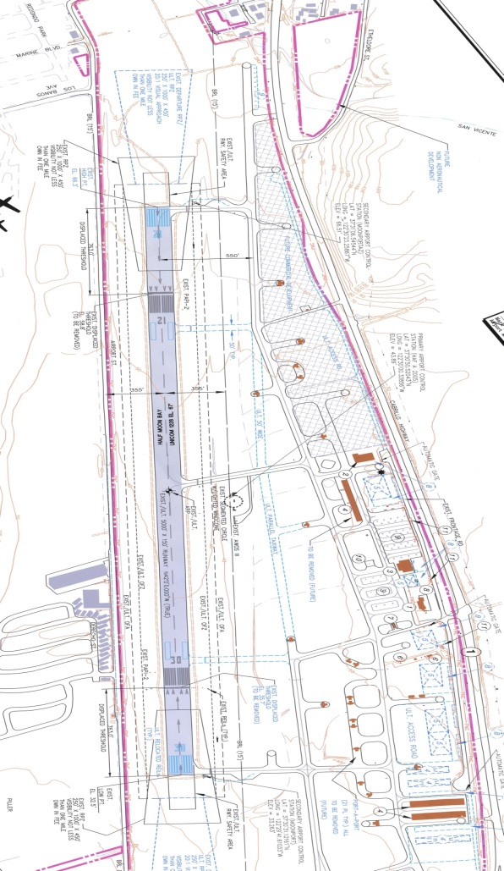
AGIS – Electronic Airport Layout Plan (eALP)
eALP module development is currently on hold pending
  Review and finalization of the Strategic Plan
  Review/modification of agency AGIS policy/ guidance
Analysis of eALP functionality to align with needs of the agency and end user requirements

Slide 15
Training
AGIS IDLE Training Level 1
  Overview of AGIS and AC Requirements
  Recommended for executives, managers, and airport sponsors
  Cost for non-FAA personnel: None.
AGIS IDLE Training Level 2
  Detailed review of AGIS requirements
  Recommended for managers, program managers, and airport managers
  Cost for non-FAA personnel: None.
AGIS IDLE Training Level 3
  Most detailed; designed for surveyors, contractors, and consultants
  Cost for non-FAA personnel: $150
Airports GIS Workshop
  In residence course at the FAA Mike Mulroney Aeronautical Center, Oklahoma City, OK
  Target audience: ARP employees, primarily region and ADO planners/engineers

Slide 16

Paul Perry
TRANSPORTATION PROGRAM MONITOR 2
TDOT AERONAUTICS

Slide 17
Q&A

Slide 18

Eric Risner, PS, IAM, PMP
ASSOCIATE, PROJECT MANAGER –AVIATION SERVICES
WOOLPERT, INC.

Slide 19


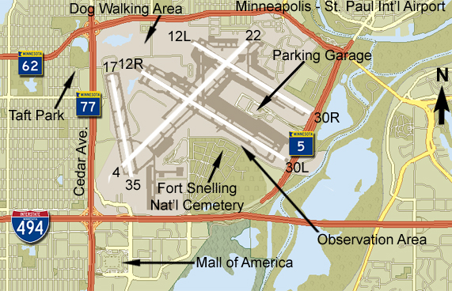



Airports GIS Mystification
What my friends think we do
What my Mom thinks we do
What society thinks we do
What airports think we do
What I think we do
What we really do !!!

Slide 20
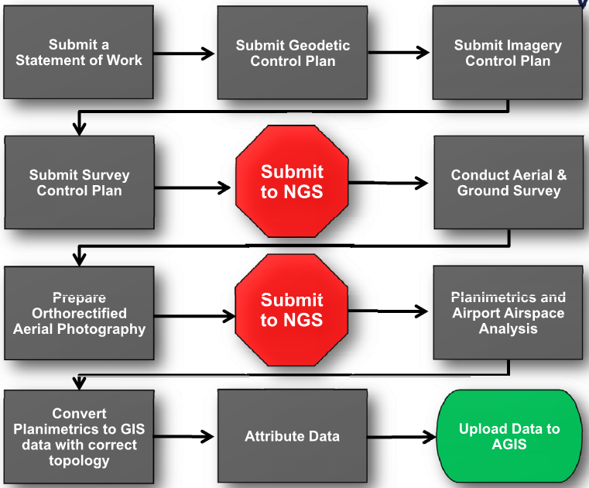
FAA AC -18 Process

Slide 21
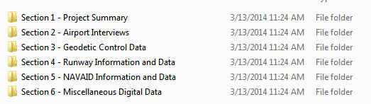
AGIS Workflow
  Final Surveyor’s report (developed by surveyor)
    This will be required for any project a survey is being completed on
    Very detail oriented broken into 6 major components
    Included in this report are a Project Summary, FAA & Airport Interviews, Geodetic Control/Runway/Navaid log sheets, sketches, photos, OPUS results & Comparisons, FAA checklists, & raw data files
    Typically 100 MB of data in over 90 files

Slide 22
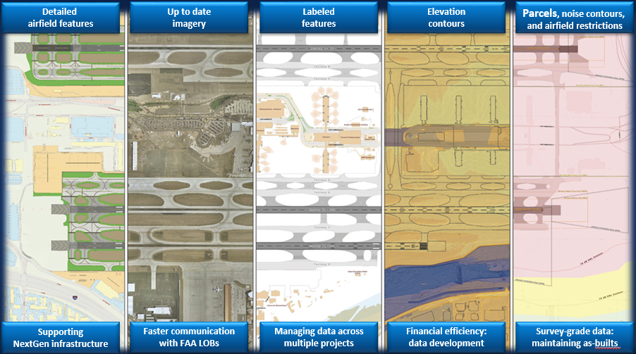
Keys to Success
Data Maintenance, Data Maintenance, Data Maintenance
Take advantage of project deliverables
  As-builts, survey data, new imagery
  Apply data standards to large construction project deliverables
  Contract language to enforce data standards
Integration with other systems

Slide 23
FAA AGIS Maintenance Issues
  Issues to Consider:
  What data to maintain?
  Who conducts the data maintenance?
    Specialized skills needed: Survey, CAD, GIS?
  How to obtain new data
    Survey
    Field Observations
  How often should data be updated?
    Whenever a change to actual conditions
  New data inaccuracies?
  When submitted to AGIS?
Notes:
To remain compliant with FAA requirements, however, airports must submit data that adheres to the specifications in this document for:
• Any project that changes safety-critical data as identified in paragraph 4.1.3 including runway end position, profiles, and NAVAIDS. Table 2-1 lists specific data submittal guidelines.
• Design, construction, or planning activities requiring the development of new or revision of existing instrument approaches
• Projects modifying the non-safety-critical data in the Airport Layout Plan (ALP). Continue to follow the guidance in AC 150/5070-6 for ALP development and changes. Additionally, collect and provide the modified non-safety critical data according to the standard of AC 150/5300-18, and submit to Airports GIS as design or as-built data projects.
• Projects involving only non-safety-critical data. Unless the airport falls into the transition period specified in the Airports GIS Transition Policy.

Slide 24






Airports GIS Cost Mystification
What my friends think it costs
What my Dad thinks it costs
What Society thinks it costs
What Airports think it costs
What I think it costs
What it really costs !!!

Slide 25
Costs – Airports (GA)
Representative costs for general reference purposes; should not substitute for individual airport scoping situation.

Slide 26

Bob Vander Meer
VP, QUANTUM SPATIAL

Slide 27
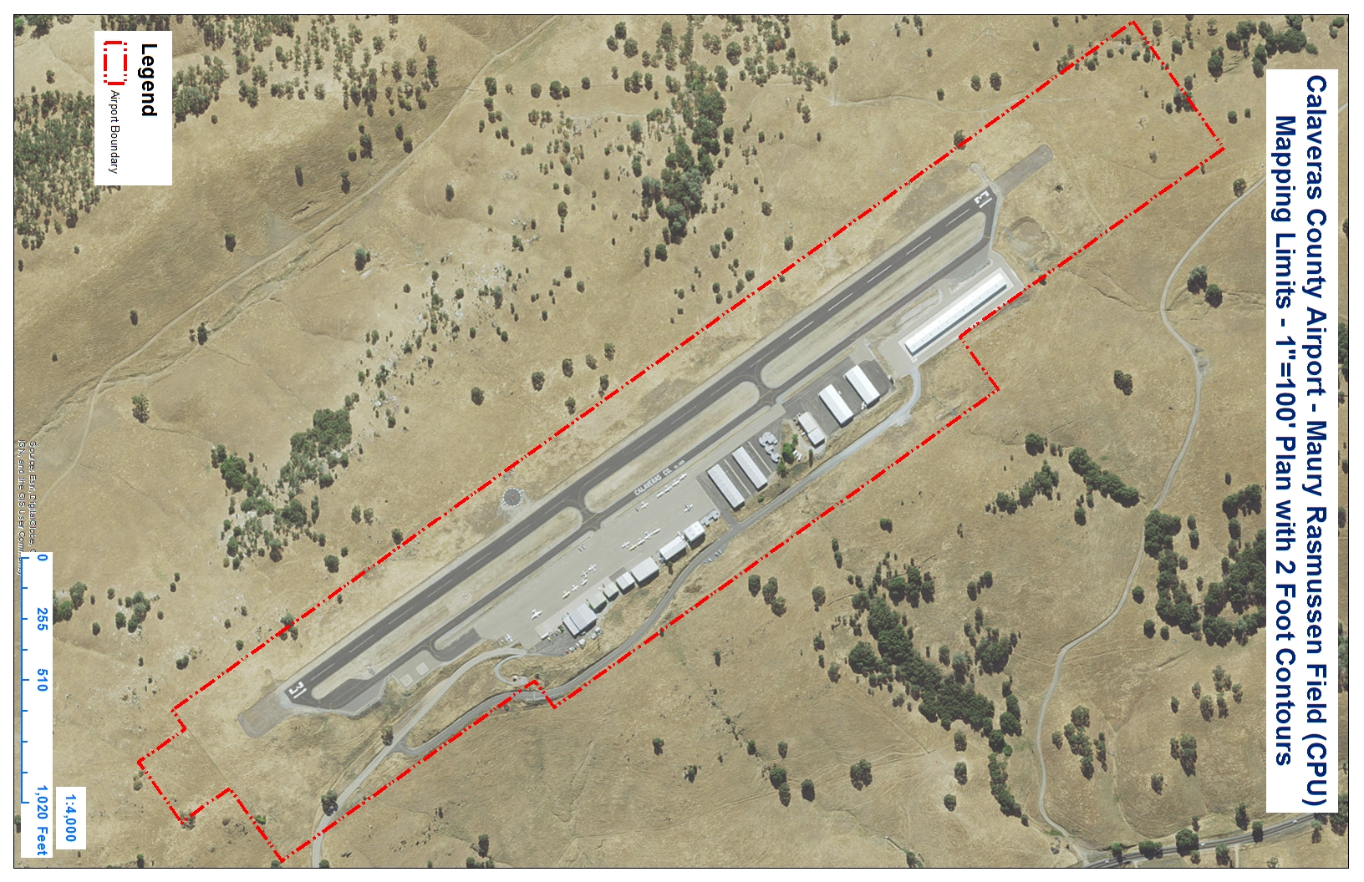
The cost comparison

Slide 28
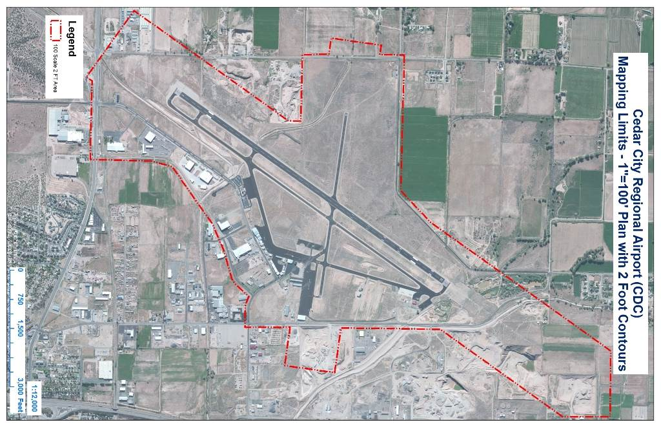
The cost comparison con’t

Slide 29
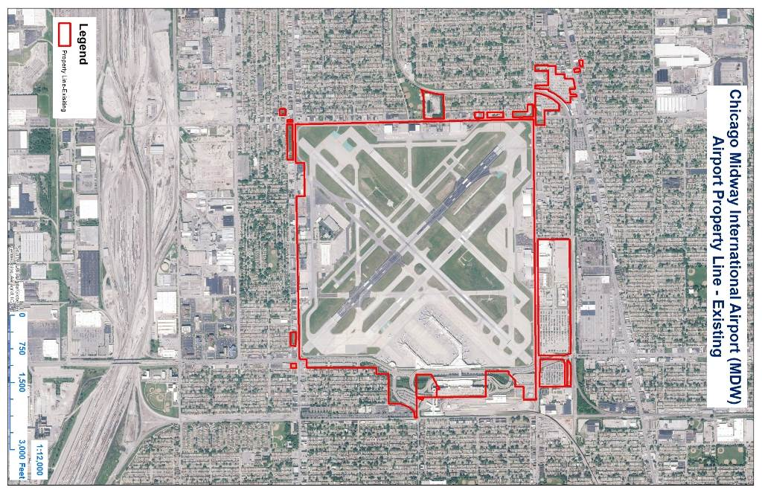
The cost comparison con’t

Slide 30
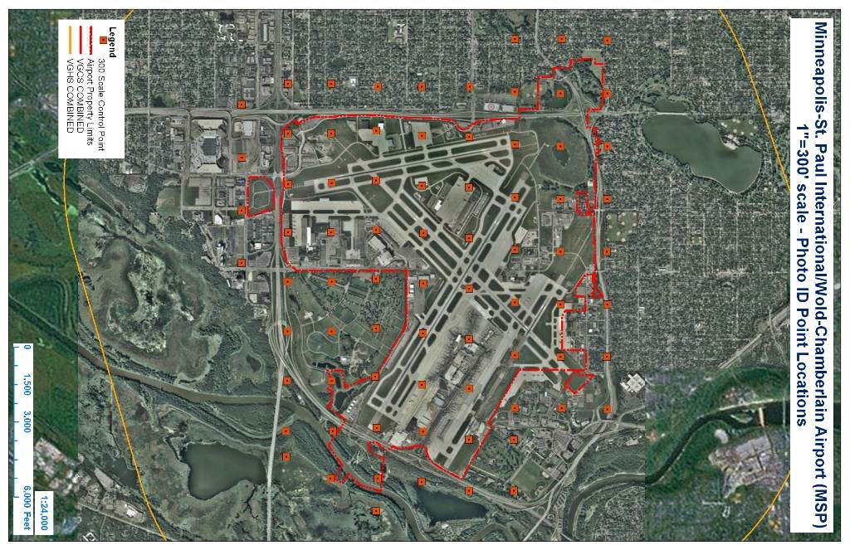
The cost comparison con’t

Slide 31
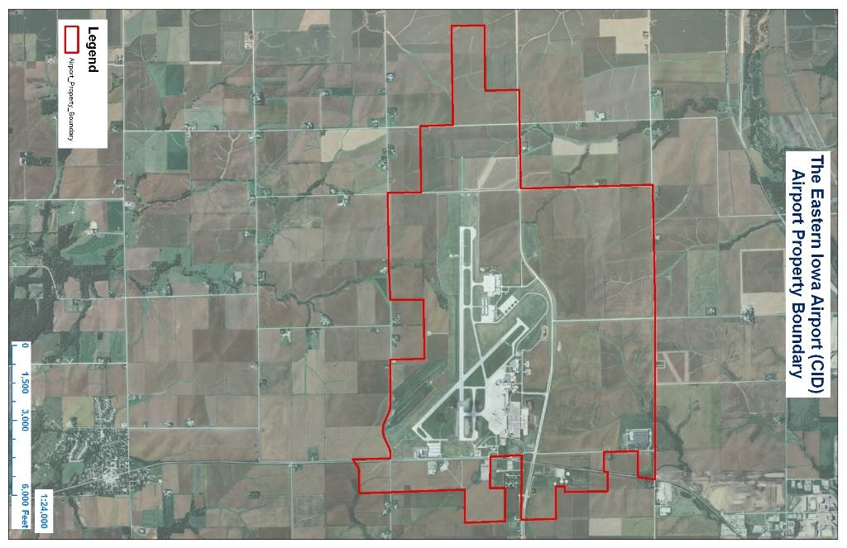
The cost comparison con’t

