Slide 1
FAA Compliance and Land Use
Tennessee Airport Conference
Kim Brockman and Lisa Reaney
March 22, 2017
Notes:
Compliance is an FAA Division – concentrates on the obligations that an airport agrees to by accepting federal grants.
Steps in when an issue or allegation comes up when people believe the airport is not following.

Slide 2
Overview
Standards of Compliance
Federal Obligations
Key Terms: Compliance
Airport Inspections with TDOT
Key Terms: Land Use
Non-Aeronautical Hangar Use Policy
Links and Resources

Slide 3
Standards of Compliance
An Airport Sponsor meets its commitments when:
Federal obligations are understood
A program is in place that the FAA deems adequate to carry out the sponsor’s commitments (e.g., preventative maintenance, leasing polices)
The sponsor satisfactorily demonstrates that such a program is being carried out
Past compliance issues have been addressed
Notes:
Part of your program would be: minimum standards with rules & regulations

Slide 4
Federal Obligations
Federal Grant Assurances (39)
Surplus Property Conveyances
Notes:
If you sign a grant to buy land
Surplus property – war asset
Obligated Land: One source to determine if an airport is federally obligated is FAA Order 5190.2R, List of Public Airports affected by Agreements with the Federal Government. Land becomes obligated through federal agreements and/or property conveyances.
Federal Grant Assurances
A grant agreement represents any agreement made between the FAA (on behalf of the United States) and an airport sponsor in which the airport sponsor agrees to certain assurances. In general, the airport sponsor assures it will operate the airport for the use and benefit of the public as an airport for aeronautical purposes. The grant agreement and assurances will apply whether the airport sponsor receives the grant of federal funding or a conveyance of land.
There are 39 standard grant assurances for airport sponsors
Sources of Obligations:
Grant agreements issued under the Federal Airport Act of 1946 (1946 Airport Act), the Airport and Airway Development Act of 1970 (1970 Airport Act), and the Airport and Airway Improvement Act of 1982 (AAIA).
Surplus airport property instruments of transfer, issued pursuant to section 13g of the Surplus Property Act of 1944.
Deeds of conveyance issued under section 16 of the 1946 Airport Act, under section 23 of the 1970 Airport Act, and under section 516 of the AAIA.
AP-4 agreements authorized by various acts between 1939 and 1944. (Note: All AP-4 agreements have expired; however, sponsors continue to be subject to the statutory exclusive rights prohibition.)
Commitments in environmental documents prepared in accordance with current Federal Aviation Administration requirements, which address National Environmental Policy Act of 1969 (NEPA) and the AAIA.
Separate written agreements between the sponsor and the FAA, including settlement agreements resulting from litigation.
Surplus Property Conveyances
Property conveyed under the Surplus Property Act of 1944. The Surplus Property Act authorizes the conversion of surplus military airports to civilian public use airports. Conveyances of surplus property are subject to the terms, conditions, reservations, and restrictions prescribed in the instruments of conveyance. In other words, the properties were conveyed with strings attached, which are the sponsor’s federal obligations.

Slide 5
Key Terms: Compliance
Economic Nondiscrimination (Grant Assurance 22)
Use your airport as an Airport
Treat similar users in a similar fashion (similarly situated)
Notes:
I WANT WHAT HE HAS!
Charging comparable rates to similarly situated aeronautical users. Grant Assurance 22, Economic Nondiscrimination, requires the sponsor to make its aeronautical facilities available to the public and its tenants on terms that are reasonable and without unjust discrimination.
This federal obligation involves several requirements:
Sponsor must make the airport and its facilities available for public use
Sponsor must ensure that the terms imposed on aeronautical users of the airport, including rates and charges, are reasonable for the facilities and services provided.
The terms must be applied without unjust discrimination

Slide 6
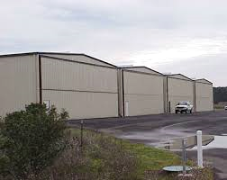
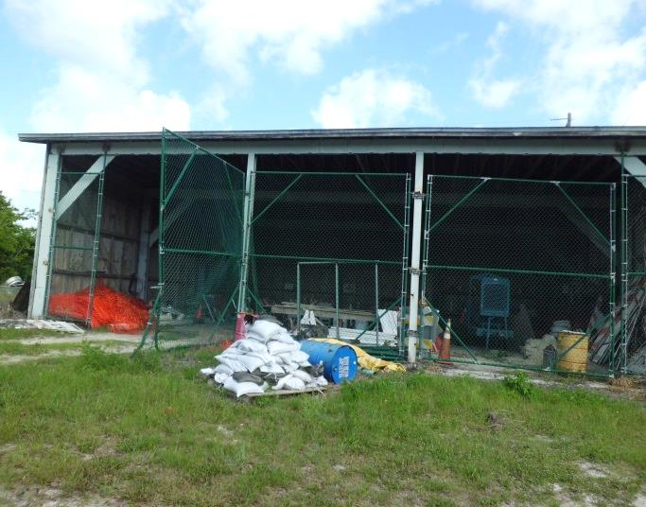
Key Terms: Compliance
Similarly Situated
Notes:
Hangar on the left gets more rent than hangar on the right – fine but spell out your methodology for establishing rates and charges. Things need to be clear and transparent.
Similarly Situated: “In order to establish a claim of unjust discrimination, a complainant must establish that it requested similar terms and conditions as other similarly situated airport users and was denied for unjust reasons” Aerodynamics of Reading, Inc. v. Reading Regional Airport Authority, FAA Docket No. 16-00-03.
NOTE: Facts and circumstances matter. “A Complainant does not establish a per se violation of Assurance 22 (unjust discrimination) simply by showing differences between two leases. The FAA has found that differences in lease terms executed at different points in time can be justified by the market conditions present at the time of lease execution.”
Wilson Air Center, LLC v. Memphis-Shelby County Airport Authority, Final Decision and Order, FAA Docket No. 16-99-10
Differences in time
Level of investment
Services offered/provided
Short term v. longer term lease
Ground lease v. lease of sponsor-owned facilities
Condition of facilities
Location
Improved practices
Reasonable and Not Unjustly Discriminatory equals:
Attainable
Relevant
Uniformly applied
Protects aeronautical service providers from unreasonable competition
Do not confer an Exclusive Right

Slide 7
Key Terms: Compliance
Exclusive Rights (Grant Assurance 23)
The oldest federal obligation (1938)
Almost always included in surplus property deeds
An “enduring” obligation (applies as long as the airport is operated as an airport)
Applies only to aeronautical users Exemptions: Nonaeronautical users and Proprietary Exclusive
Notes:
YOU CANNOT PROVIDE AN EXCLUSIVE RIGHT!
Exclusive Rights: This describes the sponsor’s federal obligation under Grant Assurance 23, Exclusive Rights. Exclusive Rights prohibits an airport sponsor from granting an exclusive right for the use of the airport, including granting an exclusive right to any person or entity providing or intending to provide aeronautical services to the public. The Sponsor may not grant a special privilege or monopoly to anyone providing aeronautical services on the airport or engaging in an aeronautical use. The intent of this restriction is to promote aeronautical activity and protect fair competition at federally obligated airports. An exclusive right is defined as a power, privilege, or other right excluding or debarring another from enjoying or exercising a like power, privilege or right. An exclusive right may be conferred either by express agreement, by imposition of unreasonable standards or requirements or by another means.
Applies to recipients of nonsurplus government property
Codified in 49 U.S.C. in three places (§ 40103 €, §47107 9a), and §47152)
Proprietary Exclusive: The exclusive rights prohibition does not apply to services provided by the sponsor itself. The airport sponsor may elect to provide any or all of the aeronautical services at its airport, and to be the exclusive provider of those services. A sponsor may exercise – but may not grant – the exclusive right to provide any aeronautical service. This exception is known as the airport’s “proprietary exclusive” right. The airport sponsor is the sole provider of one, some or all aeronautical services and can exclude others from offering these services.

Slide 8
Importance of Minimum Standards
Prevent potential Grant Assurance violations
Avoid “Hangar Queens” or non-airworthy aircraft from taking up residence on field
Preserving the physical appearance of the field, the airport is the front door to your community

Slide 9
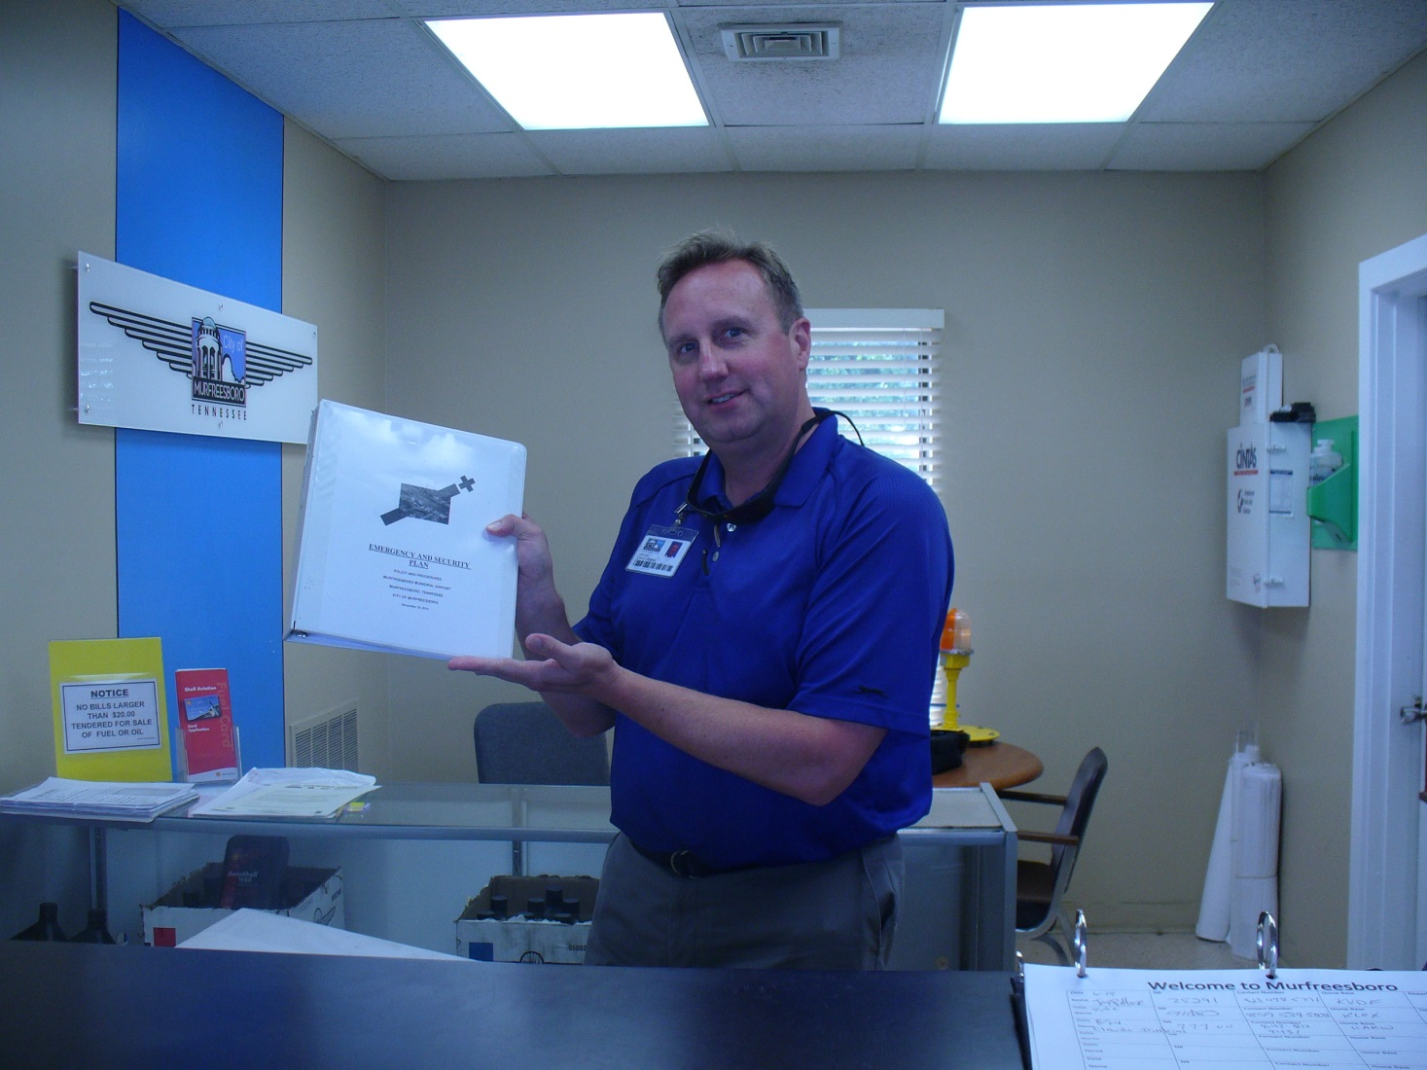
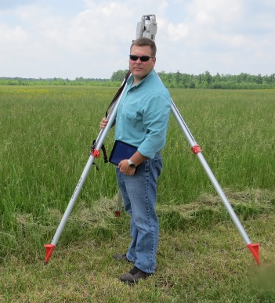
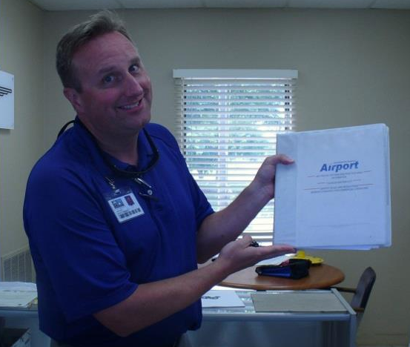
Annual Airfield Inspections
Airport inspections will be conducted annually by assigned TDOT Program Monitors
Inspectors are looking for items to preserve and protect our investments on the field, such as safety and infrastructure
Inspectors are there to assist, educate and provide guidance to the airport sponsor – ask questions and participate in the inspection process

Slide 10
Importance of Minimum Standards
Update frequently & make sure tenants and users are complying with the standards

Slide 11
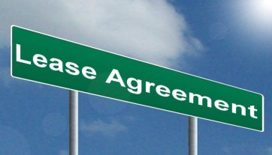
Leases and Charges On The Field
Provide a transparent methodology of rates and charges for all tenants and airfield users
Clear expectations
Rates and charges with an expected escalation clause
Fuel charges and method of fueling practices (self fueling allowed etc.)

Slide 12
Compliance Process: Part 13 & 16
Informal Review Part 13
First contact TDOT at 615-741-3208, currently Lisa Reaney
Explain the situation or issue of concern
Formal Review: Part 16
Initiate formal Part 16 complaint for review by the FAA
Provide written, accurate and factual information for each alleged Grant
Assurance violation

Slide 13
Key Terms: Land Use
Aeronautical versus Non-Aeronautical Users
Fair Market Value (FMV)
Aviation Easement
Compatible Land Use – protect your approaches!
Concurrent Land Use
Interim Use
Long Term Lease
Land Use Inspections – results from high number of complaints
Notes:
Aeronautical Activity: Any activity that involves, makes possible, or is required for the operation of aircraft or that contributes to or is required for the safety of such operations. It includes but is not limited to: air taxi and charter operations, scheduled or nonscheduled air carrier services, pilot training, aircraft rental and sightseeing, aerial photography, crop dusting, aerial advertising and surveying, aircraft sale and service, aircraft storage, sale of aviation petroleum products, repair and maintenance of aircraft, sale aircraft parts, parachute activities, ultralight activities, sport pilot activities, military flight operations, home-built aircraft.
Fair Market Value (FMV): The highest price estimated in terms of money that a property will bring if exposed for sale in the open market allowing a reasonable time to find a purchaser or tenant who buys or rents with knowledge of all the uses to which it is adapted and for which it is capable of being used. (Highest and Best Use)
Aviation Easement: A grant of a property interest in land over which a right of unobstructed flight in the airspace is established.
Compatible Land Use: The coexistence of land uses surrounding the airport with airport-related activities. Grant Assurance 21, Compatible Land Use, Sponsors are obligated to take appropriate action, to the extent reasonable, including the adoption of zoning laws, to restrict the use of land adjacent to or in the immediate vicinity of, the airport to activities and purpose compatible with normal airport operations, including aircraft landing and takeoff. In addition, if the project is for noise compatibility program implementation, it will not cause or permit any change in the land use, within its jurisdiction, that will reduce it compatibility, with respect to the airport, of the noise compatibility program measures upon which federal funds have been expended.
Concurrent Land Use: Land that can be used for more than one purpose at the same time. For example, portions of land needed for RPZ purposes could also be used for agriculture purposes at the same time.
Interim Use: Interim use of aeronautical property for nonaviation purposes. Defined as a temporary short term (not to exceed 3 years) nonaviation use of aeronautical property conveyed to, or acquired by, the airport sponsor.
Long Term Lease: A lease with a term of five (5) years or more. Not to exceed 50 years.

Slide 14
FAA Policy on Non-Aeronautical Use of Airport Hangars
Aeronautical facilities must be used for aeronautical activities
Airport Sponsor may permit non-aeronautical items to be stored
Hangars may not be used as a residence
Aeronautical uses are clarified
Hangar uses cannot impede the movement of aircraft
Airport Sponsor should have a program to monitor hangar uses
Notes:
RULES & REGS: HANGAR INSPECTION POLICY – ONCE A QUARTER – RANDOM CHECK ON 25%

Slide 15
Non-Aeronautical Use of Airport Hangars
Airport sponsor can request non-aeronautical hangar use
Interim use applies (no more than 5 years)
Provide information on vacancy rates
Provide a procedure for accepting new requests for aeronautical use
Fair Market Value applies

Slide 16
Examples of Non-Aeronautical Use
Storing items not related to aeronautical activities in hangars

Slide 17
Links and Resources
FAA Compliance Manual: http://www.faa.gov/airports/resources/publications/orders/compliance_5190_6/
Grant Assurances: http://www.faa.gov/airports/aip/grant_assurances/
Nonaeronautical Storage: http://www.faa.gov/airports/airport_compliance/hangar_use/
Part 13 and Part 16: http://www.faa.gov/airports/airport_compliance/complaints/
Part 16 Decision Database: https://part16.airports.faa.gov/
Other resources:
http://www.faa.gov/airports/resources/publications/
http://www.faa.gov/airports/airport_complaince/

Slide 18
Questions?

