Slide 1
HAMILTON COUNTY
East Brainerd (SR-320)
From East of Bel-Air Road
to Ooltewah-Ringgold Road (SR-321)
Curt Duncan - C.E. Manager 1 and Jason Ingram - Transportation Project Specialist Supervisor 2 (TDOT Region 2 Project Development)

Slide 2
MEETING PURPOSE
To provide the public with up-to-date information on the proposed project.
To display the Preliminary Design Plans for
East Brainerd Road (SR-320) in Hamilton County
To solicit comments and concerns from the public regarding this project.

Slide 3
PROJECT DEVELOPMENT PROCESS
Planning
PROJECT CURRENTLY IN DESIGN PHASE
RIGHT OF WAY TO BEGIN PENDING FUNDING APPROVAL
Environmental
Design
Right-of-Way
Construction

Slide 4
PROJECT PURPOSE
To create a consistent five lane curb and gutter roadway with bicycle lanes and sidewalks along East Brainerd Road.
To provide additional lanes of travel for safe traffic operations.
Improve major intersection at East Brainerd Road and Ooltewah-Ringgold Road.

Slide 5
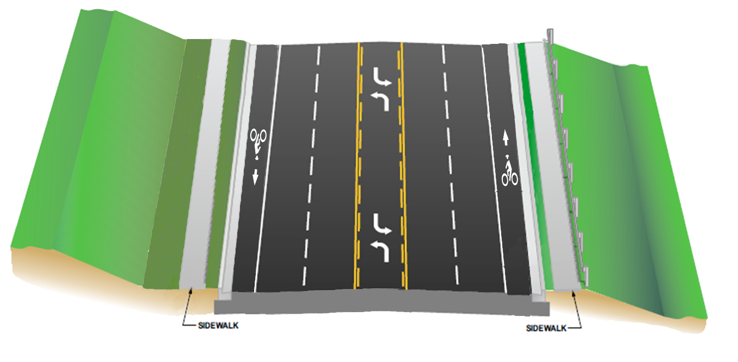
East Brainerd Rd (SR-320) Design Template
EAST BRAINERD (SR-320) TEMPLATE
5 LANE CURB & GUTTER
6’ SHOULDERS (INCLUDES BIKE LANE)
2’ GRASS STRIPS AND 5’ SIDEWALKS

Slide 6
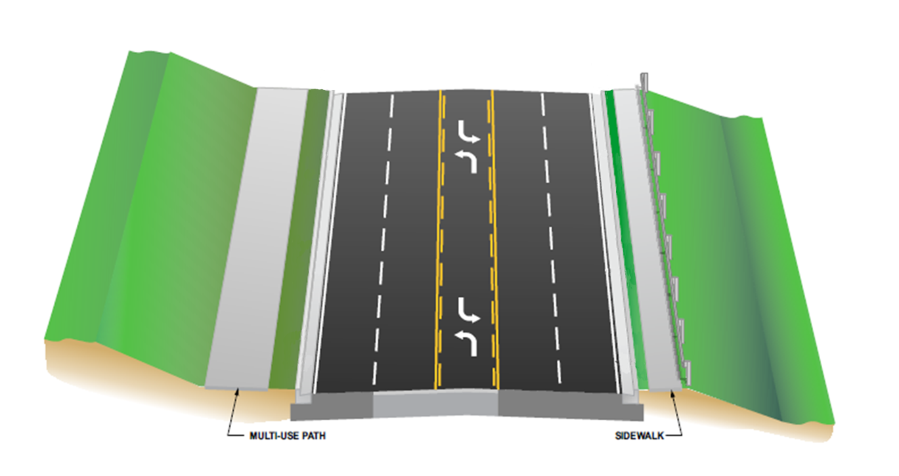
Ooltewah-Ringgold Rd (SR-321) Design Template
OOLTEWAH-RINGGOLD(SR-321) TEMPLATE
FROM EAST BRAINERD/OOLTEWAH RINGGOLD ROAD INTERSECTION TO EAST HAMILTON MIDDLE HIGH SCHOOL
5 LANE CURB & GUTTER
NO SHOULDERS
2.5’ GRASS STRIP
10’ MULTI-USE PATH AND 5’ SIDEWALK

Slide 7
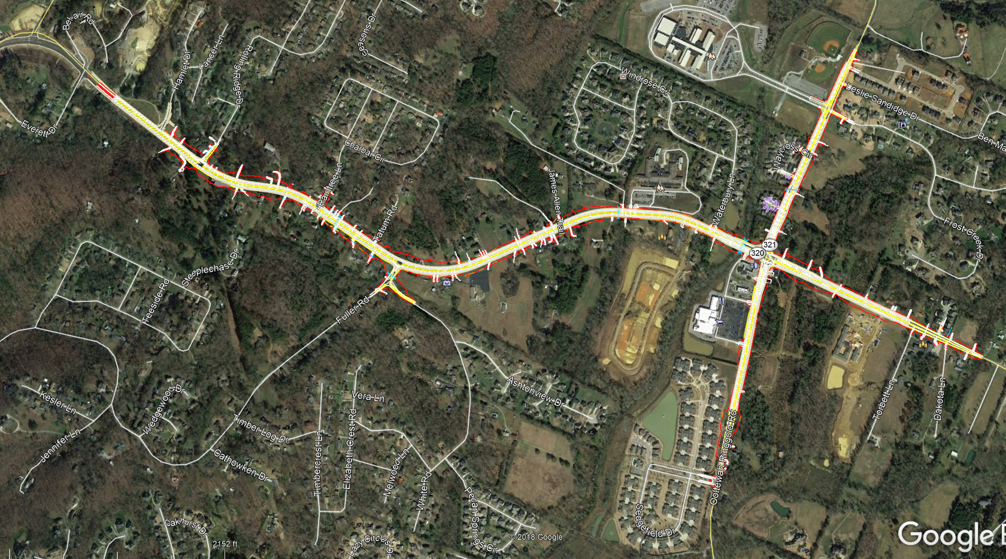
PROJECT LIMITS
BEL-AIR ROAD
EAST HAMILTON MIDDLE HIGH SCHOOL
LIMIT OF
CONST
BEGIN PROJECT
EAST BRAINERD ROAD
LIMIT OF
CONST
OOLTEWAH-RINGGOLD ROAD
LIMIT OF
CONST

Slide 8
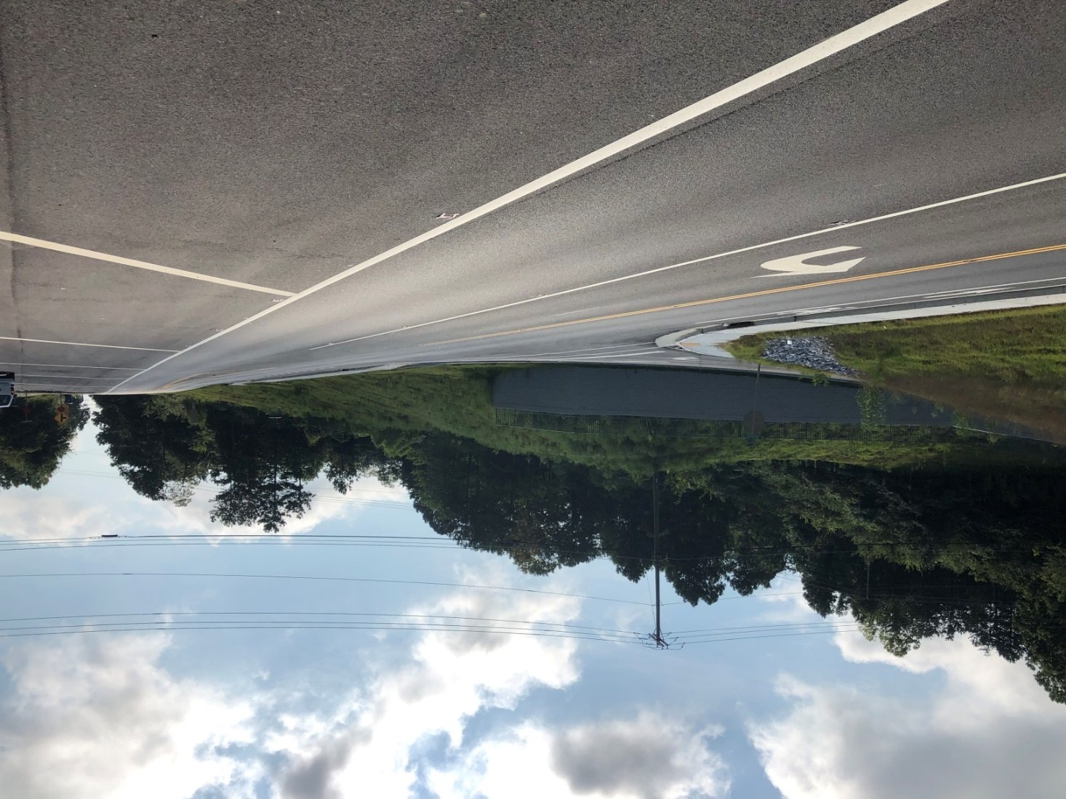
PROJECT BEGINNING East Brainerd Road (SR-320)
HAMLET DRIVE
END OF PREVIOUS EAST BRAINERD PROJECT

Slide 9
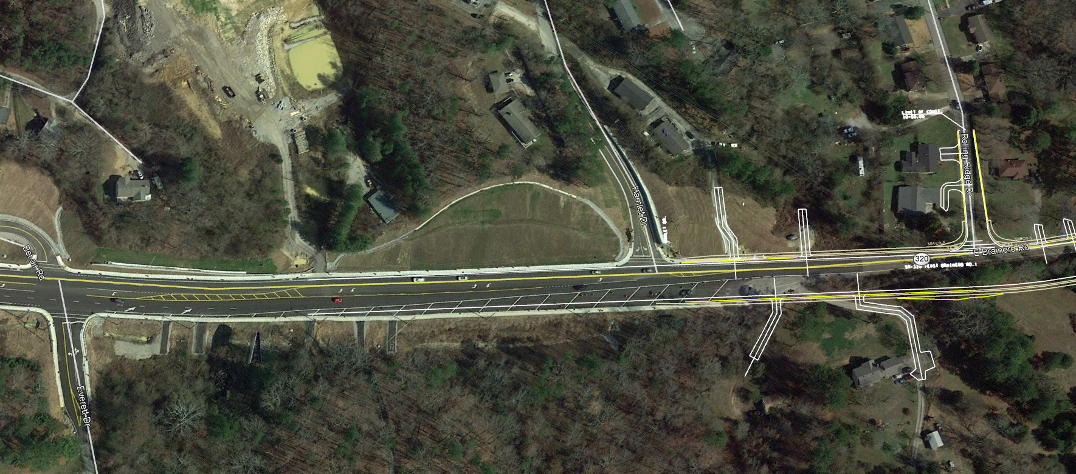
PROJECT BEGINNING (Limit of Const)
BEL-AIR ROAD
HAMLET DRIVE
EAST BRAINERD ROAD
AERIAL VIEW
PROPOSED 5 LANE ROADWAY TO EXISTING 5 LANE ROAD
RESTRIPE MARKINGS

Slide 10
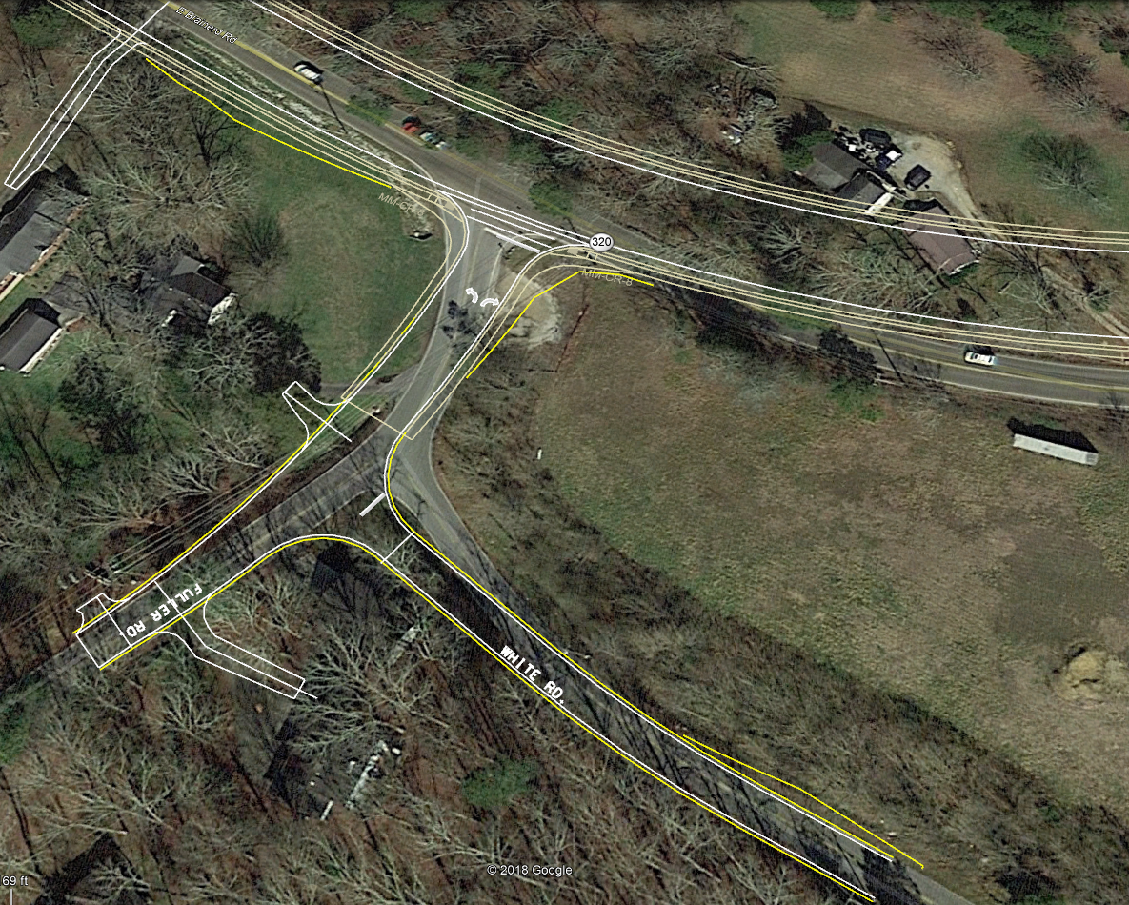
Intersection of East Brainerd Rd and Fuller Rd
EAST BRAINERD ROAD
RAISING GRADE
IMPROVE SAFETY AND SIGHT DISTANCE
FULLER ROAD

Slide 11
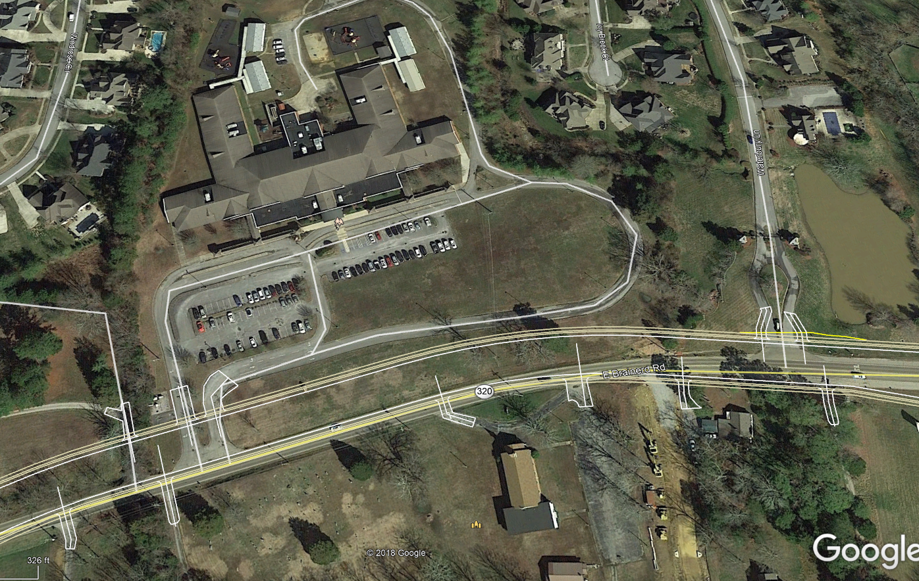
Westview Elementary School
WESTVIEW ELEMENTARY SCHOOL
EAST BRAINERD ROAD
THE CEMETERY OR DRIVE THRU AT WESTVIEW ELEMENTARY SCHOOL
CEMETERY
CORNERSTONE COMMUNITY CHURCH

Slide 12
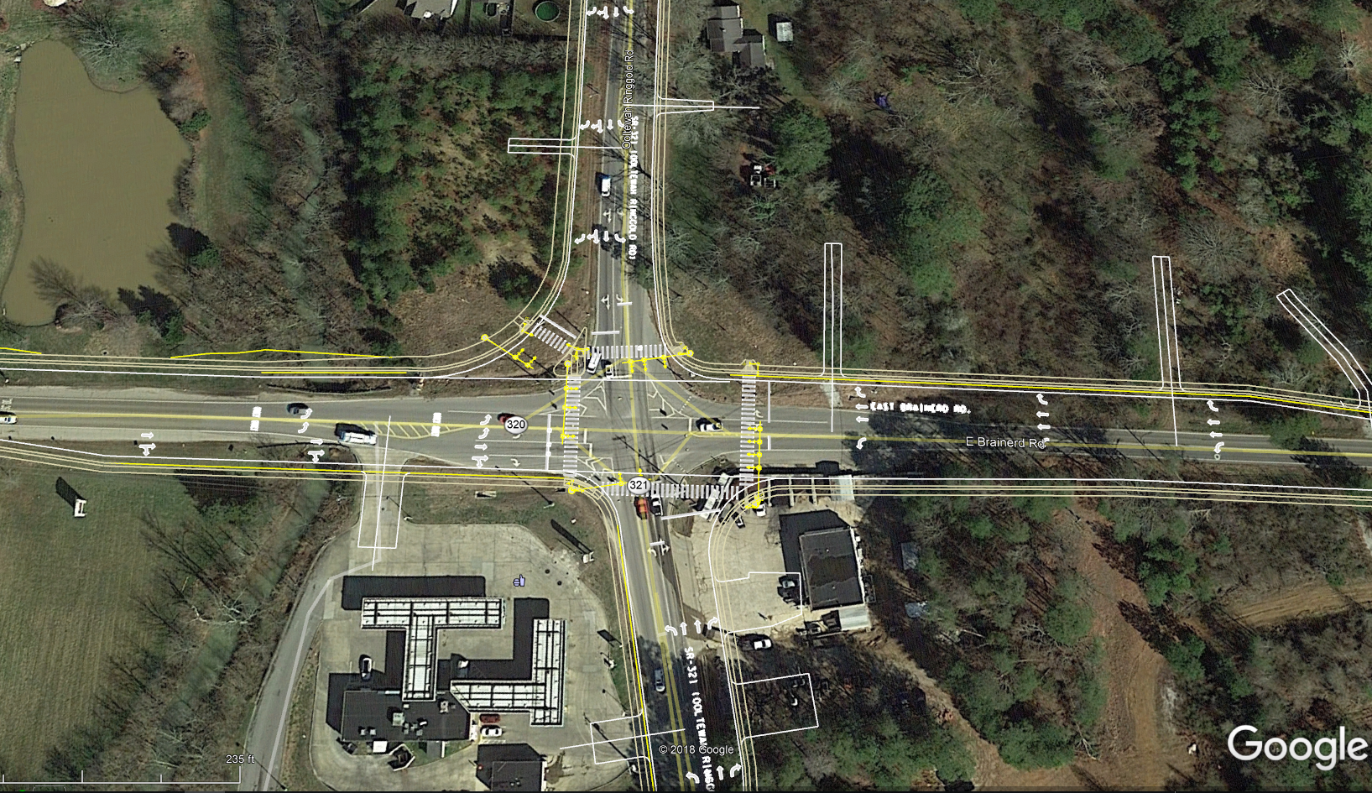
East Brainerd Rd/Ooltewah-Ringgold Rd Intersection
ADDITION OF TURN LANES
SIGNALIZED INTERSECTION
GAS STATION
Notes:
IMPROVE SAFEY AND OPERATIONAL EFFICIENCY

Slide 13
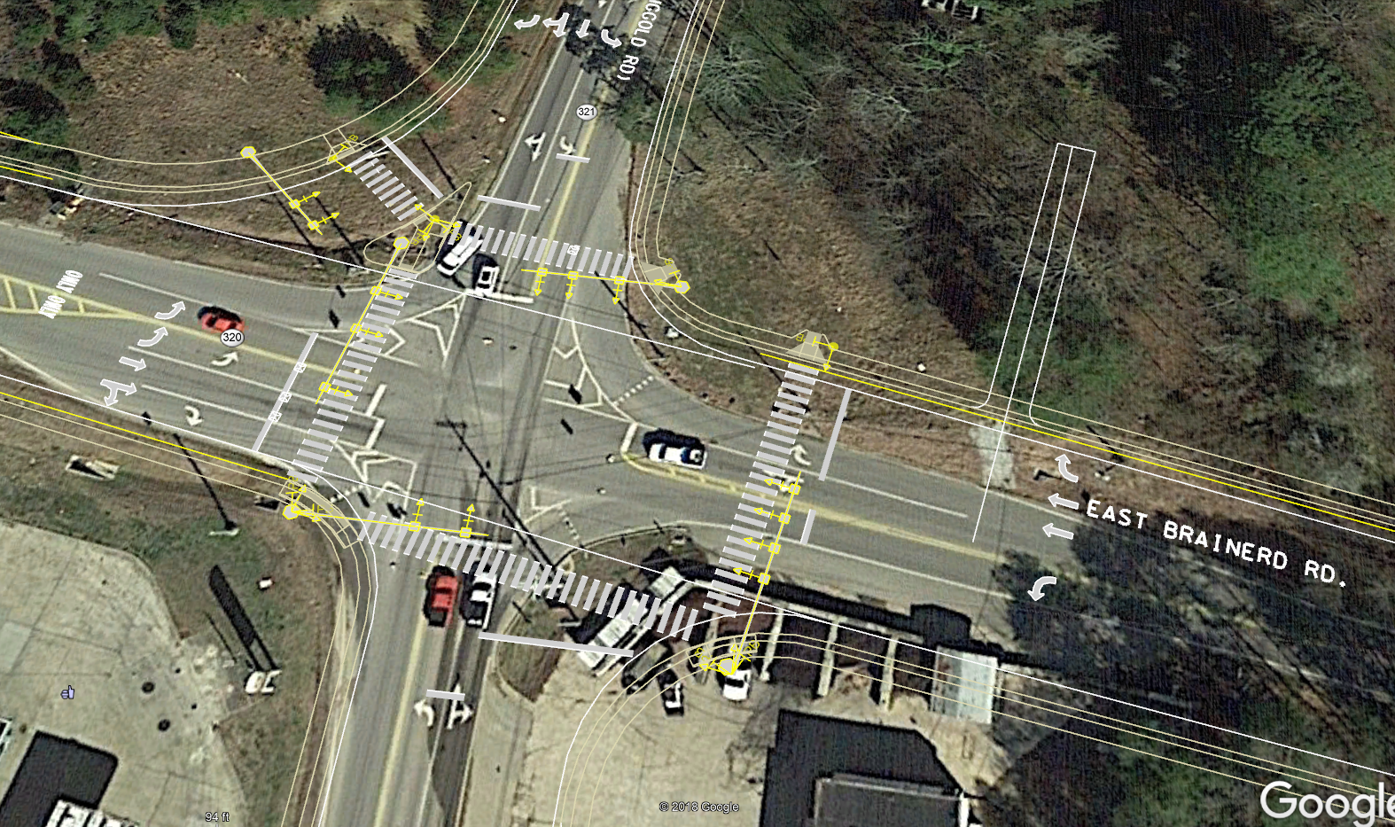
East Brainerd Rd/Ooltewah-Ringgold Rd Intersection
DEDICATED RIGHT TURN MOVEMENT
2 LEFT TURN MOVEMENTS

Slide 14
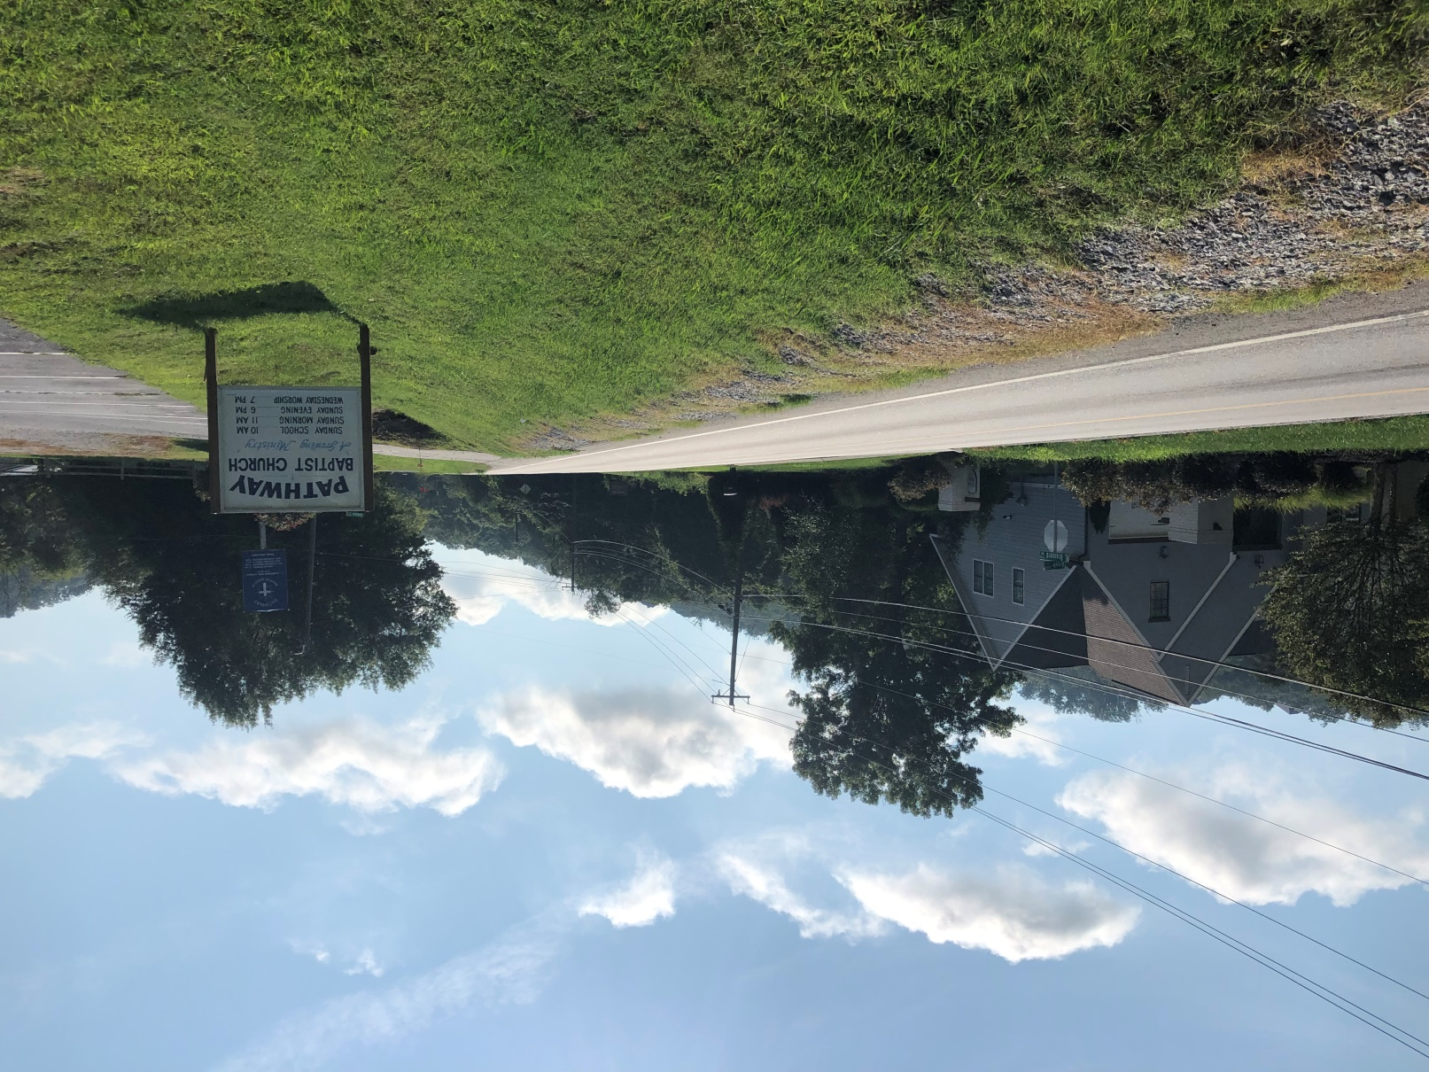
East Brainerd Road (Limit of Const)
END OF PROJECT

Slide 15
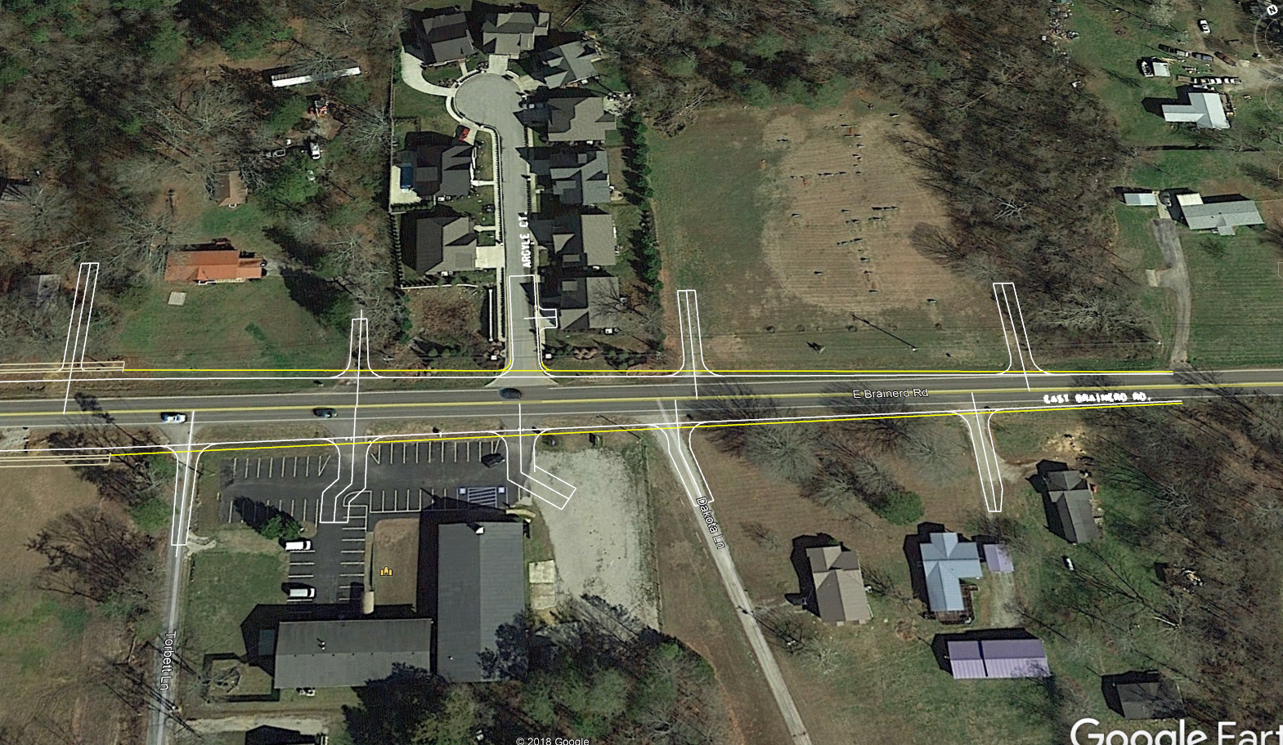
PROJECT END (East of East Brainerd Road)
LIMIT OF CONSTRUCTION
PATHWAY BAPTIST CHURCH
AERIAL VIEW OF END OF PROJECT

Slide 16
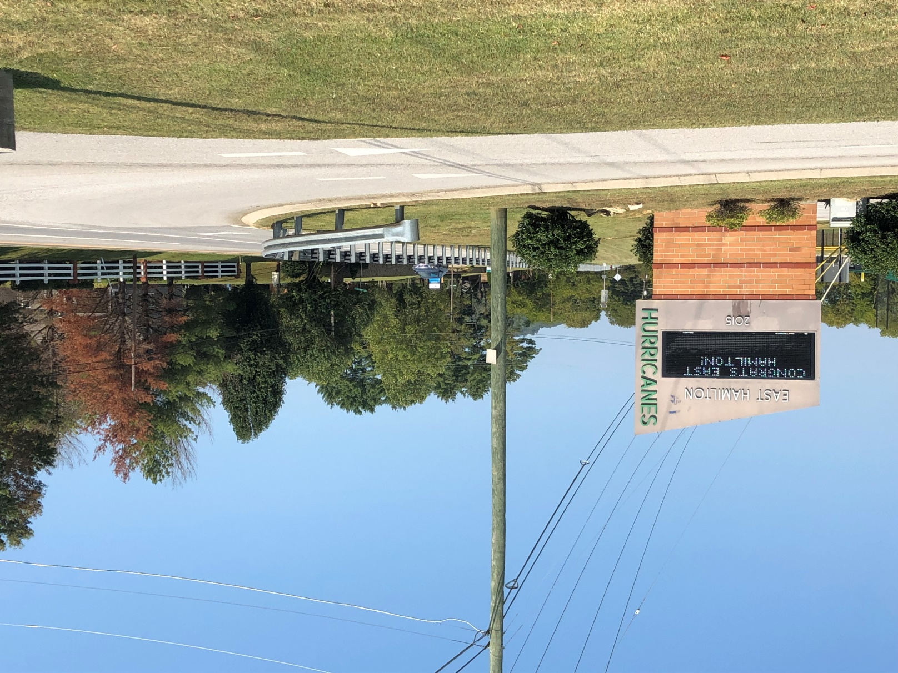
Ooltewah-Ringgold Road (Limit of Const)
END OF PROJECT NORTH OF EAST HAMILTON MIDDLE HIGH SCHOOL

Slide 17
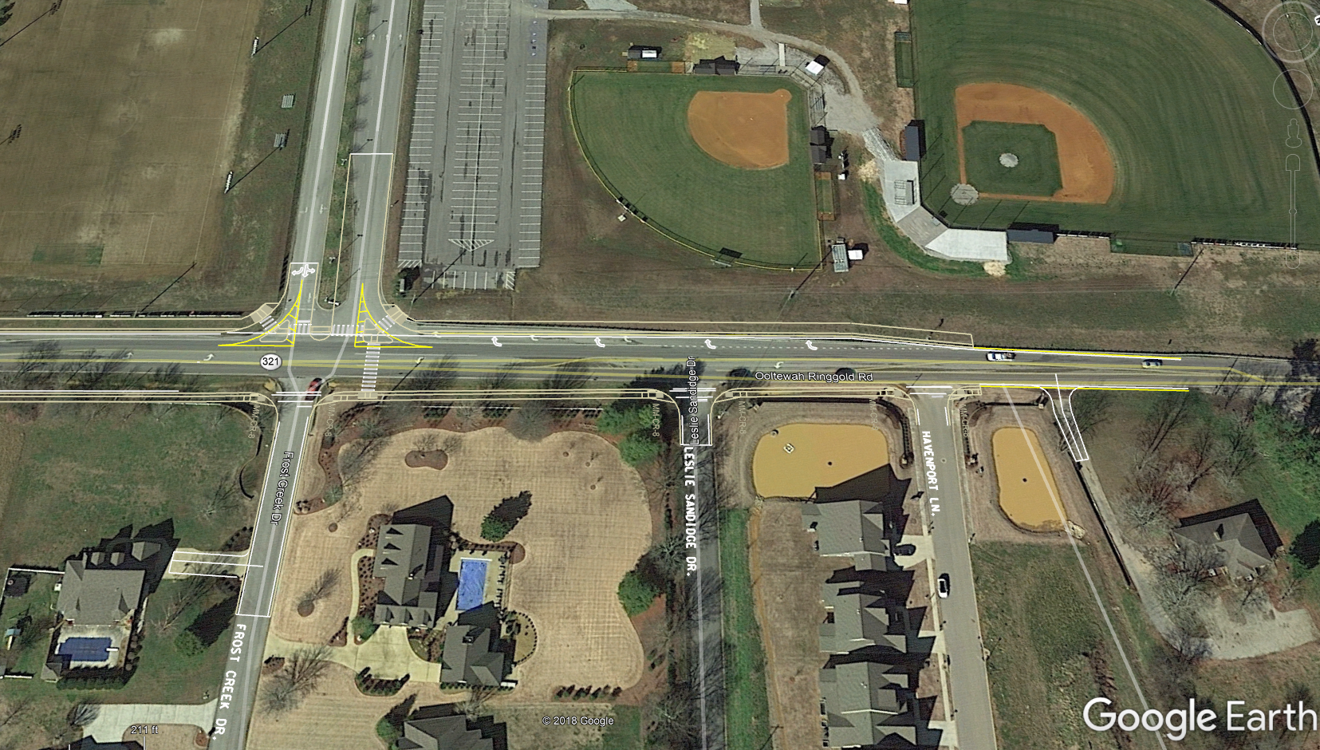
PROJECT END (North of Ooltewah-Ringgold Rd)
LIMIT OF CONSTRUCTION
EAST HAMILTON MIDDLE HIGH SCHOOL
FROST CREEK DRIVE
HAVENPORT LANE
END OF PROJECT PAST EXISTING RIGHT TURN LANE TO EAST HAMILTON SCHOOL

Slide 18
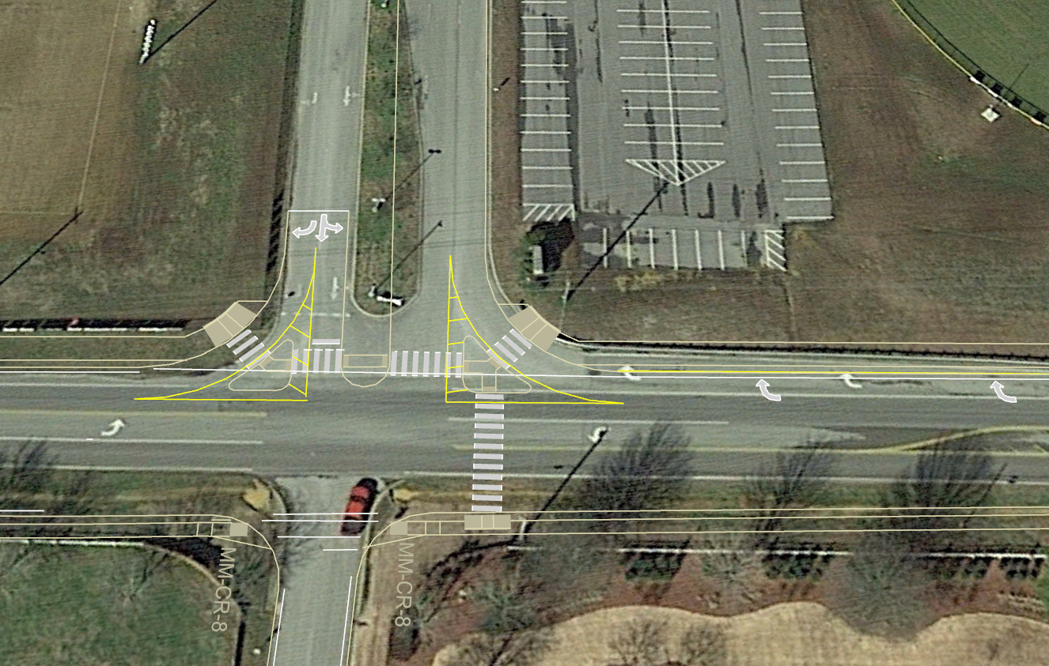
Intersection of East Hamilton Middle High
MID BLOCK PEDESTRIAN CROSSING
RIGHT TURN LANE GOING SOUTH INTO SCHOOL WILL REMAIN
FROST CREEK DRIVE

Slide 19
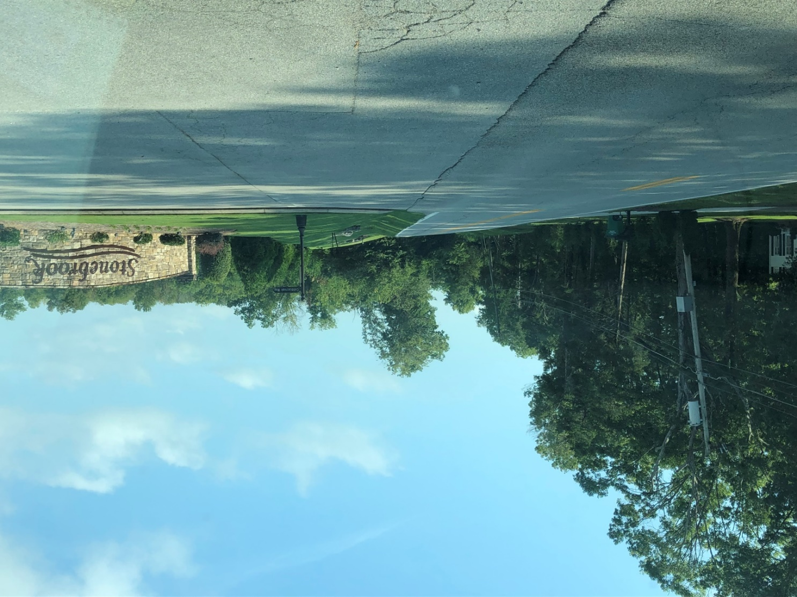
Ooltewah-Ringgold Road SE (Limit of Const)
SOUTH OF STONEBROOK WILL BE END OF PROJECT

Slide 20
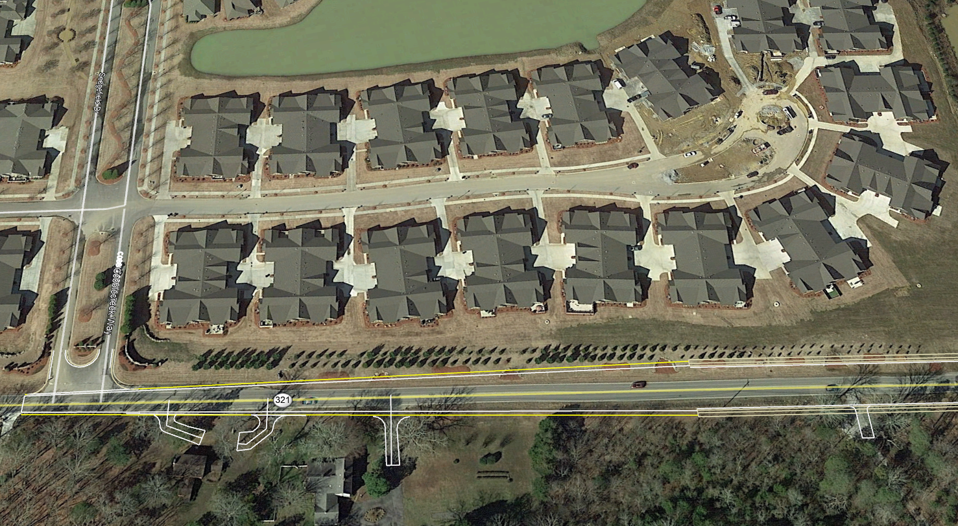
PROJECT END (South of Ooltewah-Ringgold Rd)
STONEBROOK
LIMIT OF CONSTRUCTION
AERIAL VIEW

Slide 21
PROJECT INFORMATION
TDOT Design and ROW Representatives are present to answer your questions regarding:
General project limits
Major design elements
Right-of-way process

Slide 22
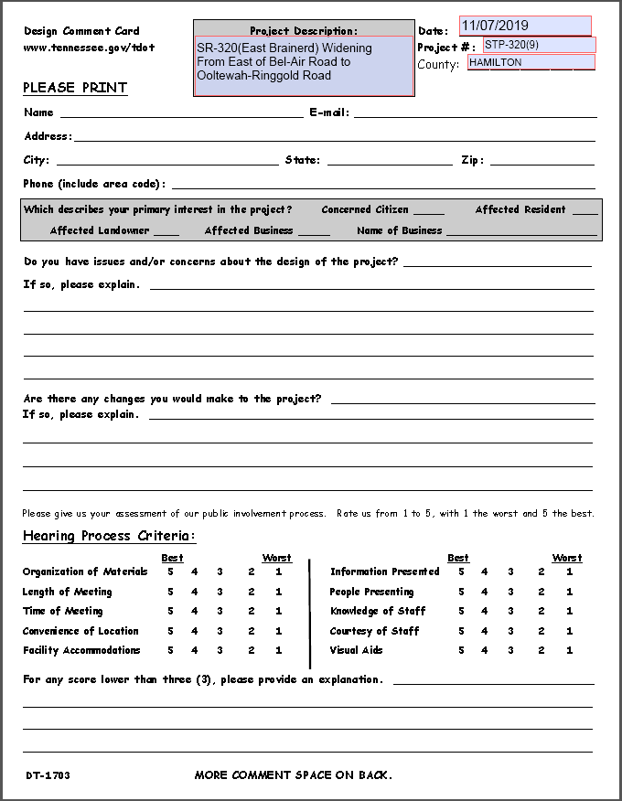
PUBLIC INPUT
3 ways to give your input:
(By November 28, 2019) Mail-in your comments or Email us with your comments at TDOT.Comments@tn.gov
Written comments on comment cards can be turned in at sign-in table
One-on-one comments with court reporter and Q & A

Slide 23
HAMILTON COUNTY
East Brainerd (SR-320),
From East of Bel-Air Road
To Ooltewah-Ringgold Road (SR-321)
Curt Duncan - C.E. Manager 1 and Jason Ingram - Transportation Project Specialist Supervisor 2 (TDOT Region 2 Project Development)

