Slide 1
TENNESSEE DEPARTMENT OF TRANSPORTATION
TITLE VI OF THE CIVIL RIGHTS ACT OF 1964 TRAINING
TDOT’s CIVIL RIGHTS DIVISION

Slide 2
Title VI is a Federal Law
Title VI of the Civil Rights Act of 1964 (42 U. S.C. 2000d et seq.)
The law states:
“No person in the United States shall, on the grounds of race, color, or national origin, be excluded from participation in, be denied the benefits of, or be subjected to discrimination under any program or activity receiving federal financial assistance.”

Slide 3
Training Objectives
To ensure all management staff, subrecipients, contractees, and service beneficiaries are aware of the provisions of Title VI of the Civil Rights Act of 1964, and that the minimum requirements of its rules, laws, and regulations are met.
FIRST REASON
SECOND REASON

Slide 4
Other Nondiscrimination Authorities
The 1970 Uniform Act (42 U.S.C 4601) – protection for people whose real property is acquired, or who move as a result of projects receiving federal funds
Section 504 of the 1973 Rehabilitation Act(29 U.S.C 790) – protection for individuals with disabilities
Federal Highway Act of 1973 - Gender Added(23 U.S.C. 324)
The 1975 Age Discrimination Act (42 U.S.C 6101)
The Civil Rights Restoration Act of 1987

Slide 5
Title VI Compliance Requirements
As a recipient of federal funds, your agency must:
Appoint a Title VI Coordinator - a person who is a neutral party who ensures that the complaint process is administered properly. They may also serve as a point of contact for your agency and staff. They ensure that Title VI of the Civil Rights Act mandates are followed;
Participate in TDOT’s Title VI training;
Provide Title VI training to agency employees;
Develop and post a Title VI Nondiscrimination policy/statement in visible areas (to include agency’s website);
Monitor contractors and subcontractors’ ethnicity and gender and report DBE utilization;
REALLYGREATSITE.COM

Slide 6
Title VI Compliance Requirements (cont’d)
As a recipient of federal funds, your agency must:
Include Title VI nondiscrimination assurances in all contracts;
Inform customers about Title VI annually and disseminate information to the public (i.e., website, poster, utility bill, water bill, newspaper, radio, etc.);
Develop and post a Title VI Nondiscrimination policy/statement in
visible areas (to include agency’s website); and,
Acquire signed Title VI Nondiscrimination Assurances.

Slide 7
Promote the Utilization of Certified
Disadvantaged Business Enterprises
(DBEs)
Disadvantaged Business Enterprises (DBEs) are firms owned by
small, minorities, women-owned, and other socially and economically
disadvantaged persons.
As a recipient of federal funds, your agency must:
Provide the opportunity for participation on TDOT federally funded contracts by means of:
Conduct outreach to Certified DBEs on both goal and non-
goal projects;
2. Solicit Certified DBEs through all reasonable and available means
(e.g., pre-bid meetings, advertisement, TDOT DBE list, etc.);
3. Advertise with local and minority media resources;

Slide 8
Promote the Utilization of Certified
Disadvantaged Business Enterprises
(DBEs) (cont’d)
As a recipient of federal funds, your agency must:
4. Arrange times for presentation of bids, quantities,
specifications and delivery schedules in ways that facilitate
DBEs’ participation; and,
5. Ensure bid notices and requests for proposals are available to
DBEs in a timely manner.

Slide 9
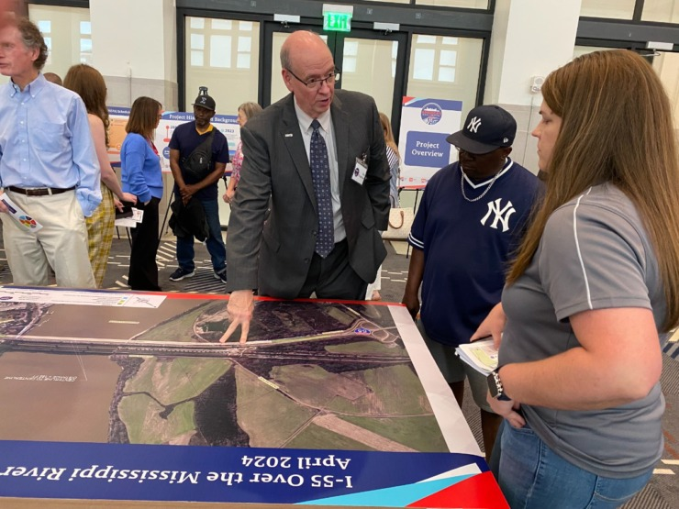
Develop a Public Participation Plan
Engage the public – make communities aware of your agency’s
projects and/or services to allow for input in the decision-making
process.
As a recipient of federal funds, your agency must:
Conduct public meetings/hearings in centralized locations
2. Conduct public meetings/hearings at convenient times for
communities that will be impacted
3. Advertise with local and minority owned media resources

Slide 10
Ensure Contractors and Subcontractors Follow the Same Guidelines
Subrecipients must ensure that all contractors and subcontractors awarded TDOT funded contracts adhere to Title VI and all other nondiscrimination authorities.

Slide 11
Minority and Women Representation on Planning Boards and Commissions
The inclusion of minorities and women on planning boards and commissions is critical in establishing an equal access planning system. Subrecipients cannot “deny a person the opportunity to participate as a member of a planning, advisory, or similar body which is an integral part of the program.”

Slide 12
Have a Written Title VI Complaint
Process and Compliant Log
A recipient’s complaint process, must:
1. Instruct on how to file a complaint;
2. Notify the complainant that a complaint must be filed within 180
days of the alleged occurrence or when the alleged
discrimination became known to the complainant;
3. Notify the complainant that the complaint should be in writing
and signed;
4. Inform complainant on determining the jurisdiction, acceptability,
and the need for additional information upon receipt;
5. Instruct complainant on other agencies a complaint could/should be
filed with for investigation, and that the complaint;
6. Provide a timeline for the length of investigation and final action
within 60 days; and,
7. Provide appeal instructions.

Slide 13
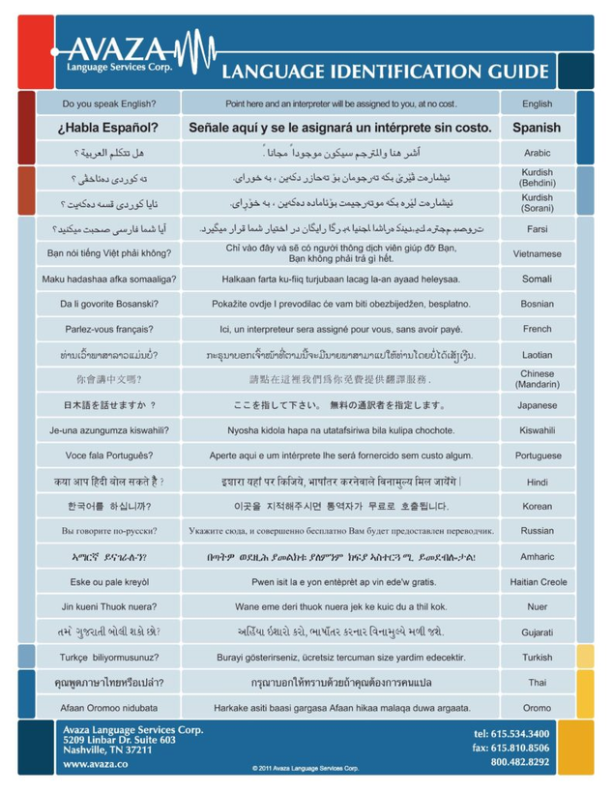
Limited English Proficiency (LEP)
Who is a LEP Person?
An individual who has a limited ability to read, write, speak, or understand English because English is not the individual’s primary language.

Slide 14
Conduct an Assessment of Community/County’s Population
Four Factor Analysis
1. Number or proportion of LEP persons eligible for services or likely to be
encountered;
2. The frequency with which LEP persons come into contact with the
program;
3. The nature and importance of the program, activity, or service provided
by the program agency); and,
4. Resources available and cost to the agency.

Slide 15
Evaluate Current Practices
Identify actions already being taken and existing tools that can be used to provide meaningful access;
Inventory existing materials that have been translated into other languages;
Ensure staff is aware of procedures; and,
Develop a response plan (have procedures in place to ensure
there are no barriers to participation in your programs and activities).

Slide 16
Noncompliance
Failure or refusal to comply with Title VI of the Civil Rights Act of 1964, other applicable Civil Rights Laws, and implementing departmental regulations.

Slide 17
Sanctions for Noncompliance
If your agency is found to be noncompliant with Title VI of the Civil Rights Act of 1964 and other nondiscrimination mandates, your agency is subject to:
Withholding of payments under the contract until compliance is met
Cancellation, termination, or suspension of the contract, in whole or in part

Slide 18
The following slides contain the U.S. Department of Justice’s videos for optional learning:

Slide 19
Understanding and Abiding by
Title VI of the Civil Rights Act of 1964

Slide 20
Providing Meaning Access
for Limited English Proficiency (LEP)

Slide 21
Title VI Program Staff & Contact Information
Jessica Starling, Civil Rights Division Director
Cynthia Howard, Title VI Program Director
Pamela Sharp, Title VI Specialist, Region 1 and Airports
James “Wes” White, Title VI Specialist, Regions 3 and 4
Robert Edwards, Title VI Specialist, Region 2 and Nonprofits
Phone: 615.741.3681
Toll Free: 1.888.370.3647
Title VI Website

