Slide 1
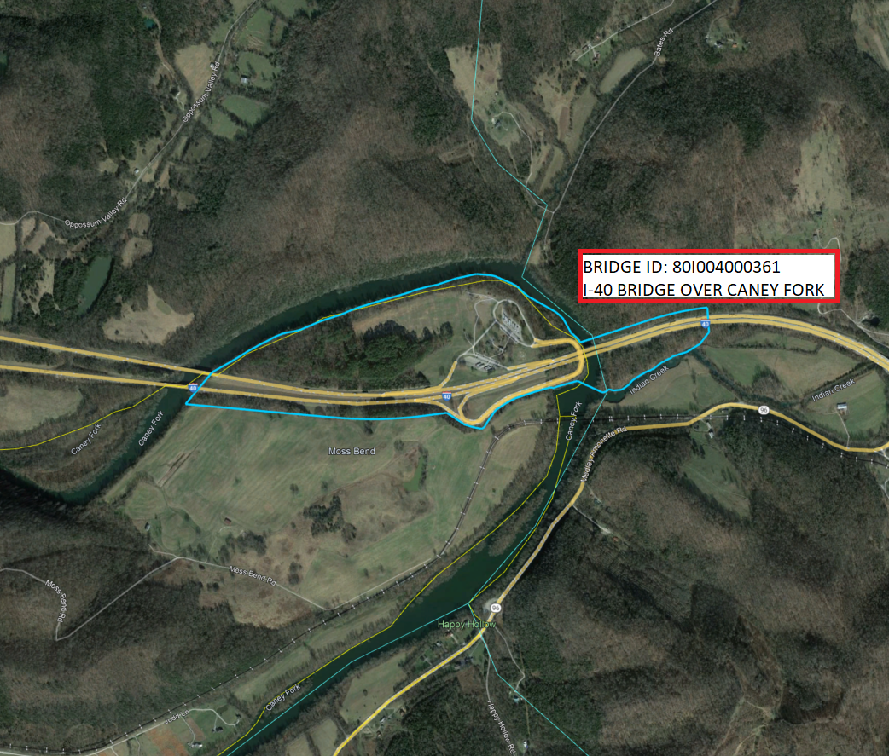
DB2502 – I40 Truck Parking & Bridges Replacement Smith County, TN
Design Builder
Mandatory Pre-SOQ Meeting
Miller Bernhardt P.E.
TDOT Region 3 Alternative Delivery
4-25-2025
Notes:
Welcome everyone to the Pre-SOQ Meeting for the I40 Bridges Replacement over the Caney Fork River and Improvements to the Smith County Rest Area. Today’s meeting will cover an overview of the project, coordination efforts, and key details about the recently released Request for Qualifications (RFQ).

Slide 2
Meeting Agenda
Team Introductions
Project Overview
TDOT Project Website
Design Build Process
RFQ & RFP Information
Key Takeaways
*PLEASE SIGN IN*
Notes:
Let's start with a quick look at today's agenda.
I will give an overview of the project and provide a high-level overview of the delivery method.
Please remember to sign in if you haven't done so already.

Slide 3
TDOT Alternative Delivery Team
*Selection Committee Chairperson*
Miller Bernhardt, P.E. TDOT Project Manager III 615-840-3954 miller.bernhardt@tn.gov
Region 3 Alternative Delivery Team
Jonathan Vogel, P.E.
Transportation Engineering Specialist Region 3
jonathan.vogel@tn.gov
Feroze Rashid, P.E.
Project Manager I Region 3
feroze.rashid@tn.gov
HMB Owner’s Rep Project Manager
Alex Carpenter, PE Project Manager acarpenter@hmbpe.com
Notes:
I'll now introduce the members of the TDOT Alternative Delivery Team
Talk about Chairperson role.

Slide 4
Project Overview
Project Goals
Provide a design and construction approach that minimizes inconvenience to the traveling public.
Minimize project delivery timeframes through streamlining the design and construction process to obtain final project acceptance no later than June 30, 2029
Optimize cost efficiency through design and construction innovation to complete the project within the allocated budget.
Notes:
Includes Design, Construction, and Utilities?
Construction complete no later than June 30, 2029

Slide 5
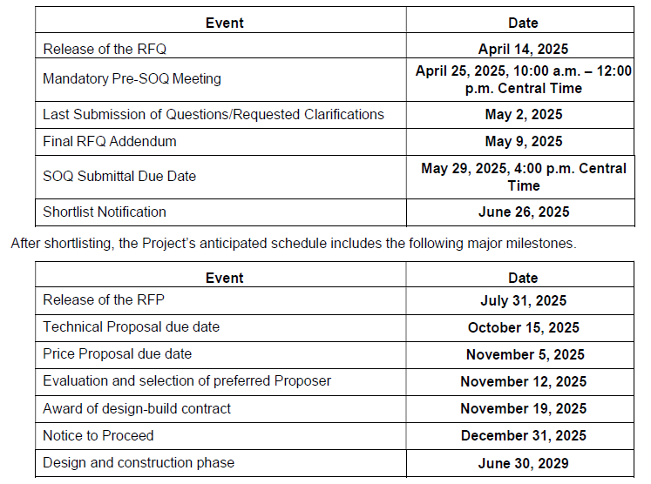
RFP Information
Key Events Schedule
You Are Here
Notes:
We are currently in the pre-proposal stage, with statement of qualifications due by May 29th , due by 4PM.

Slide 6
Project Overview
Project Description
Upgrading the acceleration and deceleration ramps to meet current national standards.
Construction of a new parking facility with approx. 125 additional truck spaces to the Smith County Welcome Center.
The existing twin structures on Interstate 40 over Caney Fork River (Bridge Nos. 80I004000035 and 80I004000036) are to be replaced. The proposed roadway section across the bridge shall accommodate six through lanes and shoulders with a design speed of 70 mph while increasing the vertical clearance to meet current standards.

Slide 7
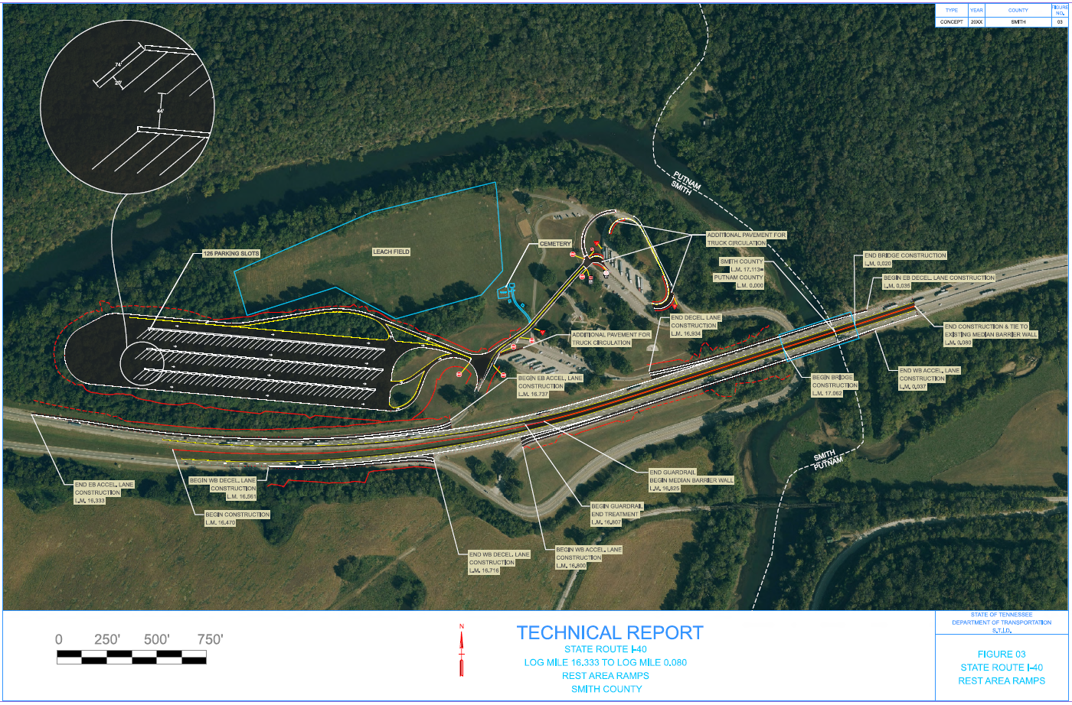
Project Overview
Notes:
The ETSA Boundary has been established, and the Draft Environmental Document is currently under review. No Right of Way (ROW) acquisition is anticipated for this project.

Slide 8
Project Overview
Current Progress
INFRA Grant Application in Review
ETSA Boundary Established
NEPA Document in Review
Bridge Structure Concepts, awaiting approval

Slide 9
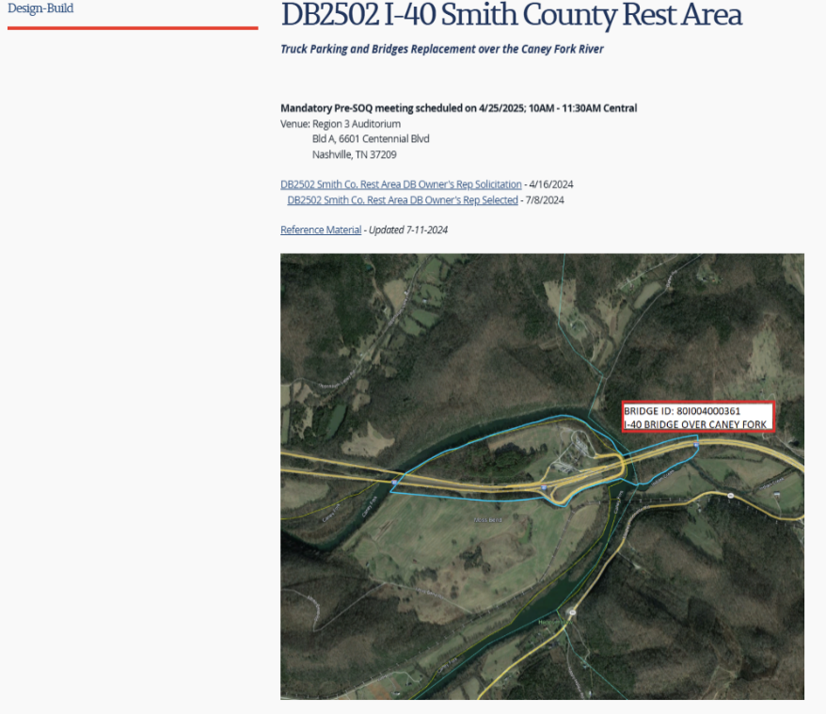
Project Website
Current Information
RFQ
Reference Material
Future Information
Mandatory Pre-SOQ Presentation
Mandatory Pre-SOQ Attendee List
RFQ Addendums (if applicable)
RFP
https://www.tn.gov/content/tn/tdot/alternative-delivery/design-build/db2502-i-40-smith-county-rest-area.html
Notes:
All current information, including the RFQ and reference material, is available on the TDOT project website. This will be updated as additional information is publicly released.
EBR and TEER documents
Historical Bridge and Repair Plans
Bridge Inspection Reports
QR Form
Sample Pre-Construction Agreement

Slide 10
Design Build Process

Slide 11
Design Build Process
Two-phase Procurement Process
Phase 1: Request for Qualifications (RFQ)
Phase 2: Request for Proposals (RFP)
Sole Point of Contact During Procurement (Advertisement to Award)
Mr. Miller Bernhardt, P.E.
Region 3 Alternative Contracting
Tennessee Department of Transportation
6638 Centennial Blvd.
Nashville, TN 37209
miller.bernhardt@tn.gov
615-840-3954
Notes:
The agreement will be like a Professional services contract.
Construction uses an itemized bridge/roadway contract like a traditional TDOT contract.
Additional information about Design Build and the process can be found on the Alternative Delivery webpage.

Slide 12
Design Build Process (RFQ Information)
Two Phase Procurement Process
Phase 1: Request for Qualifications (RFQ)
SOQ Scoring Criteria (100 points Total)
Organization (10 of 100 points)
Team Experience (50 of 100 points)
Key Individual Qualifications (40 of 100 points)
Short-Listing
TDOT will short list at least three of the most qualified Design-Builders.
TDOT will notify all teams submitting SOQs of their selection results.
The short-listed firms will be posted on the project website.
Short-listed Design-Builders will be invited to submit proposals in response to the RFP.
Notes:
The agreement will be like a Professional services contract.
Construction uses an itemized bridge/roadway contract like a traditional TDOT contract.
Additional information about Design Build and the process can be found on the Alternative Delivery webpage.

Slide 13
Design Build Process (RFP Information)
Two Phase Procurement Process
Phase 2: Request for Proposals (RFP)
The RFP Document Structure will include:
RFP Contract Book 1 (Instructions to Design-Builders – ITDB)
RFP Contract Book 2 (Design-Build Contract)
RFP Contract Book 3 (Project Specific Information)
Reference to Documents
Technical Proposals will be evaluated as Pass/Fail
From the passing Technical Proposals, project will be awarded to the lowest Price Proposal (A+B Bid)
Notes:
The agreement will be like a Professional services contract.
Construction uses an itemized bridge/roadway contract like a traditional TDOT contract.
Additional information about Design Build and the process can be found on the Alternative Delivery webpage.

Slide 14
Key Takeaways
Project Completion June 30, 2029
Innovations should help achieve project goals
Design Build Process
Notes:
To wrap up, remember these key points

Slide 15
Questions
*DON’T FORGET TO SIGN IN*
Notes:
Please don't forget to sign in if you haven't already.
We'll now open the floor to any questions.

