Slide 1


Fuel and Bituminous Payment Adjustments
Adam Guy, PE
Statewide Aviation Engineer
10/16/2025

Slide 2

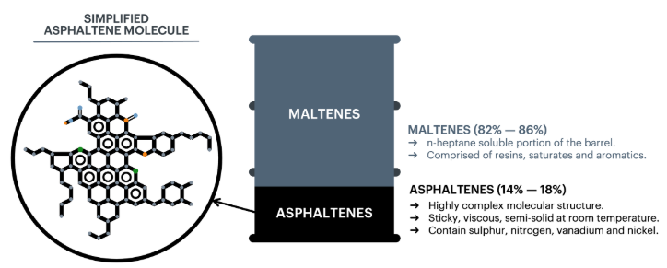
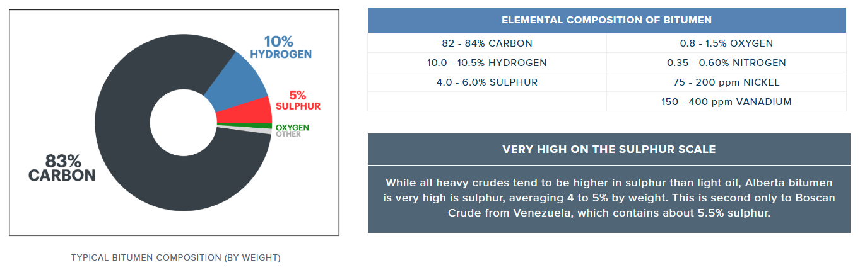
What is Bituminous Material?
Bitumen is a sticky, black, semi-solid form of petroleum that is commonly used in road construction and other applications.
Bitumen is composed of a complex mixture of hydrocarbons and other organic compounds, including long-chain molecules known as asphaltenes. This gives bitumen its characteristic sticky consistency and make it resistant to water and weathering. Bitumen is also rich in sulfur, which gives it its distinctive smell.
Commonly used in road construction
as a binder to hold together various
layers of pavement

Slide 3
Problem
Contractors are required to bid airport projects with significant bituminous, hauling, and earthwork quantities and hold their prices for an extended amount of time.
Contractors inflate prices as a contingency in the event of an unpredictable price increase of paving and fueling material.
Bituminous material, gasoline, & diesel pricing can be volatile in nature

Slide 4
Mission
Allow the contractor to bid an uninflated, market unit price which maximizes grant funding
To promote a low-risk environment for the Airport Sponsor and Contractor
Maximize number of bids by minimizing bidding uncertainty

Slide 5
Important Federal Guidance
FAA Reauthorization Act of 2024, Section 707 Price Adjustment Provisions
FAA R-PGL 25-05: Funding and Formula Changes
Draft FAA AC 150/5370-10J Standards for Specifying Construction of Airfields
FAA is now allowing submittal of MOS to allow for price adjustments in accordance with the project general specifications, since 10J is in draft version.

Slide 6
Aviation Special Provisions (ASP)
ASP109A and ASP109B were developed
Designed to mirror the way indexing is done on the TDOT Roadway side as contractors are accustomed to that already.
Designed to be added to contracts where material price volatility exists
If utilized, ASP109A and ASP109B should both be incorporated into the construction contract
“Peanut butter and Jelly”
Not intended to be precise, but accurate.
“Create a level playing field”

Slide 7
How it works – ASP109A Fuel Indexing
A Basic Fuel Index will be established based on the established TDOT “WEB Fuel Index” at the time bids are opened. The Basic Index is set during the month of project advertisement.
An estimated price per gallon of fuel for the contract will be established, along with the fuel price index. See ASP109A $/GAL Table on TDOT Aero Website for this value.
The estimated price per gallon of fuel is calculated by a weighted sum (assumes 20% gasoline and 80% diesel), derived by TDOT.
A payment adjustment is made to compensate for increases and decreases of 5% or more in the basic fuel price index compared to the fuel price index of the month in which work is performed, barring an unauthorized contract time overrun
Price Adjustment computations shall be performed on a monthly basis
Payment adjustments can only made for items of work associated with the contract that are specifically listed in ASP109A
Major excavation, embankment, subgrade, subbase, hauling, & paving items
ASP109A

Slide 8
How it works – ASP109B Bituminous Indexing
A Basic Bituminous Material Index will be established based on the established TDOT “Monthly Bituminous Material Index” at the time of project advertisement.
A payment adjustment is made to compensate for increases and decreases of 5% or more in the contractor’s material cost during the time of paving, barring an unauthorized contract time overrun
Price adjustment computations shall be performed monthly
Depending on if Virgin or Recycled Bituminous Material is placed, a specific formula is used from ASP109B.
The Asphalt Cement Percentage (AC %) from the Asphalt Job Mix Formula (Mix Design), approved by the Airport Engineer of Record (EOR), is utilized instead of actual placed AC % (i.e. use the optimum/target AC).
Since FAA Specification (AC 10H) Surface Treatments are typically paid by unit area and indexing adjustments work by unit volume, the ASP109B TAD Bituminous Adjustment Tool incorporates average application rates and number of applications. ASP109B clarifies AC Residue % to be adjusted for each type of bituminous surface treatment. Adjustments are applied per Table ASP 109-1.
ASP109B

Slide 9
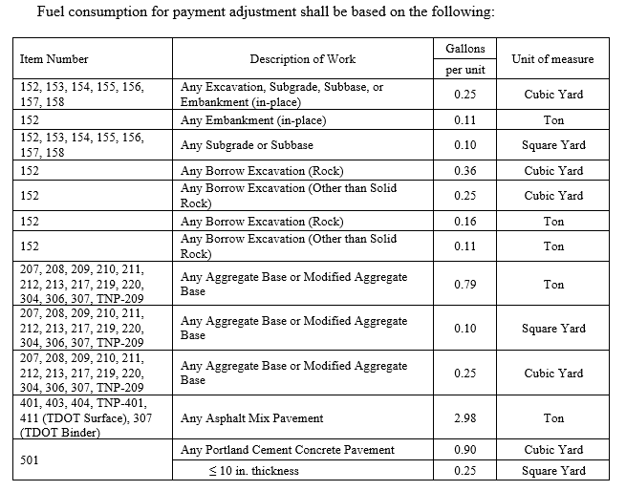
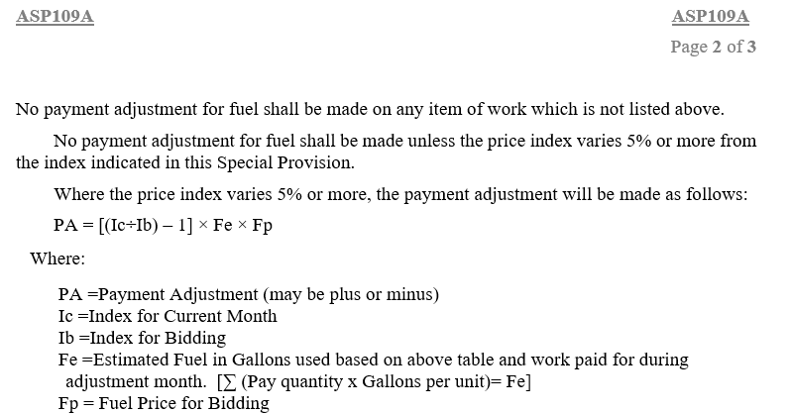
Example – Applying ASP109A and ASP109B
Fuel Payment Adjustment Formula
Fuel Payment Adjustment Eligible Items

Slide 10
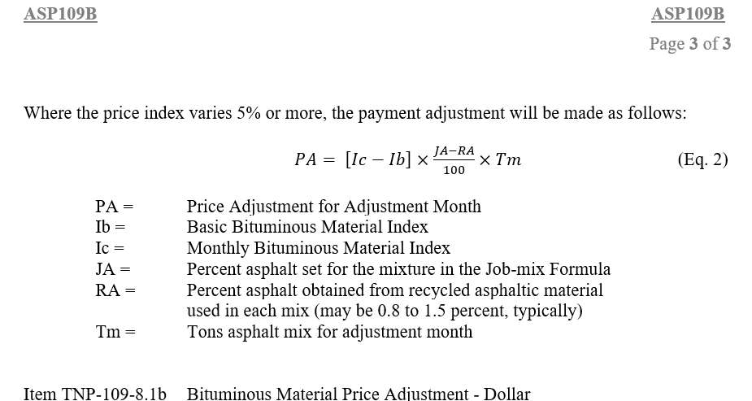
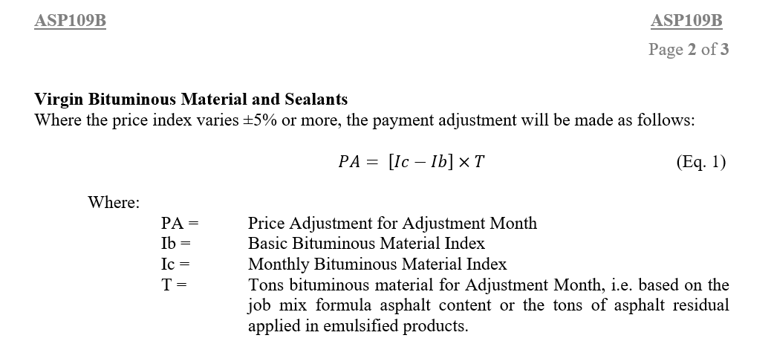
Example – Applying ASP109A and ASP109B
Bituminous Payment Adjustment Formula – without RAP
Bituminous Payment Adjustment Formula – with RAP

Slide 11
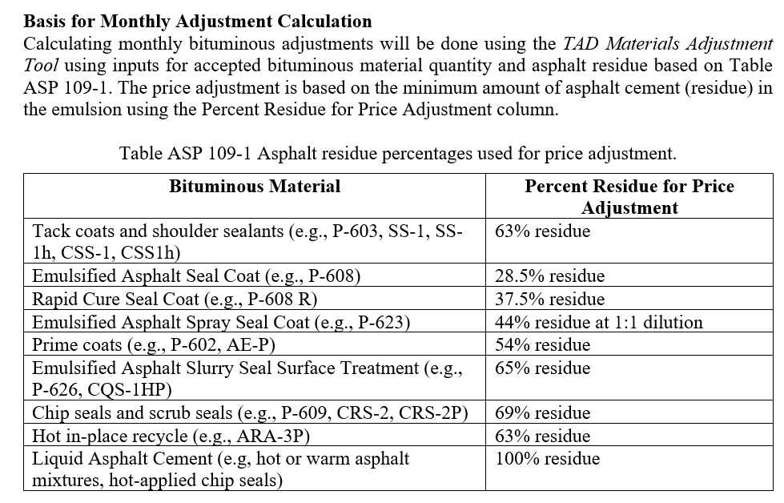
Example – Applying ASP109A and ASP109B
Table ASP 109-1 Emulsified Material Residue Assumptions

Slide 12
Example – Applying ASP109A and ASP109B
Contractor performed the following July 1 – July 31, 2022
P-152-4.1 Unclassified Excavation To On-Airport Embankment Areas – 3,300 CY
P-401-8.1 Asphalt Surface Course, 2” Lifts, ¾-inch Max. Aggregate Size, PG 70-22 (Runway) – 7,523.31 Tons
P-603-5.1 Emulsified Asphalt Tack Coat – 1500 GAL
TDOT 411E Asphalt Cement (PG64-22) (ACS), Gradation E (Roadway) – 501 Tons
P-623 Emulsified Asphalt Spray Seal Coat (Apron Area) - 5,000 SY

Slide 13
Example – Applying ASP109A and ASP109B
Fuel Index – December 2021 → 324.1 (gallons) @$2.51/gal
July 2022 Index → 524.3 (gallons)
Bituminous Index – February 2022 → 547.08 ($,ton)
July 2022 Index → 772.92 ($,ton)
This example is a hypothetical worst-case scenario

Slide 14
Example – Applying ASP109A and ASP109B
Contractor performed the following July 1 – July 31, 2022
P-152-4.1 Unclassified Excavation To On-Airport Embankment Areas – 3,300 CY → Fuel Adj. =$1,279.12; Bituminous Adj. = N/A
P-401-8.1 Asphalt Surface Course, 2” Lifts, ¾-inch Max. Aggregate Size, PG 70-22 (Runway) – 7,523.31 Tons → Fuel Adj. = $34,760.34; Bituminous Adj. = $103,642.92
Approved Job Mix Formula = 6.1% AC
P-603-5.1 Emulsified Asphalt Tack Coat – 1500 GAL→ Fuel Adj. = N/A; Bituminous Adj. = $960.38
TDOT 411E Asphalt Cement (PG64-22) (ACS), Gradation E (Roadway) – 501 Tons → Fuel Adj. = $2,314.80; Bituminous Adj. = $5,838.33
Approved Job Mix Formula = 5.6% AC; 0.44% RAP AC
P-623 Emulsified Asphalt Spray Seal Coat (Apron Area/ 2 Applications) - 5,000 SY → Fuel Adj. = N/A; Bituminous Adj. = $715.46
Table ASP 109-1 = 44% Residue
Total July Adjustments to Contractor
$38,354.26 Fuel
$111,157.09 Bituminous

Slide 15
Material Adjustment Spreadsheet
TDOT Aeronautics has developed a materials adjustment spreadsheet
Expedites and standardizes calculations
Reduces human error
Made available to the contractor
Documents adjustments on monthly invoices as needed
User-friendly

Slide 16
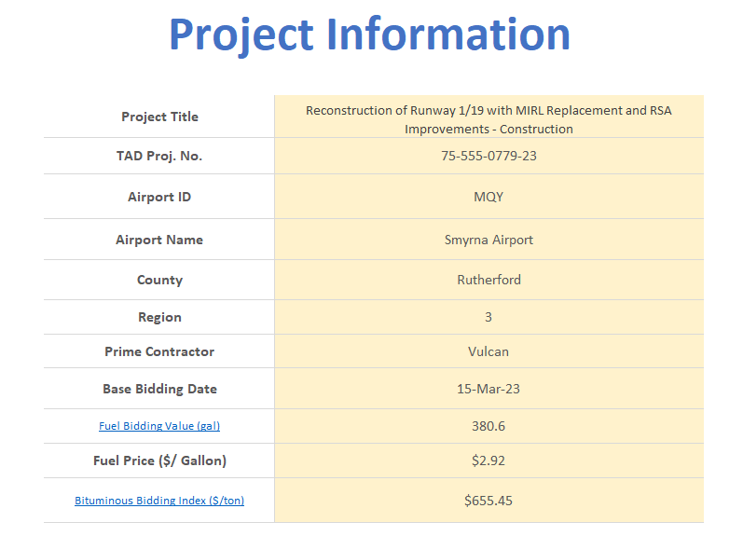
Basic Steps to Use Spreadsheet
Gain full understanding of ASP109A & ASP109B
Read “Overview” and “Start” tabs first.
Fill out “Project Information” tab

Slide 17
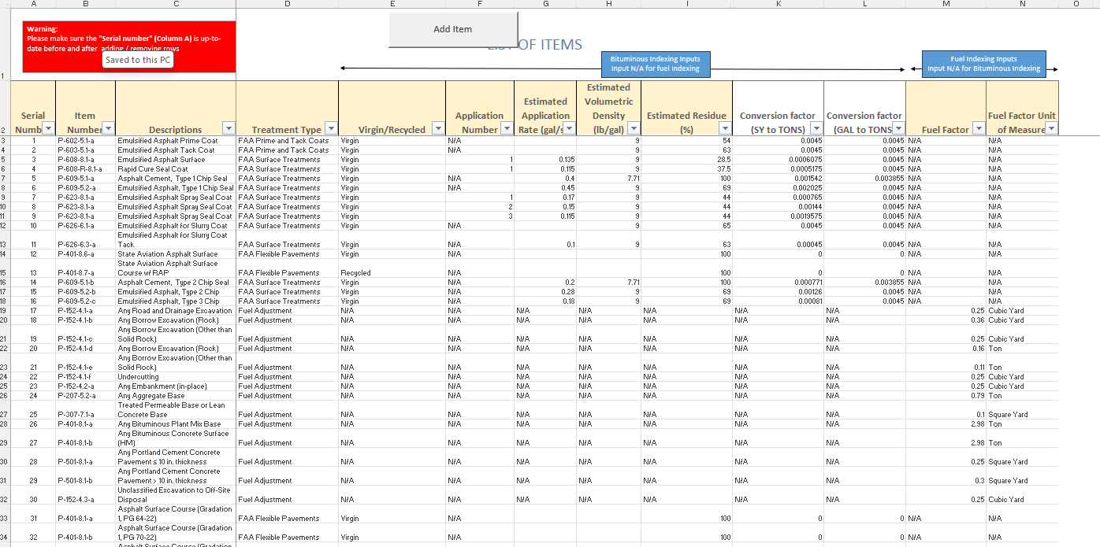
Basic Steps to Use Spreadsheet
Ensure Item Numbers for project are on “Item Lists” tab
Add Item button at top if not already listed. You can also start typing at the bottom.

Slide 18
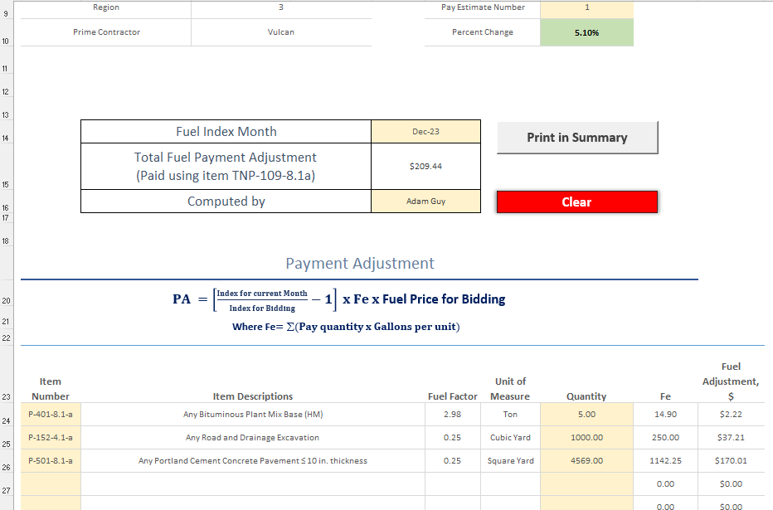
Basic Steps to Use Spreadsheet
Fill out “Fuel Index Calculations” tab for the monthly invoice
Save this page to PDF
Click Print in Summary button after filling it out

Slide 19
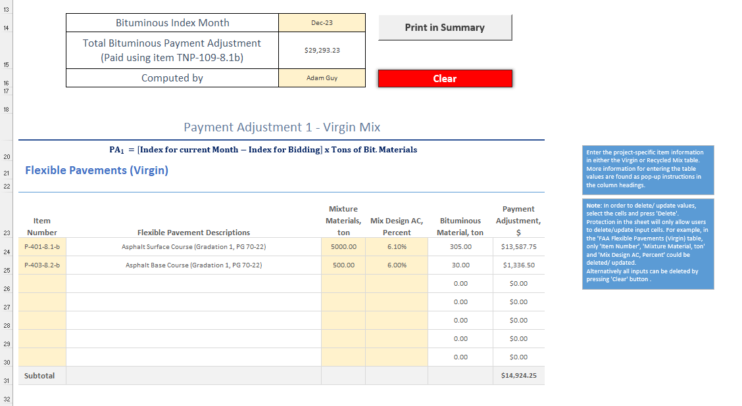
Basic Steps to Use Spreadsheet
Fill out “Bit Index Calculations” tab for the monthly invoice
Sections for Virgin Mix, Surface Treatments, Prime and Tack Coats, & Recycled Bit. Material
Save this page to PDF
Click Print in Summary button after filling it out

Slide 20
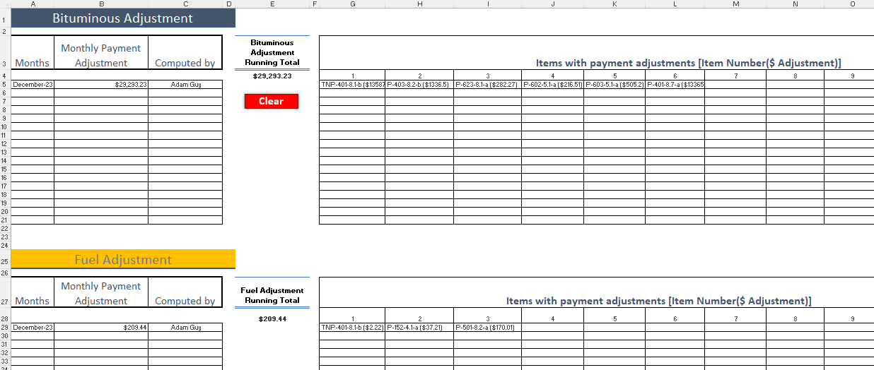
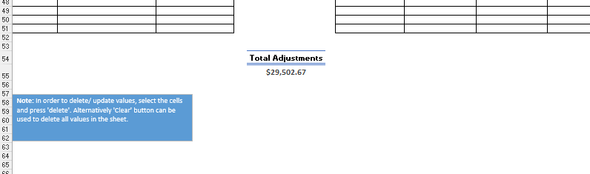
Basic Steps to Use Spreadsheet
Go to “Summary” tab
Review summary of fuel and bit. calculations
Save this page to PDF
Attach Fuel, Bit., and summary PDFs to invoice request
Follow protocol of ASP109A and ASP109B on how to show indexing on the monthly payform

Slide 21
Material Adjustment Spreadsheet - Summary
General Process
Fill out “Project Information” Tab at project start
Ensure applicable fuel and bituminous line items are on the “Item Lists” Tab
Every monthly contractor pay request, fill out “Fuel Index Calculations” & “Bit Index Calculations” Tabs and then click “Print in Summary” buttons
Attach the PDFs of the calculations’ tabs and the summary tab to your applicable monthly invoice to document the price deduction or increase.

Slide 22

Implementation
Discuss with your TDOT Project Manager during the 90% design meeting if ASP109A & ASP109B is right for the project.
The larger and longer the project, the more benefit, especially if bids are held for an extended period.
Critical – Include this as a mandatory talking point on your pre-bid conference agenda. Contractors need to understand if indexing is in the project or not as it will affect the way they price the job. Ensure contractors are aware it is the same as the way it is done on TDOT roadway projects.

Slide 23

Consideration
Calculations should be performed monthly; however, when indexing is in the form of a credit to the owner on an invoice (deduction), try to ensure this deduction is not performed on the last invoice. This could create a negative balance situation where the owner is asking for the contractor to give money back.

Slide 24
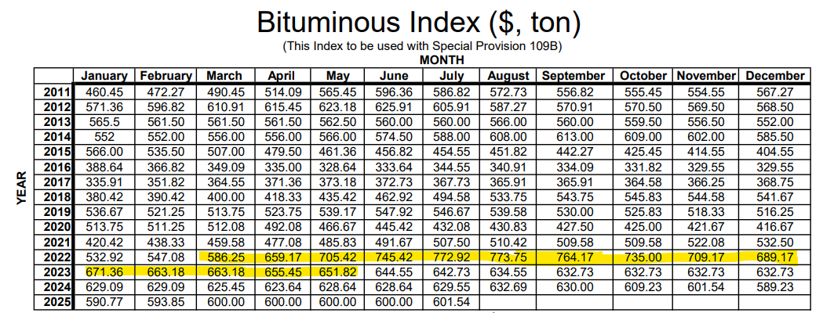
Test Case 1
Lafayette - Runway and Entrance Road Rehabilitation (ASP109B only)
March 24, 2022 Bid date
P-401 bid at $152/ton (RW 4000 tons) & $145/ton (Road 1500 tons)
Total of $63,215.25 credited to contractor
World Conflict February 2022

Slide 25
Test Case 2
Smyrna - Runway 1/19 Reconstruction and RSA Improvements (ASP109A & ASP109B)
May 16, 2023 Bid date
P-401 bid at $175/ton @12,990 tons
Engineer’s estimate was $190/ton
Total of $44,886.55 (Bituminous) and $39,703.26 (Fuel) credited to the Airport Sponsor
Global Oil demand declines

Slide 26

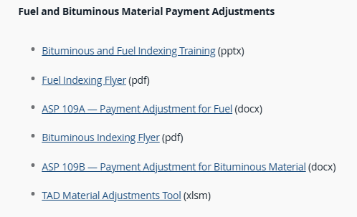
Resources
Fuel Indexing Flyer
ASP109A
Bituminous Indexing Flyer
ASP109B
TAD Material Adjustments Tool
https://www.tn.gov/content/tn/tdot/aeronautics.html/
Double Click →

Slide 27


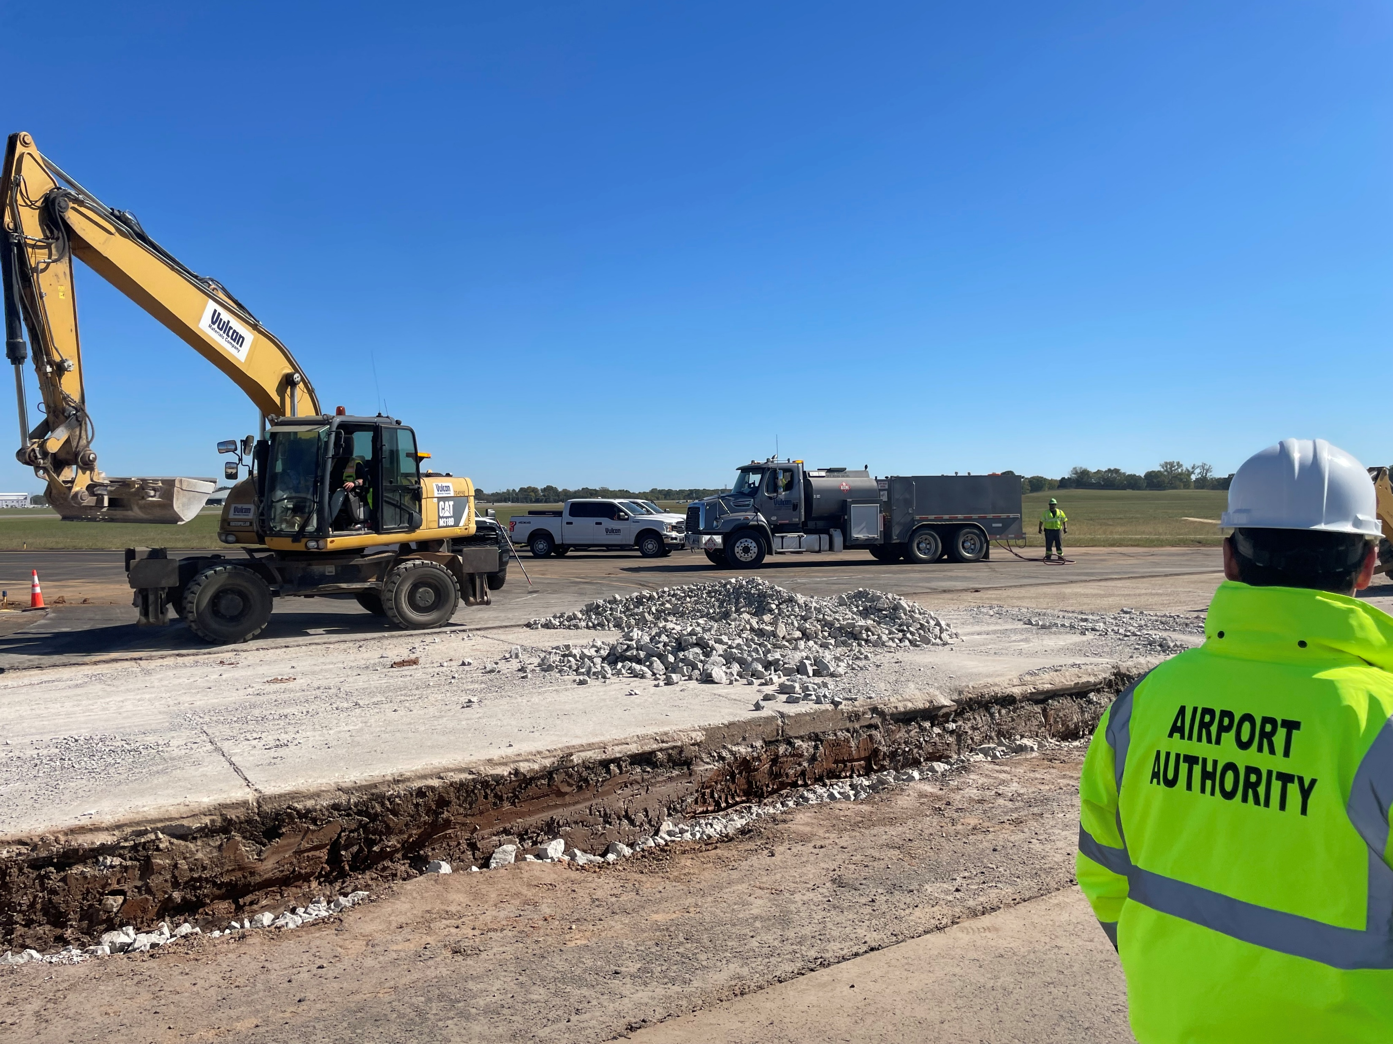



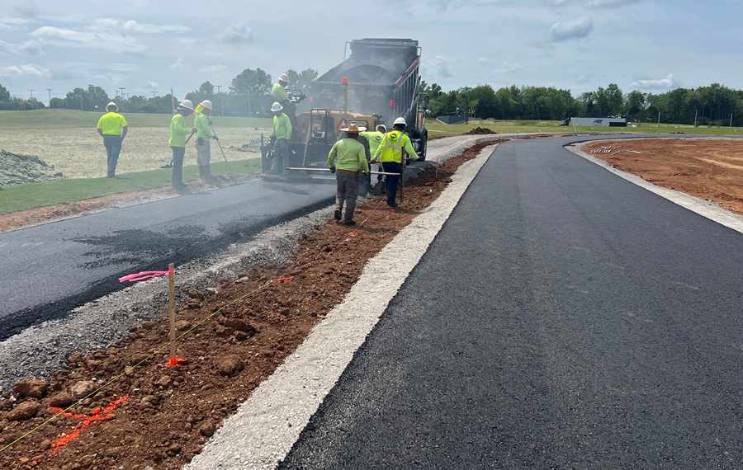
Contact Information
Adam Guy, PE
Adam.Guy@tn.gov
615-741-1531

