Slide 1
2018 National Association of State Aviation Officials (NASAO) Tennessee Art Contest Winners

Slide 2
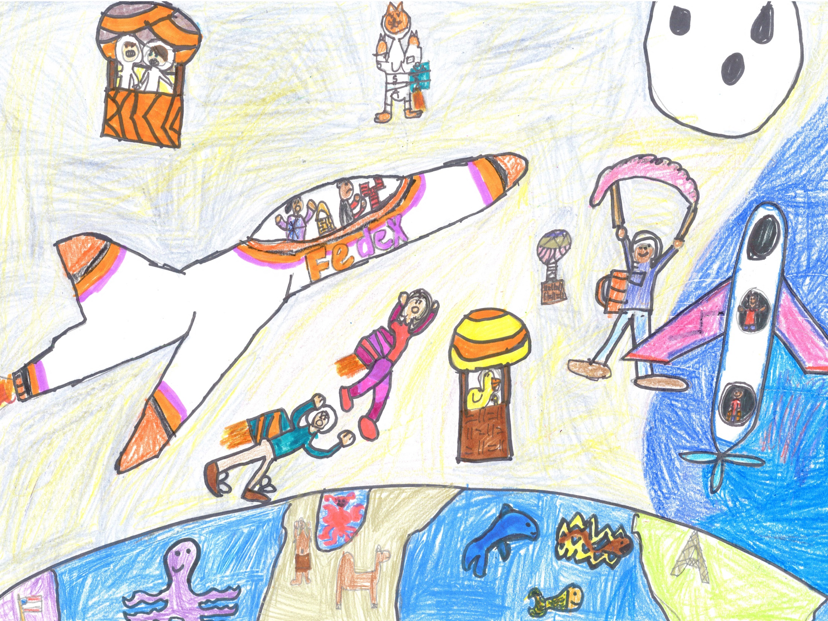
Kelsey Watson
E.A. Harrold Elementary
Junior 1st Place

Slide 3
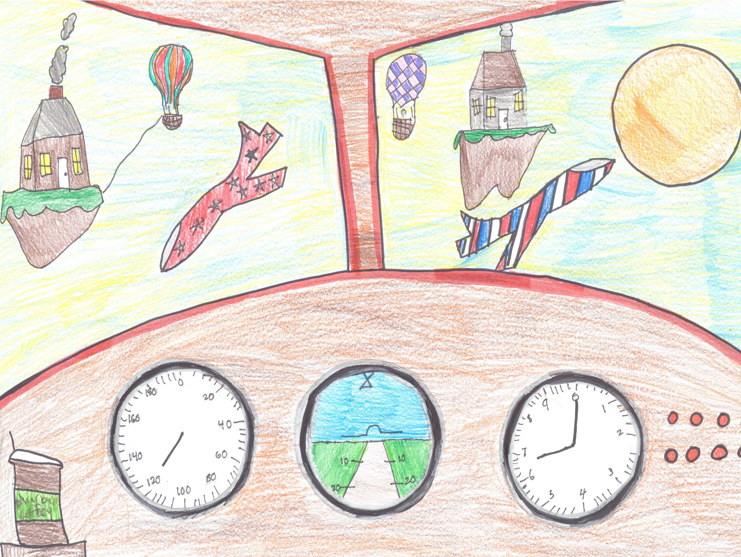
Adysen Dickson
E.A. Harrold Elementary
Junior 2nd Place

Slide 4
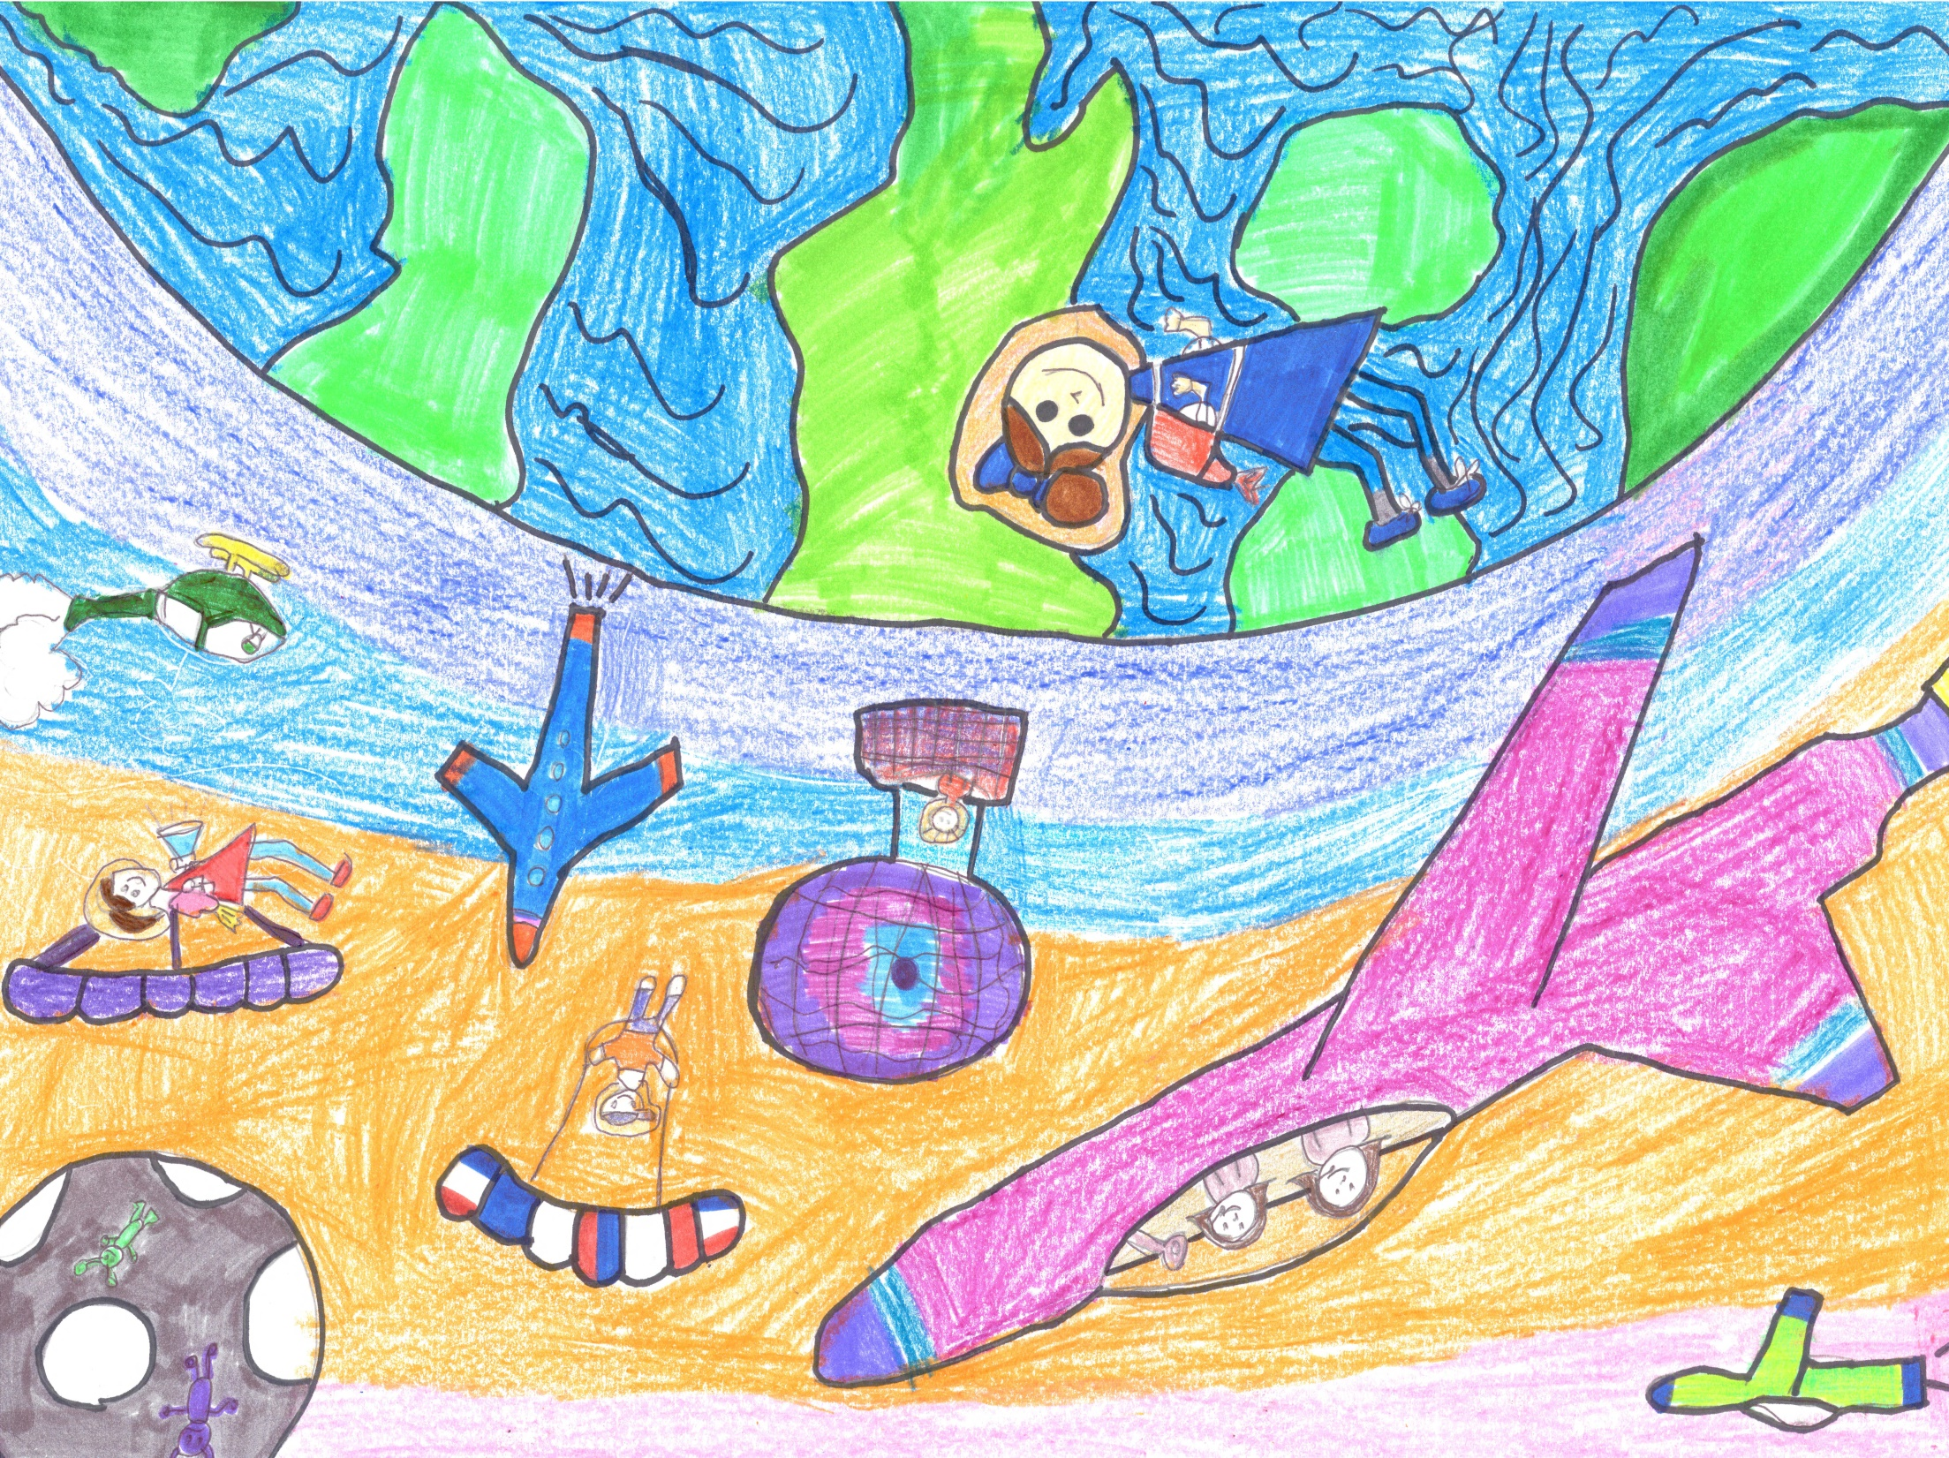
Jayme Tichenor
E.A. Harrold Elementary
Junior 3rd Place

Slide 5
Olivia Hart
Paris Elementary
Junior – Honorable Mention

Slide 6
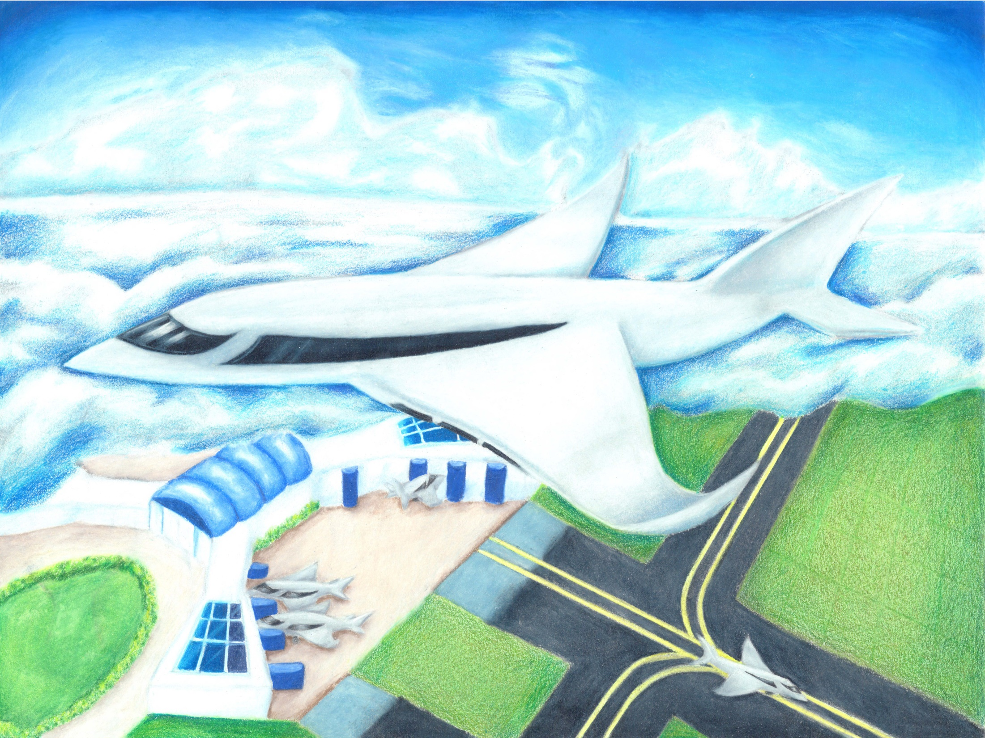
Angela Huo
Brentwood Middle School
Intermediate 1st Place
*State & National*

Slide 7
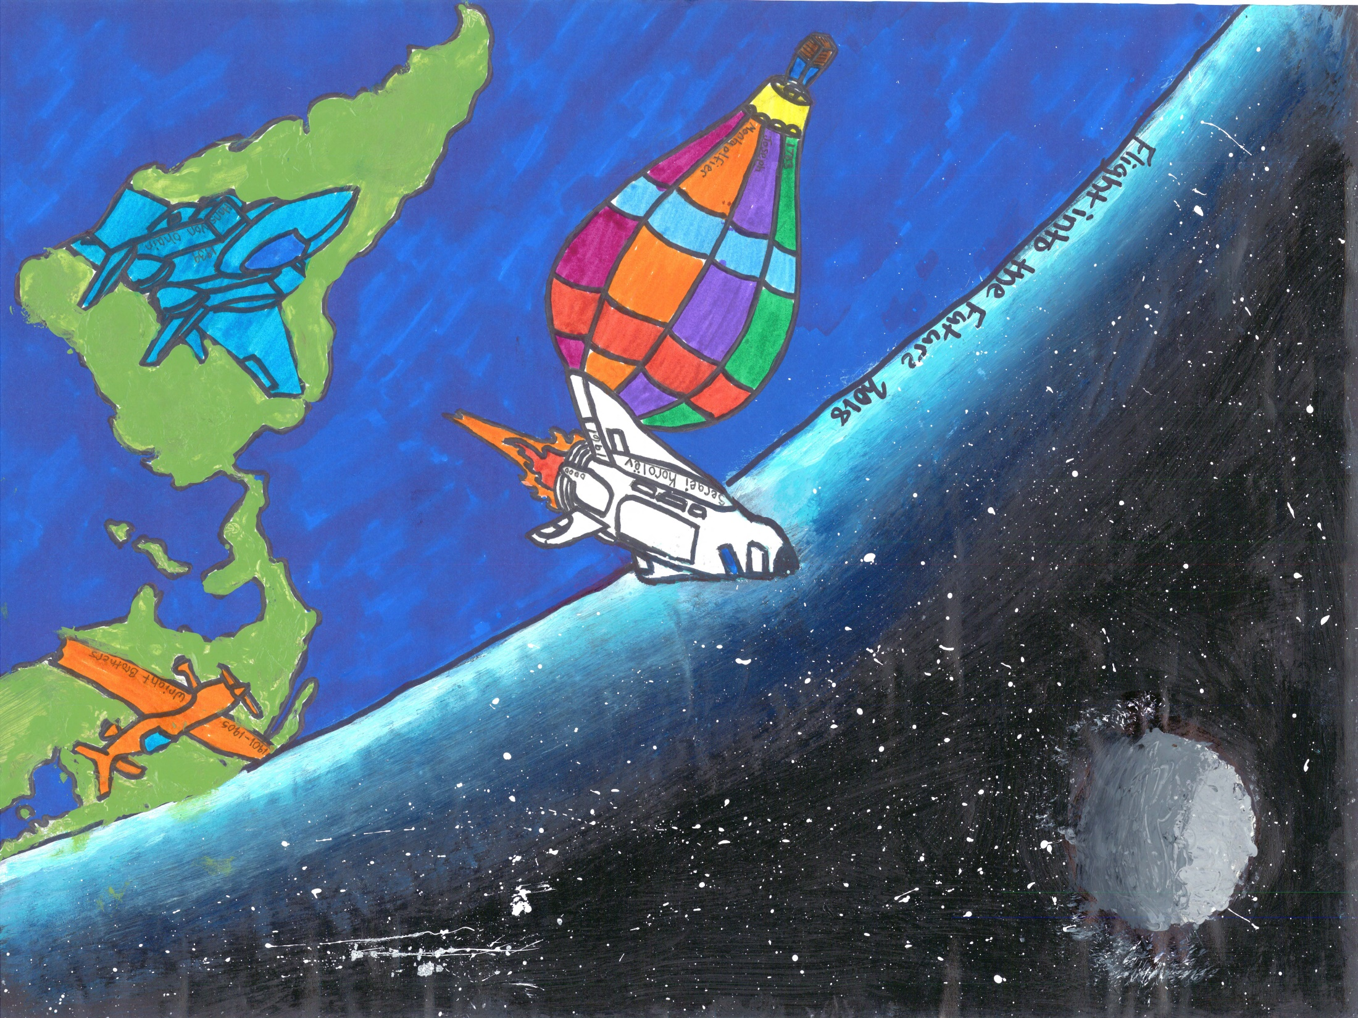
Blake Olive
Cascade Middle School
Intermediate 2nd Place

Slide 8
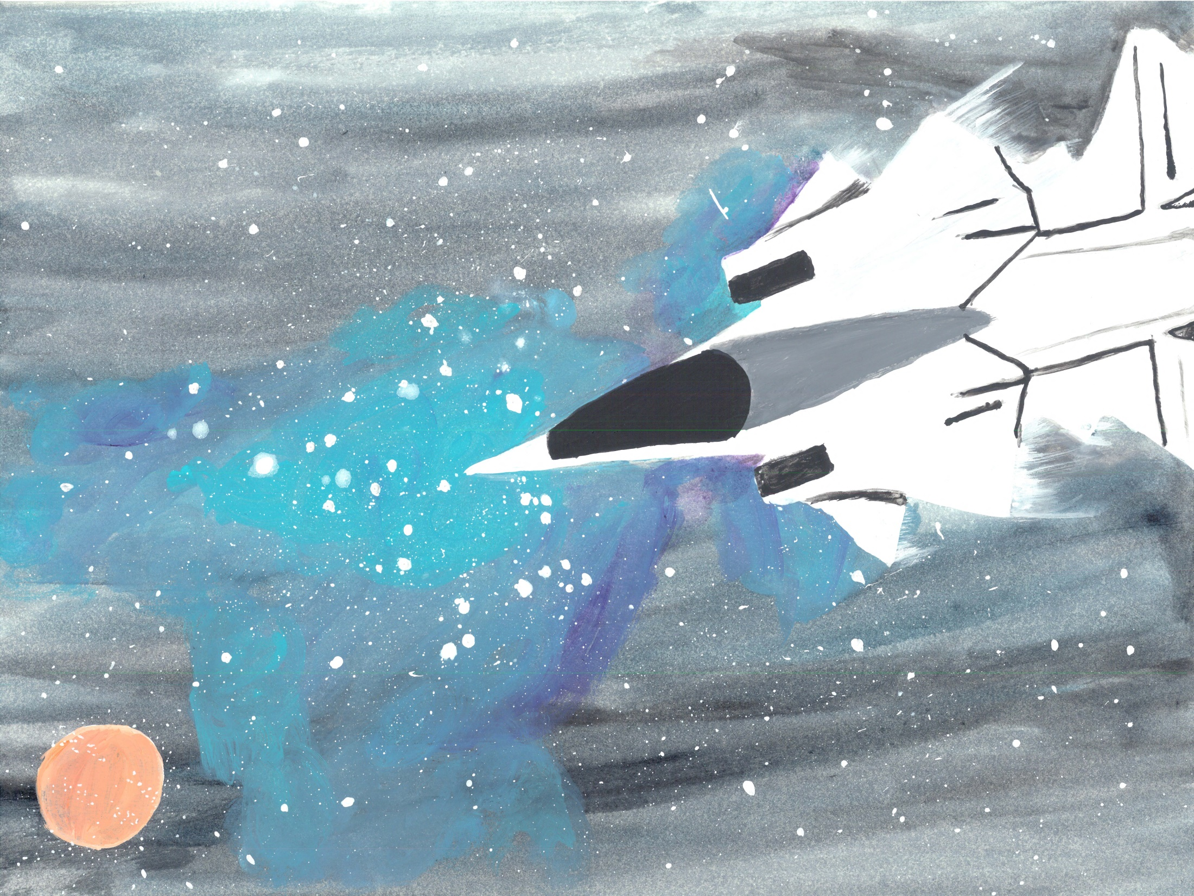
Emily Brown
HomeLife Academy
Intermediate 3rd Place

Slide 9
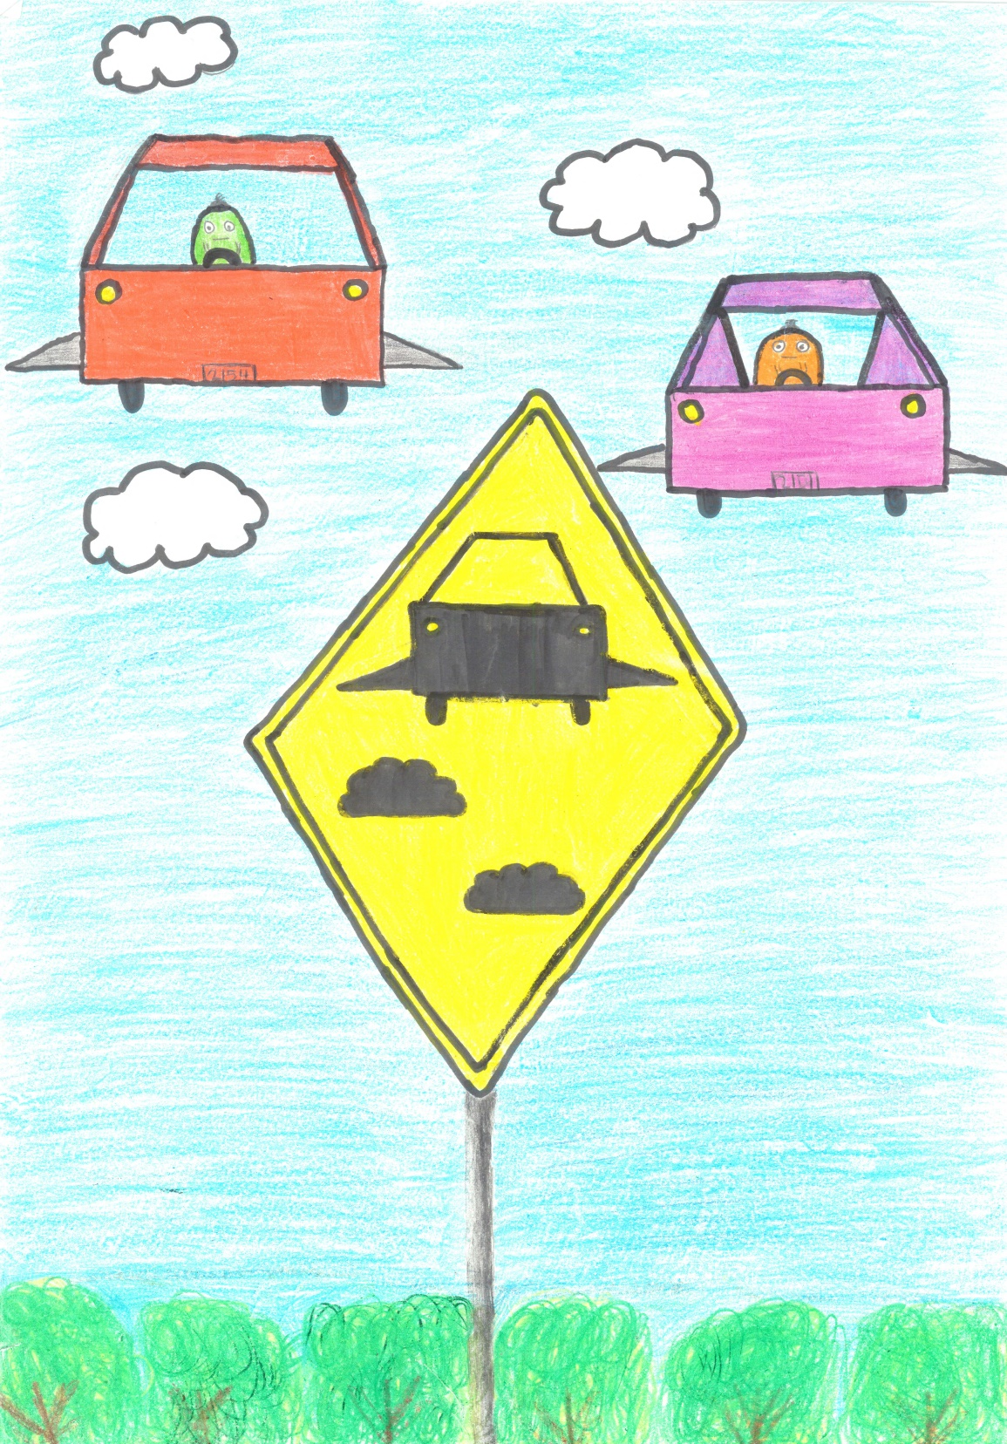
Elle Thompson
Cascade Middle School
Intermediate Honorable Mention

Slide 10
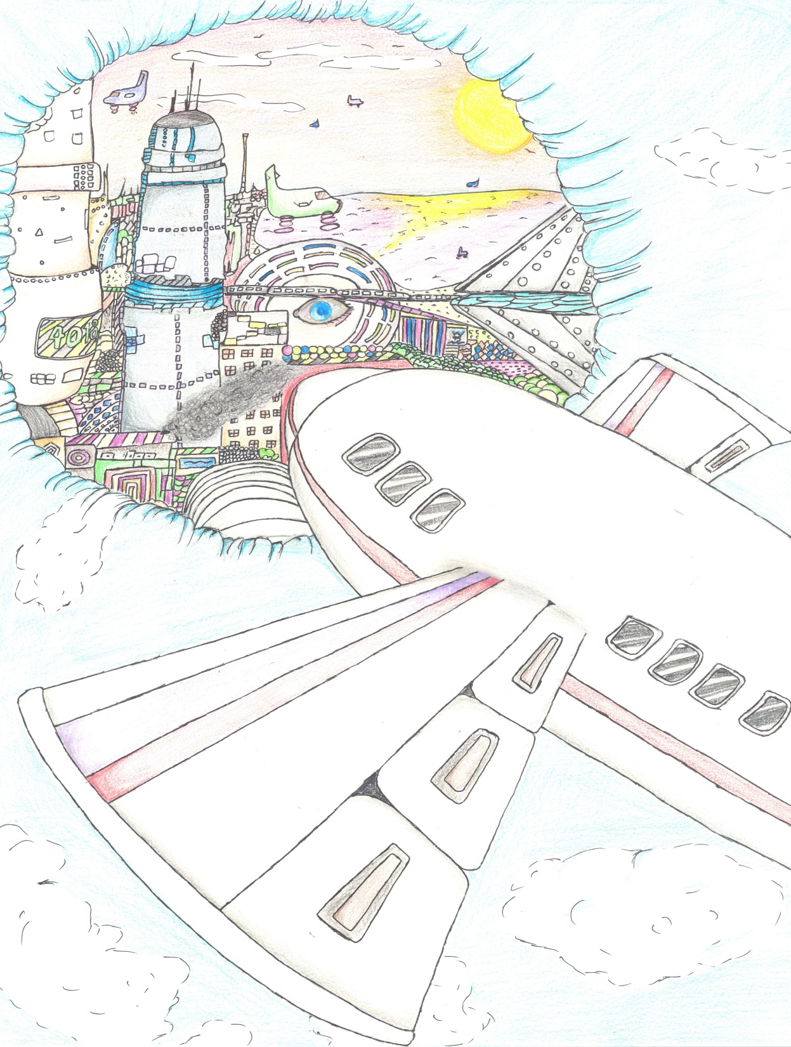
Josephine Smith
Cascade High School
Senior 1st Place

Slide 11
Cody Hodge
Cascade High School
Senior 2nd Place

Slide 12
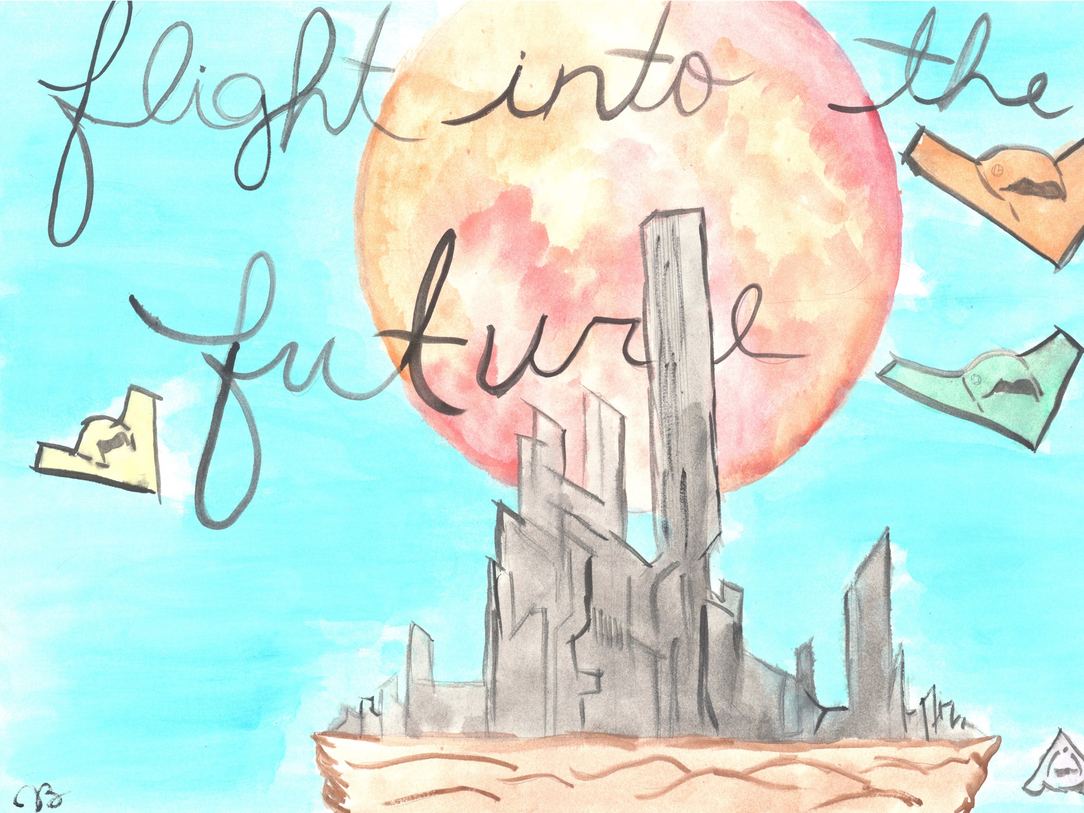
Jaycee Brown
Union City High School
Senior 3rd Place

Slide 13
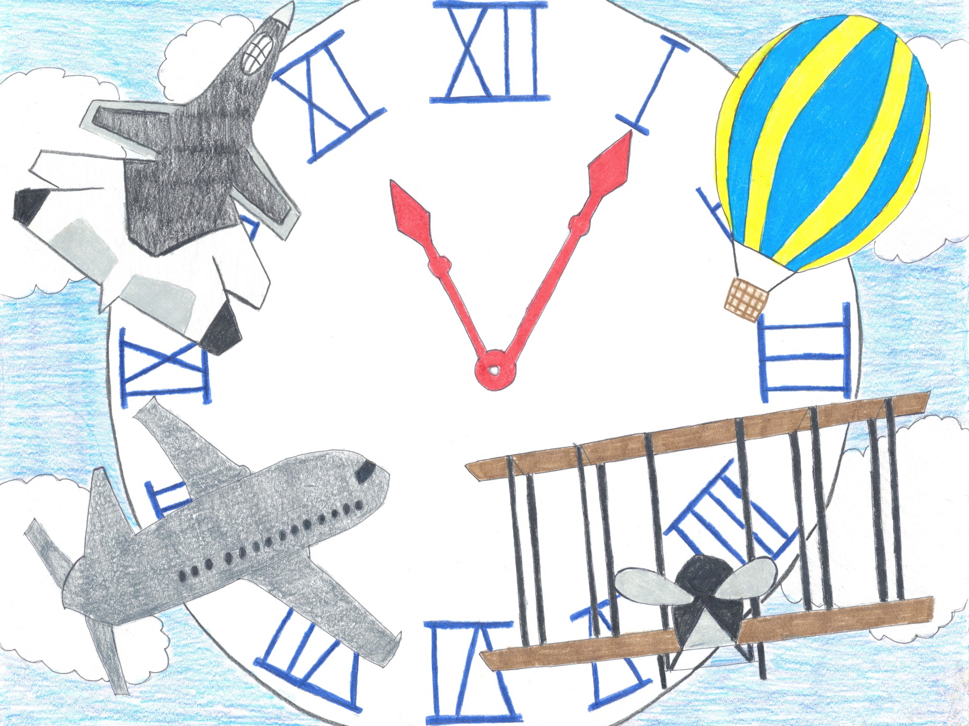
Lyndsey Patterson
Obion County Central High School
Senior Honorable Mention

Slide 14
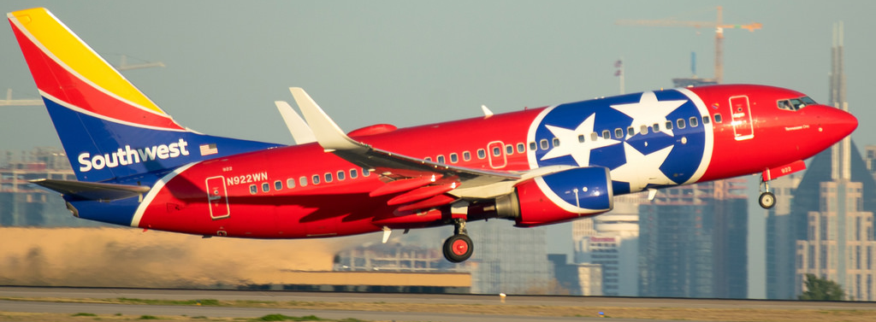
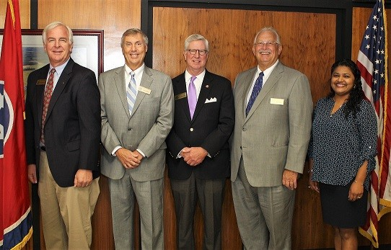
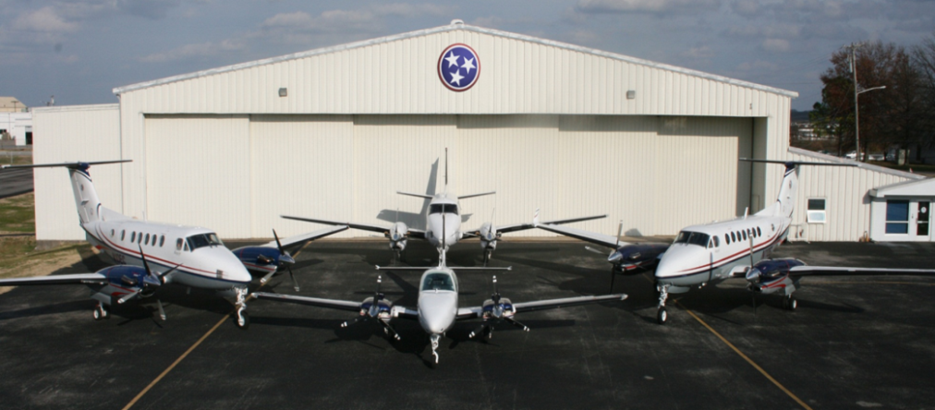
Aeronautics Division Staff
Michelle Frazier, Director
Vacant, Assistant Director
Vacant, Administrative Assistant Office Manager
Lyle Monroe, Transportation Manager 2
Transportation Program Monitoring Flight Services
John Briggs, Transportation Manager 1 Vacant, Chief Pilot
Brian Fedders, Transportation Program Monitor Supervisor Carol Lane, Administrative Services Assistant 2
Evan Lester, Transportation Program Monitor 1 Wayne Trammell, Lead Pilot
Gregg Bennett, Transportation Program Monitor 1 Brad Loveless, Lead Pilot
Ryan Traversa, Transportation Program Monitor 1 Jacob Rosser, Lead Pilot
David Demanette, Transportation Program Monitor 2 George Shotwell, Lead Pilot
Terri Tanner, Transportation Program Monitor 2 Wayne Trammell, Lead Pilot
Elliott Jakes, Chief Aircraft Mechanic
Engineering / Project Management Billy Morgan, Aircraft Mechanic 2
John Paul Saalwaechter, Civil Engineer Manager 2 Tyler Irwin, Aircraft Mechanic 1
Chuck Hoskins, Transportation Project Specialist Supervisor 2 Jerry Esaw, Hangar Attendant
Steve Upshaw, Transportation Project Specialist Senior Allen Jones, Hangar Attendant
Bill Burney, Transportation Project Specialist Senior
Jim Currey, Transportation Project Specialist
Adam Guy, Transportation Project Specialist
Michael Stultz, Graduate Transportation Associate
Ben Knack, Graduate Transportation Associate
Jordan Gunn, Transportation Program Monitor 1
Tennessee Aeronautics Commission Members
Left to Right: George Huddleston, Jr., Butch West, Kirk Huddleston, Larry Mullins, and Nisha Powers

