Slide 1


Child Well-Being and COVID
Florencia Gutierrez
March 9th, 2021
Notes:
My name is Florencia Gutierrez. I am a senior associate with the Annie E. Casey Foundation. I’d like to thank the Tennessee Commission on Children and Families for the invitation to be with you all today. And thank them and you for all you do to ensure the well-being of children in Tennessee. It is a pleasure to be here to talk about how our children are faring and what we can do to put them on a path to prosperity.

Slide 2
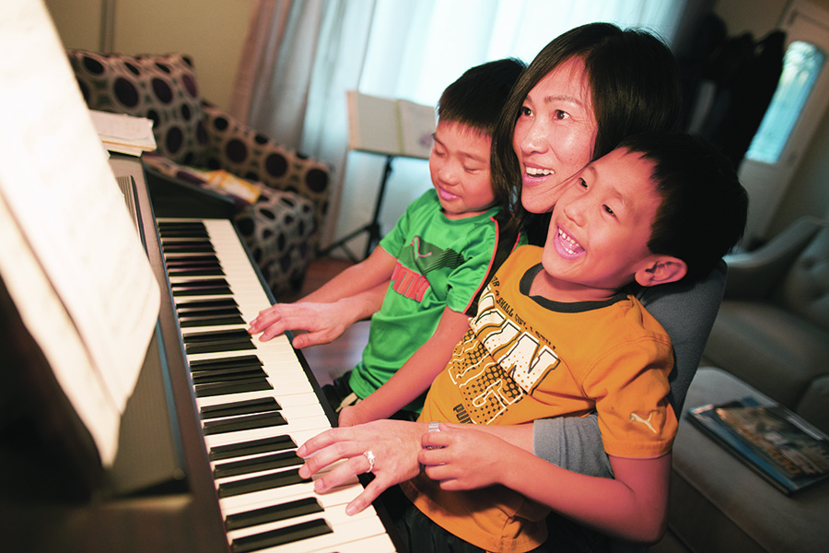

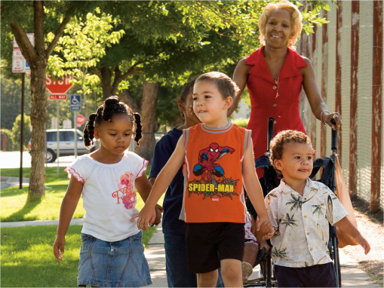
The Annie E. Casey Foundation
FAMILY
OPPORTUNITY
COMMUNITY
Notes:
For more than 7 decades the Annie E. Casey Foundation has been committed to building a brighter future for America’s children, families and communities… to ensure all young people– no matter their race, background, country of origin or zip code- can reach their full potential. In order to accomplish this we support their development, their parents and the communities where they live so that they have the resources and opportunities to succeed as young adults and beyond.

Slide 3

Increased Focus on Youth and Young Adults (14 to 24)
Notes:
Recently we have become increasingly concerned about the millions of teens and young adults who are struggling to succeed in school, to secure good jobs, to achieve financial stability and to manage anxiety and depression. Unfortunately, we often forget about this group and we don’t invest to help them make their dreams come true.
Last month the Foundation announced that we will be leveraging our expertise and partnerships to support youth ages 14 to 24 overcome obstacles they may encounter on their path to adulthood.
We will work together with young people to ensure they have their basic needs met, family connections, relationships, communities and educational and employment opportunities they need and want to be able to thrive by 25.
The Foundations increased focus on youth and young adults is not a move away from our long-standing dedication to improving the lives of all children. It is rooted in our existing efforts and acknowledges that adolescence extends well beyond 18. We are excited to be expanding our work to ensure all children can thrive and be contributors to our economy.

Slide 4
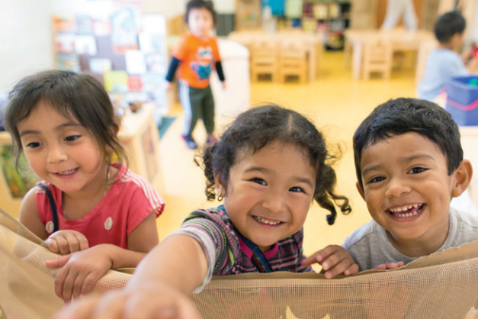
KIDS COUNT
Notes:
As, I mentioned our focus on child well-being continues to be core to our work. And KIDS COUNT is one of the key projects focused on children and their well-being. This project launched back in 1990, to provide quality data and information on children to decision makers and the public to ensure that decisions impacting child well-being were made with accurate and timely information in-hand.
Today, KIDS COUNT couples these data and information with strategic communications and effective advocacy to get the results we want for kids. We have a national project which elevates issues impacting children across the country and a state network of KIDS COUNT grantees in every state DC, Puerto Rico and the US Virgin Islands. Our work helps ensure children are top of mind when important decisions are made. In TN, our partner is the Tennessee Commission on Children and Youth. We have been partnering in this work since 1992. We are thankful for their partnership and for all they have done to ensure the well-being of children in Tennessee.

Slide 5

KIDS COUNT Publications
How are Children Faring?
Notes:
We use our publications to elevate issues impacting children. In 2020, we released the 2020 KIDS COUNT Data Book and a policy report that shed light on the impact the pandemic has had on families with children.

Slide 6
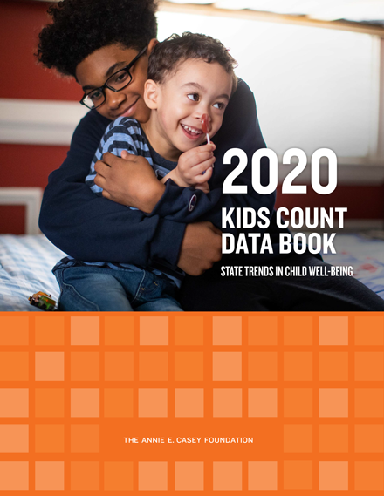




2020 KIDS COUNT Data Book
Notes:
The Foundation has been tracking the well-being of children since 1990 with the KIDS COUNT Data Book. This publication includes an index made up of 16 indicators in the areas of economic well-being, education, health and family and community. It is used to determine how children are faring across the nation and in states. Since we published the first Data Book the country has gone through periods of growth and recession and experienced times of relative prosperity and great anxiety. And during this time, we have witnessed that when we as a country want to make a difference, want to improve outcomes for kids, we do. When we choose to prioritize our children outcomes improve.
For example: The teen birth rate continues to drop and has reached a new all-time low and high school graduation rates have never been better. Not to mention that we were close to reaching universal health coverage for children with 6% of children lacking health insurance in 2019. These improvements don’t just happen by chance… they were produced by policies, programs and practices that were implemented by decision makers across the country.
Now for some key findings.

Slide 7
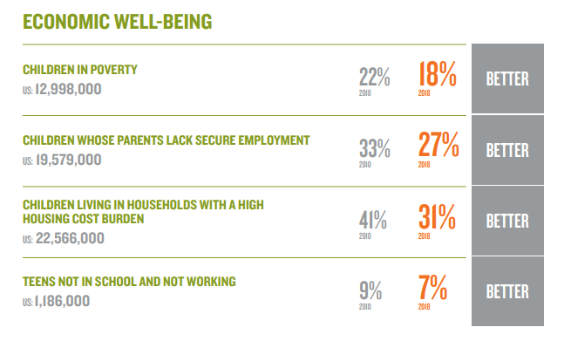
Economic Well-Being Domain
Trends in Economic Well-Being
Notes:
Prior to the pandemic, the economic well-being indicators were trending positive. The data show that families were more financially secure and more could cover their basic needs. 2019 data released in the fall after we released our Data Book, showed that the positive trends continued. For example the poverty rate in 2019 continued to improve. It dropped from 18% in 2018 to 17% in 2019. The new rate is the lowest rate in the past 17 years.
Unfortunately, we have been hit by a worldwide pandemic, that has disrupted our lives… and the pandemic has hit our economy which has shed millions of jobs. This reality has impacted our physical and mental health, our employment, our ability to stay afloat in all aspects of this term. We will have to wait for 2020 data from the ACS, but data from the Household Pulse Survey show that we as a nation are struggling.

Slide 8
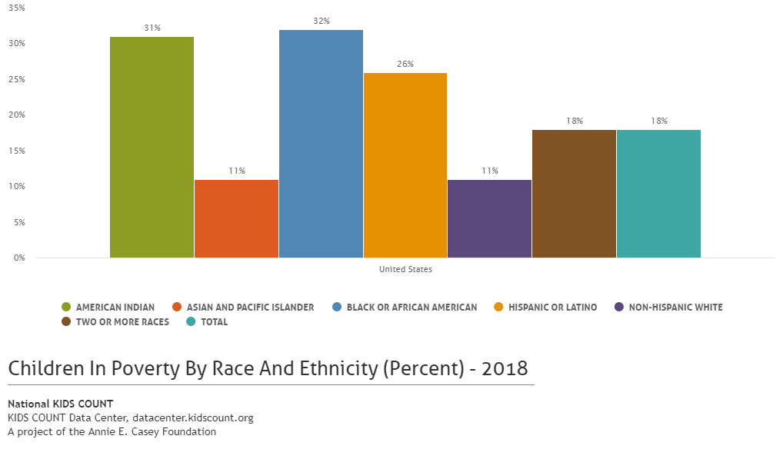
Economic Well-Being Domain
Trends in Economic Well-Being
Notes:
Even with the gains that we have seen across the board, the country is failing to dismantle barriers that African American, American Indian and Latino children especially encounter. As a result, on almost every measure children with the same potential experience disparate outcomes. The disparities shown in this graph are stubborn, persistent and impact the well-being of our children. These disparities are present in all of the indicators we track.
Data here show that one in three African American and American Indian children lived in poverty in 2018. Rates that are close to three times the rates of Asian and Pacific Islander and White children. Latino children are close behind.
These disparities are present in TN as well. With a third of African American, Latino and children who identify as two or more races living in poverty. Disparities which again are seen across the board.

Slide 9
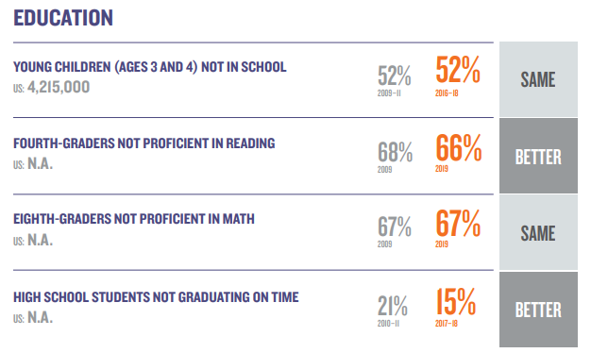
Education Domain
Trends in Education
Notes:
Trends in education were not as encouraging. The data show that more than half of our 3- and 4-year olds do not attend school; two out of three fourth graders are not proficient readers and the same… 2 out of 3 eighth graders were not proficient in math…
Apart from the high school graduation rates, which saw the largest improvement, progress has been slow or has stalled. The data was poor before the pandemic hit, what is it going to look like after? We will have to wait to see the impact that virtual and online learning, the impact of isolation has had on a system that was struggling to educate their children prior to the pandemic.

Slide 10
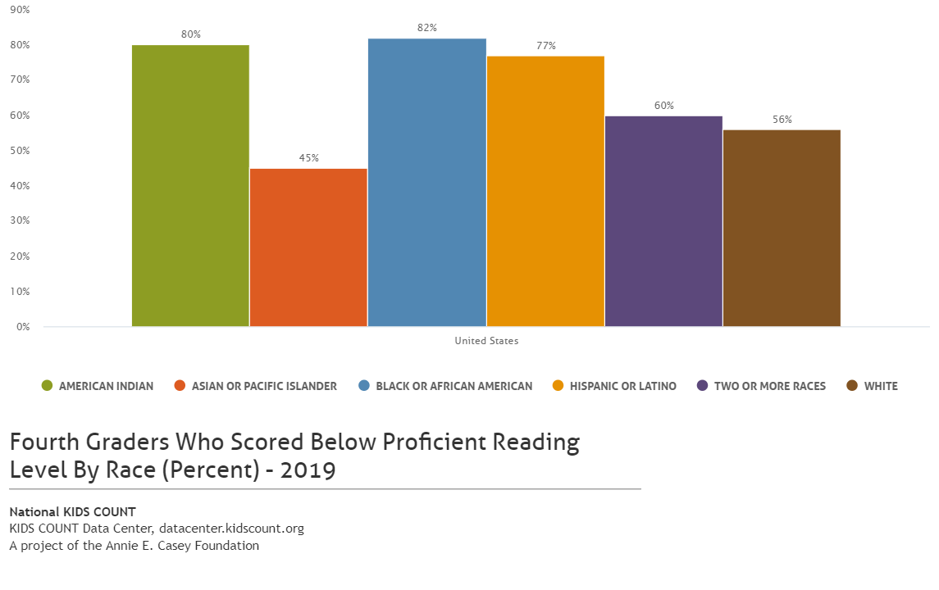
Education Domain
Trends in Education
Notes:
Like in economic well-being disparities in the education domain are stubborn and persist and show the long-complicated history of this country’s education system. Here we have data on the percentage of fourth graders who are NOT proficient readers. Overall, the outcomes are not good for any of the groups… but you can see that only 23% of Latino, 20% of American Indian and 18% of African American fourth graders were proficient readers in 2019. Math proficiency outcomes are even worse.
What impact will the pandemic have on educational outcomes and success of students? We will likely have to wait until 2022 to have the data we need to tell the full story.
In 2020, the U.S. Department of Education suspended the National Assessment of Educational Progress since kids were not in school. We will have to wait a while before we are able to see the impact that virtual learning and disconnection has on these data.

Slide 11
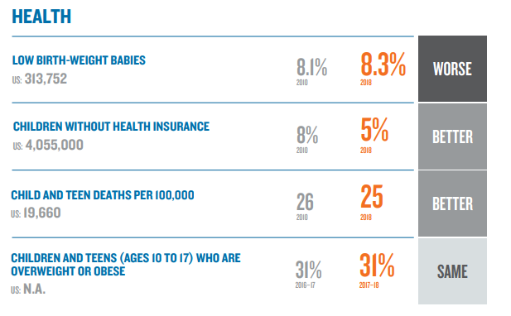
Health Domain
Trends in Health
Notes:
The Health domains also saw mixed results. With the most improvement in the child health insurance indicator. Between 2010 and 2018 the percent of children who lacked access to health insurance coverage declined. An improvement of 38%. Policies like Medicaid and CHIP have helped us make sure children in the US have access to insurance. They have made it possible for more kids to grow up healthy.
The issue is that the percent of children without insurance increased for the first time since 2013. 2019 data show that 6% of children lacked health insurance. We need to keep an eye on this indicator and help to ensure that children have access to the health care they need especially during this difficult time.

Slide 12
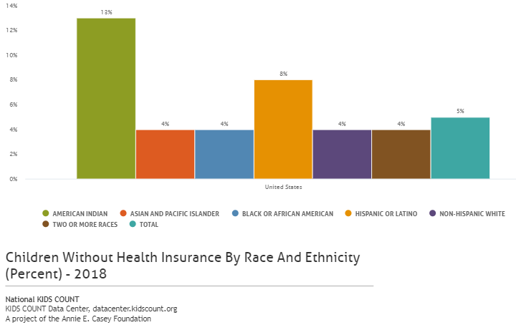
Health Domain
Trends in Health
Notes:
If we look at the data disaggregated by race, we see that rates differ across racial/ethnic groups. American Indian and Latino children are much more likely to lack access to health insurance.

Slide 13
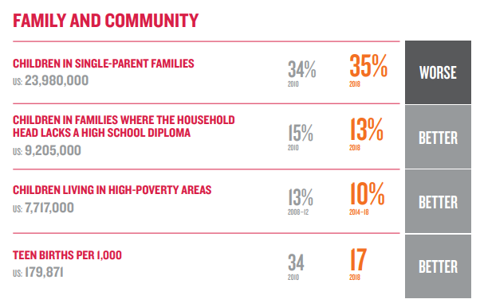
Family and Community Domain
Trends in Family and Community
Notes:
And finally, trends in the Family and Community domain were encouraging for the most part. The teen birth rate continues its decline, reaching a new low. Fewer children are living with parents who lacked a high school diploma and the percentage of children living in high-poverty communities improved for the third year in a row… all trend that is encouraging.
The percentage of children in single-parent families is the only indicator that worsened. In 2018, more than one-third of children lived in single-parent families, which tend to have fewer resources in terms of time and money and the opportunities those provide.
All of these indicators improved between 2018 and 2019.
2019 data
High Poverty Areas: 9%
Parent without HS: 12%
Single-Parent: 34%

Slide 14
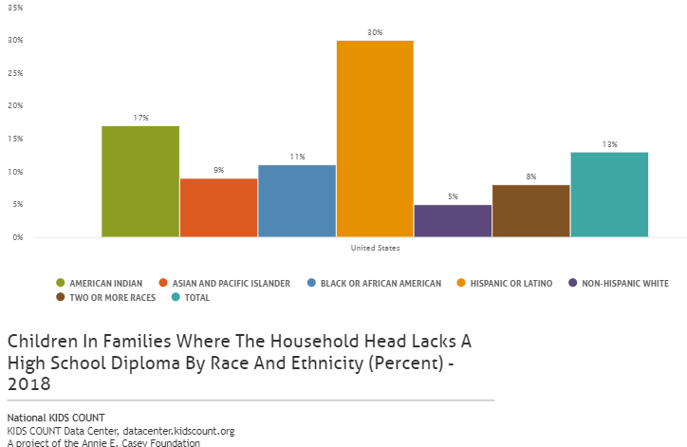
Family and Community Domain
Trends in Family and Community
Notes:
Here you see that Hispanic children are the most likely to live in a family where the household head lacks a high school diploma… greatly impacting their access to resources and opportunities.
Latinos are 6 times as likely to live in families where the head of the household lacks a high school diploma.

Slide 15
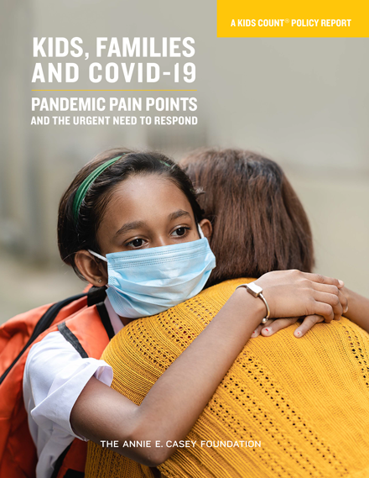
2020 Pain Points COVID Report www.aecf.org/resources/kids-families-and-covid-19/
Notes:
The data presented in the Data Book shows that we have made progress in 11 of the 16 indicators, which is great news. In TN 12 of the 16 indicators improved. But it does not tell us anything about how children have been impacted by the current pandemic. We will have to wait for the fall to have new data and in many instances until 2022. But it is likely that many of the gains that we have seen since the recovery from the Great Recession will be wipped out or will have stalled.
“KIDS, Families and COVID-19” released in December of last year presents data from the U.S. Census Bureau’s Household Pulse Survey which is the only source of data that provides insight into the impact COVID is having on households at the national and state-level. We used these data to shed light on how COVID has impacted families with children. While we wait for 2020 data from our government agencies, we have data from the Household Pulse Survey which can provide a picture of impact and need.

Slide 16
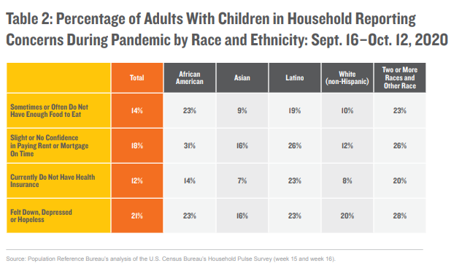
Households with Children Reporting Concerns
Notes:
Here are the four indicators that we tracked in the report. The focus was really on basic needs. Putting food on the table, a roof over their and their family’s head, and staying healthy both physically and mentally to make it through these times and to be there when needed.
The data show that adults with children in the households are struggling. The job and income loss that millions experiences really impacted the household stability.
Food insecurity, already a problem for more than one in 10 households before the pandemic increase. Overall, 14% of adults with children reported that their household sometimes or always did not have enough to eat. One in four African Americans and those who identified as two or more races and other race experienced this reality.
More than one in six people with children in the household said they had slight or no confidence that they would be able to make their next rent or mortgage payment on time. 31% of African Americans, 26% of Latinos and 26% of individuals of two or more races and other race expressed these sentiments. In addition, 33% or one in every three households with children reported that they were likely to lose their home to foreclosure or eviction.
One in eight households with children (or 12%) lacked health insurance. We know that children are more likely to be insured if their parents are, so these data are concerning, especially the 23% Latino adults with children in the household who reported. The lack of health insurance and limiting contact with the outside world has led to families forgoing the care that they need. More than a third of people with children in the household (34%) reported that they delayed getting medical care.
Mental health has also been an acute concern for millions in 2020, as they deal with uncertainty, isolation and grief associated with coronavirus-related loss. One in five people with children reported feeling down, depressed or hopeless .. Indicating a widespread need for access to mental health care and treatment.

Slide 17
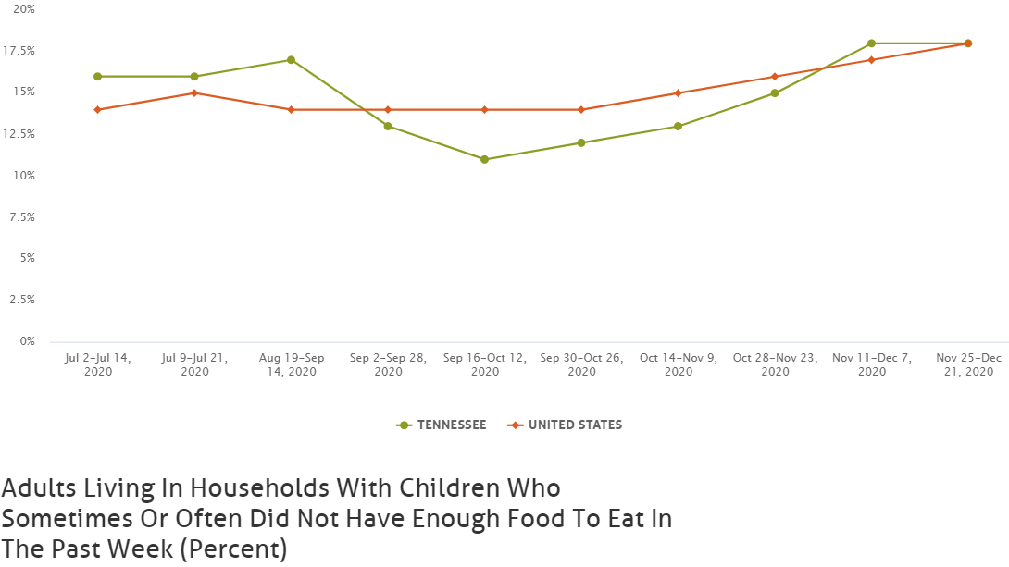
Households with Children Reporting Concerns
Notes:
In Tennessee, we see that after a drop from August to September. The rate of households with children that did not have enough food to eat steadily increased into the new year. At the end of 2020, 18%... Close to one in five people with children in the household experienced hunger. If we look at the data disaggregated by race, we see that more 1 in 3 African American children or 35% did not have sufficient food, compared to 14% of White children.
If we compare the rate to the rest of states, the rate is in the middle of the pack. Maine had the lowest rate at 9%, while Louisiana had the highest at 25%.

Slide 18
Household with Children Reporting Concerns: TN data
18% did not have enough food to eat
21% had little or no confidence in their ability to pay their next rent or mortgage payment on time
  35% very or extremely likely will have to leave home
11% lack health insurance (12% nation)
28% felt down, depressed or hopeless
Notes:
Apart from the health insurance indicator, households with children in TN are struggling more than the national average.
18% of households with children did not have enough food to eat.
21% of 1 in 5 households with children had little or no confidence they would be able to pay their next rent or mortgage payment on time.
Of these individuals 1 in 3 believed that they would be asked to leave their home.
11% lacked health insurance
28% felt down, depressed or hopeless.

Slide 19
Recommendations
Put racial and ethnic equity first in response efforts
Prioritize the physical and mental health of children
Help families with children achieve financial stability and bolster their well-being
Ensure schools are better and more equitably funded and ready to meet the needs of students disparately affected by the pandemic.
Notes:
We believe that every child in the US should have their basic needs met and that families should have support to survive the considerable stress and pain of these times.
It is important to have disaggregated data in hand to be able to identify the impact of our policies and programs. To see where our efforts need to focus. It is also critical to engage community stakeholders in the work to come up with solutions that work.
It is also critical to prioritize the physical and mental the health of children. Not only of children, but of their parents as well.
Help ensure that families are financially secure so that they can ensure basic needs are covered and children have a strong foundation to build from.
We also need to work to ensure that schools are better and more equitably funded so that they can meet the needs of all students and so they can address the disparities that currently exist and that the pandemic has exacerbated.

Slide 20

kids count Resources
Data Book and Data Center
Notes:
Before I close I wanted to let you all know of some resources that might be useful as you do your work.

Slide 21
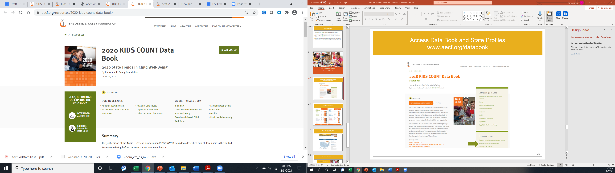
Access Data Book and State Profiles www.aecf.org/databook
Notes:
On the Data Book page you can:
Download the publication
Explore the data in the report with our online interactive
And access your state profile, if you are interested to see what is going on in your state.

Slide 22
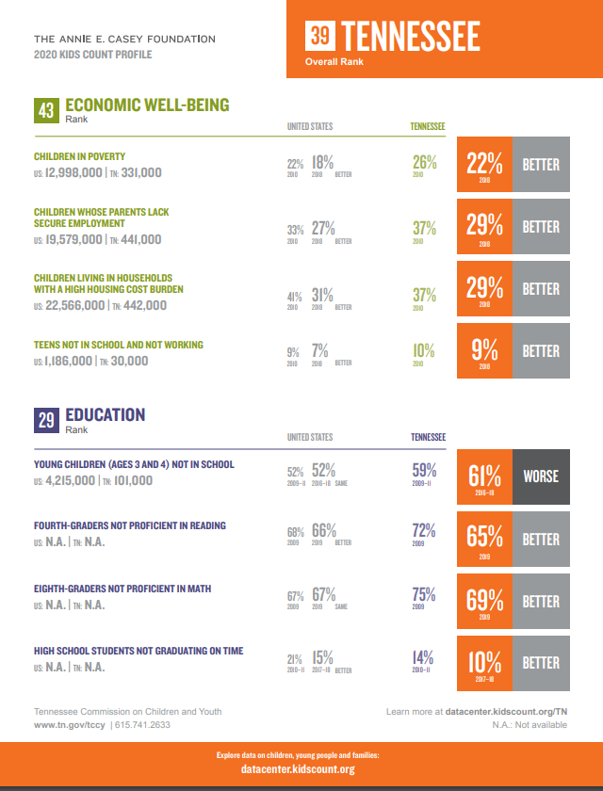
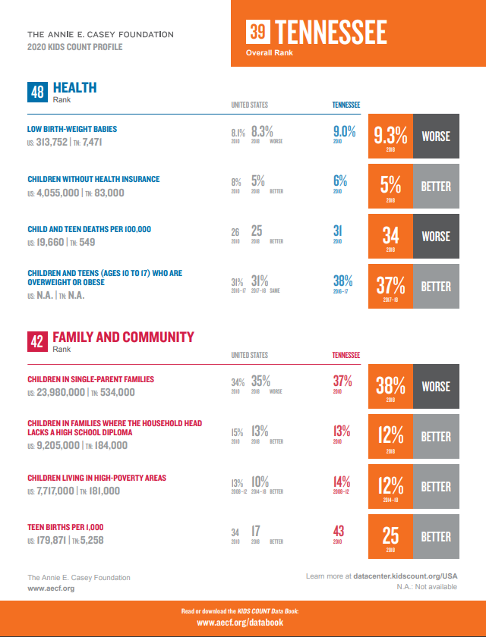
Data Book State Profiles
Notes:
Here is an example of a state profile.

Slide 23
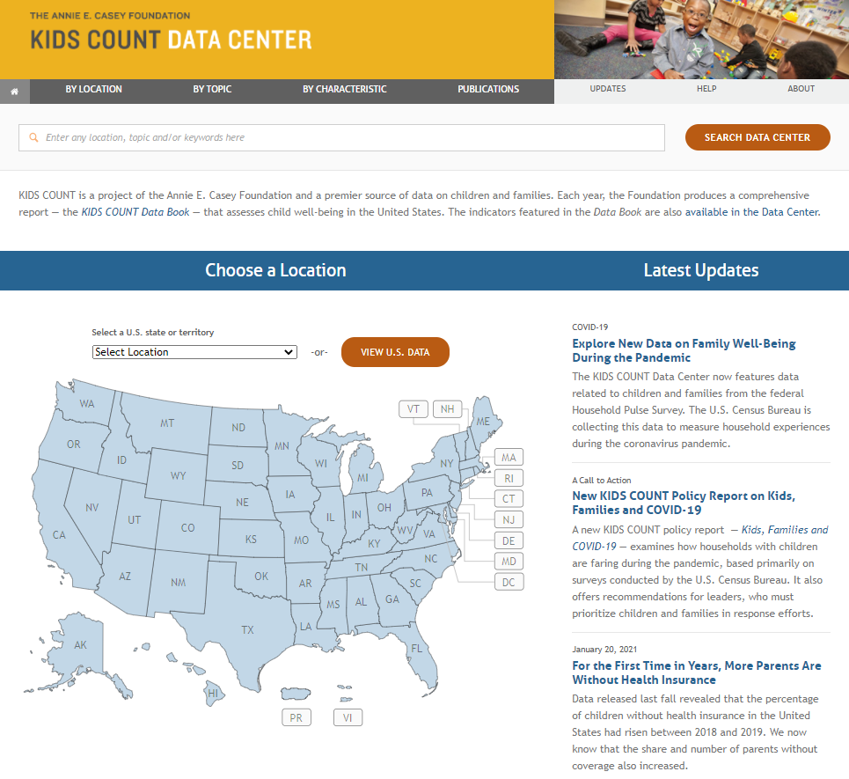
KIDS COUNT Data Center datacenter.kidscount.org
Notes:
We also have the KIDS COUNT Data Center. Here you can access all of the data that we provide and that our network partners provide at the state and local-level. We also have provided access to COVID indicators from the Household Pulse Survey with a focus on household with children. You can access that information under latest updates.
You can also access our most recent publications under “Publications” at the top of the page.

Slide 24
2020 Census: Data Quality
Net Undercount for young children under 5: 4.6%
  2.2 million children missed (10% of population)
  1.2 million children overcounted
  Net undercount: about 1 million young children
Notes:
Before I sign off, I want to talk about the importance of the decennial census for all of this work. The data are key \to our ability to measure and track the well-being of children. They are key to the distribution of resources that help promote the well-being of children and communities (education, housing, health care). To identifying need and where focus should be place. They are key to ensuring voice and representation to groups and communities that are consistently left out of the process and whose problems are ignored.
That is why the fact that the Census faced so many problems with this decennial (limited fungind, lack of leadership, citizenship question, natural disasters, COVID)… the list is endless and exhausting. But the fact these challenges exist should be concerning to all of us.
The fact is that in 2010 we missed 10% or 2.2 million children under the age of 5. And that with all of the issues 2020 faced we could have missed more. The implications for resources especially after a pandemic could be huge… and areas of greatest needs could find themselves without the resources to serve the children and the communities where they live.
The Census has been a priority for us over the past 6 years and it will continue to be as we ensure that the data released are quality and that all communities are represented as they should be. With poor data we all suffer, our states suffer and the communities that historically are isolated will suffer the most. We will continue this work to ensure we count everyone in order to get resources and voice to everyone.

Slide 25

Contact Slide
Florencia Gutierrez, Senior Associate
fgutierrez@aecf.org
410-223-2953

