Slide 1
Licensure Virtual Inspections
2020

Slide 2
What is a Virtual Inspection?
A virtual inspection is an inspection that is completely 100% remotely conducted by licensure staff. A virtual inspection is completed in two (2) stages:
Stage 1: paperwork based review. Licensure staff will request specific documentation (i.e., policy & procedure manual, personnel and service recipient record information) for record compliance review.
Stage 2: video based walkthrough of the facility, if applicable. Licensee staff are to use video conferencing to visually show the facility to off-site licensure staff at licensure staff’s direction for life/safety environment compliance review.
Please note: Stage 2 will NOT be applicable if you are licensed as an OBOT; DUI school; or PSSA

Slide 3
Why Virtual Inspections?
The department shall make at least one (1) unannounced life safety and environmental inspection of each licensed service or facility yearly. The department shall inspect for quality standards all licensees that contract with the department as part of its contract monitoring. The department shall inspect for quality standards all licensees that do not contract with the department. The department may deem a service or facility in compliance without inspection if the service or facility meets another government agency's certification or accreditation requirements provided for in rules of the department. TCA 33-2-413(a)
TDMHSAS Office of Licensure understands and appreciates the many different barriers you may be experiencing right now related to COVID-19 (otherwise known as “coronavirus”). We want you to know that we understand regulatory compliance during this time may be difficult with potential staffing shortages, programmatic disruptions and other frustrations that will be inherent during a public health crisis such as this. That said, please know that we all have legal mandates to uphold and are conducting these virtual inspections in accordance with these mandates. We will gladly give your organization reasonable allowances in time and accessibilities, so long as you sufficiently provide us information in what barriers and limitations you may be dealing with.
If you have questions about this balance, we would be happy to speak with you in more detail.
Tenn. Code Ann. § 33-2-413

Slide 4
Let’s Begin!
Licensure Surveyor in your region will reach out to you to begin the annual inspection process.
Licensure Surveyor will provide you with a checklist prior to your inspection being conducted – this checklist will put you on notice of Stage 1 and Stage 2 material
0940-05 Licensure Rules: https://publications.tnsosfiles.com/rules/0940/0940.htm

Slide 5
Virtual Inspection: Stage 1
During Stage 1, Licensure staff will be requesting records to conduct a desk audit, which shall include the following documentation:
client records,
personnel records, and
policy and procedure manual
Please include complete client and personnel records
Please note Licensure emails with “[secure email]” in the subject line are encrypted, which allows a safe and secure way to share confidential information

Slide 6
Virtual Inspection: Stage 2
During Stage 2, Licensure staff will be requesting a virtual walkthrough of your licensed facility
Please identify a staff member who you want to participate in the virtual inspection so that Licensure staff may schedule a date and time for the virtual walkthrough
Currently, Licensure staff are using the following approved electronic platforms to conduct the virtual walkthrough:
iPhone FaceTime;
Google Duo app; and
WebEx
NOTE: If you have a technology limitation, please notify your Licensure surveyor during Stage 1 so that Licensure may work with you to address these barriers.

Slide 7
Virtual Inspection: Stage 2 Examples
The Stage 2 life/safety environment compliance review may include, but is not limited to, the following:
Emergency lighting testing
Measurement of windows and corridors
General walkthrough of all licensed portions of the facility
Review of first aid kit
Review of Fire Extinguishers and Tags
Review of staff and service recipient evacuation training and fire drills
Ensure bedroom door will close to a positive latch
Ensure interior and exterior steps are equipped with secure handrails

Slide 8
Virtual Inspection Helpful Tips
Be sure to walk through the facility slowly
Be sure that the person participating in the virtual inspection has necessary keys and access to storage rooms, closets, etc.
Be sure to check the emergency lights/exit lights
Be sure to show all exit points of the facility
Be sure to show all electrical outlets
Be sure to have a tape measure and/or other measuring device to conduct measurements, if needed
E.g., windows, hallways, etc.

Slide 9
Frequently Asked Questions
What if the document/attachment I am trying to send via email is to large? Please contact your Licensure Surveyor immediately so that we may discuss alternatives
What if my license is about to expire and my virtual inspection has not been conducted yet? Your license will be extended and remain active and in good standing – this will not negatively impact on your licensure status
Will this virtual inspection be sufficient for my traditional annual inspection or will a follow-up onsite annual inspection be conducted? This virtual inspection will satisfy the requirement for your traditional annual inspection
Will virtual inspections continue beyond COVID-19 concerns? Licensure is unable to provide a definitive answer at this time as we are still discussing this with Executive Leadership

Slide 10
COVID-19 Information
For a list of statewide resources, please visit: tn.gov/governor/covid-19.html
Tennessee Department of Health status of COVID-19 in Tennessee: https://www.tn.gov/health/cedep/ncov.html
COVID-19 symptoms may be found on the CDC website: https://www.cdc.gov/coronavirus/2019-ncov/about/symptoms.html
General CDC information and guidance: www.cdc.gov/coronavirus/2019-ncov/index.html
Tennessee Department of Mental Health and Substance Abuse Services COVID-19 information: https://www.tn.gov/behavioral-health/covid19.html
Guidance document for Congregate Care Providers: https://www.tn.gov/content/dam/tn/mentalhealth/documents/TDMHSAS_COVID-19_Congregate_Care_Settings.pdf

Slide 11
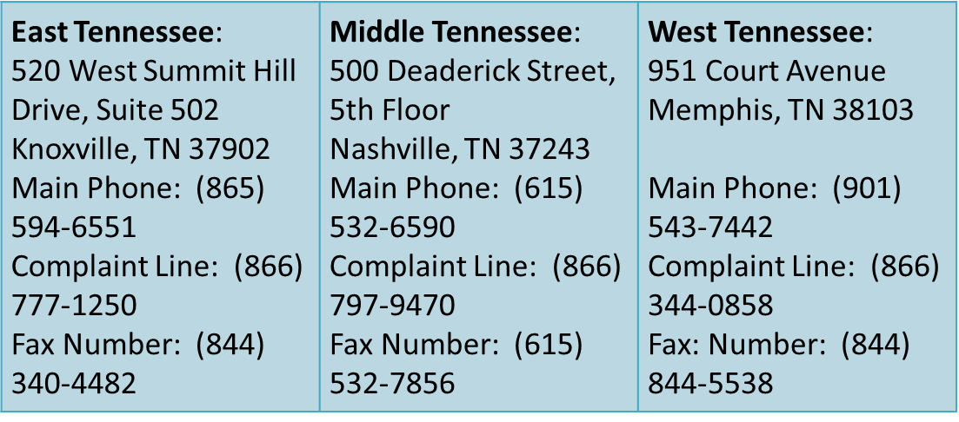
Regional Contact Information

Slide 12
State of TN Dept. of Mental Health & Substance Abuse Services Virtual Inspections
TDMHSAS thanks you for your hard work and dedication in continuing to provide exceptional services to some of the most vulnerable citizens of the State of Tennessee.

