Slide 1
Personal Support Services Agency
PSSA
Provider Information

Slide 2
Objectives
By the end of this power point, providers will be able to:
Identify applicable rules related to personal support services.
Access applicable information including forms and rules online.
Apply applicable rules to daily operation in order to maintain compliance with Licensure rules.
Get answers to frequently asked questions commonly sent to Licensure.
Learn about financial obligations of PSSA
Learn more about what qualifies as reportable situations.

Slide 3
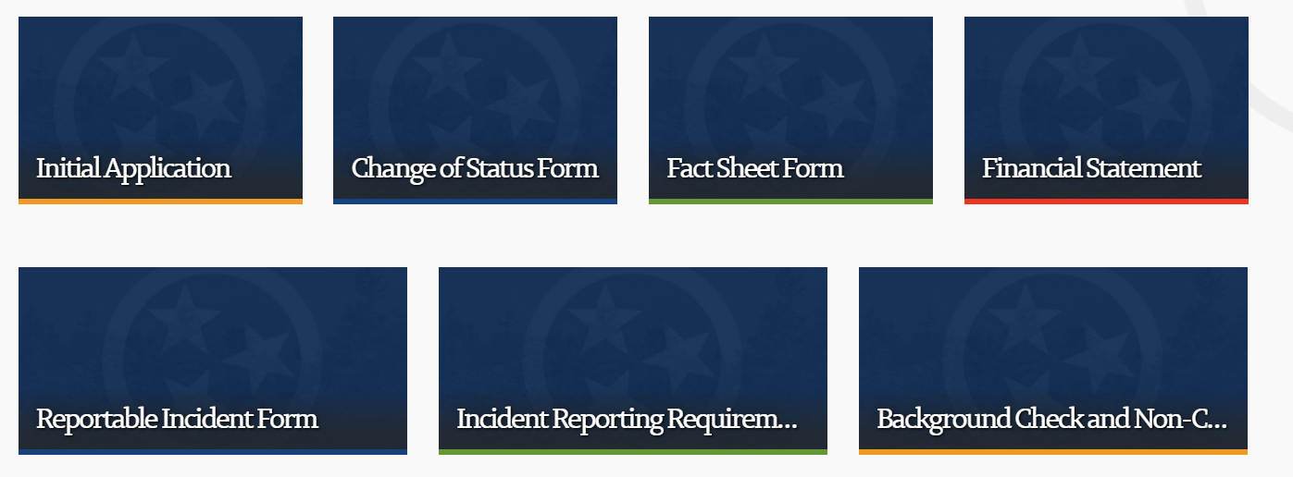
Licensure Forms
Licensing Forms link

Slide 4
Fact Sheet Form
A Fact Sheet form is used for the following:
to establish a new site/location
to add a new category to an existing license
to relocate a currently licensed facility/service to another location*
to request approval for a major renovation, expansion, or change in use or occupancy of a currently licensed facility.

Slide 5
Change of Status Form
A Change of Status form is used for the following:
Change in Chief Executive Officer or Executive Director (A Background Information form and Non-criminal Justice Privacy Rights statement must also be submitted.)
Change in licensee name (Used for change in name only. This is not a transfer of ownership.)
Change in site name
Change in licensed bed capacity
Change affecting current life safety occupancy classification such as adding or deleting safety occupancy classification to serve mobile non-ambulatory, hearing impaired, blind, or individuals incapable of self-preservation or imposing security measures upon persons which are beyond their control (e.g., exit doors or windows locked against egress, restraints, seclusion, etc.
Closure of license
Closure of category(ies) only
Closure of license due to relocation

Slide 6
PSSA Applicable Rules
0940-05-38-.02 APPLICATION OF RULES
(1) The licensee providing personal support services shall comply with and provide services that comply with the following rules:
(a) Chapter 0940-05-02 Licensure Administration and Procedures;
(b) Chapter 0940-05-38 Minimum Program Requirements for Personal Support Services Agencies; and
(c) Chapter 0940-05-06-03(1)-(6) Minimum Program Requirements for All Facilities-Financial Management of All Facilities.
Link to Rules: http://publications.tnsosfiles.com/rules/0940/0940.htm

Slide 7
0940-05-06-.03 FINANCIAL MANAGEMENT OF ALL SERVICES AND FACILITIES
(1)The licensee holding or receiving funds or property for the service recipient as trustee or representative payee will adhere to all laws, state and federal, that govern his fiduciary position and relation to the client. A licensee may not retaliate against an employee, volunteer or other individual who reports a violation of the licensee’s fiduciary obligation to the client.
(2) The licensee shall prohibit staff, volunteers and proprietors from soliciting or borrowing money or property from clients.
(3) The licensee shall ensure that all money received, held and/or disbursed on behalf of the client is for the strict, personal benefit of the client.
(4) The licensee shall not mix funds with those of the client. The licensee shall maintain a separate account in a federally insured financial institution for the deposit and/or disbursement of client funds.
(5) The licensee shall not take funds or property of the client for the licensee’s personal or organizational use or gain.
(6) The licensee shall maintain a written account of all monies received or disbursed on behalf of the client. No less than annually the licensee shall provide the client or the client’s legal representative a report of all funds held and disbursed on behalf of the client.

Slide 8
Background Requirements
38-.07(c)
That all personal support services workers shall submit to a criminal background check every two (2) years or within ten (10) days of employment or within ten (10) days of a change of responsibilities that includes direct contact with or direct responsibility for service recipients, as required by T.C.A. § 33-2-1202
Note: Because of the verbiage of this rule concerning every 2 years, Licensure will not be enforcing this part of the rule.

Slide 9
Background Requirements
38-.07(d)
That evidence of the status of every personal support services worker on the Tennessee registry of persons who have abused, neglected or misappropriated the property of vulnerable individuals (“Abuse Registry”) maintained by the Department of Health shall be checked annually and prior to direct contact with service recipients. No employee or volunteer who is listed on the Abuse Registry may be hired or otherwise permitted to provide services.

Slide 10
Background Requirements
38-.07(e)
That evidence of the status of every personal support services worker on the Tennessee Sexual Offender Registry shall be checked annually and prior to direct contact with service recipients. No individuals or volunteer who is listed on the state’s sexual offender registry may be hired or otherwise permitted to provide services.

Slide 11
T.C.A. § 33-2-1202 Highlights
The background check shall be completed before allowing the person to have any direct contact with or direct responsibility for service recipients.
Fingerprint samples must be submitted for a criminal history records check if the Tennessee Bureau of investigation or the Federal Bureau of investigation conducts the background checks.
Background checks can be obtained from a state licensed private investigation company without the use of a fingerprint sample.
TN state licensed private investigation companies can be verified by going to https://search.cloud.commerce.tn.gov/ and search for P.I. Companies.

Slide 12
Common PSSA rule deficiencies
38-.09 (1)(n) Written authorization by the service recipient or the service recipient’s authorized representative if the agency is providing medication assistance.
38-.06(1)(n) Polices to address use of devices such as a hoyer lift or gait belt, after training, to assist the service recipient in getting out of or into bed, a chair, toilet or shower but not as part of a therapeutic regimen.
38-.09(1)(p) A written consumer notice outlining general service responsibilities as well as general notification of the agency’s responsibilities as an employer or contractor provided to service recipients before beginning service, which shall include, at a minimum the duties, responsibilities, obligations and legal liabilities of the personal support services agency; the personal support services worker; and the service recipient.

Slide 13
Common PSSA rule deficiencies
38-.06(1)(e) A statement of service recipient rights as listed in 0940-05-38-.10 and the grievance procedures to be followed when a suspected violation of rights has been reported
38-.09(1)(o) Written documentation that the service recipient has evaluated the quality of personal support services provided at least semi-annually. Each agency shall develop an evaluation form for the service recipient, or legal representative of the service recipient, to fill out and sign to acknowledge this requirement has occurred

Slide 14
Common PSSA rule deficiencies
38-.09(1)(e) Written acknowledgement that the service recipient or service recipient’s legal representative (conservator, parent, guardian or legal custodian) has been informed of the service recipient’s rights and responsibilities and the agency’s general rules affecting the service recipients.
38-.08(1)(b) Individuals who provide medication assistance receive documented training in medication assistance performed by, or under the general supervision of, a registered nurse and consistent with T.C.A. § 63-7-102

Slide 15
Common PSSA rule deficiencies
38-.09(1)(c) Name, address, and telephone number of an emergency contact person
38-.06(1)(p) Policy that the agency will cooperate with the department when investigating any case of alleged abuse, neglect, mistreatment, misappropriation or exploitation of a service recipient
38-.07(1)(g) Annual performance evaluation reports evaluating, at a minimum, the ability of personal support services workers to provide daily supports to service recipients

Slide 16
Common PSSA rule deficiencies
38-.08(1)(a) Individuals who provide personal support services demonstrate basic competency in the following skill/knowledge areas prior to beginning work with service recipients:
1. Observing, reporting and documenting changes in service recipient’s daily living skills;
2. Abuse, neglect, exploitation, detection, reporting and prevention;
3. Service recipient rights;
4. Universal health precautions, including infection control;
5. How to assist service recipients with personal hygiene;
6. Service recipient safety; and
7. Procedures to be followed in the event of an emergency or disaster that at least includes emergency transportation, emergency medical care and staff coverage in such events.

Slide 17

Frequently Asked Questions

Slide 18
What is medication assistance?
“Medication Assistance” means providing medication reminders and opening medication packaging, but does not mean giving the service recipient injections or any form of medication or medication administration that would only be appropriate and acceptable for persons who are authorized to do so by Title 63, Chapter 7. Medication assistance includes, but is not limited to, any of the following:
(a) Loosening the cap on a pill bottle for oral medication;
(b) Opening pill reminder box if the box is filled by the service recipient or authorized representative or licensed medical personnel practicing within the scope of their license;
(c) Placing medication within reach of the service recipient;
(d) Holding a service recipient’s hand steady to help them with drinking liquid medication;
(e) Guiding the service recipient’s hand when the individual is applying eye/ear/nose drops and wiping the excess liquid;
(f) Helping with a nasal cannula or mask for oxygen, plugging the machine in and turning it on;
(g) Applying non-prescription cream and lotions purchased over-the-counter to external parts of the body.

Slide 19
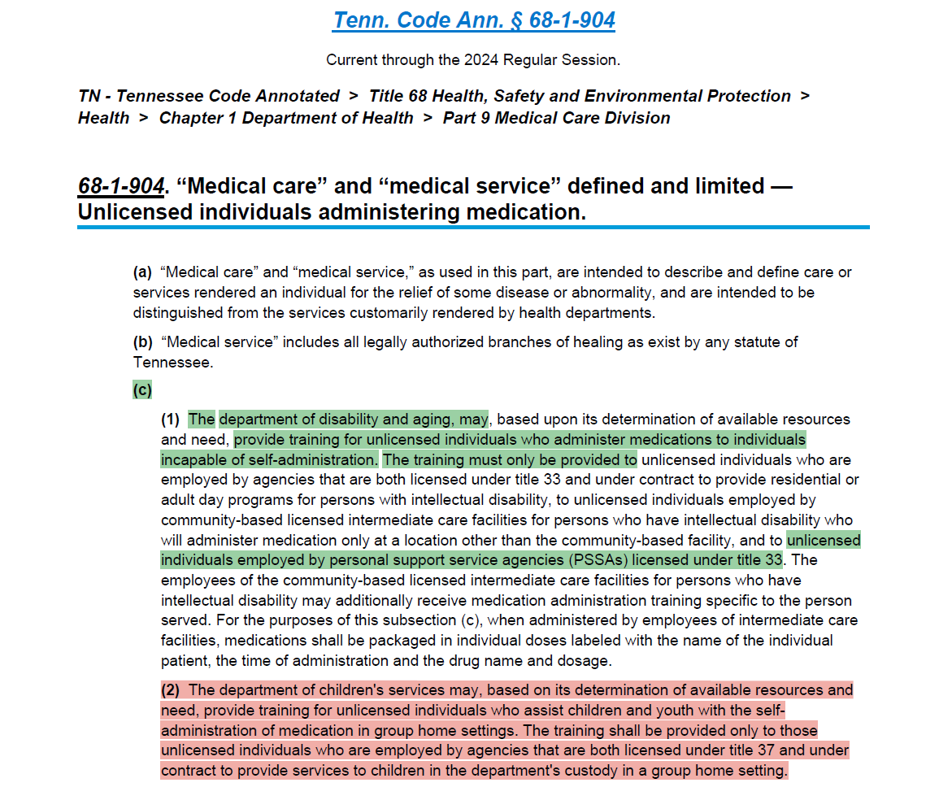
Medication Administration

Slide 20
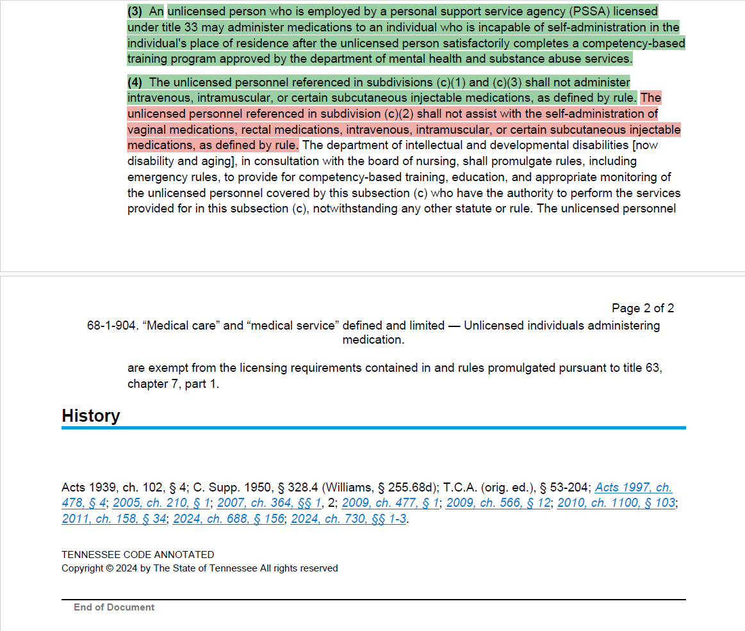
Medication Administration

Slide 21
Medication Administration Certification for Unlicensed Personnel of PSSAs
TDMHSAS PSSA Licensed Provider:
It is our pleasure to inform you that, effective immediately, pursuant to Tennessee Public Chapter No. 730 of 2024, https://legiscan.com/TN/text/SB1793/id/2989366, the Tennessee Department of Mental Health and Substance Abuse Services (TDMHSAS) has approved of a competency-based training program which will permit PSSA unlicensed personnel to administer medication upon certification. This new allowance will enable your organization, post personnel certification, to better meet the needs of clients who are unable to self-administer certain medication(s) without the administration services of a licensed professional.
While additional programs are still being reviewed and may be approved later, TDMHSAS has partnered with the Tennessee Department of Disability & Aging (DDA) to review and approve of their Medication Administration classes. This partnership allows for the immediate utilization of these classes for this purpose. Should you or your organization be interested in learning more or becoming certified, please visit this link, https://www.tn.gov/content/tn/disability-and-aging/about-us/divisions/clinical-services/nursing.html , scroll to the bottom of the page, and click on the “Medication Administration” dropdown. Class and testing schedules, administration guidelines and logs, training curriculum and materials, rules, forms, and other resources can be accessed at the same link. The cost of training and certification, as set by DDA – for those PSSAs who do not support individuals with intellectual and developmental disabilities – is $50.00 per participant for the 20-hour class and $25.00 per participant for the Test-Out renewal. The certification is valid for 3 years.
Should you wish to sign up your personnel, you can find available classes at this link, https://www.dropbox.com/scl/fo/0goar3yr7yy0uqah3mhxw/AABUAKFOVH3Jz0yFjm-mD0o?rlkey=u0c94tbugasco01wif3eo03va&e=1&st=ua70x2ge&dl=0 . The calendars of classes are updated by the 5th day of each month. Required information for enrollment includes name, date of birth, date of employment, social security number, agency name, last certification date (if applicable), and either “I” for those taking the initial 20-hr. class, “R” for those taking the 20-hr. class for renewal, or “TO” for those completing the Test-Out option for renewal. All participant registrations are subject to eligibility verification prior to attendance. Only individuals working for agencies appropriately licensed by TDMHSAS as a PSSA, or meeting other eligibility criteria, qualify to work towards certification.

Slide 22
Medication Administration Certification for Unlicensed Personnel of PSSAs
A “Medication Administration for Unlicensed Personnel – Participant Registration PSSA Providers Licensed by MHSAS” form is included with this notice and should be used if enrolling multiple caregivers into a single class simultaneously. This form should be provided to the class trainer listed on the class you intend your workers to attend.
Beyond signing individual caregivers up, TDMHSAS PSSAs should:
1. Notify their assigned TDMHSAS Licensure Surveyor that they intend to seek caregiver certification.
2. Keep a copy of each worker’s certification in their personnel file for TDMHSAS review.
3. Develop and implement a Medication Safety Policy.
i. A sample Medication Safety Policy, originally developed by DDA, can be provided to you, should you be interested. The sample policy is a standardized medication administration policy consistent with the program rules.
4. Ensure any personnel enrolled for such classes fully read and understand the purpose of the certification, as well as all expectations of them, before they attend the training and agree to perform this service for your organization. Any caregivers who become medication administration certified must maintain their certification and follow the regulations surrounding this allowance to continue performing such services.
Finally, please be aware that TDMHSAS intends to promulgate additional regulations around this new allowance, which are specific to TDMHSAS PSSAs, and will notify all TDMHSAS licensed PSSAs once these regulations are publicly filed. These regulations will mostly help frame operational expectations of the PSSA (i.e., mandate the presence of policies and procedures related to medication administration) but are not necessary on the front end of caregiver ability to receive this certification.
If you have questions for TDMHSAS Licensure around this allowance, please email us at MHLicensure@tn.gov.
If you have questions for the administrators of DDA’s Medication Administration Program, please reach out to the regional contact who corresponds to your area:
- West Tennessee
o Leah McWain (Leah.McWain@tn.gov) Phone: (901) 745-7801
- Middle Tennessee
o Carlo Desierto (Carlo.Desierto@tn.gov) Phone (615) 231-5071
- East Tennessee
o Kim Lawrence (Kimberly.Lawrence@tn.gov) Phone: (865) 594-9359

Slide 23
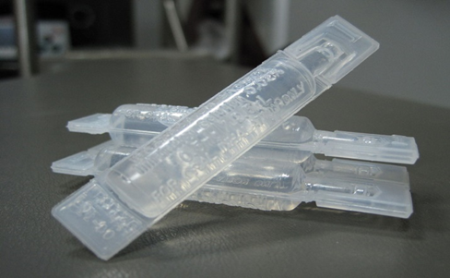
Is adding the tube of medicine to a nebulizer allowed, or is this considered medication administration?
This would be considered medication administration because the personal support worker would be determining dosage by inserting a tube of medicine into a machine for use. Licensure rules allow non­medical, non-professionally licensed staff to practice strictly medication assistance.
Note: Please consult with the Medication Administration Certification Program to determine if this is allowed for certified personnel according to the new statue.

Slide 24
Can Physician Assistants approve medication assistance training?
No. A PA cannot approve medication-assistance training. The only approved medication-administration programs are through the board of nursing.
0940-05-38-.08(b) Individuals who provide medication assistance receive documented training in medication assistance performed by, or under the general supervision of, a registered nurse and consistent with T.C.A. § 63-7-102 (pg 9 of Chapter 38 rules).

Slide 25
What are some other services that are not allowed under the TDMHSAS PSSA License?
Blood pressure monitoring
Application of wet/dry compresses to open pressure wounds
Use of hoyer lift or gait belt as part of therapy regimen
Accu-checks to test blood sugar
Administering insulin injections, oral medications, prescription topical creams, pain patches
Cleaning or removing Foley catheters or assisting with feeding tubes
Measuring/recording fluid intake or output
Taking/recording vitals - - blood pressure, pulse, temperature, respiration • Filling medication planners
Note: Please consult with the Medication Administration Certification Program to determine if these services are allowed for certified personnel according to the new statue for PSSAs under TDMHSAS Licensure.

Slide 26
What are some other services that are not allowed under the TDMHSAS PSSA License?
Putting drops in ears or eyes
Turning an IV up or down
Adjusting the setting on oxygen
Pushing the start button on an infusion pump
Changing dressings
Giving enemas or irrigating catheters
Emptying urine collection containers of internal (indwelling) catheter
Emptying collected urine from a urostomy bag
Emptying ileostomy or colostomy bags of a 2-part collection system
Note: Please consult with the Medication Administration Certification Program to determine if these services are allowed for certified personnel according to the new statue for PSSAs under TDMHSAS Licensure.

Slide 27
What are some other services that are not allowed under the TDMHSAS PSSA License?
Positioning a bed-bound client for the prevention of contractures
Peg tubes/NG tube
Ventilator management
Applying ointments of any kind (prohibited since 2007)
Note: Please consult with the Medication Administration Certification Program to determine if these services are allowed for certified personnel according to the new statue for PSSAs under TDMHSAS Licensure.

Slide 28
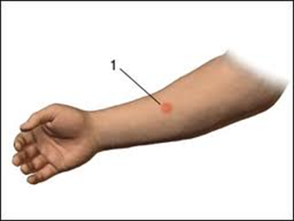
Are PSSA workers/caregivers required to have a TB skin test?
No. This is not a Licensure requirement. This may be a requirement with other entities that your agency may have a contract with so please check with that source.

Slide 29

Are PSSA workers/caregivers required to be certified in CPR?
No. This is not a Licensure requirement. This may be a requirement with other entities that your agency may have a contract with so please check with that source.

Slide 30

What is the record retention for licensed providers?
It is 10 years. According to Tenn. Code Ann. § 33-3-101(d), "The chief officer shall keep records detailing services or supports received by each person. Records shall be preserved by the chief officer for not less than ten (10) years after termination of service..."

Slide 31
Backup Staffing
Can the agency backup staffing plan state it will fall upon the client if the agency can't find anyone? What about if the agency just can't find anyone to come and they miss that visit? Outside of 24-hour clients (in which the previous caregiver will have to stay over if there is no replacement), all other clients are only served for a few hours a day and these clients are essentially on their own the rest of the day.
TDMHSAS feels it is not appropriate for care coverage to fall back on the client. The client contracts for services on a certain date and time and if the agency cannot have someone there to provide services, then the agency would be negligent in coverage. TDMHSAS sees this in two forms:
1.) If the scenario is that the caregiver was a no-call, no-show, then the deficiency should fall back on the caregiver that no-call, no-showed. Our Notice of Non-Compliance forms "substantiate" the agency in these cases but the language of the citation would read that the act falls back specifically on the caregiver themselves.
2.) If the scenario is such that a caregiver called in and the agency did not get someone there appropriately, then the agency is the one that is derelict of their responsibility. The agency would likely be substantiated for a policy violation in not implementing their back¬up plan appropriately and the supervisor aware of the coverage shortage would be at risk of an individual substantiation. This would be the case whether the client is a 24-hour client or a less frequent client.

Slide 32
Timesheets
Can family members sign off on timesheets for caregiver’s visits to indicate that they were there?
TDMHSAS feels that best practice is to avoid this sort of structure. That said, and if it is unavoidable, it would be prudent of the agency to have the family member print their name, state their relationship and why they are confirming the visit for the person served.

Slide 33
Power of Attorney (POA)
How do we deal with a potential client that self-reports he or she has a power of attorney (POA) but never submits paperwork or provides proof of the POA?
The fact that the potential client/client has a POA, or gives the appearance that they have a POA, does not by itself stop the client from being able to contract for services/be served. A POA is a document that is created for a specific purpose(s) and is to be used for when someone is incapacitated or otherwise unable to handle their own affairs. Good faith belief that the client is able to be served without duly executed documents saying the alternative is permissive.
NOTE: This section is written with the intent to be clarifying and should not be construed as legal advice.

Slide 34
When should the criminal background of a person be checked?
See Tenn. Code Ann. § 33-2-1202(b) for controlling authority. TDMHSAS has the interpretation that the background results shall be back and in the possession of the employer prior to employee direct contact with, or direct responsibility for, service recipients. This may or may not be before the hire date but most definitely should be before the direct care responsibility start date. Agencies should not be cited for having the check done after employment, if no direct contact with or direct responsibility for, service recipients has yet to commence.

Slide 35
What are the requirements for verifying work and personal references?
Again, see Tenn. Code Ann. § 33-2-1202. This statute effectively requires two things:
1.) Agency must verify work and personal references... The agency needs to be able to show attempted "direct communication”, which could be as simple as documenting the fact that the agency called the numbers listed on the application and had to leave a voicemail or printed off a copy of an email that was sent to the agency contact(s) listed. Agency must directly communicate with at least two (2) of the three (3) required references listed.
2.) Applicant is required to provide a five (5) year work history prior to employment with agency... This requirement is also mentioned in 0940-05-38-.07(1)(i) which requires a "continuous description of activities." Agency should require an explanation for gaps in employment within that timeframe, if appropriate. Agency is required to communicate with the most recent employer. There is no requirement to check with ALL places listed, only employers where the applicant has worked for more than 6 months. Verifying employment is no different than verifying references. Again, documenting your attempted phone call, fax, email, etc. is sufficient.

Slide 36
Current Employee Check during Hiring Process
What is an agency supposed to do if an applicant does not want you to check with their current employer until they are hired? Potential employee is fearful that they could lose their current job before knowing they had secured employment.
We fully understand the concern here; however, there is no real flexibility in the statute. Tenn. Code Ann. § 33-2-1202(c)(1) states, "The organization shall check past work and personal references prior to employment of applicants.

Slide 37
Client Inability to Sign documents
Does the agency have to decline a client for services when the client can only sign with an "x" or drop a client when they can no longer sign their name and can only do an "x"?
No, whether they are signing with an "x" or actually signing their name, this is fine. "Signing" to show their intent or agreement is what is important. Good faith belief that the service recipient is able to denote/sign the document is the standard.

Slide 38
Policies not required by Licensure
Can the agency be cited for policies that are not required by Licensure rules?
No, an agency should only be cited for violation of policy rules that are listed in the applicable administrative rules for the agency.

Slide 39
Personal References
Can relatives be listed as personal references?
Yes, relatives can qualify as personal references. Relatives could also be listed as professional references, depending on the situation and whether the relative worked in a professional capacity with the person or not.

Slide 40
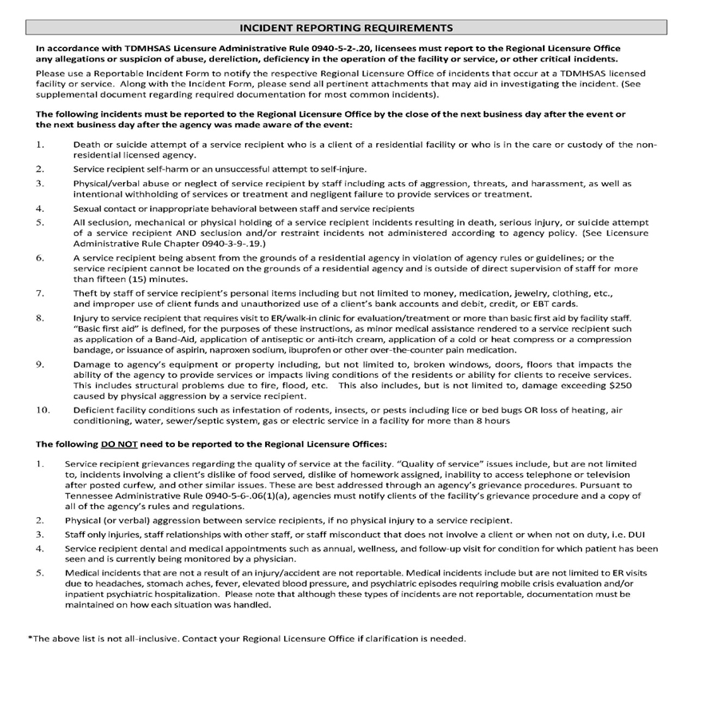
Incident Reporting Requirements

Slide 41
Reporting Guidelines -Common PSSA Incidents
When reporting the following incidents/allegations please provide the following information along with your incident report. Please note that the information/documentation requested for each type of incident is not all-inclusive and you may be asked to provide additional information during the investigation.
Accidents with or without injury: Provide the location of staff at the time of the accident. Provide a description of how the staff responded to the accident. Provide a copy of the needs of assessment and Plan of Care. If the accident occurred during a transfer, provide a copy of the equipment training that the caregiver received. Provide documentation of any injuries and the medical attention that was received. Provide a copy of any related policies and disciplinary actions.

Slide 42
Reporting Guidelines -Common PSSA Incidents
Deaths: Deaths that occur when the agency is not providing services or scheduled to provide services are not reportable unless there is suspicion of abuse or neglect of the assigned caregiver(s) that is believed to have contributed to the death. Provide a list of medical illnesses. Provide the name, social security number, and date of birth of the staff on duty at the time of the death or at the time the death was discovered. Provide a copy of the autopsy report (if any) and official documentation of the cause of death. Provide a copy of the DNR, if applicable. Provide a copy of the medical emergency policy.

Slide 43
Reporting Guidelines -Common PSSA Incidents
Thefts: Provide the name, social security number, and date of birth of all staff that were involved or implicated. Provide a copy of the criminal background checks that also include the abuse and sex registries conducted at the time of hire. Provide the most current address, telephone number, and email address of the alleged perpetrator. If there were any disciplinary actions as a result of this incident, provide a copy. Provide a copy of the policy related to the receipt and disbursement of money on behalf of the client. Provide copies of any written accounts of any money transactions on behalf of the service recipients and any related receipts, bank statements, etc. Provide copies of any written witness statements. Provide information if there are any other agencies that also provide services for the service recipient. Provide information on whether the service recipient lives alone or others outside of the agency’s caregivers have access to the home or items. If the agency is reporting an allegation related to theft of medication and the agency has performed a urine drug screen, provide the results and any documentation the caregiver has provided related to their prescribed medications.

Slide 44
Technical Assistance
If you have any additional questions, please contact the TDMHSAS Regional Office.
East Tennessee Regional Office Knoxville, TN Telephone: (865) 594-6551 Fax: 844-340-4482 Email: LicensureEast.fax@tn.gov | Middle Tennessee Regional Office Nashville, TN Telephone: (615) 532-6590 Fax: 615-532-7856 Email: LicensureMiddle.fax@tn.go | West Tennessee Regional Office Memphis, TN Telephone: (901) 543-7442 Fax: 844-844-5538 Email: LicensureWest.fax@tn.gov | Investigations Office Statewide Telephone: (866) 797- 9470 Fax: 615-401-7644 Email: LicensureInv.fax@tn.gov

