Slide 1
Tennessee Employee Mediation Program
Virtual Mediation Training for Mediators

Slide 2
Benefits of Virtual Mediation
DOHR conducted a pilot virtual mediation on April 21, 2020 for the Department of Environment and Conservation (TDEC) via WebexTraining. The TDEC virtual mediation had representation from East, Middle, and West Tennessee.
The mediator and designee provided positive feedback on the process to include ease of technology, efficiency in reaching a resolution, and time saving due to no travel.
Virtual mediation eliminates the need for:
  Travel
  Parking
  Conference Room Space/Location

Slide 3
Virtual Mediation Platform
WebEx Training
Scheduling Availability (Talent Management)
Disclaimer for audio or video recording during mediation
Agreeing to a virtual mediation is agreeing to be on camera for the designated time outside of the breakout sessions
  Eye contact and face to face is important for a successful mediation

Slide 4
Designee & Mediator Roles
Meet prior to mediation to discuss the technical process for:
Electronic signatures for agreement to mediate and memorandum of agreement
Hosting breakout sessions
  Setting breakout session times
Setting ground rules
  Announcing break times

Slide 5
WebEx Training Features
Roles
  Presenter
  Host
  Attendee
Bottom emojis icon feature
Chat box
Move ball to switch presenter/host
Breakout sessions
Electronic agreement signatures

Slide 6
Mediation Documents
Adobe Sign Website Link:
https://tennessee.na1.echosign.com/public/compose
You can add multiple recipients
Have full e-mail address ready to insert as a global directory will not populate automatically
Use outlook to directly copy-paste the correct e-mail
E-mail needs to be entered correctly (Enter all fields – print name, signature, date) Do not submit until all fields have been entered

Slide 7
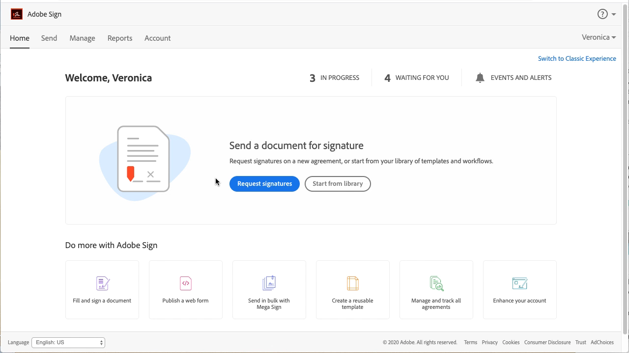
Mediation Documents

Slide 8
Overview
Opening statement
  Setting ground rules
  Explain how break out rooms will work
  Setting break times
E-Signing (Agreement to Mediate
  Follow Adobe E-signing process
Begin Mediation
Utilize Breakout Sessions
E-Signing (Memorandum of Agreement)
  Follow Adobe E-signing process

Slide 9
Questions?

