Slide 1
Sick Leave Bank (SLB) Open Enrollment Employee Self Service
Office of General Counsel | Employee Sick Leave Bank

Slide 2
Objective
At the end of this presentation, eligible employees who are not currently Sick Leave Bank Members, will be able to apply for membership in to the Sick Leave Bank .

Slide 3
State of TN Employee Sick Leave Bank (SLB)
The Sick Leave Bank (the “Bank”) grants paid sick leave to members who are medically certified as unable to perform the duties of their jobs as a result of a personal or minor child’s illness, injury, accident, disability, medical condition, or quarantine and who have exhausted all their personal sick, compensatory, and annual leave balances. The Bank is administered by a Board of Trustees (the “Board”) as established in T.C.A. § 8-50-903.

Slide 4
Sick Leave Bank Open Enrollment
For employees who are not SLB Members that want to join the Sick Leave Bank, they will follow the below path:
Navigator> HCM> Self Service> Time Reporting> Sick Leave Bank

Slide 5
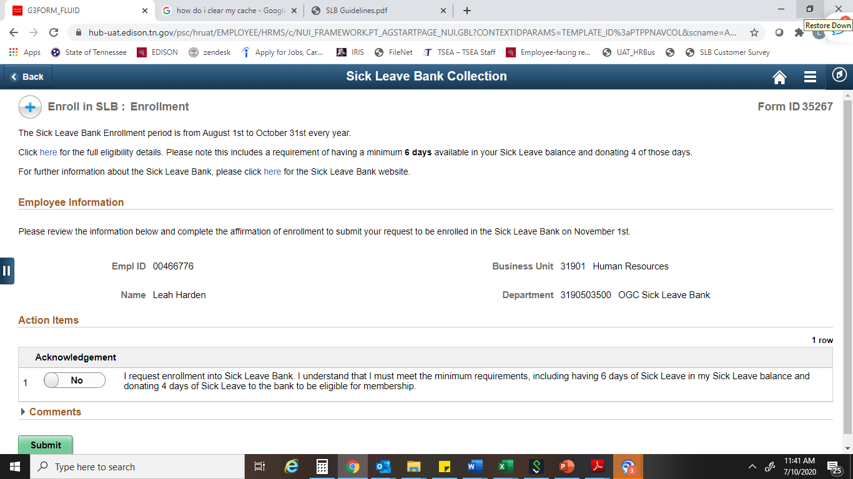
Sick Leave Bank Open Enrollment
The below page will generate and an eligible employee will be able to change the “No” button to “Yes” in the acknowledgement box below confirming their desire to enroll and then will click Submit. The employee will receive an email notification confirming their application for enrollment was submitted
If an employee is not eligible to enroll due to not meeting all of the SLB Membership eligibility criteria, the page will advise the employee that they do not meet the requirements to become a SLB Member and will not allow the employee to submit an application.

Slide 6
Sick Leave Bank Open Enrollment
Pursuant to T.C.A. § 8-50-802, SLB eligibility requirements for enrollment and membership are as follows:
The employee must be a full-time state employee and have 12 full months of continuous employment immediately preceding application for membership.
The employee must be in leave accruing status at the time of enrollment.
The employee must have a sick leave balance of at least 6 days by October 31st of the current enrollment year.

Slide 7
Sick Leave Bank Open Enrollment
REMINDERS for New Enrollees:
Employees who successfully join the SLB will have a membership effective date of November 1st of the current enrollment year.
New Members are eligible to apply for grants of sick leave on January 1st of the following year following open enrollment.
Any employee wanting to cancel their membership once membership is effective, must submit a written request to the SLB Board of Trustees requesting their membership be canceled. It must include their employee ID and signature. Please be advised that if a new enrollee submits this request at any time prior to June 30th, their membership will not be canceled until the next June 30th and they will forfeit the 4 sick days assessed to become a member of the SLB.
Applications for grants from the Bank for pre-existing conditions will be denied until November 1 of the following year. “Pre-existing” means a condition that existed for which a member received treatment or advice during the 12-month period prior to the effective date of initial Bank membership.

Slide 8
Sick Leave Bank (SLB) Office Contact Information
For any questions regarding Open Enrollment, please contact the Sick Leave Bank (SLB) office at the below email, phone number or see our website:
Email: SLB.SickBank@tn.gov
Phone Number: 615-741-5431
SLB Website: https://www.tn.gov/hr/employees1/sick-leave-bank.html

