Slide 1
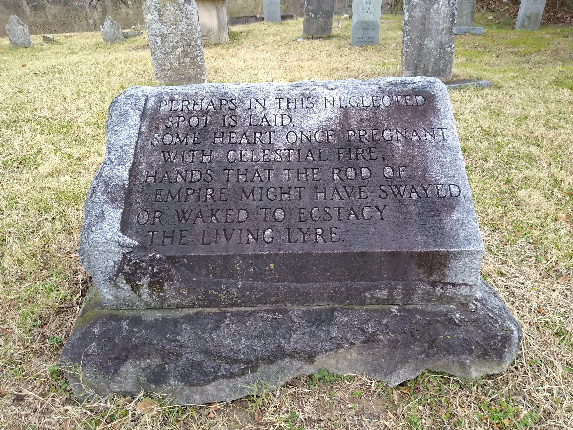
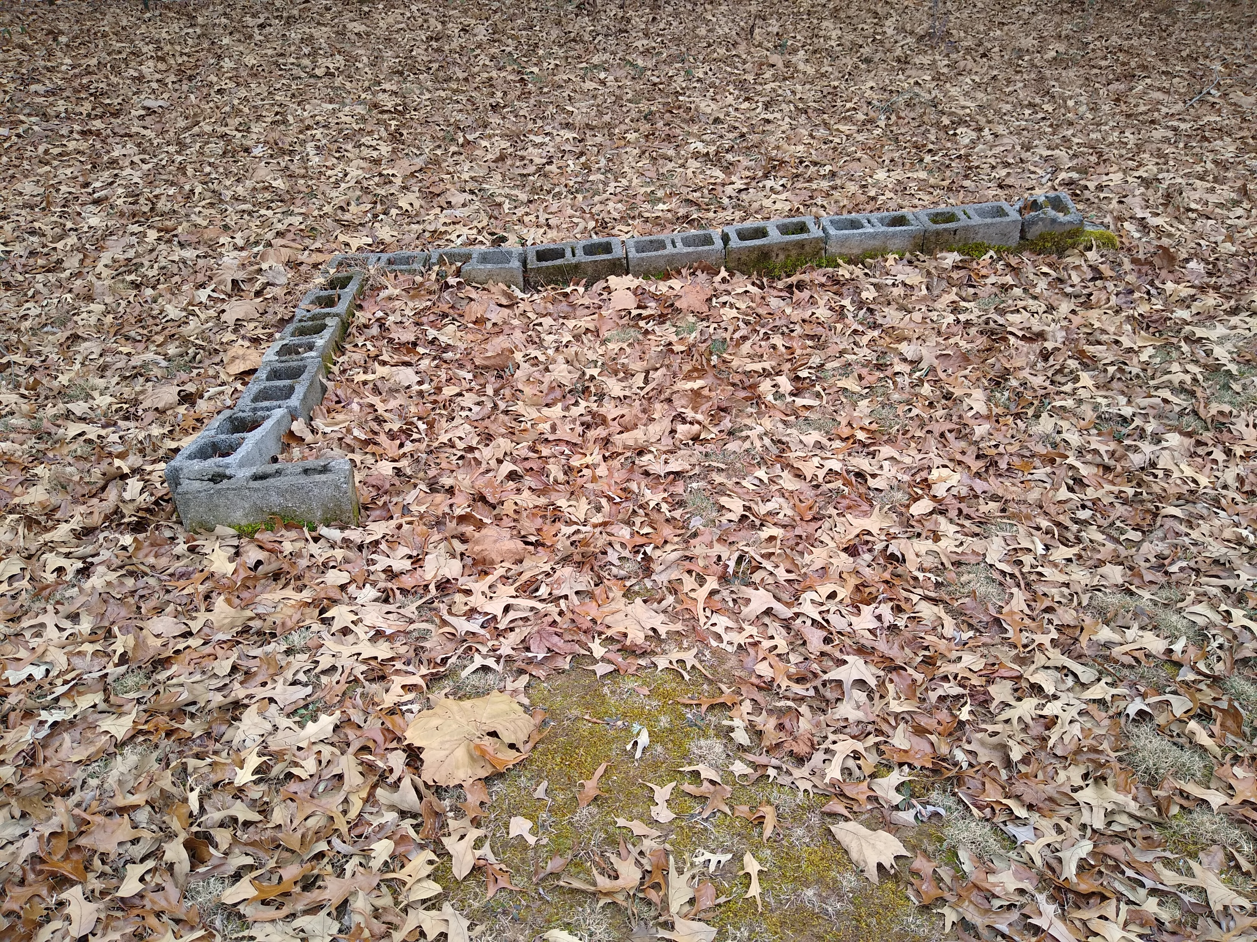
CEMETERY LAW
Memorial at William Ewing Cemetery, Nashville, TN
African American grave outlined with cinder blocks
Mt. Olive Baptist Church Cemetery
Robertson County, TN
Tennessee Historical Commission
Presented by:
G. Graham Perry III, ABD
Historic Cemetery Preservation Specialist
graham.perry@tn.gov

Slide 2
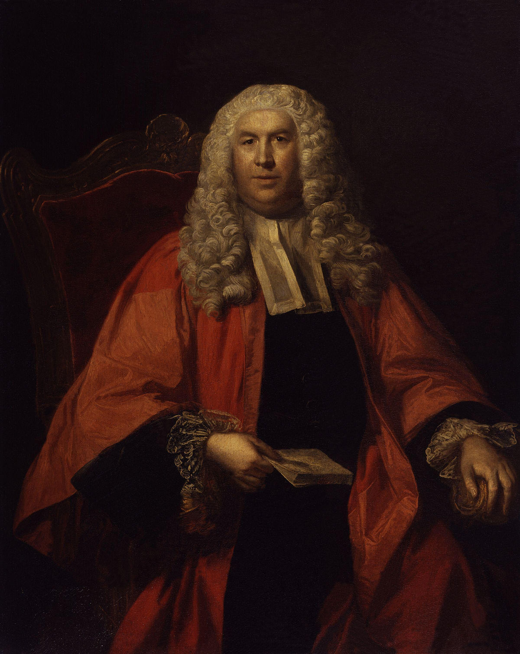
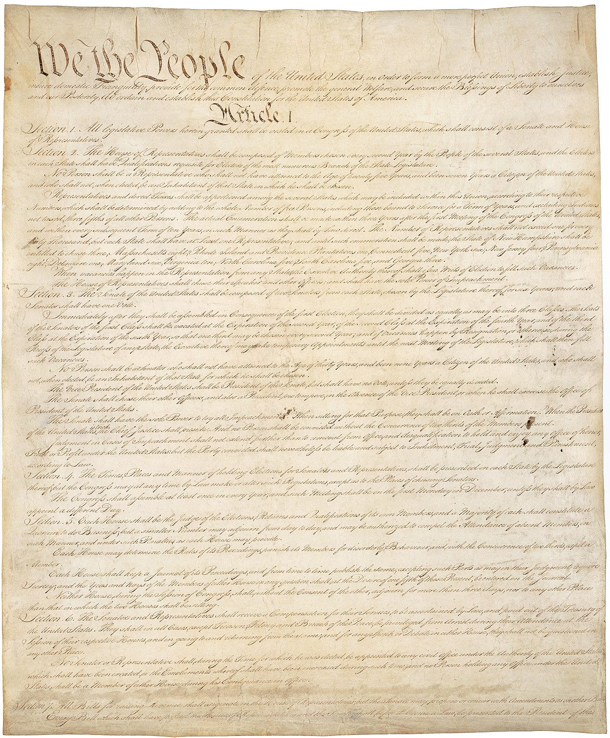
TENNESSEE LAW OVERVIEW
William Blackstone (1723-1780)
US Constitution
STRONG POINTS
WEAK POINTS
Family Graves Protection Act (TCA 46-8)
Relocation process is clear (TCA 46-4)
Tax incentives exist
Desecration law clear (TCA 46-1-313)
Criminal Penalties (TCA 39 Ch. 17)
Hines v. Tn (1911) strengthens law
Many don’t read it before taking action
Expensive: Noncompliance worth risk?
Benefits tiny & often reported incorrectly
Enforcement?; 46-1 only for comm. cems
Defined in TCA 39, not TCA 46
Visitation not in Title 46; Seen as old

Slide 3
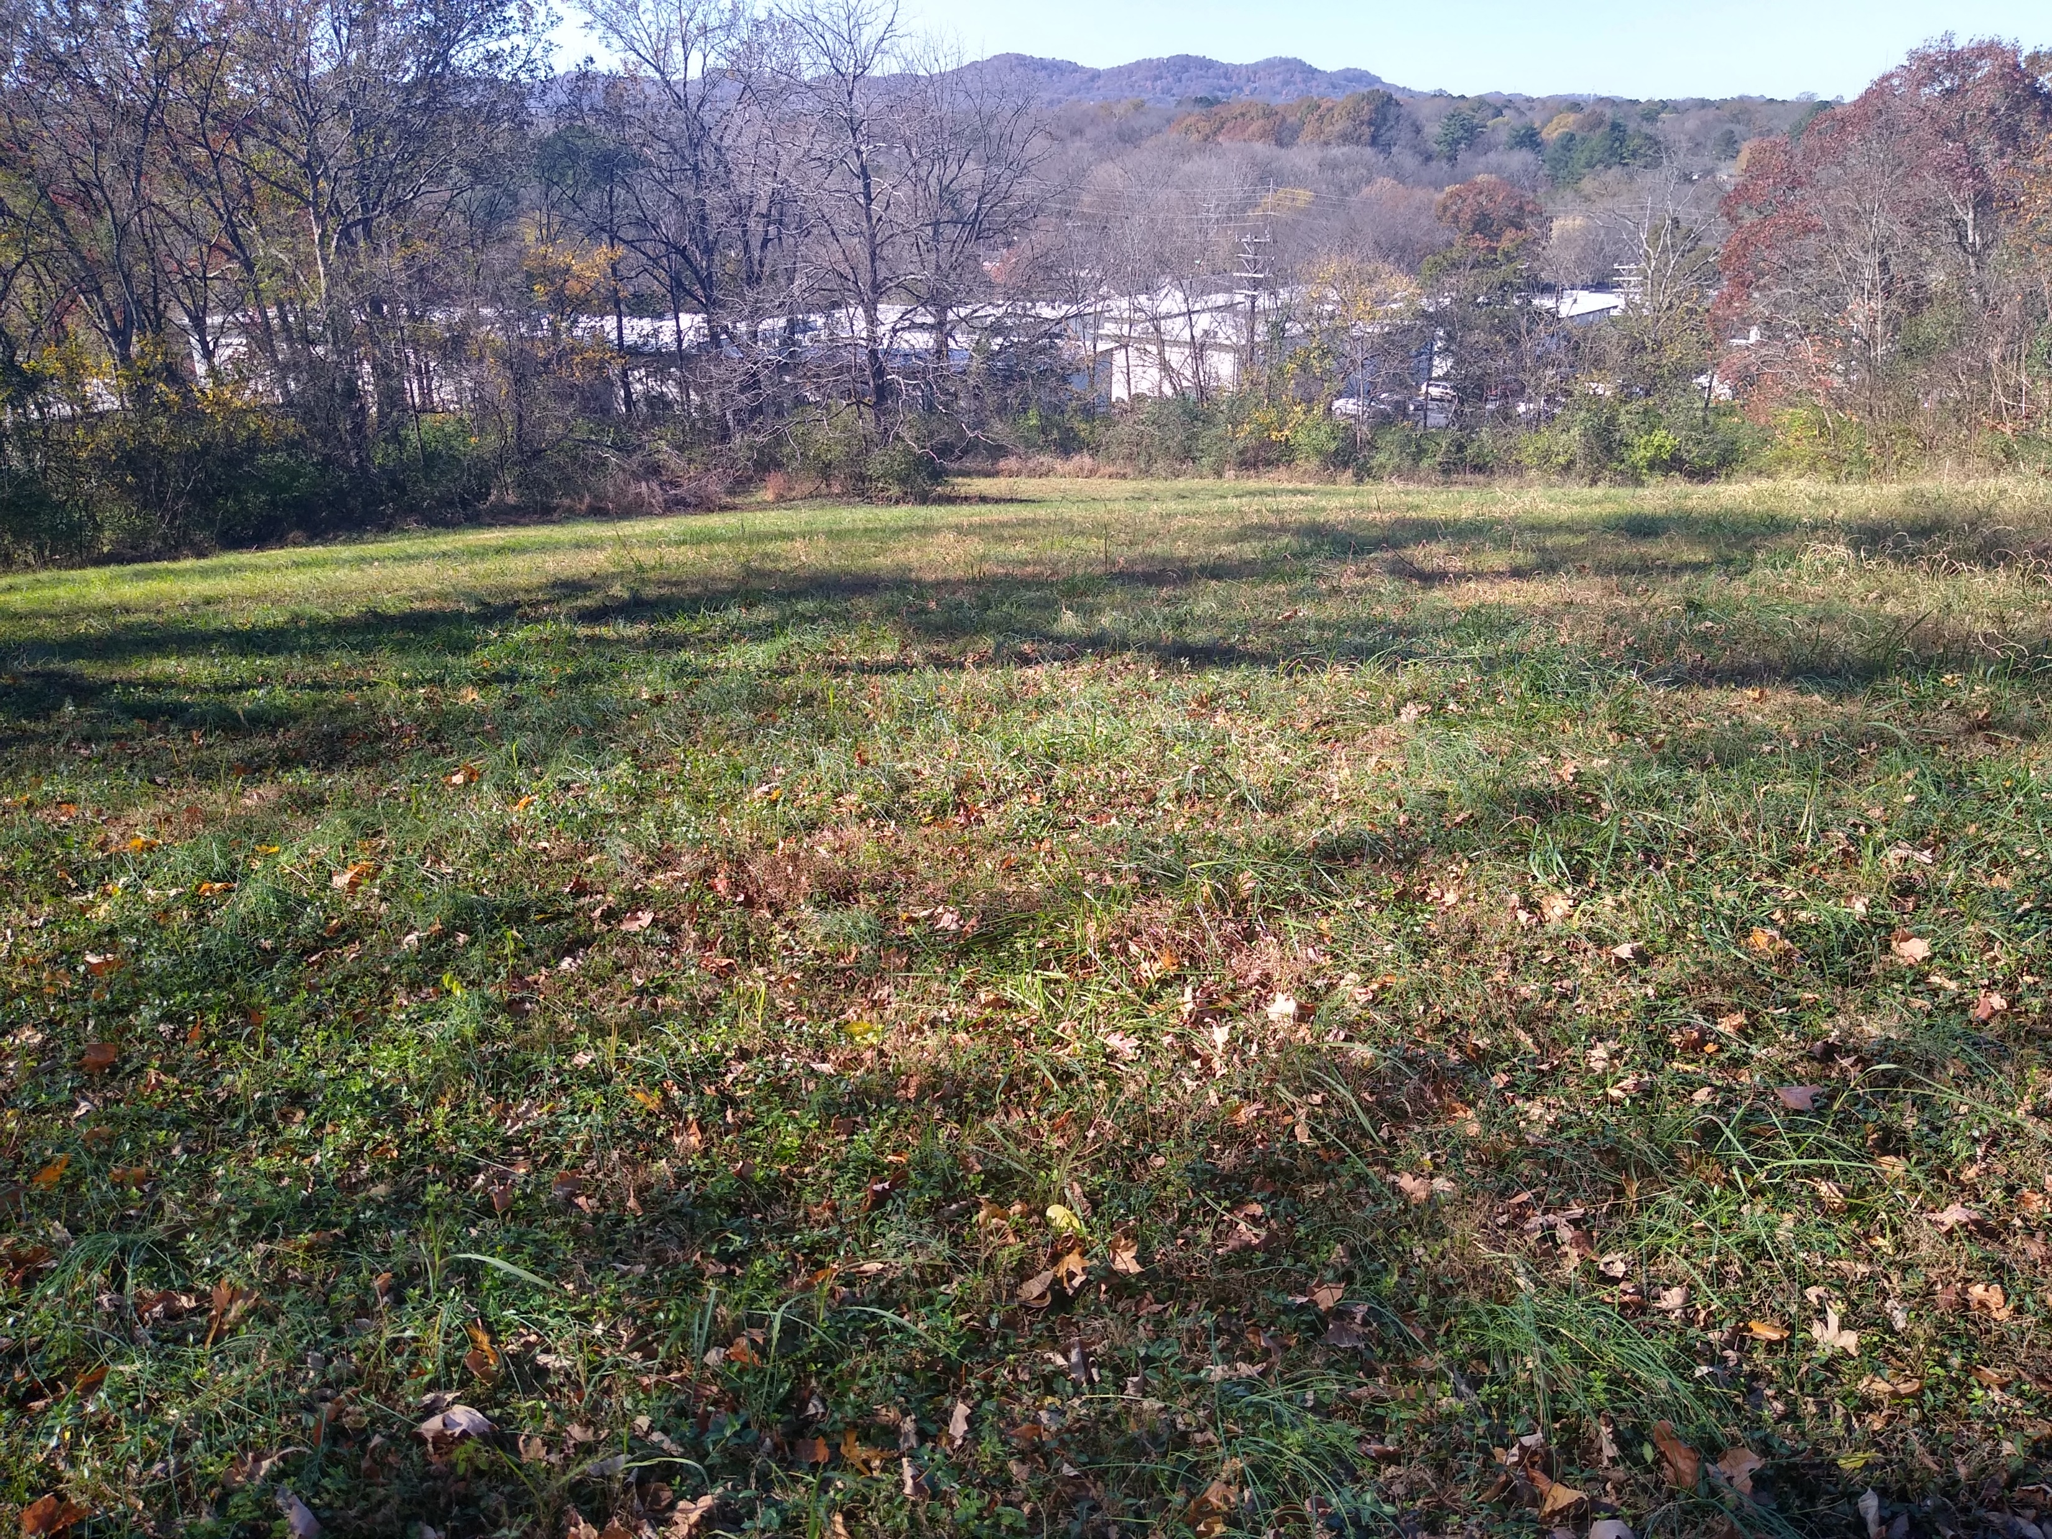
T.C.A. 46 cemeteries
Tennessee General Assembly
TCA 46-4
Edmonson Cemetery (African American) Nashville, TN
TCA 46-8
Termination of Use of Land as Cemetery
46-4-101: Abandoned, neglected, threatened
46-4-102: Interested persons (Families)
46-4-103: Process for termination
46-4-104: Provisions for reinterment
Family Burial Grounds Protection Act
46-8-103: Landowner duty to “protect”
46-8-103a: MUST be on deed of transfer
46-8-103b: Protection boundary defined
46-8-103c: See TCA 46-4

Slide 4
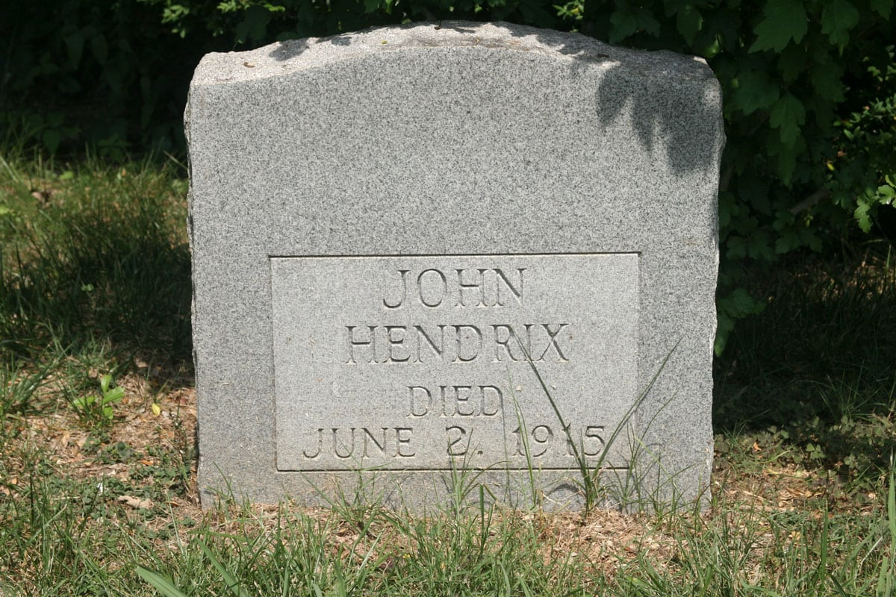
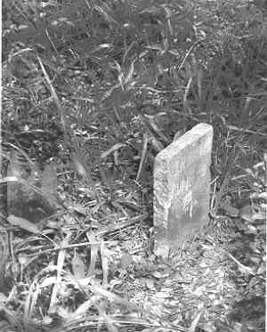
TCA 46-1
46-1-102: Definitions (Commercial Cemeteries Only. Why?)
CEMETERY
“any land or structure in this state dedicated to and used, or intended to be used, for interment of human remains”
1 grave = cemetery
Cemetery can even have no graves. Intention of use is all that is needed
CEMETERY PURPOSES
“any and all things requisite or necessary for or incident or convenient to the establishment, maintenance, management, operation, improvement and conduct of a cemetery, the preparation of the premises for interment and the interment of the human dead, and the care, preservation and embellishment of cemetery property”
John Hendrix “the Prophet of Oak Ridge” gravesite
Robertsville, Anderson County
(The Tennessee Magazine)
John Hendrix “the Prophet of Oak Ridge” gravesite
original marker, Robertsville, Anderson County
(Ed Westcott, Photographer, 1944)

Slide 5
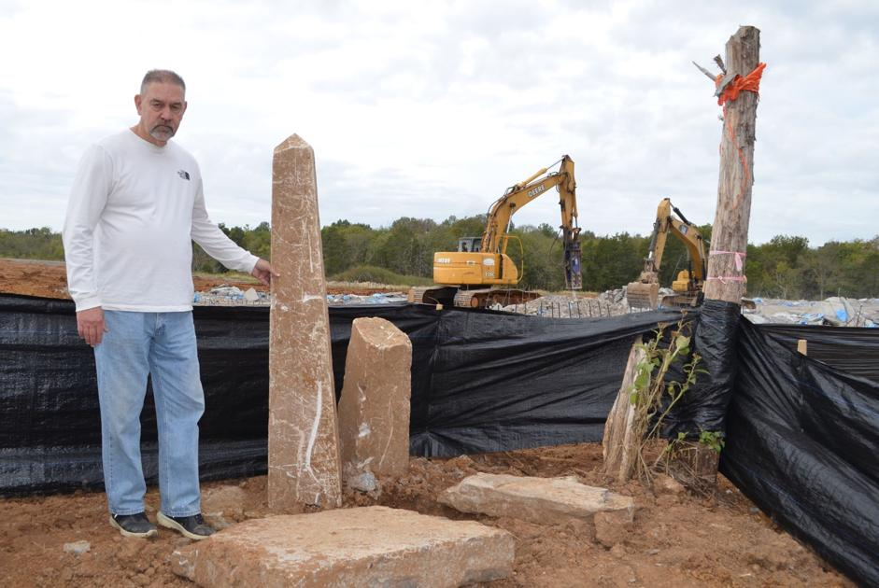
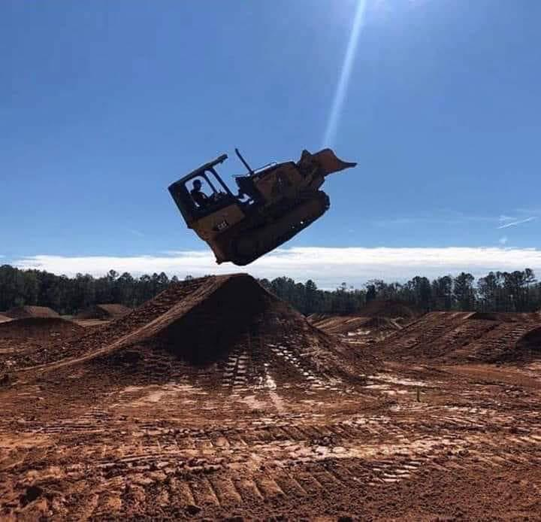
TCA 46-4 Termination of Use of Land as Cemetery
46-4-101 Defines purpose of the act
Is Cemetery Abandoned/Neglected?
Is purpose of property surrounding a cemetery inconsistent with proper reverence?
46-4-102: Defines interested parties
Can be family members, relatives, and anyone having right of easement
Applies to ALL cemeteries in Tennessee
46-4-103: Actions and Proceedings
Step 1: Check to see if you really own the cemetery (you may not; that may not matter, but…)
Step 2: Complainant MUST first publish notice of intent using press sources common to county.
Step 3: County chancery court MUST then be contacted to petition for termination
Remaining Interested parties are considered defendants
Step 4: Petition MUST be filed with THC and posted on the THC website
46-4-104: Judgments and Decrees; Termination and Removal
Circuit Court determines outcome based on evidence tied to 46-4-101
Steve Primm standing beside ancestor’s
Markers, bulldozed “accidentally” by
developer. Rutherford County, TN
(Jason M. Reynolds, Murfreesboro Post, 2019)
“So Why Did You Get Fired?”
Image by Mike Hoonigan

Slide 6
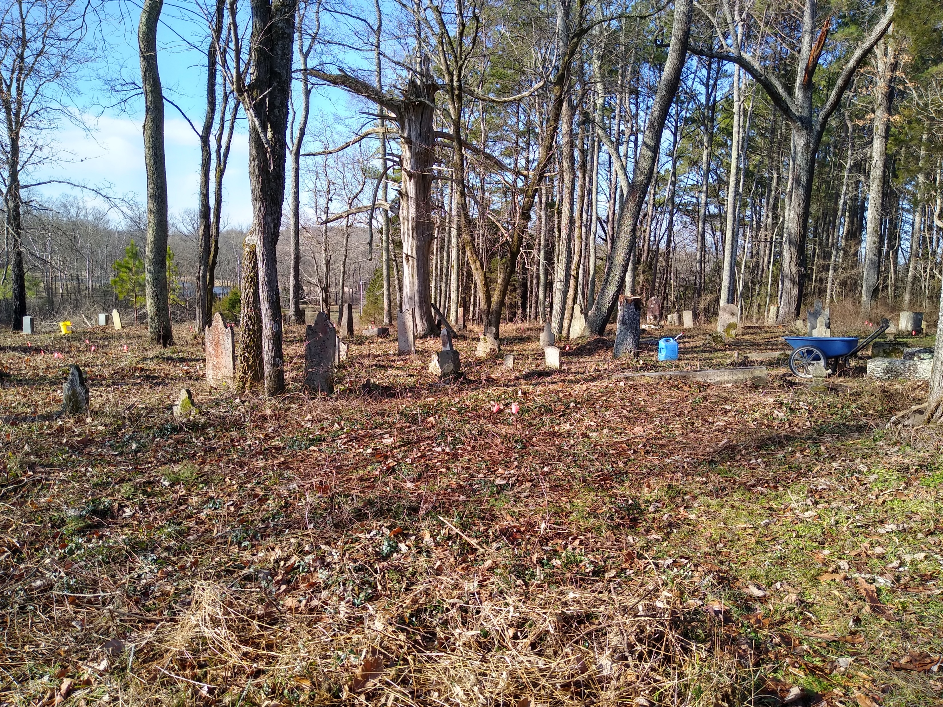
TCA 46-8 Family Burial Grounds Protection
TCA 46-8-101 Purpose
“intended to provide notice to buyers of property with known burial grounds and gravesites.”
TCA 46-8-102 Definitions
Defines Crypt, Gravesite and applies to Human remains
TCA 46-8-103 Duty to protect graves or crypt; Disturbances prohibited; Transfer of remains.
Cemetery owner has “duty to protect” known graves
Owner MUST ensure cemetery is on Deed prior to sale or transfer
Defines prohibited area: 10 ft. from grave, 5 ft. from crypt
Notifies owner that there is an option and a process for removal (see TCA 46-4)
Old Jordan Family Cemetery
College Grove, Williamson County

Slide 7
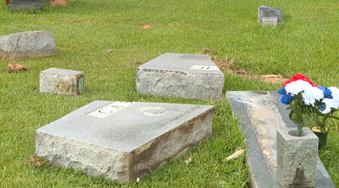
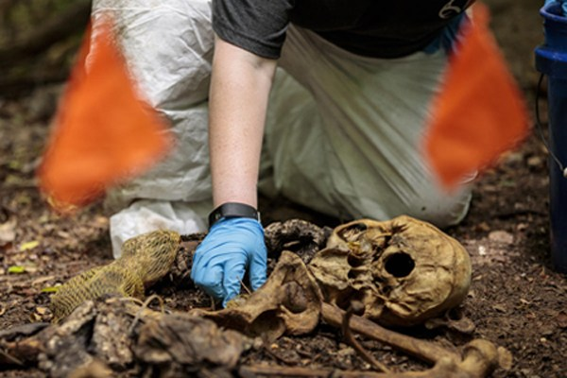
TCA 39-17-3 Criminal offenses
TCA 39-17-311 Desecration; honored places or flags
A) Person may not desecrate a place of worship or burial
B) Class E Felony
TCA 39-17-312 Corpses; abuse
Class E Felony (prison time 1-6 years; fine of up to $3,000)
Don’t forget: You lose right to vote
Vandalism of Cash family monument at Hopewell Cemetery, Medina, Gibson County, 2020. (WBBJ Eyewitness News)
Ask yourself: Are these human remains ancient or current?
(University of Tennessee, Knoxville)

Slide 8
What do I do If?
Desecration
Report it to local police ASAP
Contact County Court to notify them of desecration
These entities MUST uphold Tennessee Law
If they refuse, call regional DA (and notify me)
If regional DA doesn’t act call me and call Attorney General
Corpse Abuse
Accidental disinterment
Stop work immediately!!!
Call Police and Health Department immediately!!!
Remember, you may have found a murder victim. Don’t be an accessory to murder.
Call TN Dept of Archeology-They should be notified also (615)-741-1588
If you see intentional disinterment
Call local police immediately!!!
Fayette County Sheriff Office Seal
Phil Hodge, State Archeologist

Slide 9
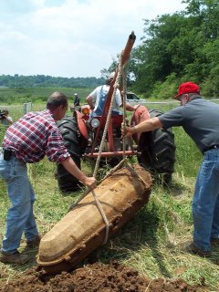
TCA 68-5-508 DisInterment; Reinterment
68-5-508(a): “Authorization for disinterment and reinterment in cases of movement of cemeteries or parts of cemeteries or for reuniting families shall be required prior to disinterment of a dead body or fetus.”
68-5-508(b): “Such authorization shall be issued by the state registrar to a licensed funeral director or person acting as such, upon proper application.”
Who is allowed
Funeral Homes
Can use for graves after 1920s
Archeology companies
Can use for any grave
Archeologists remove coffin of Civil War soldier
Isaac Newton Mason for relocation, Giles County, 2003

Slide 10
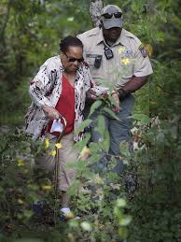
Walter Hines v. State 149 SW 1058-1060 (1911)
Sets precedent in Tennessee and Across Nation
Not completely included in TN Code…yet
Defines Interested Party Rights
Right to maintain, repair and beautify
Right of visitation
Right of burial
Declares a cemetery is a cemetery forever (Unless Title 46-4)
Landowner CANNOT
Obstruct interested party visitation
Desecrate
This also means plowing up headstones and using land for something else (see TCA 46-4)
Cheatham County law enforcement office escorts
Family member to visit ancestor grave ,
Belltown Cemetery, Cheatham County, 2017.
(Courtesy of the Tennessean)

Slide 11
OTHER RELEVANT PRECEDENTS
Davis V. May (Texas, 2003)
Confirmed right of ingress and egress
McCoy v. Barr (Kansas, 2012)
County employees granted easement to maintain cemetery
Rhodes v. Nicklas (Missouri, 1981)
Relatives granted right to restrain owner from interfering with cemetery’s purpose
Stoker v. Brown (Tennessee, 1979)
In a nutshell = Cemetery area is same as it ever was, even though it “miraculously shrank”

Slide 12
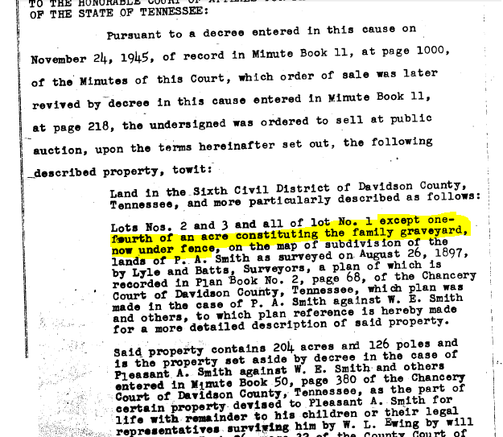
Why can’t I plow up a cemetery? Its my land!
It might not really be “yours”
Call register of deeds confirm
Even if it is yours, you still MUST leave it alone!!
See TCA 46-8
There is a legal process for relocation
See TCA 46-4
If the rules make you angry…
Blame English Common Law
Blame the 1st Amendment, US Constitution
Blame yourself for purchasing the land before you knew the law
Deed of Transfer to State of Tennessee from
Nashville Trust Co. et. al., 1945

Slide 13
What I should do IF I AM A…
Landowner
Follow the law
If you don’t, you’re going to lose-its expensive and will take up your limited time on earth!
Be Nice!
Visitors may be annoying, but try to work something out if they request access.
Don’t just do what you want and hope no one finds out
If you do, interested parties will call me, and I’ll investigate
Trust me, my investigation will really annoy you.
Visitor
Be Courteous
There are many reasons a landowner is reluctant to have you on his/her property
If landowner is a curmudgeon, be nice anyway (and document everything)
Follow the law
If you don’t, you’re only going to incur unwanted expenses and penalties

Slide 14
For more information
Graham Perry - Historic Cemetery Preservation Specialist Tennessee Historical Commission (615) 532-0087; graham.perry@tn.gov
Tennessee Division of Archeology – Phil Hodge (615) 687-4776; phil.hodge@tn.gov
Graham Perry

