Slide 1
UT Medical Center at Northshore
Proposed 60 Bed General Acute Care Hospital
Certificate of Need
Project Number CN2608-018

Slide 2
UT Medical Center at Northshore
Services and Departments:
60 Medical & Surgical Beds
Inpatient & Outpatient Surgery with 8 ORs
Emergency Department with 14 Exam & Treatment Rooms
Inpatient and Outpatient Imaging including CT and MRI
Cardiac Cath (2 labs)
Radiation Therapy/Linear Accelerator

Slide 3
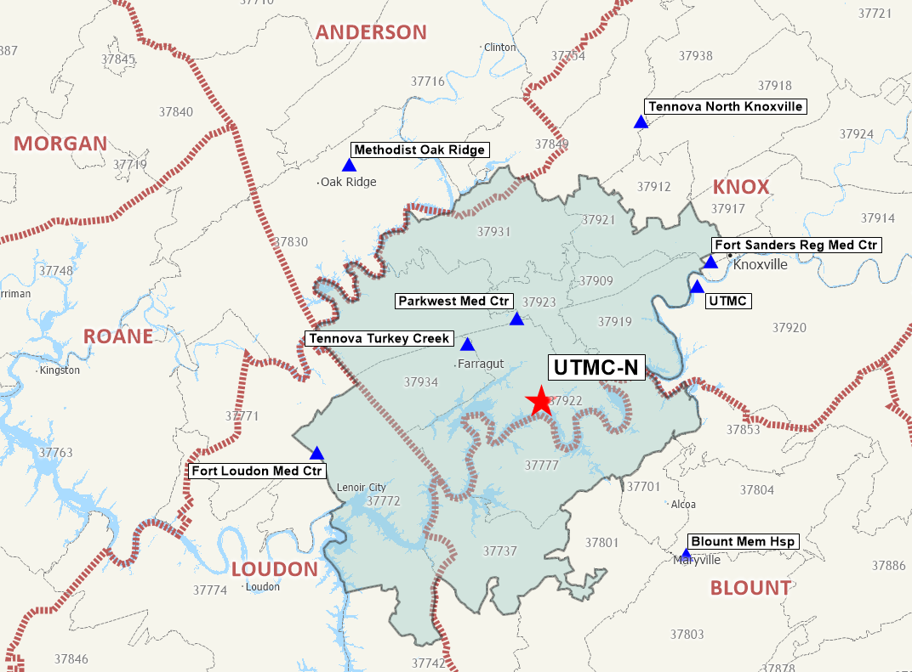
UT Medical Center at Northshore covers 11 zip codes in Knox, Blount, and Loudon Counties - Primary Service Area

Slide 4
UT Medical Center trains the next generation of physicians, nurses and technicians
Teaching hospital and training site for future doctors
    273 physician residents and fellows
BSN Scholars Program - full scholarships at UTK/UTM School of Nursing
    153 students currently enrolled
Radiography Technology Program
    On-campus training school for radiography technicians
Internships for 865 high school students interested in health care careers

Slide 5
UT Medical’s academic mission brings advanced care to the East Tennessee Region
710 Acute Care Beds
    39,361 Admissions in 2026 (annualized)
    29,230 IP and OP surgeries
    86,388 ED visits
Level I Trauma Center
Level III NICU
State-designated Perinatal Center
Federally designated Rural Referral Center
Transplant Center

Slide 6
UT Medical Center’s main campus is stressed to capacity
Most inpatient admissions come through the ED
In 2026 (annualized) there were 20,936 patients who were in ED hold waiting for a bed 4+ hours
Sept. 2026 boarding hours are a 300% increase over September 2025.
YTD 2026 UTMC has been forced to decline 1,230 transfer admissions due to lack of available beds.

Slide 7



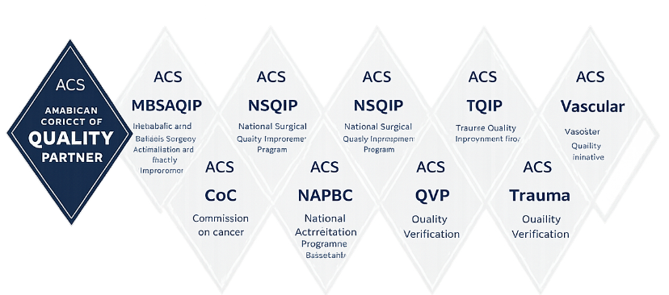


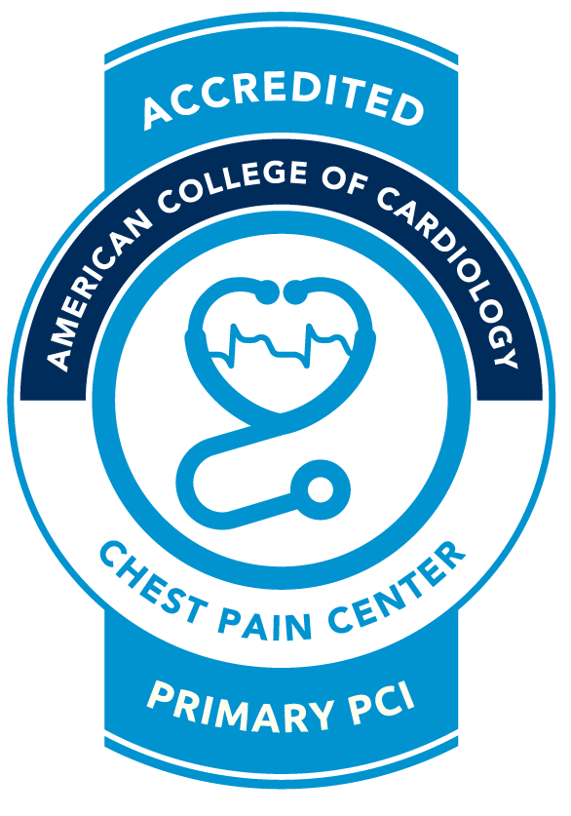
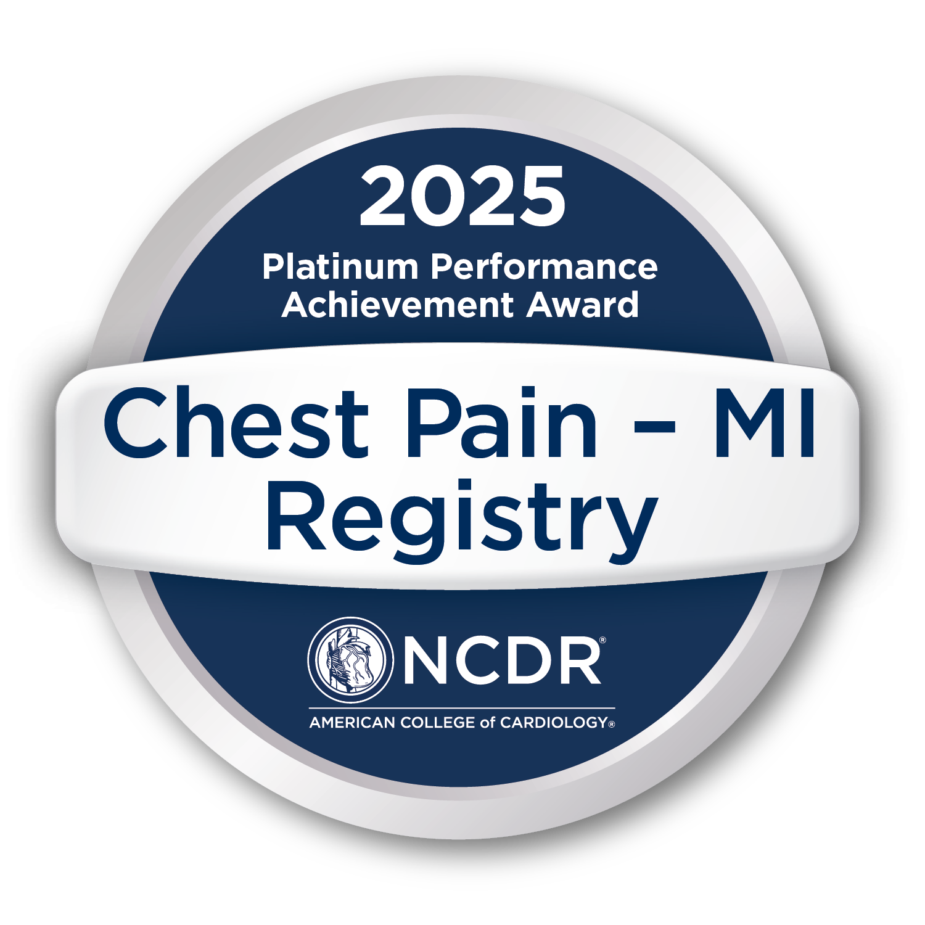
UT Medical Center’s nationally recognized quality will carry over to the Northshore facility
  Commitment to Quality Award 2025 ​
  Get With The Guidelines® Heart Failure: Gold Plus Achievement​
  Get With The Guidelines® Resuscitation: Silver Achievement​
  Get With The Guidelines® Stroke: Gold Plus Achievement ​
  Target: Aortic Stenosis™ Honor Roll

Slide 8
UT Medical Center at Northshore – Primary Service Area
Sources: Caliper Mapping Software, Definitive Healthcare

Slide 9
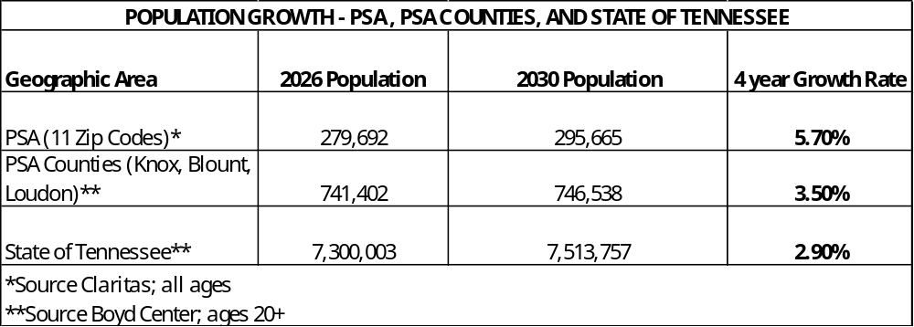
The Northshore service area is growing almost twice as fast as the State of Tennessee

Slide 10
UT Medical Center’s main campus is stressed to capacity
Most inpatient admissions come through the ED
In 2026 (annualized) there were 20,936 patients who were in ED hold waiting for a bed 4+ hours
Sept. 2026 boarding hours are a 300% increase over September 2025.
YTD 2026 UTMC has been forced to decline 1,230 transfer admissions due to lack of available beds.

Slide 11
Local, State and Federal Elected Officials support the UT Medical Center at Northshore project
Elected Officials - Federal
U.S. Senator Marsha Blackburn
U.S. Senator Bill Hagerty
U.S. Congressman Tim Burchett
Elected Officials - State
Lt. Governor Randy McNally
State Senator Richard Briggs
State Senator Becky Massey
State Representative Elaine Davis
State Representative Jason Zachary
Elected Officials – Local
Knox County Mayor Glenn Jacobs
Knoxville Mayor Indya Kincannon

